Slide 1
Flood risk Areas in the rio grande valley colonias
Monica Guerra Uribe
GIS in Water Resources
Fall 2017

Slide 2
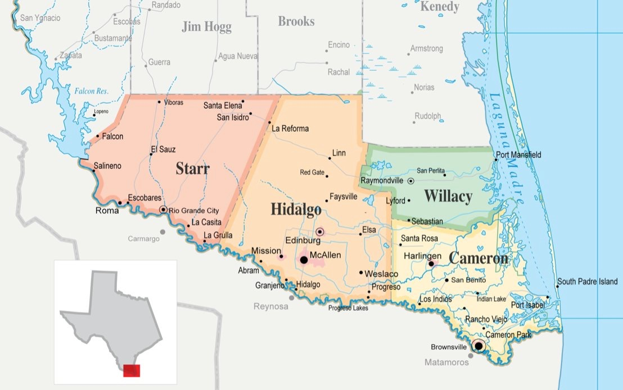
Rio grande valley
  South East Texas
  4 Counties
  1,267 Colonias

Slide 3
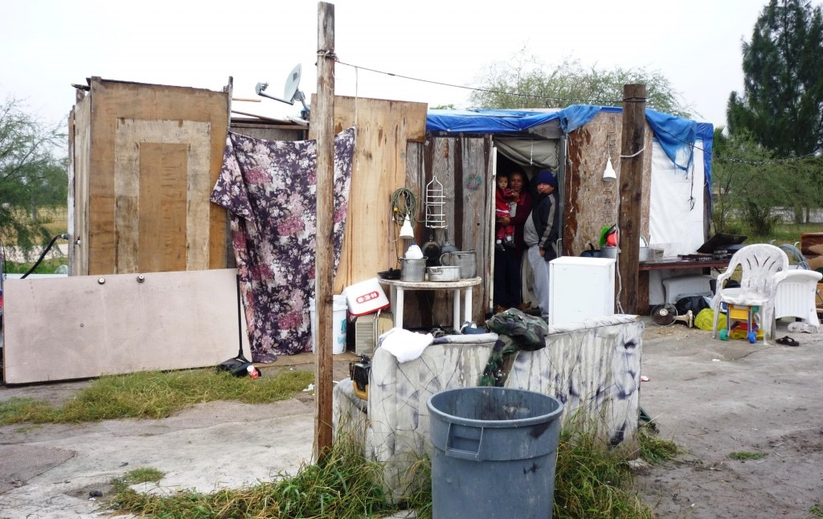
Colonias in the USA
Different sources of data
  OAG, SOS, TWDB, USDA, Counties
1920’s
Unincorporated subdivisions
Lack basic living necessities
  Potable water
  Drainage
  Paved roads
Source: https://urbanedge.blogs.rice.edu/2015/07/17/in-texas-colonias-third-world-conditions-are-the-norm/#.WhsprrQxH58

Slide 4
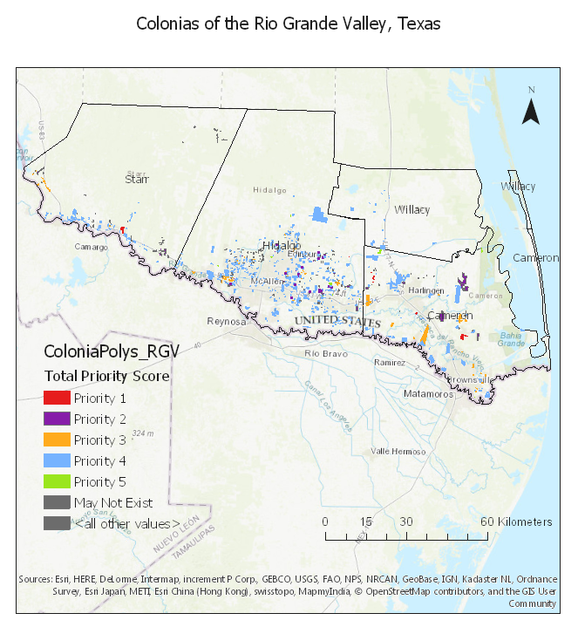
RGV colonias
Rural Community Assistance Partnerchip
Estimated population 197,689
5 Priorities

Slide 5

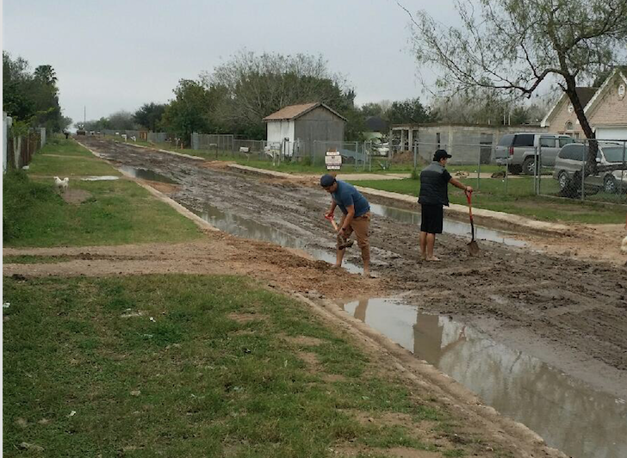
“We wait until the water evaporates”
Health risks
Reconstruct
No transportation
Work
School
Source:https://texashousers.net/2017/03/06/basic-public-services-at-long-last-may-come-to-some-current-and-future-s-texas-colonias/

Slide 6
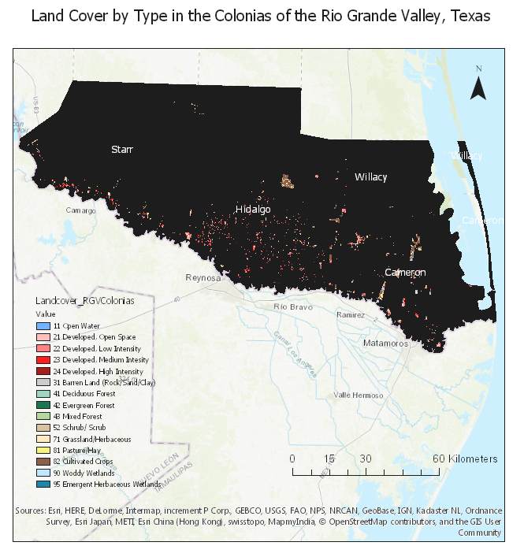
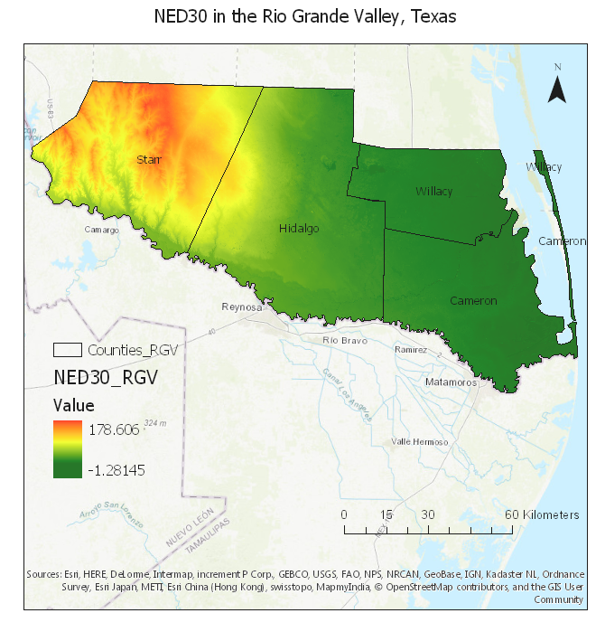
Cultivated crops
Flat terrain
FEMA Flood Risk Areas

Slide 7
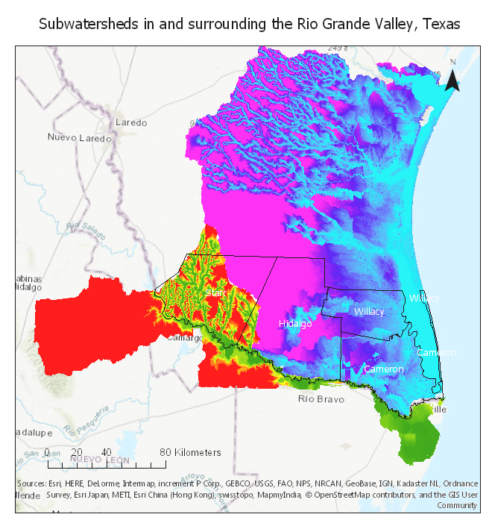
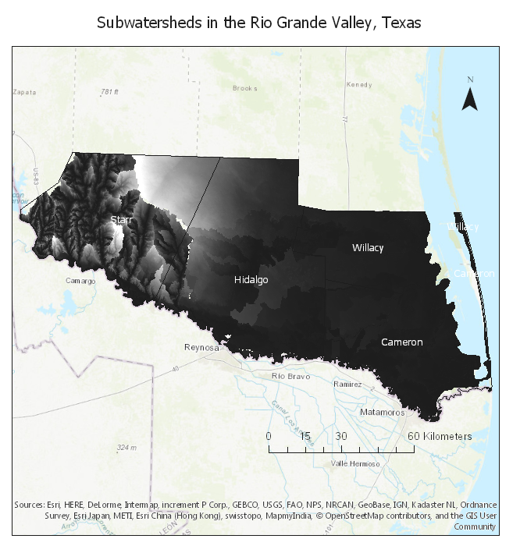
Flood risk areas
HUC 130900
HUC 121102

Slide 8
1.6

Slide 9
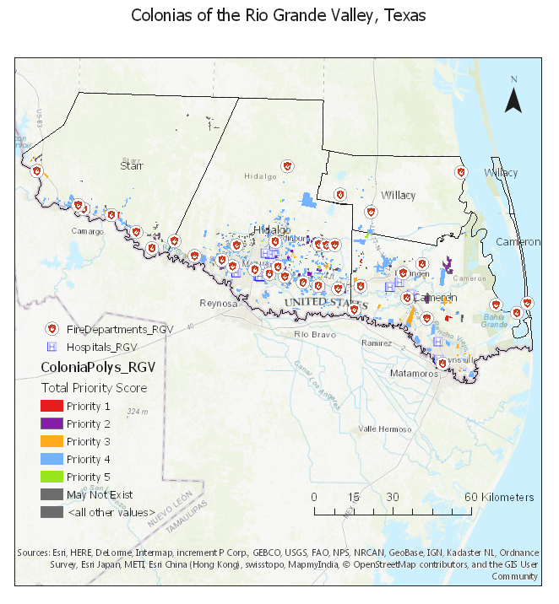
Response to Flooding
Distance from flooding areas to hospitals and fire departments

Slide 10
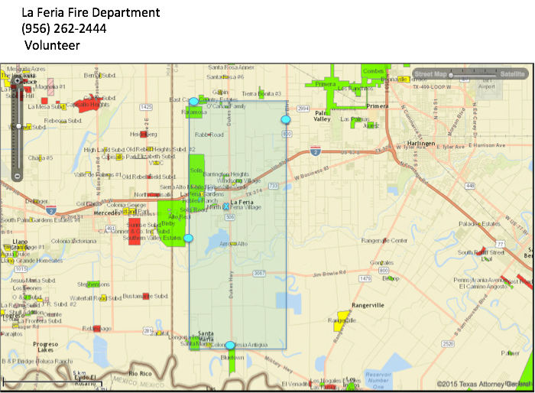
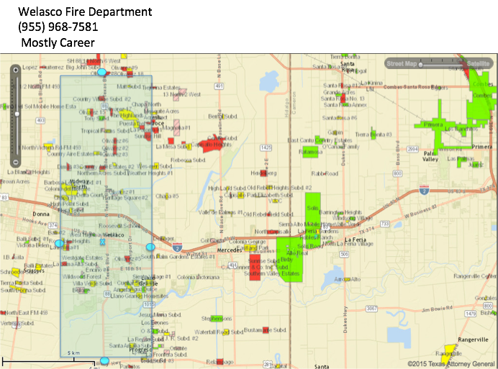
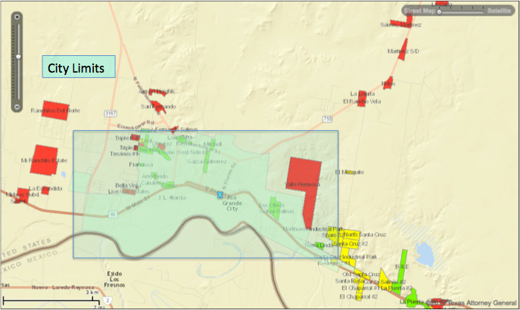


Slide 11
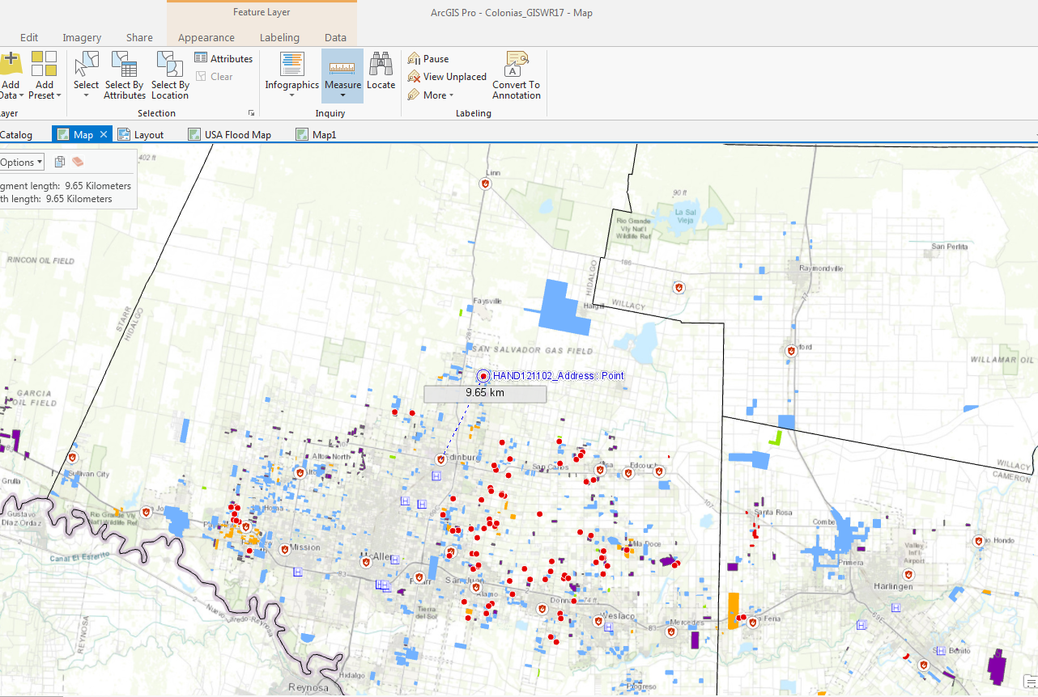

Slide 12
To do
Analyze more area in the RGV
  More addresses and HAND
  Raster Calculation: Elevation and water level
Relationship between floods and Colonias Priority level.
Distance of fire departments and hospitals to flooding areas

Slide 13
  thank you
Questions?

