Slide 1
flooding and housing buyouts in onion creek
Rachel Piner
GIS in Water Resources
Dr. Maidment

Slide 2
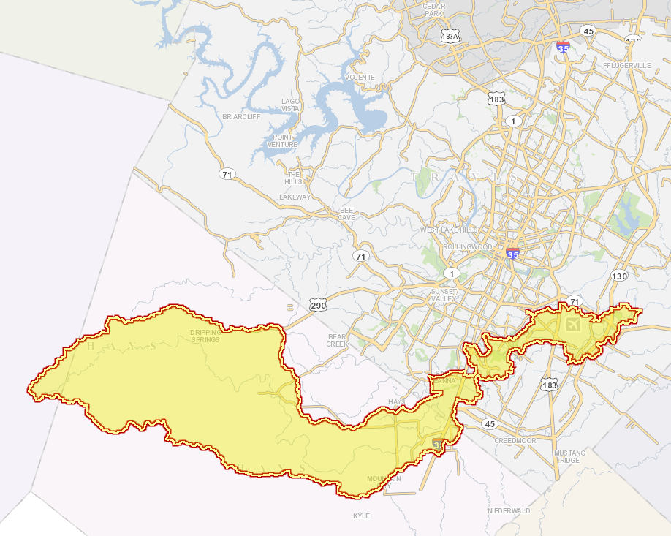
Background
The Lower Onion Creek Watershed
  183 subbasins
  Majority in Travis and Hays counties
  Prone to immense flooding:
    Halloween Floods of 2013
    Memorial Day Floods of 2015
  Total Area = 211 square miles
  Neighborhoods constructed in the 1970s, prior to being designated as a floodplain zone
Travis County
Austin
Hays County
Onion Creek Watershed

Slide 3
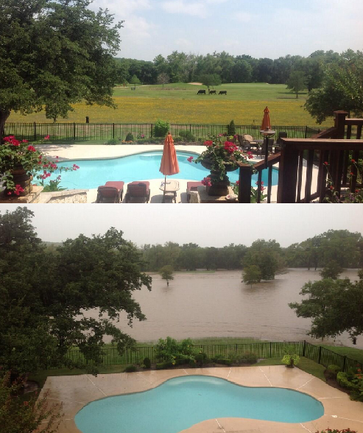
Objectives
Before Memorial Day Flood
Investigate effects of flood events on Onion Creek
Lower Onion Creek Housing Buyout Program
    Understand how it lowers the risk from flooding
    See progress and future plans for buyouts
Look at floodplain maps from the City of Austin and FEMA & see how it correlates with buyouts
Investigate the relationship between socioeconomic status and risk of flooding
After Memorial Day Flood

Slide 4
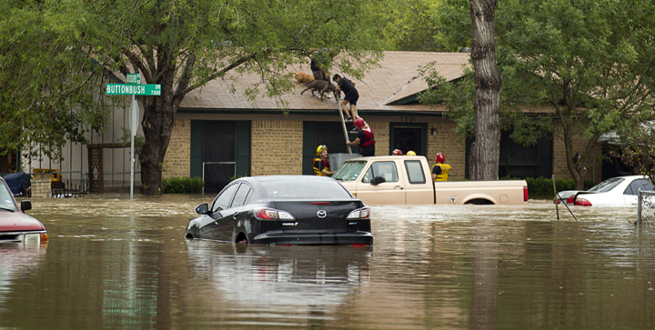
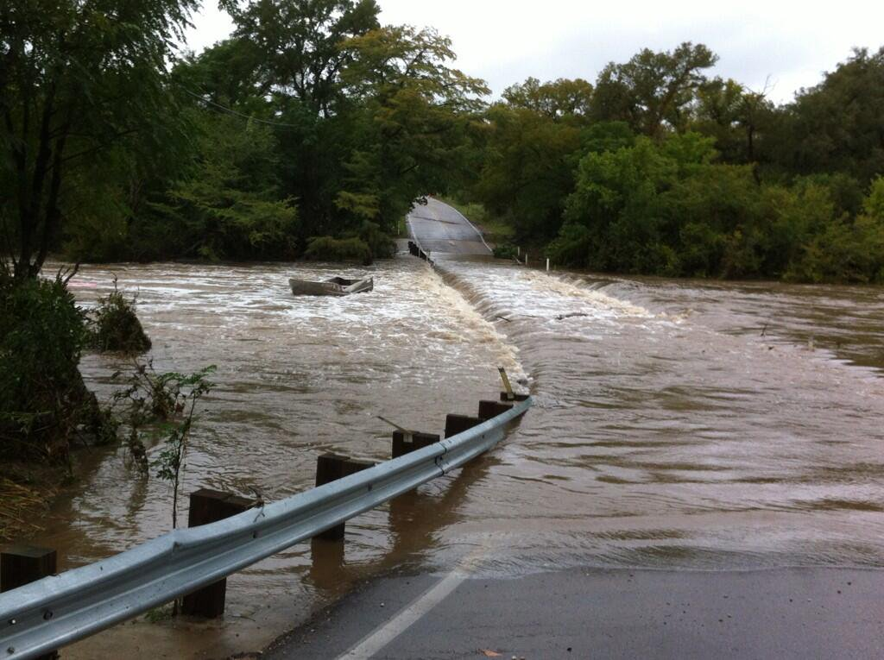
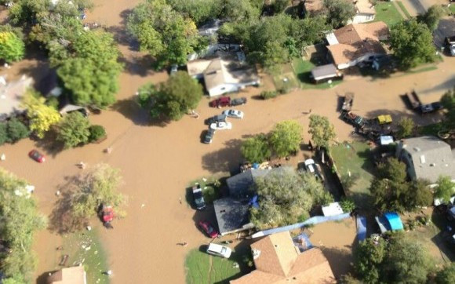
Past flood events
Halloween Floods of 2013
Memorial Day Floods of 2015

Slide 5
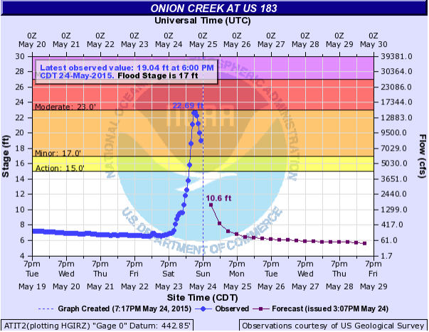
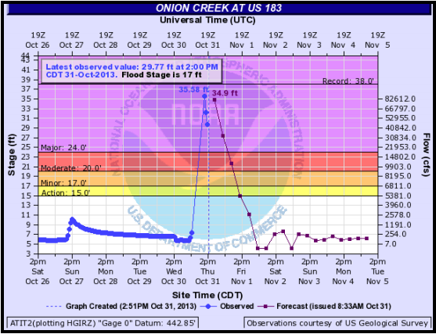
Past flood events
2013 Flood Stage height: 35.58 ft
2015 Flood Stage height: 22.69 ft
May 2015 Memorial Day Flood Stage Height vs. Time
2013 Halloween Flood Stage Height vs. Time
Source: Weather.gov

Slide 6
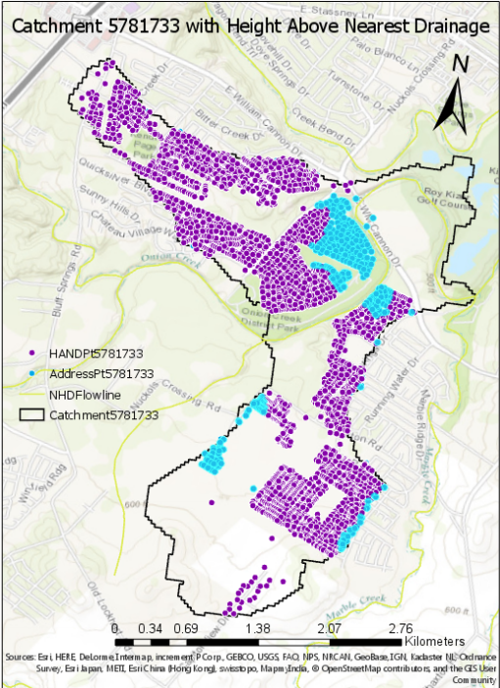
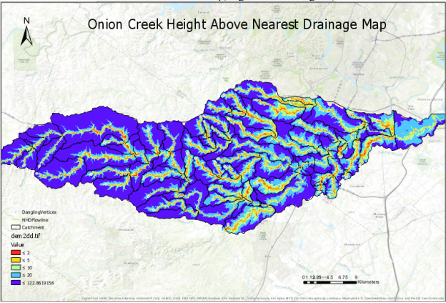
Height above nearest drainage
HAND exercise 5: modeled Lower Onion Creek Buyout neighborhood
Storm reach in 2013 Halloween floods: 36 feet→ neighborhood flooded (HAND<water depth)

Slide 7
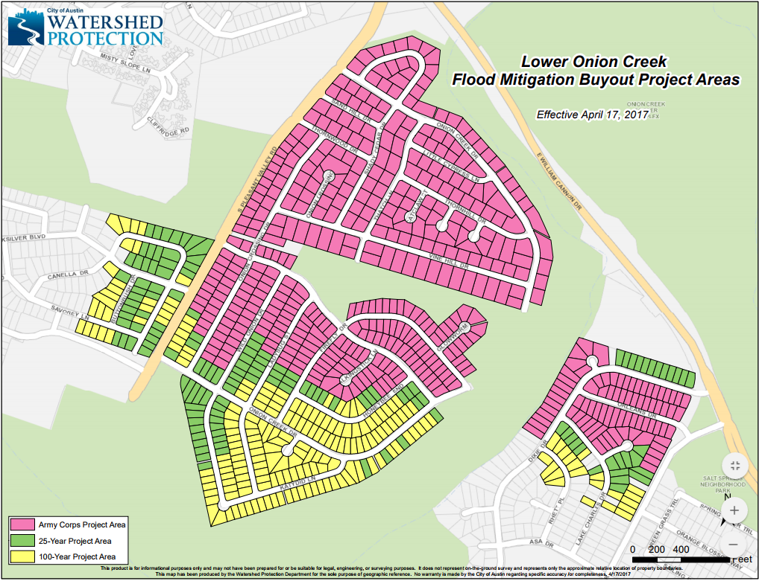
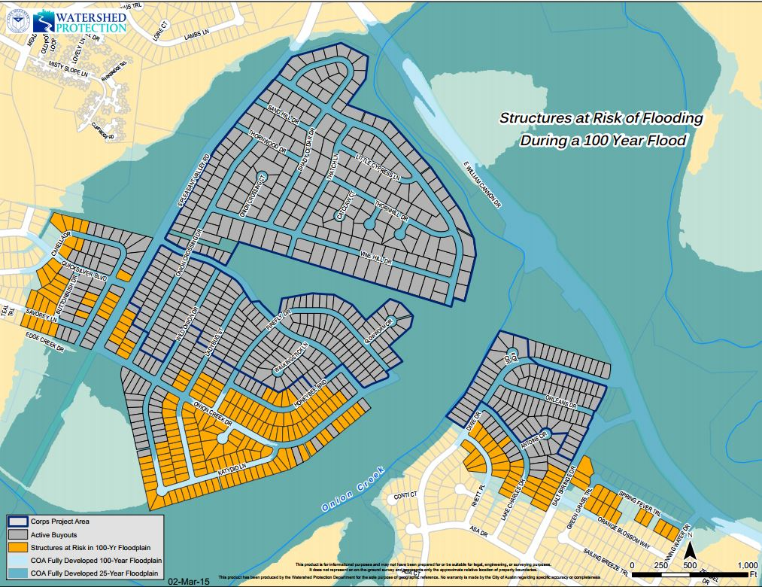
Lower Onion Creek Housing Buyout Program
Army Corps of Engineers Project Buyouts and COA-WPD Housing buyouts
Goal: To purchase homes at high risk of structural flooding in the 25- and 100-year floodplain with federal funding
Area of main concern: SE corner of William Cannon Dr. and S. Pleasant Valley Dr.
Notes:
Right photo--Dark blue: 25 yr flood plain; Light Blue: 100 yr flood plain
These homes were built before the area was in the 25-year floodplain
Climate change can be causing floodplain models to change drastically!

Slide 8
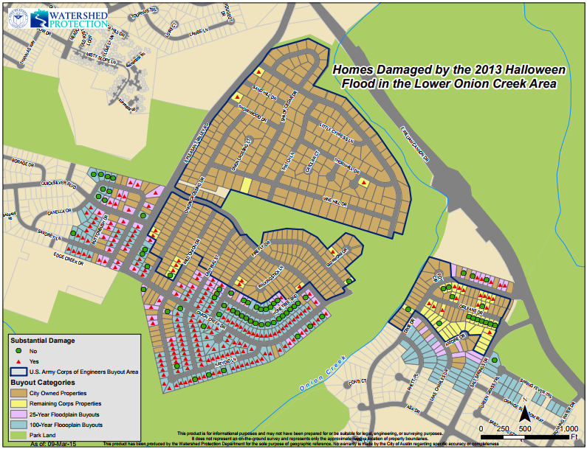
Lower Onion Creek Housing Buyout Program
Corps Buyout Project Progress:
  Authorized by US Congress in 2007 & funded by March 2014
  483 buyouts completed by May 2017
COA Watershed Protection Department Progress:
  133/137 properties in 25-year floodplain
  187/203 properties in 100-year floodplain
  Funded by City Council~ $100 million spent
Notes:
All of the homes shown with the completed buyouts were also the ones that were shown to be inundated in the HAND exercise.

Slide 9
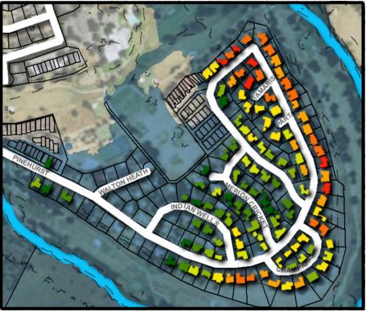
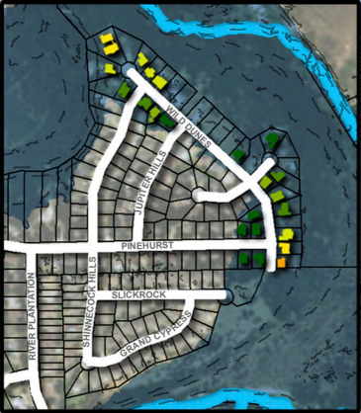
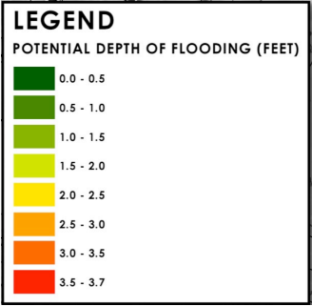
Future for buyout land
Pinehurst Neighborhood
Rezoning from single-family to public designation
100 acres will become a recreational area to be completed by 2019
Remaining 190 acres will undergo ecological restoration
2 flood studies conducted for Wild Dunes and Pinehurst neighborhoods in Onion Creek Watershed—possible buyouts soon
Wild Dunes Neighborhood

Slide 10
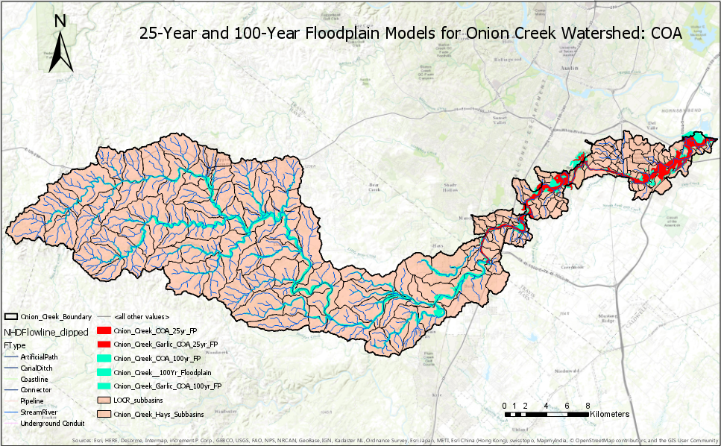
City of Austin floodplain models
Data extracted from:
Austintexas.gov/floodpro
NHDPlus Flowlines
Onion Creek Watershed in Travis County

Slide 11
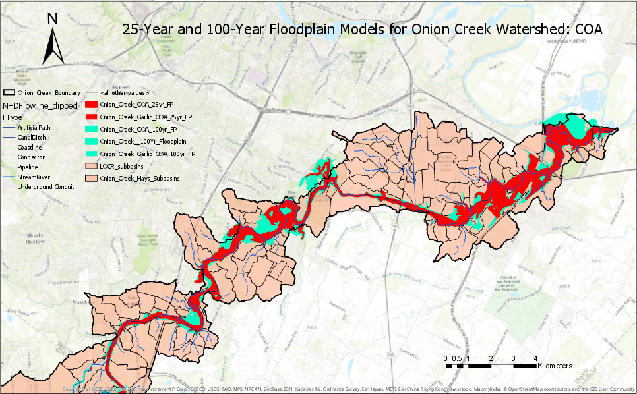
City of Austin floodplain Models
Buyout Neighborhood

Slide 12
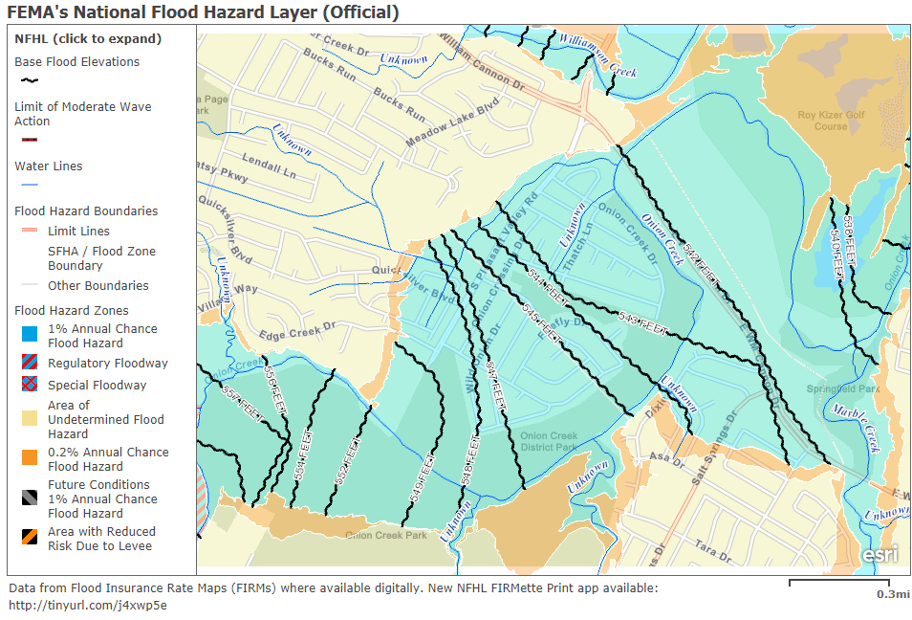
Fema’s national flood hazard layer
Buyout Neighborhood

Slide 13
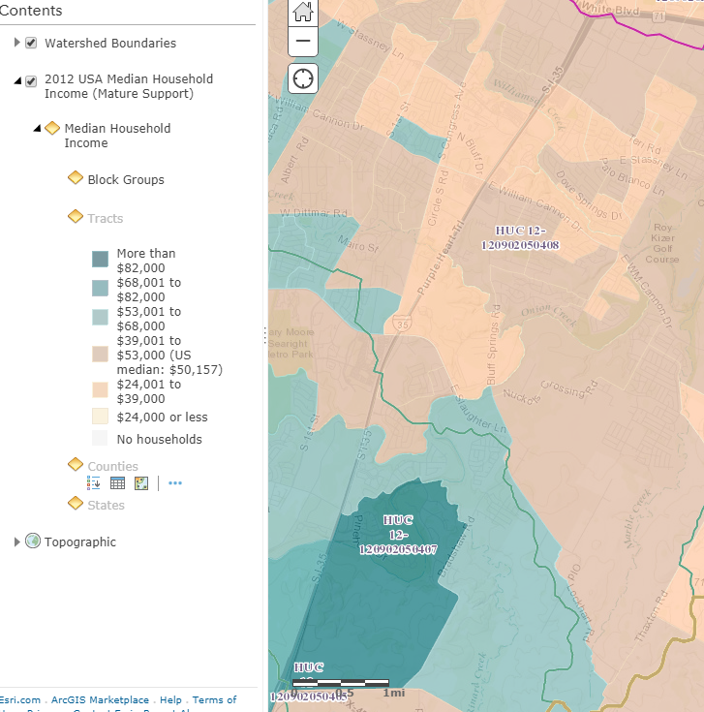
Socioeconomic impacts
Strong correlation between:
  Low median household income and 25-year floodplain
Neighborhood is mostly in $24,001 to $39,000 range for median household income (2012)
National Average: $50,157 (2012)
Source: US 2010 Census
Buyout Neighborhood

Slide 14
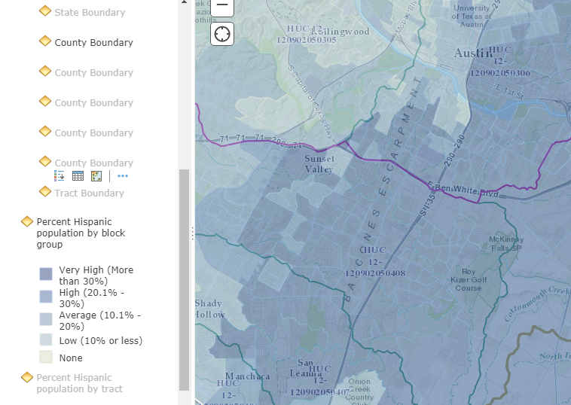
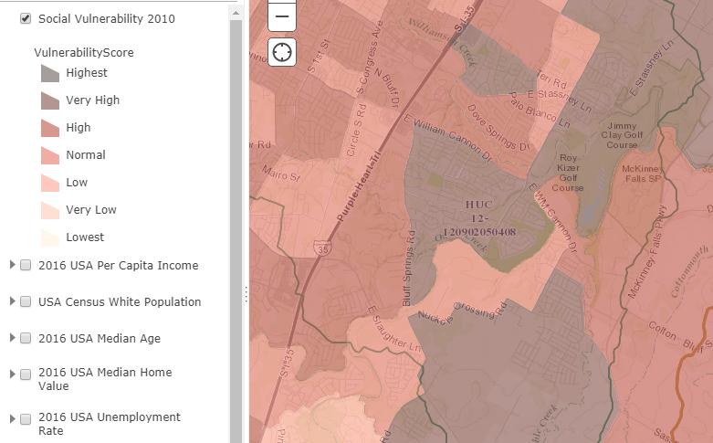
Socioeconomic impacts (cont.)
Conclusion: high flood risk homes are more affordable → Catastrophic flooding often disproportionately effects lower-income households
Social Vulnerability Score (2010): Highest
Source: http://artsandsciences.sc.edu/geog/hvri/sovi%C2%AE-0
Percent Hispanic Population by Block Group (2010): >30%
Source: US Census Bureau

Slide 15
Future work
Obtain data from the COA and/or FEMA to examine how floodplain maps have changed over time (1970s → Now)
Understand how future floodplain maps could impact communities and future buyouts

Slide 16
Sources
Memorial Day Flood: https://www.weather.gov/media/ewx/wxevents/ewx-20150524.pdf
Halloween flood: https://www.weather.gov/media/ewx/wxevents/ewx-20131031.pdf
NHD Data: http://nhd.usgs.gov/
Photos: http://www.breakingnews.com/item/2013/10/13/photo-flooding-in-onion-creek-at-old-san-antonio/
https://greggklar.wordpress.com/2015/10/30/austin-flooding/
Demographic data: https://ut-austin.maps.arcgis.com/home/webmap/viewer.html?webmap=5bd0c03150854bf28cab333a9a1c196b
Lower Onion Creek Buyout Program: http://www.austintexas.gov/department/onion-creek

Slide 17
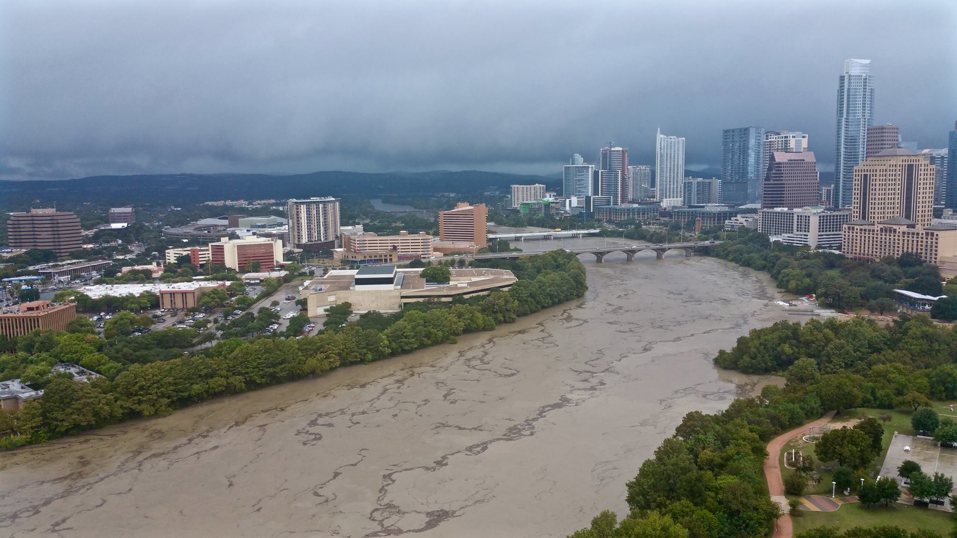
Thank you!
Questions?

