Slide 1

November 2017
CCS: Source-Sink Pairing
A model for generating a network of low cost paths for source-sink pairs
Peter Tutton
Energy and Earth Resources, The University of Texas at Austin

Slide 2
Contents
CCS Overview
Sources
Sinks
Data
Model
Output
Future Work

Slide 3
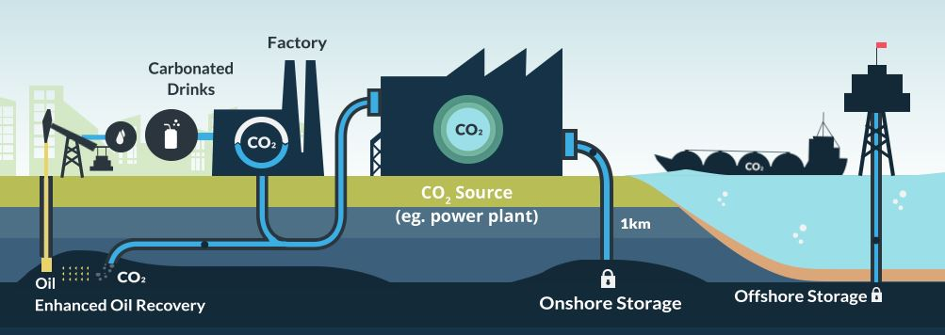
Carbon Capture and Storage
Capture
  Concentrate
Compress
  Supercritical
Store Geologically
IPCC
[1]
Notes:
Intergovernmental Panel on Climate Change (IPCC, 2014) describes the need for CO₂ Capture and Storage as part of the many possible global mitigation models if the 2ºC target is to be met. Without this technology, the IPCC estimates the costs of reaching this goal could be 138% higher.

Slide 4
Sources
High concentration streams
  Hydrogen, ethylene oxide, ethanol, LNG
EPA GHG Reporting
TCEQ Permit Database
Notes:
Prevalent in the Gulf Coast region due to the oil and gas industry. High purity/concentration streams reduce capture costs.
Determined large scale sources. Sorted by production type, developed a macro to mine all the information and leave me with certain types of sources. Then manually went into TCEQ and reviewed the permits for the top sources and determined if they had separation technology and whether the carbon dioxide was already being used.
MDEA, MEA, KCO3, Rectisol etc.

Slide 5
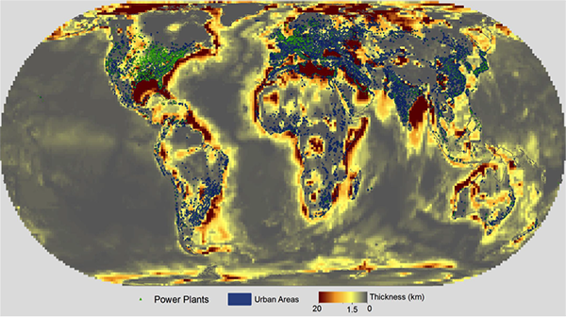
Sinks
Suitable formation
  Permeable, porous, impermeable cap rock
Offshore
  Reduced opposition
  Thick sandstones
  Limited onshore storage
Gulf Coast
  Extensively characterized
  State waters
[2]
Notes:
Storage is technically ready – need to store for geologically significant time periods
Traps, permeability, porosity, extent are well mapped in the Gulf Coast – CarbonSAFE
Texas General Land Office is single surface owner up to 3 marine leagues (about 10 miles) off the coast of Texas.
Many areas have very few/negligible onshore carbon sink options

Slide 6
Data
NLCD
NED
National Parks
NHD
Roads
Railroads
State Parks
Notes:
Added all the feature classes to the geodatabase and the rasters in folders. Made iterating in model easier.
Rasters
NLCD - https://viewer.nationalmap.gov/basic/#productGroupSearch
NED - http://elevation.arcgis.com/arcgis
Feature Classes
National Parks - https://irma.nps.gov/DataStore/Reference/Profile/2224545?lnv=True
NHD - http://www.horizon-systems.com/NHDPlus/V2NationalData.php
Roads - https://catalog.data.gov/dataset/2015-roads-national-geodatabase
Railroads - http://osav-usdot.opendata.arcgis.com/datasets?keyword=Rail
State Parks - http://tpwd.texas.gov/gis/#data

Slide 7
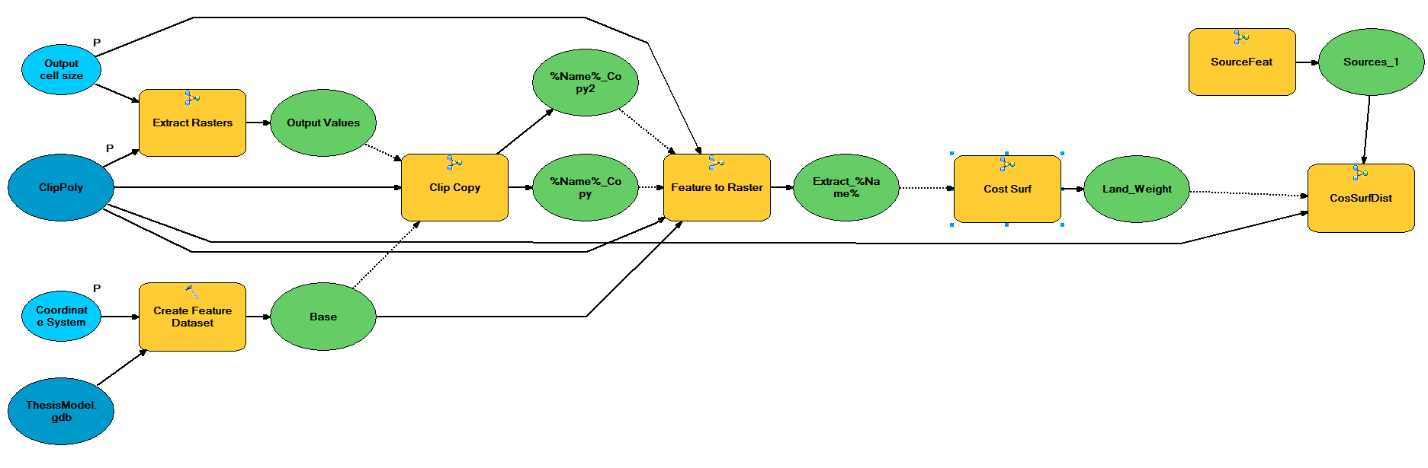
Model
User Defined
Top Level
  8 Sub-Models
Least Cost Paths [3]
Notes:
User Defined
Coordinate System
Extent
Resolution
Cost Paths – CO2 Pipeline Transport Cost Estimation NETL Study

Slide 8
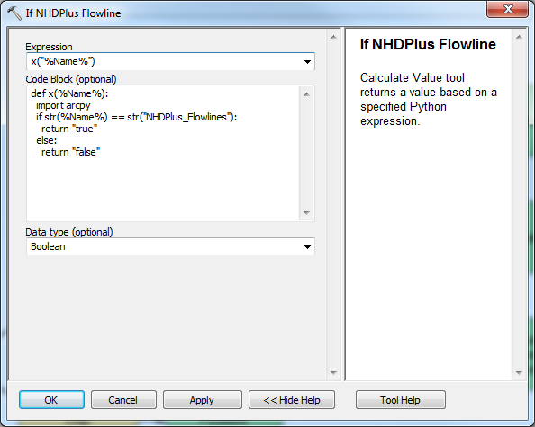
Model – Lessons Learned
Iterators
  One per model
Parameters
If-Else
  Calculator
In-line variables
  %
Notes:
Can only have one iterator per model so use sub-models to run loops within loops
As a result need to parametrize inputs/outputs to pass from one model to another
Environments can be create for each tool – allows user to define or create variables to determine processing options such as extent
If-else: calculate value → Boolean → raster calculator
In-line: can use percent sign to use variables that have not yet been created in tools/naming

Slide 9
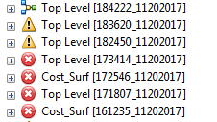
Model – Lessons Learned
Patience!

Slide 10
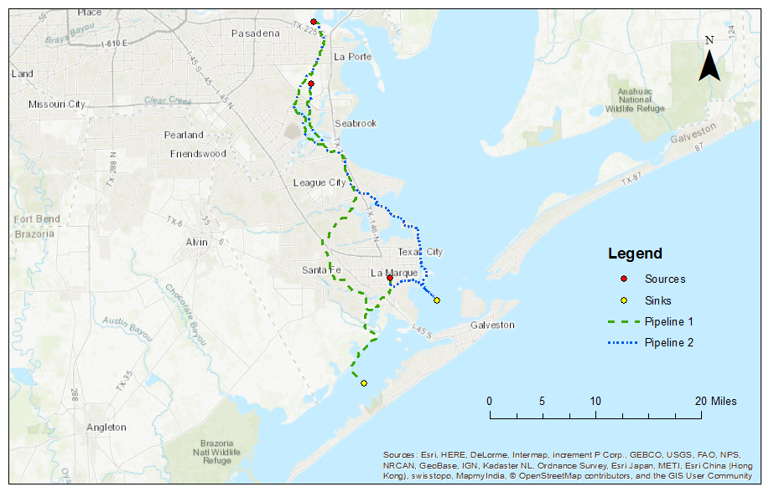
Output
User Friendly Model
  Draw Extent
  USA Data
Least Cost Path
  Sources-sinks
  Aggregated
Notes:
User selects area of interest. Only has to add applicable state park file and NLCD raster
Has data for the whole of the USA
Generates the least cost path between each source and sink. Where these overlay it creates trunklines.

Slide 11
Future Work
Incorporate Existing Pipelines
Output
  Nodes
  Arc ‘weights’
Perform 2-stage optimization
Notes:
How do existing pipelines affect overall cost – cheaper because ROW issues already resolved?
Do you build the cheapest network now – everything close to sinks and operating at capacity. Or do you build in redundancy – larger pipes further sources given potential future CCS goals → there not be any.

Slide 12
References
Global CCS Institute, 2015, CCS features at European Sustainable Energy Week, http://www.globalccsinstitute.com/insights/authors/SilviaVaghi/2015/06/23/ccs-features- european-sustainable-energy-week
Gulf Coast Carbon Center, Offshore Storage Source-Sink Synergies,
  http://www.beg.utexas.edu/gccc/themes/themeE.php
National Energy Technology Laboratory, 2009, CO₂ Pipeline Transport Cost Estimation
  http://www.canadiancleanpowercoalition.com/pdf/CTS12%20-%20Transport.pdf

