Slide 1
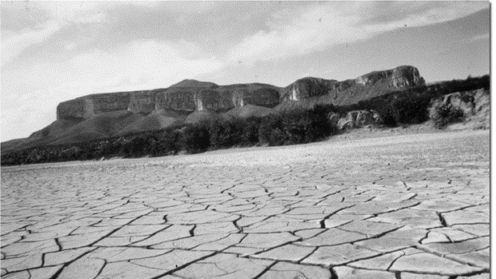

TEXAS DROUGHT PLANNING
November 9th, 2017
Elbin A. Collado
M.SC. Energy & Earth Resources | 2018
The Jackson school of geosciences
CE394k GIS in Water Resources, Fall 2017
The University of Texas at Austin

Slide 2
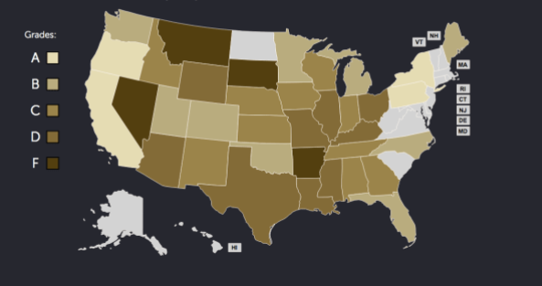
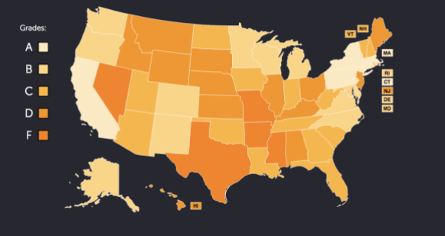
Drought Prone Texas
Parts of Texas have been in drought conditions for 60% of the time since 1990
Texas is the most exposed state for extreme heat, drought and wildfire
Texas gets an overall F grade for preparedness

Slide 3
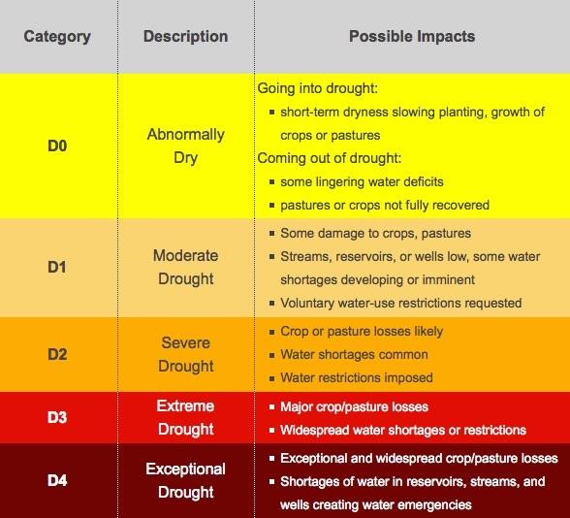
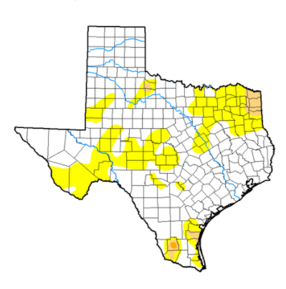
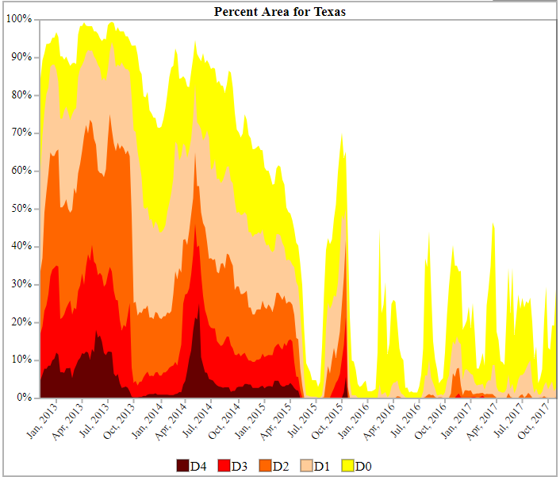
Current Conditions: Texas
portions of the state is considered to be under severe drought.
Areas under abnormal dryness across southwestern, west-central and southern Texas expanded.
Severe drought in Texas is affecting 2,000 people
moderate drought is affecting another 9,177,000 (36% of population)

Slide 4
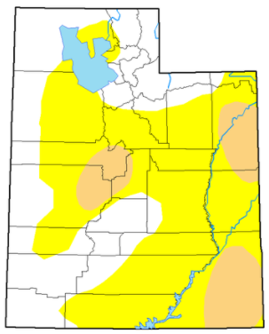
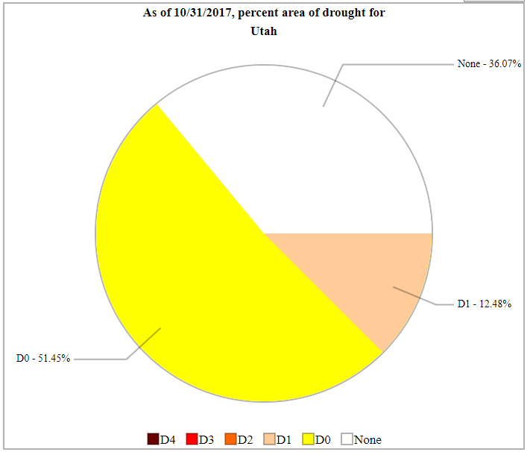
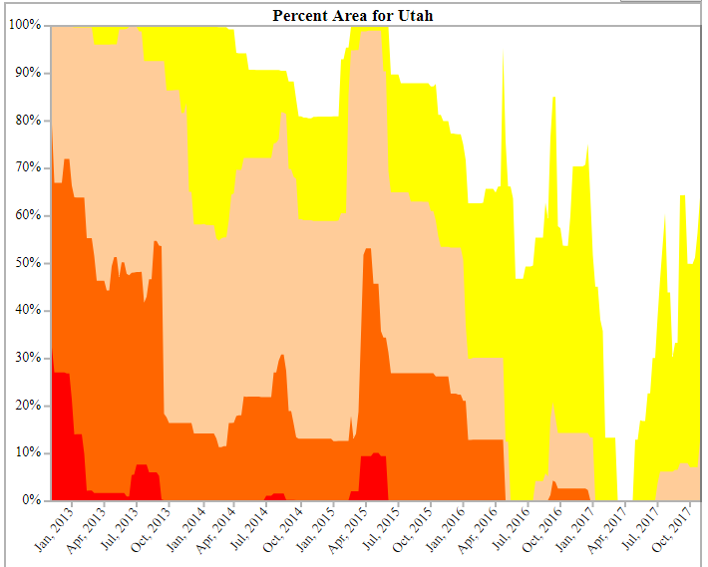
Current Conditions: Utah
Salt Lake City is the 5th drought riskiest metro area in the country
Utah has experienced abnormally dry to extreme drought conditions.
26.8% of Utah is in drought
Affecting an estimated 2.6 million people

Slide 5
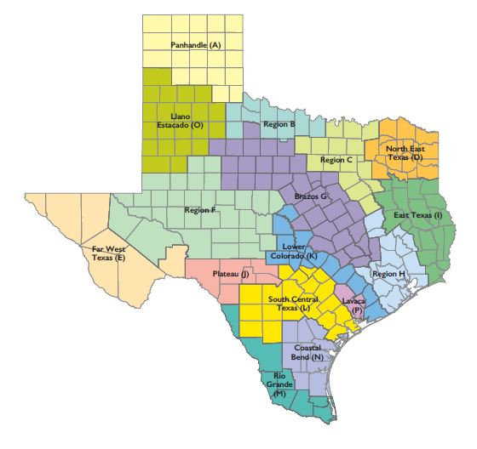
Regional Water Planning Areas
Texas Water Development Board (TWDB) creates long-term plans of the State’s water resources based on regional planning.
Regional Water Planning : provide for the orderly development, management of water resources and preparation for and response to drought conditions
16 planning regions (A-P)

Slide 6
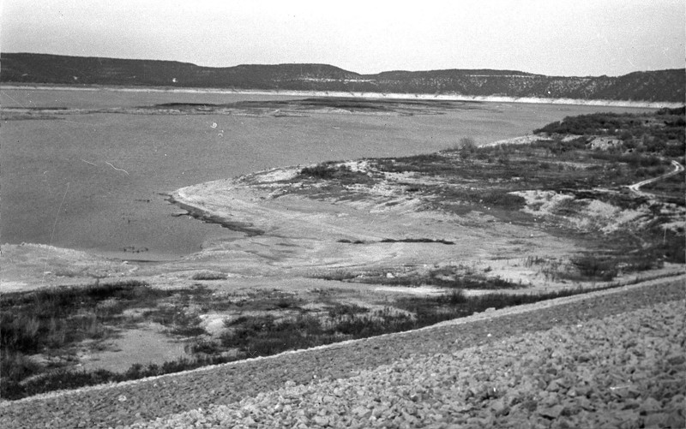
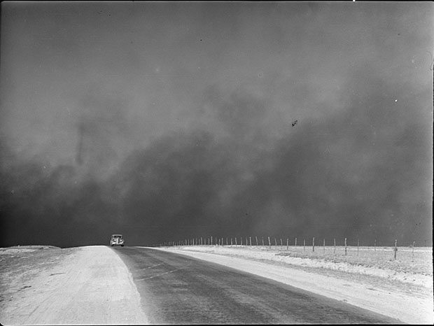
The 1950s Drought
Drought Of Record (DOR) = the worst drought to occur for a particular area
Regional planning focuses on the hydrological drought
The frequency and severity of hydrological drought is defined on a watershed or river basin scale
1956: 244 of 254 of the state’s counties are listed as “drought disaster”
Losses from 1950 to 1957 were estimated at $22 billion

Slide 7
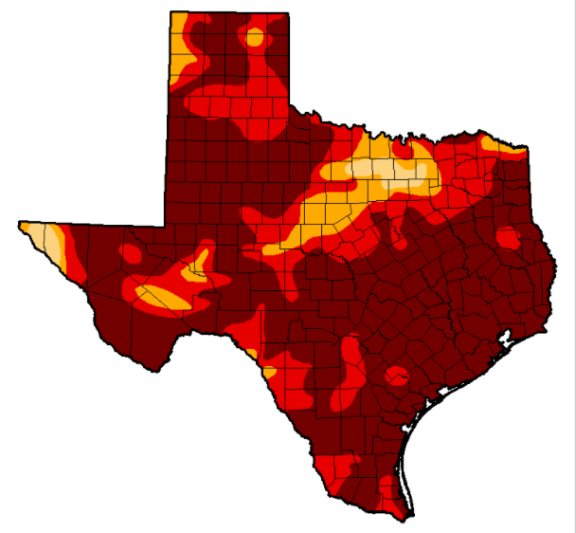
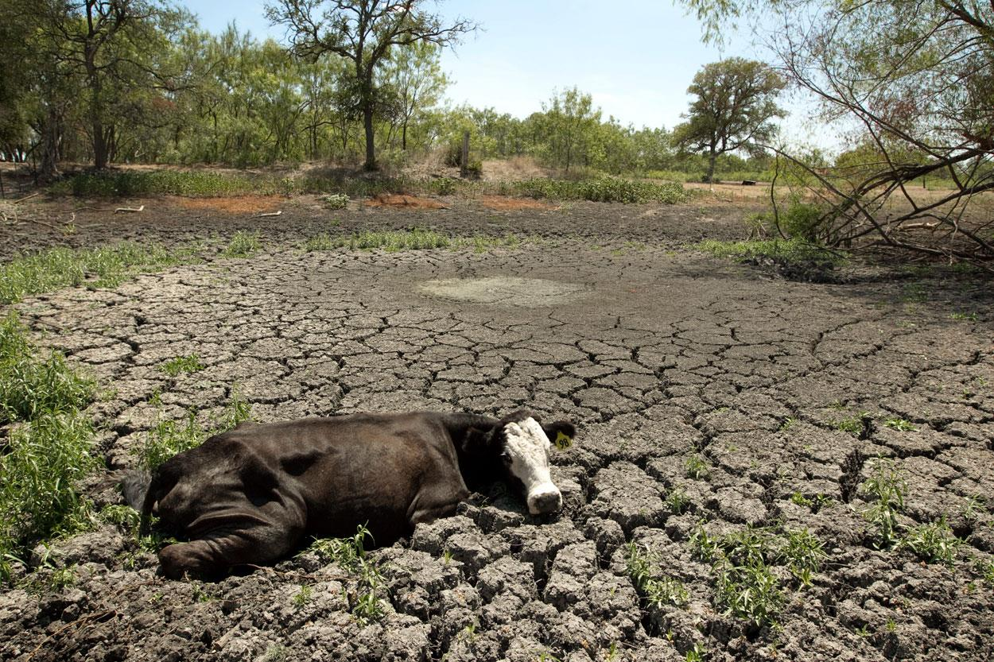
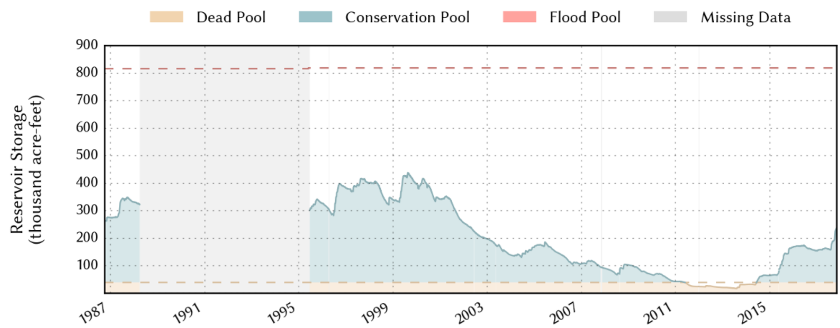
The 2011 Drought: Driest Year in Texas
2010-2011: Most current severe drought
Rainfall averaged 11 inches
Agricultural losses are estimated at over $5.2 billion.
In 2011, Lake Meredith recorded the lowest historical inflow at approximately 6,300 acre‐feet.

Slide 8
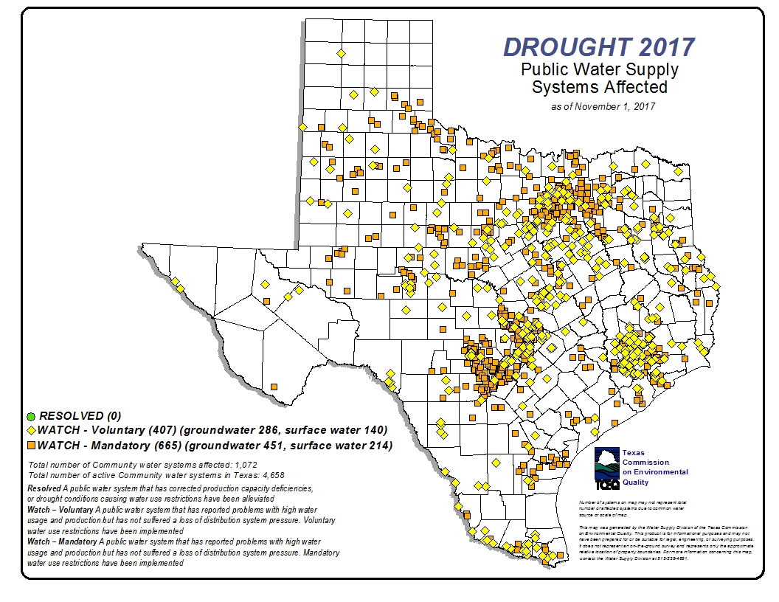
Drought Contingency Plans
serving 3,300 connections submit drought contingency plans
Strategies for temporary supply and demand management responses water supply shortages
Regional Water Planning mandate water restrictions contained in Drought Contingency Plans.
DCPs include:
targets for water use reductions
Drought response stages
Triggers to begin and end each stage
Supply management measures
Demand management measures
Descriptions of drought indicators
Notification procedures
Enforcement procedures
Coordination with regional water planning group
Adoption of plan
Ongoing public education
Public input to the plan
Procedures for granting exceptions

Slide 9
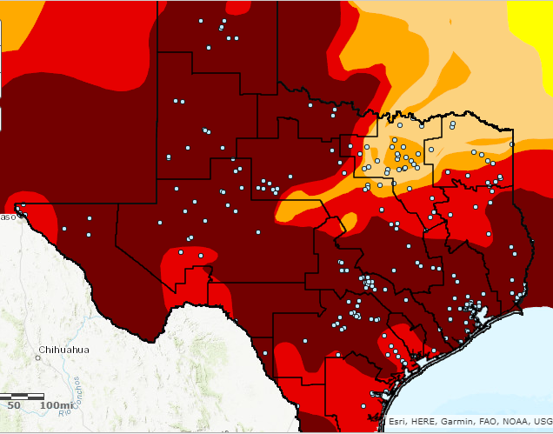
Drought Impacts on Energy
Demand for electricity was at an all-time high because of the heat
Water needed to cool the state’s coal, nuclear and gas power plants was in short supply
Texans were warned of rolling blackouts
Water was taken away from senior rights holders
10-18 percent of the electricity came from wind

Slide 10
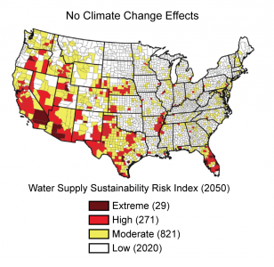
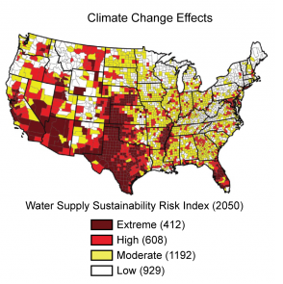
Future Predictions
State’s population is projected to grow to 46.3 million in fifty years.
Water use in TX power plants will increase 120% by 2060
Water demand is estimated to be 22 million acre-feet a year (20% more than current demand)
Drought are expected to be more frequent and more severe
Water availability is expected to decline
Possible solutions
DCP to include mandatory restriction in earlier stages of drought
Power plants can use non-potable water (ex: sewage effluent)
Use high salinity groundwater

Slide 11
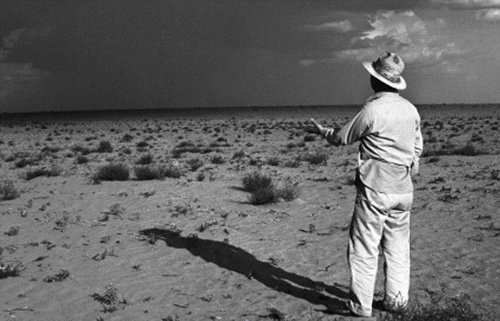
The End…

