Slide 1
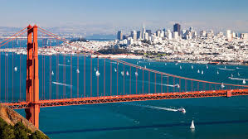
Air Pollution Trends in the San Francisco Bay Area
Rivkah Gardner-Frolick

Slide 2
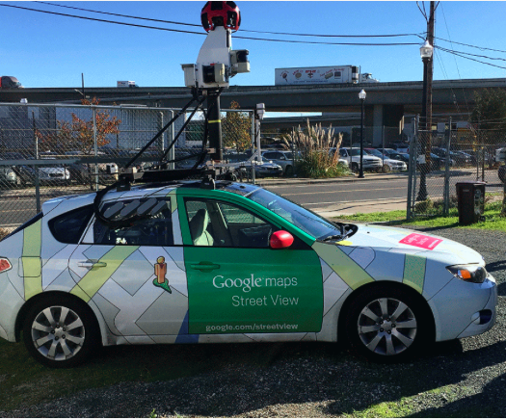
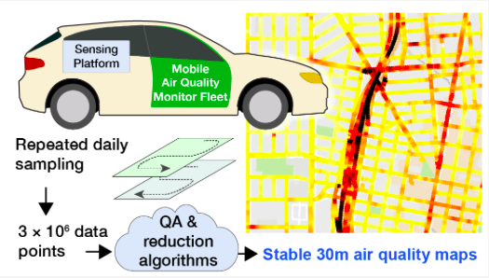
Introduction to Google Street View Project
1-Hz measurements of black carbon (BC), nitrogen oxide (NO), nitrogen dioxide (NO₂)
May 2015 ➔ now
Notes:
Google SV cars outfitted with BC, NO, NO2 instruments from Aclima
BC – from sources that burn fossil fuel like engines
NO – from diesel engines
NO2 – oxidation product of NO, both are precursors to ozone and particulate matter
The cars drive each street in the areas (called polygons) that were decided upon to represent a variety of land uses, climates, etc
Drive each street multiple times (for Oakland each point had an average of 30 unique measurement days)
Get a lot of data points, reduce them to create a map
Began in May 2015, focusing on Oakland, still ongoing

Slide 3
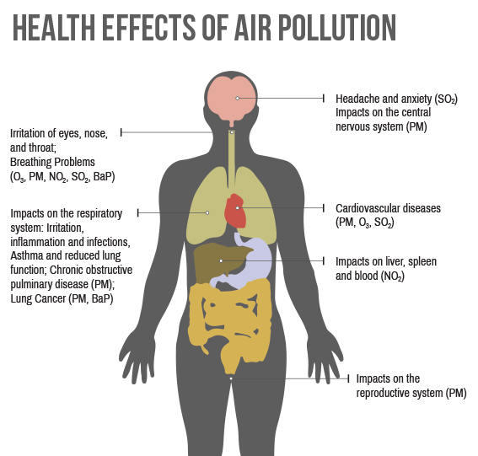
Why is it important?
Health effects
Personal exposure affected by fine-scale pollution
Lack of fine-scale data
http://mccog.net/cleanairdare/air-quality-explained.html
Notes:
Air pollution is one of the leading causes of death globally, can affect health even at relatively low concentrations
Personal exposure could really be affected by fine scale pollution
Very little fine-scale data available, few fixed monitoring site, those are regulatory monitors

Slide 4
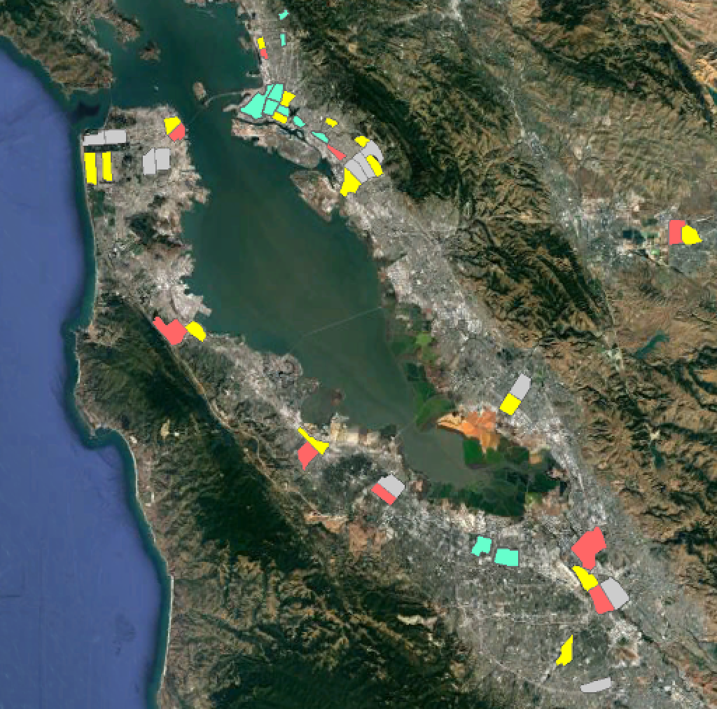
Project Introduction
Goals:
Determine extent of spatial variability within and between polygons, hotspots
Relate concentrations to land use, climate, and demographics

Slide 5
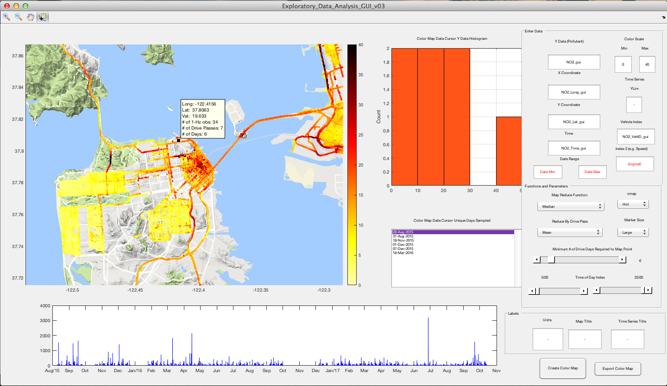
Matlab Visualization GUI
Notes:
A postdoc in the group made this gui to visualize the data
Can set a minimum number of days, a time frame, see which days the points were driven
Pretty cool!

Slide 6
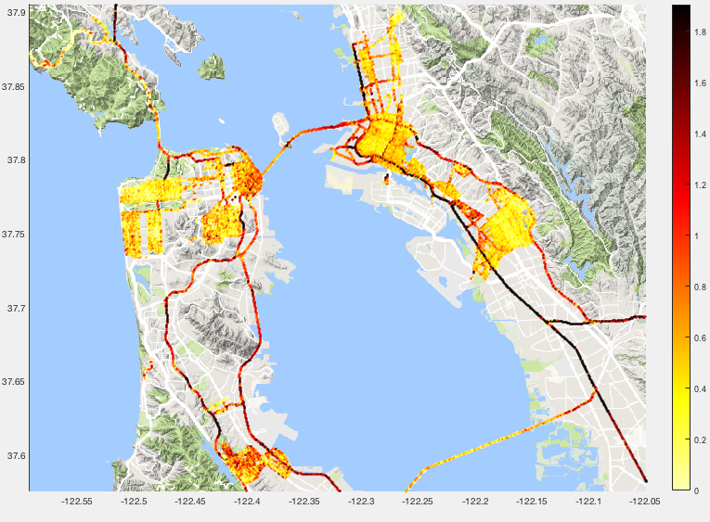
BC Concentrations
Notes:
I used this to preliminarily look at concentrations (the dataset was huge and I couldn’t export that many points into GIS)
Highways have higher concentrations as expected
Richmond is pretty clean, inner sunset cleaner than outer sunset, financial district really dirty – lots of traffic, makes sense
Millbrae looks as dirty as the financial district yet it’s a residential area – shouldn’t be much traffic or industry – whats causing it? – maybe the airport

Slide 7
Reducing the Data
Drive pass = measurements collected at one point from one pass
Analysis:
Drive pass mean
Median of all separate drive passes
Minimum 6 drive days
Result is 16 million data points to ~90,000
Notes:
What drive pass is
How I did the analysis
Got a stable map and got one value for every point for GIS analysis

Slide 8
Data Sources
BC, NO, NO₂ measurements
Land use data – from data.sfgov.org
Climate – designated by polygon
Demographics – US Census

Slide 9
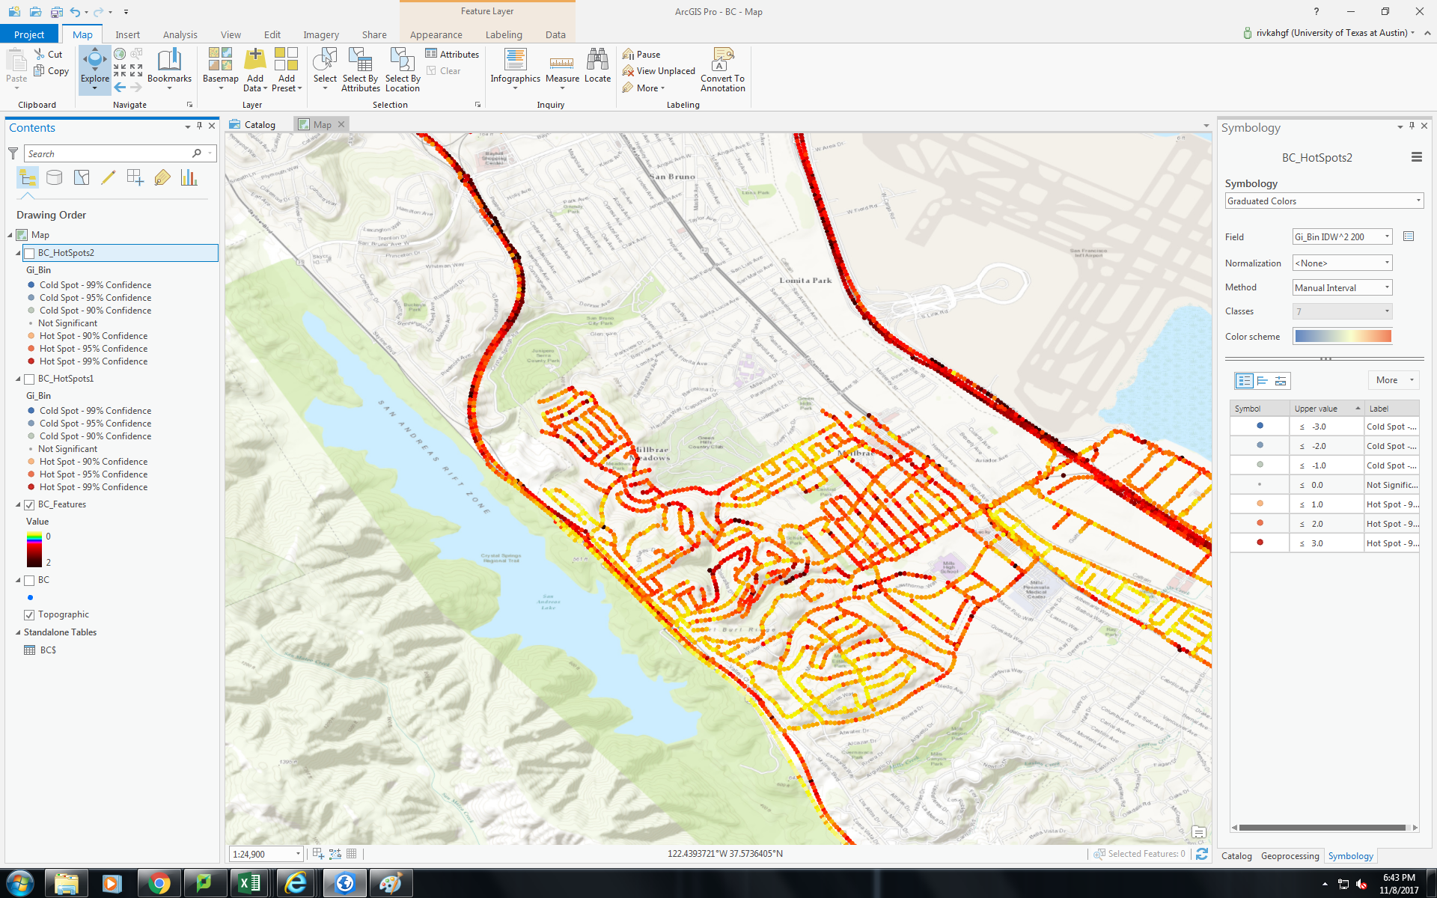
GIS Hotspot Analysis
Millbrae, CA – BC (μg/m³)
Notes:
Going back to Millbrae, by the airport
One thing that came out of Oakland data was the discovery of quite a few local hotspots – one or a handful of data points elevated in relation to surroundings
Could be an intersection where cars are constantly stopped, local industrial source in some cases (warehouse, metals recycling)
Important for finding local high levels that could be driving air pollution exposure for some in an overall clean area

Slide 10
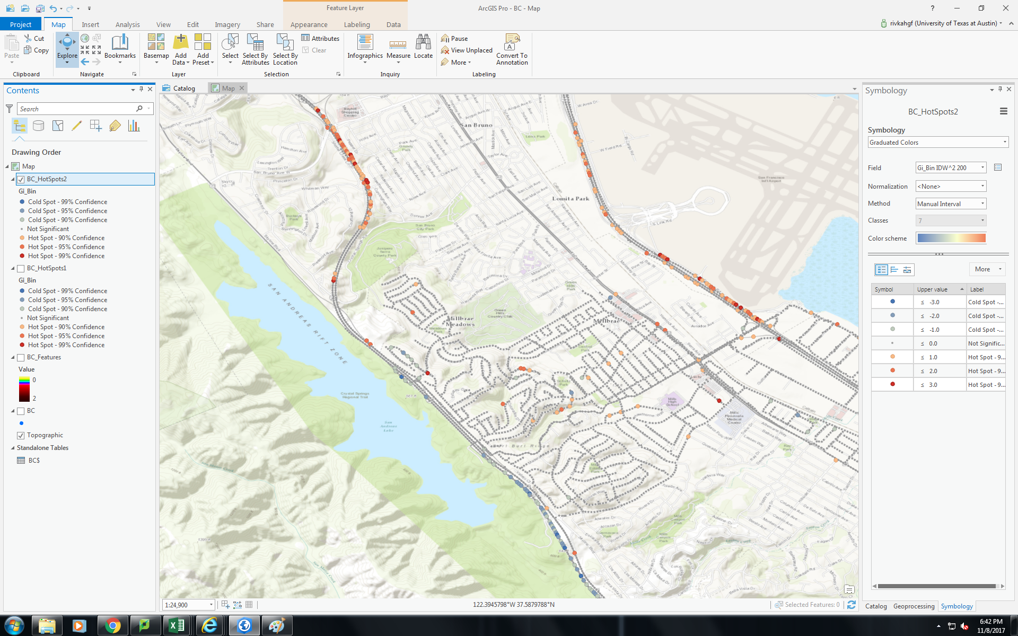
GIS Hotspot Analysis
Hot Spot Analysis (Getis-Ord Gi*)
Notes:
Performed a GIS hotspot analysis – want an automated/systematic way of picking out hotspots
Based on z-scores and p-values
Determines where there is an unusually high little cluster, how I defined

Slide 11
GIS Hotspot Analysis
Hotspots with 95%, 99% confidence
Notes:
The analysis picked out these spots as hotspots
Visually looks pretty accurate

Slide 12
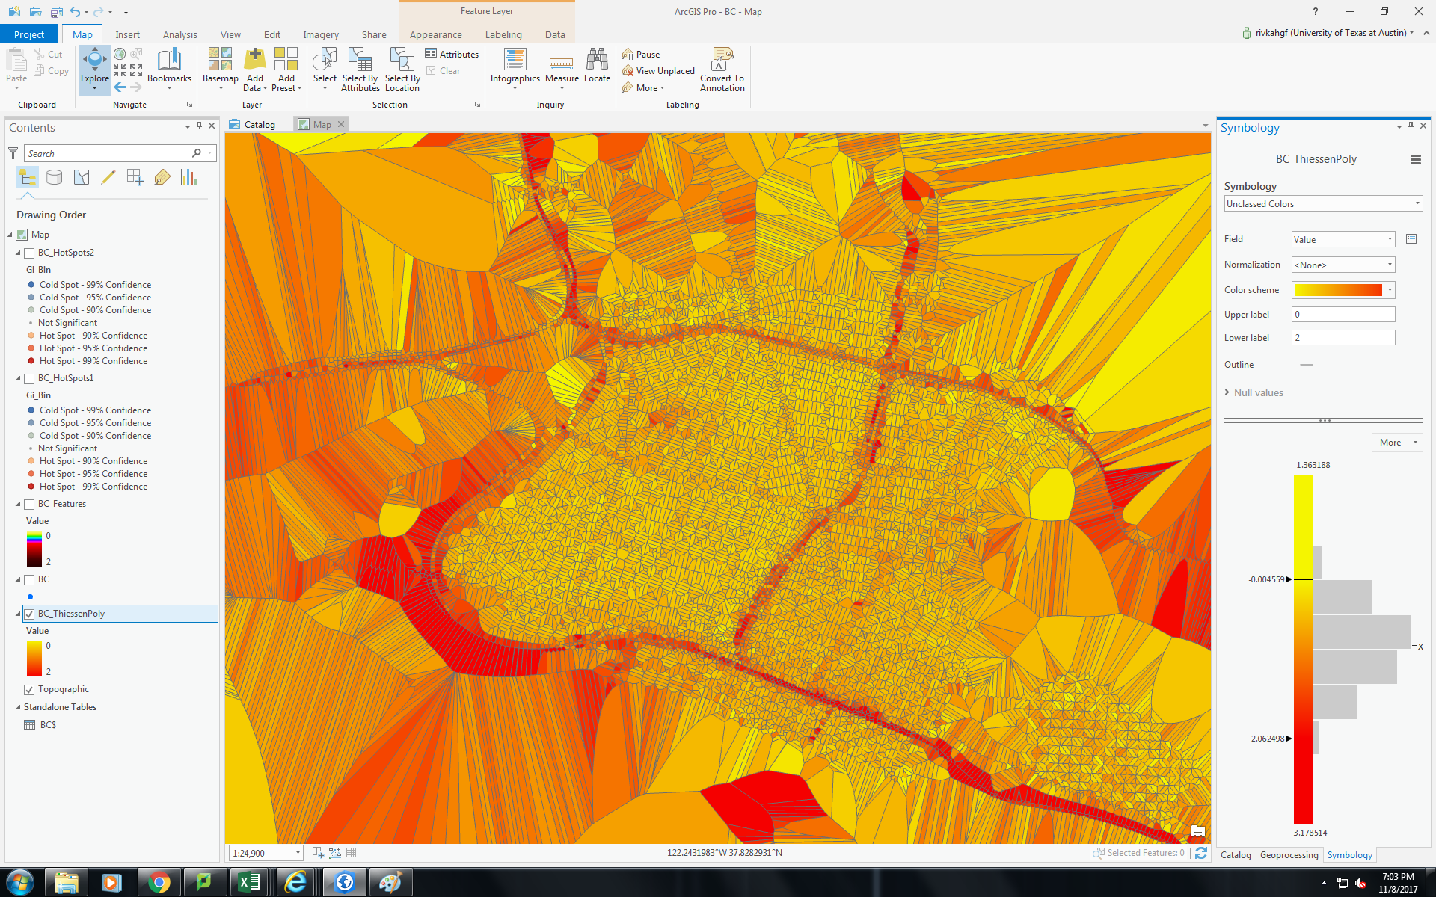
Thiessen Polygon
Notes:
Also was curious and did some Thiessen Polygons to see what kind of surface I could create
Want to compare it to land use regression the lab did for Oakland

Slide 13
Future steps
Explain spatial variability
  Elevation
  Prevailing winds
Analyze correlation with
  Land use
  Climate
  Demographics

