Slide 1
Quantifying alluvium effects on karst aquifer recharge: Shallow groundwater and surface water exchange in the upper Nueces River, Texas
Caroline Hackett
GISWR 2017
November 9, 2017
Notes:
Hi, again my name is Caroline Hackett, and I’m presenting work done by myself and my advisors, Marcus Gary and Daniella Rempe, investigating the role that alluvium deposits play in storage and transmission of river underflow and thus discrete recharge from streambeds in the contributing and recharge zones of the Edwards Aquifer in central Texas.

Slide 2
Edwards Aquifer
1
Notes:
I’ll keep my background material very brief since we’ve heard so much about the Edwards Aquifer today.
Map:
Edwards Aquifer overview→
San Antonio segment→
Uvalde County Pool→
Nueces River basin→
“Contributing zone”
Current conceptual model and quantification of recharge
Contributing zone, recharge zone
Puente method
Recent improvements on Puente method
It is estimated that 46% of the total average groundwater recharge of the
San Antonio segment of the Edwards Aquifer can be attributed to Uvalde County (Edwards Aquifer
Authority, 2005). –Green et al. 2006

Slide 3
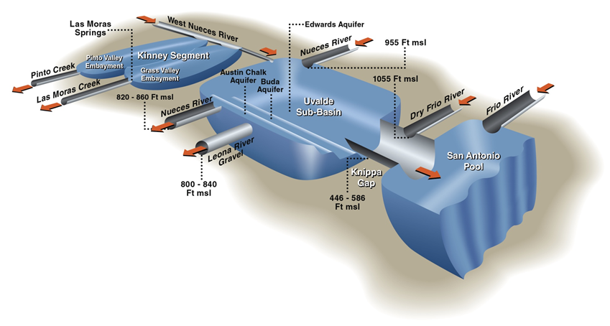
Uvalde pool and current discrete recharge estimation
Introduction
Fratesi et al., 2015
2
Notes:
Explain current recharge calculation by stream gauging
Explain Leona River Gravel discharge
As previously discussed, methods to quantify recharge are based on stream and river flow measurements
located a short distance up-gradient of the northern edge and down-gradient of the southern edge of the
recharge zone (Land et al., 1983). The calculated quantity of recharge is the stream-volume loss that
occurs between the two gages. Quantifying recharge with this method assumes that all flow in the
floodplain is surface water and that subsurface flow in the floodplain is insignificant at the measurement
locations.
Are losing reaches of the Nueces really recharging TA (which may become EA recharge) or is it being stored and transmitted in alluvium?

Slide 4
Alluvium across the Edwards Plateau
Notes:
Scaling up: basin water balance
Extent of alluvium
Refine recharge model
TWDB ONLINE MAP VIEWER USED WRONG GAT! Use TNRIS map
Do map of upper Nueces then go to map of alluvium on whole plateau
Geometry of floodplain, put in parameters for K, T, travel times (based on dye times), sat thickness
Extent of alluvium
Importance of alluvium across plateau
Map of alluvium and wells in alluvium
Weather station data
Stream gaging
Modeling:
Edwards Aquifer Authority’s Hydrologic Simulation Program-Fortran (HSPF model)
US Geological Survey’s GSFLOW model
→Scalability of my local conceptual model, field measurements, water balance model

Slide 5
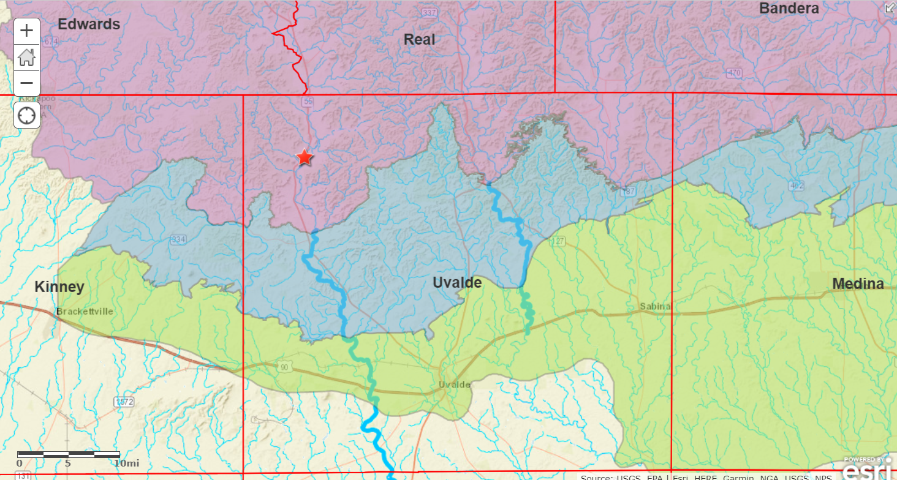
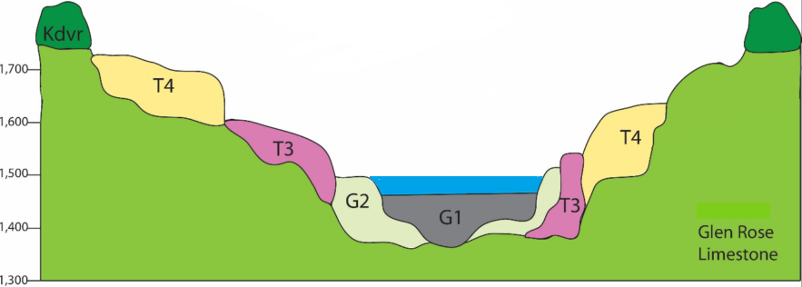
Nueces River basin: Flood conveyance system
Nueces River Basin: Floodplain Conveyance System
Nueces basin
Adapted from Kromann, 2015
Notes:
**age of alluvium!!
Nueces River valley cross-section with mantled alluvium: Nueces River Alluvium Aquifer (TWDB)
Extent of alluvium
Importance of alluvium across plateau
Map of alluvium and wells in alluvium
-Floodplain conveyance system conceptual model
-Estimate of % direct stream recharge from Nueces basin vs. distributed recharge in inter-stream area (precipitation infiltration) → from contrib zone on GlenRose vs recharge zone on Edwards
-Part of EAA’s Interformational Flow Study
-The consensus of these analyses is that inflow from the Trinity Aquifer to the Edwards Aquifer is not large and probably does not exceed 5% of the total water that recharges the Edwards Aquifer in Kinney and Uvalde counties. Additional analysis, however, is required to substantiate this hypothesis. (Green

Slide 6
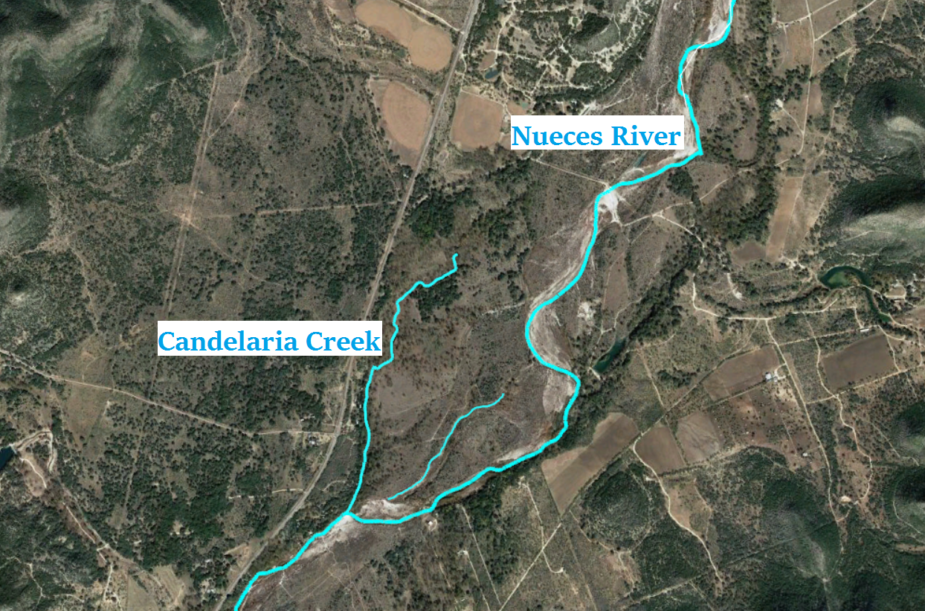
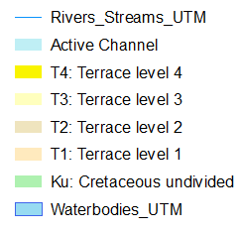
Representative study site: Candelaria Creek
Nueces basin
Notes:
Gaining-losing stream data
Candelaria Creek, a Major Tributary
Show with red, green, purple for sites that are both in time
Daily stage fluctuations from ET?
Nueces River Alluvium Aquifer- recognized by TWDB

Slide 7
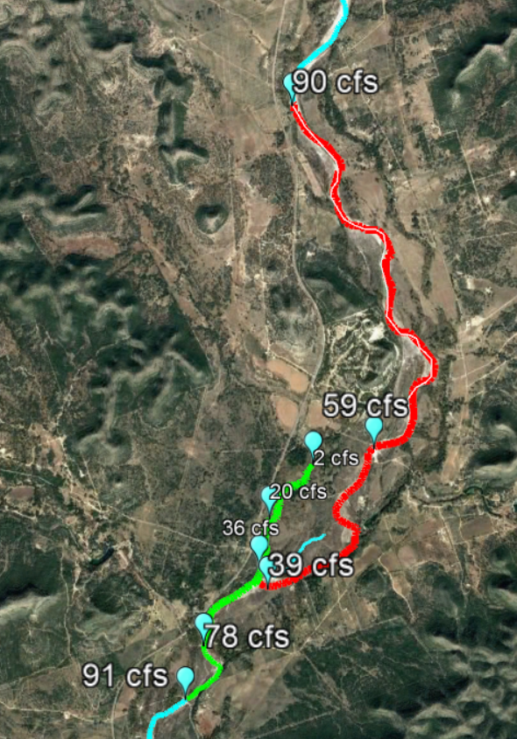
Nueces basin discharge gains and losses
January 28, 2017
February 18, 2017
July 18, 2017
Notes:
Gaining-losing stream data
Candelaria Creek, a Major Tributary
Show with red, green, purple for sites that are both in time
Mention other Nueces gain loss studies
Daily stage fluctuations from ET?
Nueces River Alluvium Aquifer- recognized by TWDB

Slide 8
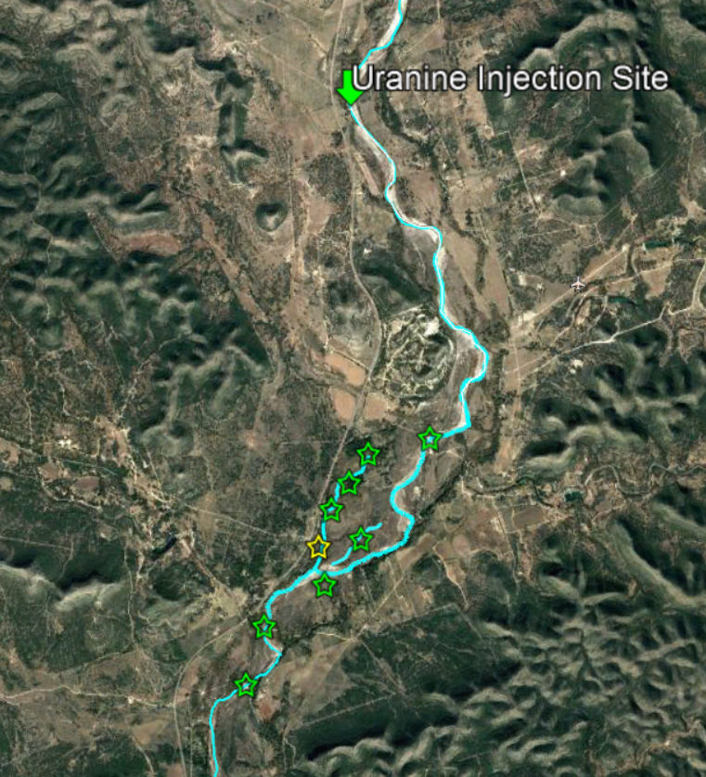
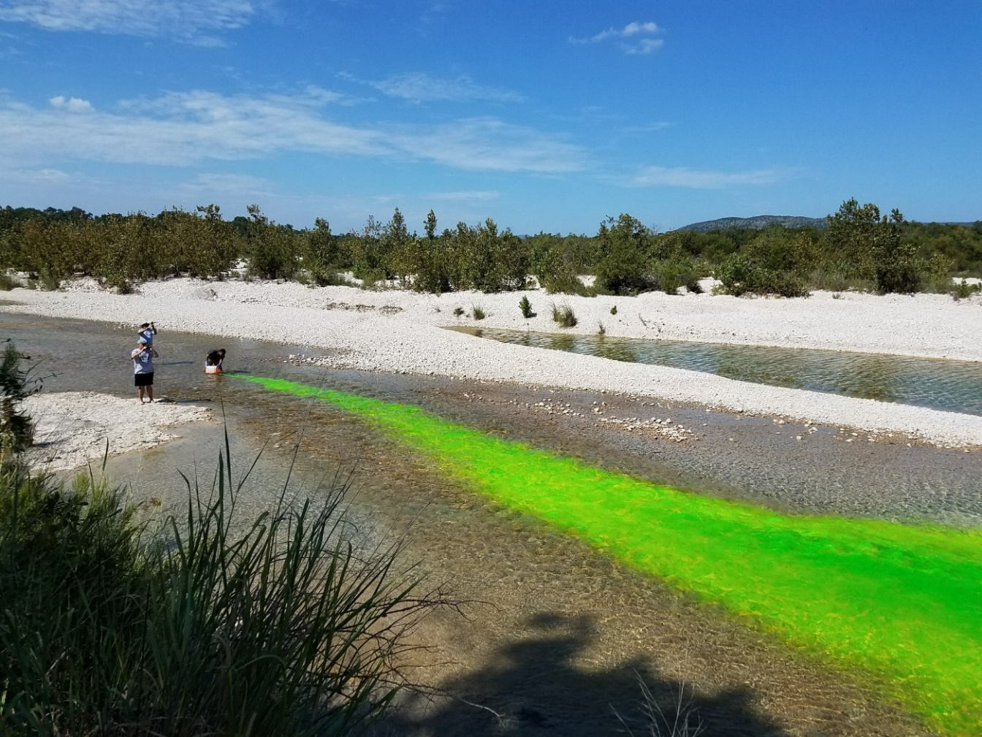
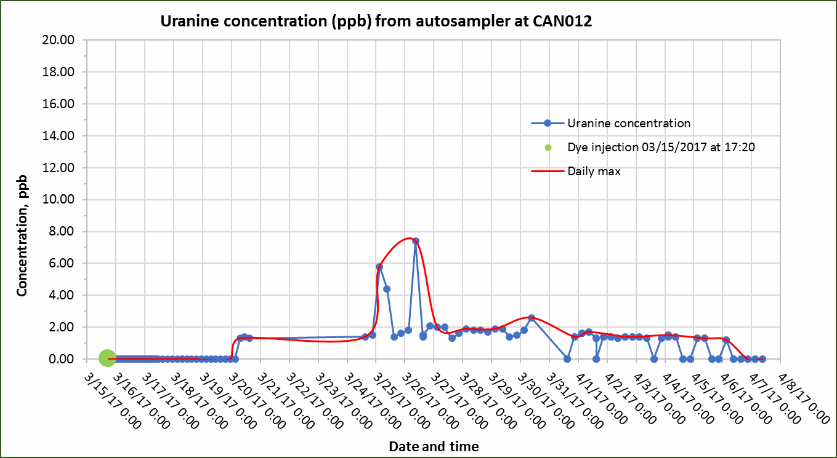
Subsurface connection between Nueces River and Candelaria Creek
Notes:
River underflow through alluvium to Candelaria springs!
-breakthrough time, peak time at CAN012, OX01,
Contribution of hillslope flowpaths!
Subsurface velocities
Storage of dye in alluvium from spring
Alluvium vs karst conduit flow
Spring vs summer flow conditions
Heterogeneity of alluvium– fluoxine did not travel

Slide 9
Nueces Headwaters HUC8 Subbasin

Slide 10
Nueces Headwaters HUC12 Subwatersheds
 | acres | mi^2 | Amount
Area of Nueces HW Subbasin (mi^2) | 522714.0 | 816.7
# of HUC12 subwatersheds in Nueces HW Subbasin |  |  | 21
Avg area of HUC12 subwatersheds (mi^2) | 24891.0 | 38.9
# of HUC10 watersheds in Nueces HW Subbasin |  |  | 4
Avg area of HUC10 watersheds (mi^2) | 24756.2 | 38.7
 | km or km^2 | mi or mi^2 | Amount
Total area of Nueces HW Subbasin- sum of catchment areas (mi^2) | 2115.9 | 817.0
Total area of Nueces HW Subbasin- most downstream flowline (mi^2) | 2115.1 | 816.6
Total area of Nueces HW Subbasin- from Q#1 (mi^2) |  | 816.7
# of NHDPlus catchments in Nueces HW Subbasin |  |  | 489
Avg area of NHDPlus catchments (mi^2) | 4.3 | 1.7
# of NHDPlus flowlines in Nueces HW Subbasin |  |  | 493
Avg length of NHDPlus flowlines in Nueces HW Subbasin (mi) | 2.5 | 1.6
Total length of NHDPlus flowlines in Nueces HW Subbasin (mi) | 1235.7 | 767.8
Best est. of actual mean flow at outlet of Nueces HW Subbasin (cfs) |  |  | 203.0
Average slope of flowlines in Nueces HW Subbasin |  |  | -81.1

Slide 11
Nueces Headwaters Subbasin Data
Weather station data from the Edwards Aquifer Authority (EAA), including precipitation and soil moisture, from Montell, TX
Stream stage on Candelaria Creek, a representative tributary creek to the Nueces River in Montell, TX (EAA data)
Groundwater levels from the Texas Water Development Board from several representative wells in Real and Uvalde counties
Stream discharge from the U.S. Geological Survey gages at Barksdale, Montell, and Laguna in Real and Uvalde counties
Texas geological map from the Texas Natural Resources Information System (TNRIS), to estimate aerial extent of alluvial deposits
Soil type map in the study area
Land cover map in the study area

Slide 12
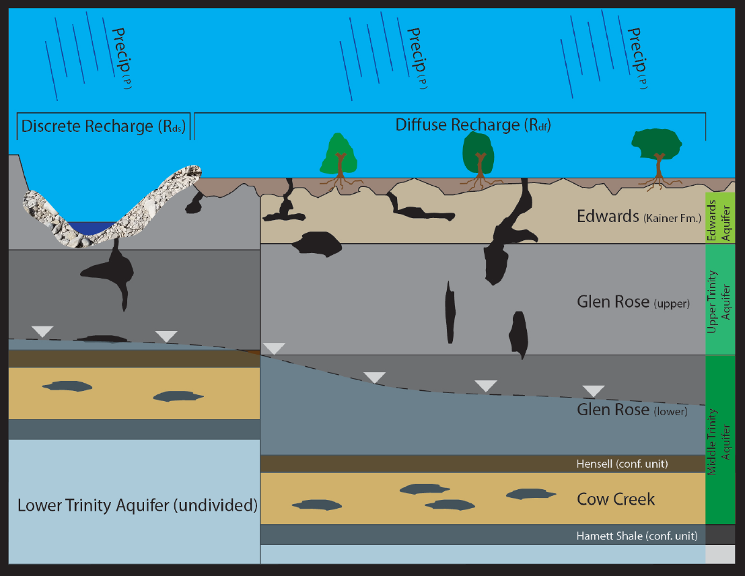
Term Project Deliverable & Next Steps
Nueces Headwaters Subbasin water balance
Groundwater recharge
Extent of alluvium deposits and alluvial terraces in subbasin
Storage in alluvium deposits
Evaluate applicability to other Edwards Plateau watersheds
Notes:
in Contributing Zone
Write out explicit conclusions: rapid subsurface transit times but also no transit
Flood conveyance system transport of river underflow
Storage of river water in alluvium
ignificant storage time and Recharge to alluvial aquifer or recharge to Trinity, Edwards
Impacts on conceptual model and methods of recharge calculations
Do a back of envelope calculation of alluvium thickness, extent, volume
Check well logs in alluvium, cross sections for idea of depth of alluvium
Look up dye flow times in karst conduits– Kinney Co, Barton Springs (Onion Creek)

