Slide 1
Impact of Wildfires on Northern California Water
Quality
By Rahul Naik
https://commons.wikimedia.org/wiki/File:San_Francisco_Bay_aerial_view.jpg

Slide 2
OVERVIEW
Impact of Wildfires
Water Bodies – Sonoma Creek, Napa River, Santa Rosa Creek, San Francisco Bay
Water Data
Issues
Future Work

Slide 3
Northern California Wildfires
Began October 8, 2017
42+ dead, estimated 5,700 structures damaged
Nuns, Tubbs, & Atlas Fires
All have been contained
(Peter da Silva)
(Genaro Molina)

Slide 4
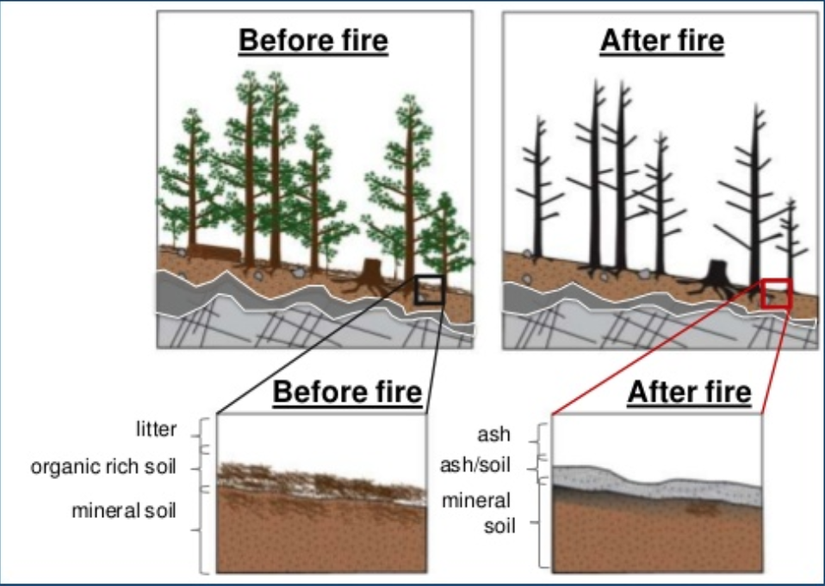
Wildfire Impact
Erosion
Interception
Infiltration
Evapotranspiration
Runoff
Deposition
(John A. Moody)

Slide 5
Wildfire Impact Concerns
Increased streamflows → flooding
Debris in waterbodies
Debris flows (landslides)
(John A. Moody)

Slide 6
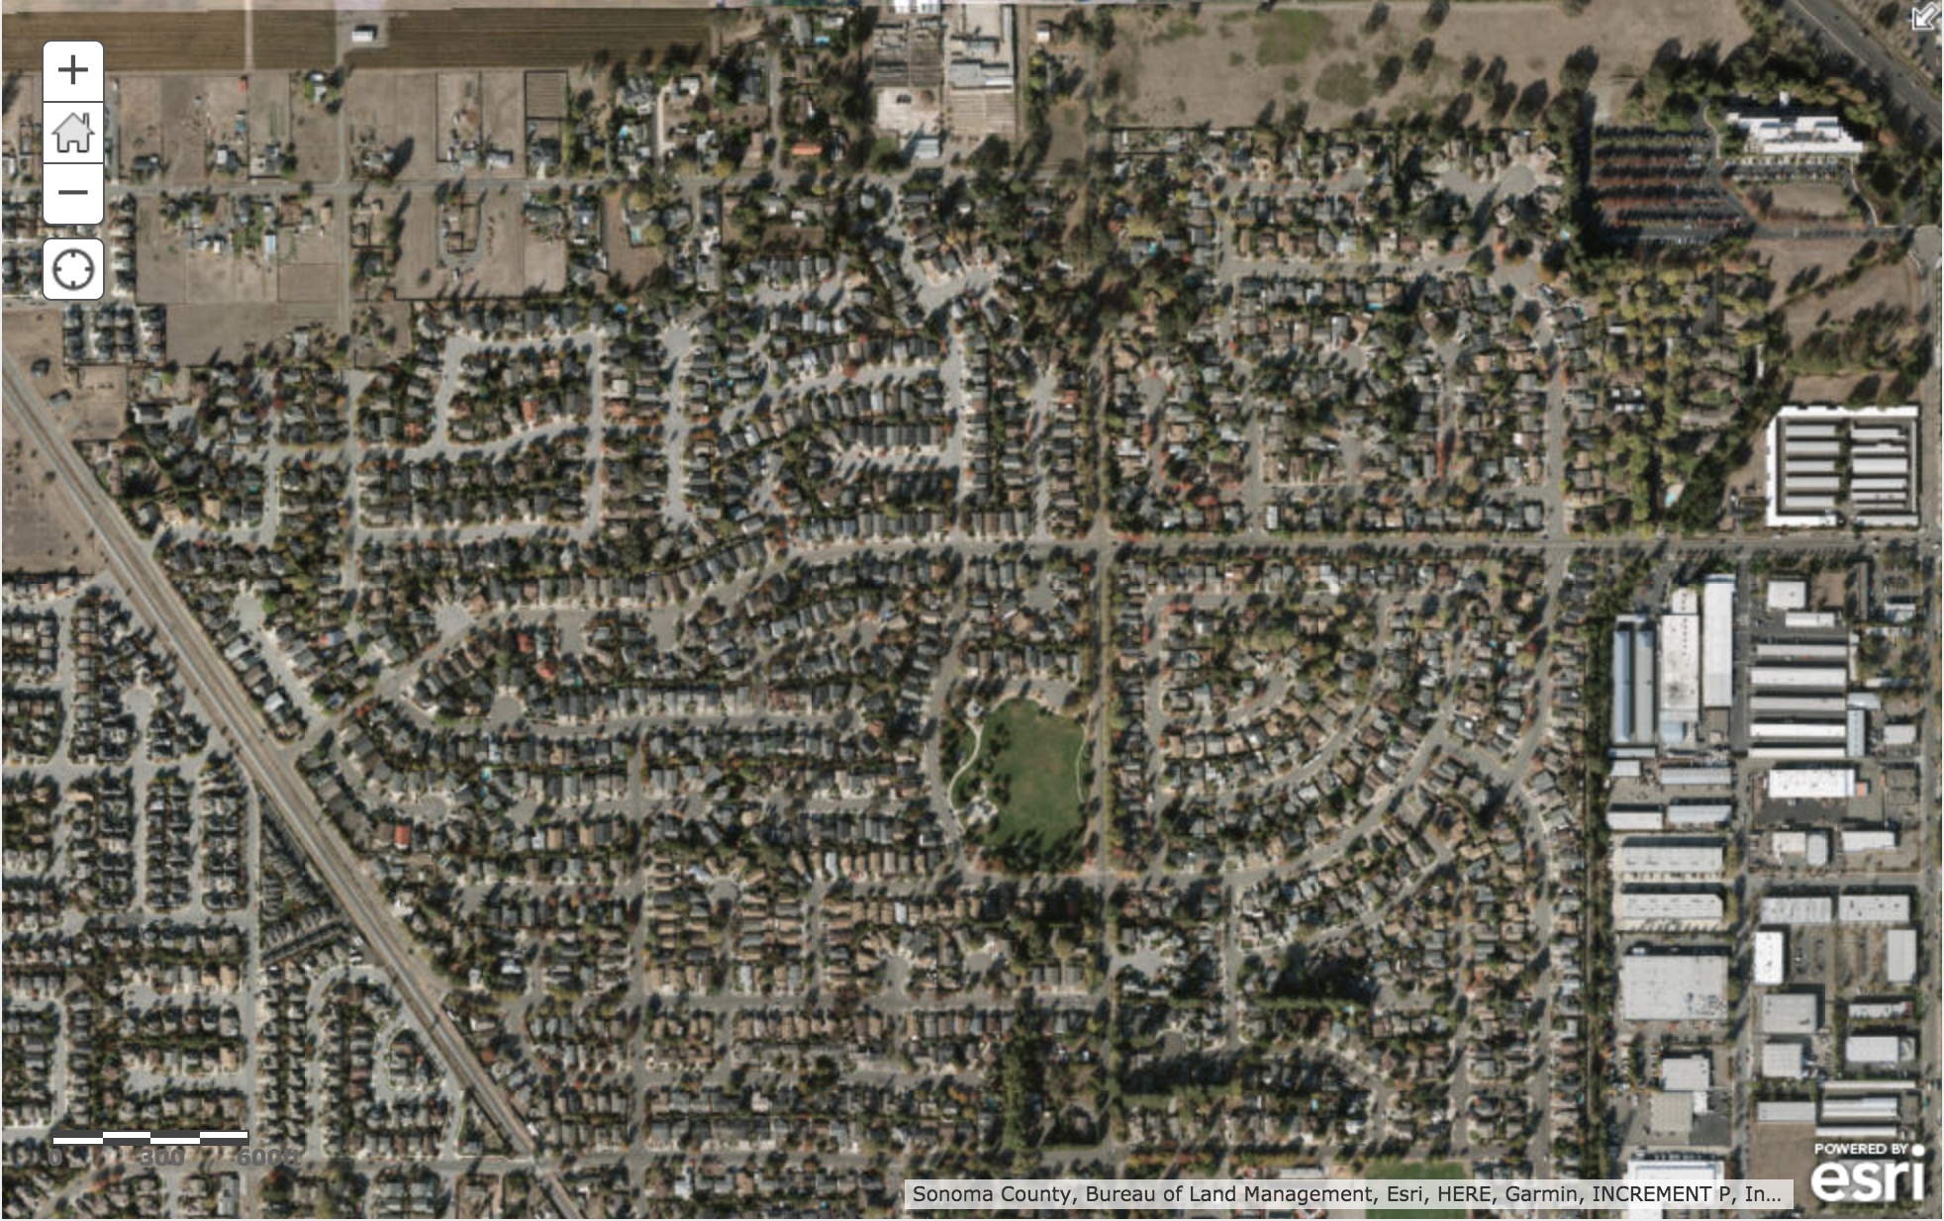
Extent of Wildfires

Slide 7
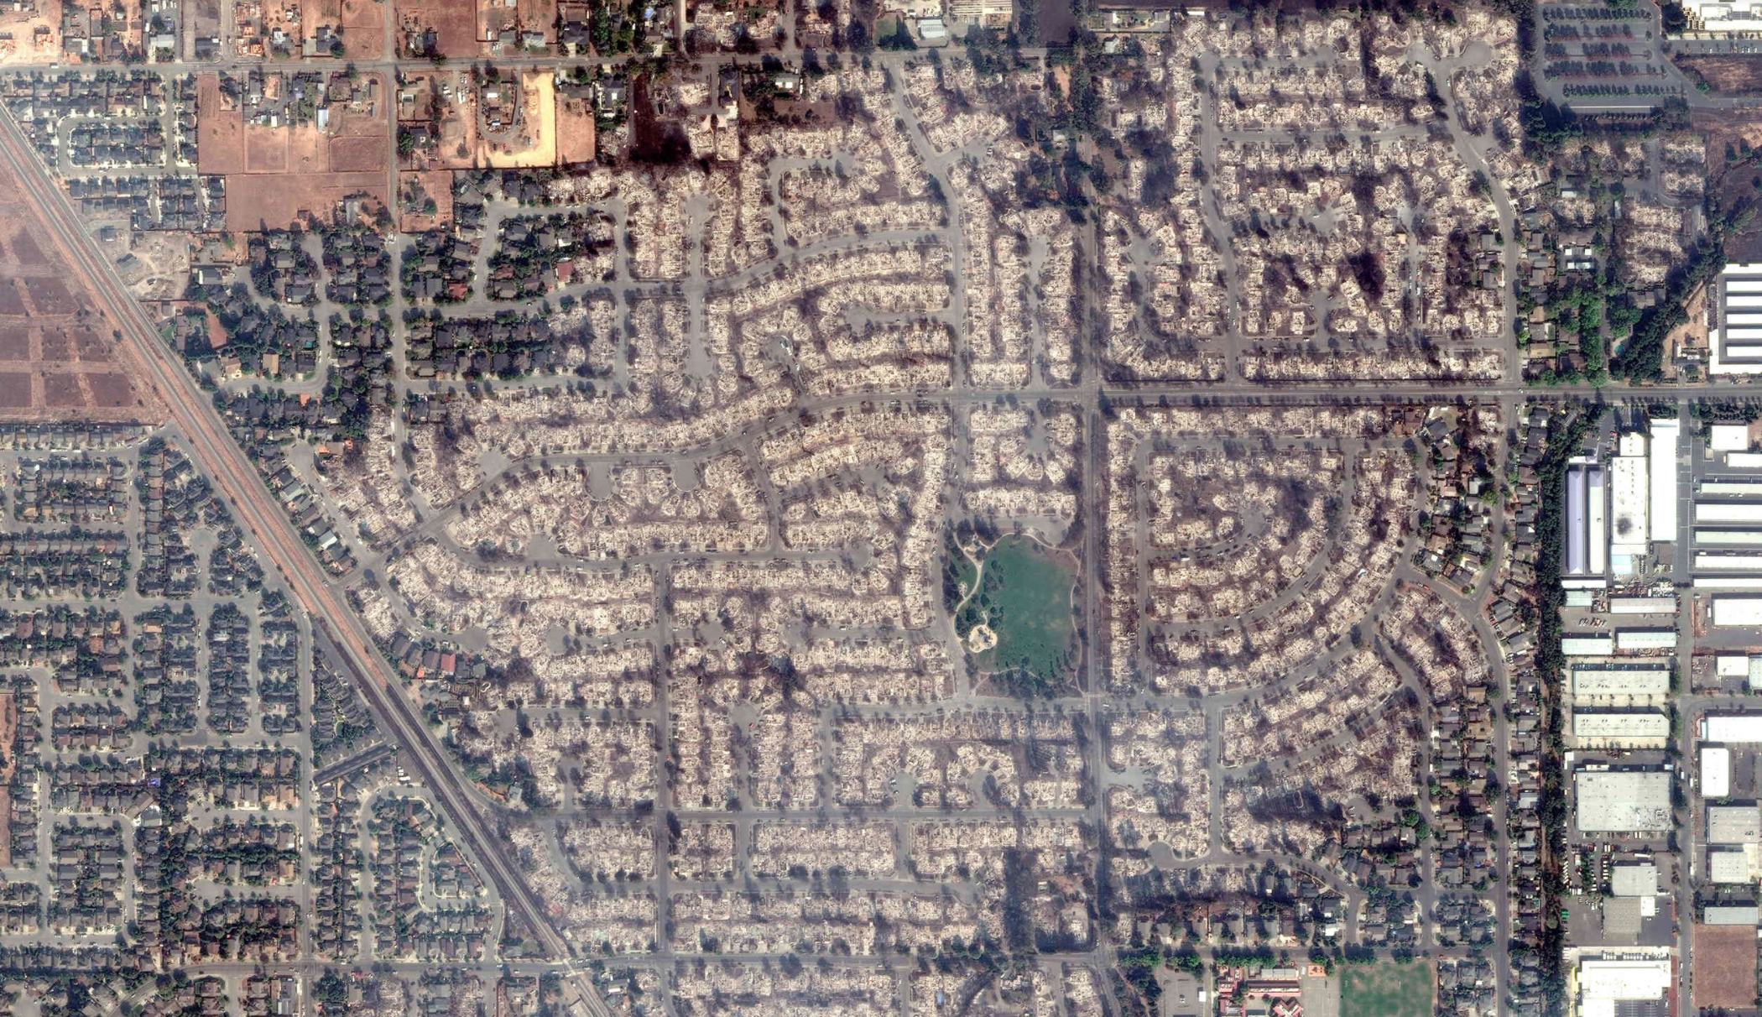
Extent of Wildfires

Slide 8
Bodies of Water
Sonoma Creek
Napa River
Santa Rosa Creek
San Francisco Bay
  West Coast’s largest estuary
  Biological diversity and richness
  Bay Area population & tourism
http://www.sfbws.com/
https://www.fws.gov/refuge/Don_Edwards_San_Francisco_Bay/wildlife_and_habitat/index.html

Slide 9
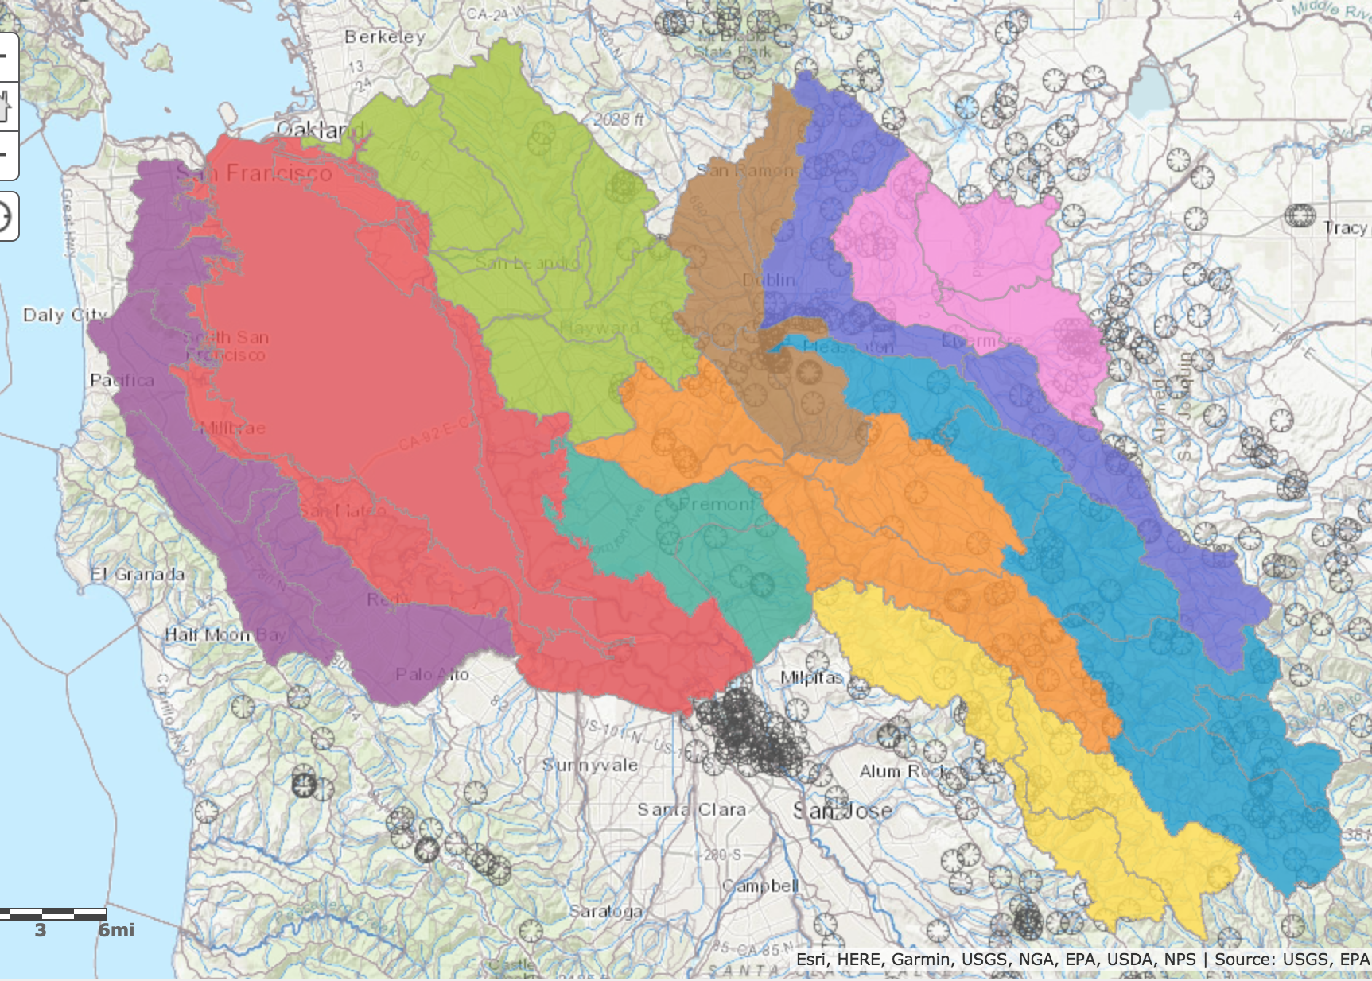
San Francisco Bay Watershed
~50–60 miles south of Santa Rosa, Sonoma County, and Napa County
Drains 40% of California’s water

Slide 10
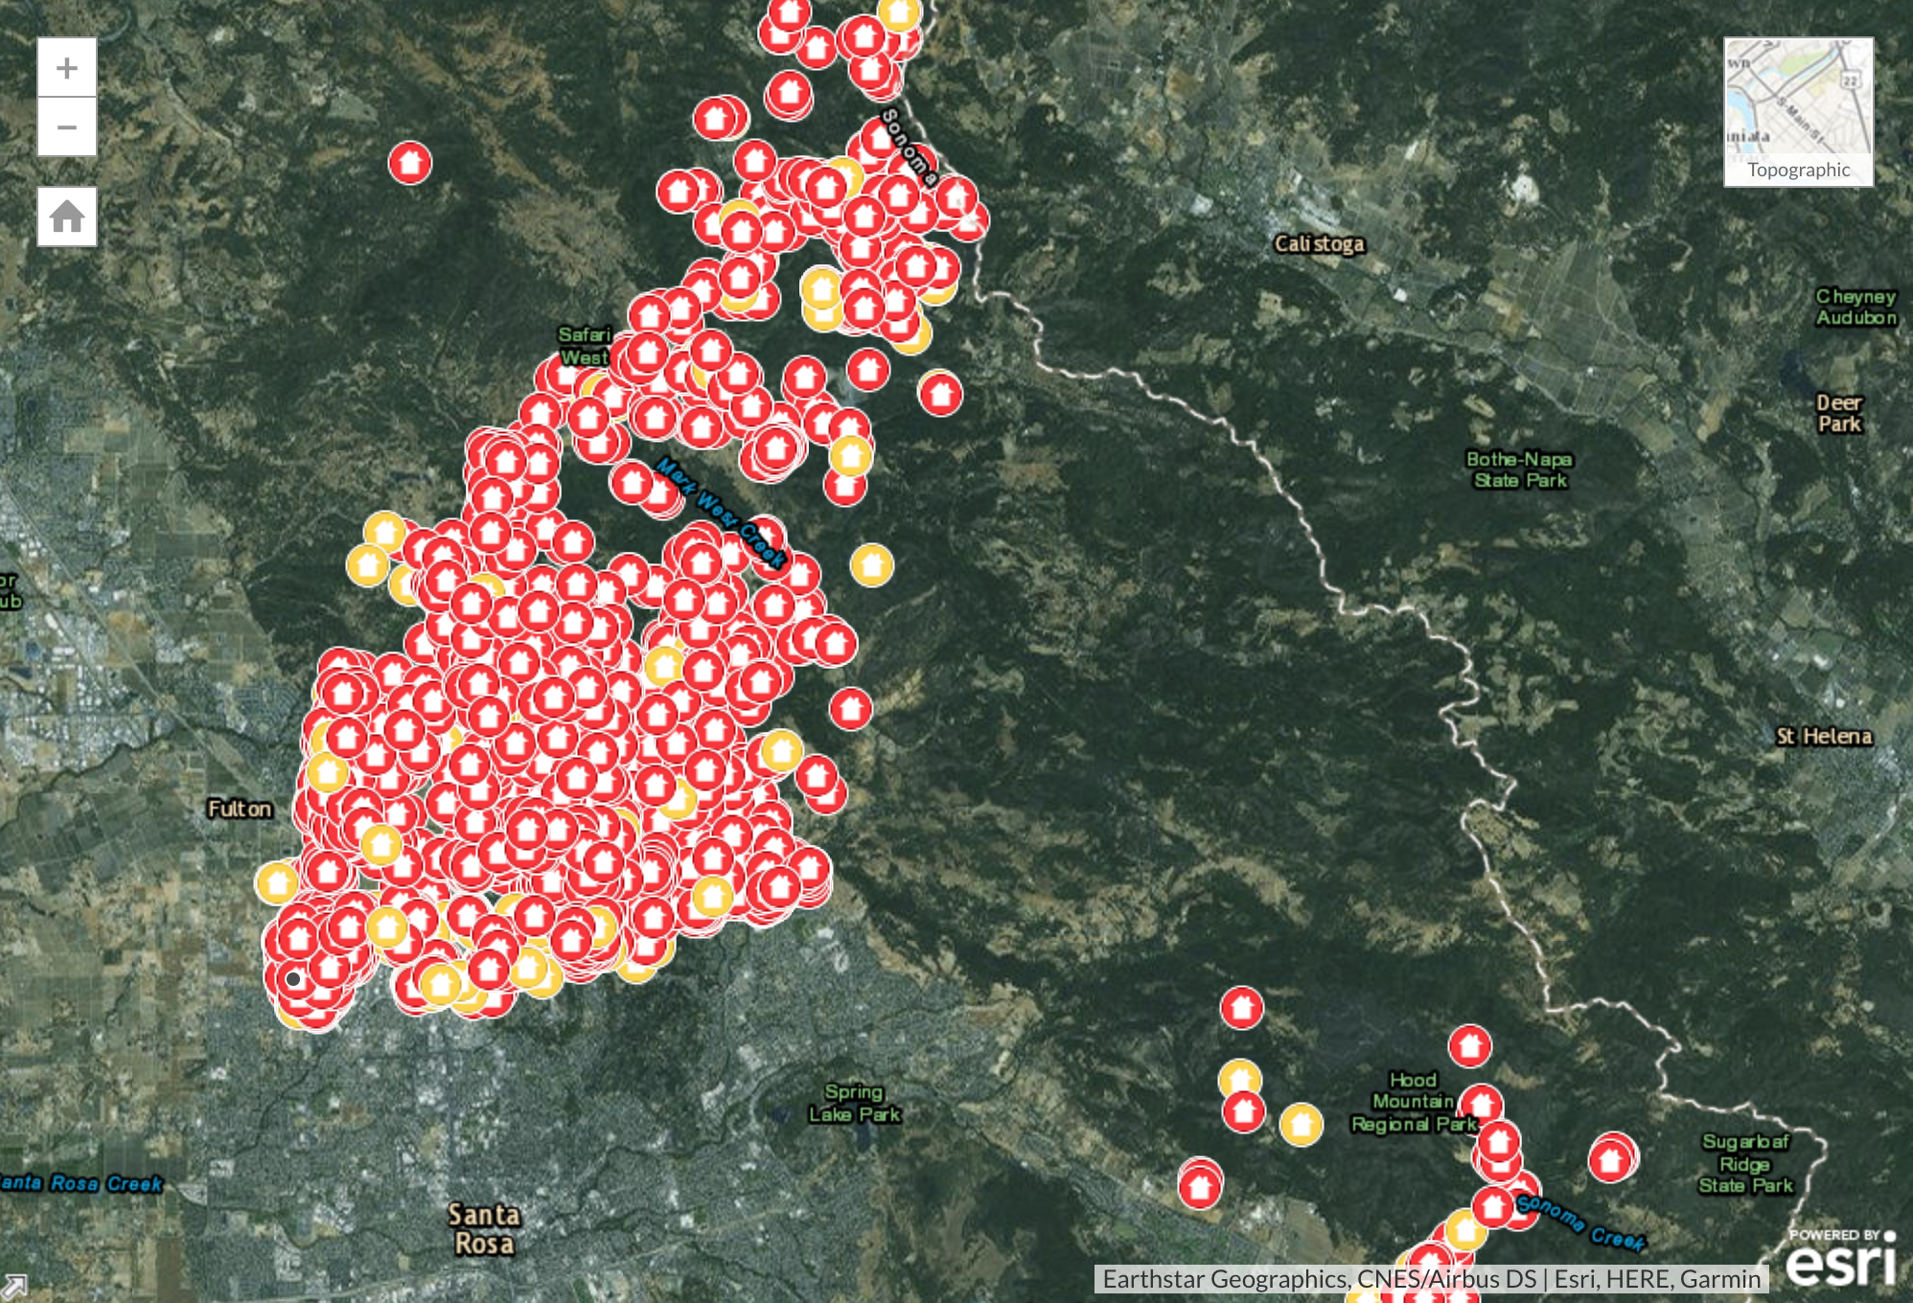
Napa River

Slide 11
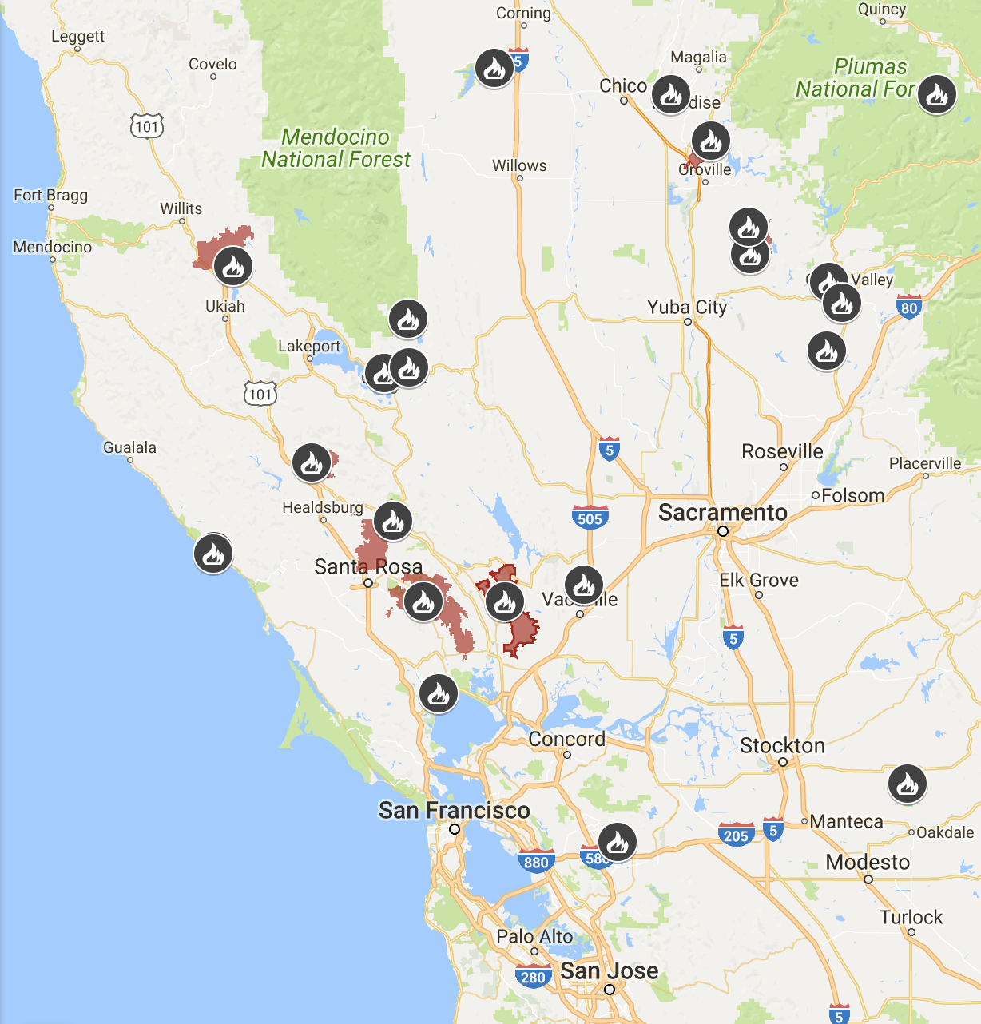

Slide 12
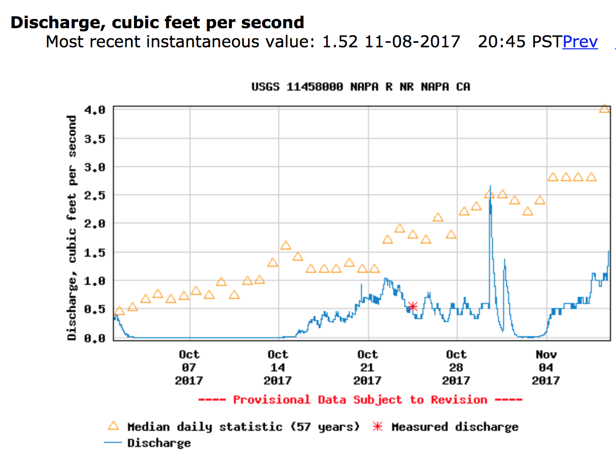
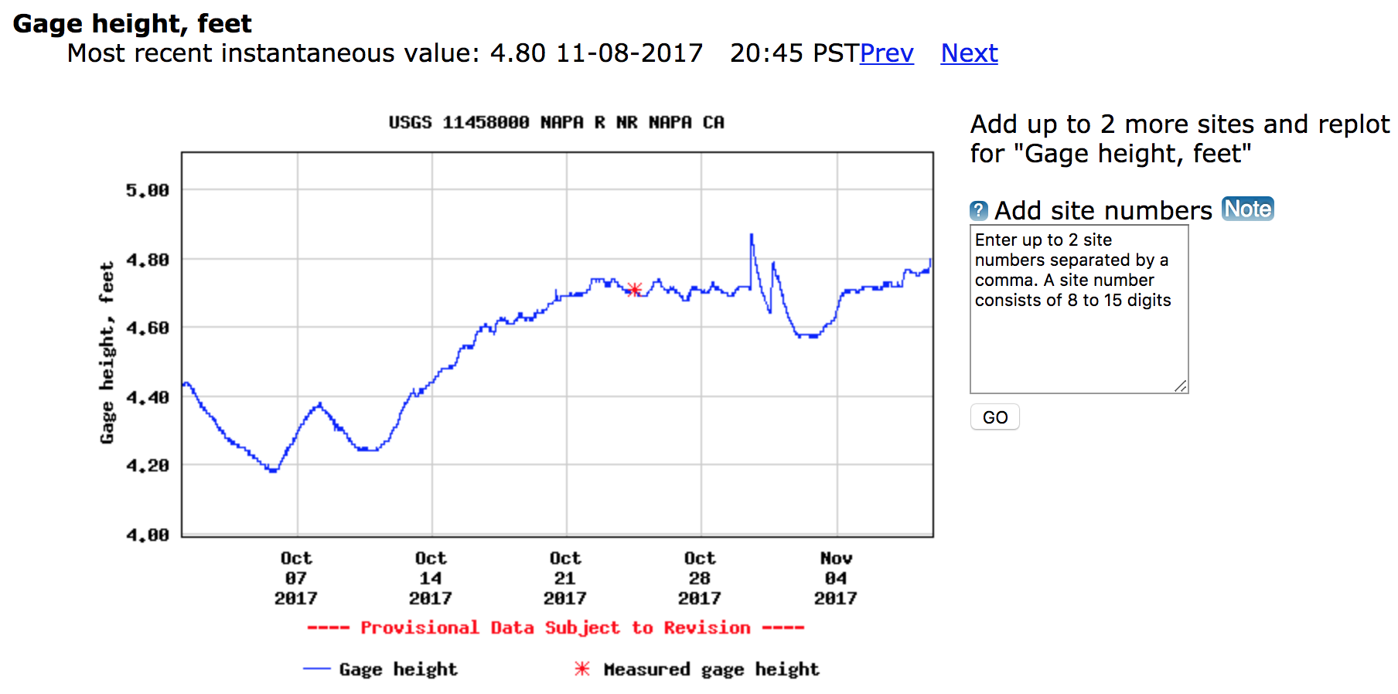
Napa River Streamflow

Slide 13
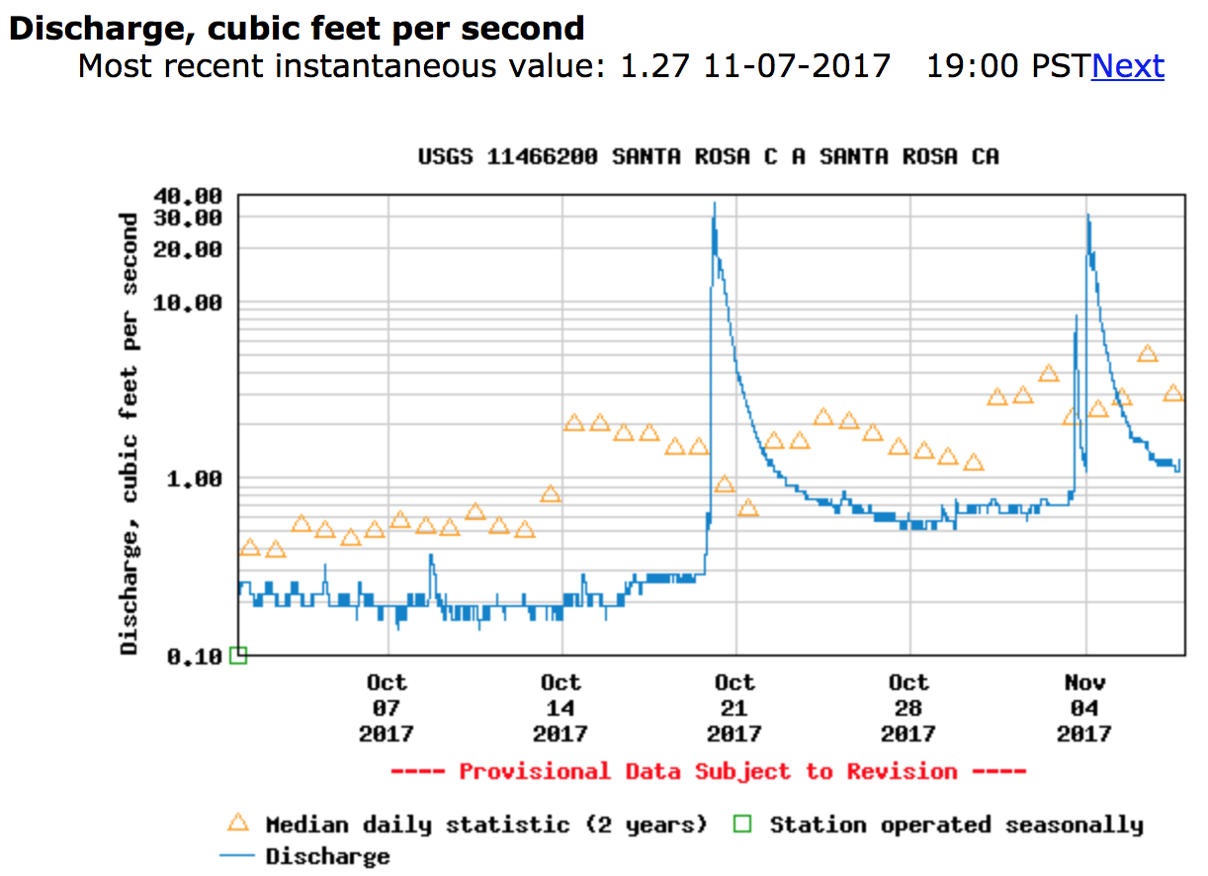
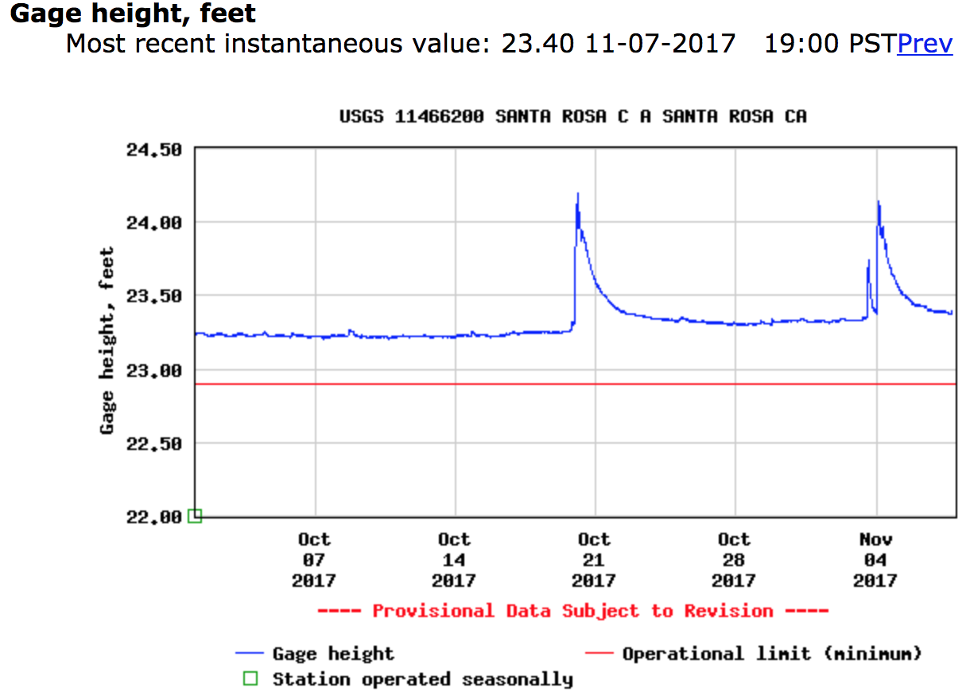
Santa Rosa Creek Streamflow

Slide 14
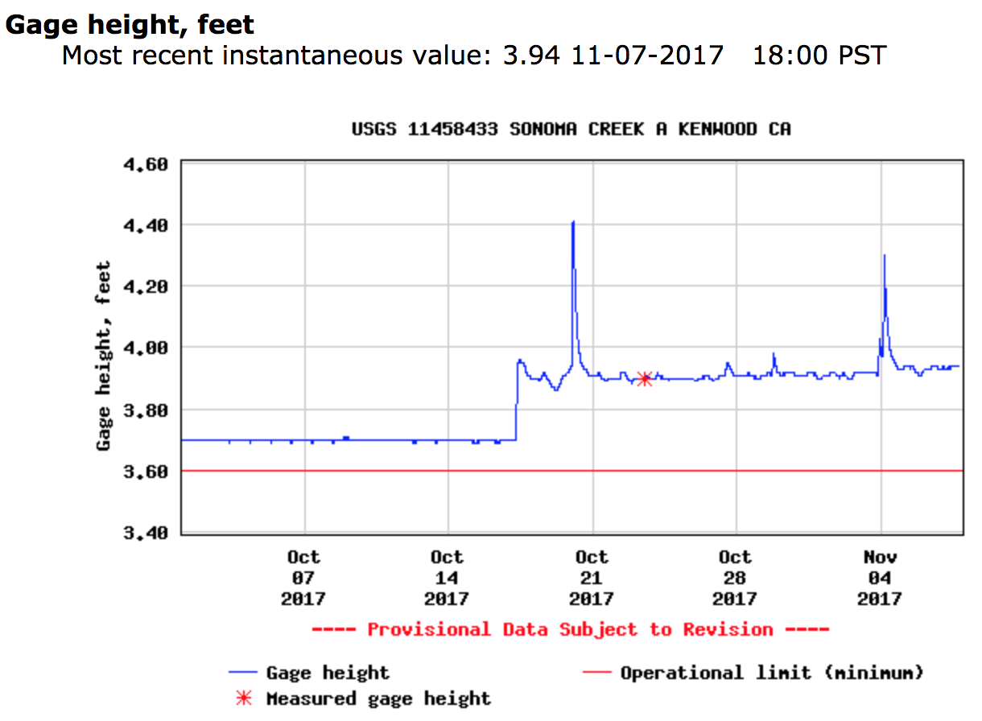
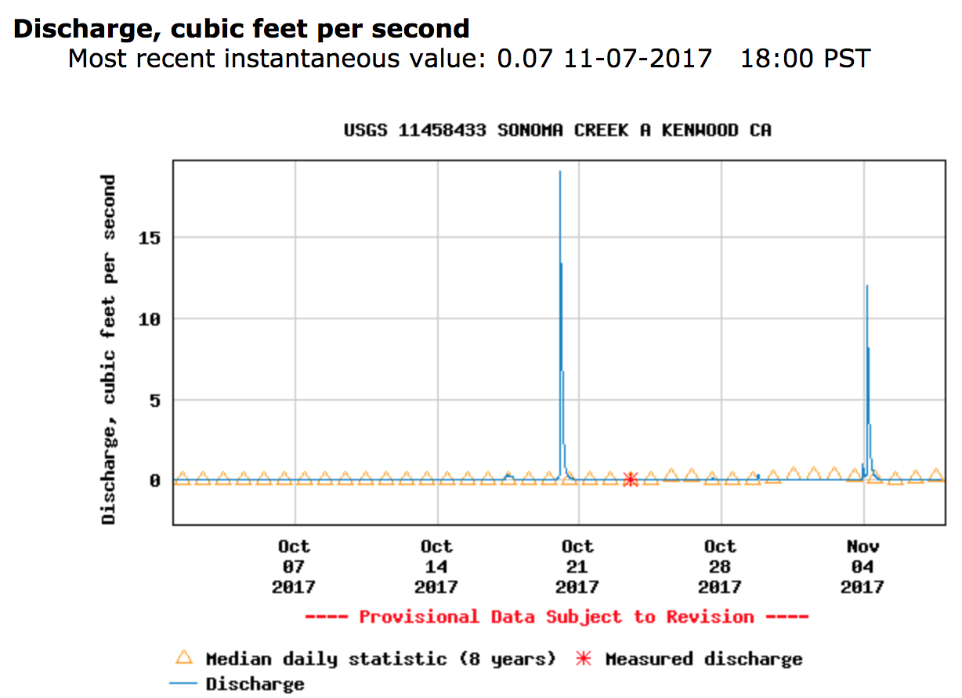
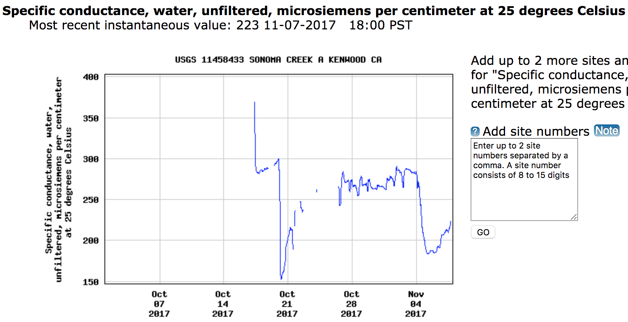
Sonoma Creek Streamflow & Specific Conductance

Slide 15
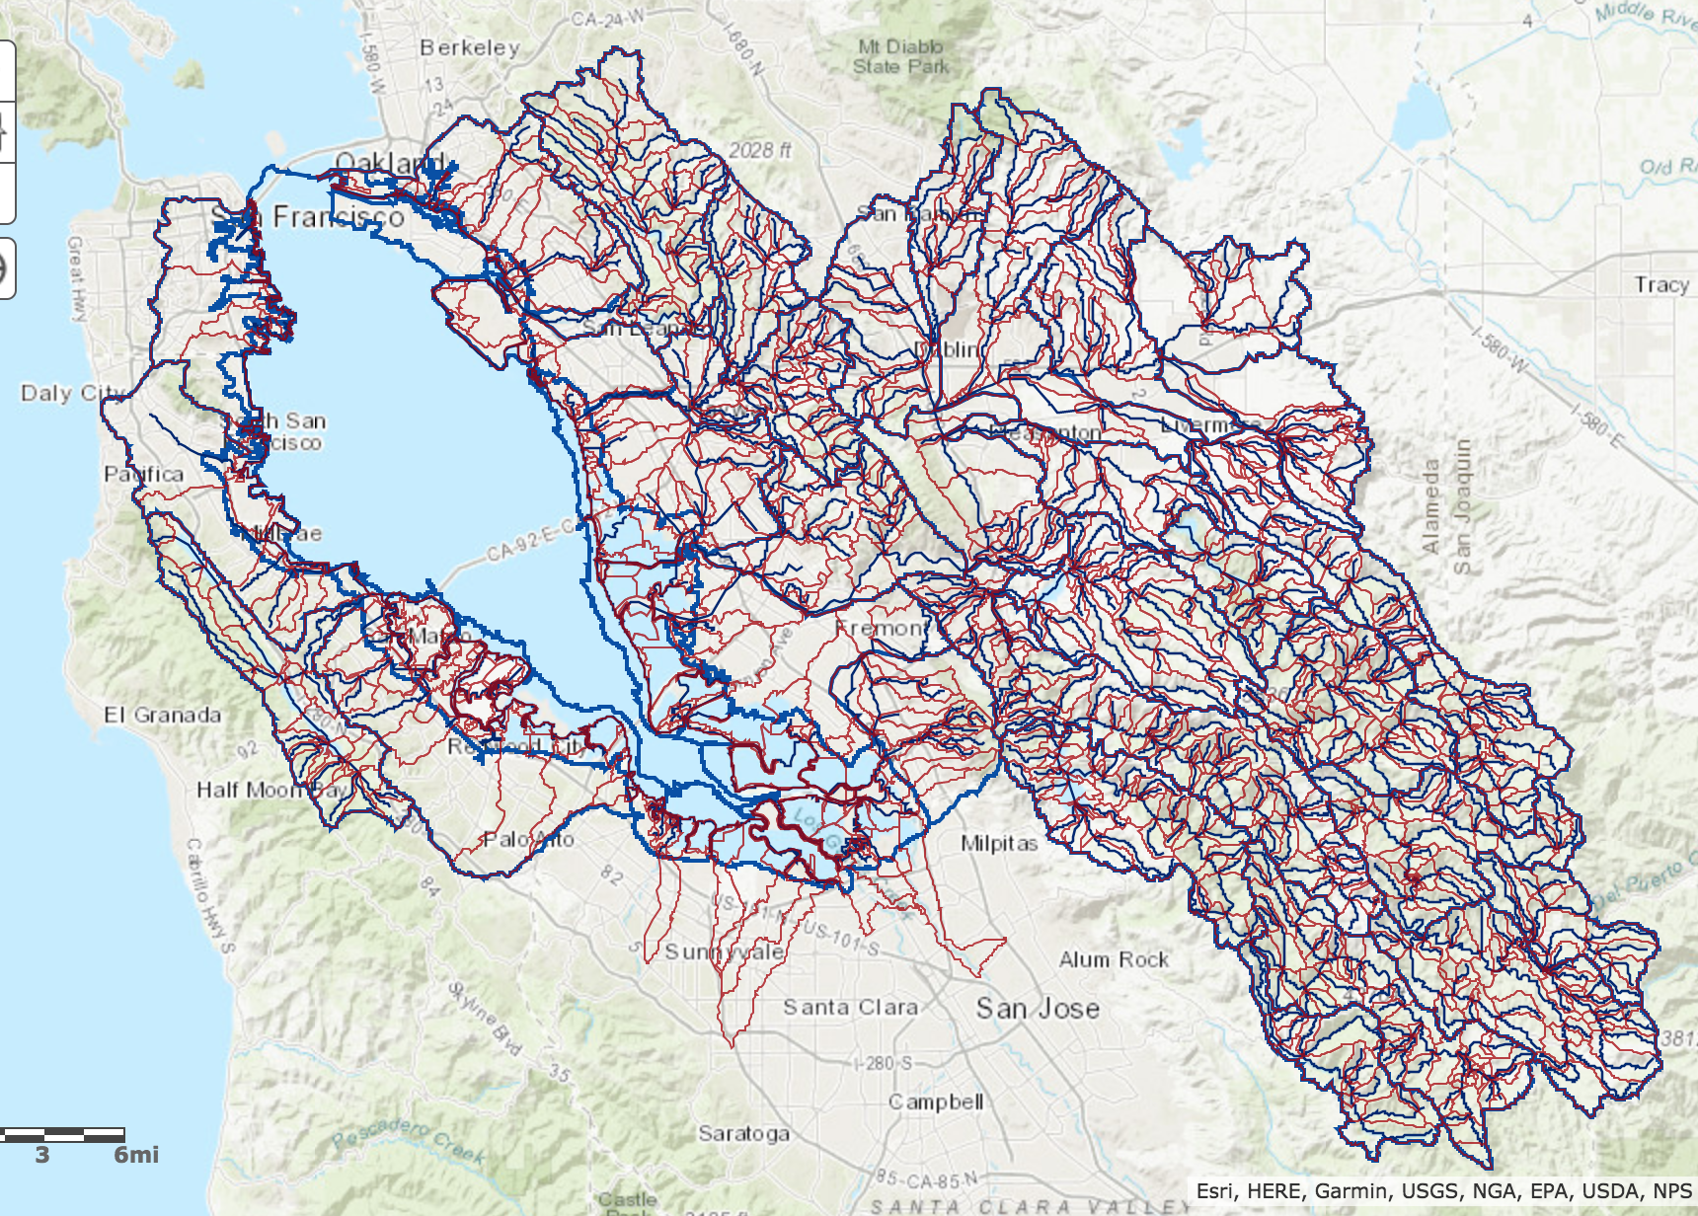
San Francisco Bay Watershed
Water Quality
  Specific Conductance
  Turbidity
  Suspended Sediment Concentration

Slide 16
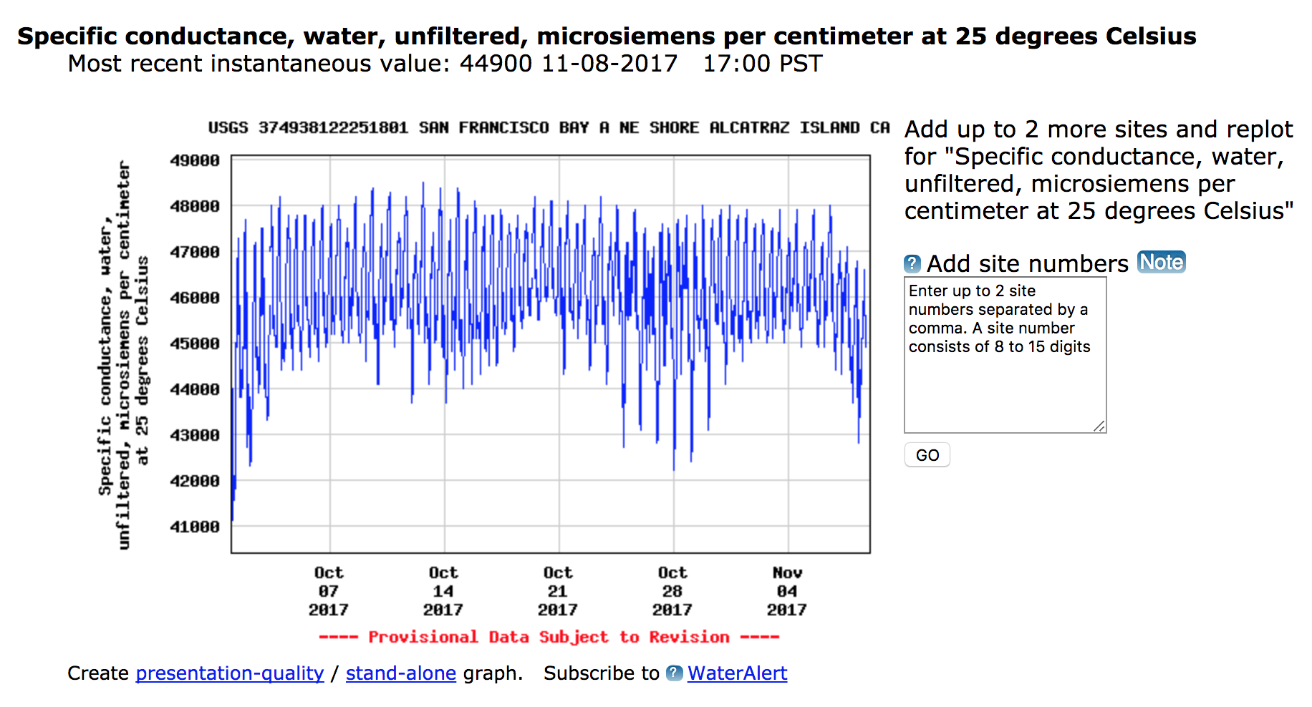
San Francisco Bay Specific Conductance

Slide 17
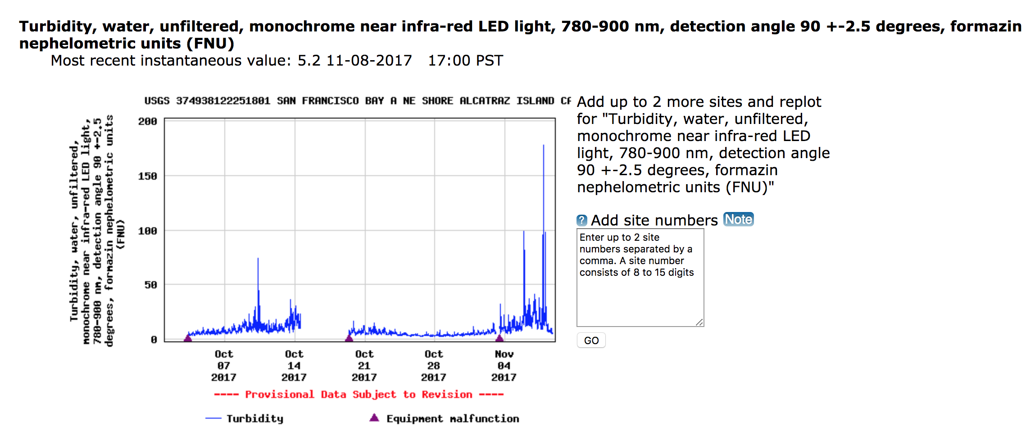
San Francisco Bay Turbidity

Slide 18
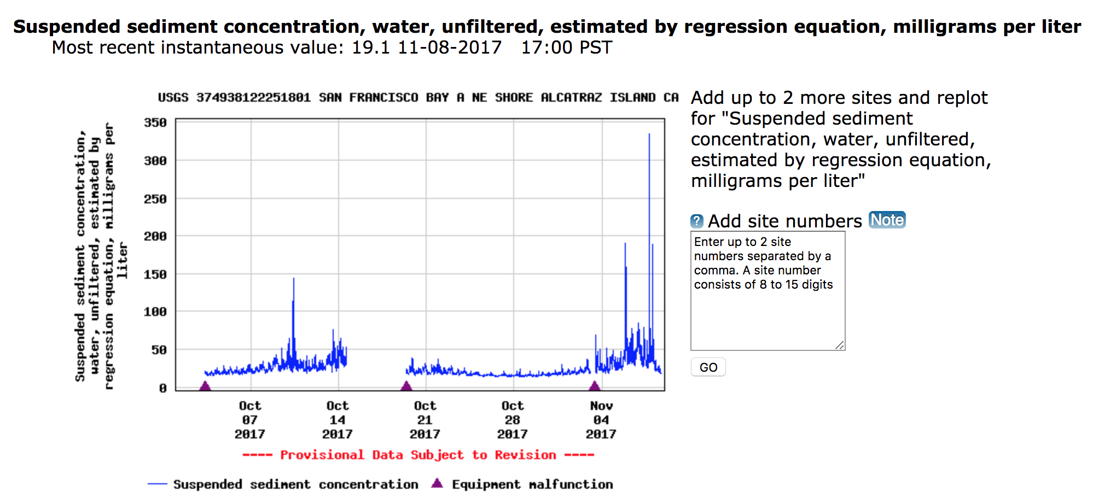
San Francisco Bay Suspended Sediment Concentration

Slide 19
Issues
“potential soil impacts difficult to predict...most critical component determining the degree and type of erosion response is timing, magnitude, and duration of storms immediately following the fire.” (Ryan et al., 2011)
Timing – wait for large precipitation event

Slide 20
Future Work
Soil/Land Cover Map
Follow precipitation statistics, precipitation modeling
Take data from Sacramento River

Slide 21
Questions, Comments, Suggestions?

Slide 22
Thank you and Go Astros!

