Slide 1
Data Sources for GIS in Water Resources by David R. Maidment, and David G. Tarboton
GIS in Water Resources
Fall 2017

Slide 2
Outline
The hierarchical system of watersheds and basins
Where to obtain data and maps
  National/State/Global Data repositories
  Hydrography
  USGS National Water Information System
  Land Cover
  Census
  Elevation
  Soil (Statsgo/Surgo)
  Weather
  Regional data for Texas and Utah

Slide 3
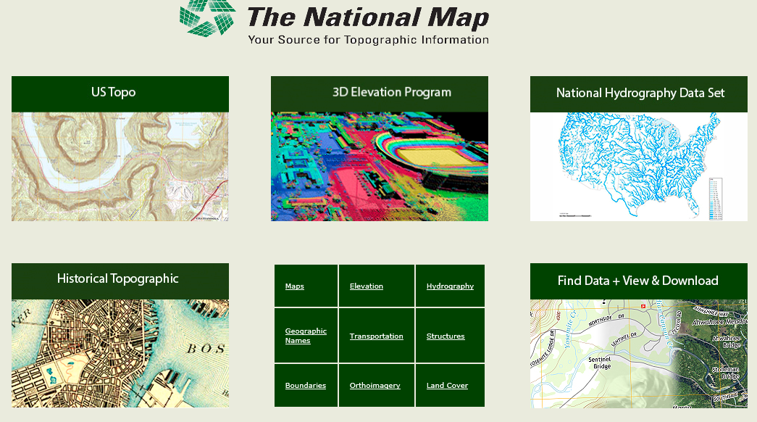
The National Map
http://nationalmap.gov/
A central source for US Government data

Slide 4
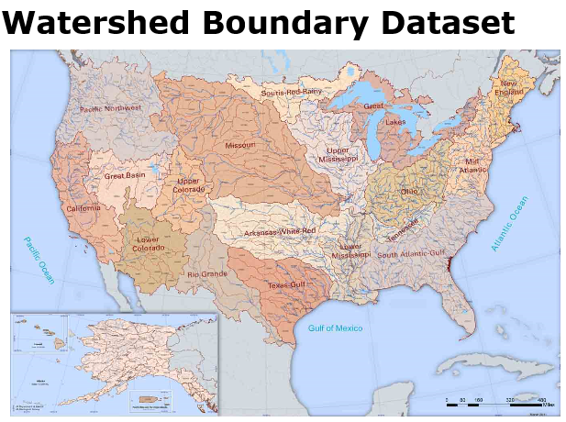
https://nhd.usgs.gov/wbd.html

Slide 5
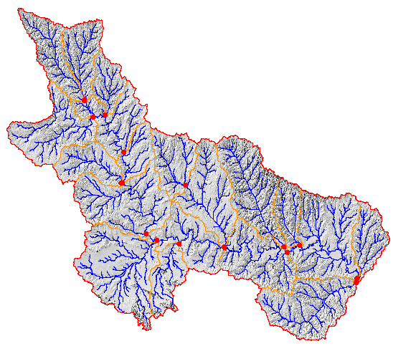
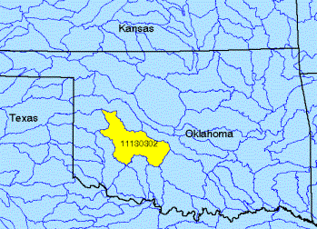
Watershed Boundary Dataset
http://nhd.usgs.gov/wbd.html
National Program by USGS and USDA (NRCS)
Boundaries for 10- and 12- digit watersheds
First cut is by automated delineation from NED
Hand checked and edited
10-digit watersheds

Slide 6
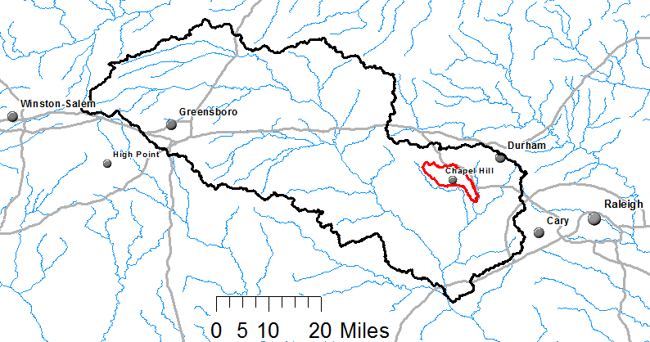
Watershed Hierarchy
Each hydrologic unit is identified by a unique hydrologic unit code (HUC) consisting of two to or more digits based on the levels of classification in the hydrologic unit system.
Digit #
2
4
6
8 HUC
10
12
NHDPlus
HAW HUC 8 03030002
Little Creek HUC 12 030300020603

Slide 7
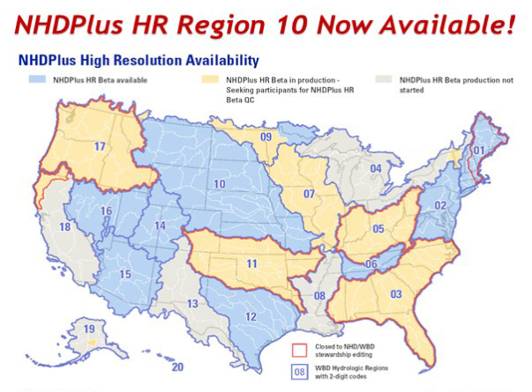
National Hydrography Dataset
https://nhd.usgs.gov/

Slide 8

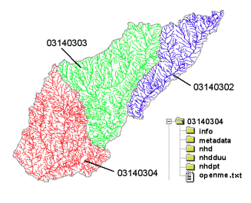
River networks
for 8-digit HUC
watersheds
http://nhd.usgs.gov/

Slide 9
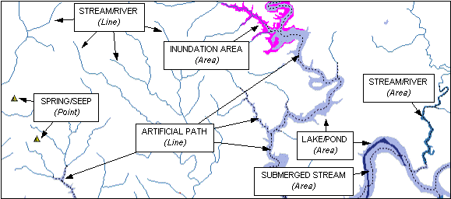

Slide 10
River Reach Codes
Used for river address locations
ReachCode =
12030102000151
ReachCode = 12030102000005
HUC#
Segment#
Location 0.392
on Reach
12030102000005

Slide 11
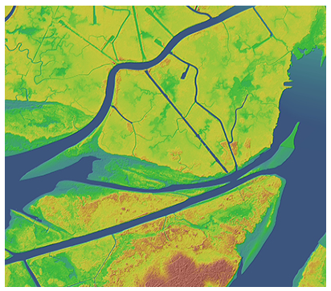

National Elevation Dataset
https://nationalmap.gov/elevation.html

Slide 12

National Elevation Dataset
Digital Elevation Model with 1 arc-second (30m), 1/3 arc-second (10m) and some 1/9 arc second (3m) cells
Distributed as part of the National Map
10 billion data
Derived from USGS 1:24,000 quadrangle sheets and at higher resolution from LIDAR

Slide 13
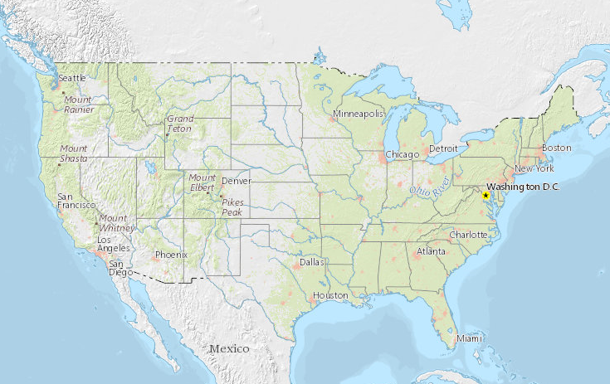
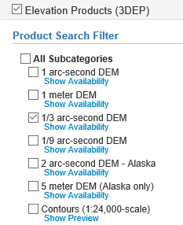
National Elevation Dataset Availability
https://viewer.nationalmap.gov/basic/

Slide 14

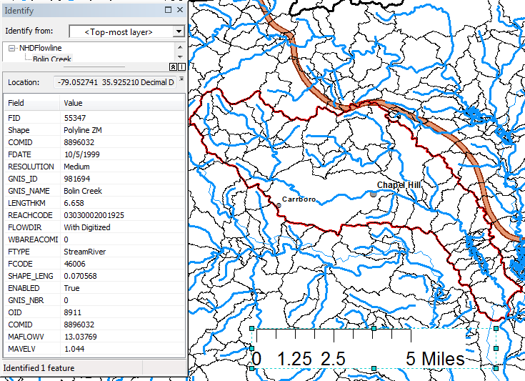
Slope
Elevation
Mean annual flow
  Corresponding velocity
Drainage area
% of upstream drainage area in different land uses
Stream order
http://www.horizon-systems.com/nhdplus/

Slide 15
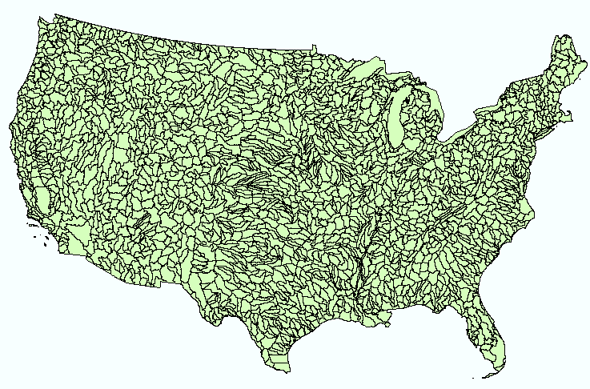
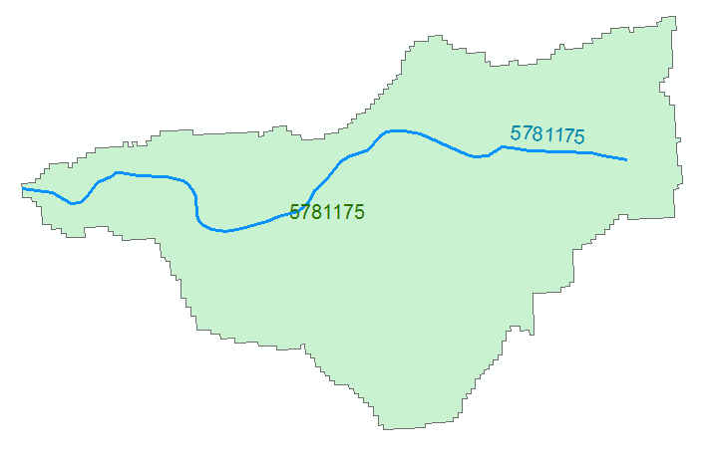
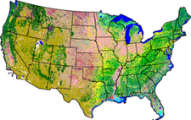
NHDPlus Version 2.1
Foundation for a Geospatial Hydrologic Framework for the United States
NHDPlus
2.7 million reach catchments in US
average area 3 km²
reach length 2 km
Uniquely labelled
National Elevation Dataset
Watershed Boundary Dataset
National Hydrography Dataset
National Land Cover Dataset
http://www.arcgis.com/home/item.html?id=5600cf6b463043ec97b764fb258997be#!

Slide 16
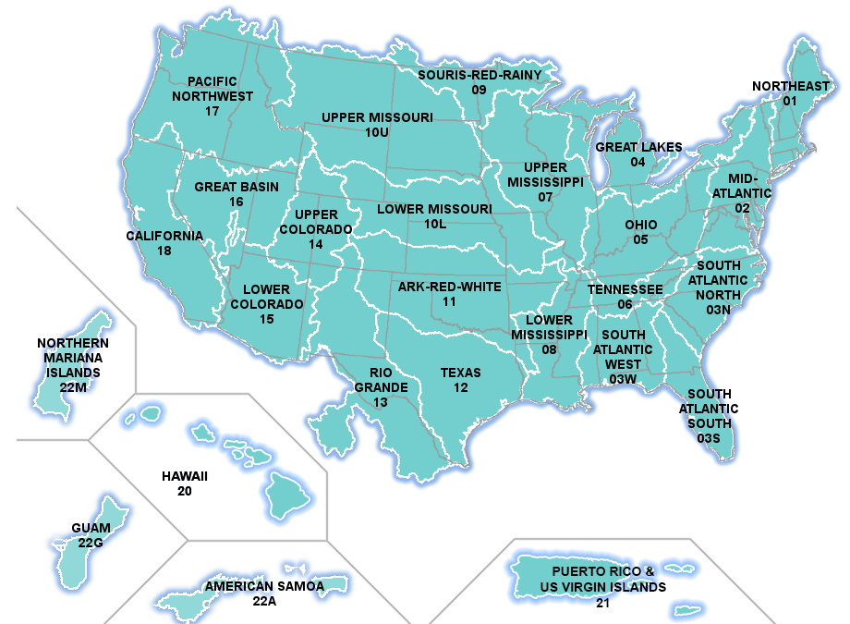
NHDPlus Data Download
http://www.horizon-systems.com/nhdplus/NHDPlusV2_data.php

Slide 17
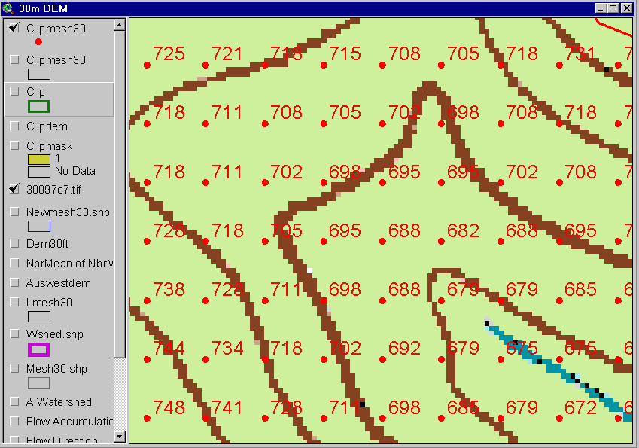
Digital Elevation Model (DEM)
720
720
Contours
740
720
700
680
740
720
700
680

Slide 18
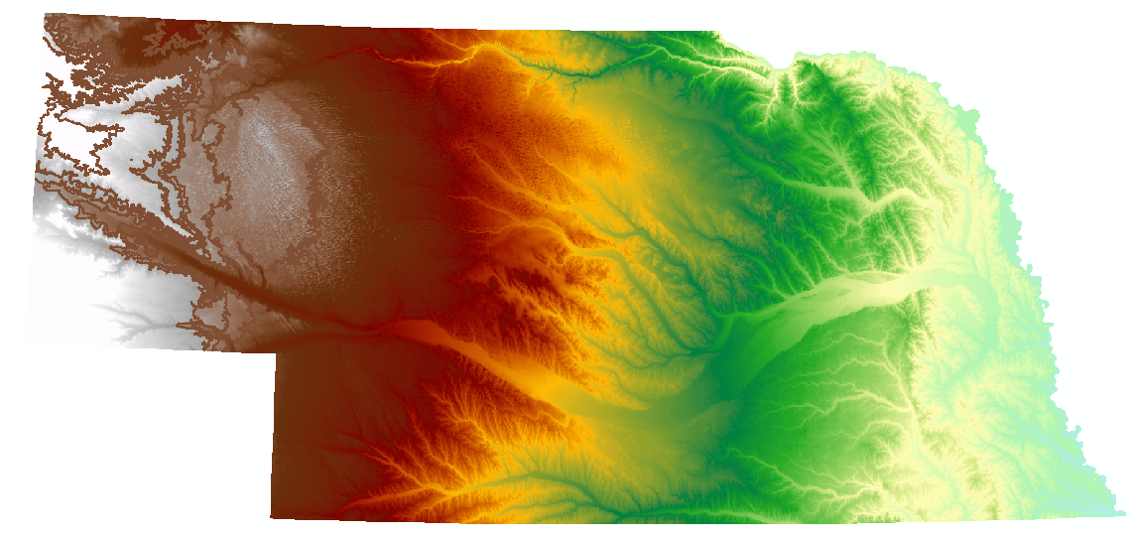
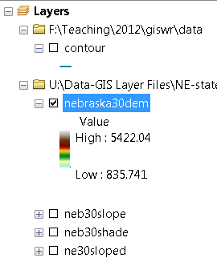
Digital Elevation Model (DEM)-30 meter

Slide 19
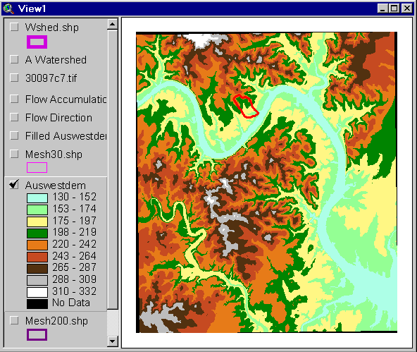
Austin West 30 Meter DEM

Slide 20
Eight Direction Pour Point Model
ArcGIS raster operations involved in watershed delineation are derived from the premise that “water flows downhill, in doing so, will follow the steepest descent
32
64
128
16
1
8
4
2
Water in a given cell flows one or more of eight adjacent cells in the direction of steepest descent (ArcGIS)

Slide 21
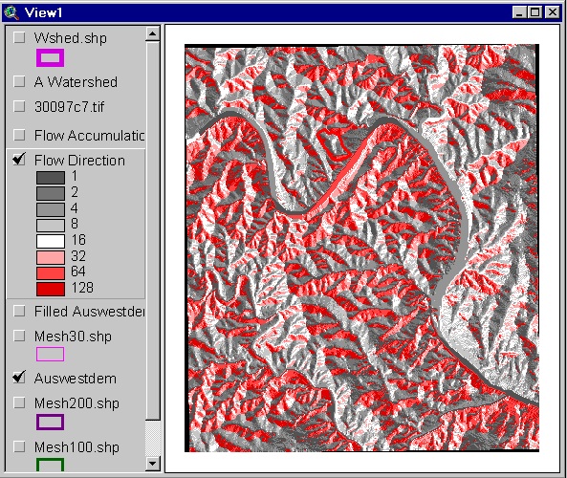
Flow Direction Grid
32
64
128
16
1
8
4
2

Slide 22
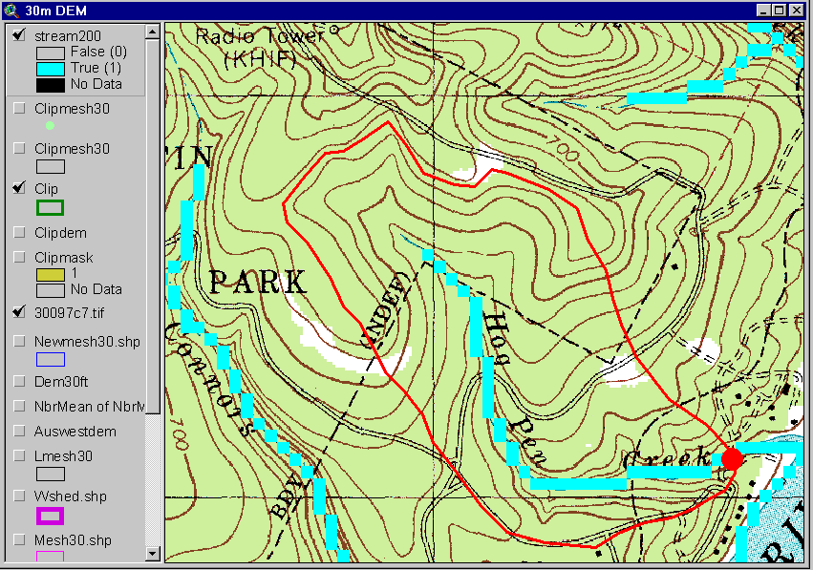
Delineation of Streams and Watersheds on a DEM

Slide 23

https://lta.cr.usgs.gov/SRTM

Slide 24
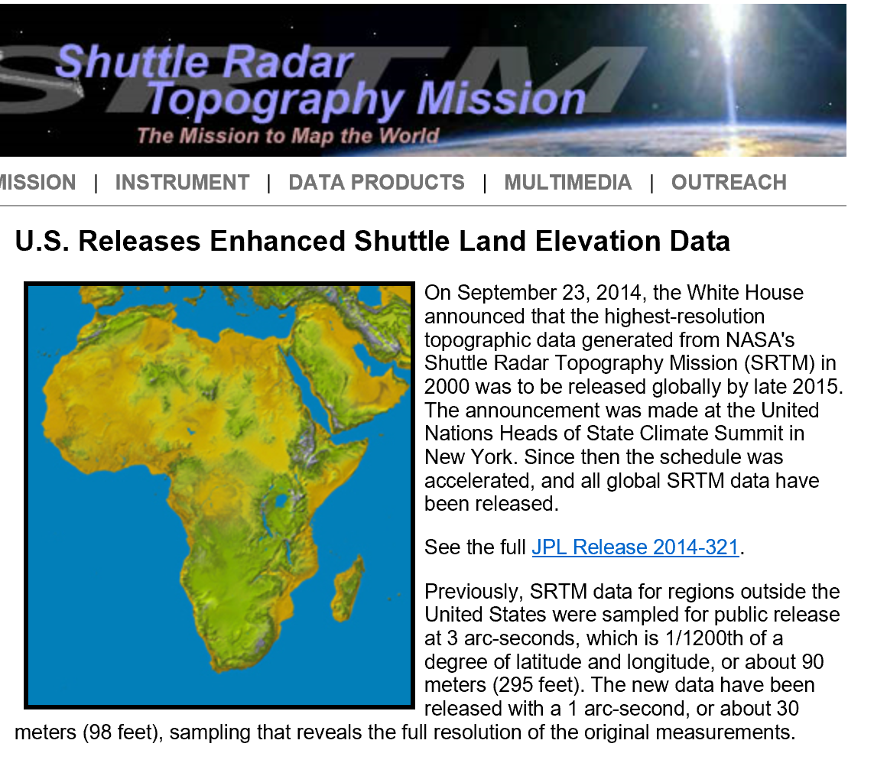
SRTM Topographic Data
http://www2.jpl.nasa.gov/srtm/

Slide 25
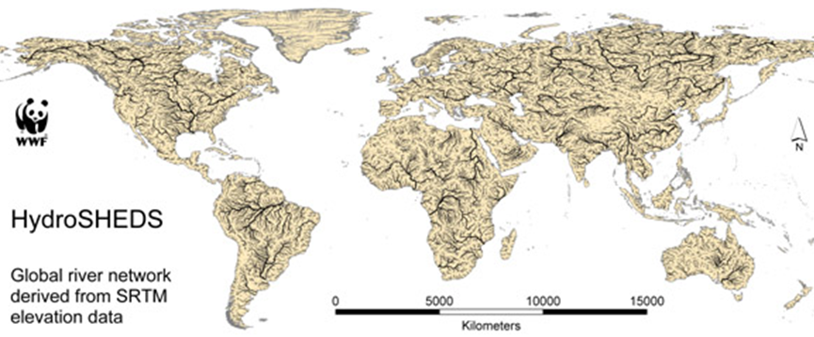
HydroSheds derived from SRTM
http://hydrosheds.cr.usgs.gov/

Slide 26
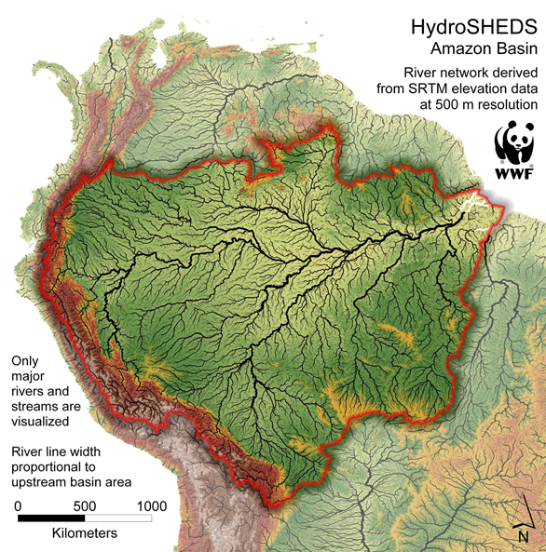

Slide 27
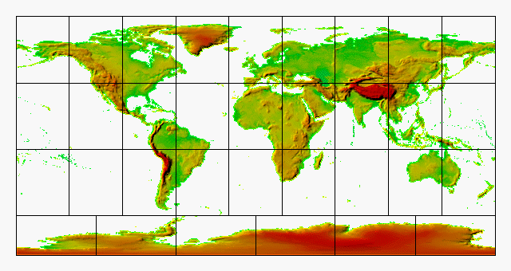
GTOPO30 - 1 km Digital Elevation Model of the Earth
https://lta.cr.usgs.gov/GTOPO30

Slide 28
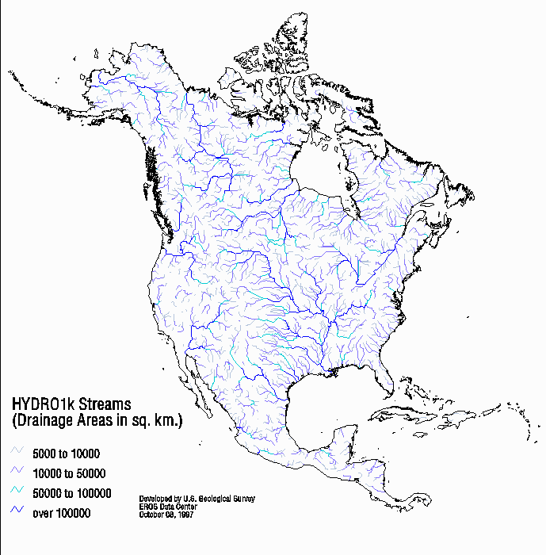
Drainage in North America
Hydro1K is
derived from
GTOPO30
using raster
GIS analysis
https://lta.cr.usgs.gov/HYDRO1K

Slide 29
Soil Data
Natural Resources Conservation Service (NRCS)
State Soil Geographic Database-STATSGO
Soil Survey Geographic Database- SSURGO
http://www.nrcs.usda.gov/wps/portal/nrcs/site/soils/home/
http://websoilsurvey.sc.egov.usda.gov/App/WebSoilSurvey.aspx
https://gdg.sc.egov.usda.gov/

Slide 30

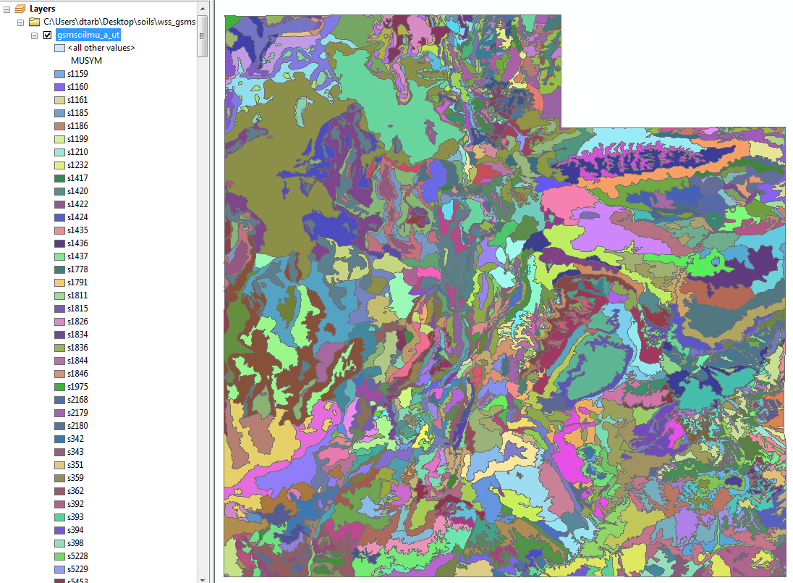
1:250,000 Scale Soil Information
https://gdg.sc.egov.usda.gov/

Slide 31
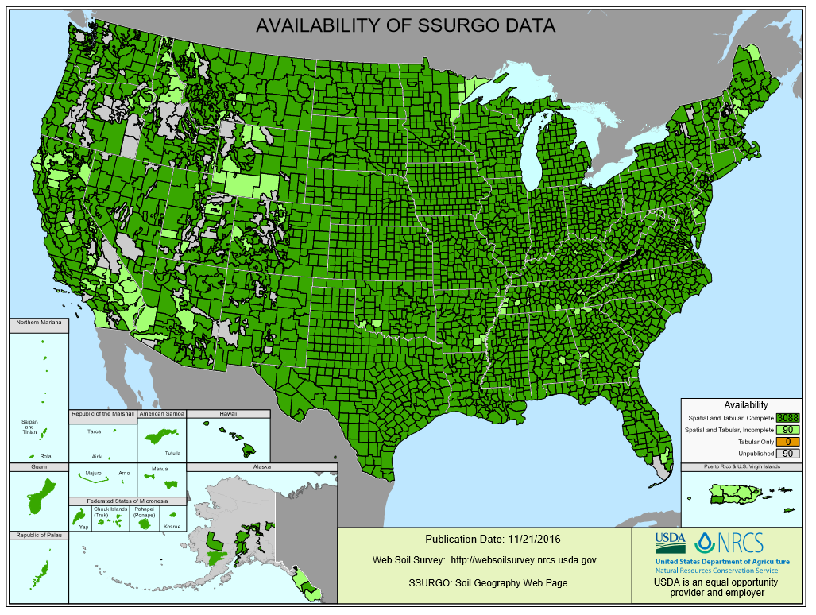
SSURGO:
County Level
Digital Soil Maps
1:24,000 scale
soil information
http://websoilsurvey.nrcs.usda.gov/DataAvailability/SoilDataAvailabilityMap.pdf

Slide 32
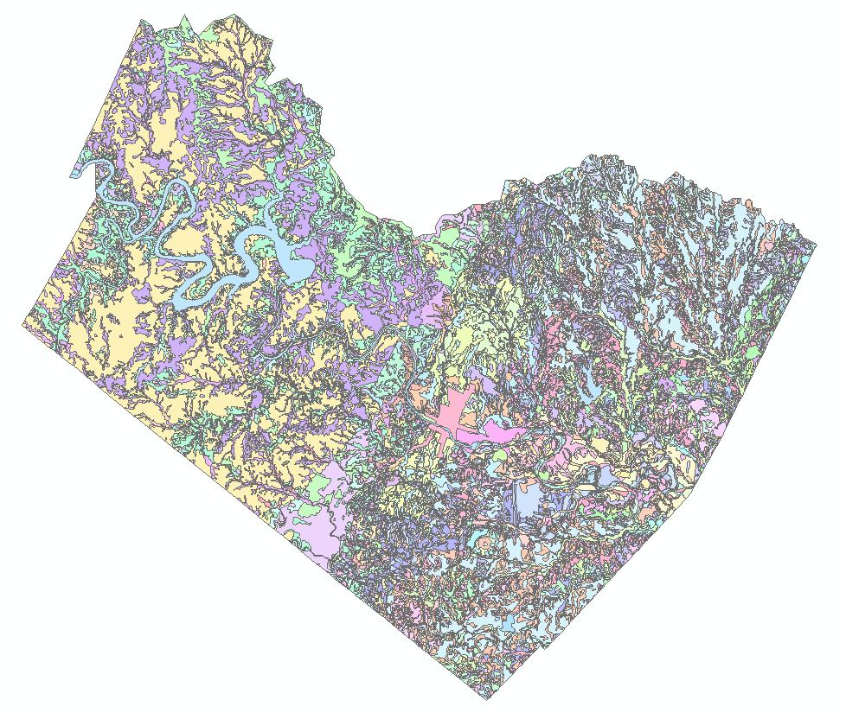
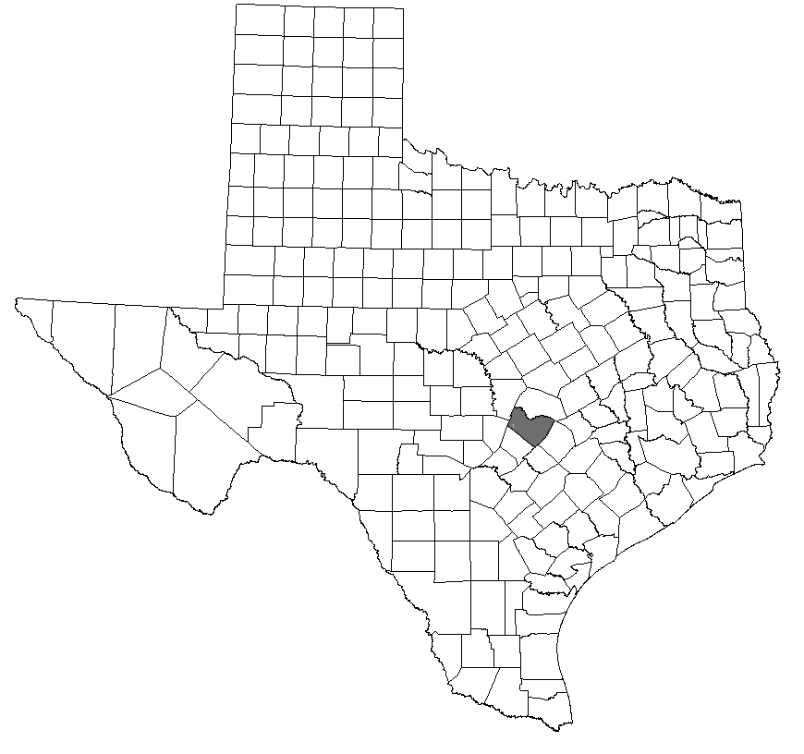
Ssurgo for Travis County
103 soil map units described by 7530 polygons of average area 35.37 ha (87 acres)

Slide 33
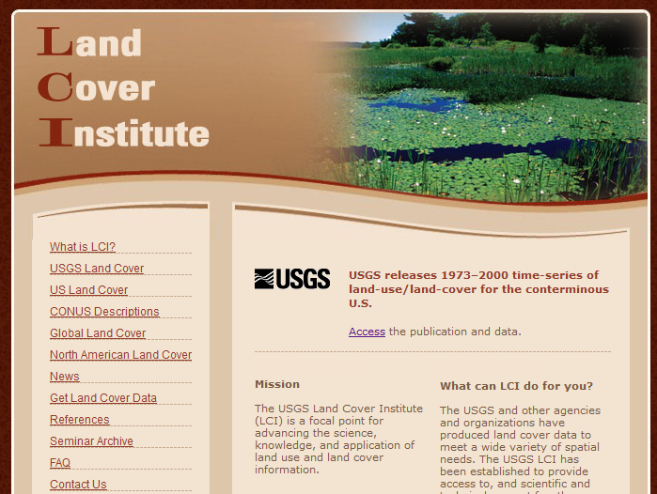
http://landcover.usgs.gov/

Slide 34
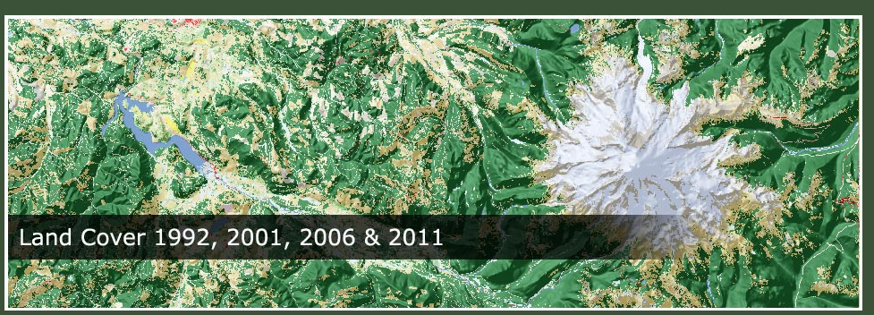
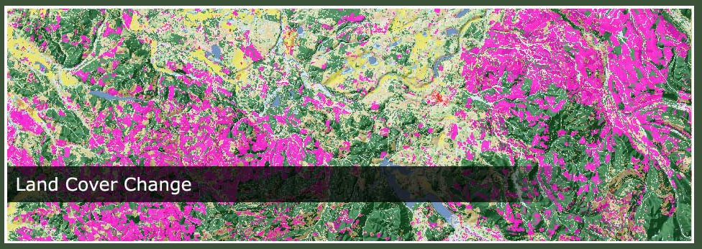
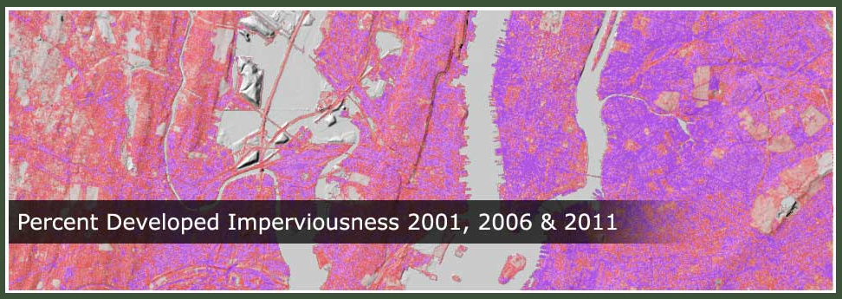
National Land Cover Data
http://www.mrlc.gov/

Slide 35
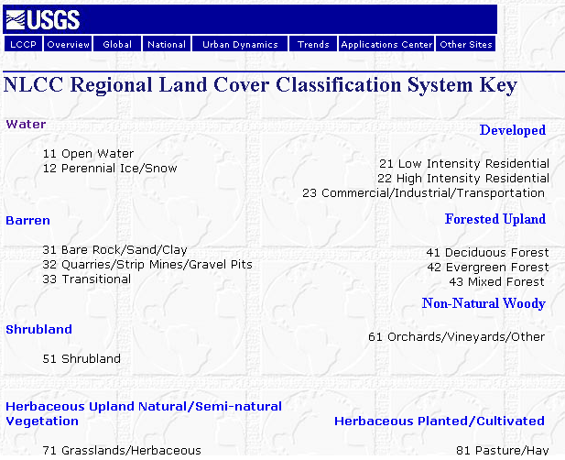

Slide 36
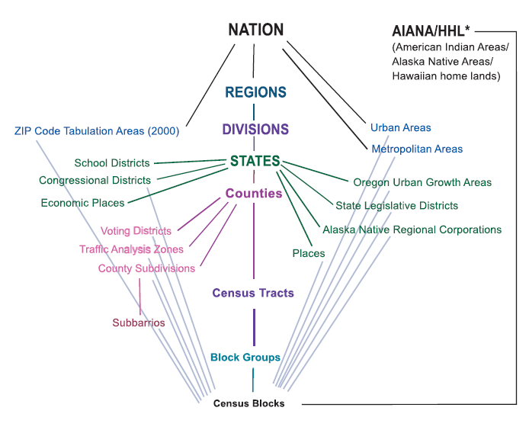
Hierarchy of Census Geographic Entities
http://www.caee.utexas.edu/prof/maidment/giswr2014/Census/AccessingCensusData.pdf
74,000
220,000 (avg 600 households/block grp)
US Population: 316 million
US Households: 133 million
11,000,000
Notes:
This diagram depicts the geographic hierarchy, as a series of nesting relationships, based on the legal, administrative, or areal relationships of the entities. For example, a line joining the lower-level entity “place” and the higher-level entity “state” means that a place cannot cross a state boundary.

Slide 37
American Community Survey
Source of detailed demographic and housing characteristics, including:
  Income
  Language spoken at home
  Educational attainment
  Occupation
  Place of work and journey to work
Data collected annually from approximately 3 million households per year. Approximately 250,000 households per month.
Data collected throughout the year—produces period estimates rather than point estimates.
 | ACS 1-Year Data | ACS 3-Year Data | ACS 5-Year Data
Geographic Areas | 65,000 or more population | 20,000 or more population | All areas, block group or higher

Slide 38
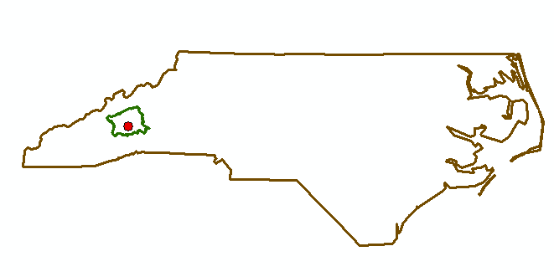
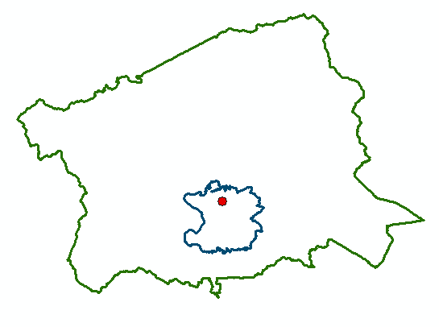
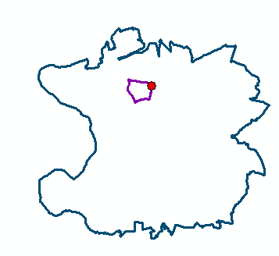
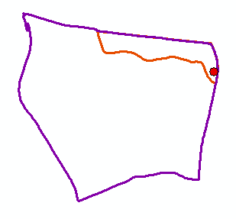
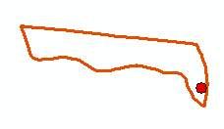
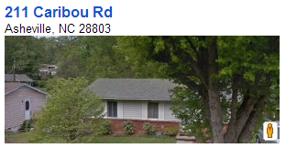
North Carolina
Buncombe County
Zip Code 28803
Census Block Group 370210020004
Scales of
Data Aggregation
Census Block 370210020004000
A single property – 211 Caribou Rd

Slide 39
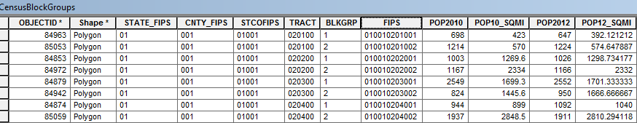
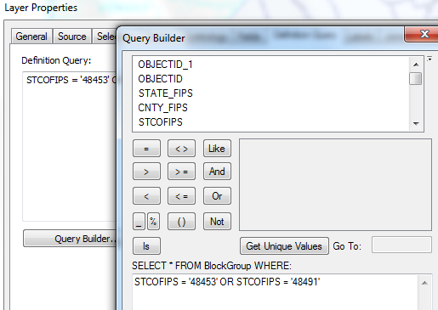
Census Block Groups for the US
http://www.caee.utexas.edu/prof/maidment/giswr2014/census/census.gdb.zip (308MB)
State
County
Tract
Block Group
Definition query to isolate Travis and Williamson Counties

Slide 40
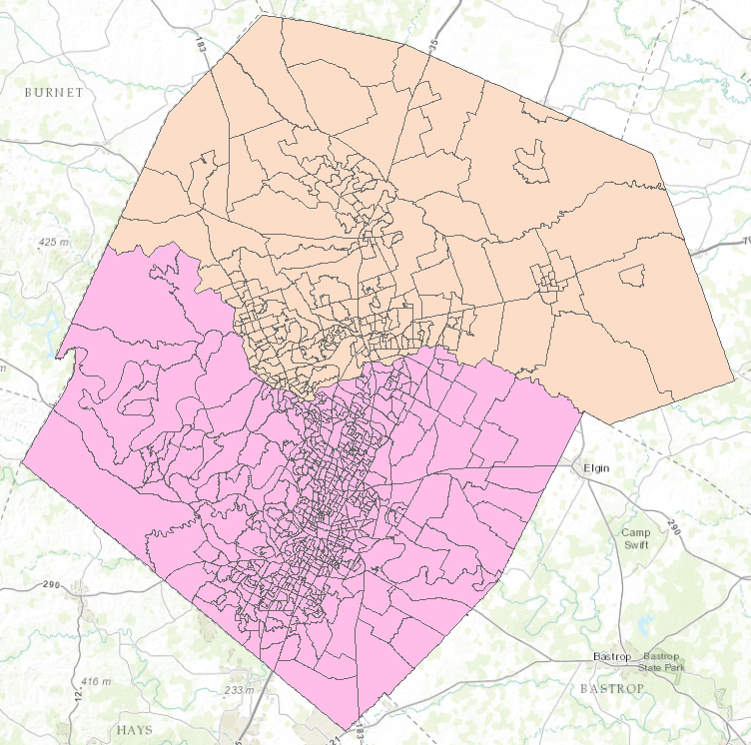

Census Block Groups in Travis and Williamson Counties
Williamson County
Travis County

Slide 41
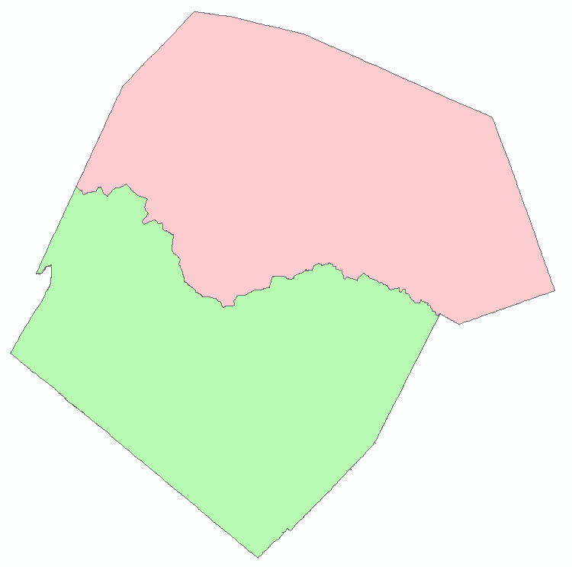
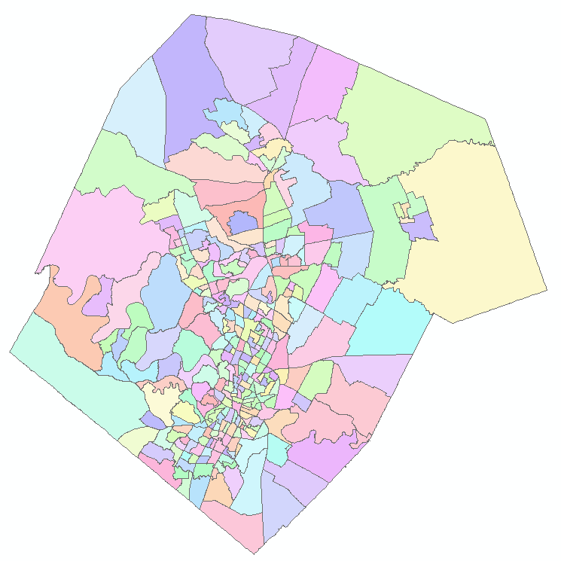
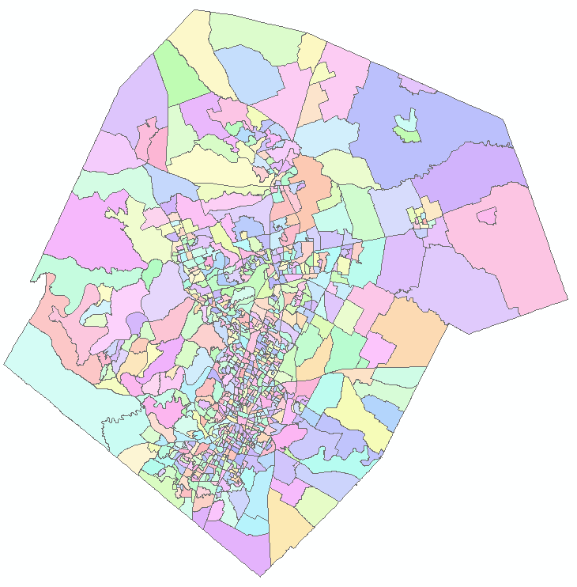
Demographic Analysis
Williamson
Travis
Two Counties
307 Tracts
823 Block Groups

Slide 42
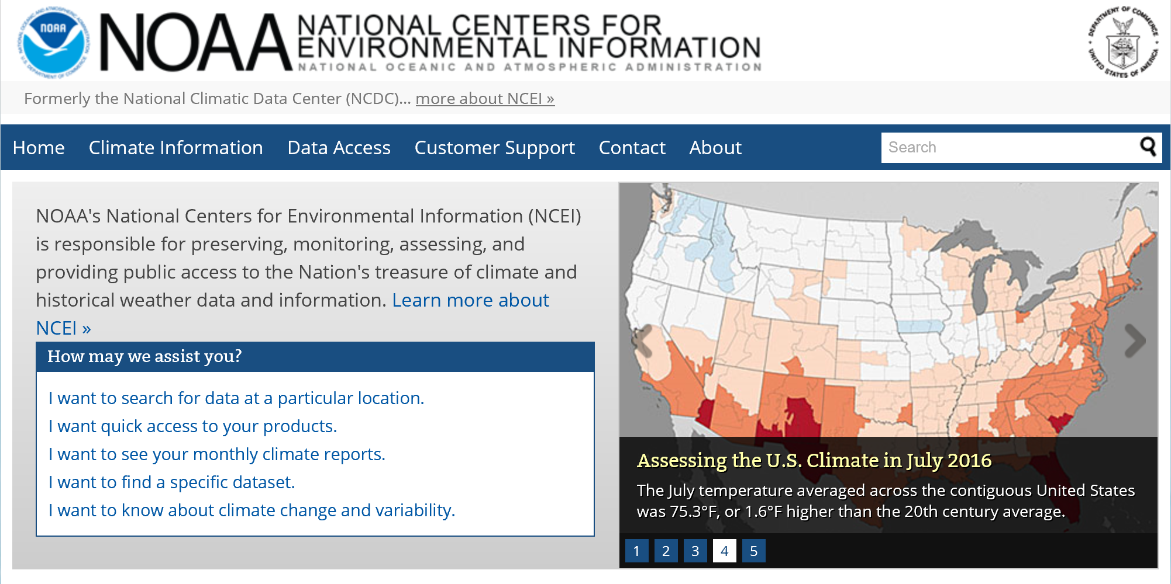
https://www.ncei.noaa.gov/

Slide 43

www.climate.gov

Slide 44


PRISM Mean Annual Precipitation (Oregon State U.)
http://prism.oregonstate.edu/

Slide 45

National Water Information System
Web access to USGS water
resources data in real time
http://waterdata.usgs.gov/usa/nwis/

Slide 46


USGS Water Watch
Web access to USGS water resources data in real time
http://waterdata.usgs.gov/nwis/rt

Slide 47


USGS National Water Information System.
http://water.usgs.gov
Real-time and Historic Data
  Streamflow and stage
  Groundwater levels
  Water Quality
  Site information
Tabular or Graphical Format

Slide 48

CUAHSI Water Data Services
http://data.cuahsi.org

Slide 49


NOAA National Water Model
http://water.noaa.gov/map

Slide 50



ArcGIS Online: Living Atlas
http://doc.arcgis.com/en/living-atlas/
Land Cover
Elevation
Soils

Slide 51

Ready to Use Services in ArcGIS Pro
http://pro.arcgis.com/en/pro-app/help/projects/connect-to-a-gis-server.htm

Slide 52

http://water.weather.gov/ahps/

Slide 53

http://water.weather.gov/ahps/
Three Month Forecast for Flow in the Logan River
September to December 2017

Slide 54

River Forecast Centers
https://www.cbrfc.noaa.gov

Slide 55




Logan River
1460 cfs 6/5/17

Slide 56


http://www.weather.gov/serfc/

Slide 57


http://enviroatlas.epa.gov/enviroatlas/

Slide 58



Texas Natural Resource Information System http://www.tnris.org/

Slide 59


TWDB http://www.twdb.texas.gov/mapping/gisdata.asp

Slide 60


http://www.wcc.nrcs.usda.gov/snotel/

Slide 61

SNOTEL System for Measuring Snow and Supporting Spring Runoff and Water Supply Forecasts

Slide 62

USU Doc Daniels SNOTEL Site

Slide 63


Measuring Snow Water Equivalent

Slide 64


http://www.cbrfc.noaa.gov

Slide 65

CBRFC SNOTEL Ensemble
http://www.cbrfc.noaa.gov/station/sweplot/sweplot.cgi?tglu1

Slide 66

http://gis.utah.gov

Slide 67

Utah GIS Portal Download GIS Data
http://gis.utah.gov/data/

Slide 68

http://geology.utah.gov/maps/gis/index.htm

Slide 69

http://www.wrcc.dri.edu/

Slide 70

Bear River Watershed
http://www.bearriverinfo.org/

Slide 71


MODIS on NASA Worldview
(Shrinking Great Salt Lake)
2012-05-11
2017-08-27
https://worldview.earthdata.nasa.gov/?p=geographic&l=MODIS_Aqua_CorrectedReflectance_TrueColor,MODIS_Terra_CorrectedReflectance_TrueColor,Reference_Features,Coastlines&t=2012-05-11&v=-114.20487628044651,40.12581729563662,-110.51347003044651,42.16048526438662
https://worldview.earthdata.nasa.gov/?p=geographic&l=MODIS_Aqua_CorrectedReflectance_TrueColor,MODIS_Terra_CorrectedReflectance_TrueColor,Reference_Features,Coastlines&t=2017-08-27&z=3&v=-114.20487628044651,40.12581729563662,-110.51347003044651,42.16048526438662

Slide 72

Smoke from Fires over W US
MODIS 2015-08-19
https://earthdata.nasa.gov/labs/worldview/?p=geographic&l=MODIS_Aqua_CorrectedReflectance_TrueColor,MODIS_Terra_CorrectedReflectance_TrueColor,Reference_Features,Coastlines&t=2015-08-19&v=-134.01859698357154,33.61092471751162,-104.48734698357154,49.88826846751162

Slide 73
Summary
There are a plethora of data sources available
Knowing what is available is important to scope GIS analyses and projects
GIS is about creating knowledge, telling stories, making decisions – all involve integrating information from multiple sources
The way that data is organized can enhance or inhibit the analyses that can be done
Data dissemination is increasingly becoming service based

