Slide 1
Demography
David R. Maidment
GIS in Water Resources
Fall 2017

Slide 2
Data Tabulation Programs
  Decennial Census of Population and Housing: every 10 years
  Population Estimates and Projections Program: every year
  Small Area Income and Poverty Estimates Program: every year
  American Community Survey: every year
  Economic Census: every 5 years
  Local Employment Dynamics Program: every year
  Census of Governments: every 5 years
  Over 100 Annual, Quarterly or Monthly Surveys, including 13 principal economic indicators
(Political Reapportionment)
(Socioeconomics)

Slide 3
American Community Survey
Source of detailed demographic and housing characteristics, including:
  Income
  Language spoken at home
  Educational attainment
  Occupation
  Place of work and journey to work
Data collected annually from approximately 3 million households per year. Approximately 250,000 households per month.
Data collected throughout the year—produces period estimates rather than point estimates.
 | ACS 1-Year Data | ACS 3-Year Data | ACS 5-Year Data
Geographic Areas | 65,000 or more population | 20,000 or more population | All areas, block group or higher

Slide 4
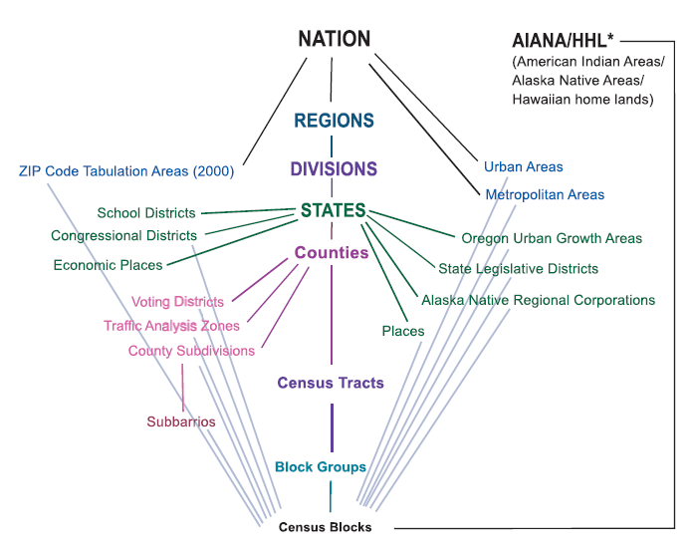
Hierarchy of Census Geographic Entities
74,000
220,000 (avg 600 households/block grp)
US Population: 316 million
US Households: 133 million
11,000,000
Notes:
This diagram depicts the geographic hierarchy, as a series of nesting relationships, based on the legal, administrative, or areal relationships of the entities. For example, a line joining the lower-level entity “place” and the higher-level entity “state” means that a place cannot cross a state boundary.

Slide 5
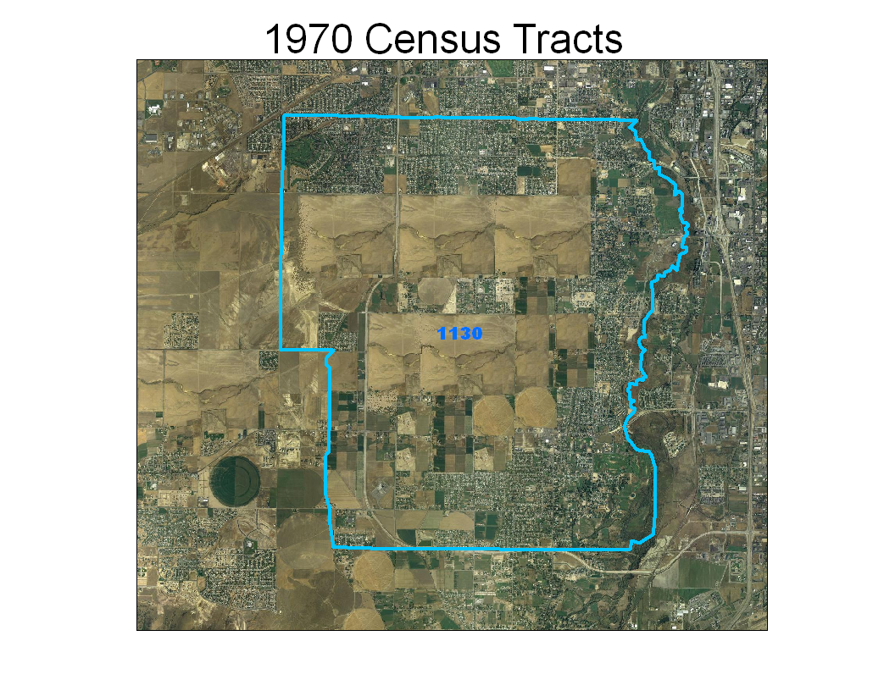
Notes:
The next few slides show an example of an area where population continues to grow and therefore the census tract is split over the decades.
This is the original tract 1130 in South Jordan City, Utah during the 1970 Census

Slide 6
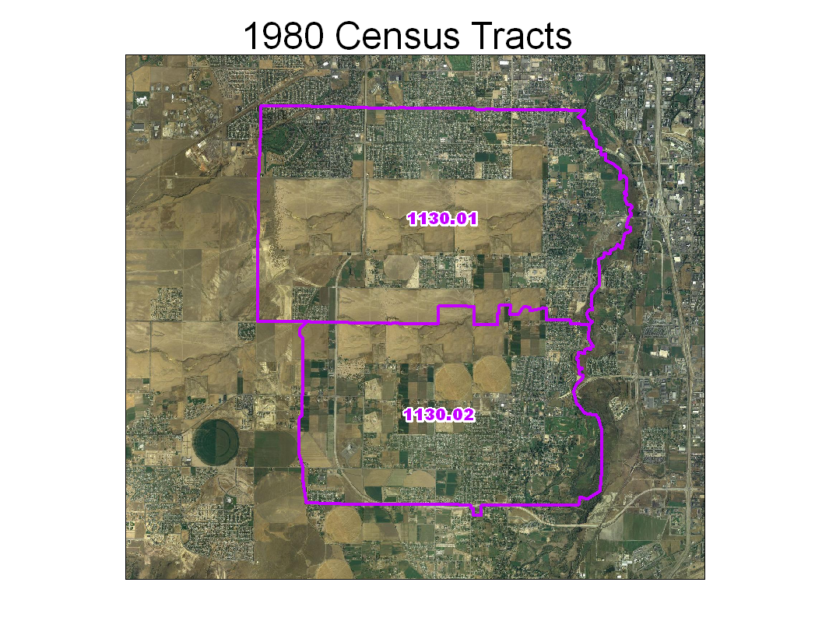
Notes:
For the 1980 Census, enough growth occurred to split the original tract 1130 into two new pieces. Note the tract suffixes .01 and .02.

Slide 7
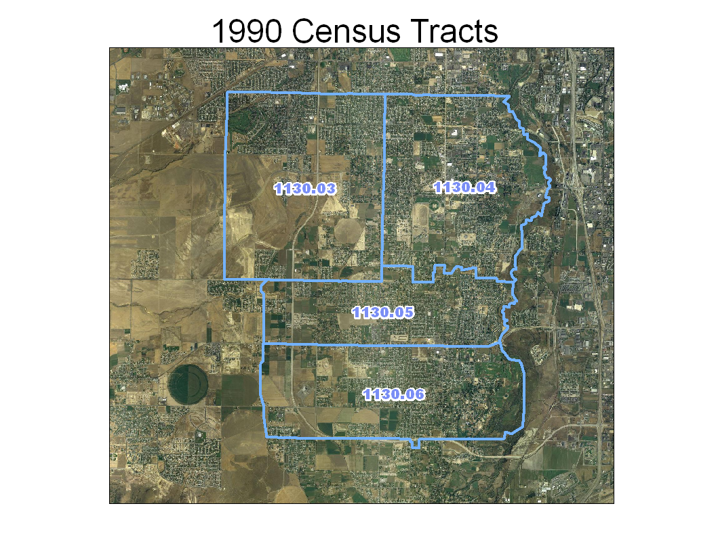
Notes:
For the 1990 Census, growth has again continued at an accelerated pace requiring the two tracts from 1980 to be split further. Notice the original suffixes are no longer used and new ones are provided.

Slide 8
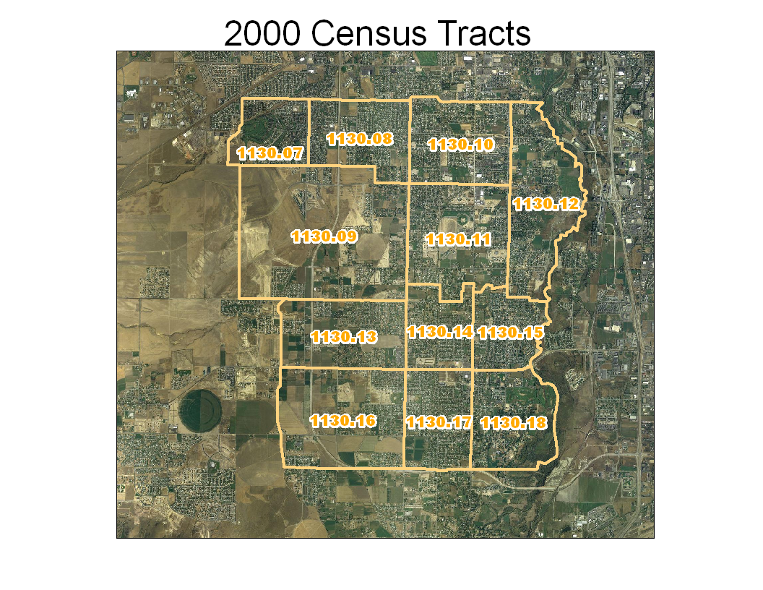
Notes:
Finally in the 2000 Census, the four tracts from 1990 had to be further sub-divided. Once again, the tract suffixes from 1990 are no longer used and new ones are given. You can see that the original outline of tract 1130 still exists, so you can compare the data from 2000 to the same geographic area in 1970.

Slide 9
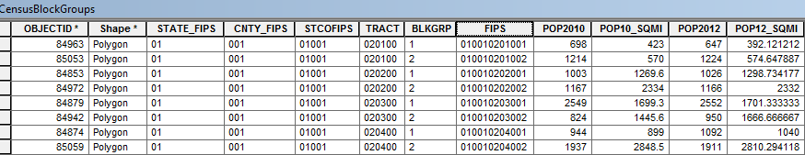
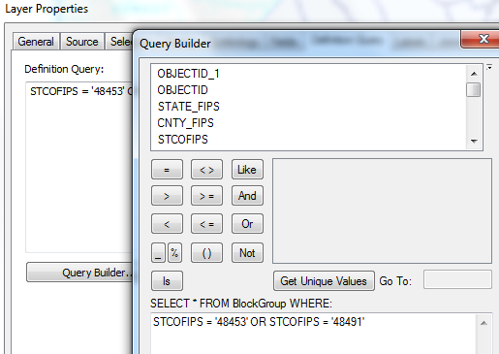
Census Block Groups for the US
http://www.caee.utexas.edu/prof/maidment/giswr2014/census/census.gdb.zip (308MB)
State
County
Tract
Block Group
Definition query to isolate Travis and Williamson Counties

Slide 10
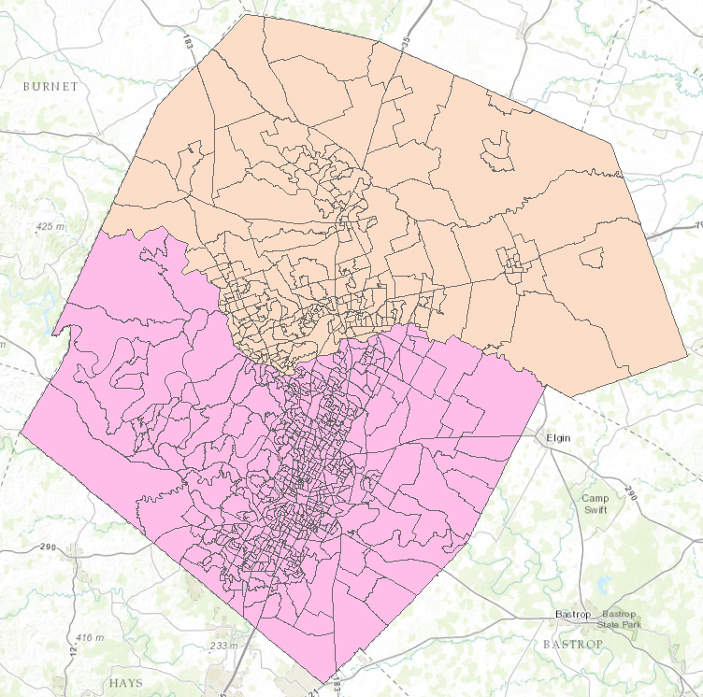

Census Block Groups in Travis and Williamson Counties
Williamson County
Travis County

Slide 11
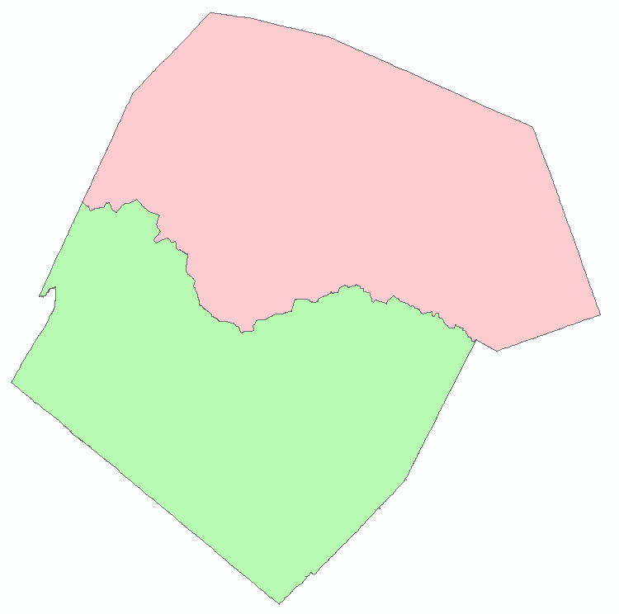
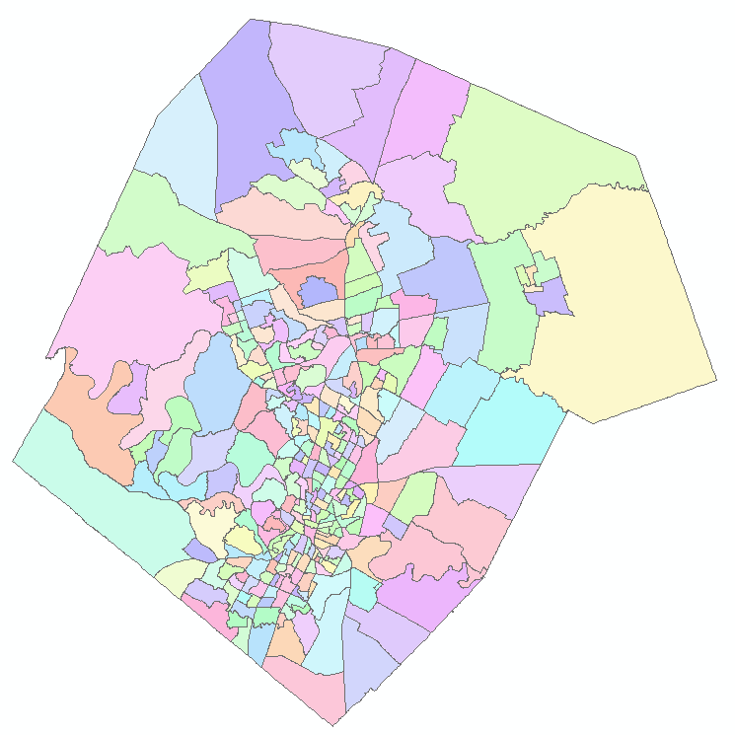
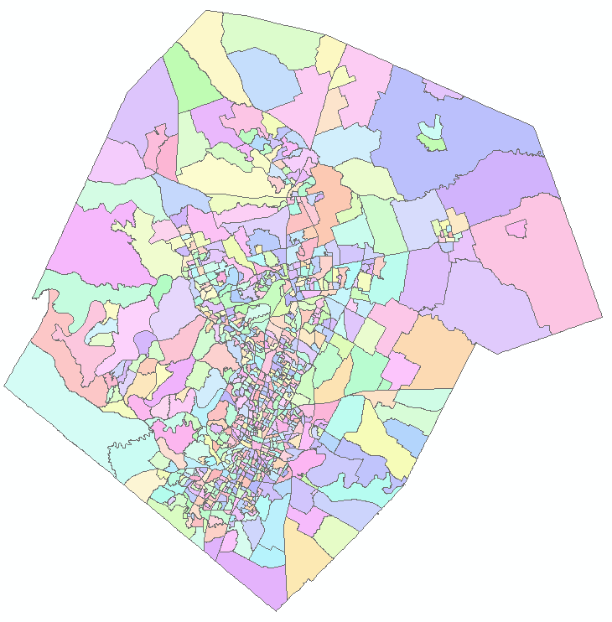
Demographic Analysis
Williamson
Travis
Two Counties
307 Tracts
823 Block Groups

Slide 12

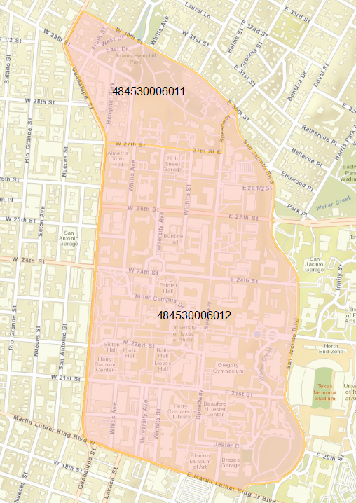
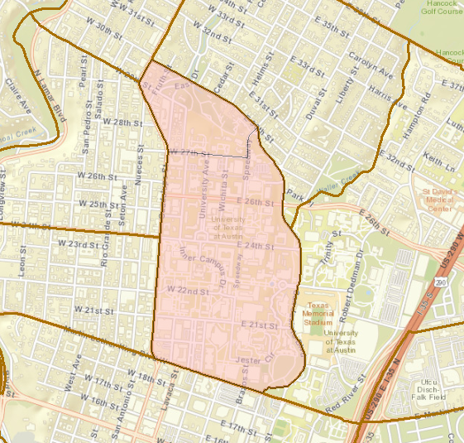
UT Demography
Census Block Groups
UT Campus
48 453 000601

Slide 13
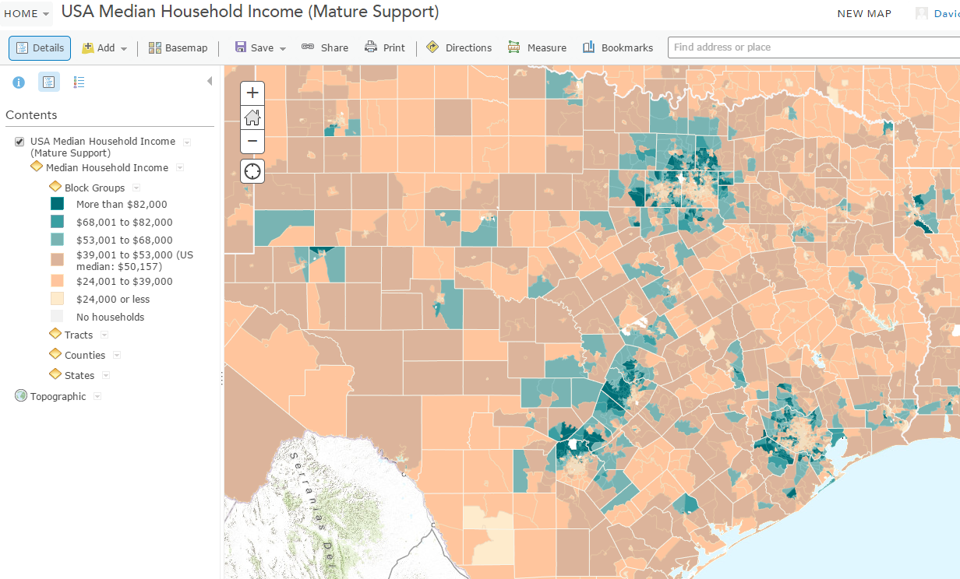
Median Household Income
https://ut-austin.maps.arcgis.com/home/webmap/viewer.html?layers=da76de09076b4959ad005e1dc2c48049

Slide 14
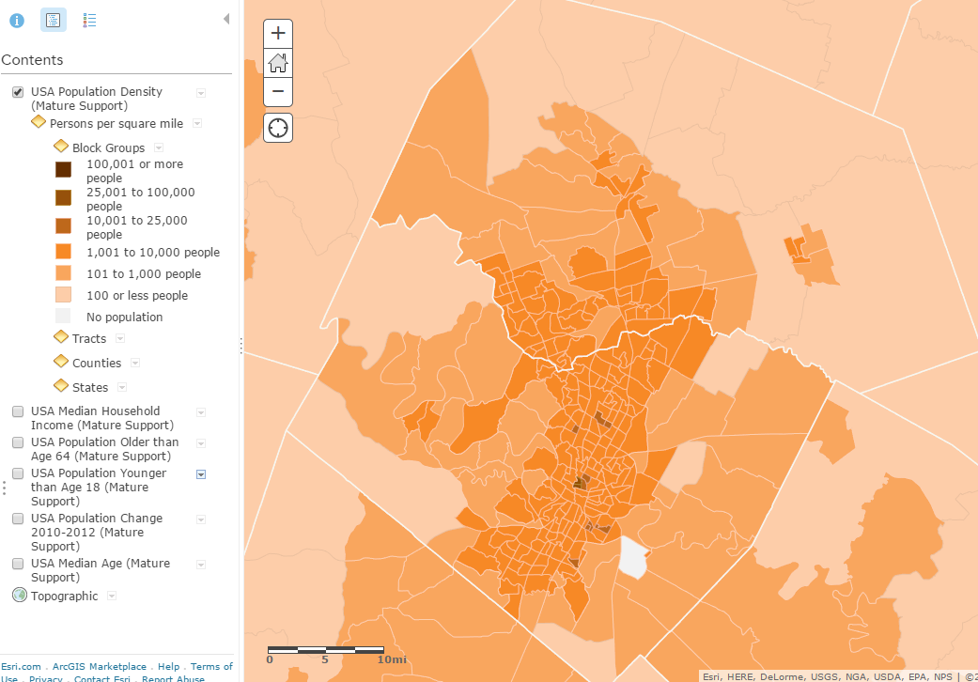
Population Density

Slide 15
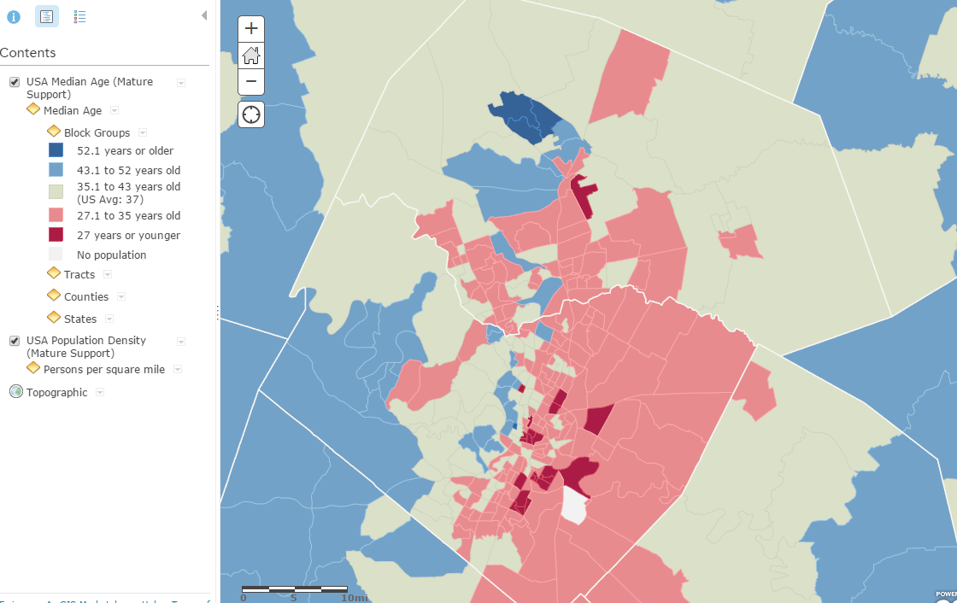
Median Age

Slide 16
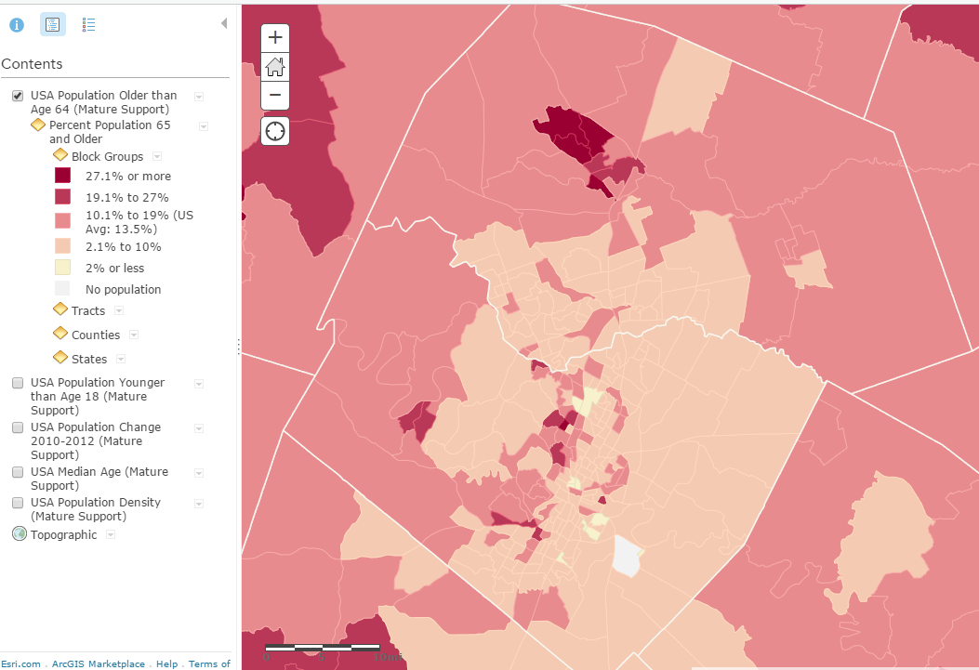
% Population 65 and older

Slide 17
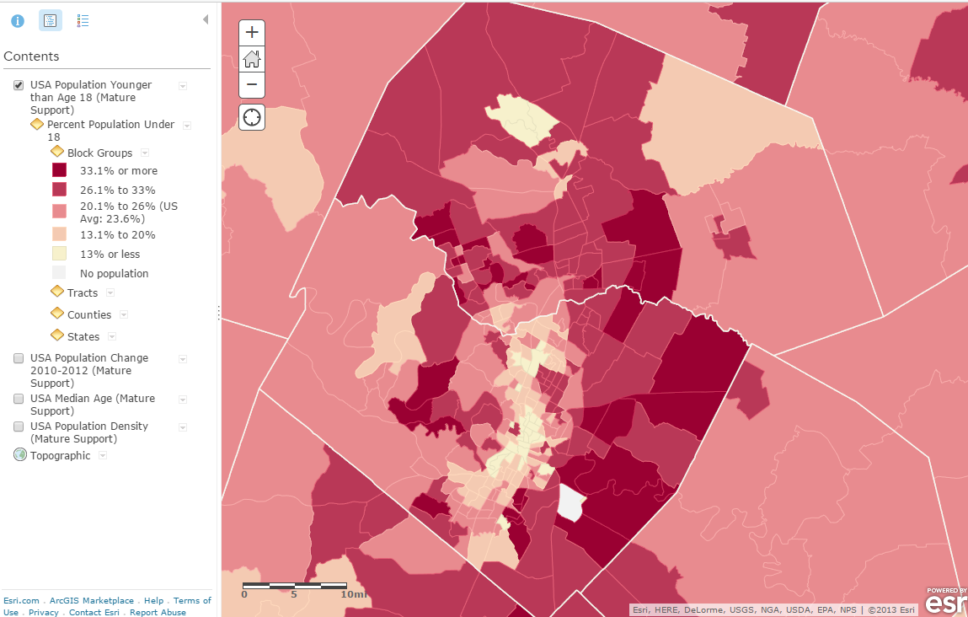
% Population under age 18

Slide 18
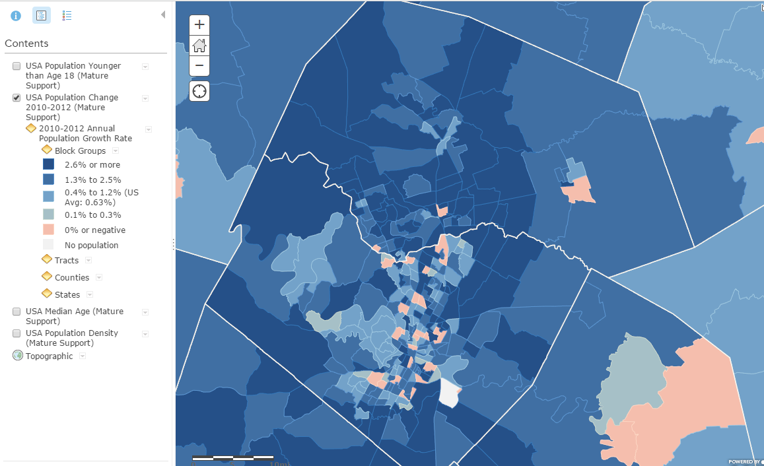
Annual Population Growth Rate

Slide 19
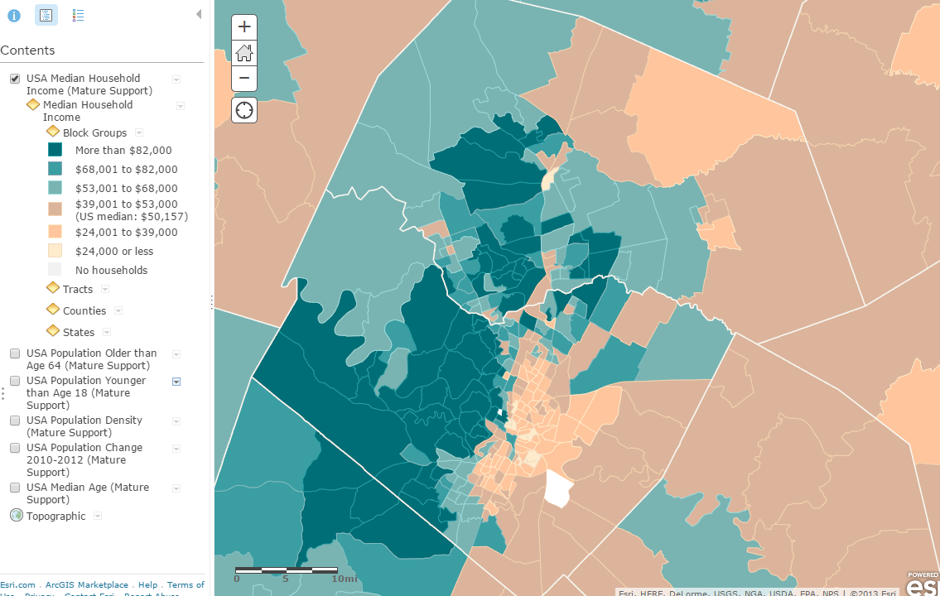
Median Household Income

Slide 20
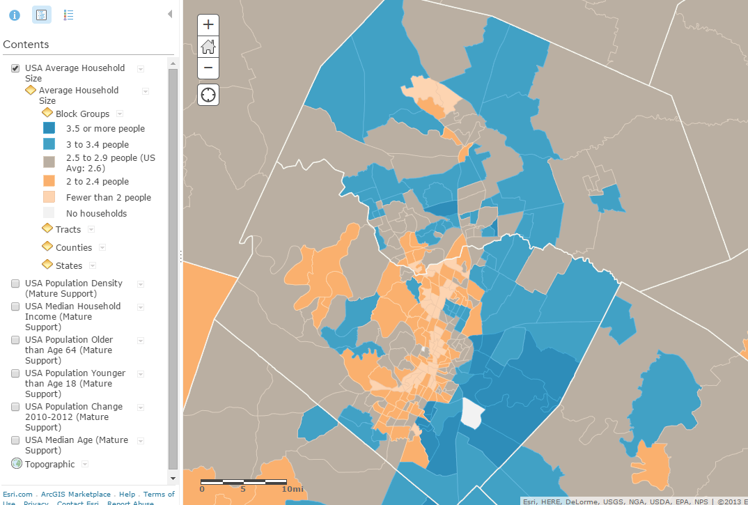
Average Household Size

Slide 21
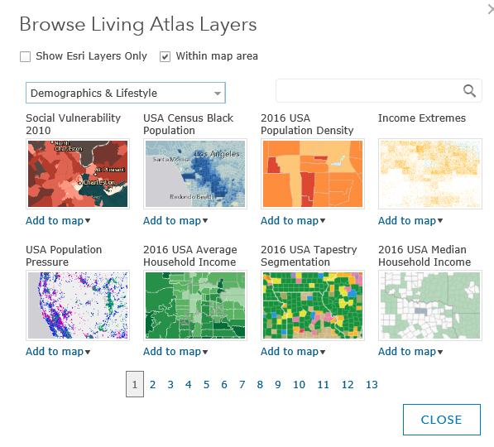
Demography in Living Atlas

Slide 22
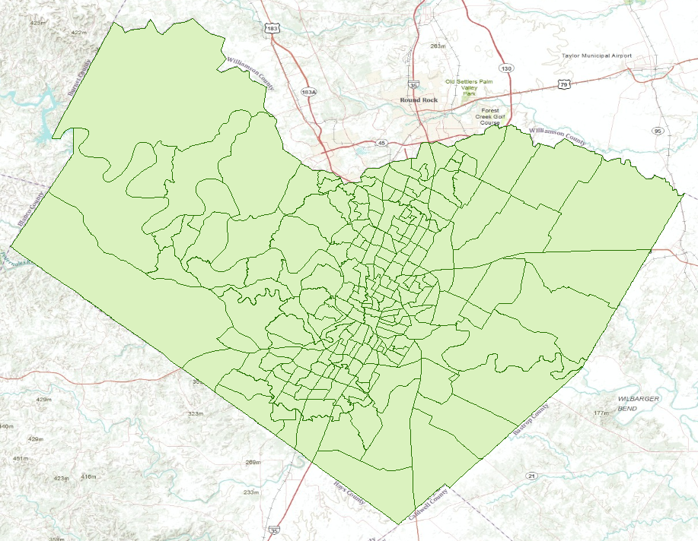
Travis County Census Tracts (218)

Slide 23
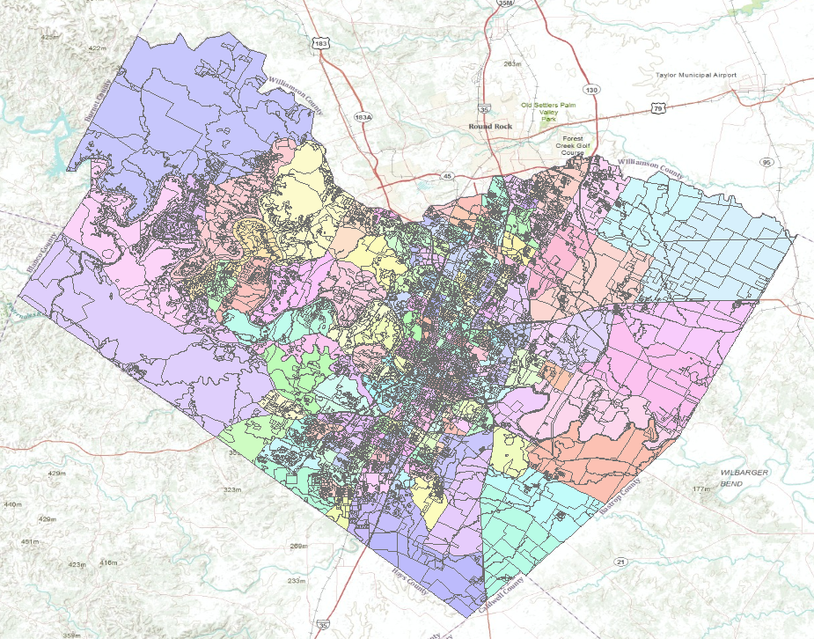
Travis County Census Blocks (15922)
Average of 73 Blocks per Tract

Slide 24
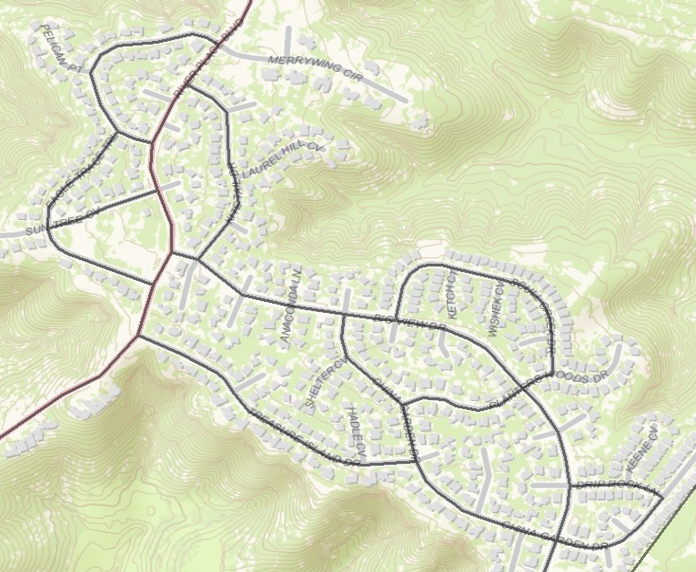
Census Blocks

Slide 25
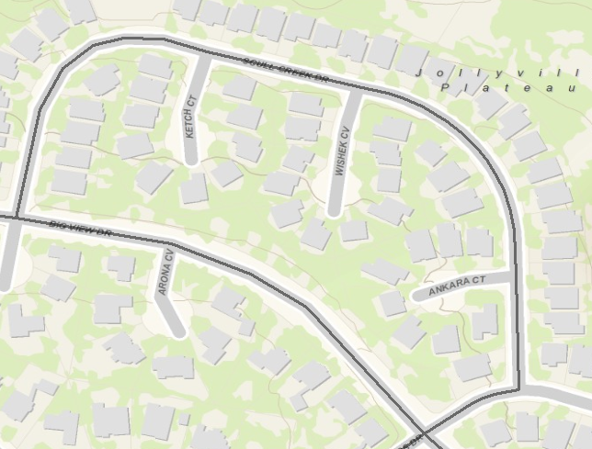

A Census Block (38 houses)
Texas
Travis

Slide 26
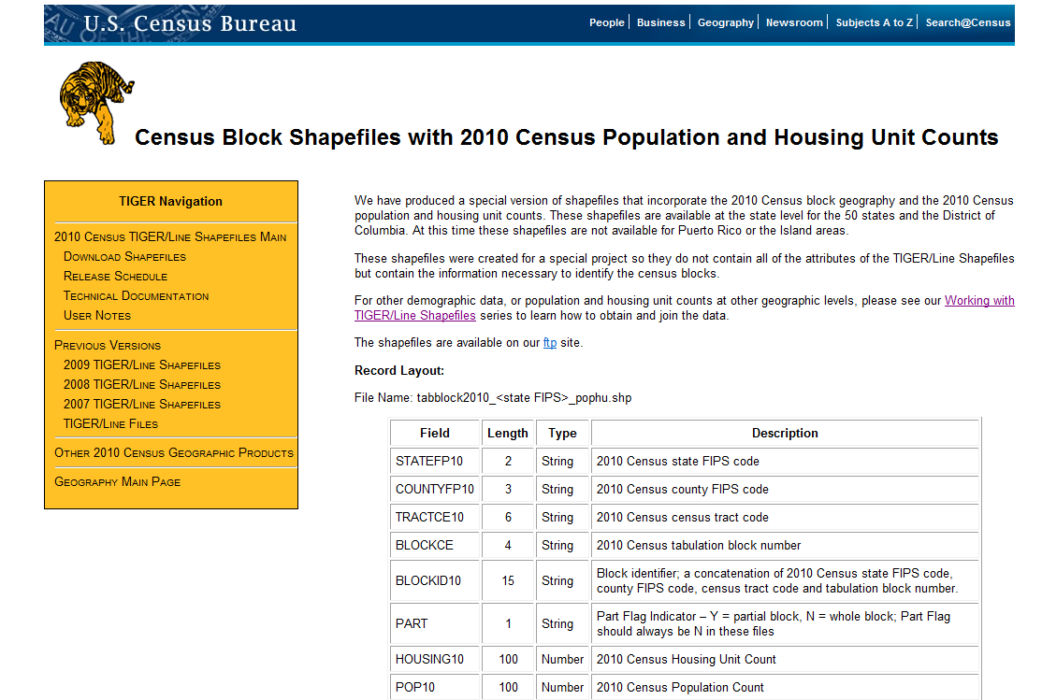
Census Shapefiles with Population
ftp://ftp2.census.gov/geo/tiger/TIGER2010BLKPOPHU/
http://www.census.gov/geo/www/tiger/tgrshp2010/pophu.html

Slide 27
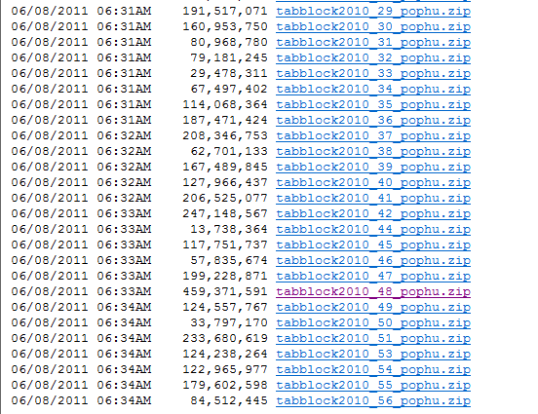
All the Census Blocks for a State
ftp://ftp2.census.gov/geo/tiger/TIGER2010BLKPOPHU/

Slide 28
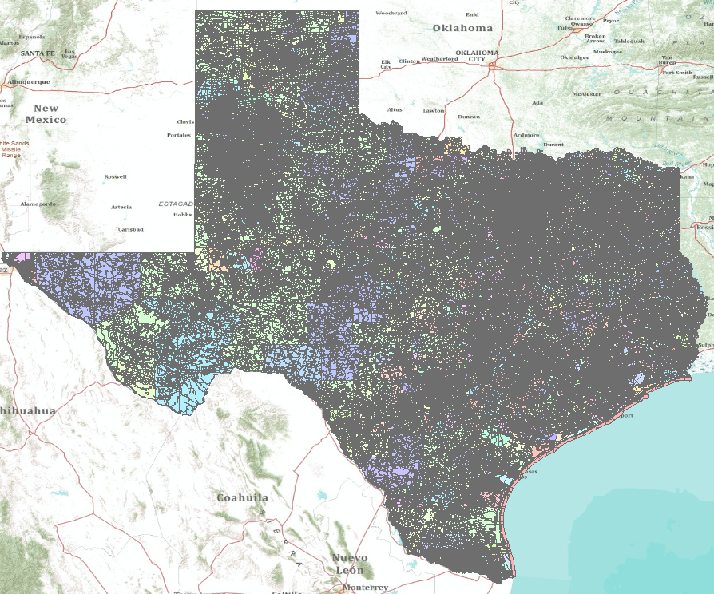
Census Blocks for Texas (914,231)

Slide 29
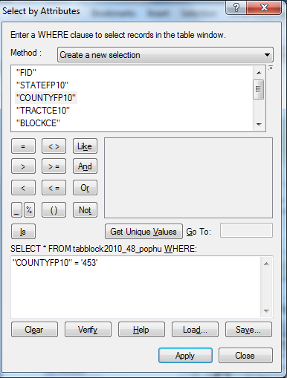
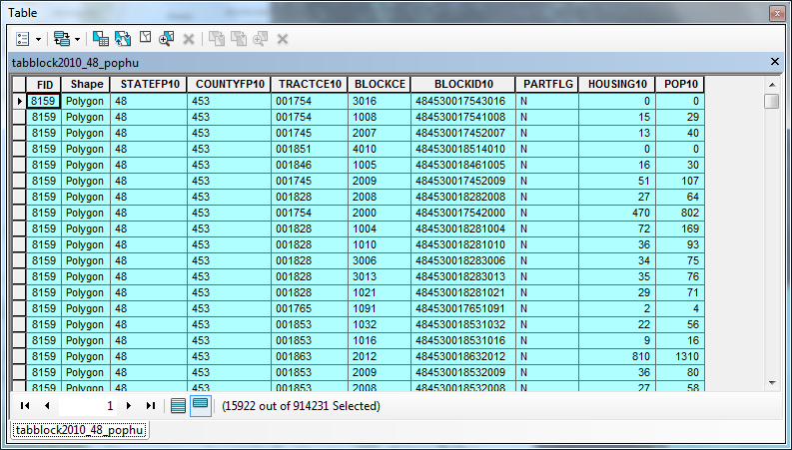

Census Blocks in Travis County

Slide 30
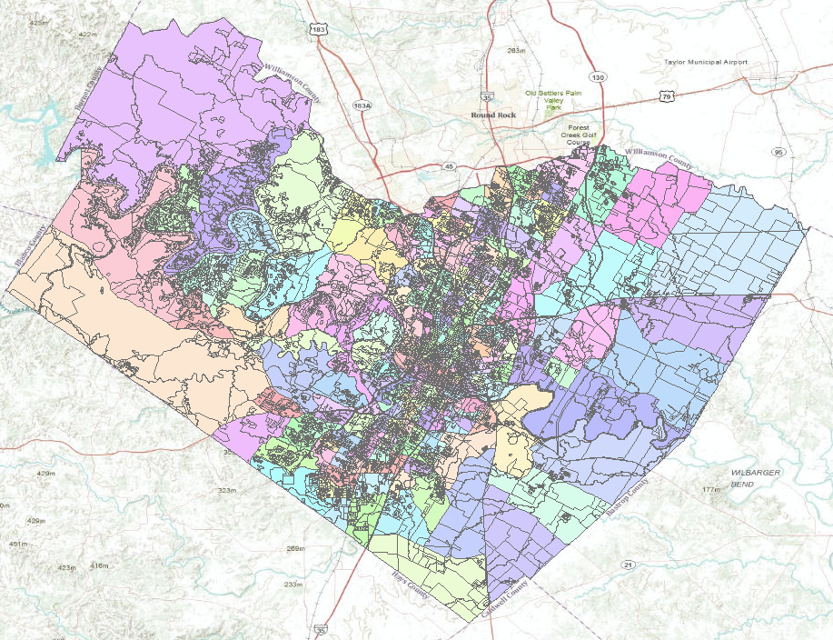
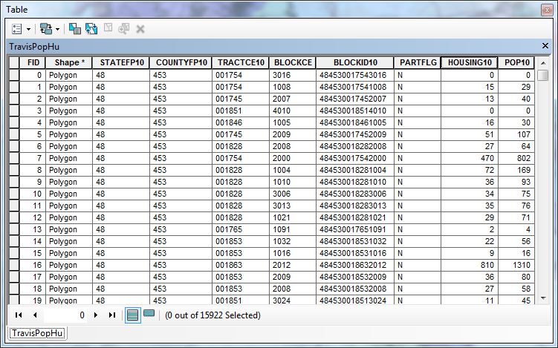
Population and Housing Units

Slide 31
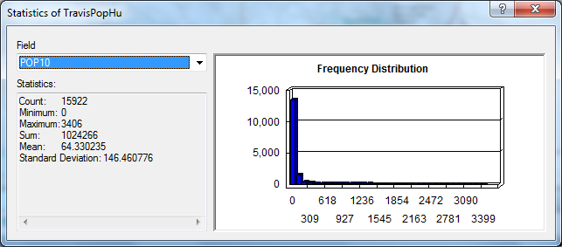
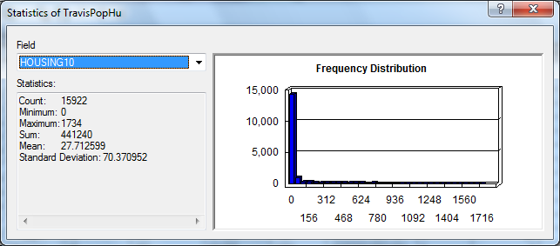
Population and Housing Units in Travis County
Population = 1,024,266
Pop/HU = 2.32
Housing Units = 441,240

Slide 32
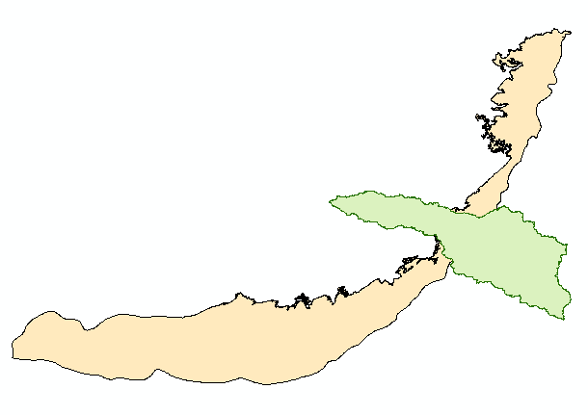

Surface and Groundwater Systems

Slide 33
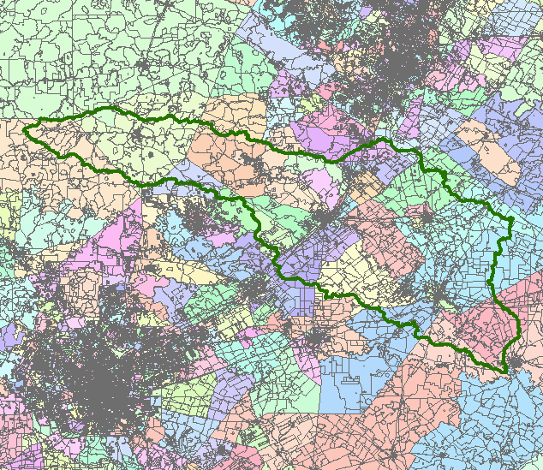
San Marcos Basin
Austin
San Antonio

Slide 34
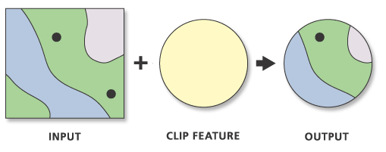
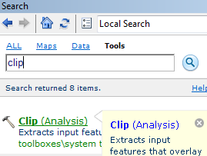
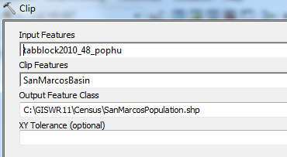
Clip Function

Slide 35
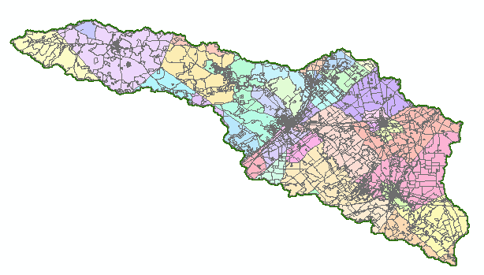
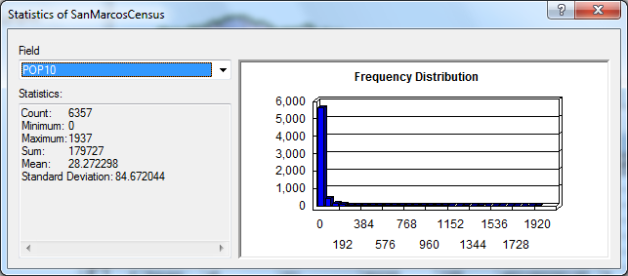
Population of the San Marcos Basin
Population (2010) = 179,727

Slide 36
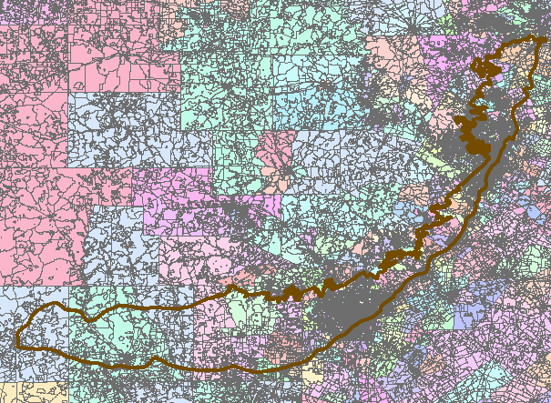
Edwards Aquifer

Slide 37
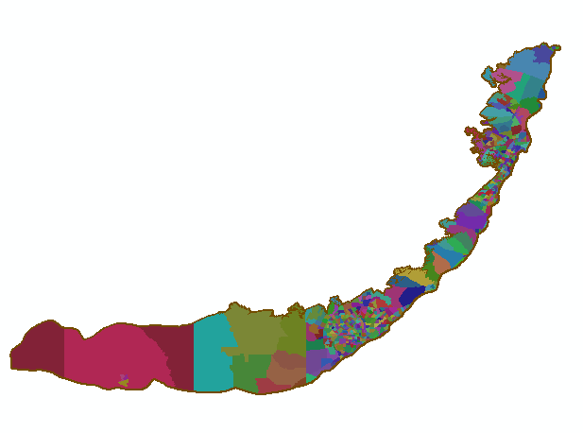
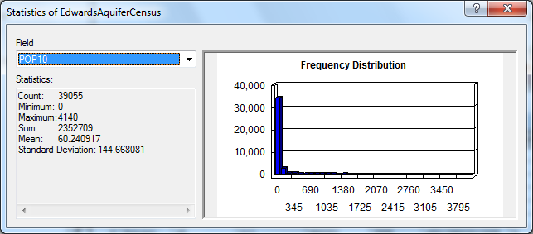
Population Living Over the Edwards Aquifer
Population (2010) = 2,352,709
Small Tracts in High Population Areas
Large Tracts in Low Population Areas

Slide 38
Demography Summary
Demographic data are compiled by Counties
  Counties contain Census Tracts
  Tracts contain Census Block Groups
  Block Groups contain Census Blocks
American Community Survey data are compiled by Census Block Groups – a continually functioning sample of economic and population info
Population Census is done once every 10 years by Census Blocks – a complete enumeration of population and household units
Sources for map info: (1) Living Atlas; (2) Following links:
http://www.caee.utexas.edu/prof/maidment/giswr2014/census/census.gdb.zip
ftp://ftp2.census.gov/geo/tiger/TIGER2010BLKPOPHU/

