Slide 1
Hurricane Harvey Response
By Sydney Kase
GIS in Water Resources Class
5 Sept 2017

Slide 2
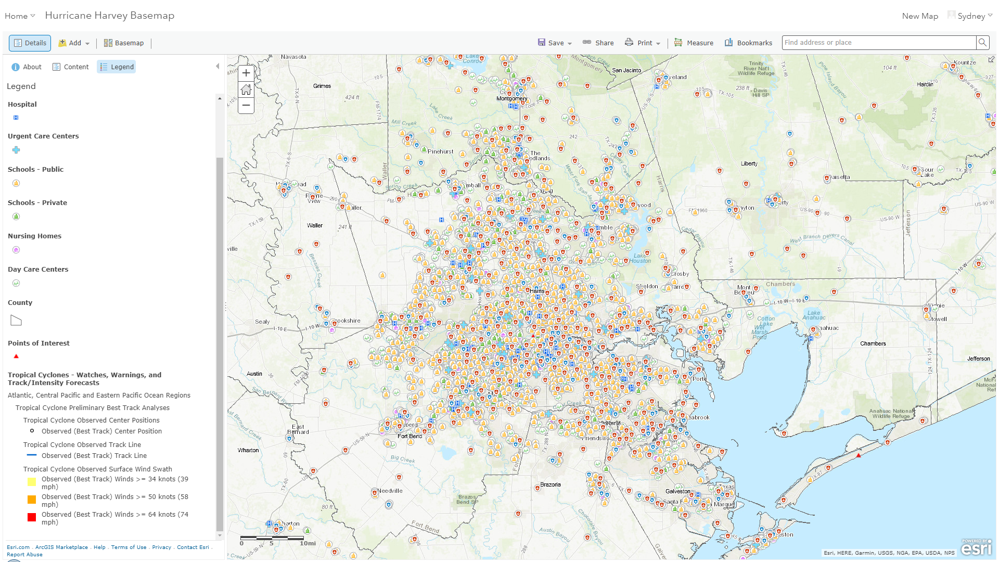

Slide 3
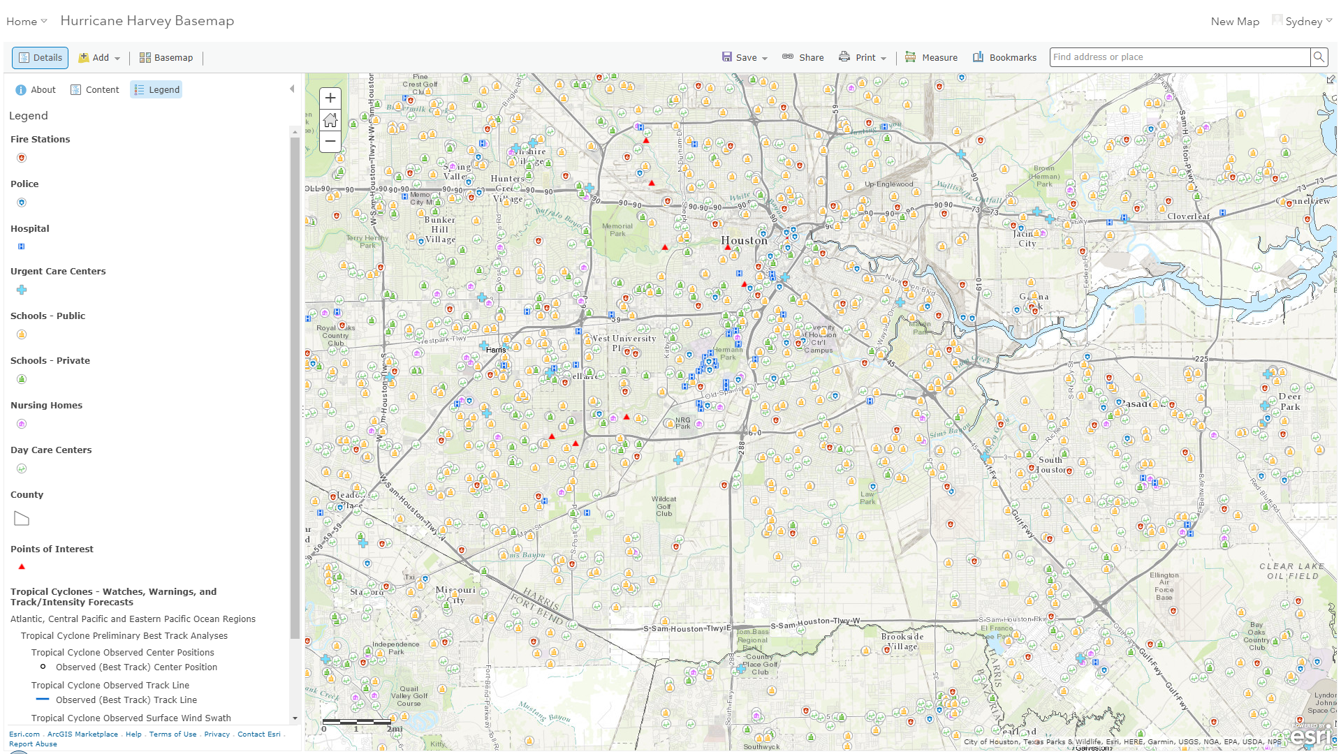

Slide 4
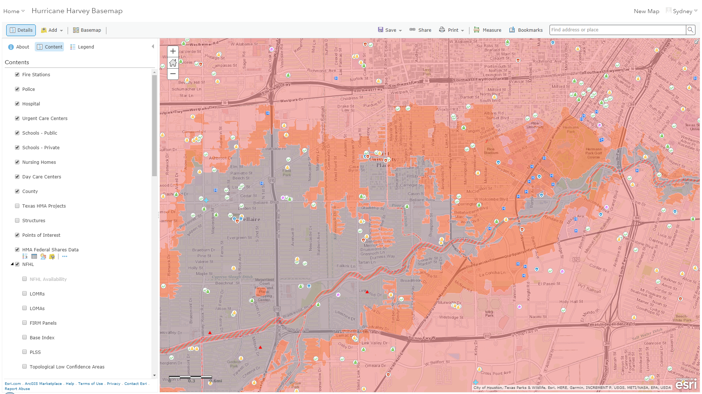

Slide 5
