Slide 1


Water Information Sharing and HydroShare
Advancing Hydrology through Collaborative Data and Model Sharing using HydroShare
David G Tarboton, Ray Idaszak, Jeffery S Horsburgh, Daniel P Ames, Jonathan L Goodall, Alva Couch, Lawrence E Band, Venkatesh Merwade, Richard P Hooper, David R Maidment, Pabitra K Dash, Michael Stealey, Hong Yi, Christopher Calloway, Tian Gan, Anthony M Castronova, Zhiyu Li, Mohamed M Morsy, Shawn Crawley, Mauriel Ramirez, Jeffrey Sadler, Zhaokun Xue, Martyn Clark, Shaowen Wang, Bart Nijssen and Christina Bandaragoda
Utah State University, RENCI - University of North Carolina, CyberGIS Center – University of Illinois, Consortium of Universities for the Advancement of Hydrologic Sciences Inc., Brigham Young University, University of Virginia, Tufts University, National Center for Atmospheric Research, University of Washington, University of Texas, Purdue University, Caktus Group.
http://www.hydroshare.org
OAC-1664061
OAC-1664018
OAC-1664119
2017-2021

Slide 2
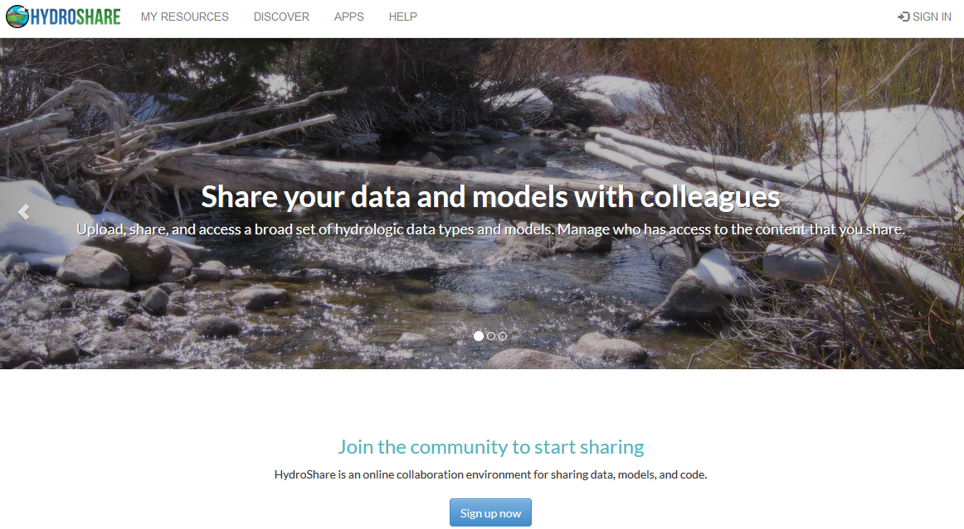
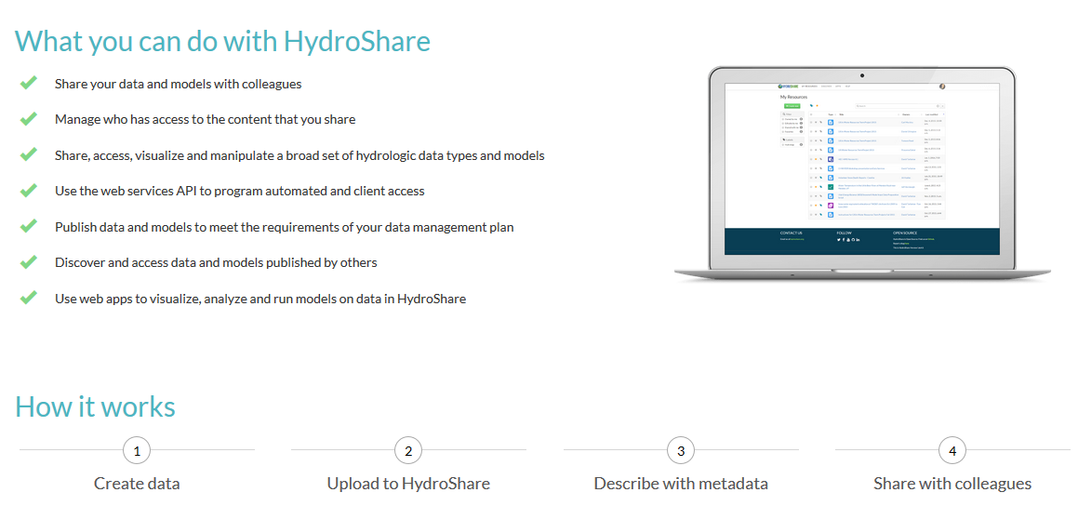
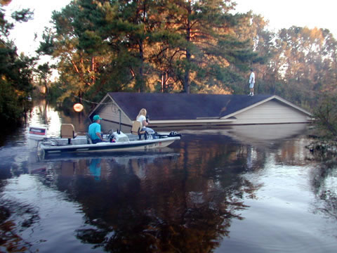
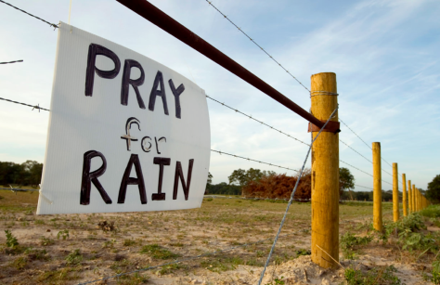
Motivation: Hydrologic research is a team sport
  Advancing Hydrologic Understanding
  requires integration of information from multiple sources
  is data and computationally intensive
  requires collaboration and working as a team/community
Grand challenge (NRC 2001):
Better hydrologic forecasting that quantifies effects and consequences of land surface change on hydrologic processes and conditions
Floods and Droughts

Slide 3

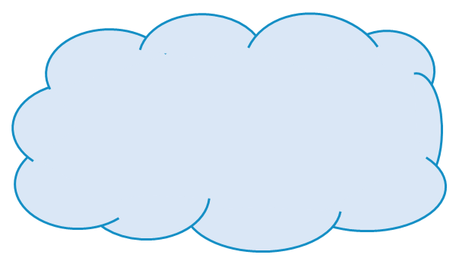
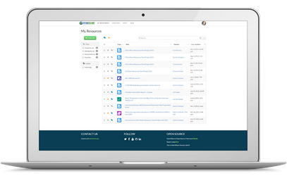
CyberInfrastructure Challenges
The data deluge
  Large datasets, data heterogeneity, Inadequate metadata
Data Organization and Model Input preparation
Reproducibility
Software installation and configuration
  Platform dependencies, Library dependencies, Licensing
Computational resources
  Memory, disk and processing
Analysis
Data
Models

Slide 4
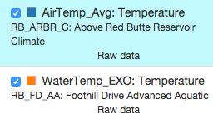
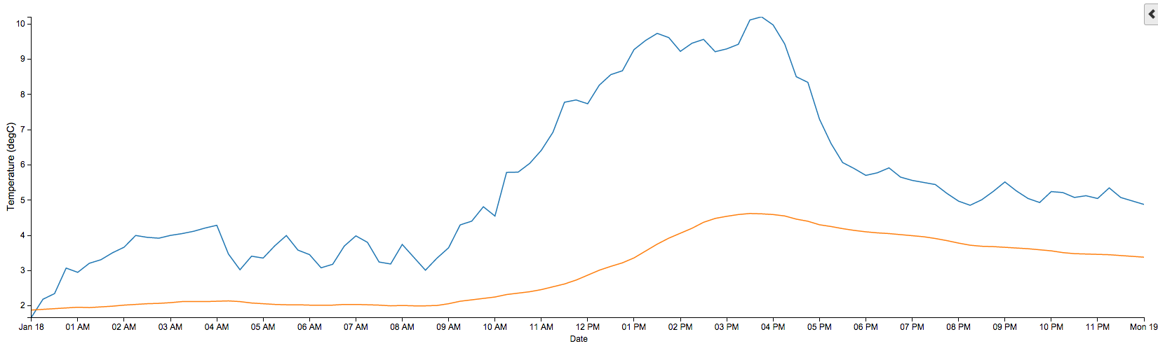
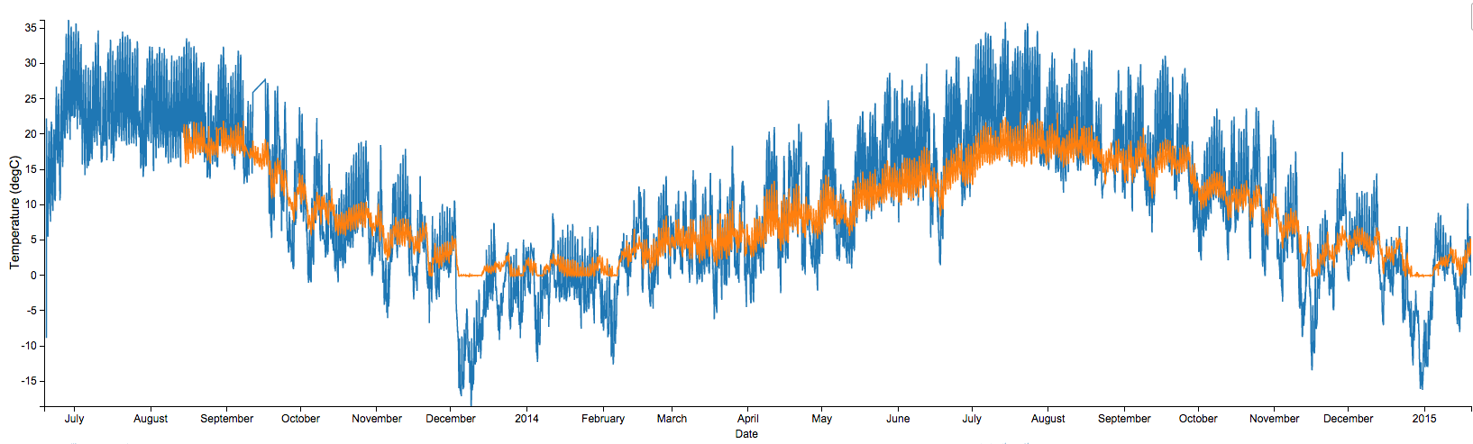
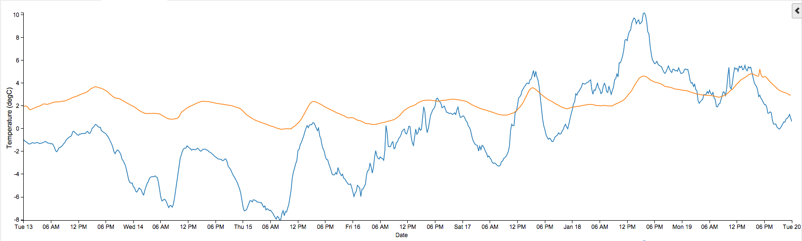
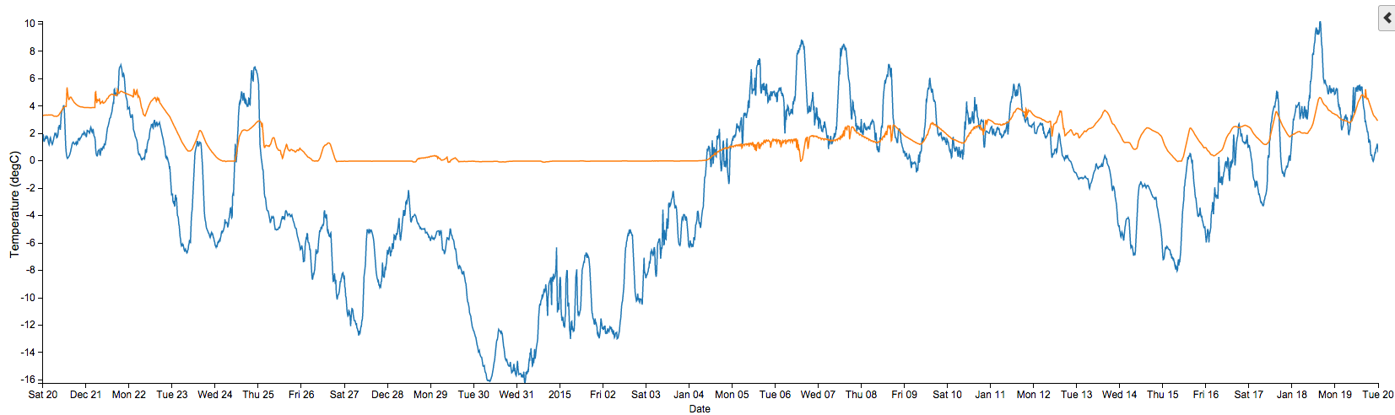
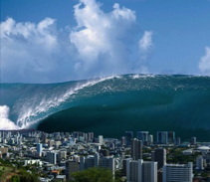
The Data Deluge
One week = 672 observations
One day = 96 observations
One month = 2880 observations
One year = 35,040 observations
So far (~1.5 years) = 55,000+ observations
Times 14 Aquatic Sites with ~26 Variables
Times 14 Climate Sites with ~74 Variables
Plus different versions of the data (raw versus checked) = 43,400,000+ observations
You need some infrastructure to manage and share the data.
From Jeff Horsburgh
Notes:
So, let’s talk about the volume of data being generated in the network.

Slide 5
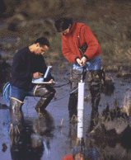
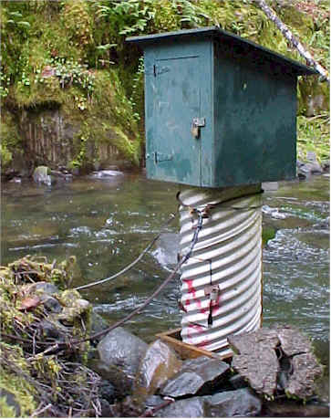
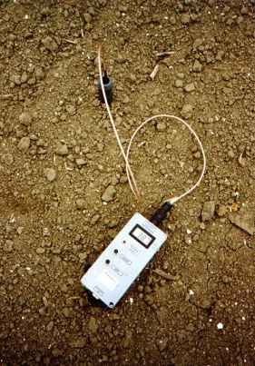
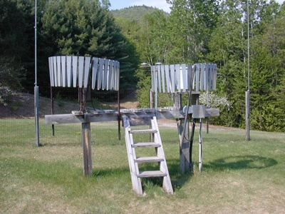
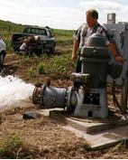
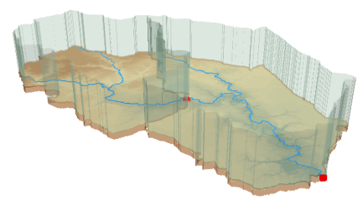
The challenge of data heterogeneity
Water quality
Water quantity
From dispersed federal agencies
From investigators collected for different purposes
Different formats
  Points
  Lines
  Polygons
  Fields
  Time Series
Rainfall and Meteorology
Soil water
Groundwater
The way that data is stored can enhance or inhibit the analysis that can be done
We need ways to organize the data we work with
Data models
GIS

Slide 6
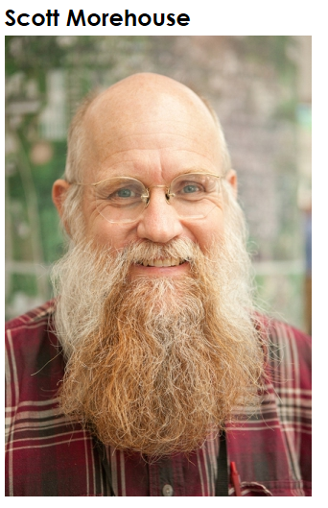
Geographic Data Model
“All geographic information systems are built using formal models that describe how things are located in space. A formal model is an abstract and well-defined system of concepts. A geographic data model defines the vocabulary for describing and reasoning about the things that are located on the earth. Geographic data models serve as the foundation on which all geographic information systems are built.”
Scott Morehouse, Preface to “Modeling our World”, First Edition. He was the chief software engineer at ESRI
Or, more simply: the way that data is organized can enhance or inhibit the analysis that can be done

Slide 7

The way that data is organized can enhance or inhibit the analysis that can be done
I have your information right here …
Picture from: http://initsspace.com/

Slide 8
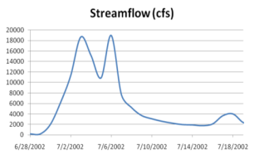
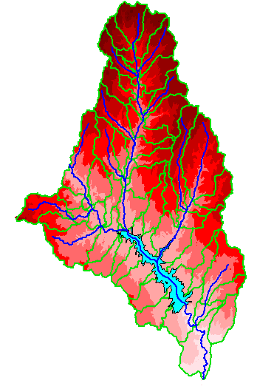
Hydrologic Science
It is as important to represent hydrologic environments precisely with
data as it is to represent hydrologic processes with equations
Physical laws and principles
(Mass, momentum, energy, chemistry)
Hydrologic Process Science
(Equations, simulation models, prediction)
Hydrologic conditions
(Fluxes, flows, concentrations)
Hydrologic Information Science
(Observations, data models, visualization
Hydrologic environment
(Physical earth)
From David Maidment

Slide 9
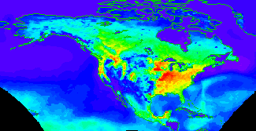


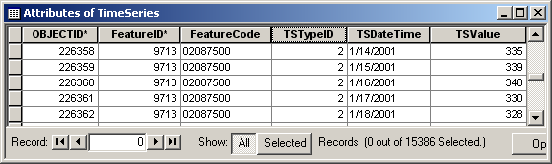
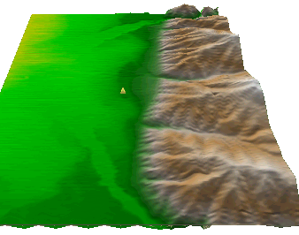
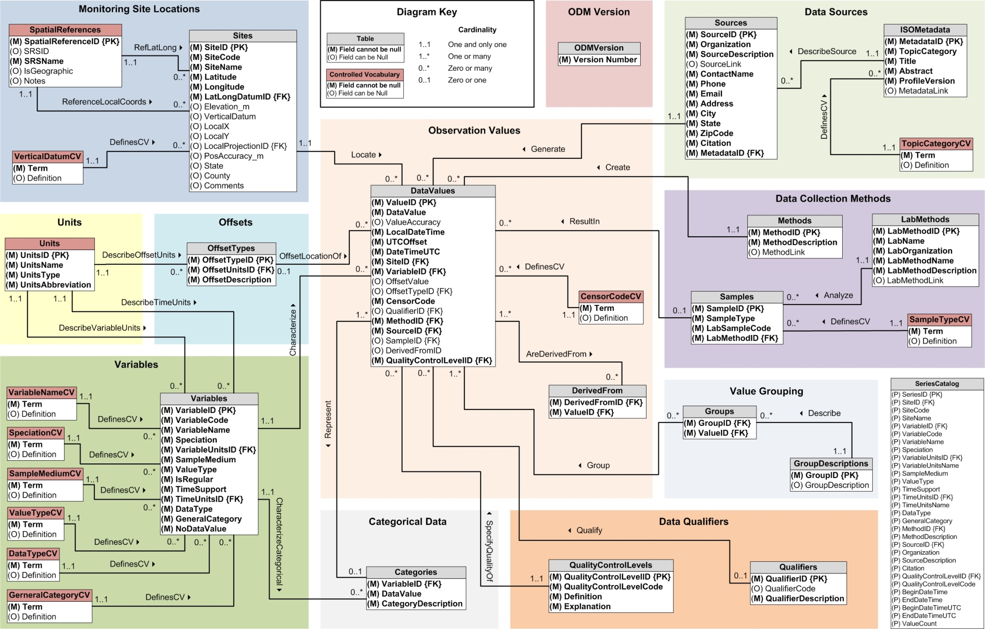
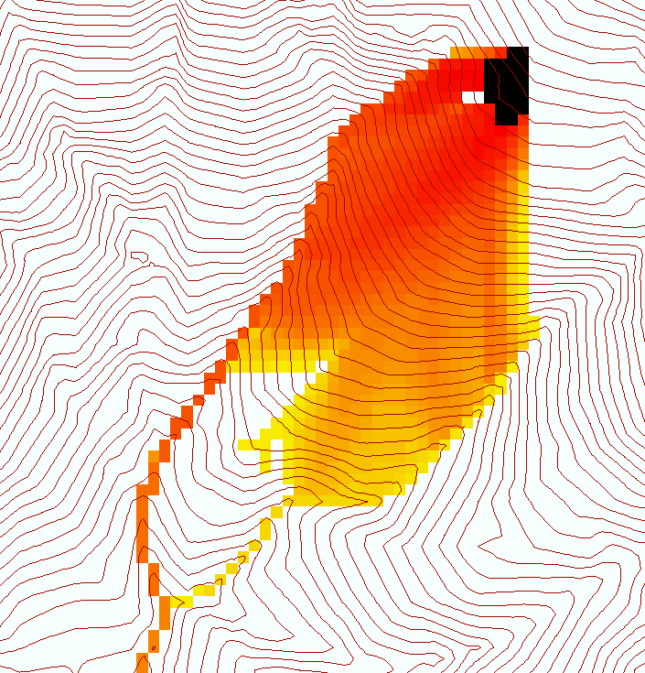
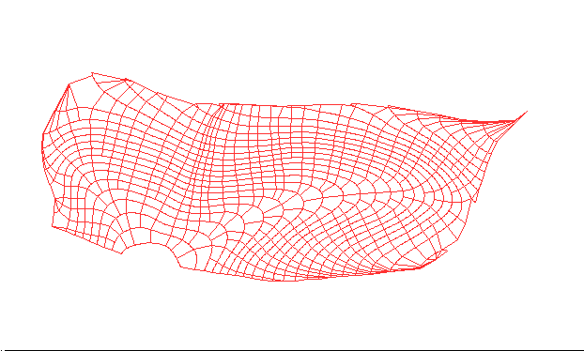
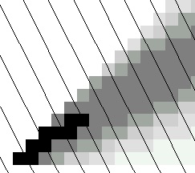
Data models organize the diversity of natural systems
NetCDF (Unidata) - A model for Continuous Space-Time data
ArcHydro – A model for Discrete Space-Time Data
Time, TSDateTime
Time, T
Coordinate
dimensions
{X}
TSValue
D
Space, FeatureID
Space, L
CUAHSI Observations Data Model: What are the basic attributes to be associated with each single data value and how can these best be organized?
Variables, TSTypeID
Variables, V
Variable dimensions
{Y}
Terrain Flow Data Model used to enrich the information content of a digital elevation model

Slide 10
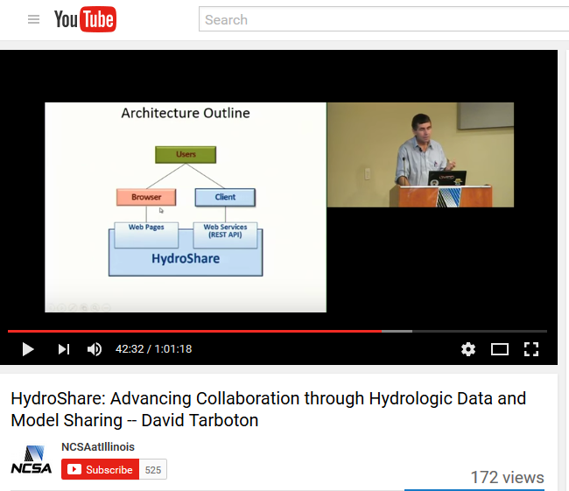
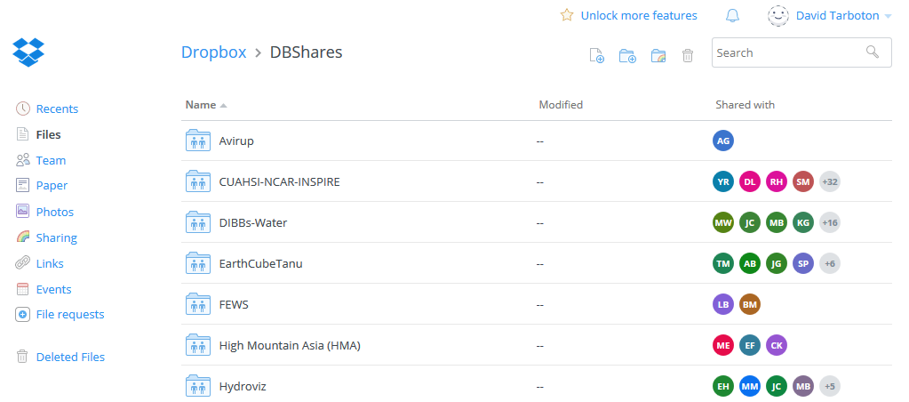
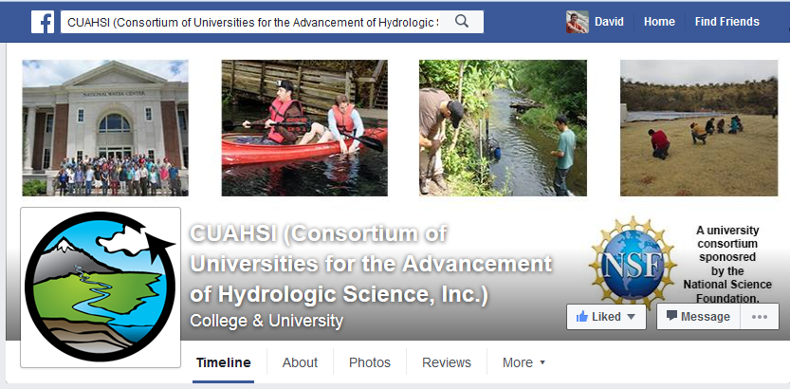
How do people share other content now
YouTube
Facebook
Instagram
Drop Box
Google Drive
ArcGIS Online
Hydrologic data ?
From Jeff Horsburgh

Slide 11
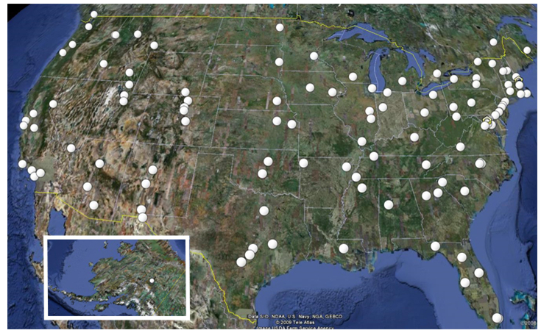
CUAHSI
Consortium of Universities for the Advancement of Hydrologic Science, Inc.
CUAHSI is made up of more than 130 U.S. universities and international water science-related organizations.
CUAHSI receives support from the U.S. National Science Foundation (NSF) to develop infrastructure and services for the advancement of water science in the United States.
http://www.cuahsi.org/

Slide 12
What is HIS?
HIS = Hydrologic Information System
The CUAHSI* Hydrologic Information System (HIS) provides web services, tools, standards and procedures that enhance access to more and better data for hydrologic analysis.
https://www.cuahsi.org/data-models/
Notes:
HIS helps you discover and access hydrologic data.

Slide 13
Major Challenges Addressed by CUAHSI HIS
How do I find and access hydrologic observations for use in my work?
How can I store, manage, and share hydrologic observations in a way that makes my life easier and in a way that others could use them?

Slide 14




Finding Information on the Internet
Catalogs
Catalog
Publish/Register
Find
Access
Server
Desktop
Servers
Desktops, Clients, Browsers

Slide 15
CUAHSI Hydrologic Information System
HydroCatalog
Data Discovery and Integration
Metadata Services
WaterML, Other OGC Standards
Search Services
HydroServer
HydroDesktop
Data Publication
Data Services
Data Analysis and Synthesis
Information Model and Community Support Infrastructure

Slide 16
What are the basic attributes to be associated with each single data value and how can these best be organized?
DateTime
Interval (support)
“When”
Time, T
t
A data value
v_{i} (s,t)
Variable
Method
Quality Control Level
Sample Medium
Value Type
Data Type
Source/Organization
“Where”
Location
Feature of interest
Latitude
Longitude
Site identifiers
s
Space, S
V_{i}
“What”
Variables, V
Units
Accuracy
Censoring
Qualifying comments

Slide 17
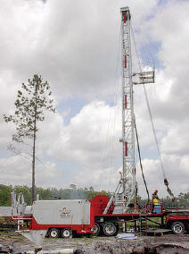
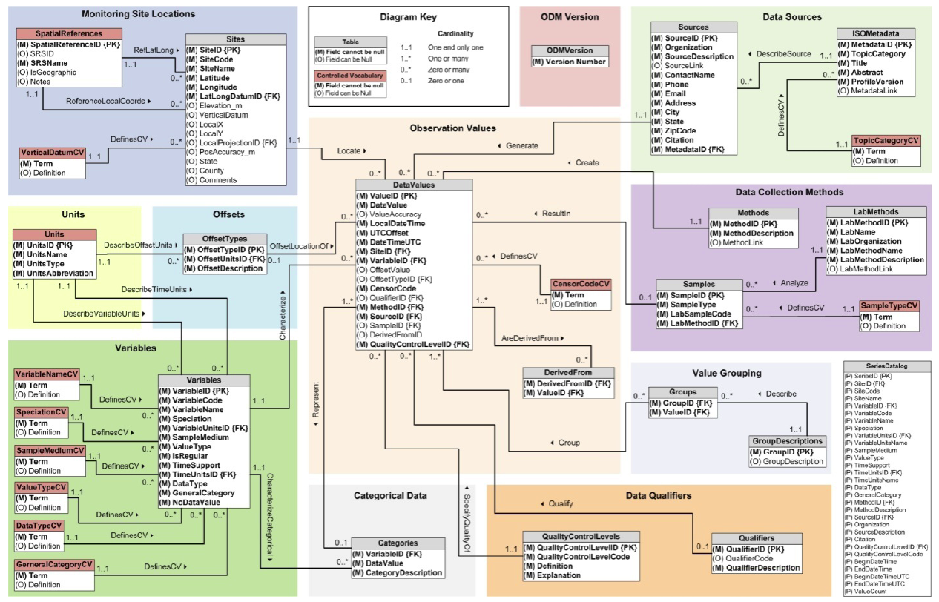
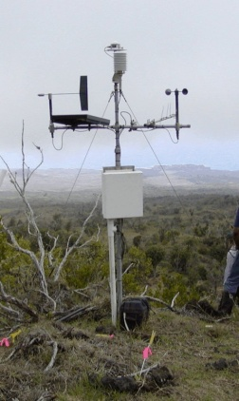
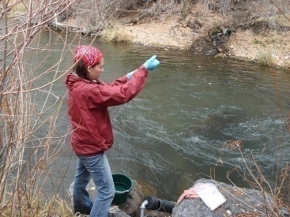
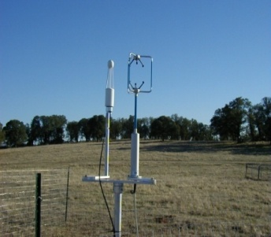
Observations Data Model (ODM)
Streamflow
Groundwater
levels
Precipitation
& Climate
Soil
moisture
data
Water Quality
Flux tower data
A relational data model at the single observation level
Metadata for unambiguous interpretation
Traceable heritage from raw measurements to usable information
Promote syntactic and semantic consistency
Cross dimension retrieval and analysis
Horsburgh, J. S., D. G. Tarboton, D. R. Maidment, and I. Zaslavsky (2008), A relational model for environmental and water resources data, Water Resources Research, 44, W05406, doi:10.1029/2007WR006392.

Slide 18
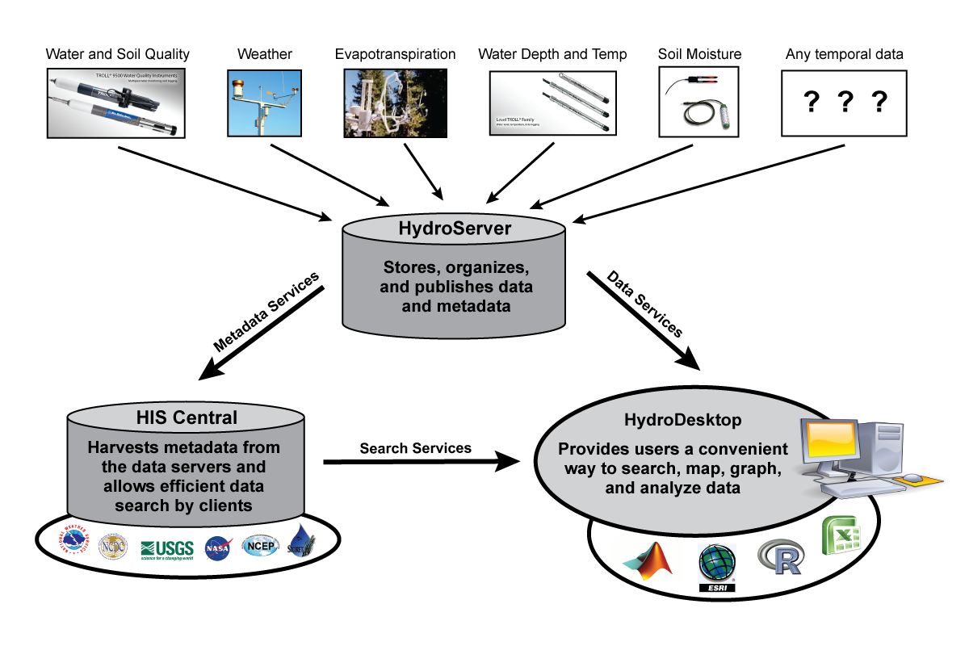


CUAHSI HIS
Enabling Water Data Discovery
From Jeff Horsburgh

Slide 19
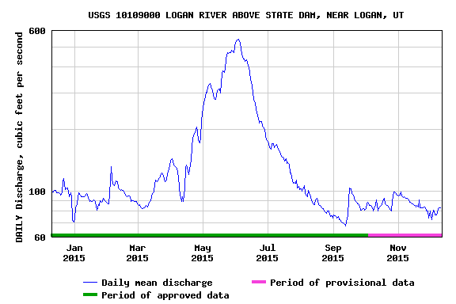
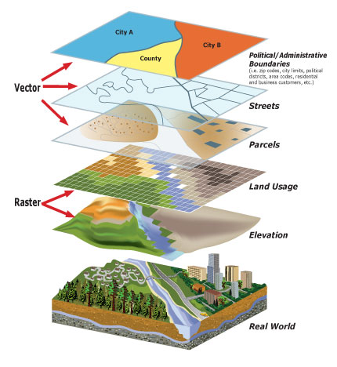
Data and models used by hydrologists are diverse…
Time series
Geographic rasters
Geographic features
Multidimensional space/time
Model programs
Model instances
…
http://www.usgs.gov
http://www.unidata.ucar.edu
http://www.esri.com
From Jeff Horsburgh
Notes:
But, the data we use are diverse, and we don’t currently have a lot of options for sharing models or model instances. We’ve nailed time series down, but we still don’t have great cyberinfrastructure embraced by our community that supports the broad spectrum of data and models we use.

Slide 20
HydroShare is a collaborative environment for data sharing, analysis and modeling
Share your data and models with colleagues
Manage who has access to the content that you share
Share, access, visualize and manipulate a broad set of hydrologic data types
Sharing and execution of models
Access to and use of high performance computing
Publication of data and models with a DOI
Our goal is to make sharing of hydrologic data and models as easy as sharing videos on YouTube or shopping on Amazon.

Slide 21
Data and models used by hydrologists are diverse…
Time series
Geographic rasters
Geographic features
Multidimensional space/time
Model programs
Model instances
…
http://www.usgs.gov
http://www.unidata.ucar.edu
http://www.esri.com
HydroShare can hold data in a wide variety of formats, and data in any format as “generic”
From Jeff Horsburgh
Notes:
But, the data we use are diverse, and we don’t currently have a lot of options for sharing models or model instances. We’ve nailed time series down, but we still don’t have great cyberinfrastructure embraced by our community that supports the broad spectrum of data and models we use.

Slide 22
Value that HydroShare provides
Integration of information from multiple sources to enhance research
Re-use of data beyond the purpose for which it was originally collected, extending the value of measurement, monitoring and research investments
A platform for data management to support mandates for open data and access to the data that supports research findings
Enhanced trust in research findings and management decisions through transparency and support for reproducibility
Primary audience is US Hydrologic Research community (NSF funding) but open to international use and use by water resource professionals, educators and citizen scientists

Slide 23
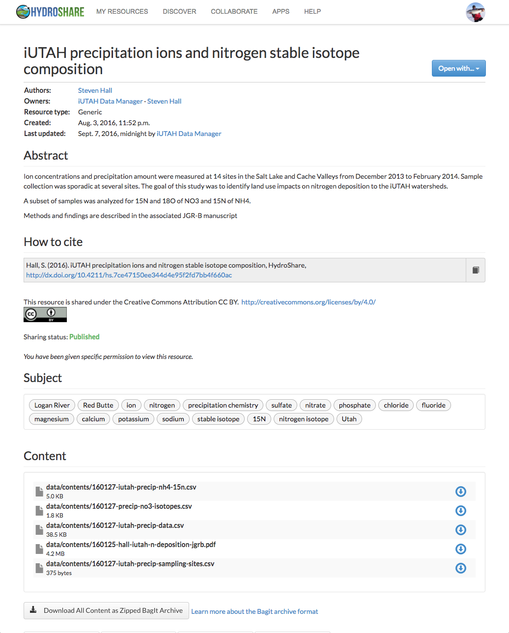
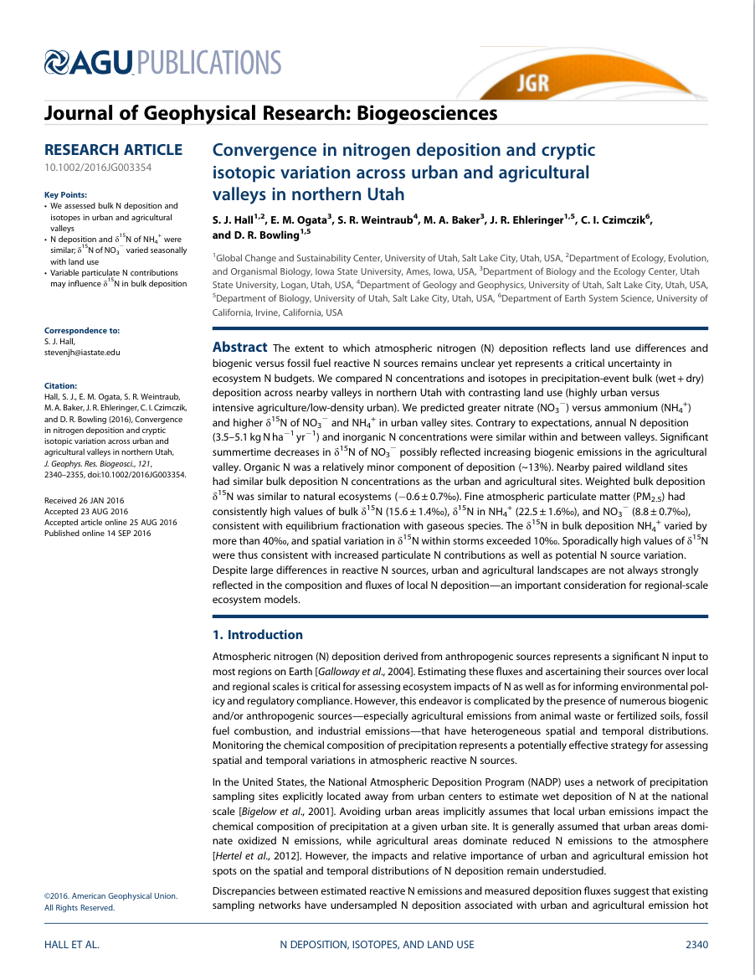





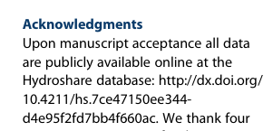
The Steven Hall Story
Steven verified his data and metadata were correct but kept the data private
Steven submitted his paper for publication and responded to reviews
With a little help, Steven deposited his dataset in the online HydroShare repository
Steven published his data in HydroShare and received a DOI
Steven collected his data in the field and transformed into a sharable format
Steven published his paper and cited published data in HydroShare
From Jeff Horsburgh

Slide 24
How HydroShare Works
Organize and annotate your content
Manage access
Web software to operate on content you have access to (Apps)
Extensibility
Django website
API
HydroShare Apps
Resource exploration
Actions on Resources
OAuth
API
API
Anyone can set up a server/app platform (software service) to operate on HydroShare resources through iRODS and API
Distributed file storage
iRODS “Network File System”
SWATShare (Hubzero)
CyberGIS
Unidata - THREDDS, Hyrax
Landlab
HydroShare
Data Store
CyberGIS
Data Store

Slide 25
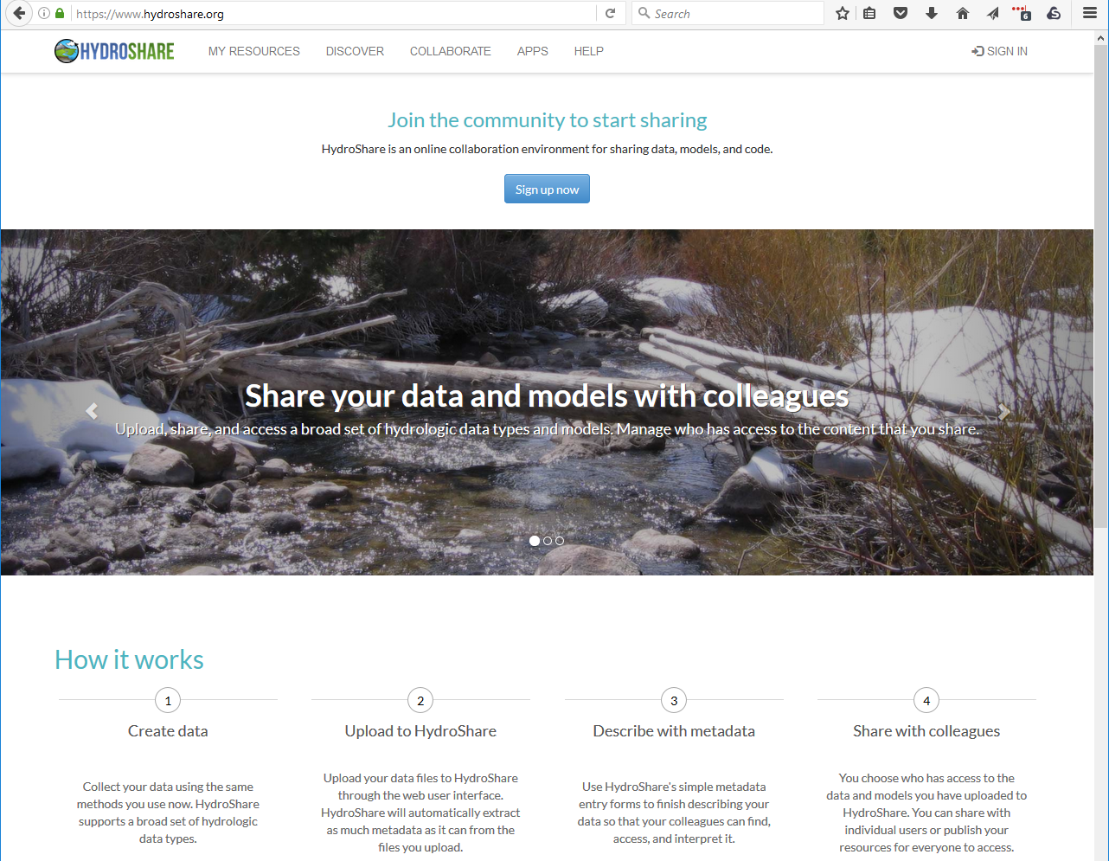
Demo

Slide 26
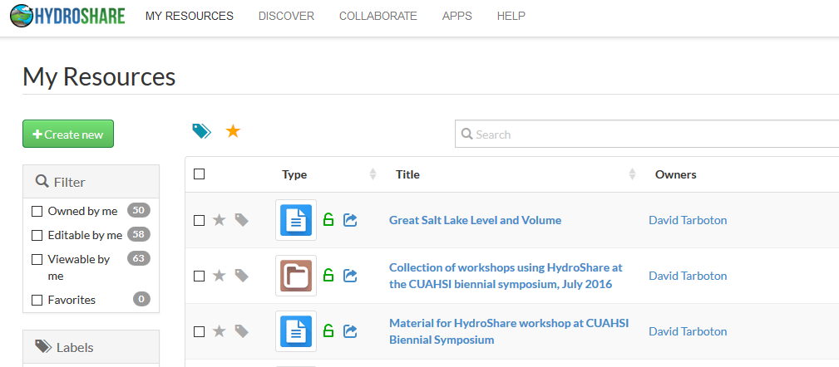
Collaborative data sharing
Add content to HydroShare to share with your colleagues or formally publish to document result reproducibility

Slide 27
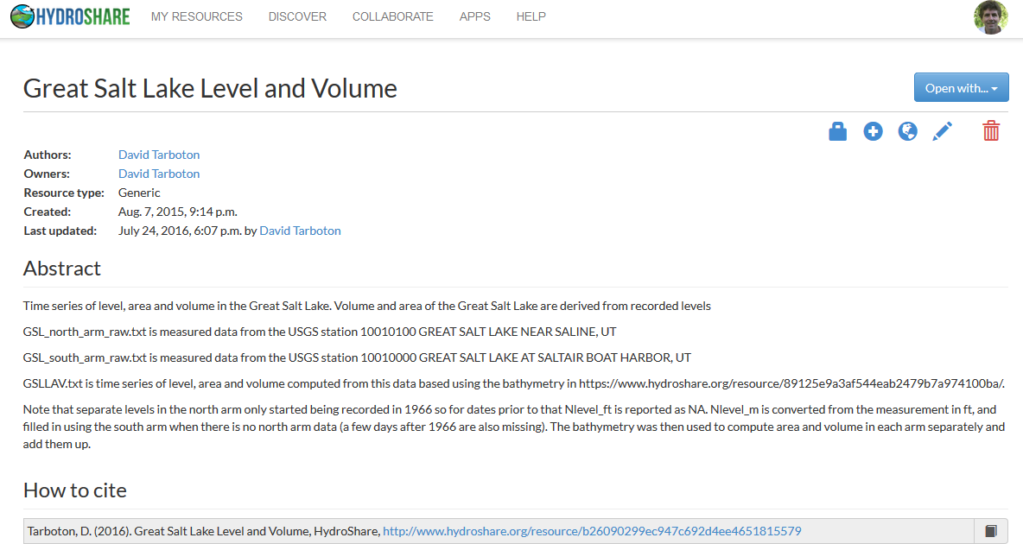
Resources (data and models) in HydroShare are objects of collaboration (social objects)
For each resource you can
Manage who has access
  To edit
  To view
Comment or rate
Get unique identifier
Describe with metadata
Organize into collections
Formally publish
Version
Open with compatible web app

Slide 28
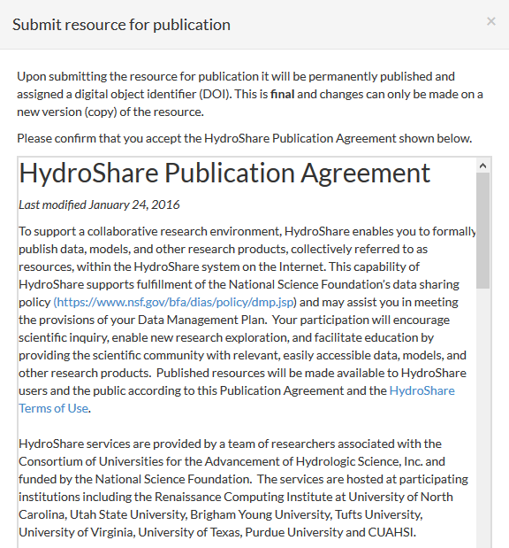
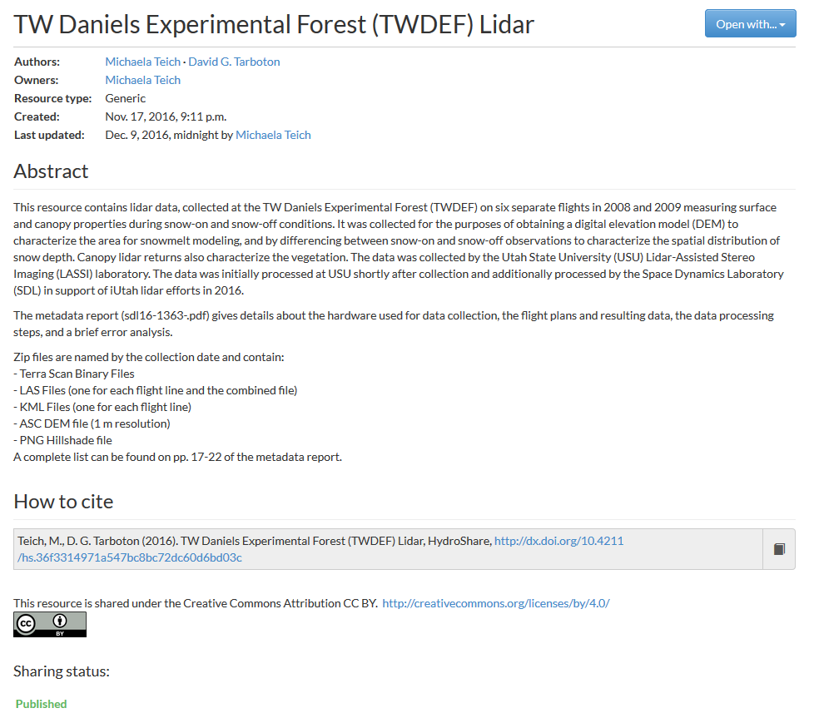
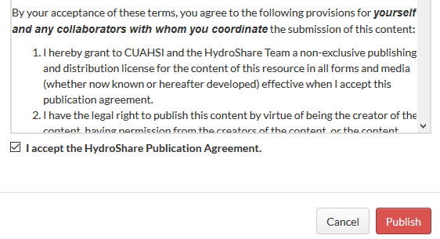
Formal data publication
...
Resources formally published receive a citable digital object identifier (DOI) and are made immutable to changes

Slide 29
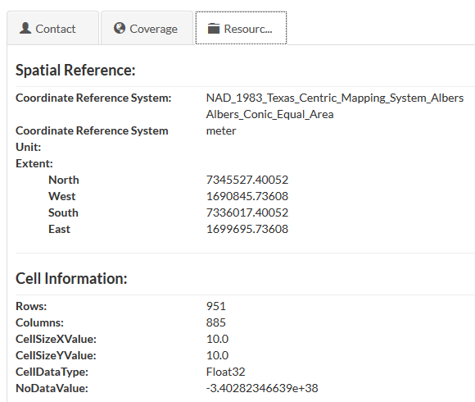


Automatic and natural metadata gathering eases some of the pain of metadata entry
For geographic raster WGS 84 Coverage information automatically harvested from GeoTIFF coordinate system information
For multidimensional netCDF data with CF convention metadata the HydroShare metadata can be fully and automatically completed

Slide 30

Model Program and Model Instance Resource Types
Model Instance:
Inputs
Outputs generated from inputs (optional)
Model Program:
Software (source code)
Documentation

Slide 31


Apps act on resources to support web based visualization and analysis http://apps.hydroshare.org

Slide 32


Slide 33



Hyrax OPeNDAP Server for public Multidimensional resources in netCDF format
Snapshot in time in visualized in Panoply

Slide 34






TauDEM in CyberGIS with Data in HydroShare
http://gateway.cigi.illinois.edu/
Submitted
Running
Visualizations
Results data created
Results Ready

Slide 35

Jupyter Python Notebook App
Write and execute python code acting on content of HydroShare resources and saving results back to HydroShare

Slide 36

HydroShare 2.0
Hydrologic modeling
  Systematic hypothesis testing (SUMMA)
  Transform National Water Model into community water model platform
Social Collaboration
  User driven design
  Incentives, metrics, group collaboration
Storage Agility
  Use 3rd party storage (Dropbox, Box, Google, University libraries and digital commons)
App Nursery
  Make it easier to write apps
  Develop and deploy new apps

Slide 37

HydroShare 2.0 (CI for fully web based hydrologic innovation environment)

Slide 38


Slide 39
Summary
A new, web-based system for advancing model and data sharing
Access multiple types of hydrologic data using standards compliant data formats and interfaces
Flexible discovery functionality
Model sharing and execution
Facilitate and ease access to use of high performance computing
Social media and collaboration functionality
Links to other data and modeling systems
Enable more rapid advances in hydrologic understanding through collaborative data sharing, analysis and modeling
Sustained operation by CUAHSI
A growing community of users

Slide 40

To learn more
www.hydroshare.org

Slide 41

Thanks to the HydroShare team!
  USU
  RENCI/UNC
  CUAHSI
  BYU
  Tufts
  UVA
  Texas
  Purdue
  SDSC
  Caktus
http://www.hydroshare.org
ACI-1148453
ACI-1148090
2012-2017
Notes:
The HydroShare project is part of a broad effort in CUAHSI in the area of Hydrologic Information Systems. We have a team of developers and domain scientists from eight universities working on HydroShare. This is part of the even broader focus in NSF on data management, Cyberinfrastructure and sustainable software.

