Slide 1
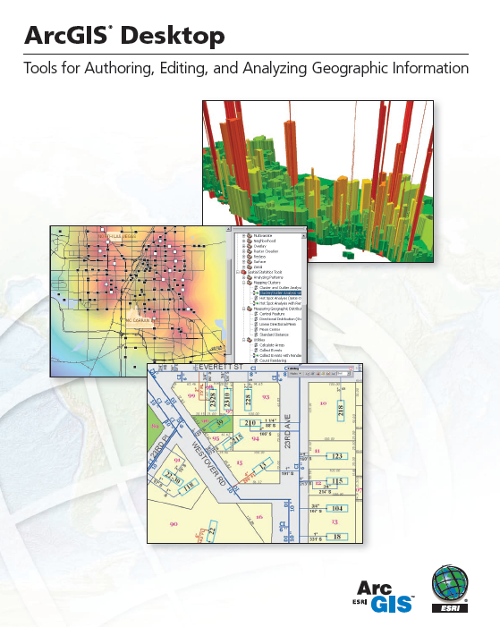
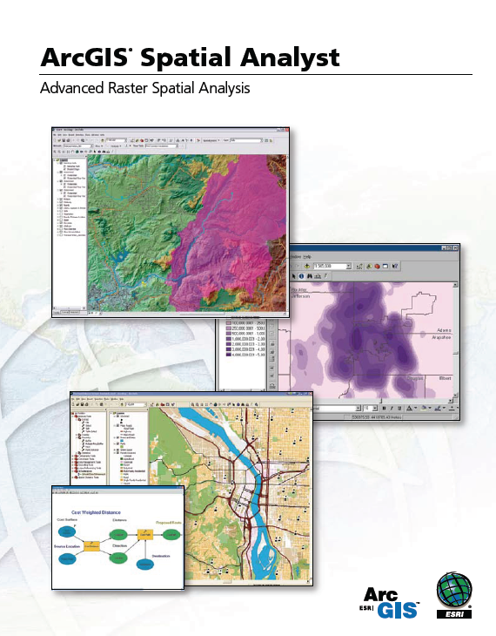
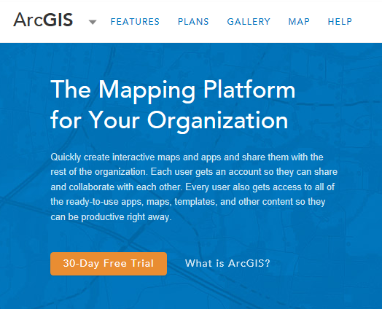
Introduction to ArcGIS Software

Slide 2

Jack Dangermond, President, ESRI
Article from NY Times:
http://www.nytimes.com/2011/07/10/business/esris-chief-on-tending-his-plants-and-his-company.html?_r=2

Slide 3

Videos from Plenary Session of ESRI User Conference
https://www.youtube.com/watch?v=HkehjoYK6hY

Slide 4





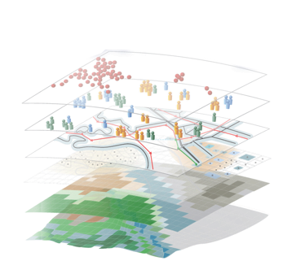


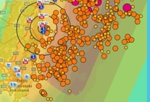

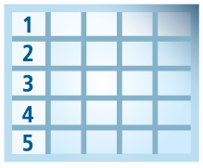
Geospatial Systems Are Helping Us Understand
Understanding
Sharing and Collaboration
Knowledge
Information
Integration
Mapping
Data
. . . Helping Us Make Better Decisions

Slide 5
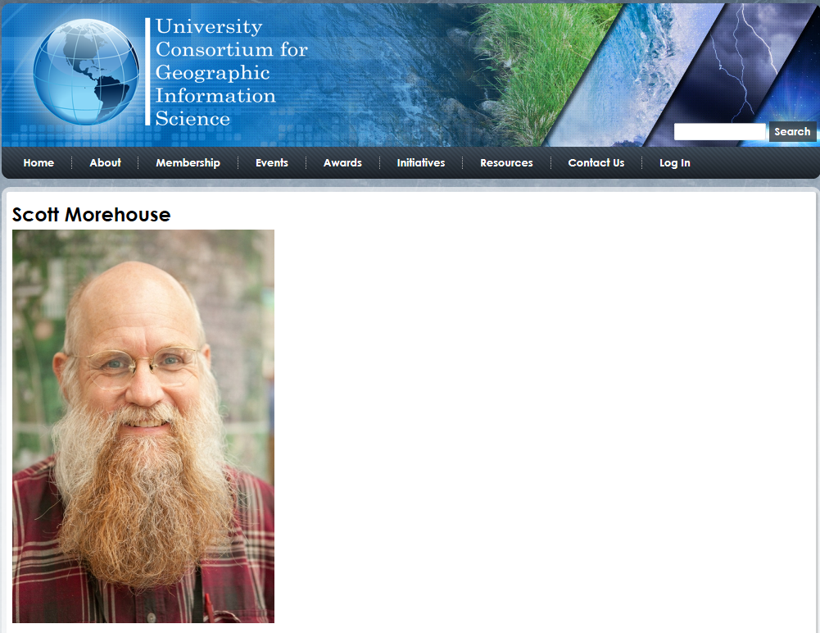
http://ucgis.org/ucgis-fellow/scott-morehouse
Made a Fellow of UCGIS in 2014
“All geographic information systems are built using formal models that describe how things are located in space. A formal model is an abstract and well-defined system of concepts. A geographic data model defines the vocabulary for describing and reasoning about the things that are located on the earth. Geographic data models serve as the foundation on which all geographic information systems are built.”
Scott Morehouse, Preface to “Modeling our World”, First Edition. He is the chief software engineer at ESRI

Slide 6
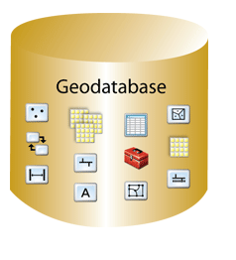
Geodatabase – a store for all types of geospatial information

Slide 7
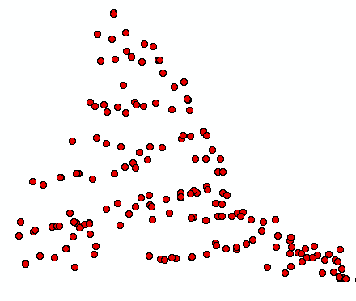
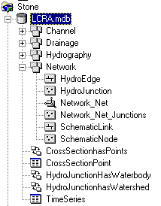
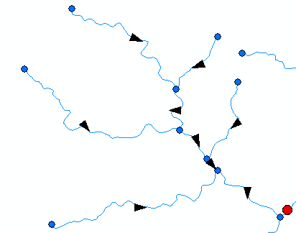
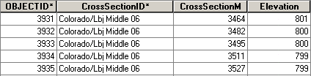
ArcGIS Geodatabase
Workspace
Geodatabase
Feature Dataset
Feature Class
Geometric
Network
Relationship
Object Class

Slide 8
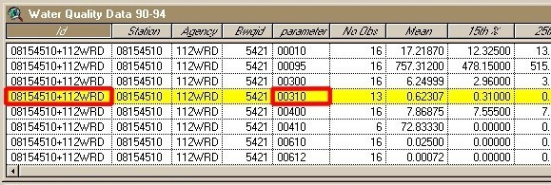
Object Class
An object class is a collection of objects in tabular format that have the same behavior and the same attributes.
An object class is a table that has a unique identifier (ObjectID)
for each record

Slide 9
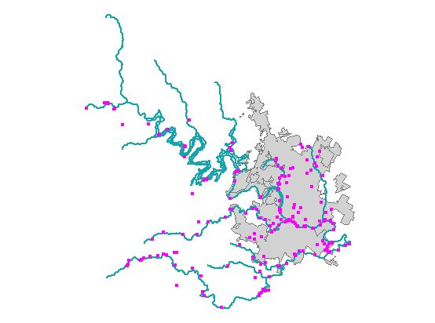
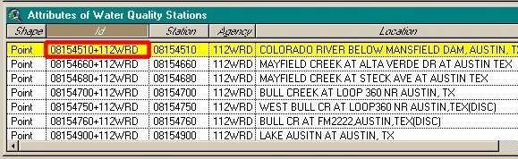
Feature Class
A feature class is a collection of geographic objects in tabular format that have the same behavior and the same attributes.
Feature Class = Object class + spatial coordinates

Slide 10
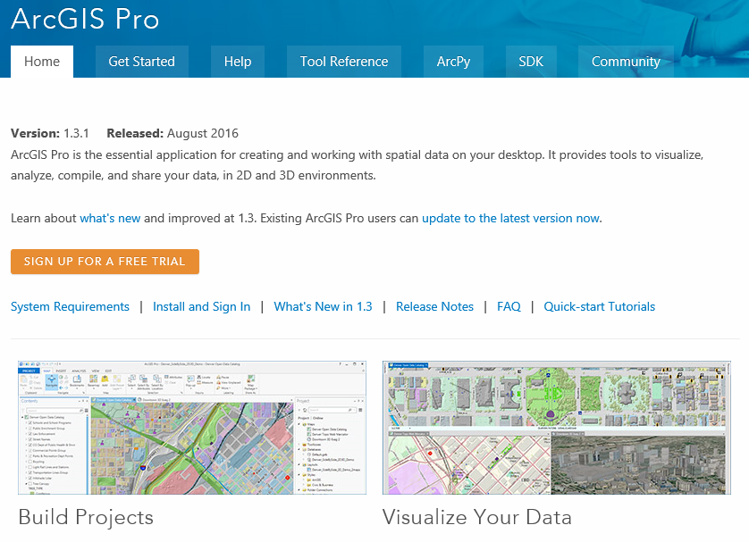
ArcGIS Pro
https://pro.arcgis.com/en/pro-app/
New Interface for ArcGIS for 64-bit computing

Slide 11
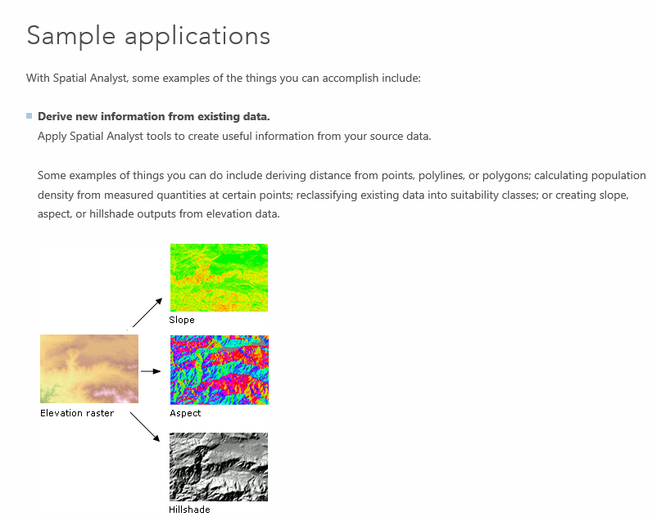
Spatial Analyst
https://desktop.arcgis.com/en/arcmap/latest/extensions/spatial-analyst/what-is-the-spatial-analyst-extension.htm

Slide 12
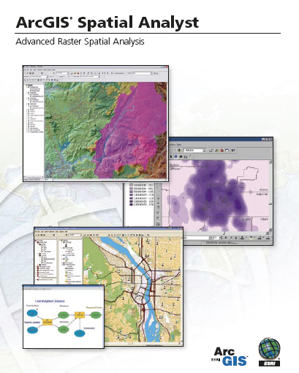
Spatial Analyst
Analysis of land surface terrain as a grid
Key means of defining drainage areas and connectivity to stream network

Slide 13
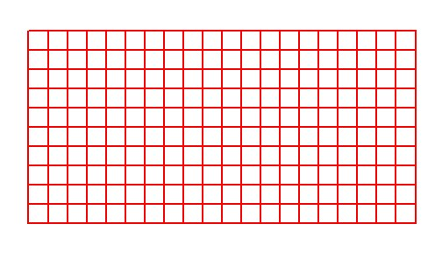
Grid Datasets
Cellular-based data structure composed of square cells of equal size arranged in rows and columns.
The grid cell size and extension (number of rows and columns), as well as the value at each cell have to be stored as part of the grid definition.
Number of columns
Cell size
Number of rows

Slide 14
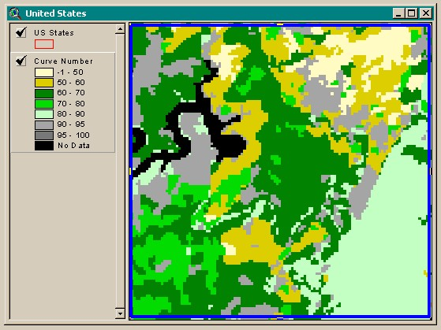
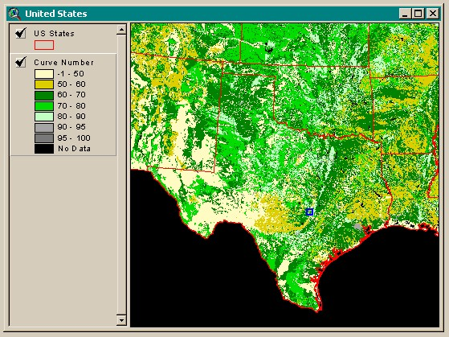
Grid Datasets
Grid datasets

Slide 15
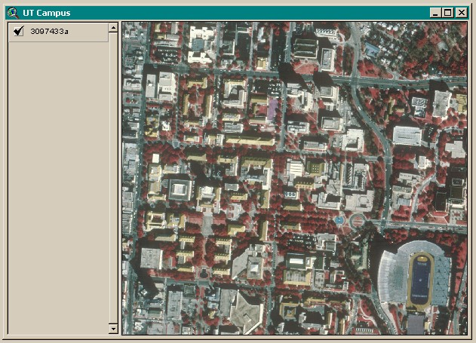
Image Datasets
Digital Orthophotos and satellite imagery
Image datasets

Slide 16
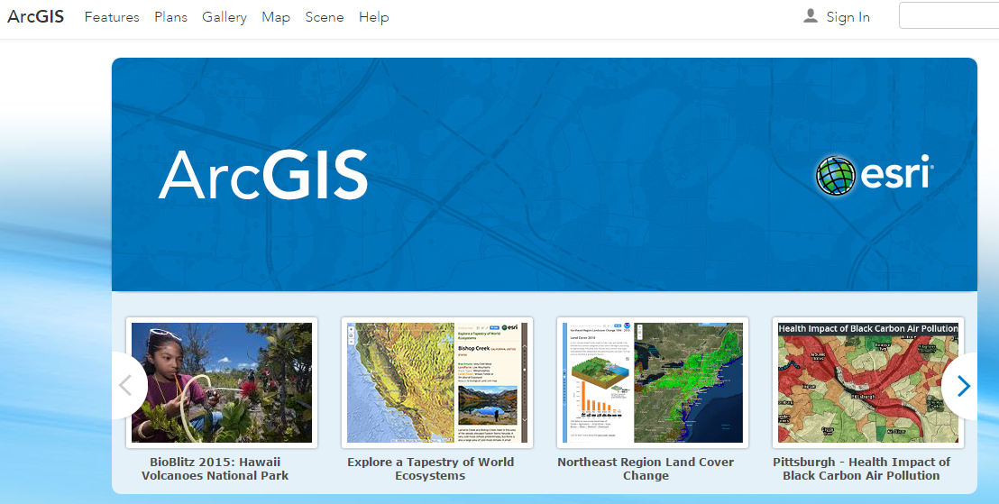
ArcGIS Online
Mapping on the web

Slide 17
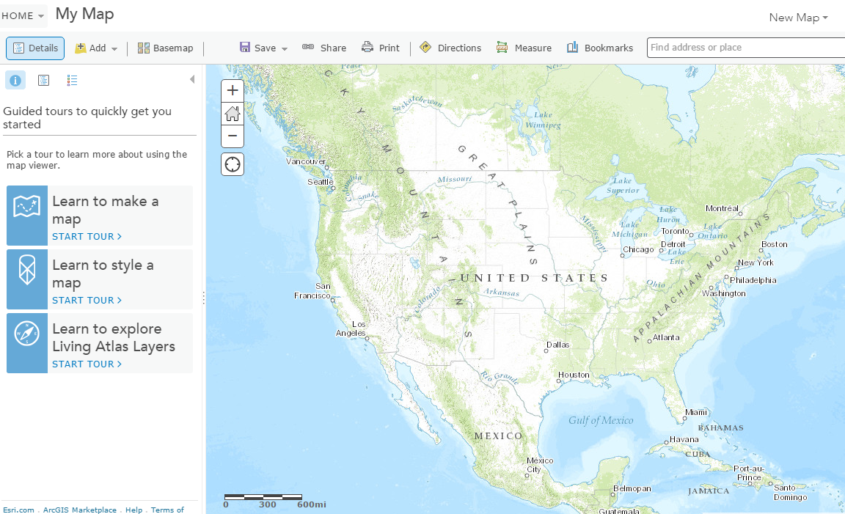
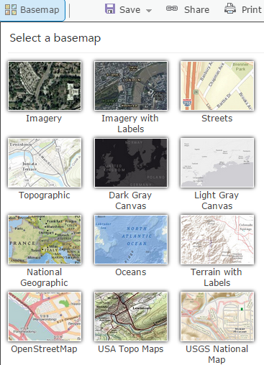
Make a Map
Select a base map and add things to it

Slide 18
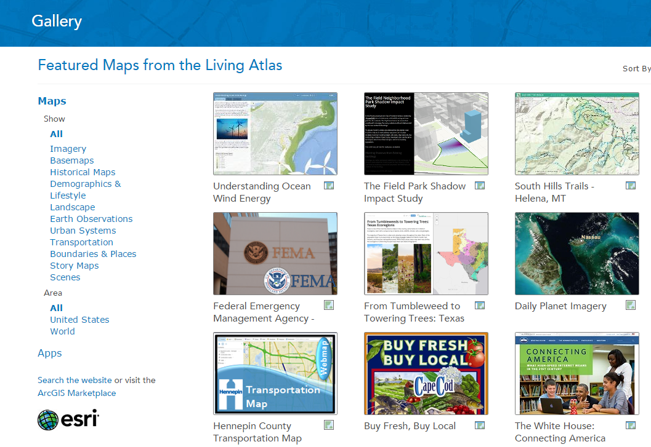
Living Atlas
http://www.arcgis.com/home/gallery.html

Slide 19
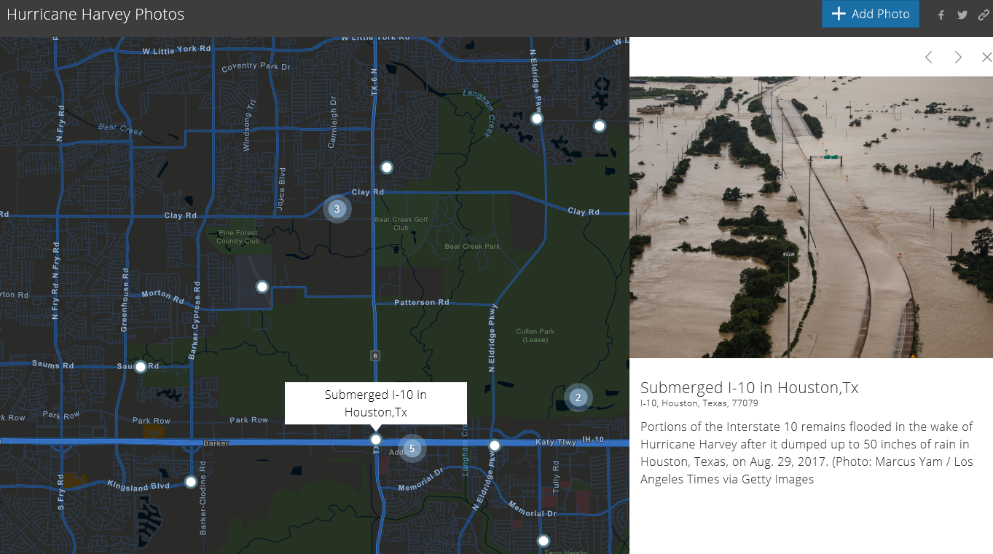
Story Maps: Hurricane Harvey
https://napsg.maps.arcgis.com/apps/StoryMapCrowdsource/index.html?appid=b6ef838e4d26489e8f62102639dc3d91

