Slide 1
GIS in Water Resources Midterm Review 2017

Slide 2
Blooms Taxonomy of Educational Objectives
6. Evaluation – advantages and limitations
of alternative approaches
Final Exam
5. Synthesis – bring new knowledge
together
Term Project
4. Analysis – break a problem into
parts and solve sequentially
Numerical
problems
3. Application – calculate a formula
Midterm
2. Comprehension – what does it mean?
Define,
explain,
illustrate
1. Knowledge – basic facts

Slide 3
Geographic Data Model
“All geographic information systems are built using formal models that describe how things are located in space. A formal model is an abstract and well-defined system of concepts. A geographic data model defines the vocabulary for describing and reasoning about the things that are located on the earth. Geographic data models serve as the foundation on which all geographic information systems are built.”
Scott Morehouse, Preface to “Modeling our World”, First Edition. He was the chief software engineer at ESRI
Or, more simply: the way that data is organized can enhance or inhibit the analysis that can be done

Slide 4
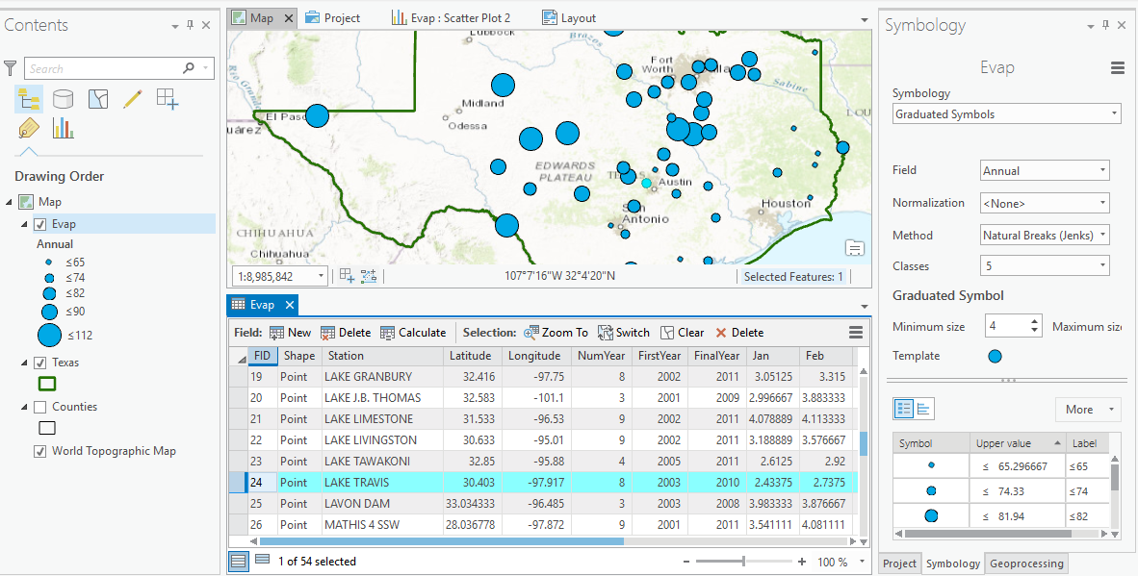
GIS: Map Features and Tabular Records

Slide 5
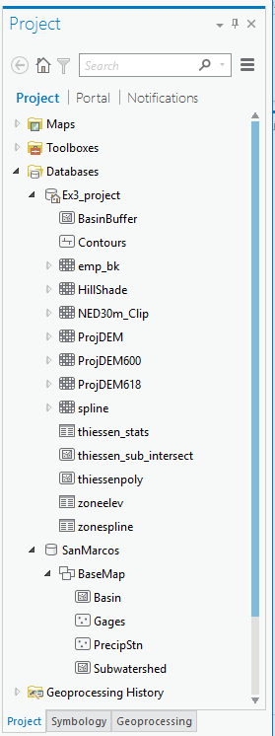
Databases and their components
Geodatabase
Raster
Table
Feature Dataset
Feature Class

Slide 6
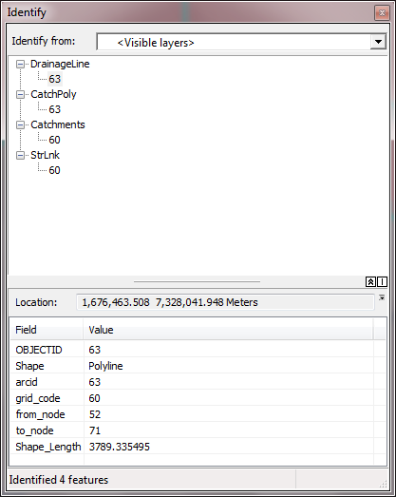
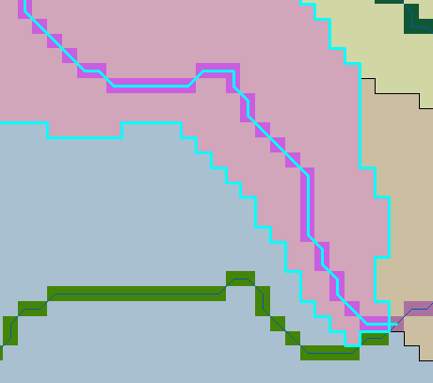
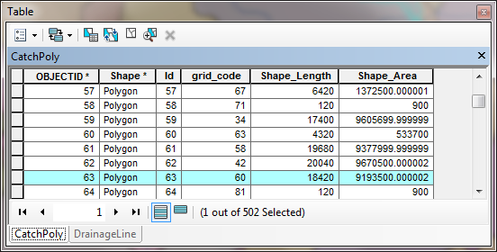
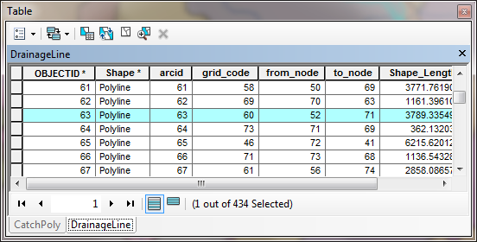
Database keys, values and relationships in support of analysis
The grid values for Catchments and the corresponding StrLnk rasters are the same. These values are inherited by the gridcode attribute of DrainageLine and CatchPoly thereby providing a one to one association between drainage lines and the subwatershed polygon that drains to them.

Slide 7
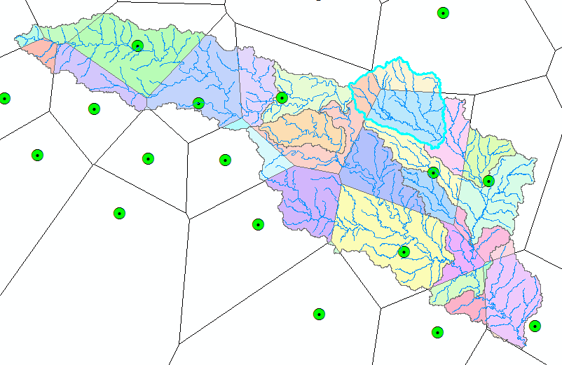
Subwatershed Precipitation by Thiessen Polygons
Thiessen Polygons
Intersect with Subwatersheds
Evaluate A*P Product
Summarize by subwatershed
$$P_{i}=\frac{\sum_{k}{A_{ik}P_{k}}}{\sum_{k}{A_{ik}}}$$

Slide 8
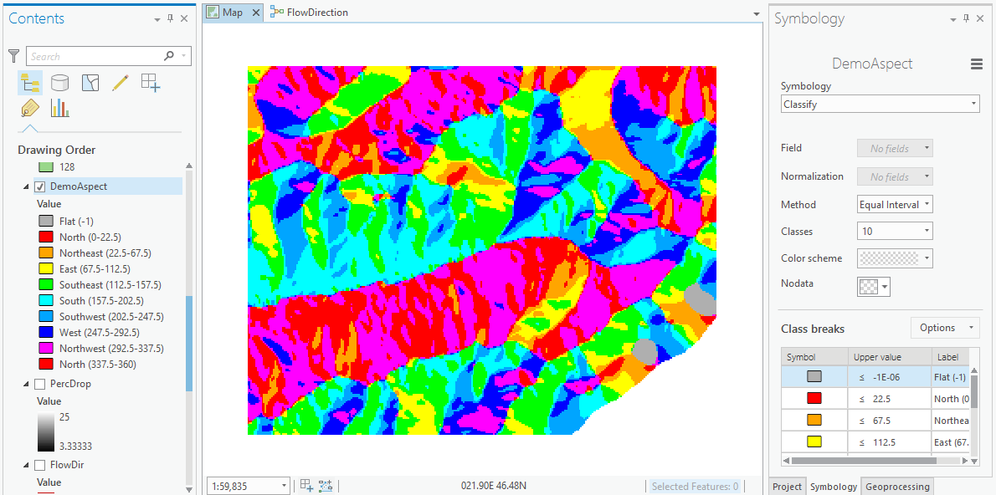
Visualization and Map Symbology

Slide 9
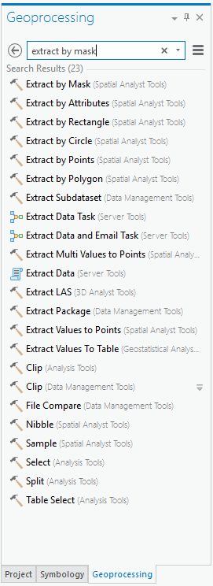
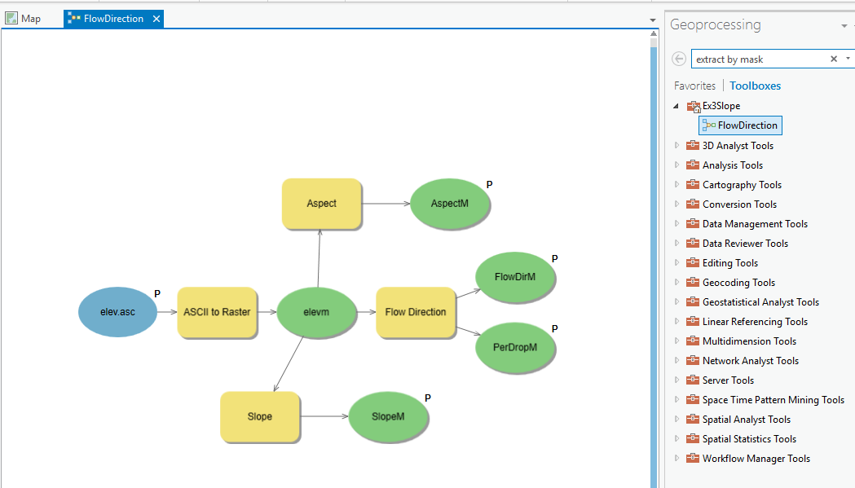
Analysis using Geoprocessing
Tools and Toolboxes
Model Builder for executing Workflows

Slide 10
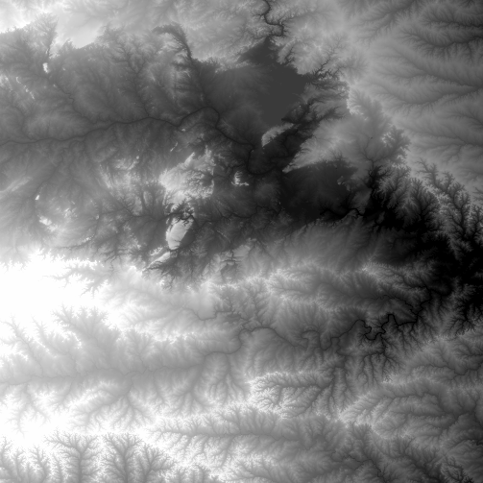
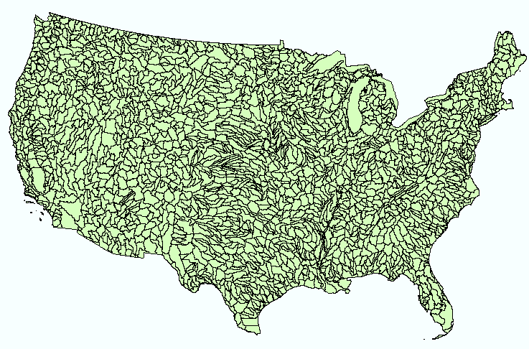
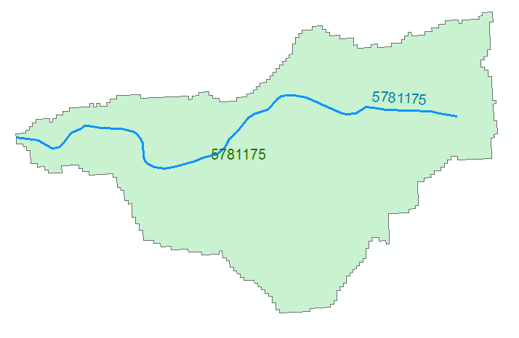
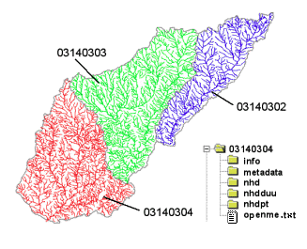
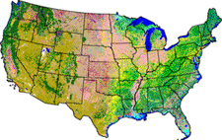
NHDPlus Version 2.1
Foundation for a Geospatial Hydrologic Framework for the United States
NHDPlus
2.7 million reach catchments in US
average area 3 km²
reach length 2 km
Uniquely labelled
National Elevation Dataset
Watershed Boundary Dataset
National Hydrography Dataset
National Land Cover Dataset

Slide 11
National Water Prediction Model Configurations
Four Forecasting Horizons for National Water Model
Analysis & Assimilation
Short-Range
‘Flood Prediction’
Medium Range
‘Flow Prediction’
Long Range
‘Water Resources’
Cycling Frequency
Hourly
3-Hourly
Daily
~Daily (x16)
Forecast Duration
- 3 hrs
0-2 days
0-10 days
0-30 days
Spatial Discretization & Routing
1km/250m/NHDPlus Reach
1km/250m/NHDPlus Reach
1km/250m/NHDPlus Reach
1 km/catchment /NHDPlus Reach
Meteorological Forcing
MRMS blend/ HRRR-NAM bkgnd.
Downscaled HRRR /RAP/NAM blend
Short-range + Downscaled GFS
Downscaled & bias-corrected CFS

Slide 12
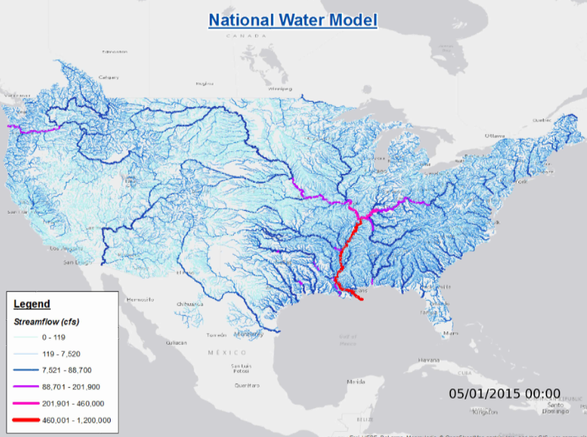
National Water Model Forecasts
Now
Analysis
Best estimate of current conditions
Short Range
Hourly for 18 hours ahead (18 time steps)
Medium Range
3 Hourly for 10 days ahead (80 time steps)
Long Range
Daily for 30 days ahead (30 time steps)
Ensemble of 4 forecasts each 6 hours (24 forecasts total)

Slide 13
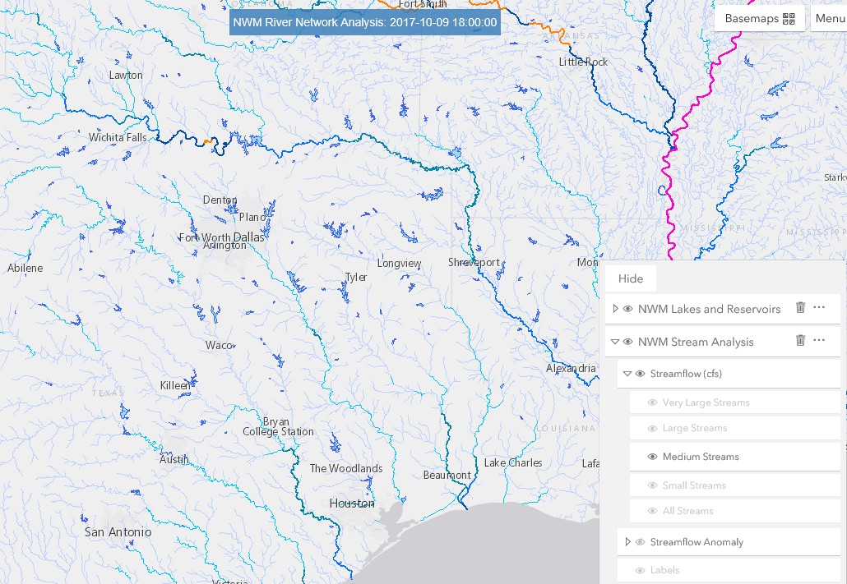
NWM Forecast Viewer
http://water.noaa.gov/map

Slide 14
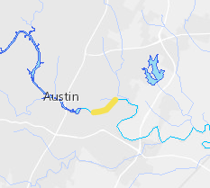
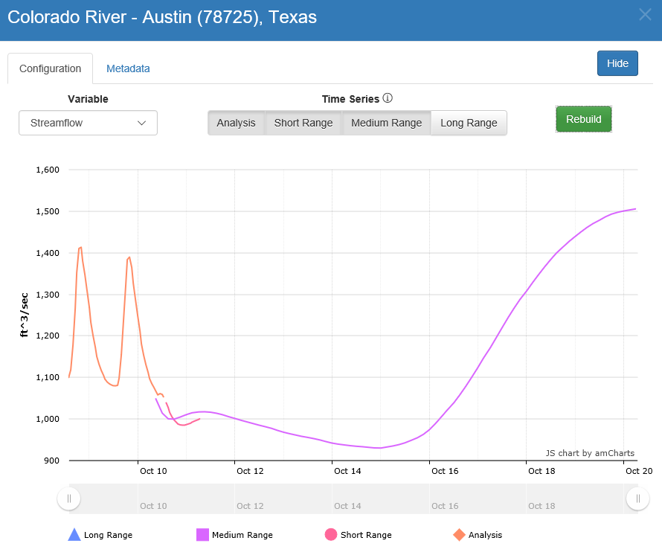
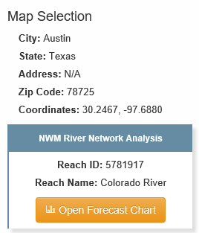
Streamflow Forecast
http://water.noaa.gov/map

Slide 15
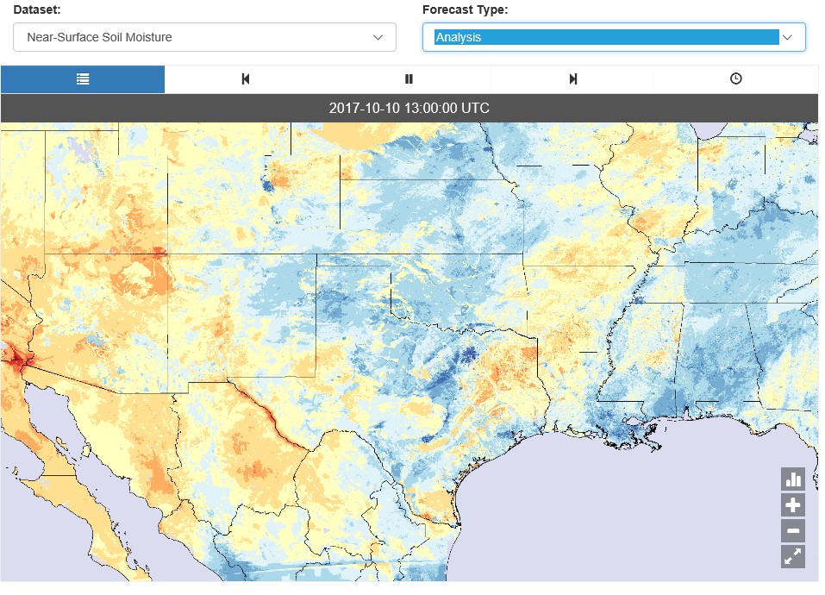
Soil Moisture: Current Conditions
Analysis model
http://water.noaa.gov/tools/nwm-image-viewer

Slide 16
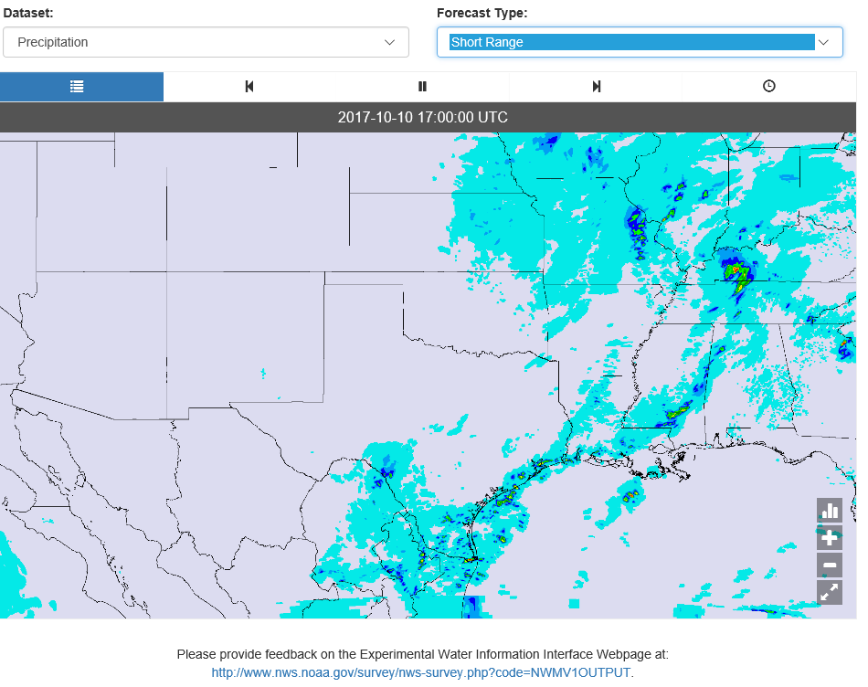
Precipitation: Short Range Forecast
Hourly data for 18 hours ahead, updated hourly
http://water.noaa.gov/tools/nwm-image-viewer

Slide 17
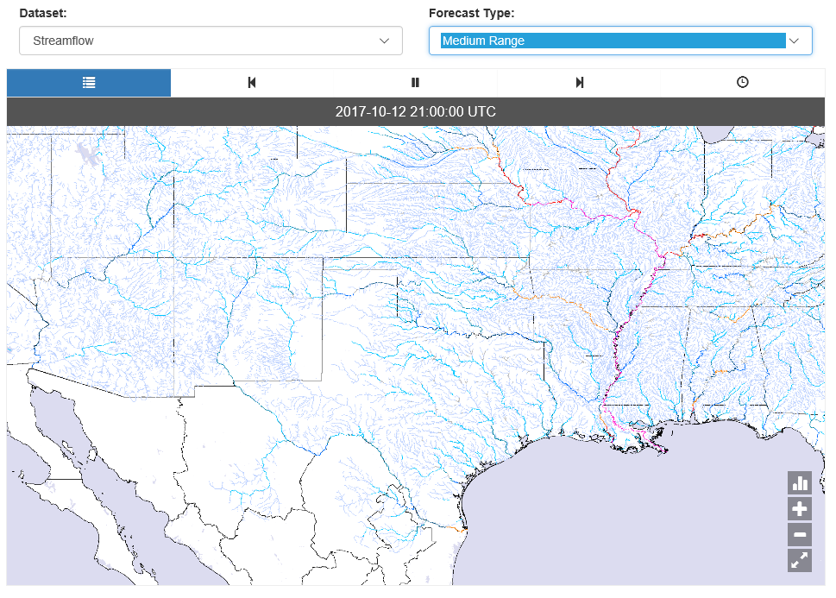
Streamflow: Medium Range Forecast
3-hour data for 10 days ahead, updated each 6 hours
http://water.noaa.gov/tools/nwm-image-viewer

Slide 18
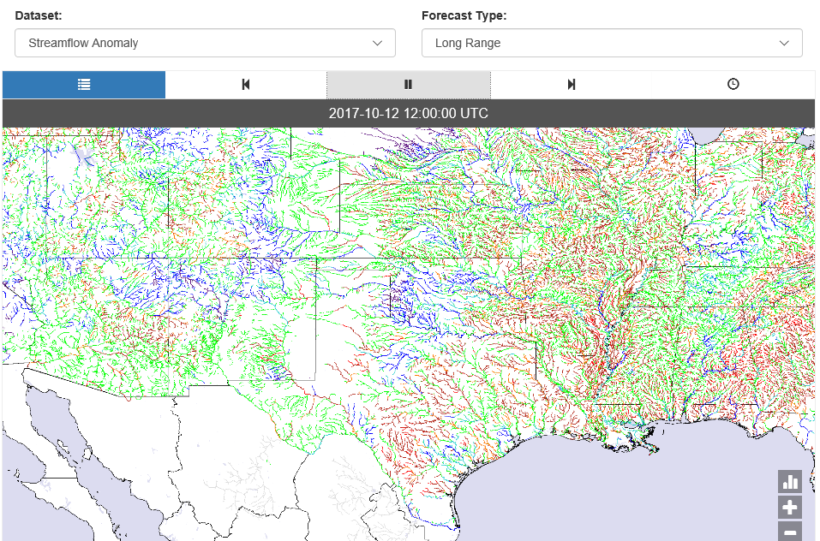
Streamflow Anomaly: Long Range Forecast
6-hour data for 30 days ahead, updated daily
http://water.noaa.gov/tools/nwm-image-viewer

Slide 19
Readings on Map Projections
What are Map Projections
http://desktop.arcgis.com/en/arcmap/latest/map/projections/what-are-map-projections.htm
Geoid, Ellipsoid, Spheroid and Datum
http://desktop.arcgis.com/en/arcmap/latest/map/projections/about-the-geoid-ellipsoid-spheroid-and-datum-and-h.htm
Geographic Coordinate Systems
http://desktop.arcgis.com/en/arcmap/latest/map/projections/about-geographic-coordinate-systems.htm
Projected Coordinate Systems
http://desktop.arcgis.com/en/arcmap/latest/map/projections/about-projected-coordinate-systems.htm
ArcGIS Pro Help (More about tools than concepts)
https://pro.arcgis.com/en/pro-app/help/mapping/properties/coordinate-systems-and-projections.htm
https://pro.arcgis.com/en/pro-app/help/mapping/properties/specify-a-coordinate-system.htm
https://pro.arcgis.com/en/pro-app/tool-reference/data-management/an-overview-of-projections-and-transformations-toolset.htm

Slide 20
Definition of Latitude, φ
m
S
p
O
n
φ
q
r
(1) Take a point S on the surface of the ellipsoid and define there the tangent plane, mn
(2) Define the line pq through S and normal to the
tangent plane
(3) Angle pqr which this line makes with the equatorial
plane is the latitude φ, of point S

Slide 21
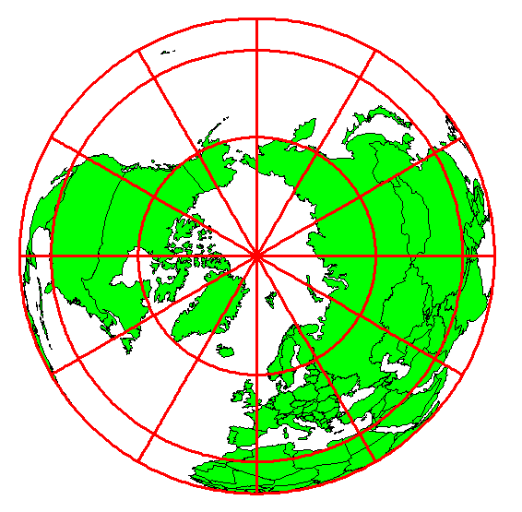
Definition of Longitude, λ
λ = the angle between a cutting plane on the prime meridian
and the cutting plane on the meridian through the point, P
180°E, W
-150°
150°
-120°
120°
90°W
(-90 °)
90°E
(+90 °)
-60°
P
λ
-60°
-30°
30°
0°E, W

Slide 22
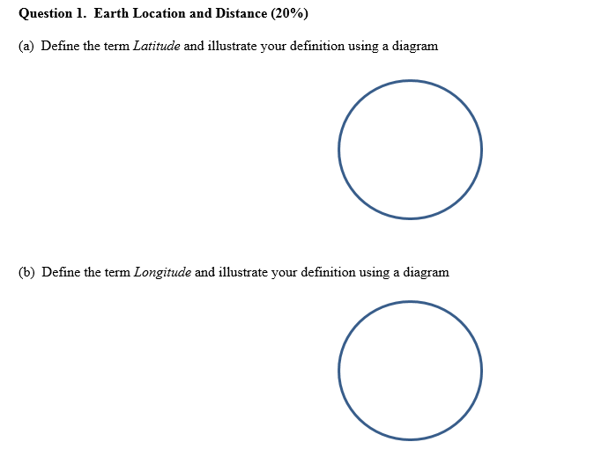
2014 Midterm Questions

Slide 23
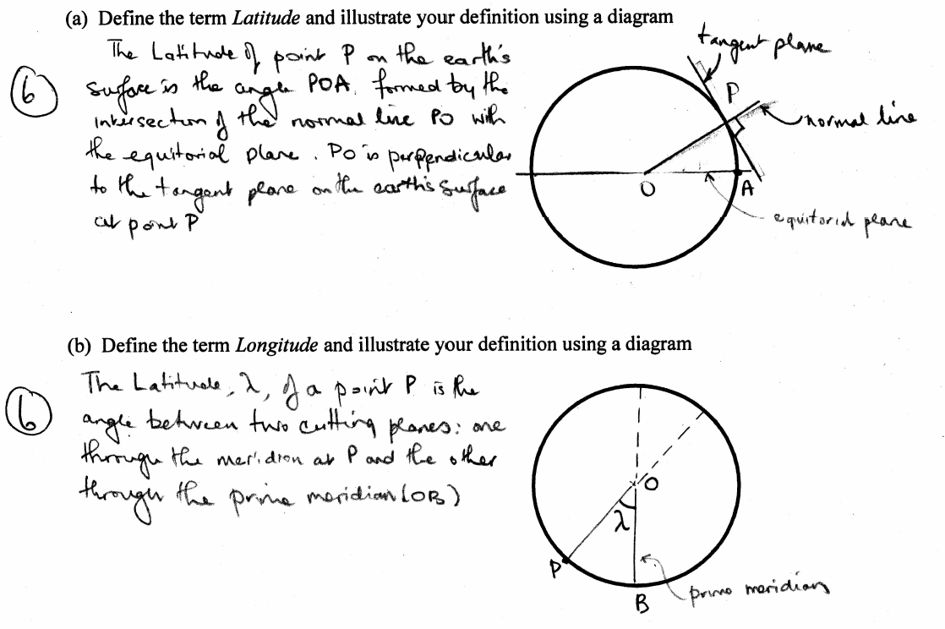

Slide 24
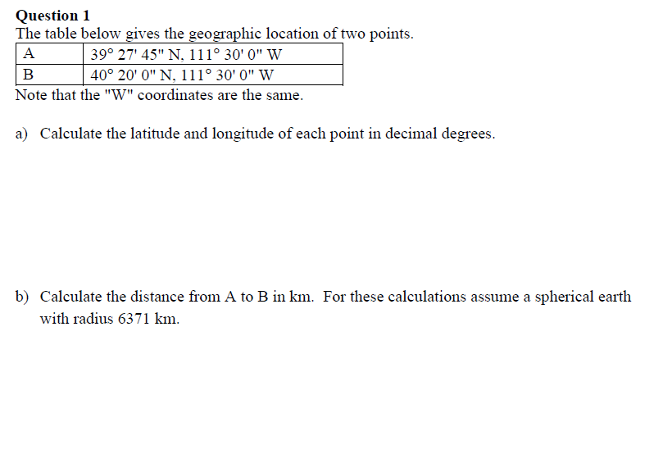
2013 Midterm Questions

Slide 26
Length on Meridians and Parallels
(Lat, Long) = (φ, λ)
Length on a Meridian:
AB = R_{e} Δφ
(same for all latitudes)
R
Δλ
D
30 N
R
C
R_{e}
Δφ
B
0 N
R_{e}
Length on a Parallel:
CD = R Δλ = R_{e} Δλ Cos φ
(varies with latitude)
A

Slide 27
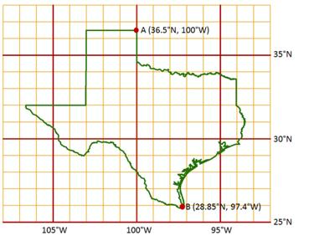
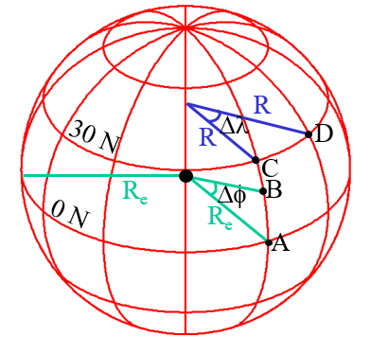
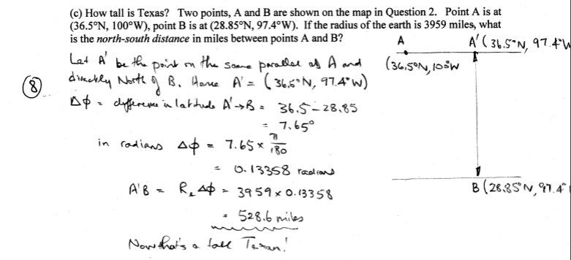
Calculating Length on Meridians and Parallels

Slide 28
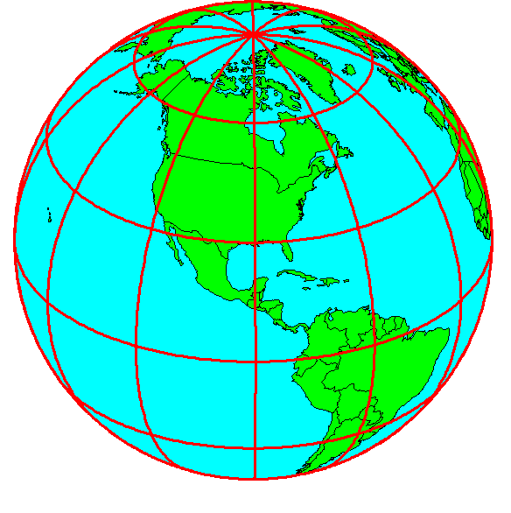
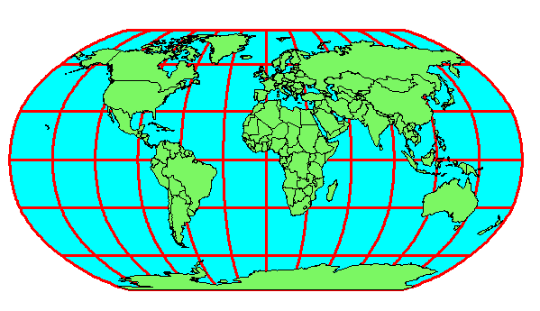
Geospatial Reference Frames
Requires definition of (1) an earth datum (spheroid); (2) a map projection to convert the spheroidal earth to a flat map; (3) a coordinate system to use on the map
Y
Origin
X
(x_{o},y_{o})
(φ_{o},λ_{o})

Slide 29
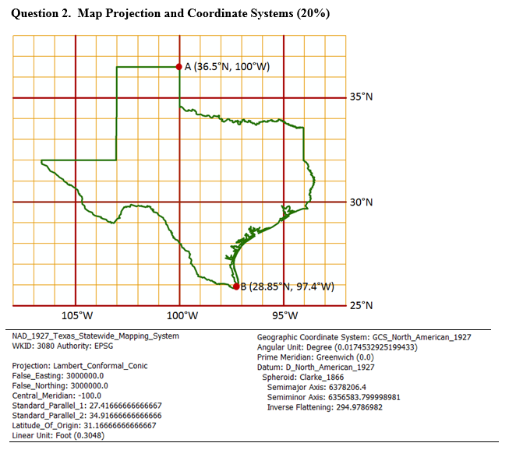
Describing a Geospatial Reference Frame
A map of Texas and a set of map projection parameters for the state are given above.
(a) Please draw and label on the map: the central meridian, the latitude of origin, and the two standard parallels.
(b) Give the numerical values (in degrees and minutes) for (ϕ₀, λ₀):
(c) Give the numerical values for (X₀, Y₀):
(d) What earth datum is used?
(e) What spheroid is used?
(f) What map projection is used?
(g) What are the distance units in the coordinate system?

Slide 30
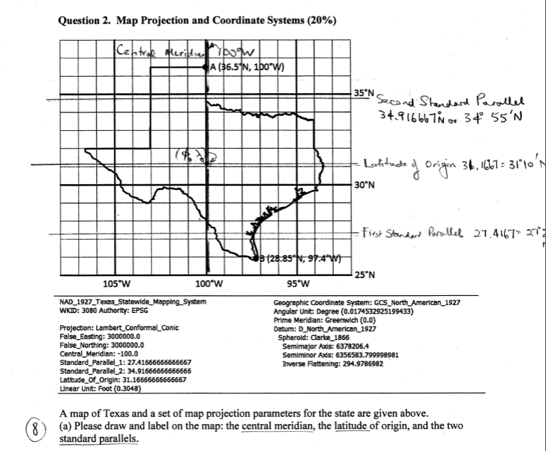

Slide 31
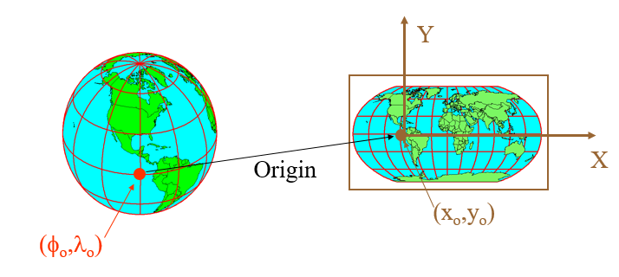
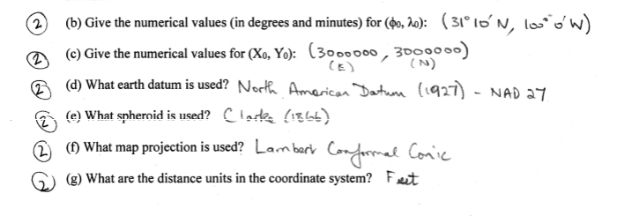

Slide 32
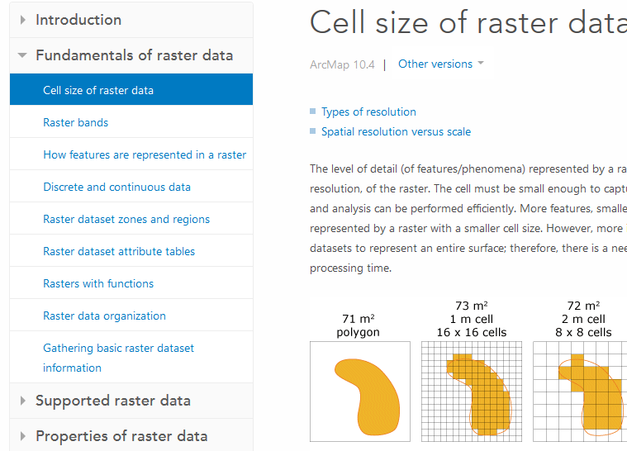
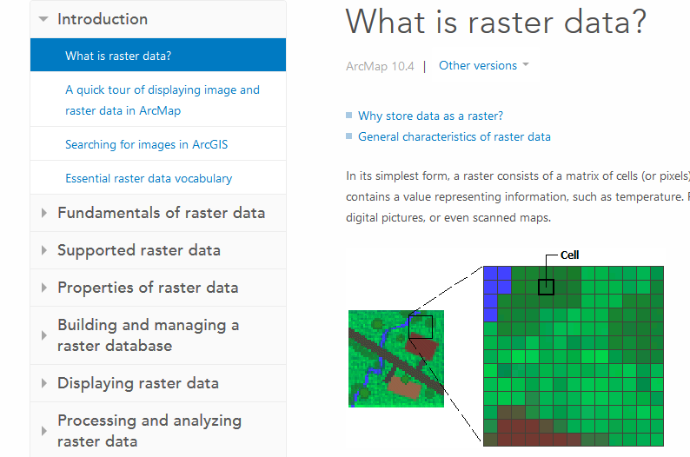
Readings - Theory
ArcMap help: What is raster data? http://desktop.arcgis.com/en/arcmap/latest/manage-data/raster-and-images/what-is-raster-data.htm
ArcMap help: Fundamentals of raster data from Cell size of raster data to Raster dataset attribute tables http://desktop.arcgis.com/en/arcmap/latest/manage-data/raster-and-images/cell-size-of-raster-data.htm

Slide 33
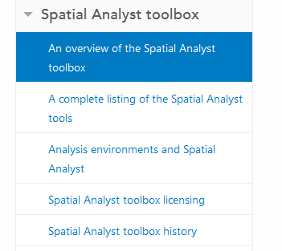
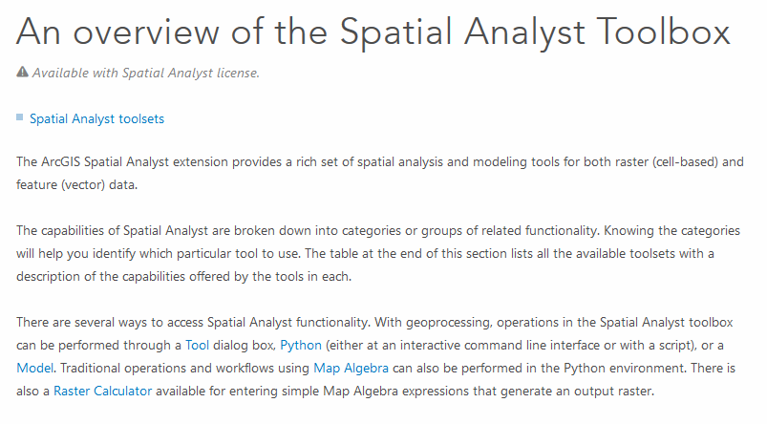
Readings – ArcGIS Pro Tools
ArcGIS Pro An overview of the Spatial Analyst Toolbox https://pro.arcgis.com/en/pro-app/tool-reference/spatial-analyst/an-overview-of-the-spatial-analyst-toolbox.htm.

Slide 34
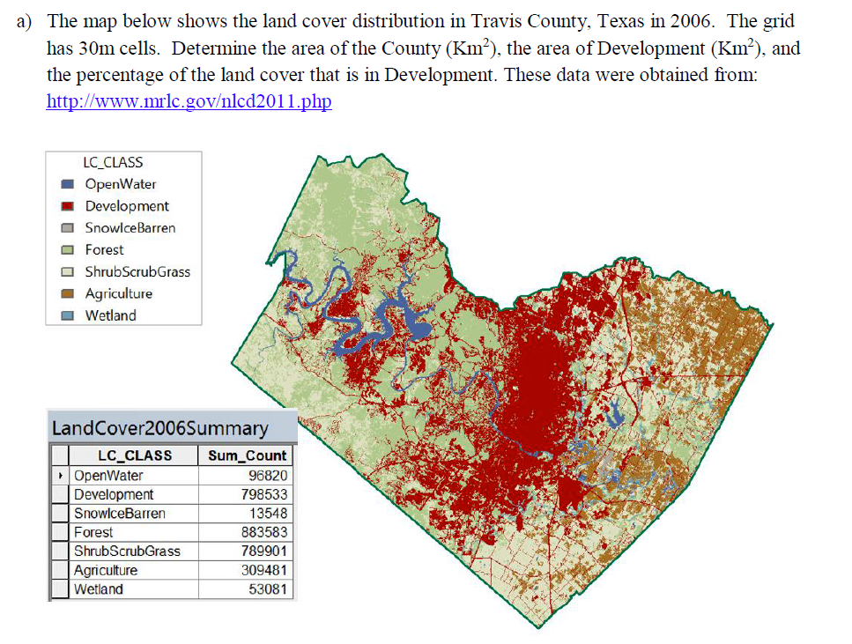
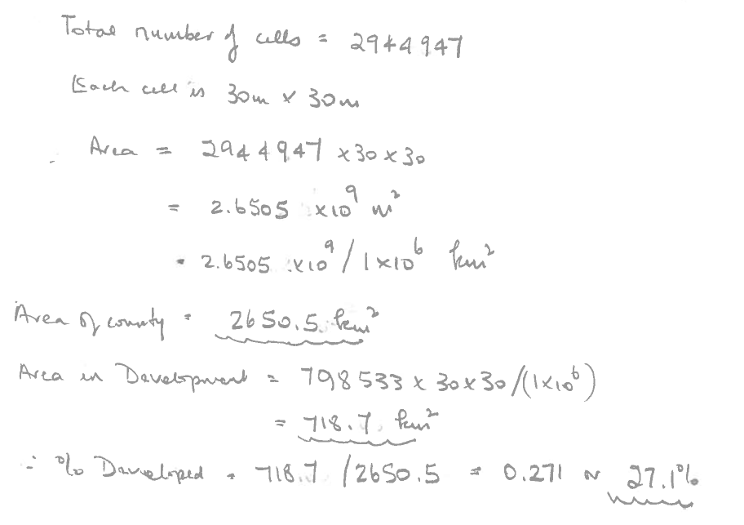

Slide 35
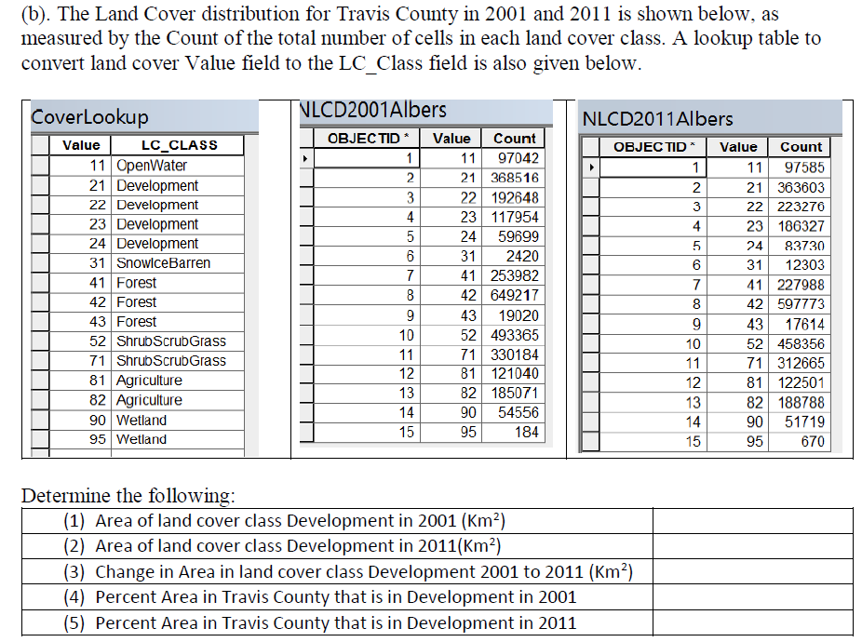
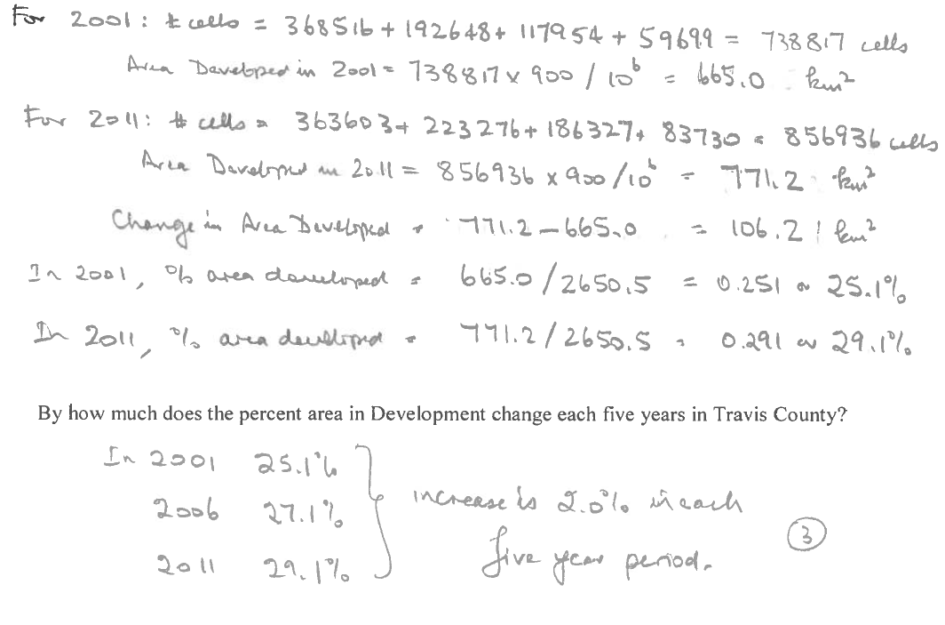
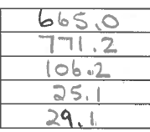

Slide 36
Readings – Slope and Aspect
How Slope Works https://pro.arcgis.com/en/pro-app/tool-reference/spatial-analyst/how-slope-works.htm
How Aspect Works https://pro.arcgis.com/en/pro-app/tool-reference/spatial-analyst/how-aspect-works.htm

Slide 37
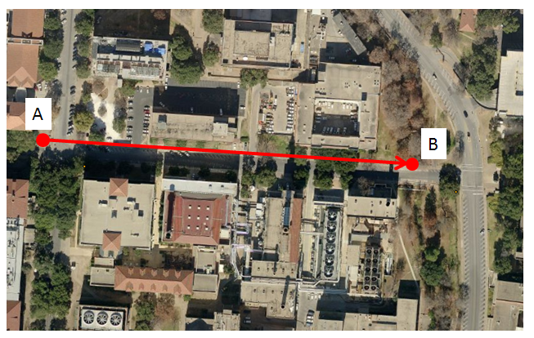
Slope Handout
http://hydrology.usu.edu/dtarb/giswr/2016/Slope.pdf
Determine the length, slope and azimuth of the line AB.

Slide 38
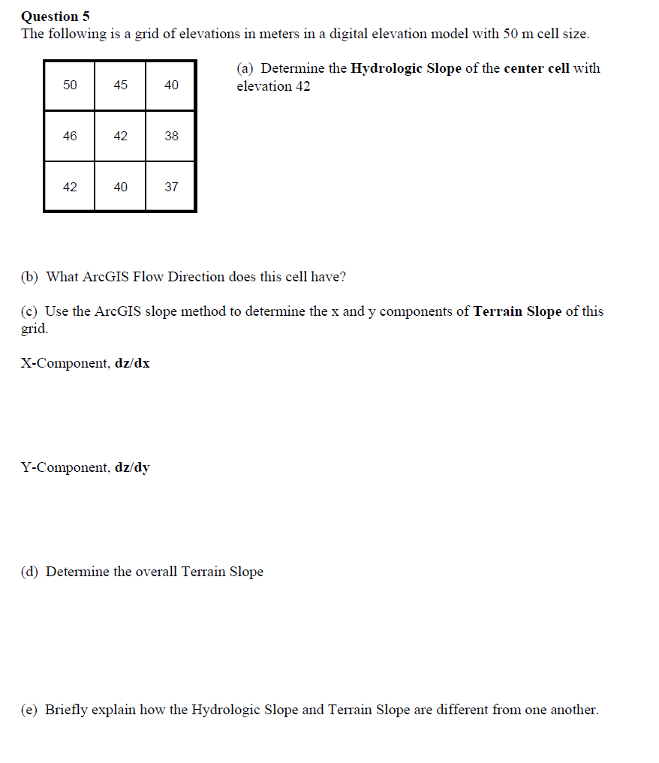
2012 Midterm Question

Slide 39
ArcGIS “Slope” tool
y
a
b
c
$$\frac{\frac{\frac{a−c}{2∆}+\frac{d−f}{2∆}}{2}+\frac{\frac{d−f}{2∆}+\frac{g−i}{2∆}}{2}}{2}$$
$$\frac{dz}{dx}=\frac{\left(a+2d+g\right)−\left(c+2f+i\right)}{8∆}$$
Similarly
$$\frac{dz}{dy}=\frac{\left(g+2h+i\right)−\left(a+2b+c\right)}{8∆}$$
Slope magnitude =
$$\sqrt{{\left(\frac{dz}{dx}\right)}^{2}+{\left(\frac{dz}{dy}\right)}^{2}}$$
d
e
f
g
h
i
x
$$\frac{a−c}{2∆}$$
$$\frac{d−f}{2∆}$$
c
$$\frac{g−i}{2∆}$$
$$∆$$
b
f
a
e
i
d
h
g
$$2∆$$
x
y

Slide 40
ArcGIS Aspect – the steepest downslope direction
$$Δy=$$
$$Δx=$$
$$Δx$$
Use atan2 to resolve ambiguity in atan direction
$$Δy$$
$$α$$
$$−Δx$$
$$−Δy$$
$$α+{180}^{o}$$

Slide 41
Example
30
a
b
c
80
74
63
d
e
f
145.2º
69
67
56
g
h
i
60
52
48

Slide 42
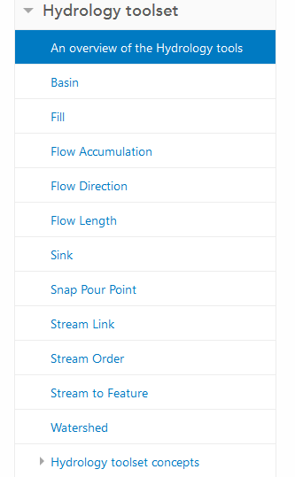
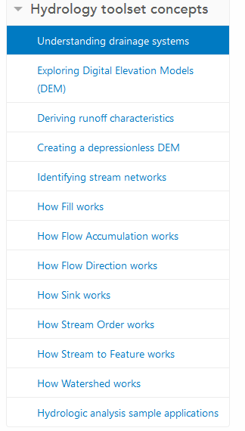
Digital Elevation Model Based Watershed and Stream Network Delineation
Reading
https://pro.arcgis.com/en/pro-app/tool-reference/spatial-analyst/an-overview-of-the-hydrology-tools.htm
How to use
Understanding

Slide 44
Pit Filling
Original DEM
Pits Filled
Pits
Pour Points
Grid cells or zones completely surrounded by higher terrain
The lowest grid cell adjacent to a pit
Notes:
Elevations are filled to that of the pools pour point

Slide 45
Hydrologic Slope
- Direction of Steepest Descent
30
30
80
74
63
80
74
63
69
67
56
69
67
56
60
52
48
60
52
48
Slope:

Slide 46
13
9
9

Slide 48
Flow Accumulation Grid.
Area draining in to a grid cell
0
0
0
0
0
0
0
0
0
0
0
2
2
2
0
0
2
2
2
0
0
0
10
0
1
0
0
1
0
10
1
0
0
14
0
1
0
0
0
14
0
4
1
19
1
0
4
1
1
19
ArcHydro Page 72

Slide 49
Stream Network for 10 cell Threshold Drainage Area
Flow Accumulation > 10 Cell Threshold
0
0
0
0
0
0
0
0
0
0
0
2
2
2
0
0
2
2
2
0
0
0
10
0
1
0
0
1
0
10
1
0
0
14
0
1
0
0
0
14
0
4
1
19
1
0
4
1
1
19

Slide 50
Watershed Draining to Outlet
Watershed mapped as all grid cells that drain to an outlet
Streams mapped as grid cells with flow accumulation greater than a threshold

Slide 51
Watershed and Stream Grids
Watershed mapped as all grid cells that drain to an outlet
Streams mapped as grid cells with flow accumulation greater than a threshold

Slide 54
Raster calculation and resampling
Resampling or interpolation (and reprojection) of inputs to target extent, cell size, and projection within region defined by analysis mask
+
=
Analysis mask
Analysis cell size
Analysis extent

Slide 57
Subwatershed Precipitation by Thiessen Polygons
Thiessen Polygons
Intersect with Subwatersheds
Evaluate A*P Product
Summarize by subwatershed
$$P_{i}=\frac{\sum_{k}{A_{ik}P_{k}}}{\sum_{k}{A_{ik}}}$$

Slide 58
Real-Time Flood Inundation Mapping
Black Warrior River
at Oliver Lock and Dam
Flooding
Major
Moderate
Minor

Slide 59
Flood Inundation Mapping – NHDPlus-HAND Method
Water surface elevation
h = z + y
y
NHDPlus
h
z
Geodetic datum
Catchments and Flowlines
Height Above Nearest
Drainage (HAND) (relative elevation of land
surface cell above cell in
NHDPlus stream to which it flows)
Inundation map Height above
drainage < 15 ft)
Digital Elevation Model

Slide 60
Height above Nearest Drainage (HAND) evaluated using TauDEM Dinfinity Vertical Distance Down function
TauDEM Distance Down and Distance Up
Ridge
sr
sr
pr
pr
vr
Point of interest
Stream
ps
ps
ss
vs
ss
D∞
hr
hs
hr
hs
Vertical distance to stream evaluated as weighted average over multiple flow paths. This results in a “smooth” height above nearest stream layer
You should be able to interpret DEM elevations to be able to identify the height above the nearest stream and area of inundation

