Slide 1
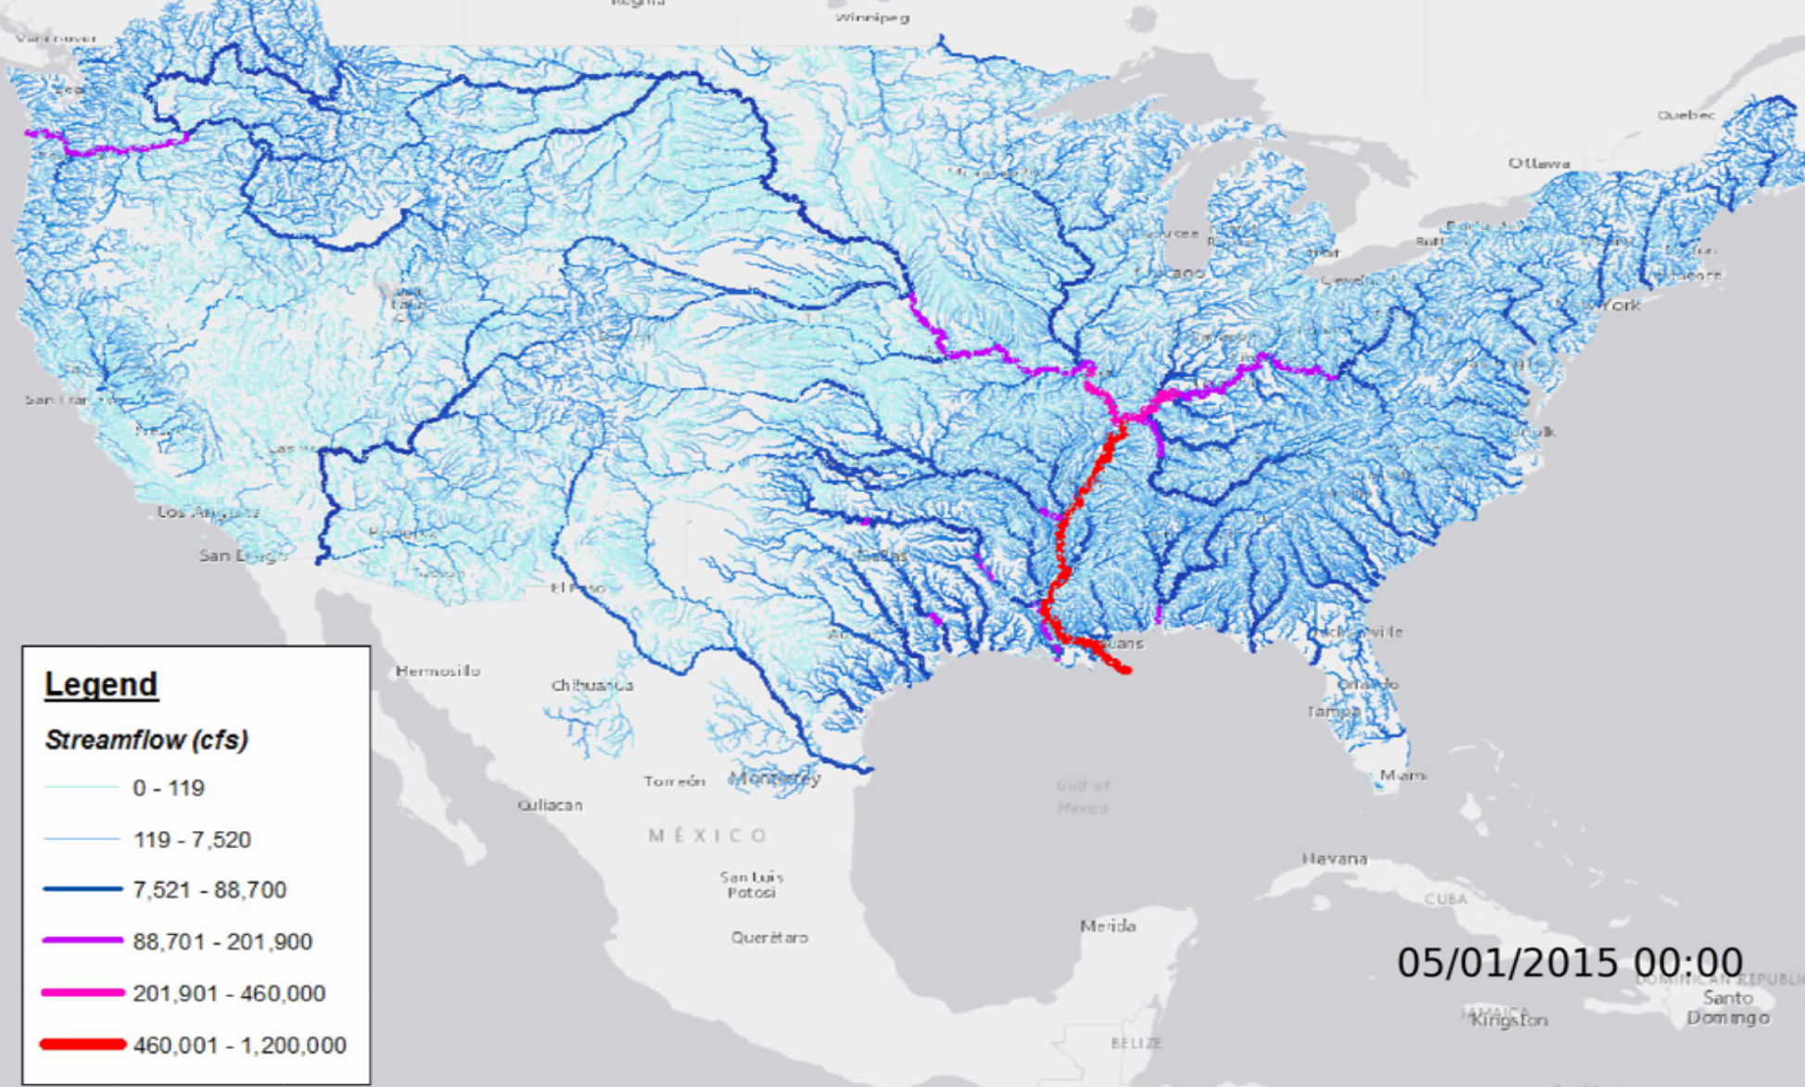
National Water Model
David R. Maidment
Center for Research in Water Resources
University of Texas at Austin
Acknowledgments: Slides in this presentation come from Tom Graziano and Brian Cosgrove of
NWS and David Gochis of NCAR

Slide 2
Web Links for the National Water Model
National Water Model Viewer: http://water.noaa.gov/tools/nwm-image-viewer
National Water Model forecasts at points:
Ftp site for National Water Model Results: ftp://ftpprd.ncep.noaa.gov/pub/data/nccf/com/nwm/prod/
Hydroshare Map for Geospatial Data: http://arcg.is/1JW0DBm
http://water.noaa.gov/map

Slide 3
Forecasts
Now
Analysis
Best estimate of current conditions
Short Range
Hourly for 18 hours ahead (18 time steps)
Medium Range
3 Hourly for 10 days ahead (80 time steps)
Long Range
Daily for 30 days ahead (30 time steps)
Ensemble of 4 forecasts each 6 hours (24 forecasts total)

Slide 4
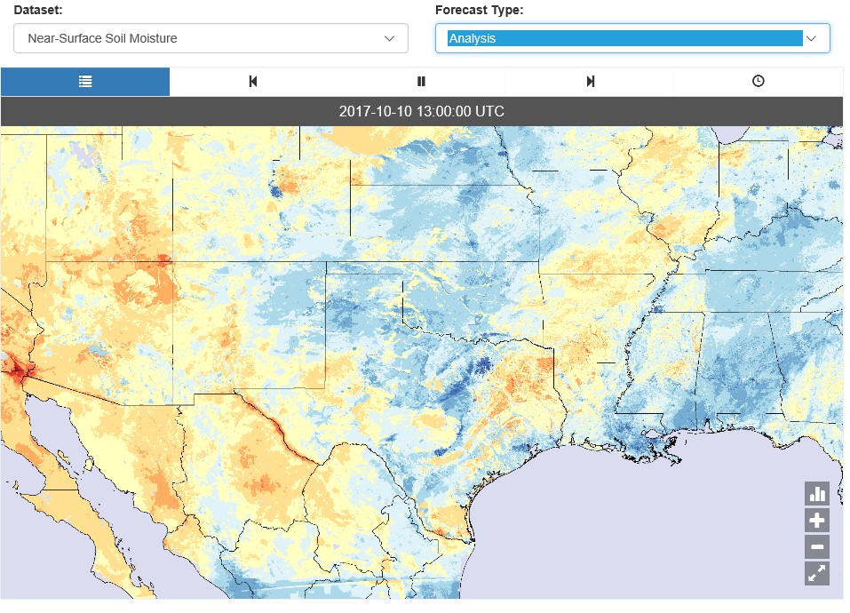
Soil Moisture: Current Conditions
Analysis model
http://water.noaa.gov/tools/nwm-image-viewer

Slide 5
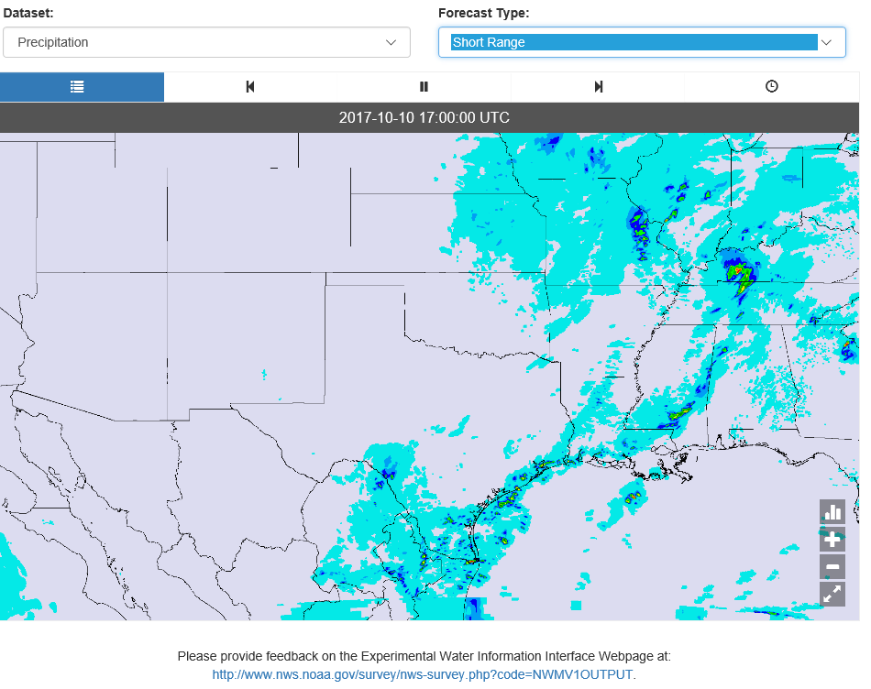
Precipitation: Short Range Forecast
Hourly data for 18 hours ahead, updated hourly
http://water.noaa.gov/tools/nwm-image-viewer

Slide 6
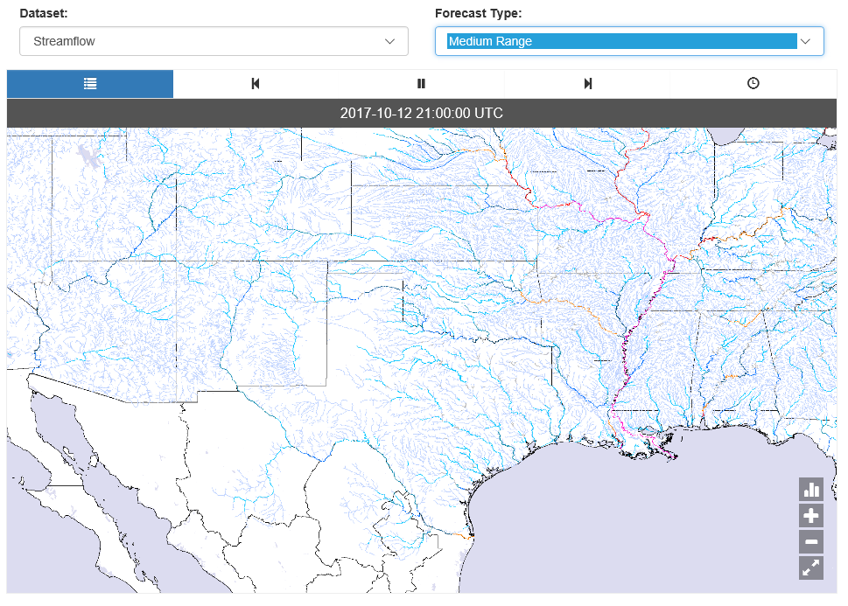
Streamflow: Medium Range Forecast
3-hour data for 10 days ahead, updated each 6 hours
http://water.noaa.gov/tools/nwm-image-viewer

Slide 7
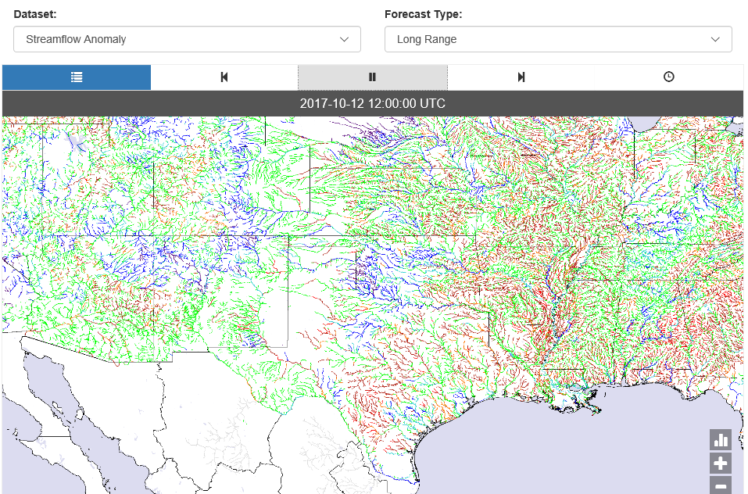
Streamflow Anomaly: Long Range Forecast
6-hour data for 30 days ahead, updated daily
http://water.noaa.gov/tools/nwm-image-viewer

Slide 8
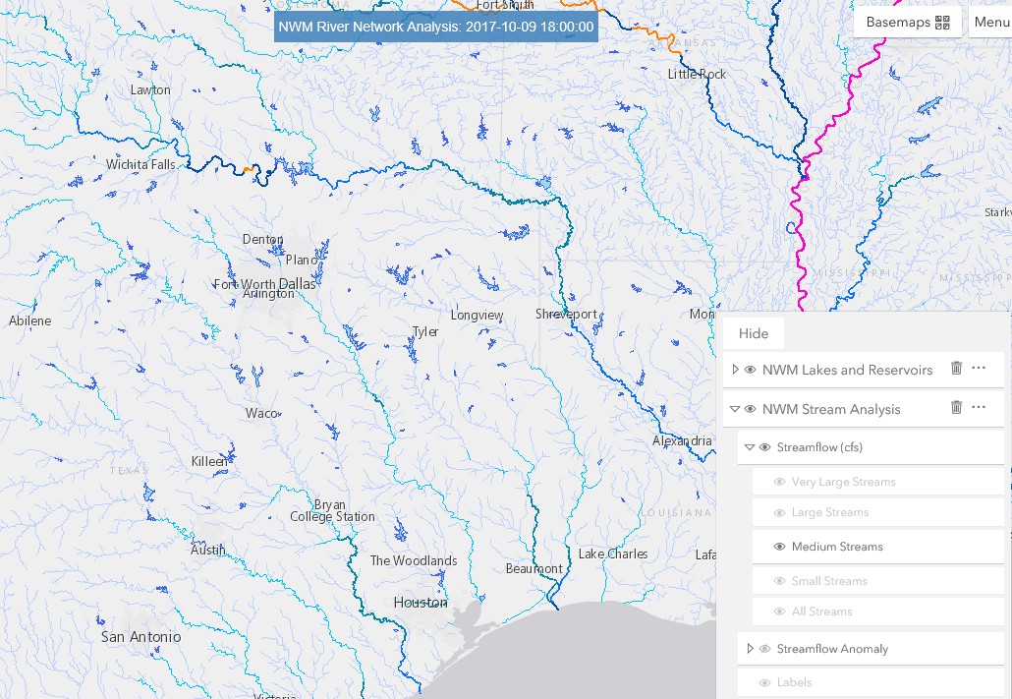
NWM Forecast Viewer
http://water.noaa.gov/map

Slide 9
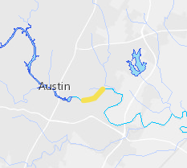
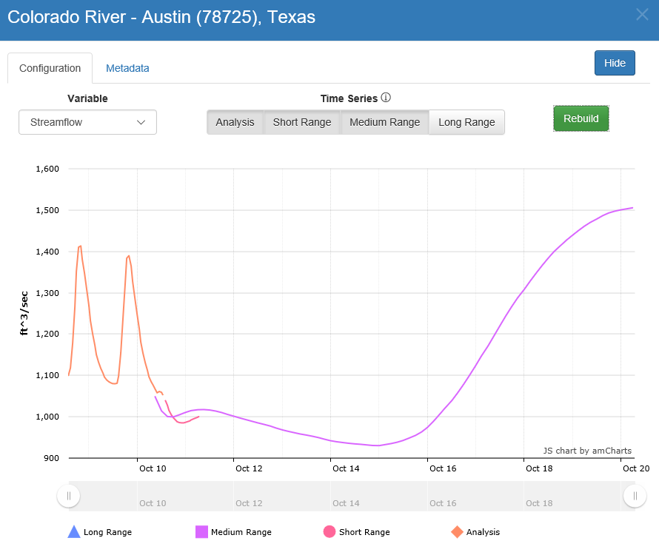
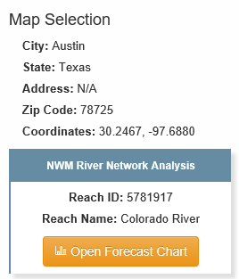
Streamflow Forecast
http://water.noaa.gov/map

Slide 10
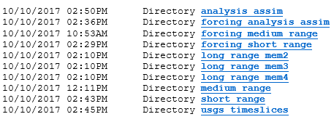
FTP Site for Model Results
ftp://ftpprd.ncep.noaa.gov/pub/data/nccf/com/nwm/prod/
Today and yesterday

Slide 11
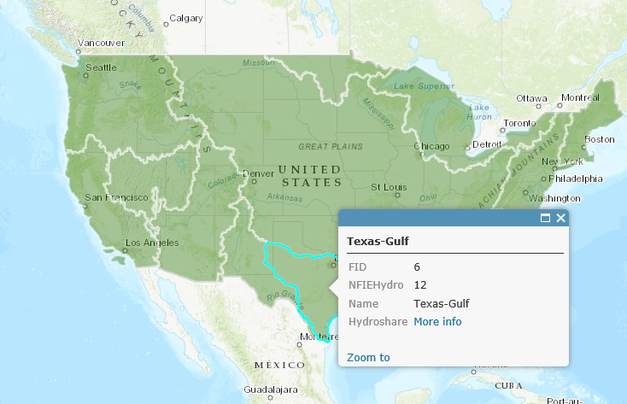
Geospatial data for NWM
http://arcg.is/1JW0DBm

Slide 12
NWM Geospatial Data in Hydroshare

Slide 13
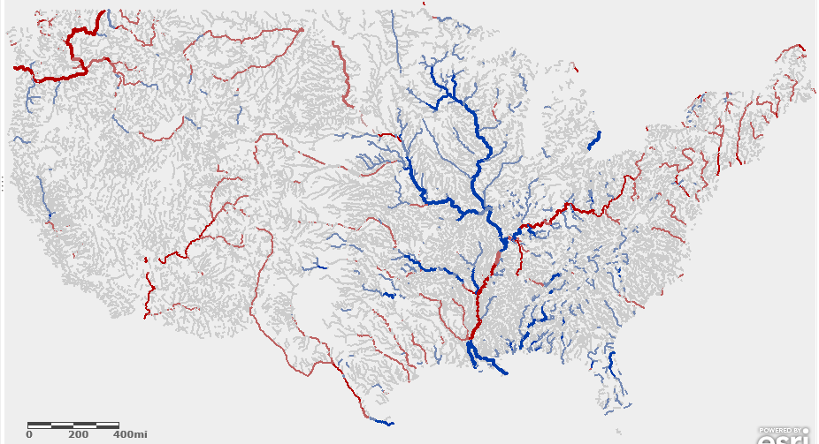
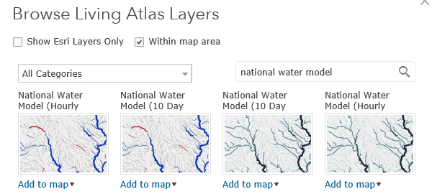
NWM in ArcGIS Online

Slide 14
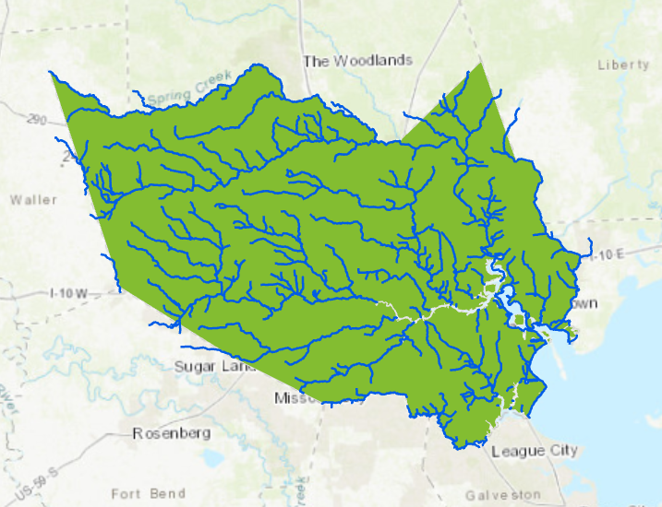
Water Balance for Harris County during Hurricane Harvey
(a work in progress)
Change in Storage = Precipitation – Evaporation + Inflow - Outflow

Slide 15
TRANSFORMING
NOAA Water
Prediction
Informing Decisions for a Water-Prepared Nation
National Water Model (NWM)­ Outyear Enhancements and Upgrade Planning Meeting
Tom Graziano
Acting Director, National Water Center
National Weather Service, NOAA
Notes:
Total Water Prediction is NOAA’s comprehensive approach to improving the Nation’s resilience to water issues, whether too much, too little, or poor quality.
It’s about providing actionable water intelligence that can help drive decision making across a spectrum of socio-economic sectors
It leverages the new National Water Center and the state-of-the-art science and technology from NOAA, other federal partners, and the academic sector

Slide 16
Initial Stakeholder Priorities
Flooding
Water Quality
Water Availability
Drought
Climate Change
Need integrated understanding of near- and long-term outlook and risks
Actionable Water Intelligence
High Resolution, Integrated Water Analyses, Predictions and Data
Transform information into intelligence by linking hydrologic, infrastructural, economic, demographic, environmental, and political data
Notes:
We asked stakeholders “What water issues keep you up at night?”
Essentially, what are the fundamental information and service gaps that need to be addressed to adequately inform the water related decisions they need to make
Once the feedback was distilled, 5 major themes emerged
Fundamentally, stakeholders requested consistent, high fidelity water information for their entire domains of responsibility; and forecasts of more than just flow

Slide 17
Stakeholder Priorities
Relevant to scales of local decision making and infrastructure
Forecast inundation maps depicting street level impacts
Easy Access
Broader Range of Hydrology
(Not just Floods)
Detailed Characteristics of Small Watersheds, Hillslopes
Consistent and Coherent across Large Watersheds
Examples
Total Water Level along Nation’s coasts
Climate Change
Low Flows, Droughts
Prediction Uncertainty
Risk-informed
Relevant to integrated water resource management
Need the same type of information consistently throughout domain
Forecasts of full range of hydrologic parameters
Notes:
The message was loud and clear:
While flooding remains a high priority, most stakeholders are concerned about the full gamut of water
They need more, and better integrated water prediction information
They need actionable WATER INTELLIGENCE
<< CLICK ONCE TO REVEAL LIST >>

Slide 18
Multi-Year Strategic Science and Services Plan
Integrated Water Prediction and the National Water Center (NWC)
FY 19-23
Major Integration
FY 18-22
Water Quality
Key Enhancement
FY 17-21
Dry Side: Drought and Post-Fire
Integrate enhanced NWM with key water quality data sets, models and tools to begin water quality prediction
Incorporate water quality data from federal and State partners into NWM
Link NWM output to NOAA ecological forecasting operations
New decision support services for predicting water quality issues such as Harmful Algal Blooms
New decision support services for emergencies such as chemical spills
NWC operations center expands to include water quality decision support services
Major Integration
FY 16-20
Coastal Total Water Level
Key Enhancement
FY 15-19
Flash Flood and Urban Hydrology
Couple NWM with groundwater and transport models to predict low flows, drought and fire impacts
Add NWM processes that capture subsurface water movement and storage during dry conditions
Add NWM ability to track constituents (e.g. sediment, contaminants, nutrients) through stream network
New decision support services for water shortage situations and waterborne transport
NWC operations center expands to include drought and post-fire decision support services
Core Capability
Couple NWM with marine models to predict combined storm surge, tide, and riverine effects
More complete picture of coastal storm impacts
Summit-to-sea water prediction information linked to geospatial risk and vulnerability
New service delivery model implemented – increased stakeholder engagement and integrated information
NWC operations center opens and provides national decision support services and situational awareness
Centralized Water Forecasting
Enhance NWM with nested hyper- resolution zoom capability and urban hydrologic processes
Heightened focus on regions of interests (e.g. follow storms)
Street level flood inundation forecasts for selected urban demonstration areas
NWC increases guidance to NWS field offices to improve consistency and services for flash floods
National Water Model (NWM) operational [V1.0 July 2016]
Water forecasts for 2.7 million stream reaches
Expand from only flow/stage forecasts to forecasts of full water budget
100 million people get a terrestrial water forecast for first time
Forecasts linked to geospatial informational to provide water intelligence

Slide 19
Transforming NOAA Water Prediction
TODAY | THE FUTURE
Approximately 4000 forecast locations at points | Approximately 2,700,000 forecast stream reaches
Forecast river flow/stage, from summit to coastal zone | Forecast all hydrologic parameters which define the water budget, from summit-to-sea
Driven by large catchment “lumped” modeling | Driven by high resolution Earth System modeling
Forecaster “in the loop” – serial, basin to basin, modeling of flow through the river network | Forecaster “over the loop” – simultaneous modeling of the nation’s entire river network
Average basin size greater than 420 square miles | Average basin size ~1 square mile
13 River Forecast Centers developing separate versions of the same regional model | NOAA, academia, and federal partners developing/evolving same national, community-based model
Impact-based forecasts at selected points | Predictions linked with detailed local infrastructure data to communicate street level impacts
For the hydrology community, the implementation of the NWM and the leap ahead capability it provides parallels the implementation of mesoscale atmospheric models in the 1970s (i.e., model resolution substantially greater than available observational network)
19
Notes:
In summary, NWS water prediction today is done at 4000 locations
These are all stream gage locations
The modeling is done by averaging conditions over large catchments (what we call lumped modeling), and this is rooted in a legacy of when we didn’t have much data or sufficient computers to model the true hydrology explicitly
With the opening of the NWC, we are preparing to provide water predictions at all 2.7 million stream reaches across the CONUS, expanding to Alaska, Hawaii, and Puerto Rico.
This is driven by access to big data, increased availability of supercomputing, and the latest scientific research and development
The NWC is transforming water prediction into the realm of Earth system modeling, and coupling this with comprehensive infrastructural and demographic information to provide water intelligence

Slide 20
Key Elements of the FY15, FY16 and FY17 NOAA Water Initiatives
Enhanced Water Prediction Capability (FY16-20):
Hyper-Resolution Modeling
Enhance NWM with nested hyper-resolution zoom capability to capture urban and other fine-scale hydrologic processes
Heighten focus on regions of interest (e.g. follow storms/issue of the day)
Real-Time Flood Forecast Inundation Mapping
Develop, demonstrate and implement real-time street-level flood inundation forecasts
Provide critical information on areal extent, depth and timing of flood waters
Enhance Impact-Based Water Resources Decision Support Services
Evolve NWM-based guidance to NWS field offices to improve consistency and services for flash floods
Forecasts linked to geospatial information to assess impacts/risks
NWC and NWS field offices generate actionable water intelligence to provide enhanced IDSS at appropriate scales

Slide 21
NWC Innovators Program
Partnership between NWS and the academic community (Interagency Agreement between NSF and NOAA)
Two Thematic Goals
Provide a framework for collaboration between the federal and academic communities that fosters innovation and creativity, and enables a pathway for that innovation to transition into operational water prediction
Target emerging technologies such as advanced water resources modeling capabilities, cutting edge data and interoperability services, or interdisciplinary techniques aligned with NOAA and the NWC’s strategic Science and Service

Slide 22
National Flood Interoperability Experiment (NFIE) (Sept 2014 to August 2015)
First instance of the NWC Innovators Program
Included 3 Summer Institutes for 105 graduate students from 49 Universities at the National Water Center on the University of Alabama Campus and NWC
Demonstrated ability to simultaneously model the entire continental United States river network at high spatial resolution, in near real-time for 2.7 million stream reaches
Developed capability for continental scale flood inundation mapping

Slide 23
The National Water Model Version 1.0
Operational and Technical Overview
Brian Cosgrove (NWC)
David Gochis (NCAR)
Large integrated NWC and NCAR team

Slide 24
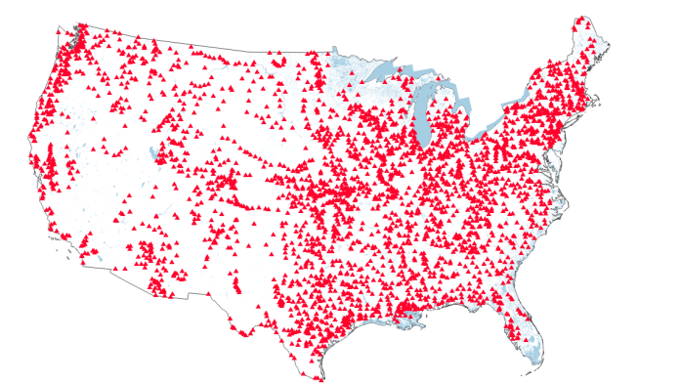
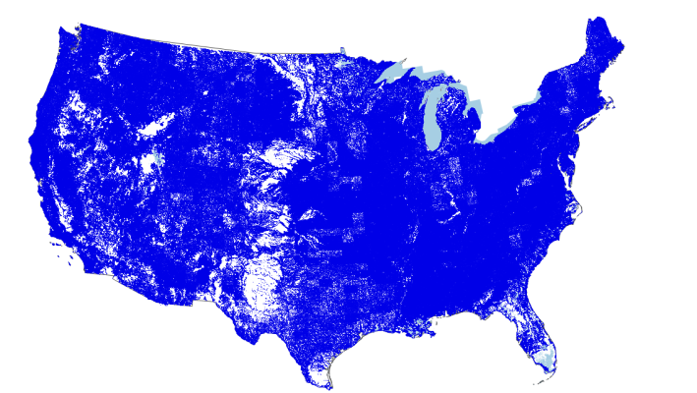
National Water Model Version 1.0
National hydrologic model being put into NWS operations via NWC/NCAR/NCEP partnership, 6/28 implementation
Utilizes community WRF-Hydro model as core
Establishes a solid foundation supporting year-over-year growth in operational hydrologic forecasting capability
Goals for version 1.0 (three year project accelerated into one year)
Provide forecast streamflow guidance for underserved locations
Produce spatially continuous national hydrologic states
Implement a modeling architecture that permits rapid infusion of new data and science, allows for geointelligence linkages
Current River Forecast Points (~3,600)
NWM Forecast Points (~2.7 mil)
+
24

Slide 25
NWM V1.0 Operational Configuration
Analysis & Assimilation
Short-Range
Medium-Range
Long-Range
Cycling Frequency
Hourly
Hourly
Daily
Daily Ens (16 mem)
Forecast Duration
- 3 hrs
0-15 hours
0-10 days
0-30 days
Meteorological Forcing
MRMS blend/ HRRR/RAP bkgnd.
Downscaled HRRR/RAP blend
Downscaled GFS
Downscaled & bias-corrected CFS
Spatial Discretization & Routing
1km/250m/NHDPlus Reach
1km/250m/NHDPlus Reach
1km/250m/NHDPlus Reach
1 km/NHDPlus Reach
Assimilation of 8k USGS Obs
Reservoirs (1240 water bodies parameterized with level pool scheme)
25
Notes:
BC
Note: Forecast range of HRRR currently 15 hours – we list short-range forecast on this graphic as 0-18 hours based upon pending extension of HRRR forecast range to 18 hours (which will occur just before or just after NWM implementation)
Utilizing direct atmospheric model output to force the NWM underscores the need for accurate and unbiased forcing data, particularly QPF

Slide 26
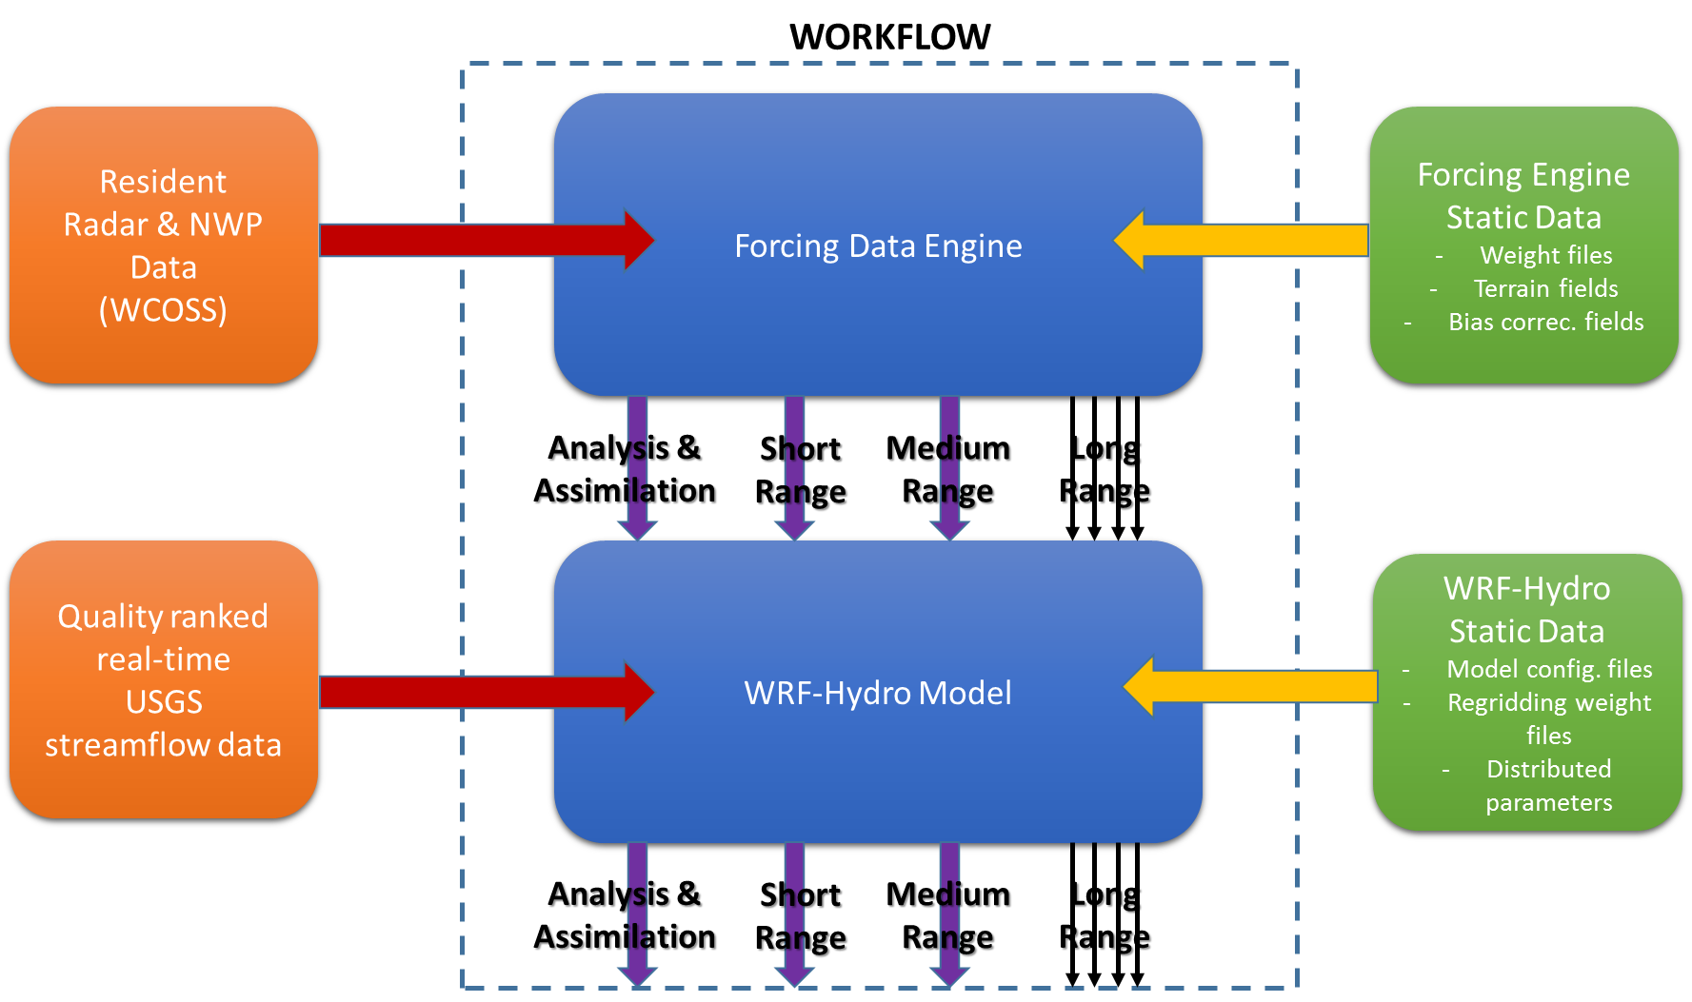
National Water Model Version 1.0: Workflow
26

Slide 27
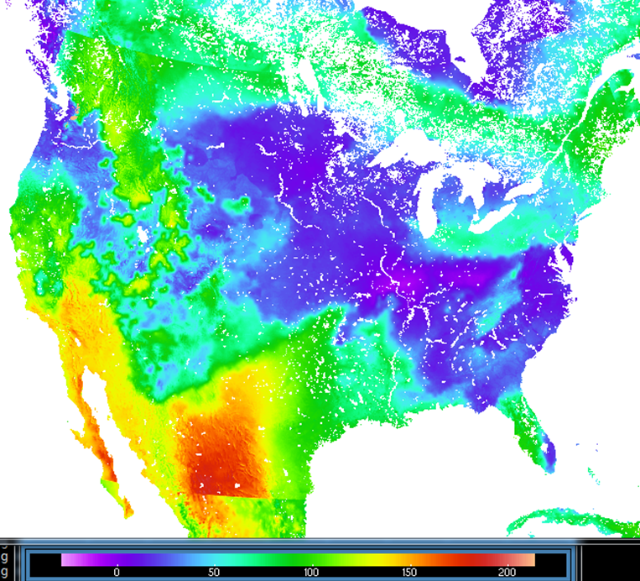
National Water Model Version 1.0: Forcing Data
HRRR-RAP incoming longwave radiation
GFS – derived incoming shortwave radiation
27

Slide 28
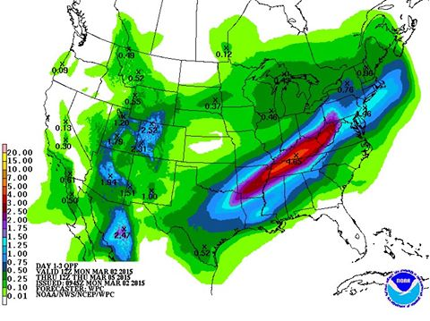
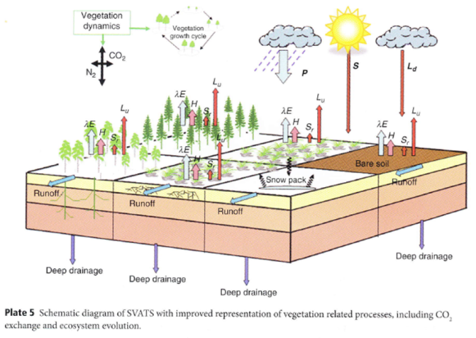
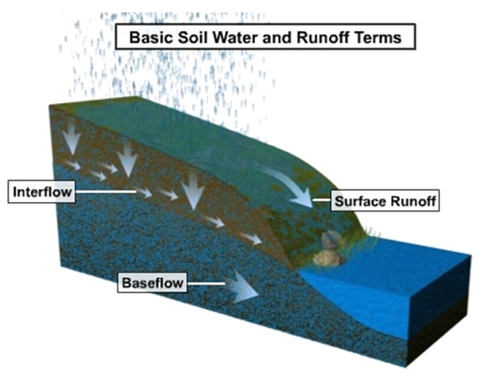
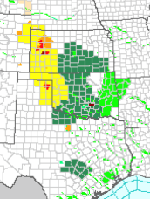
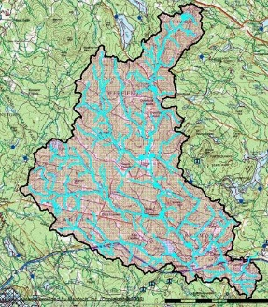
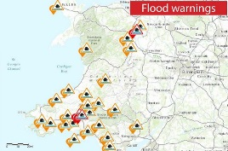
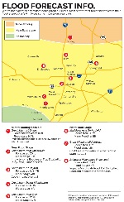
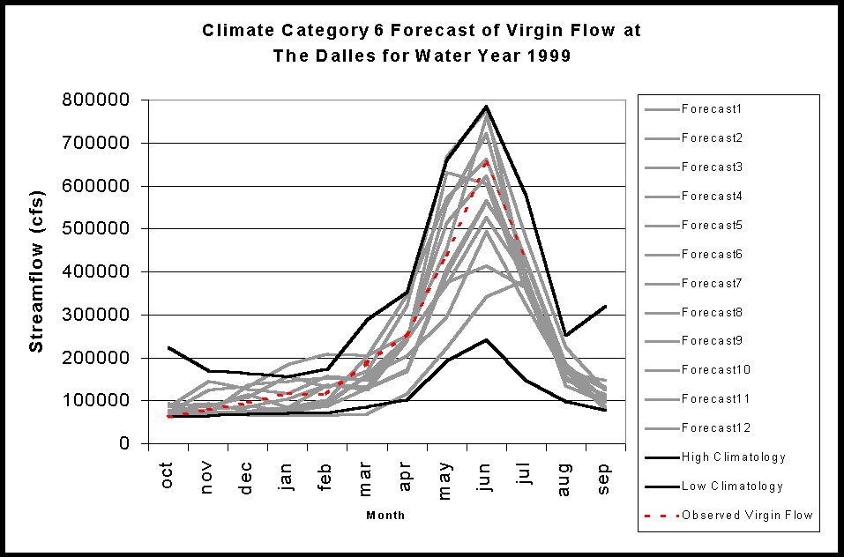
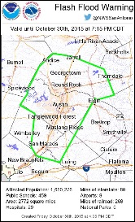
1. WRF-Hydro Forcing Engine
(1 km grid)
National Water Model:
Model Chain
(Analysis, Short and Medium Range Configurations)
2. NoahMP LSM
(1 km grid)
3. Terrain Routing
Module
(250 m grid)
2-way coupling
4. NHDPlus Catchment
Aggregation
(2.6M unique
catchments and
river reaches)
5. Channel &
Reservoir
Routing
Modules
USGS Streamflow
Data Assimilation
Forecast
Products

Slide 29
1. WRF-Hydro Forcing Engine
(1 km grid)
National Water Model:
Model Chain
(Long Range Configuration)
2. NoahMP LSM
(1 km grid)
3. Terrain Routing
Module
(250 m grid)
4. NHDPlus Catchment
Aggregation
(2.6M unique
catchments and
river reaches)
5. Channel &
Reservoir
Routing
Modules
Forecast
Products

Slide 30
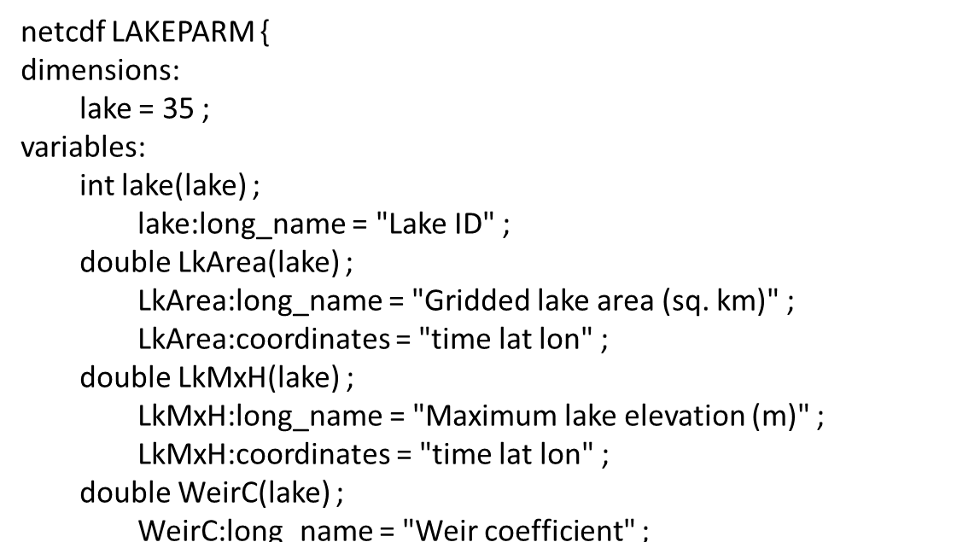
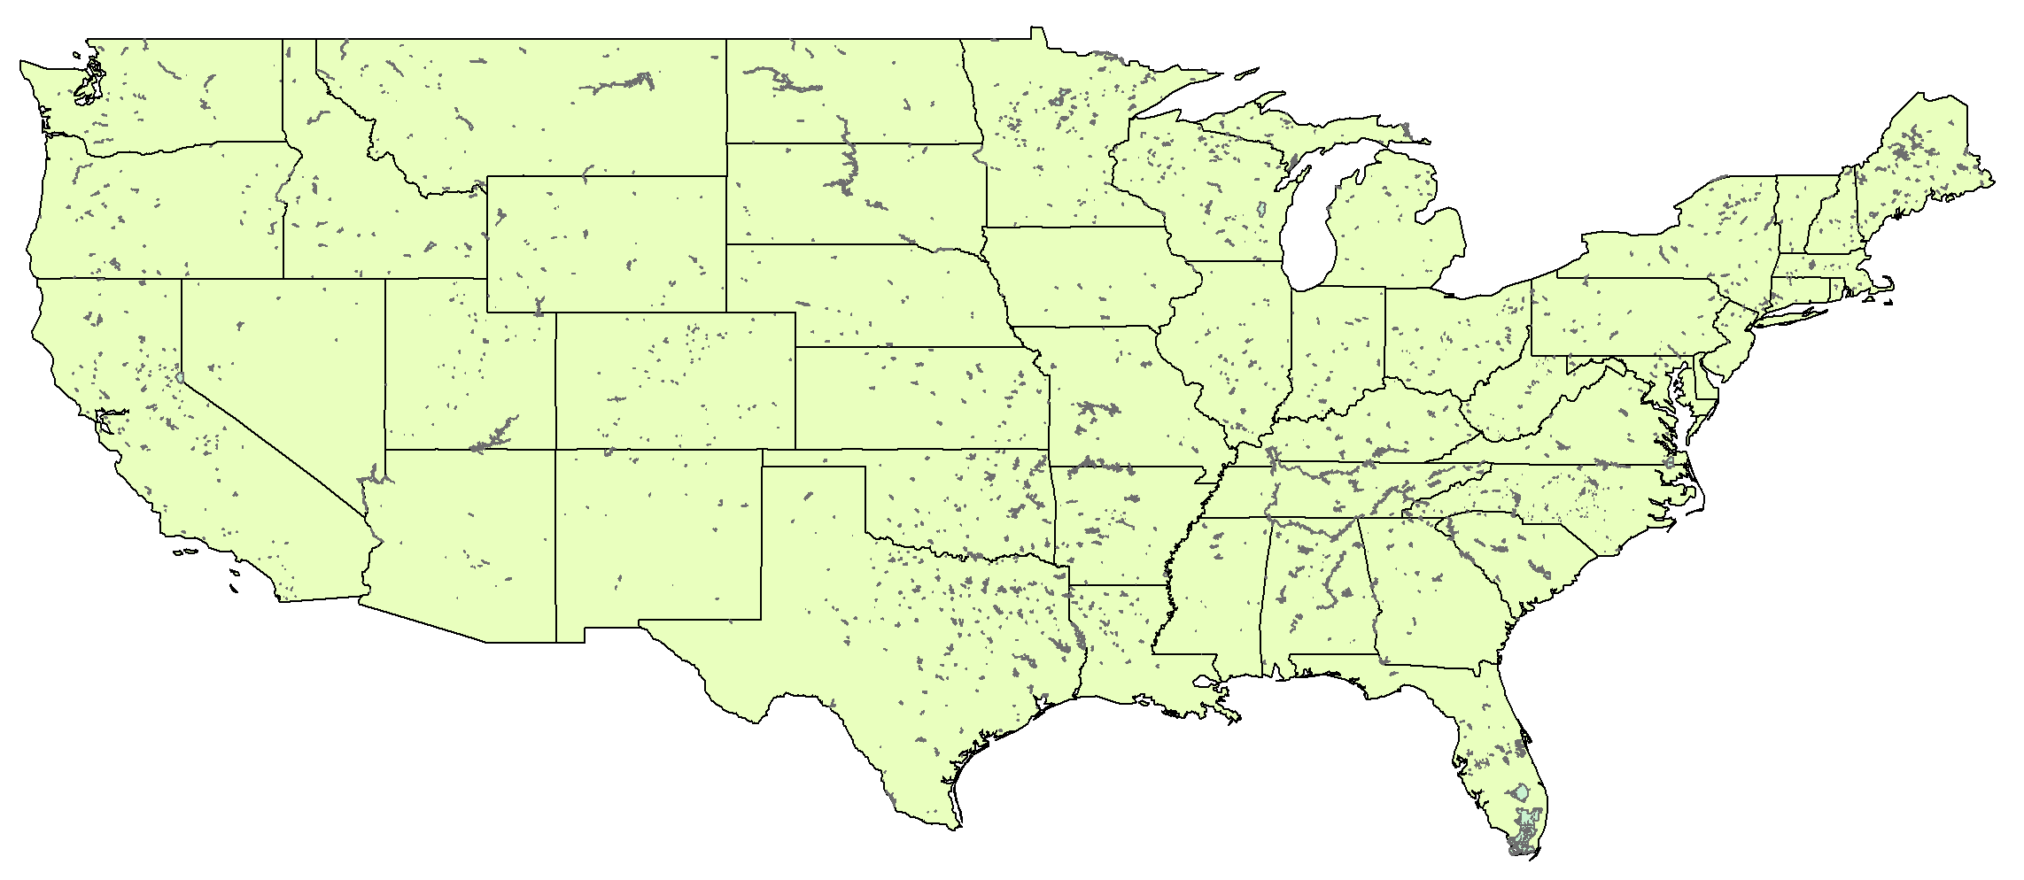
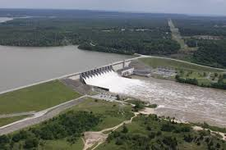
National Water Model Version 1.0: Reservoirs
1,260 NHDPlus water bodies
Specified spillway characteristics (length, height)

Slide 31
WRF-Hydro IOC System: Land Surface Model Outputs
Total Column % Saturation (“SOILSAT”): Sept. 13, 2013

Slide 32
WRF-Hydro IOC System: Land Surface Model Outputs
Snow Water Equivalent (SNEQV): March 1, 2015

Slide 33
WRF-Hydro IOC System: Land Surface Model Outputs
Depth to Shallow Water Table (m): Apr 18, 2016

Slide 34
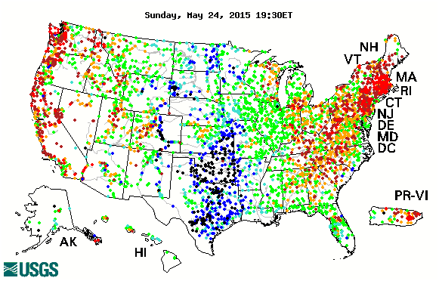
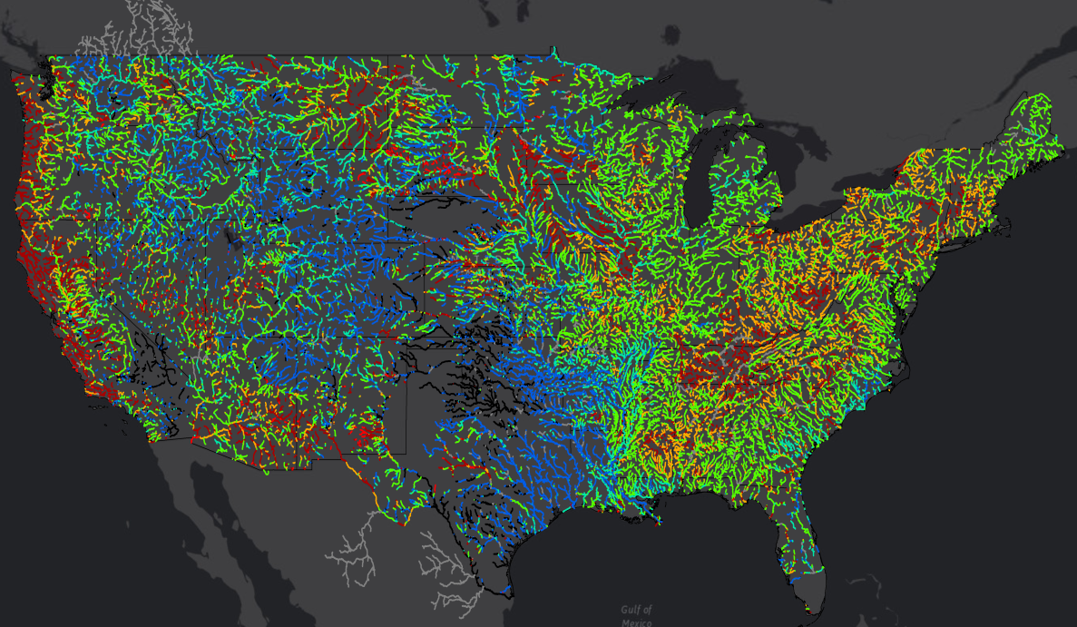
Initial NWM CONUS Evaluations: Streamflow Percentile Anomalies
Observed USGS Gauge Anomalies May 24, 2015 19:30ET
NWM Analysis and Assimilation (Simulated) Anomalies May 24, 2015 00:00Z
Key Points
Pattern of NWM simulated anomaly values broadly matches USGS observations
NWM Anomaly computation not self-referencing, produces artifacts
NWM analysis fills in “gaps” in hydrologic situational awareness
34
34

Slide 35
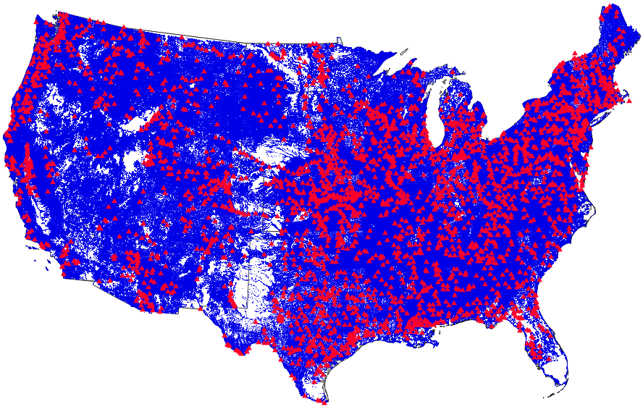
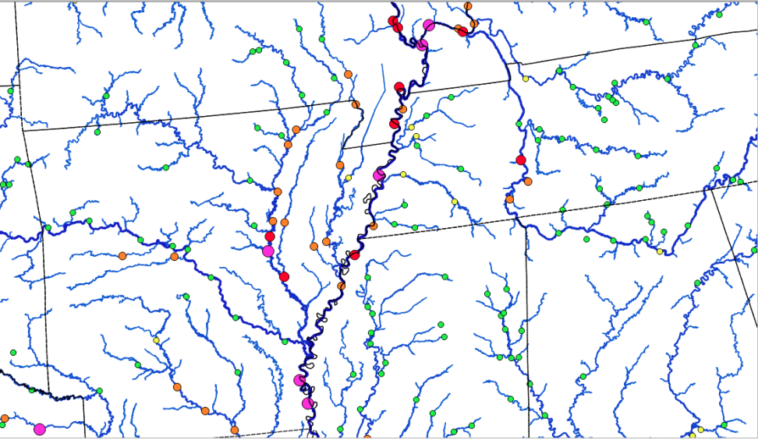
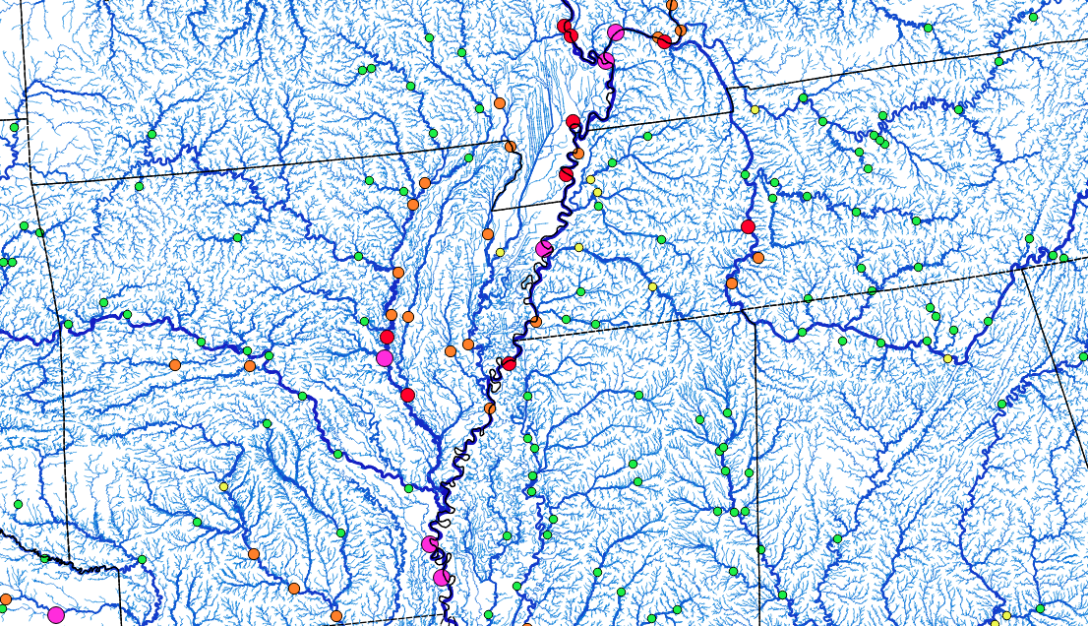
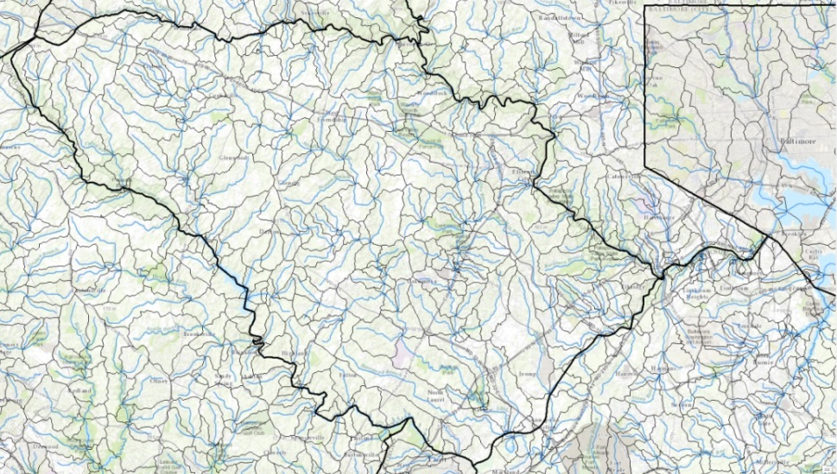
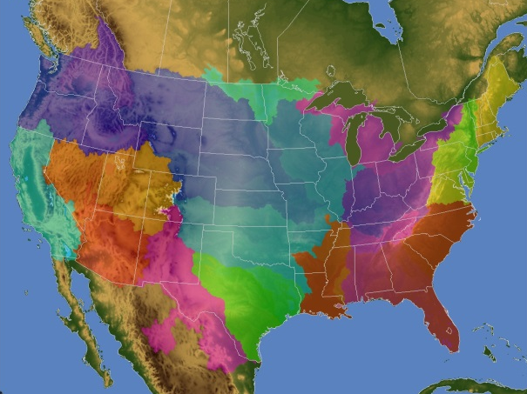
NWM V1.0 Experimental Output
Hydrologic Output
River channel discharge and velocity at 2.7 million river reaches
Reservoir inflow, outflow, elevation
Surface water depth and subsurface flow (250 m CONUS+ grid)
Land Surface Output
1km CONUS+ grid
Soil and snow pack states
Energy and water fluxes
Direct-output and derived products (e.g. stream flow anomalies)
Current NWS AHPS points (red)
NWM output points (blue)
35
NWM 1km LSM Domain
Current NWS River Forecast Points (circles)
Overlaid with NWM Stream Reaches
35
Notes:
BC

Slide 36
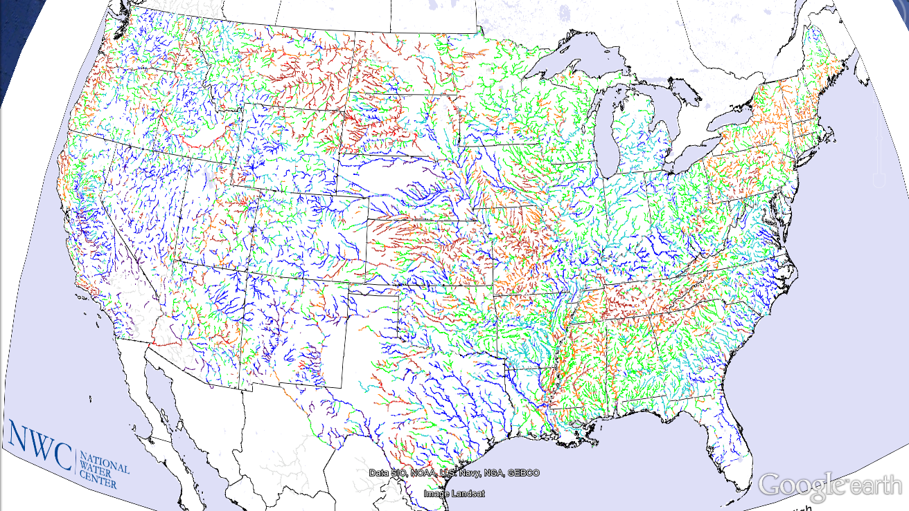
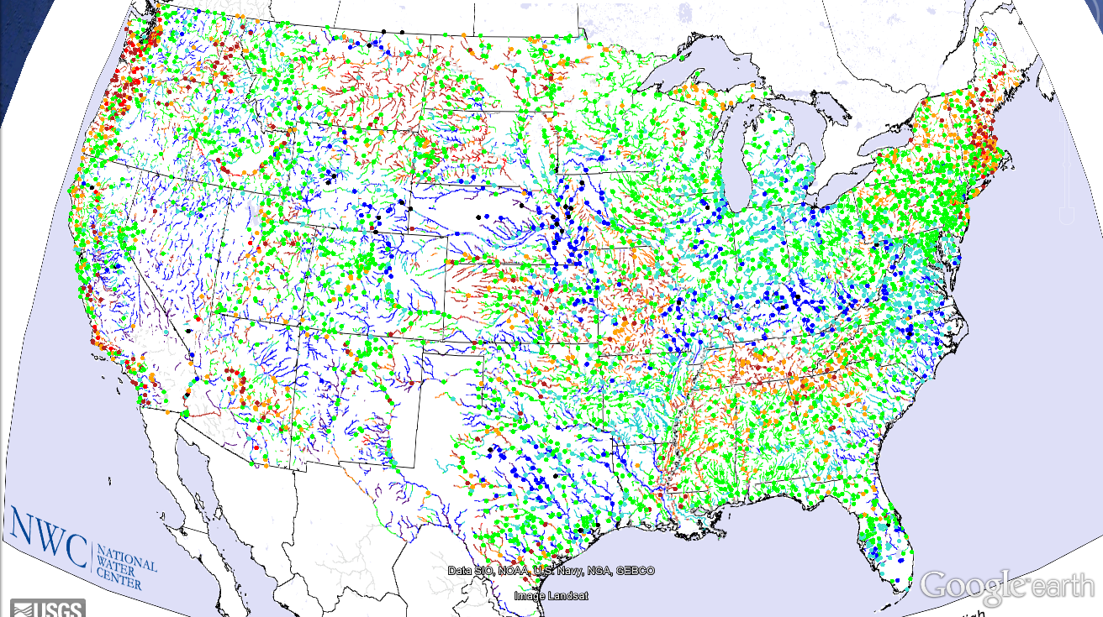
Real-time Output: Streamflow Anomaly 00Z 5/14/16 Streamlines = NWM circles = USGS

Slide 37
National Water Prediction Model Configurations
Four Forecasting Horizons for National Water Model
Analysis & Assimilation
Short-Range
‘Flood Prediction’
Medium Range
‘Flow Prediction’
Long Range
‘Water Resources’
Cycling Frequency
Hourly
3-Hourly
Daily
~Daily (x16)
Forecast Duration
- 3 hrs
0-2 days
0-10 days
0-30 days
Spatial Discretization & Routing
1km/250m/NHDPlus Reach
1km/250m/NHDPlus Reach
1km/250m/NHDPlus Reach
1 km/catchment /NHDPlus Reach
Meteorological Forcing
MRMS blend/ HRRR-NAM bkgnd.
Downscaled HRRR /RAP/NAM blend
Short-range + Downscaled GFS
Downscaled & bias-corrected CFS

Slide 38
Conclusions
National Water Model is now operational
– water is being forecast like weather
This is a large complex enterprise that
will take time to become routine
How will this affect the future of
water science and engineering?

