Slide 1
Extending ArcGIS using programming
David Tarboton

Slide 2
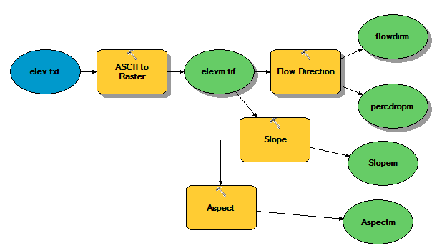
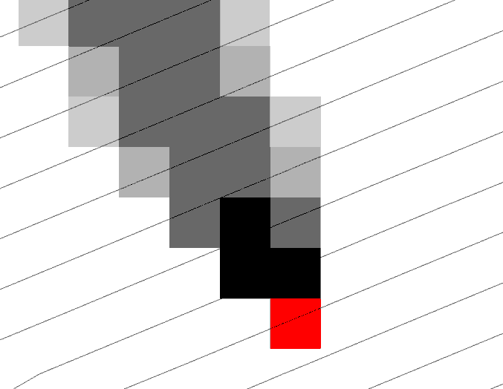
Why Programming
Automation of repetitive tasks (workflows)
Implementation of functionality not available (programming new behavior)

Slide 3
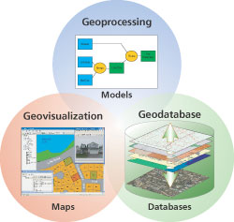
Three Views of GIS
Geodatabase view: Structured data sets that represent geographic information in terms of a generic GIS data model.
Geovisualization view: A GIS is a set of intelligent maps and other views that shows features and feature relationships on the earth's surface. "Windows into the database" to support queries, analysis, and editing of the information.
Geoprocessing view: Information transformation tools that derive new geographic data sets from existing data sets.
adapted from www.esri.com

Slide 4
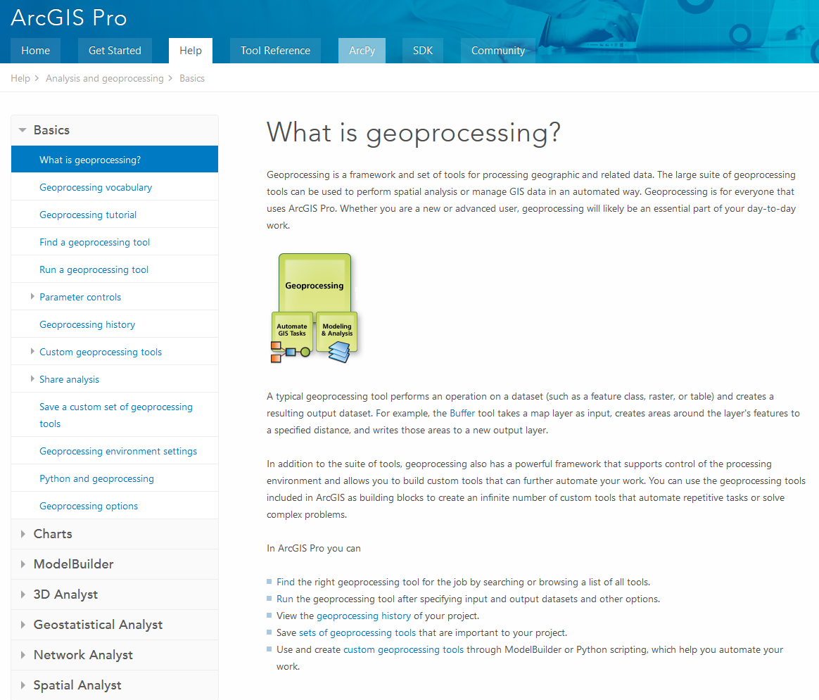
ArcGIS Pro Geoprocessing Help
http://pro.arcgis.com/en/pro-app/help/analysis/geoprocessing/basics/what-is-geoprocessing-.htm

Slide 5
ArcGIS programming options
Model builder
Python scripting environment
ArcObjects library (for system language like C++, .Net)
AML
Open standard data formats that anyone can use in programs (e.g. shapefiles, geoTIFF, netCDF)

Slide 6
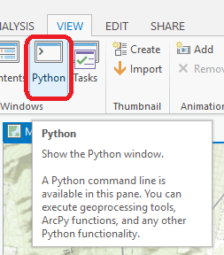
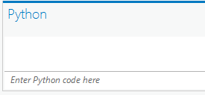
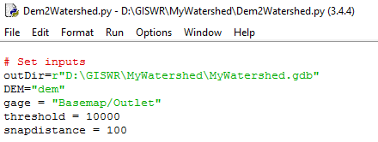

Python Environments
Python Window built into ArcGIS Pro
  http://pro.arcgis.com/en/pro-app/arcpy/get-started/python-window.htm
Idle: Simple editor that is part of Python
PyCharm: Powerful professional development environment, https://www.jetbrains.com/pycharm/

Slide 7
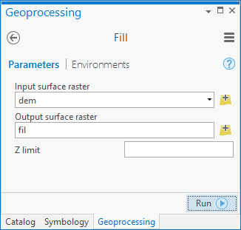
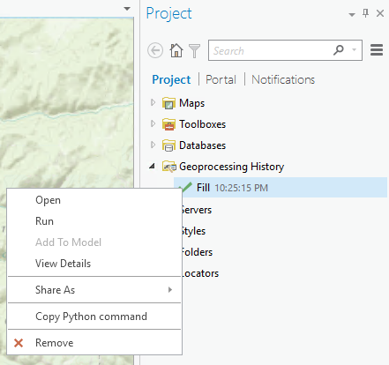
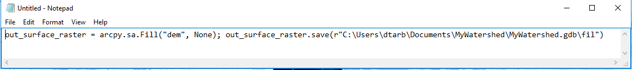
Each Geoprocessing tool has it’s own Python Command

Slide 8
Demo
Python code from Geoprocessing History
Use of Python Window
Python code from online help
Sequencing code into a script
Editing and running with Idle

Slide 9
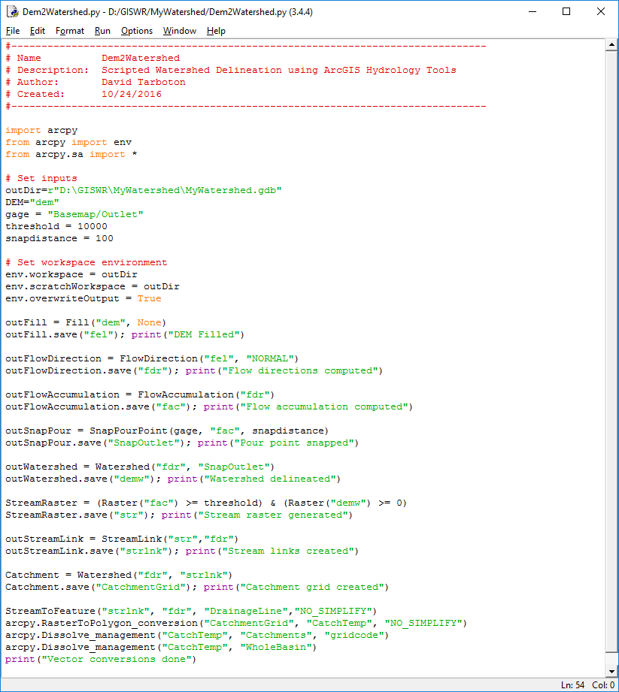
Example – Watershed delineation using Python
(Steps from Exercise 4)
Set Inputs
  DEM
  Outlet
  Threshold
Set workspace
Fill
Flow Direction
Flow Acumulation
Snap Outlet
Watershed
Stream Raster
Stream Link
Catchment
Vector Conversion
1
2
3
4
5
6
7
8
9
10
11

Slide 10
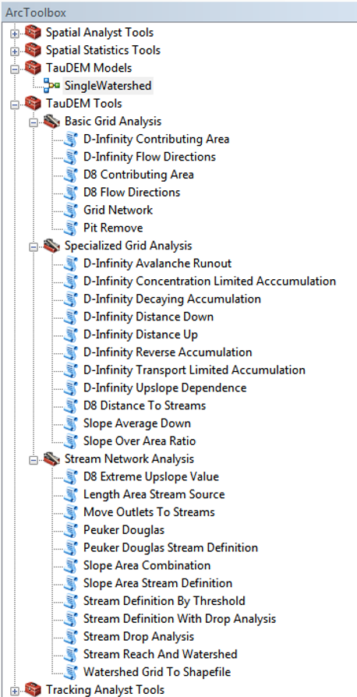
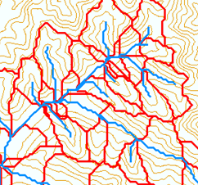
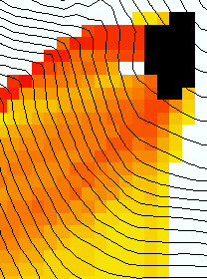
TauDEM
Stream and watershed delineation
Multiple flow direction flow field
Calculation of flow based derivative surfaces
MPI Parallel Implementation for speed up and large problems
Open source platform independent C++ command line executables for each function
Deployed as an ArcGIS Toolbox with python scripts that drive command line executables
http://hydrology.usu.edu/taudem/

Slide 11
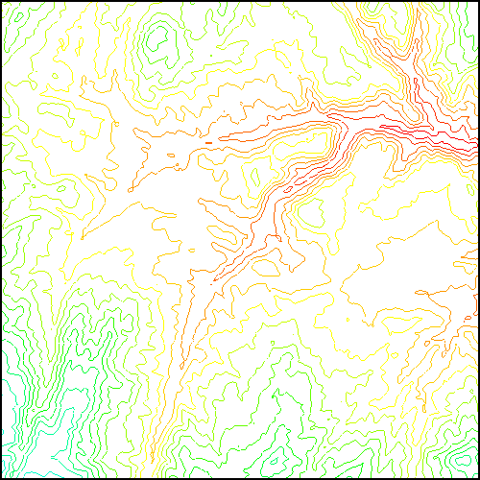
TauDEM Parallel Approach
MPI, distributed memory paradigm
Row oriented slices
Each process includes one buffer row on either side
Each process does not change buffer row
Improved runtime efficiency
Capability to run larger problems

Slide 12
Programming
C++ Command Line Executables that use MPI
Use GDAL/OGR library to read and write datasets in open standard formats for exchange with other programs
ArcGIS Python Script Tools
Python validation code to provide file name defaults
Shared as ArcGIS Toolbox
Any computer
Requires ArcGIS

Slide 13
Q based block of code to evaluate any “flow algebra expression”
while(!que.empty())
{
//Takes next node with no contributing neighbors
temp = que.front(); que.pop();
i = temp.x; j = temp.y;
// FLOW ALGEBRA EXPRESSION EVALUATION
if(flowData->isInPartition(i,j)){
float areares=0.; // initialize the result
for(k=1; k<=8; k++) { // For each neighbor
in = i+d1[k]; jn = j+d2[k]; flowData->getData(in,jn, angle);
p = prop(angle, (k+4)%8);
if(p>0.){
if(areadinf->isNodata(in,jn))con=true;
else{
areares=areares+p*areadinf->getData(in,jn,tempFloat);
}
}
}
}
// Local inputs
areares=areares+dx;
if(con && contcheck==1)
areadinf->setToNodata(i,j);
else
areadinf->setData(i,j,areares);
// END FLOW ALGEBRA EXPRESSION EVALUATION
}
C++

Slide 14
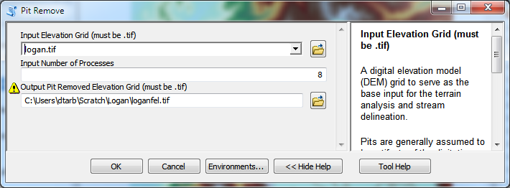
Python Script to Call Command Line
mpiexec –n 8 pitremove –z Logan.tif –fel Loganfel.tif

Slide 15
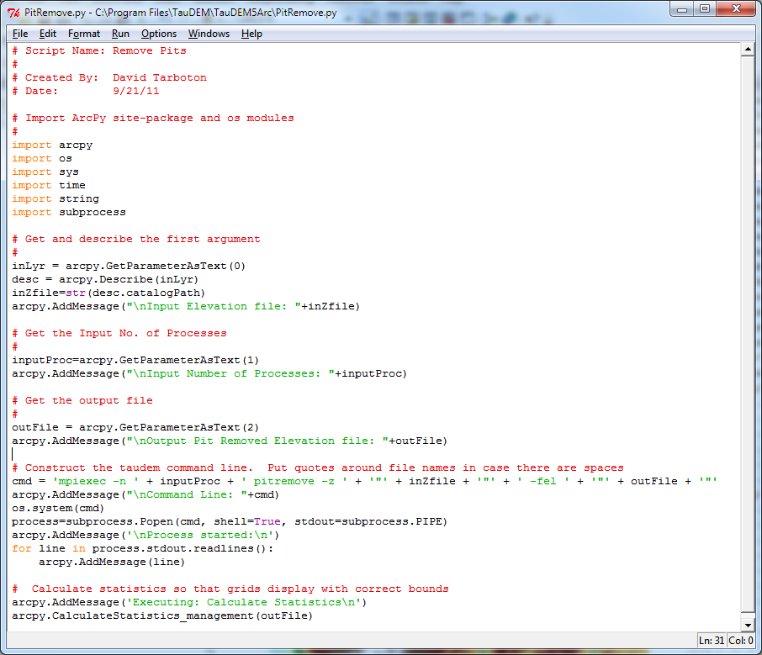
PitRemove
Python

Slide 16
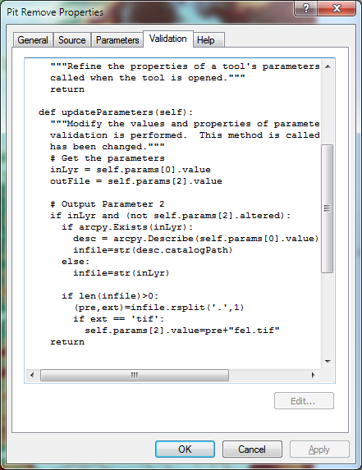
Validation code to add default file names
Python

Slide 17
Summary
GIS and Water Resources analysis capabilities are readily extensible with programming
to do something new
to repeat something needed frequently
Model builder provides visual programming and helps learn ArcGIS python commands
Python – cross platform, powerful and easy to use is a good programming language to start with (when your time is valuable)
Compiled language programming for developers (C++) to achieve optimal efficiency (when the computers time is valuable)

