Slide 1
Water Resources Analysis using WEAP and GIS
CEE6440
GIS in Water Resources
Ayman Alafifi
Utah State University
Nov. 7, 2017

Slide 2
Learning Objectives
Describe priority-based water allocation models
Understand water resources system schematic and components
Demonstrate WEAP as an example software for river basin water allocation models
Build web GIS applications to facilitate communicating model data
Many slide materials are from the WEAP website, Dr. David Rosenberg USU CEE 6490, and Dr. Joseph Kasprzyk – University of Colorado Boulder

Slide 3
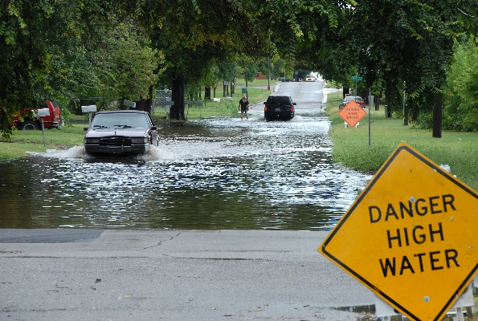
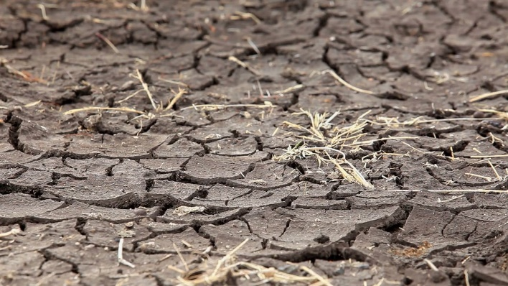
Motivation
Too Much?
Too Little?

Slide 4
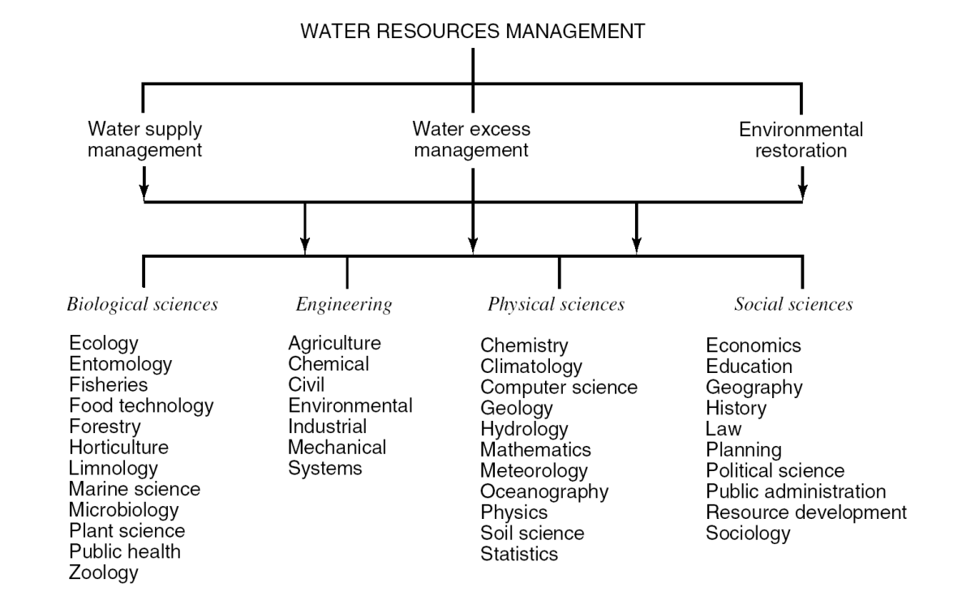
Water resources management aims to increase water security
Figure 1.1.1 (p. 1). Ingredients of water resources management (from Mays, 1996). Water Resources Management, 2005 Edition by Larry W. Mays Copyright © 2005 by John Wiley & Sons, Inc. All rights reserved

Slide 5
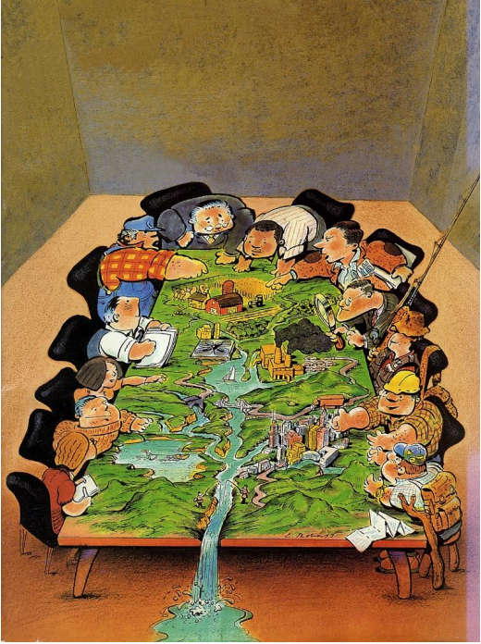
Motivation
How much water is projected to be available in the future?
Who benefits the most from using water at a given time and location?
How should the benefits of a water project be spread throughout a basin?
Courtesy: Joseph Kasprzyk - University of Colorado Boulder

Slide 6
Challenges
Water Supply
  Headflow, groundwater, soil moisture
  Reach gains and losses
  Return flow
  Multiple reservoir operations
Water Demand
  River flow vs population and industrial needs
  Demand Projections
  Consumptive vs non consumptive uses
  Environmental users

Slide 7
Challenges
Delivery targets and water allocation priorities
  By purpose: urban demands before environmental
  By location: upstream, then downstream, or reverse
Water laws:
  Prior Appropriation, “first in time, first in right”
  Water rights are property that can be bought, sold, and leased
  All rights are processed through water court
  Many senior water rights are from agriculture
  Upstream users do not necessarily have more senior rights
Multi-jurisdictional rivers

Slide 8
Modelling Software
Allocation of limited water resources, environmental quality and policies for sustainable water use are issues of increasing concern.
Over the last decade, an integrated approach to water development has emerged which places water supply projects in the context of demand-side issues, water quality and ecosystem preservation.

Slide 9



Water Allocation Models
Name | Short name | Organization
River and Reservoir Operations | RiverWare | University of Colorado CADSWES and USBR http://riverware.org
Reservoir System Simulation | (HEC-ResSim) | U.S. Army Corps of Engineers (USACE) Hydrologic Engineering Center (HEC) http://www.hec.usace.army.mil
River Basin Management Decision Support System | MOSDIM | Colorado State University (CSU) and U.S. Bureau of Reclamation (USBR) http://modsim.engr.colostate.edu
Water Evaluation And Planning System | WEAP | Stockholm Environment Institute www.weap21.org
Water Rights Analysis Package | WRAP | Texas Water Resources Institute (TWRI) and Texas Commission on Environmental Quality http://ceprofs.tamu.edu/rwurbs/wrap.htm
And many more…
A Hydrologic Modeling Inventory is maintained at Texas A&M University at the web site http://hydrologicmodels.tamu.edu/ in collaboration with the U.S. Bureau of Reclamation

Slide 10
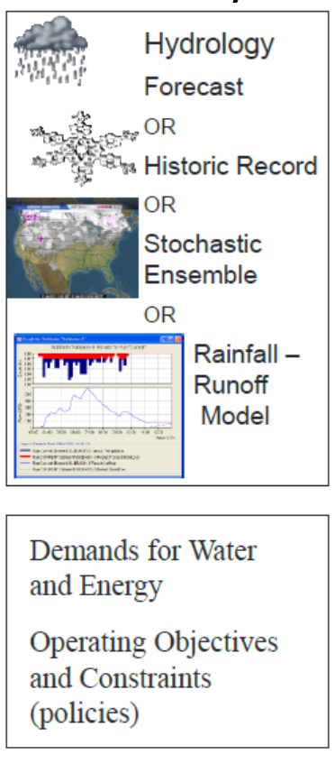
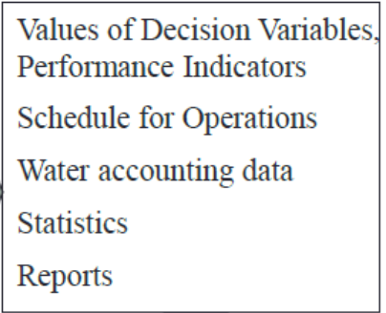
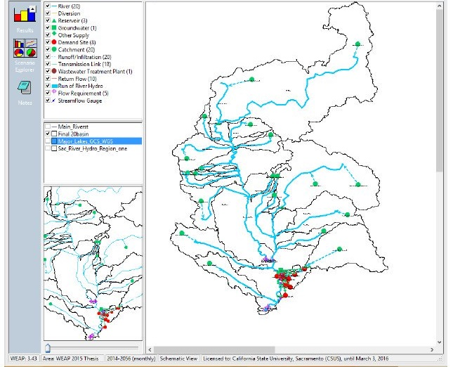
General Workflow
Water Allocation Model
Outputs
Inputs
Post-processing:
Statistical Analysis
Tradeoff Analysis
GIS Maps

Slide 11


Water Evaluation And Planning System (WEAP)
WEAP History
  First developed in 1992
  WEAP21 version in 2005
  Over 500 published applications
  Key model development steps
  Draw the system schematic
  Identify data for system components
  Enter data and run the model

Slide 12
Why WEAP?
  WEAP has an integrated approach to simulating water systems
  Policy-oriented
  Demand includes: patterns, equipment efficiencies, re-use, prices
  Supply includes: streamflow, groundwater, reservoirs and water transfers
  Includes costs, water quality, and priorities
  Manage scenarios and examine alternative water development and management strategies
  User-friendly

Slide 13
WEAP applications
  Create a simple water management system with supply and demand nodes
  Analyze optimal water use within the water management system as a result of changing demand and supply scenarios
  Analyze the impact of population growth and climate change on demand and supply equilibrium

Slide 14
Scenario analysis in WEAP
  Scenarios are used to explore the model with an enormous range of “what if” questions, such as:
  What if population growth and economic development patterns change?
  What if reservoir operating rules are altered?
  What if groundwater is more fully exploited?
  What if water conservation is introduced?
  What if ecosystem requirements are tightened?
  What if new sources of water pollution are added?
  What if a water recycling program is implemented?
  What if a more efficient irrigation technique is implemented?
  What if the mix of agricultural crops changes?
  What if climate change alters demand and supplies?

Slide 15
Install WEAP
Go to the WEAP home page http://www.weap21.org
Sing up for a free account
Download and install WEAP
WEAP requires at least Windows 2000, 256 MB of RAM
Needs Bootcamp for Mac

Slide 16
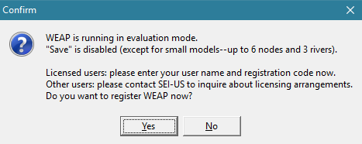
Install WEAP
The free, evaluation version of WEAP (53 MB) is a fully working version of the software - only the Save Data feature is disabled. To enable, you will need a license number
For USU students: check with Dr. David Rosenberg (CEE) or Dr. Sarah Null (NR)

Slide 17
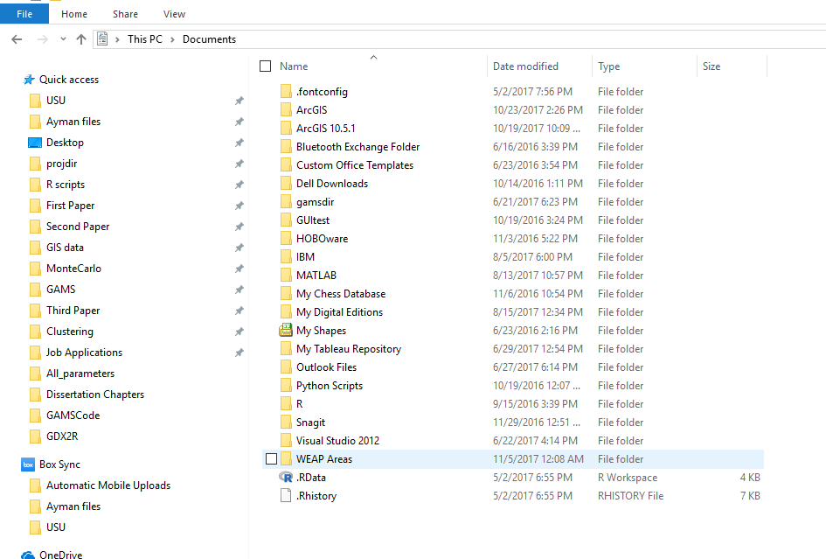
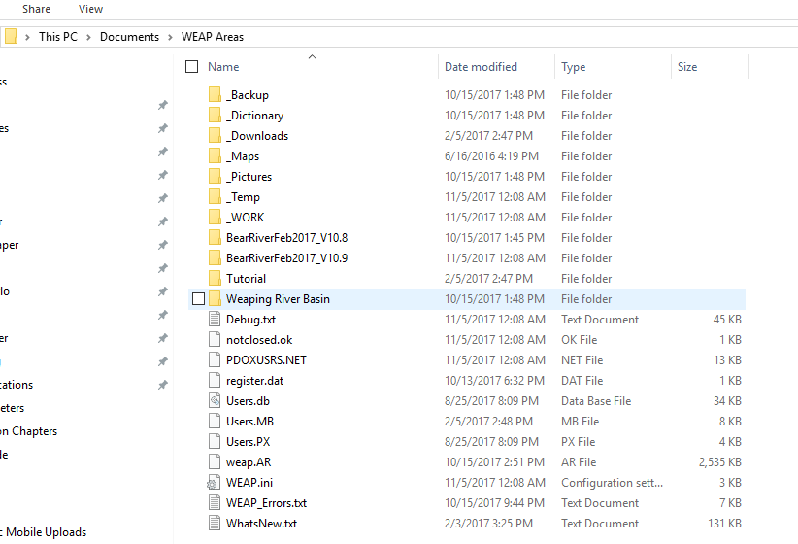
Install WEAP
The WEAP program (weap.exe) will install under Program Files
WEAP data files will be stored under My Documents

Slide 18
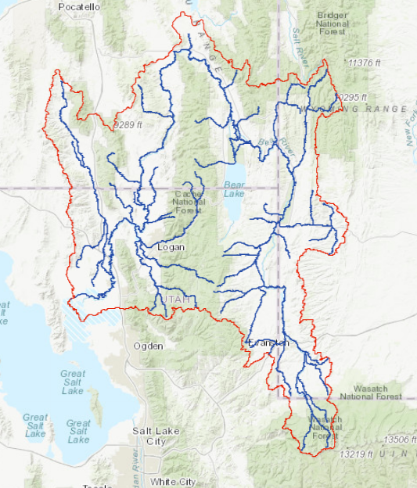
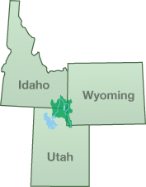
Case Study: Bear River
Multi-state 500-mile river
Delivers water to over 450 irrigation companies delivering water to over 400 thousand acres of agricultural land
One of the few rivers in Utah that has water development potentials
Central to growth and development debate for several counties within the basin such as Cache and Box Elder Counties, Utah in addition to the off-basin Wasatch Front metropolitan region
The largest water source flowing into the Great Salt Lake and its 30,000 acre-Bear River Migratory Bear Refuge
Provide habitat to several threatened species

Slide 19
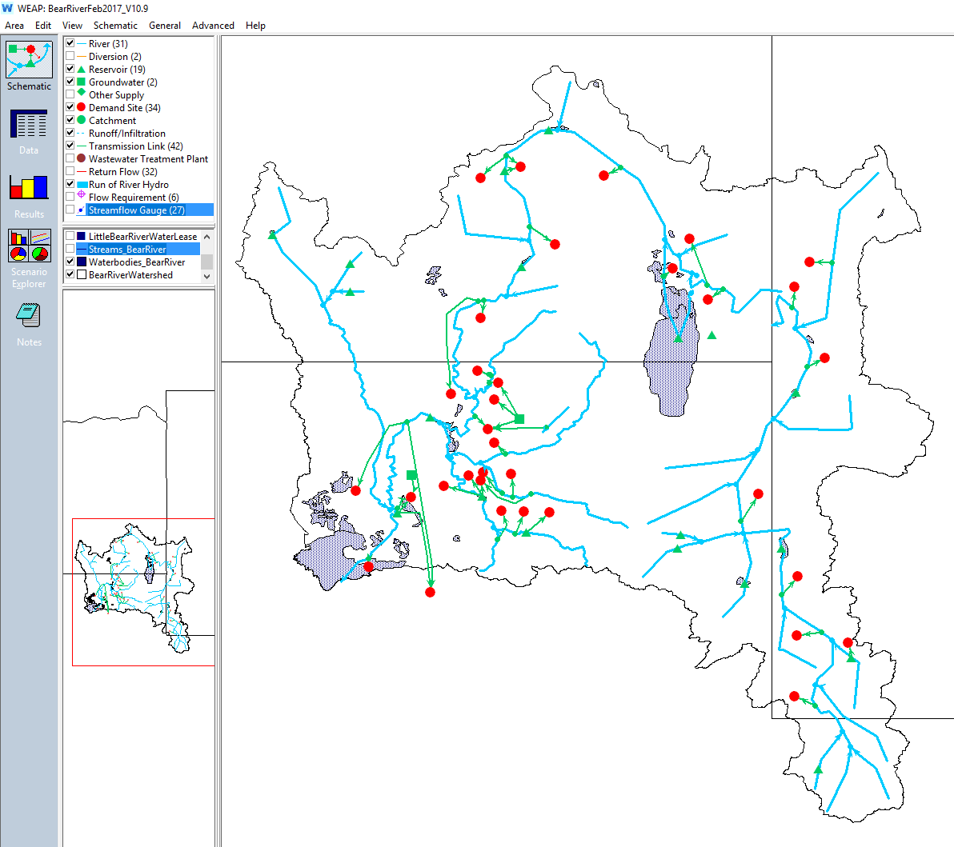
Using WEAP
  Schematic
  Data
  Results
  Scenario Explorer

Slide 20
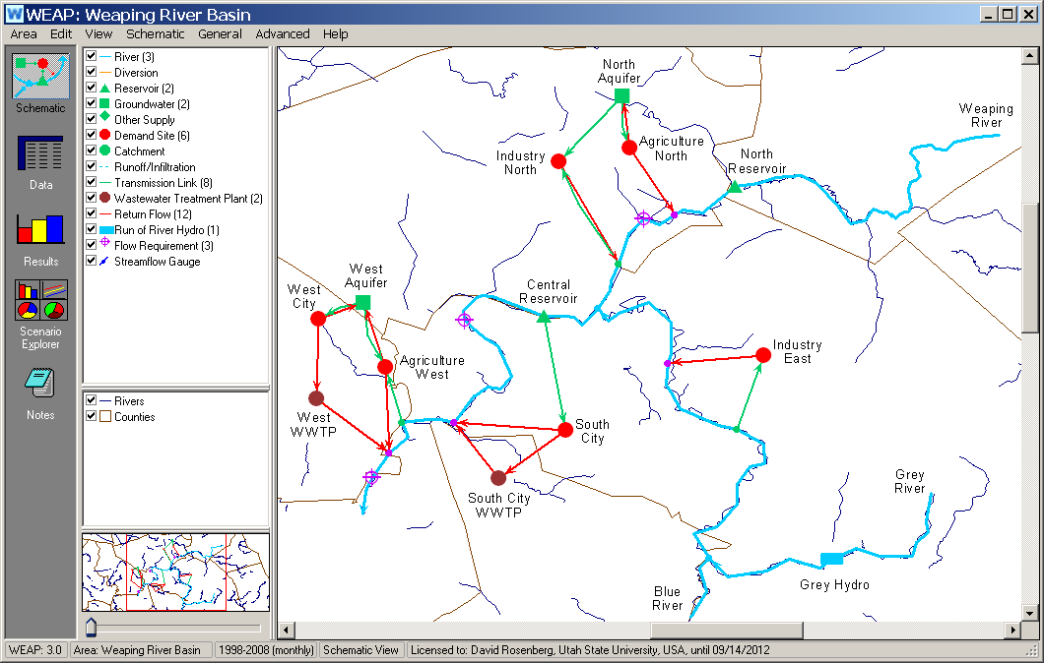
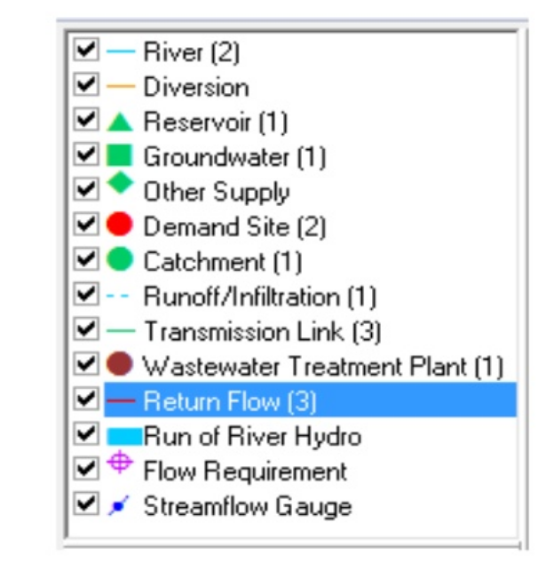
System Schematic
Identify the major system components
  Water sources (surface and groundwater)
  Demand sites (agricultural, urban, etc..)
  Source connections to demand sites
  Outflows from demand sites after use

Slide 21

WEAP Schematic (Nodes and Links)
Drag and drop system node components
  Demand sites
  Reservoirs, etc.
Drag, click, and drop system link components
  Rivers
  Transmission links
  Return flows
Add GIS layers to help place components
Must include all infrastructure you plan to test in Scenario Explorer

Slide 22
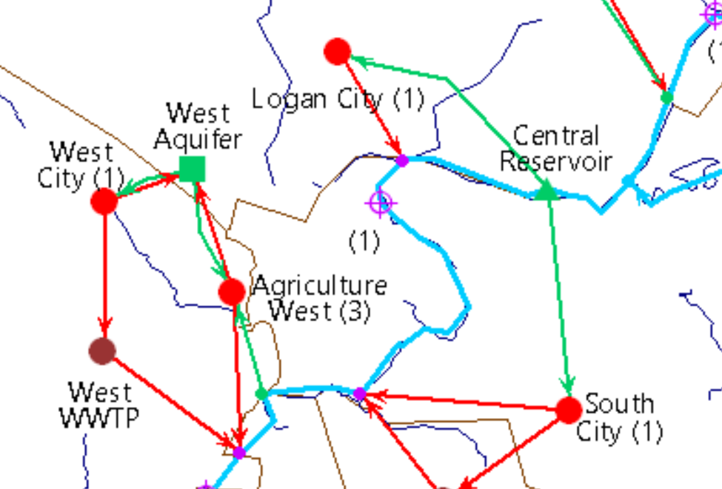
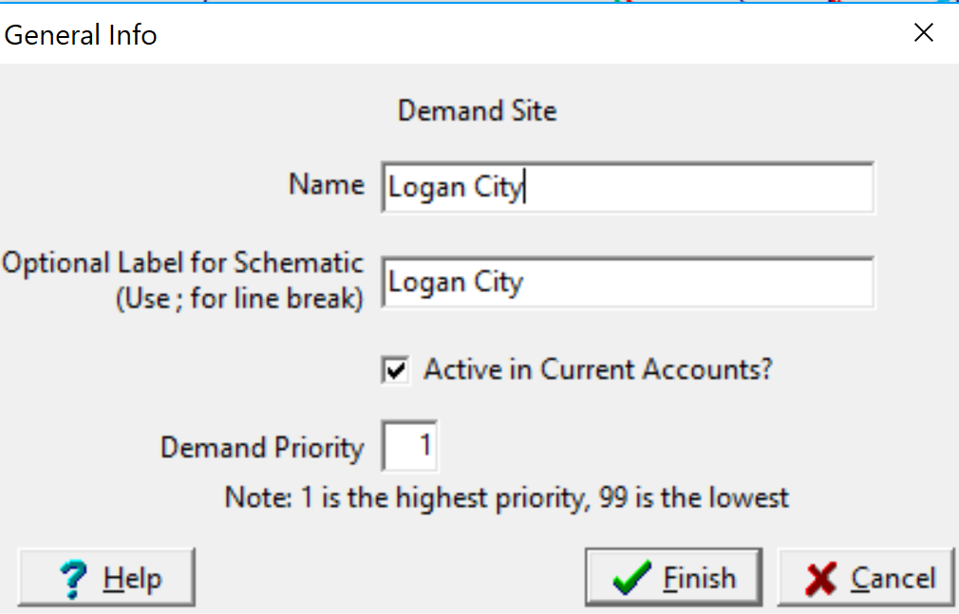
WEAP Schematic
Add to the schematic:
  A Demand site
  Diversion
  Return flow

Slide 23

WEAP Data Module
Enter data for each schematic component
  Rivers: Headflows for each month of the simulation
  Demand sites: activity levels, use rates, losses, consumption, demand priority (1=highest; 99=lowest)
  Transmission links: Max flows, supply preference
  Return flows: routing (percent returned)
  Reservoirs: storage capacity, initial storage, volume-elevation curve, evaporation, pool definitions, buffer coefficients, priority
Enter data for a base case or a scenario
Enter data or read from input file

Slide 24
Adding Reservoirs
Reservoirs are just another supply source
Reservoir source availability determined by
  Storage at end of previous time step
  Reservoir release rules
  Reservoir inflows, evaporation losses, etc.

Slide 25
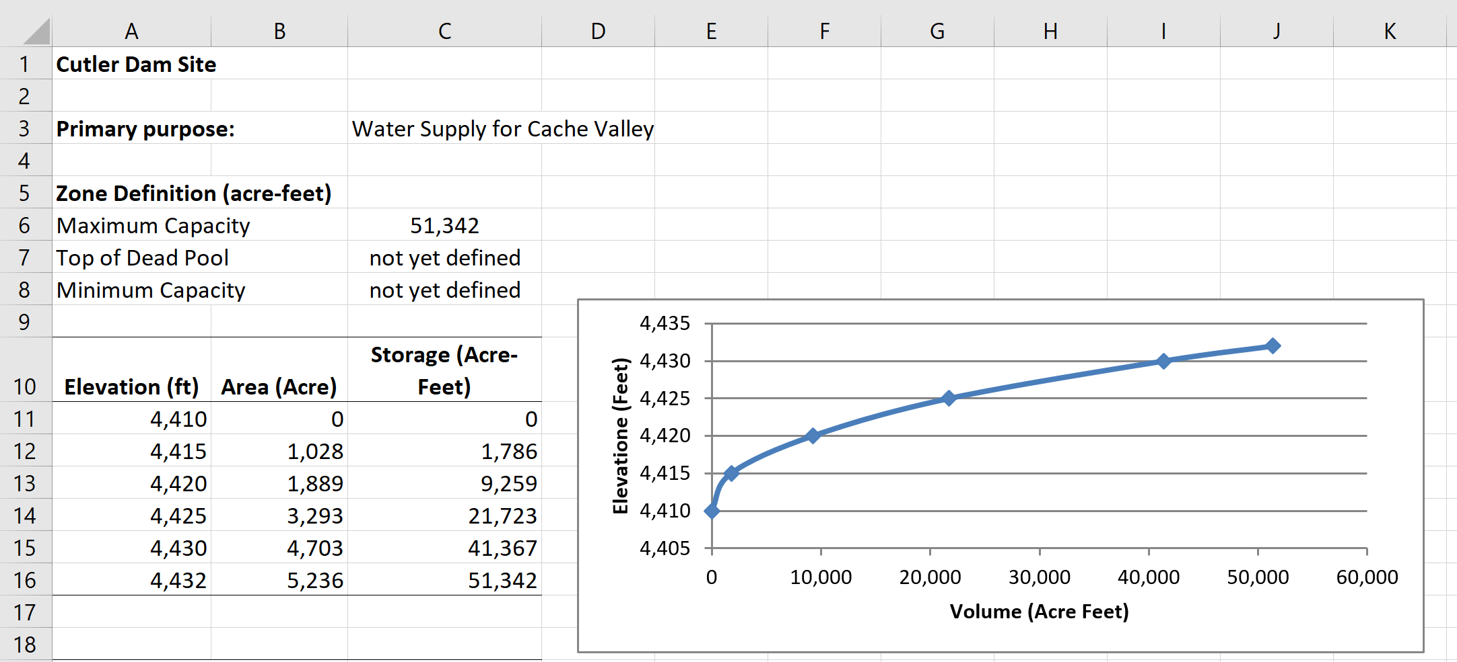
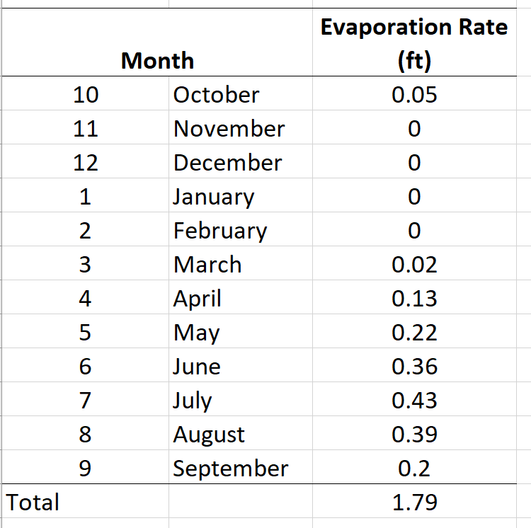
Reservoir Data

Slide 26
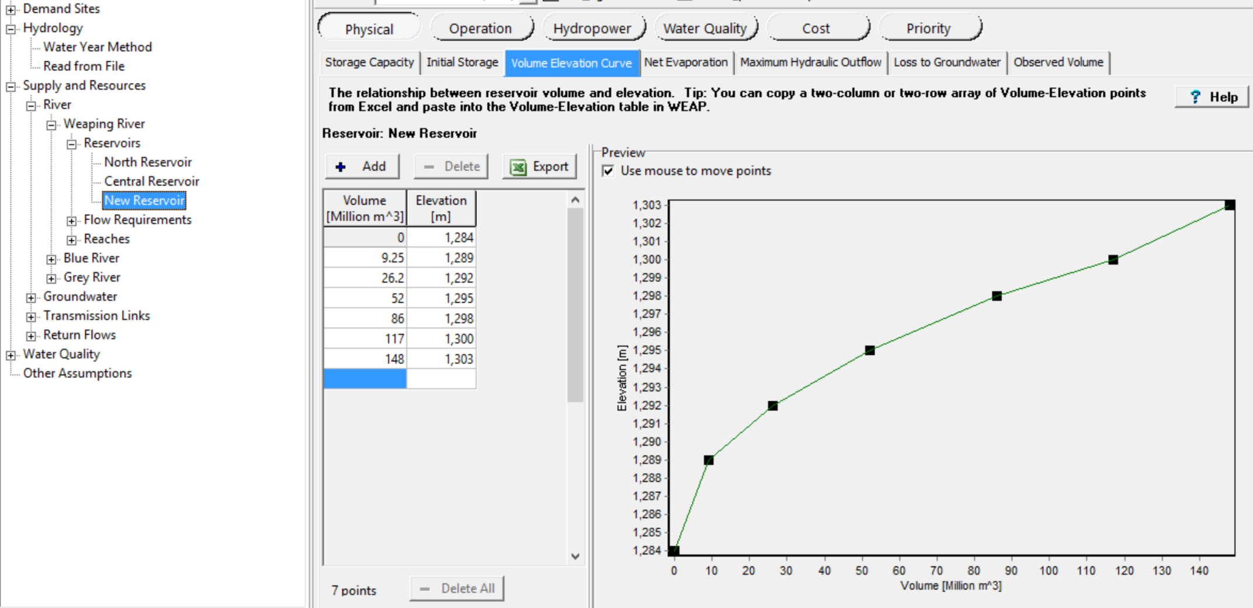
Reservoir Data

Slide 27
Adding Reservoirs (cont.)
  WEAP uses in-stream flows to meet Demand Site targets
  If in-stream flows are inadequate, it withdraws from reservoirs
  Withdrawal is a function of reservoir storage
  Can also assign priorities to refill reservoirs
  Storage partitions

Slide 28
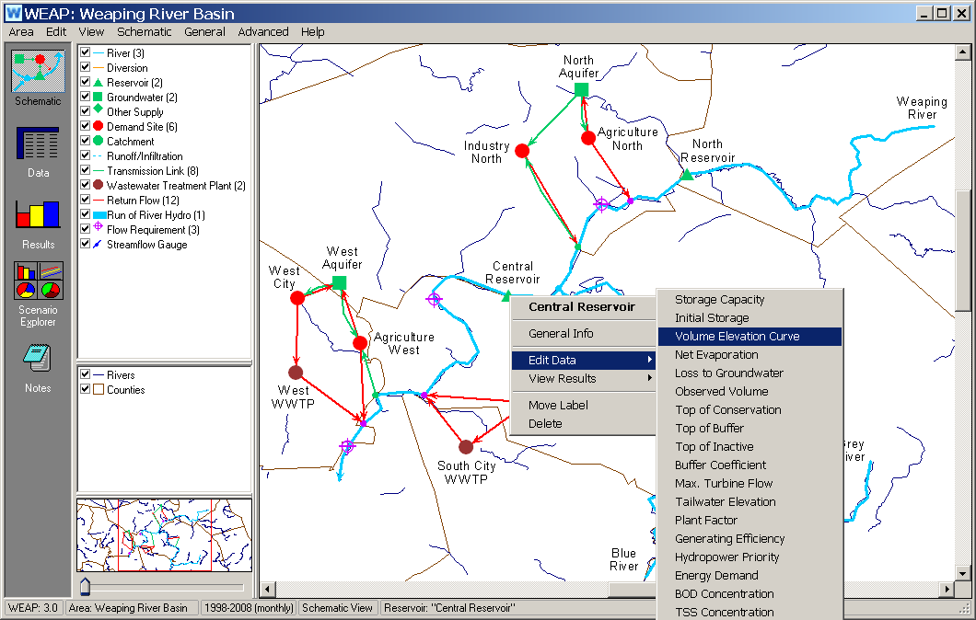
  Add data from schematic:
  right-click any schematic component to also get to the Data module

Slide 29
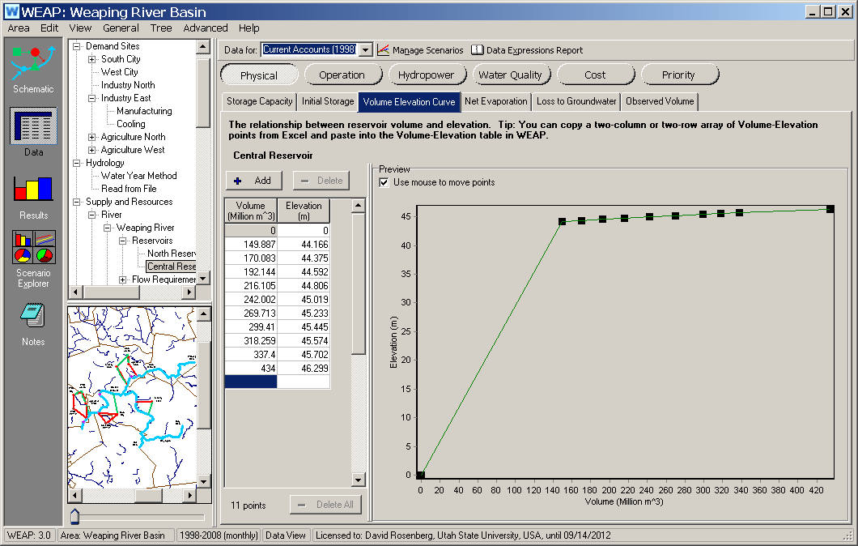
  Tree view, Buttons, and Tabs to navigate to desired data

Slide 30
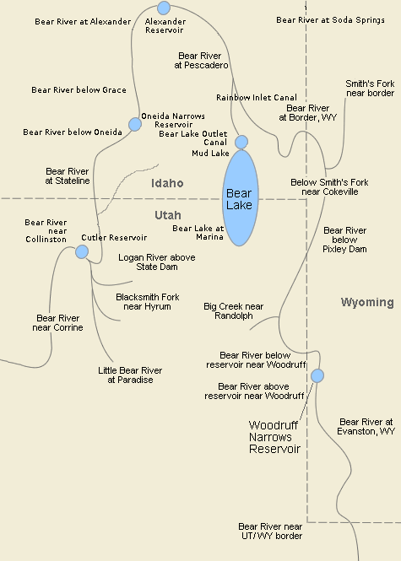
Bear River Network
Segment the river into nodes and links
Inventory available data
Include several stakeholders, river managers, numerous cities, counties, environmental groups, and legislators

Slide 31
Bear River WEAP Application
22 on-river nodes
31 river links
34 municipal and agricultural demand sites
2 Groundwater supply sources
42 transmission links
32 return flow links
27 streamflow gauges
6 flow requirement sites
Monthly data for 40 years (1966 – 2006)

Slide 32
WEAP Allocation Math
In each time step, WEAP solves a small linear program
  Maximize Demand Satisfaction
    Meet supply priorities
    Obey demand site preferences
    Mass balance
    Other constraints
Such that:

Slide 33
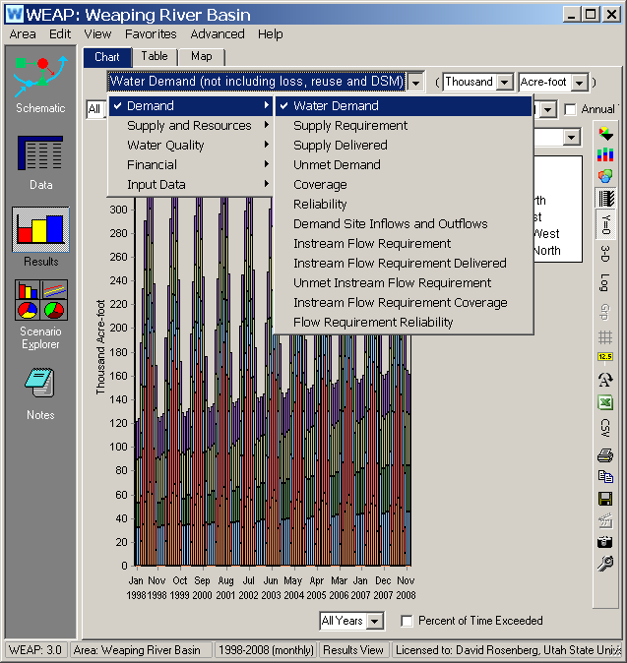

WEAP Results Module
  Click the Results icon and recalculate (all scenarios)
  Choose results from schematic or dropdown lists
  Numerous options to view, tabulate, and export

Slide 34
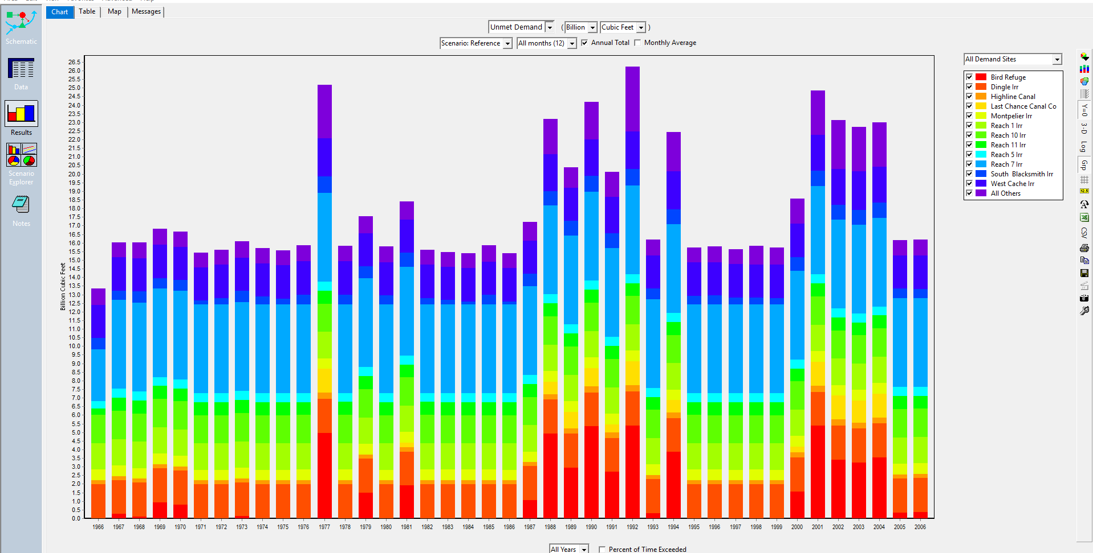
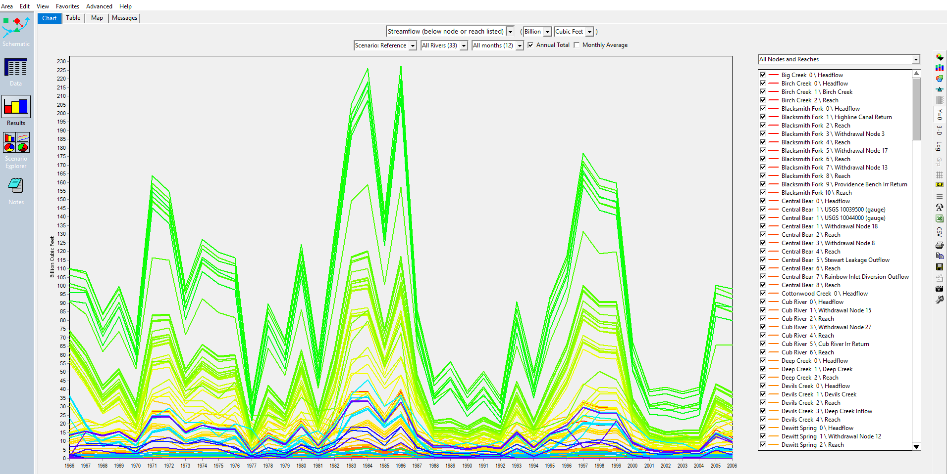
WEAP Results
Supply system reliability
Shortages and unmet demand
Stream flow on every reach
Groundwater storage
Environmental flows
.. and many more

Slide 35
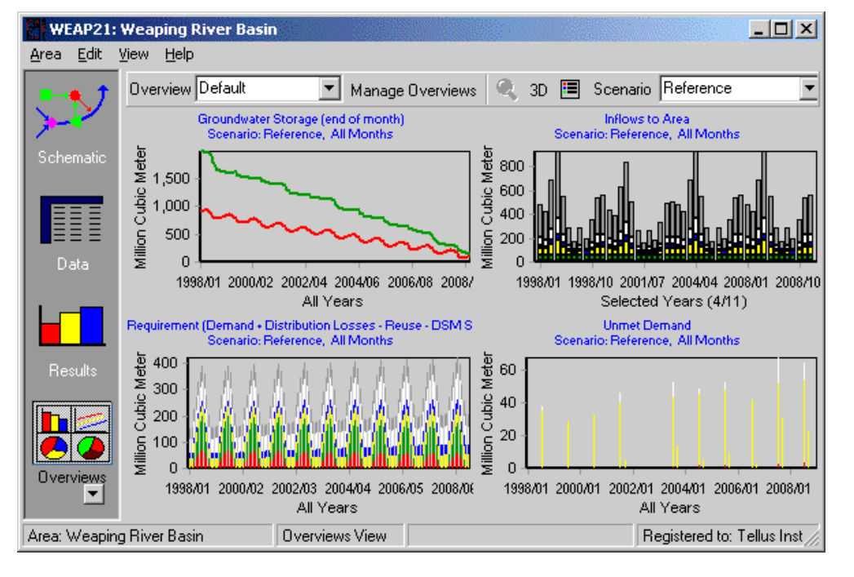
WEAP Results Module

Slide 36
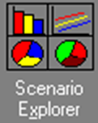
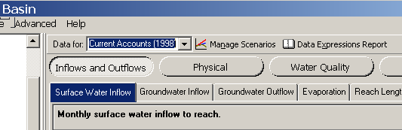
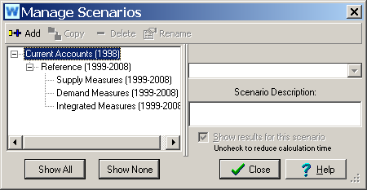
WEAP Scenario Explorer
Define and manage scenarios from the Data module
Enter input data here too

Slide 37
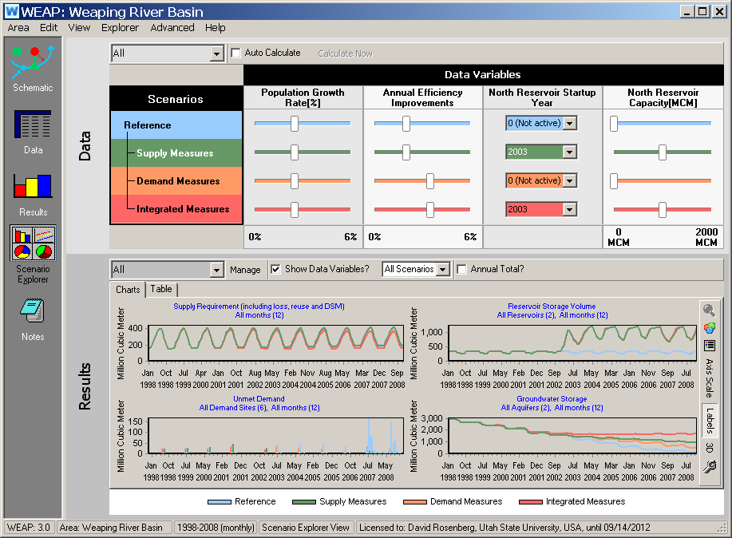
WEAP Scenario Explorer
Use Scenario Explorer icon to open scenario dashboard

Slide 38
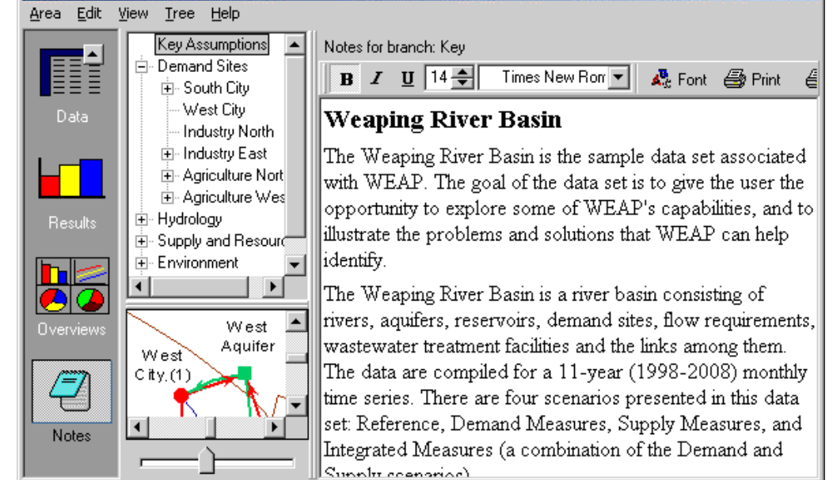
WEAP Notes

Slide 39
Extending WEAP
Scripts can be used with WEAP in two different ways:
Internally: to create more powerful expressions and functions for a WEAP model (e.g., create a script to calculate reservoir water quality, and Call the script from a WEAP expression).
Externally: to automate WEAP via its Application Programming Interface (API) to perform a sequence of actions (e.g., create and run 100 WEAP scenarios by varying the value of several parameters (sensitivity analysis), and export the results to Excel for further analysis);
WEAP has its own built-in script editor that can be used to edit, interactively debug and run scripts.

Slide 40
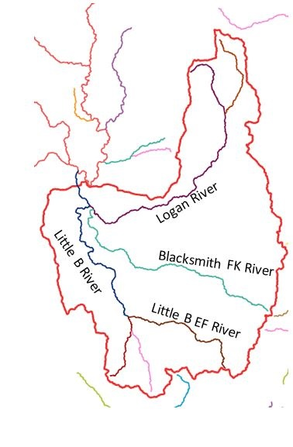
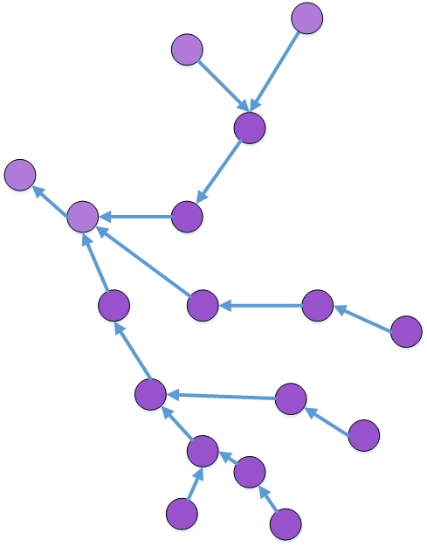
Challenges remain…
Node and link network schema conceptually represent spatial distribution of river components
Communicate WEAP results with policy makers and the public
User-friendly and interactive environment facilitates decision-making and enables inputs on model development and results
Make data and results accessible
Solution:
Create and upload results to a web GIS app

Slide 41
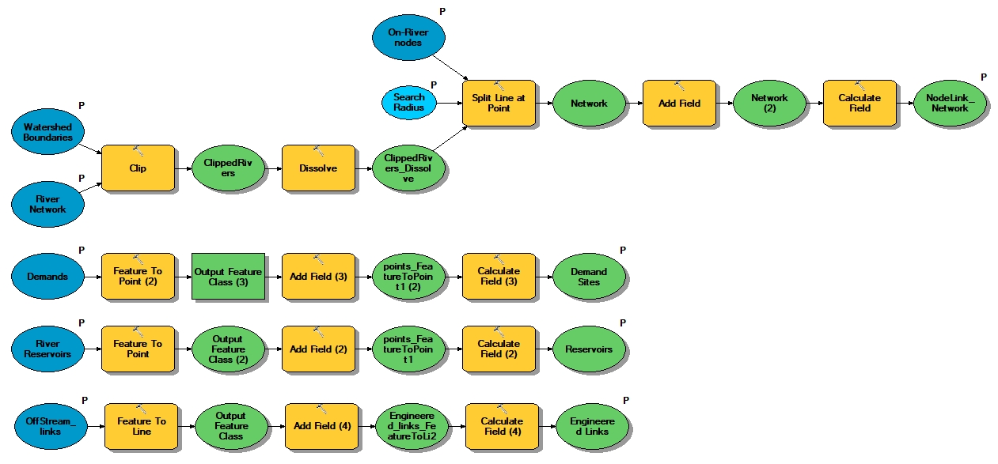
Create River Network tool – Desktop version
Create GIS layers of nodes and links that matches the network
Assign unique identifiers to each feature

Slide 42
Create River Network – web tool
Creates all layers on the web – does not require ArcGIS software
Created and tested in ArcMap Model Builder
Published to a GIS Server
Hosted on an ArcGIS Online web App
Will be accessible at: www.webmapbuilder.usu.edu (work in-progress)

Slide 43
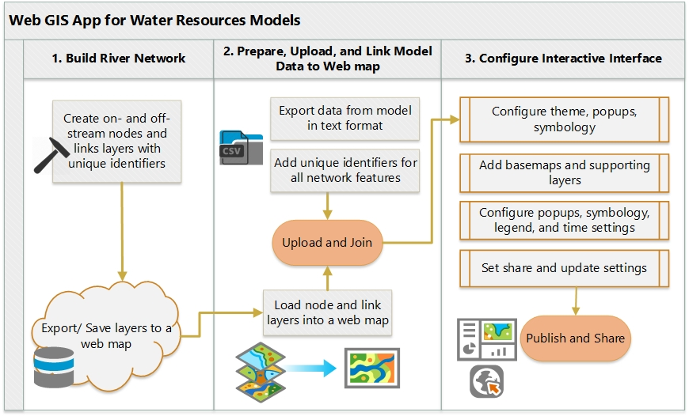
Web tool workflow

Slide 44
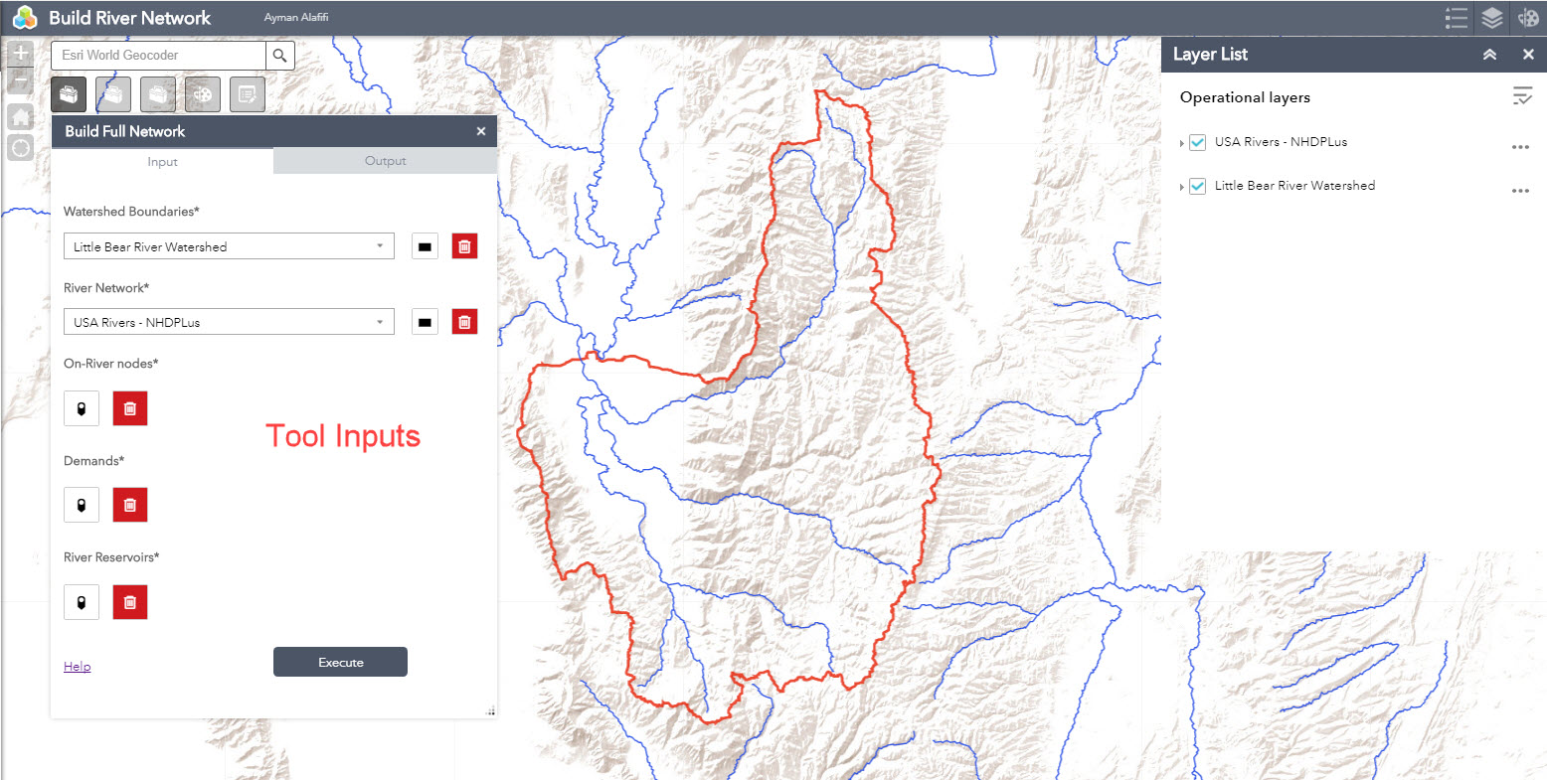
1. Select inputs

Slide 45
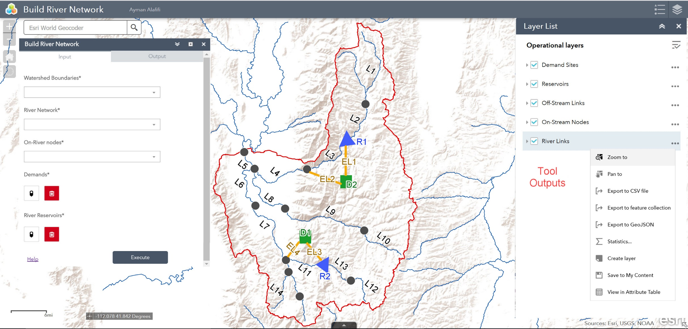
2. Create web layers and save them to your contents

Slide 46
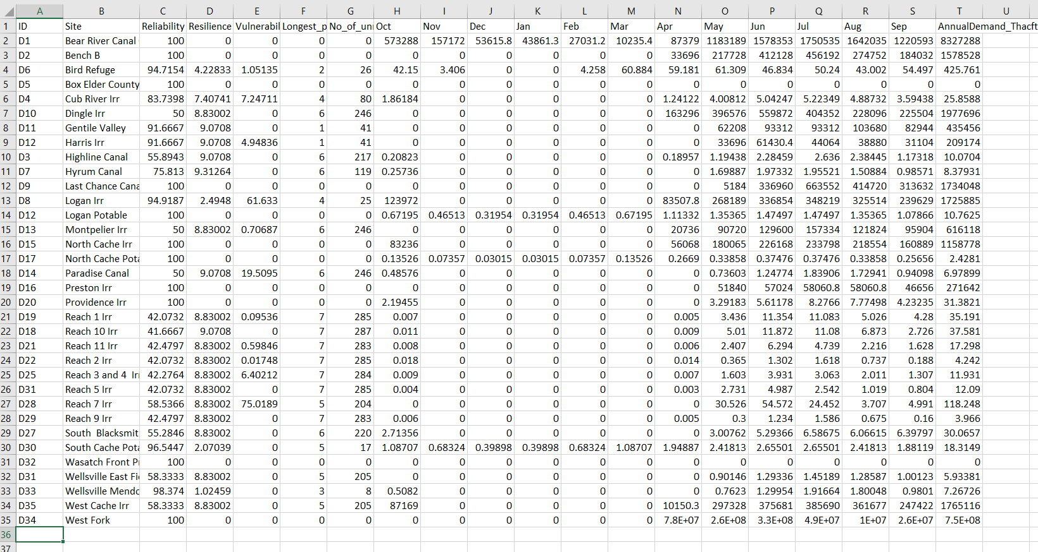
3. Export Data from WEAP
Export results from WEAP to a csv file
Add same unique identifiers for all demand sites

Slide 47
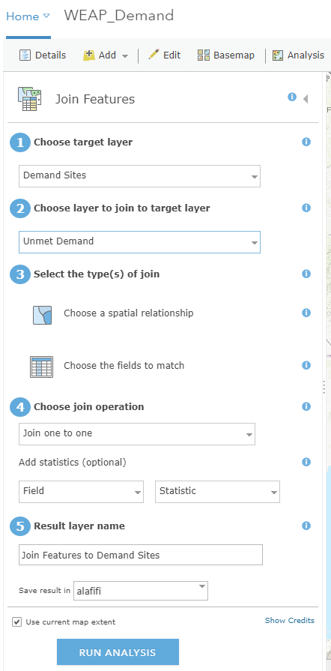
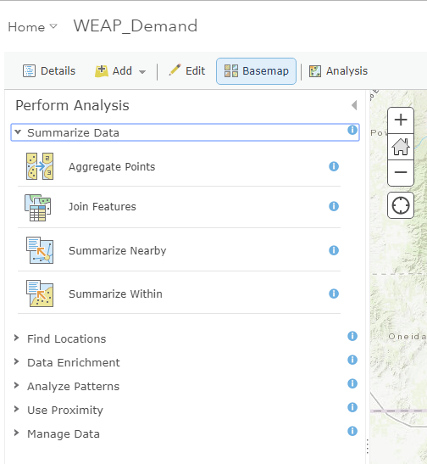
4. Upload to a web map
Add river web layers to a new web map
Add WEAP results to the same web map
Use the Join feature to merge the two layers
Create web app

Slide 48
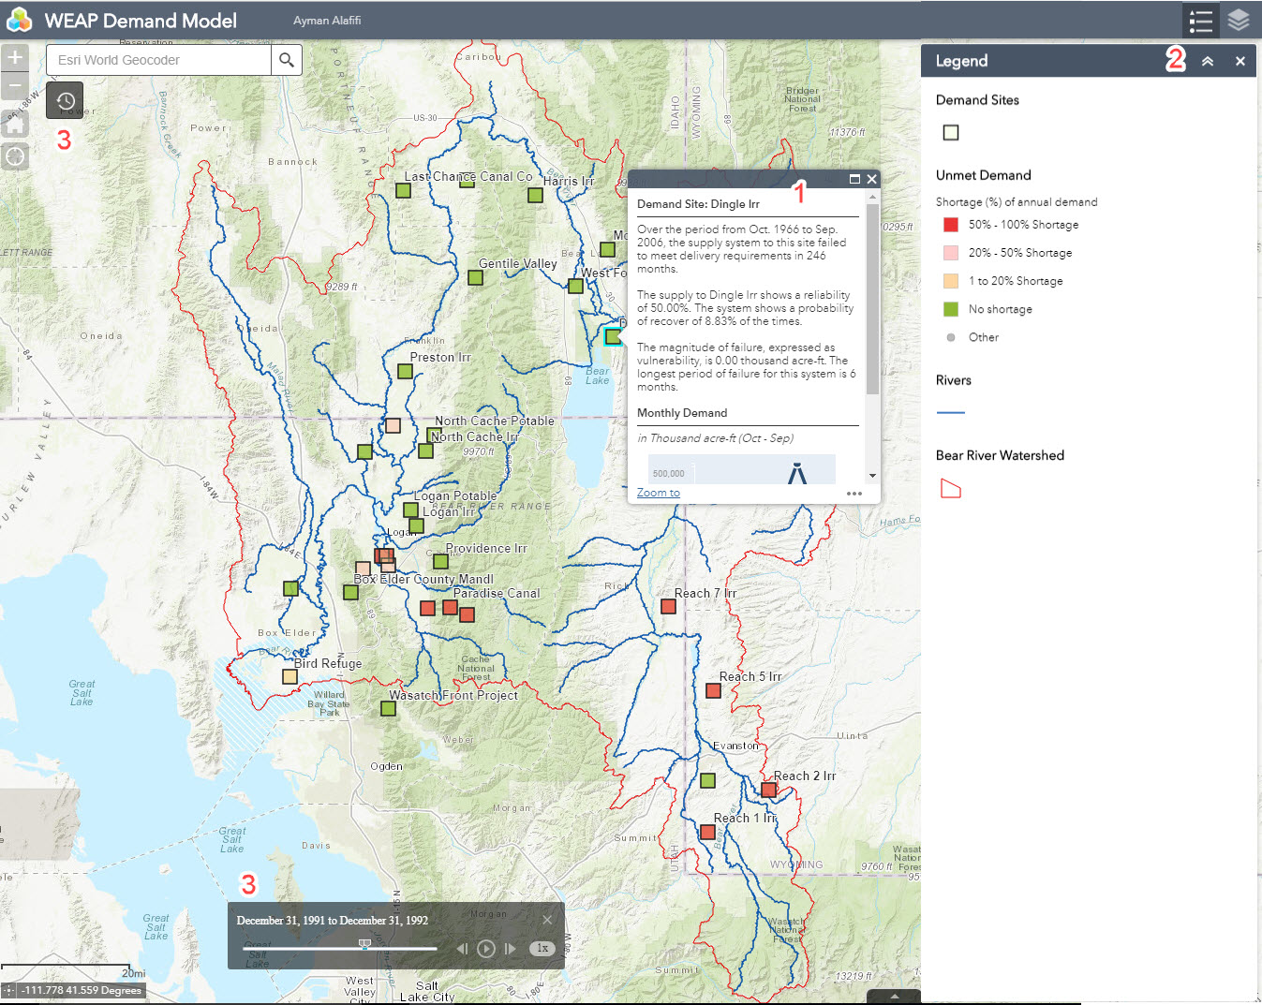
5. Configure interactive settings
Symbolize by shortage as (%) of annual demand
Pop-ups for information about each site including supply performance and monthly delivery targets
List of layers and legend with data download enabled
Time-slider for monthly variations of shortage

Slide 49
6. Share and customize web app
One web map can be used in multiple apps.
Know your audience and customize interactivity
Communicate targeted messages with minimal instructions
Follow web design best practices in colors, fonts, symbols, and authorship

Slide 50
Conclusions
Water resources allocation models consider multiple users, priorities, and connectivity in the network
WEAP is a valuable tool for water resource planning and evaluation
WEAP is useful for policy decision in water resource management
WEAP results can be better communicated on an interactive web app
Build River Network web tool creates web layers for river nodes and links and facilitates building web GIS applications

Slide 51
Thank you..
Ayman Alafifi
ayman.alafifi@gmail.com

