Slide 1
Water and Peace in Iraq
Resources, Access, and Conflict in Iraq’s Peacebuilding Process
Jill Baggerman

Slide 2
Objective: where (for whom) to concentrate Iraq’s peacebuilding efforts?
To understand the relationship between ethno-religious identity and access to safe drinking water with incidents of violence in Iraq

Slide 3
Objective: where to concentrate peacebuilding efforts?
Anecdotal evidence suggests there is a link between ethno-religious groups and water access.

Slide 4
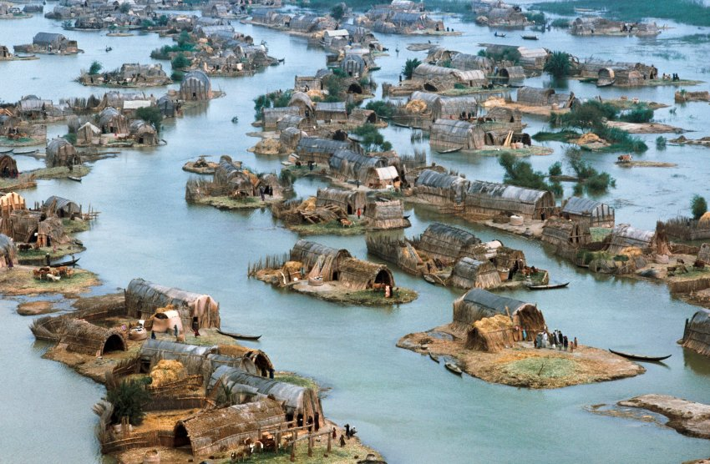
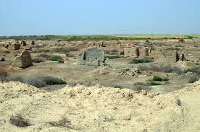
Historic Water Access and Discrimination

Slide 5
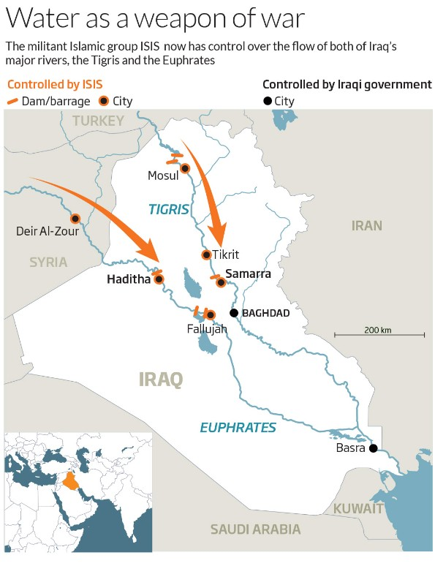
Recent Water Access and Discrimination

Slide 6
Objective: where to concentrate peacebuilding efforts?
Anecdotal evidence suggests there is a link between ethno-religious groups and water access.
  To what extent is this supported by empirical evidence?
How are ethno-religious identities and water access related to incidents of violence post-1991 and post-2013?
Dropped Component:
  Geographic-based correlations between incidents of violence and agricultural productivity.

Slide 7
Data Sources
Ethno-religious Data
Water Access Data
Violent Event Data
CIA World Factbook
Empirical Studies of Conflict (ESOC) at Princeton University
2003
Household level surveys from the United Nations International Children’s Emergency Fund (UNICEF), for:
1996
2000
2006
2011
Unpublished: 2018
Empirical Studies of Conflict (ESOC) at Princeton University
Long-run violence 1991 - 2017
Mid-term violence 2013 – 2017
Global Terrorism Database

Slide 14
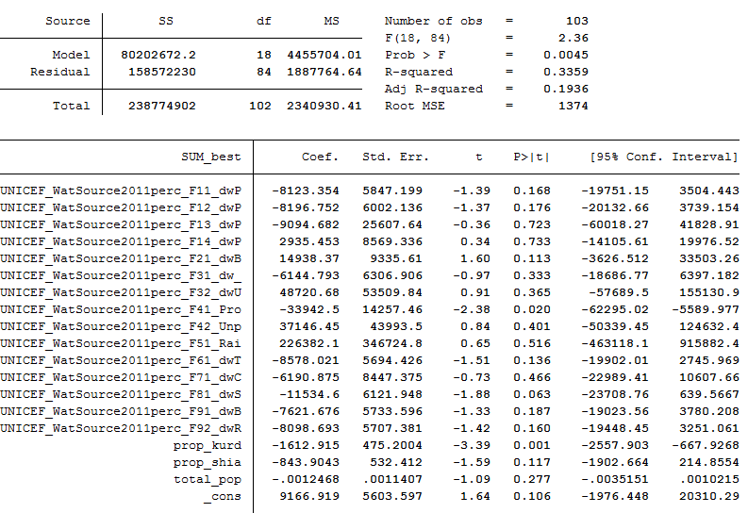
Probability of Violence, from Ethno-religious identity and percent water source
model explains 19% of variation in violent events

Slide 15
Limitations
Ethno-religious Data
Water Access Data
Violent Event Data
Demographic Changes
Uncollaborated
UNICEF data had to be geo-coded by hand. Sought assistance for matching districts, e.g.:
Daquq = Daqooq
Dibis = Aldbs
Mosul = Ninewa
Measuring violence based on deaths in events is not the best measure for peacebuilding or conflict prevention.

Slide 16
Thank you!
Special thanks to Amal Bakchan and Tahar Hichri for translation assistance and to the Strauss Center for International Security and Law for funding of the wider project this sub-project is associated with.

