Slide 1
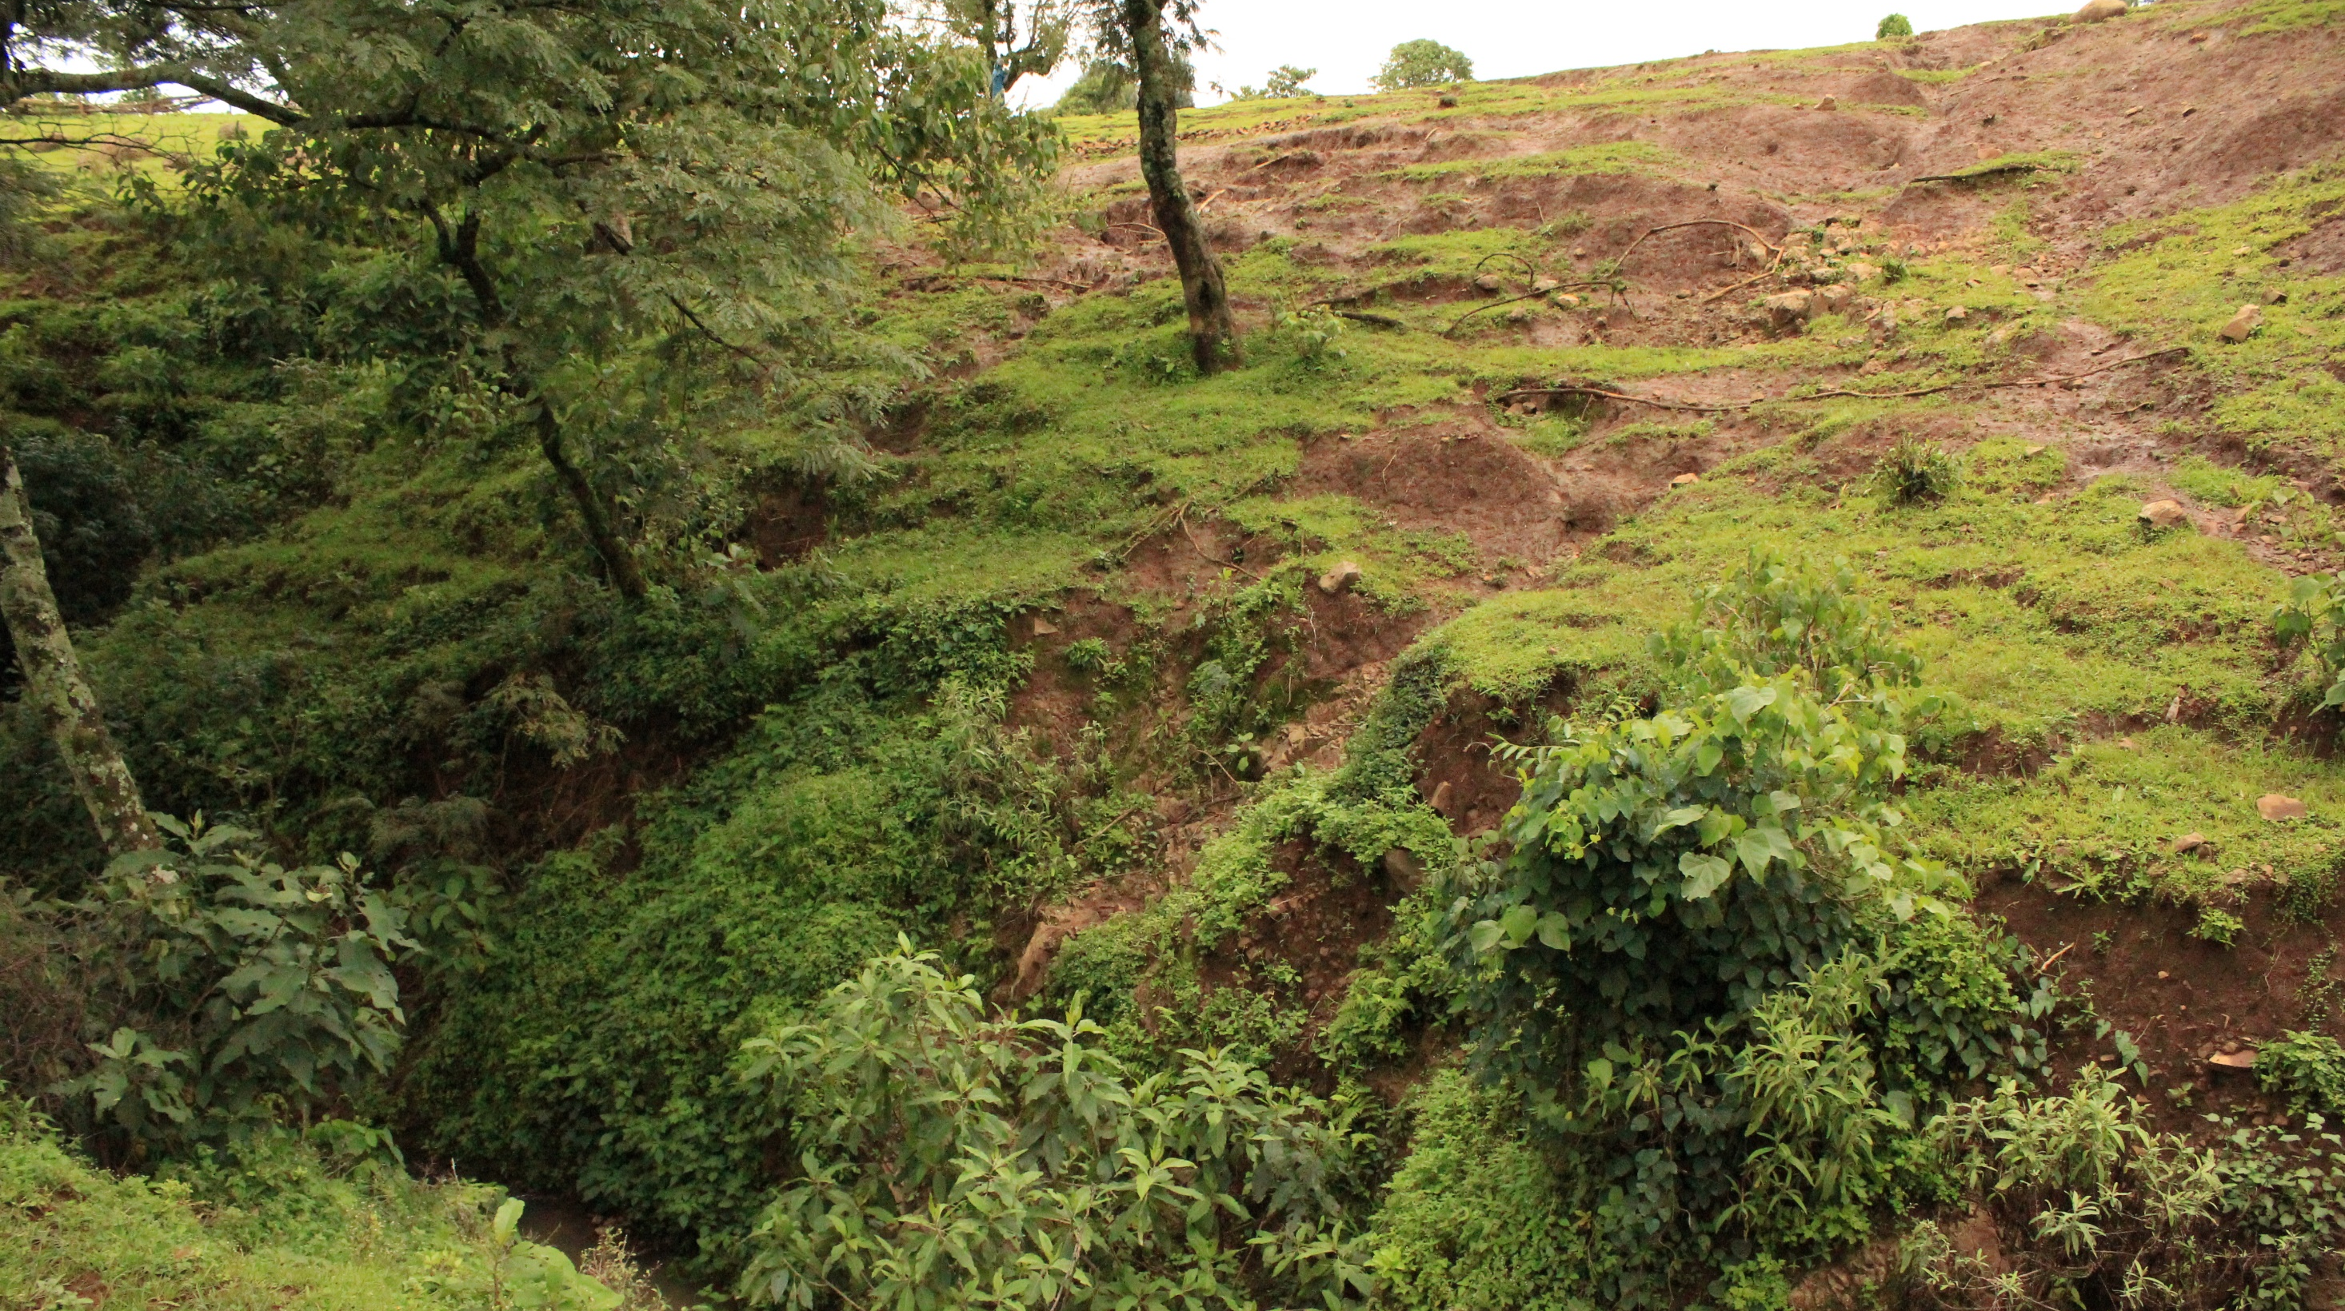
Examining the role of land use and precipitation on the water quality of Lake Tana, Ethiopia
Brian S. Kim

Slide 2
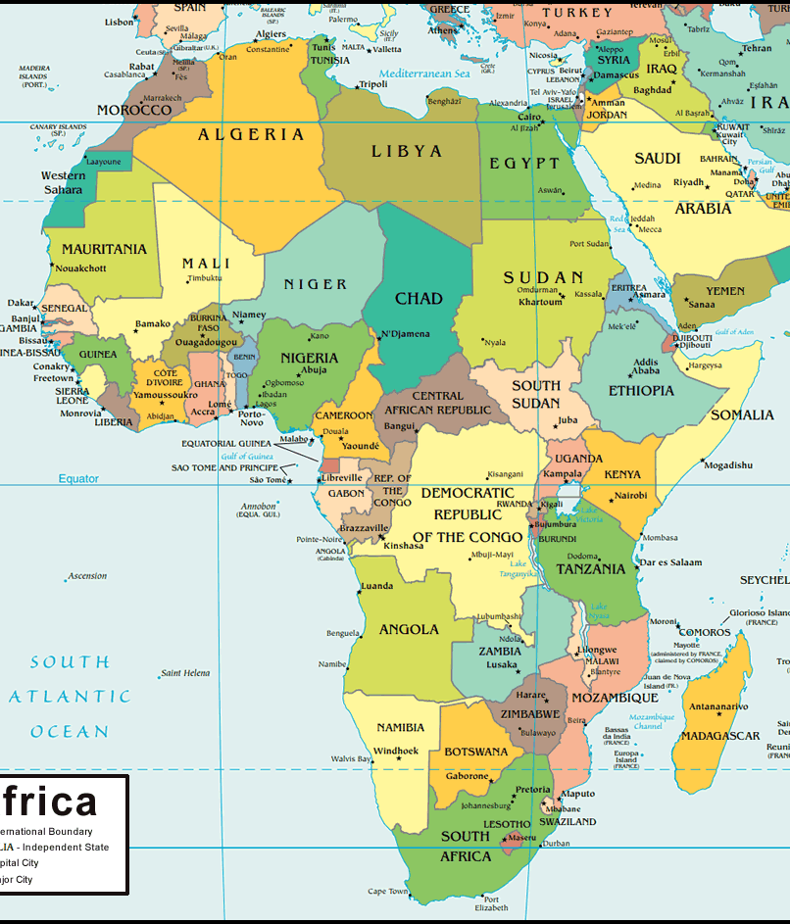
Amhara Region of Ethiopia
Population: 19 million
Land Use: 81% agriculture
Agriculture: teff, sugarcane, cotton, livestock
Forest Cover: 1.65%
Religion:
82% Orthodox Christian
18% Muslim

Slide 3
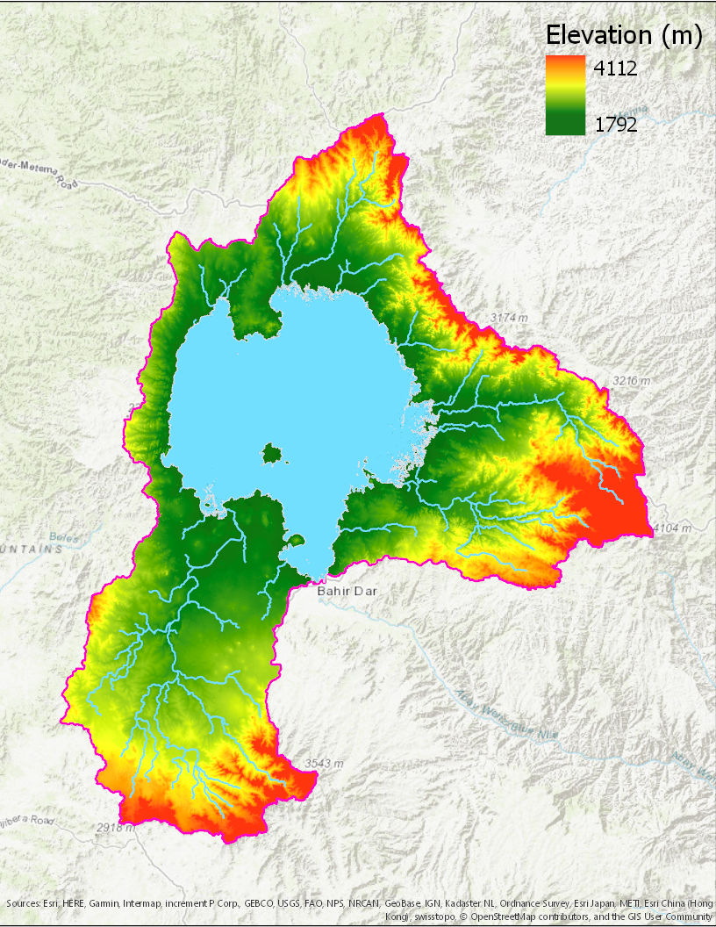
Lake Tana, Ethiopia
Surface Area: 3200 km2
Elevation: 1788 m
Max Depth: 15 m
Lake Tana supports a large fishing industry (Nile tilapia and sharptooth catfish)
1454 tons of fish annually

Slide 4
Forest Loss in Northern Ethiopia
In the early 1990s, over 50% of the Northern Highlands were primary forest
Afromontane forest loss has been severe and widespread
Agricultural expansion
Livestock grazing
Only 2% of Ethiopia’s original forest cover remains

Slide 5
GIS Data Sources
Elevation: Aster Global DEM
Land Cover: MODIS
Precipitation: GPCC
TSS: Landsat 7 ETM+

Slide 6
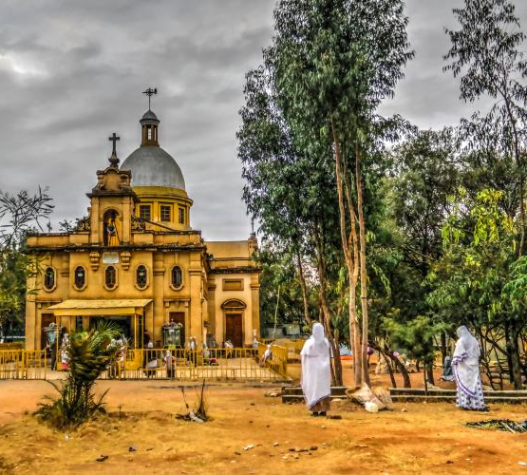
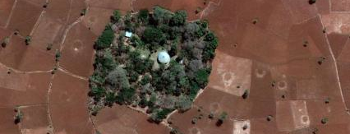
Ethiopian Church Forests
Over 10,000 church forests in the Amhara Region have been identified, including over 6,000 greater than 3 ha in size
Church forests can be found at every elevation, and every latitude, longitude, and agro-ecological zone in the Amhara Region.

Slide 7
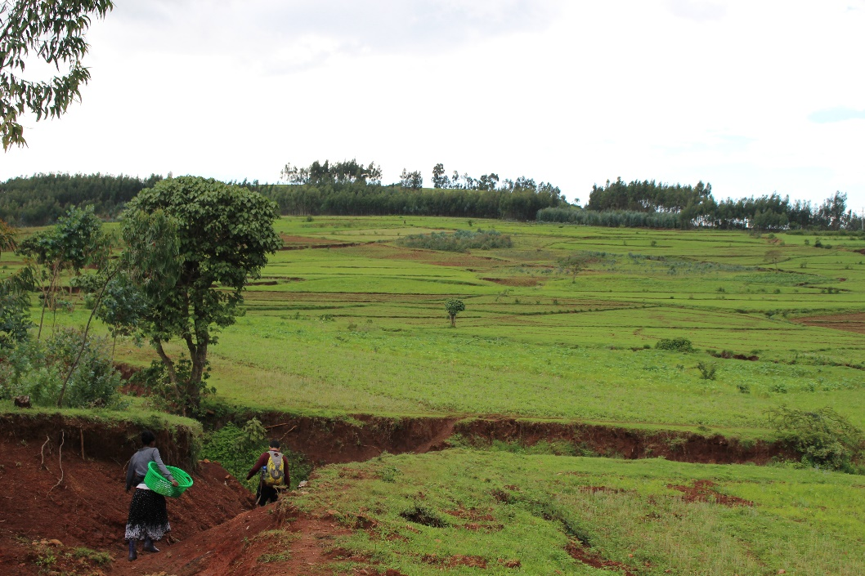
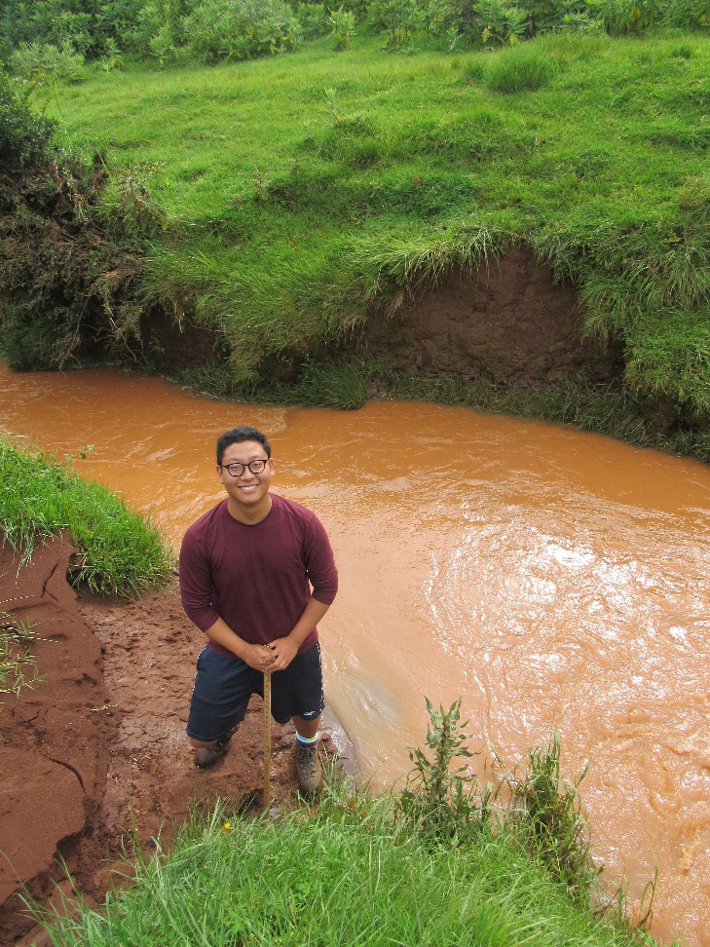
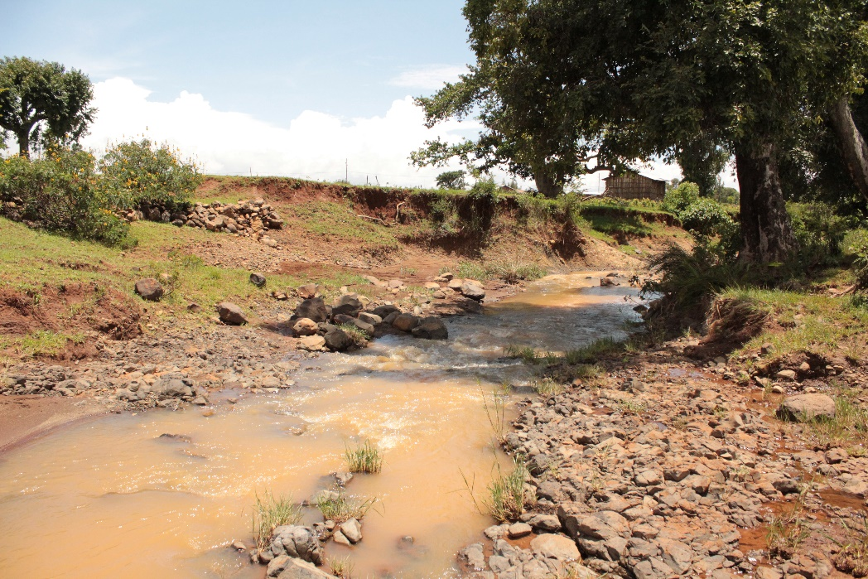
Erosion
Soil Type
Tree Cover
Streams
Precipitation
Slope/Direction

Slide 8
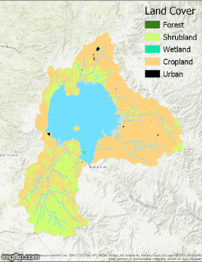
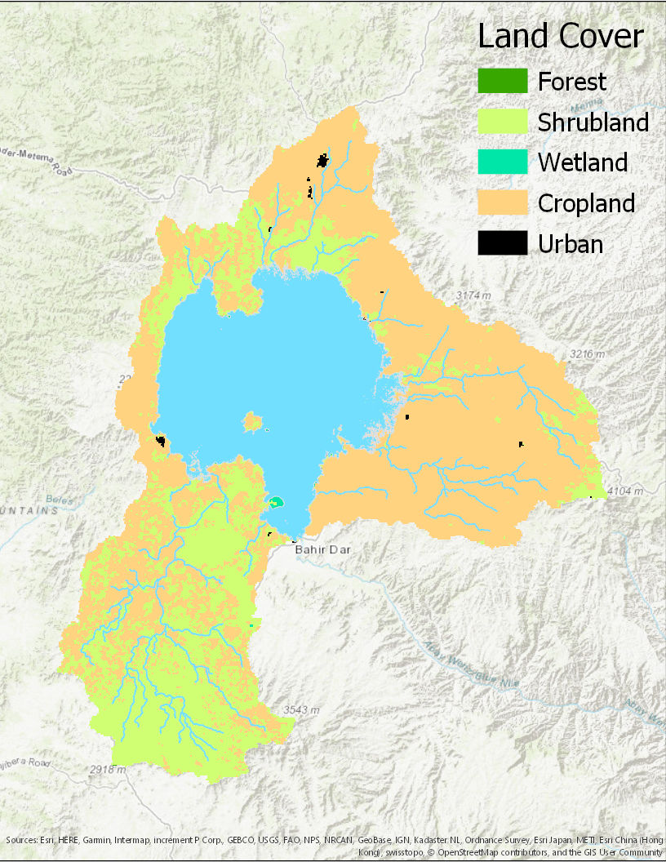
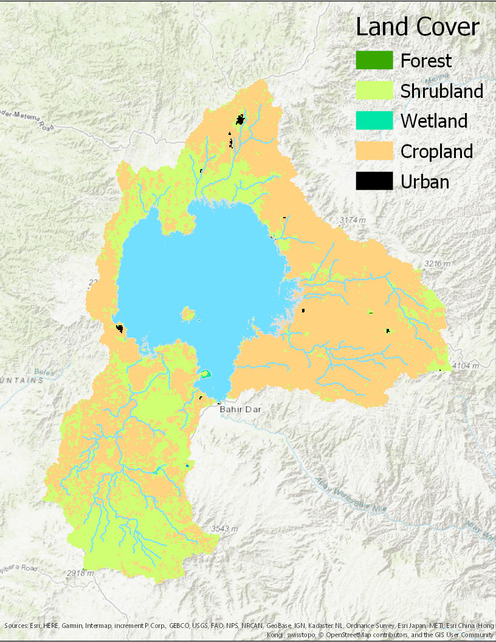
Land Cover Change 2001-2017
2001
2017

Slide 9
Land Cover 2000-2017
REDD (Reducing Emissions from Deforestation and Degradation)?
Percent of Lake Tana Basin (%)

Slide 10
Precipitation 1980-2017

Slide 11
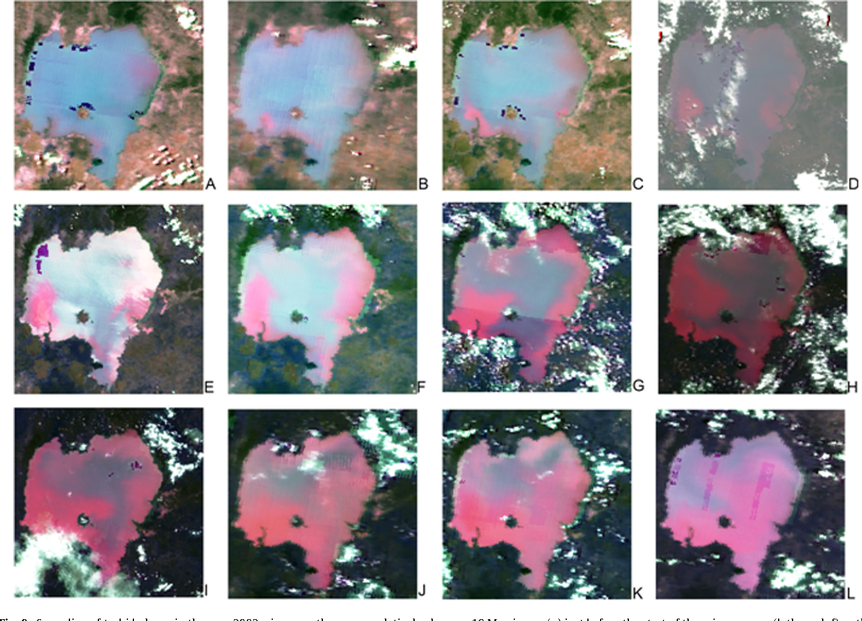
Total Suspended Solids
Fig. 9. Spreading of turbid plume in the year 2002; river mouths appear relatively clean on 19 May image (a) just before the start of the rainy season; (b through f) as the rainy season begins reddish turbid plume appear at entry location on 6 June, 11 June, 25 June, 2 July, and 6 July images; (g through j) the plume spreads along the shore and over a wider area as seen on 22 July, 23 August, 28 August and 10 September images; (k and l) with a reduced outflow from the lake during this typically low flow season the plume spreads to cover the whole lake as is seen on 17 September and 9 October images.

Slide 12
Moving Forward …
Identify heavy precipitation events
Using Landsat 7 ETM determine TSS
Identify TSS difference between eastern and western basin

Slide 13
Questions?

