Slide 1
Assessment of damage due to Hurricane Florence in Wilmington, NC
Shazzadur Rahman

Slide 2
Outline
2
3
4
5
Background
Data Sources
Results
Conclusion
1
Methodology

Slide 3
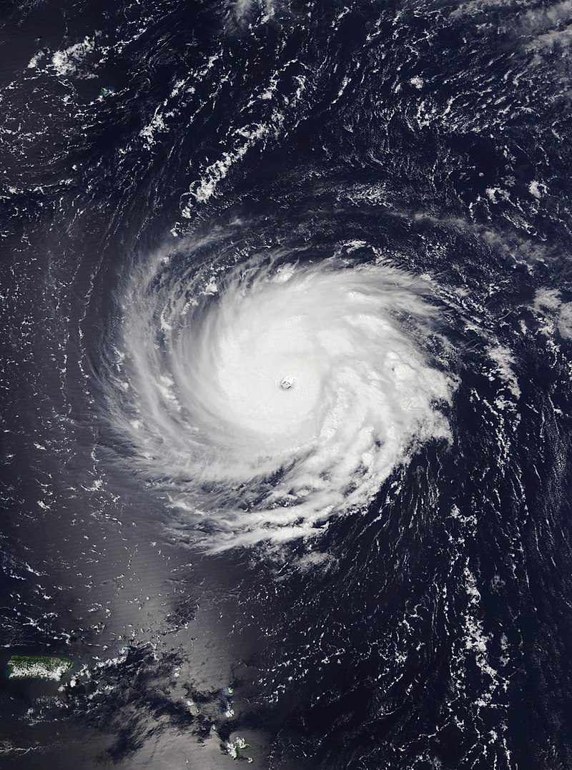
Hurricane Florence
Landfall in NC on September 14, 2018 as a category 1 hurricane
Through NC, SC, Virginia and Florida
55 deaths
$17 billion damage for NC
Record annual rainfall of 86.7 inches in Wilmington, NC after 1877

Slide 4
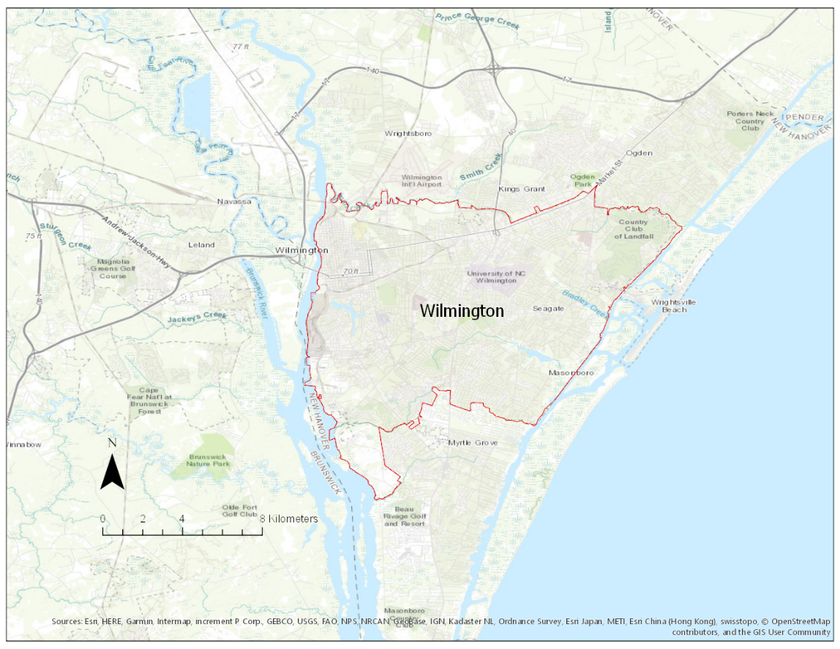
Study Area

Slide 5
Crowdsource Data (NAPS Foundation)

Slide 6
Methodology
1
2
3
4
Prepare Input Data
Build A Model
Prepare HAND Map
Prepare Inundation Map
5
Quantify Affected Households

Slide 7
Base Map

Slide 8
HAND Model

Slide 9
HAND MAP

Slide 10
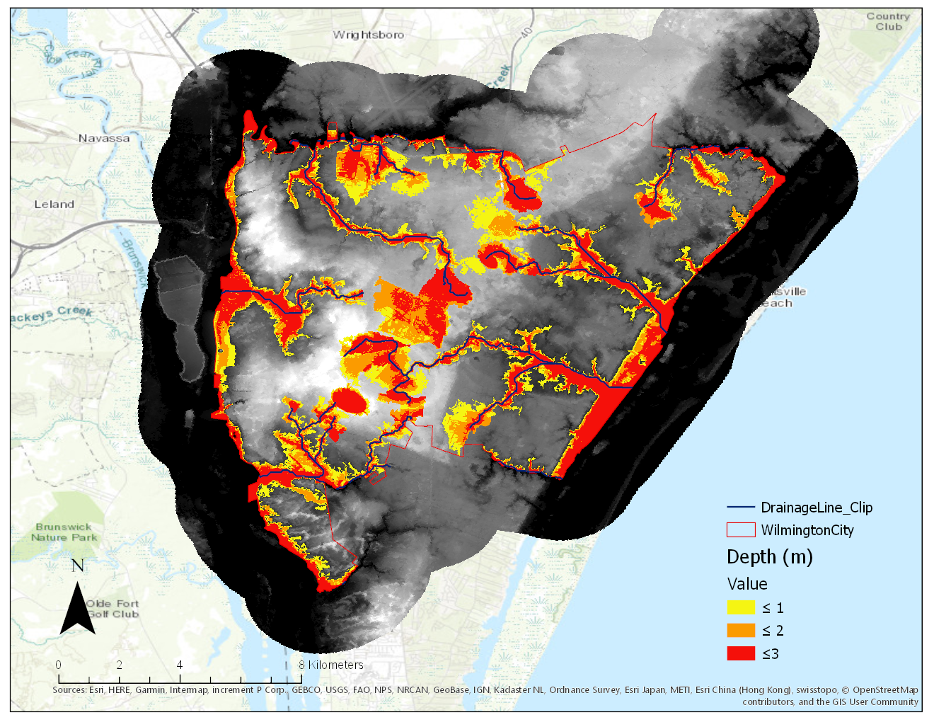
Inundation Map

Slide 11
Inundated Households
Address NC 2014 Data
10588 households inundated out of 49405
Almost 21.5% inundated

Slide 12
Conclusion
HAND maps are easy to prepare and helpful to provide some useful information
Crowdsource data can be easily obtained and used to get some good approximation about the flooding
More refined data would give better results

Slide 13
THANK YOU! ANY QUESTION?

