Slide 1

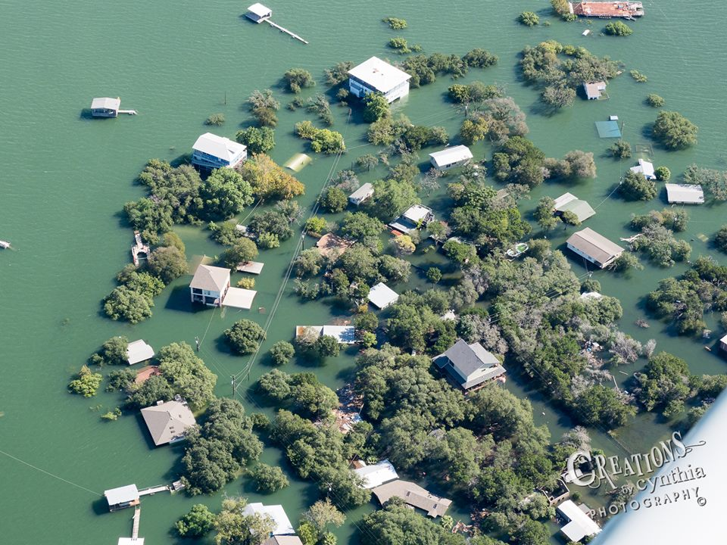
CE 394K.3 GIS in Water Resources
Fall Semester 2018
Central Texas Hill Country flooding

Slide 2
Central Texas Hill Country flooding
Outline
Context
Focus area
Height Above Nearest Drainage
Limitations and suggestions

Slide 3
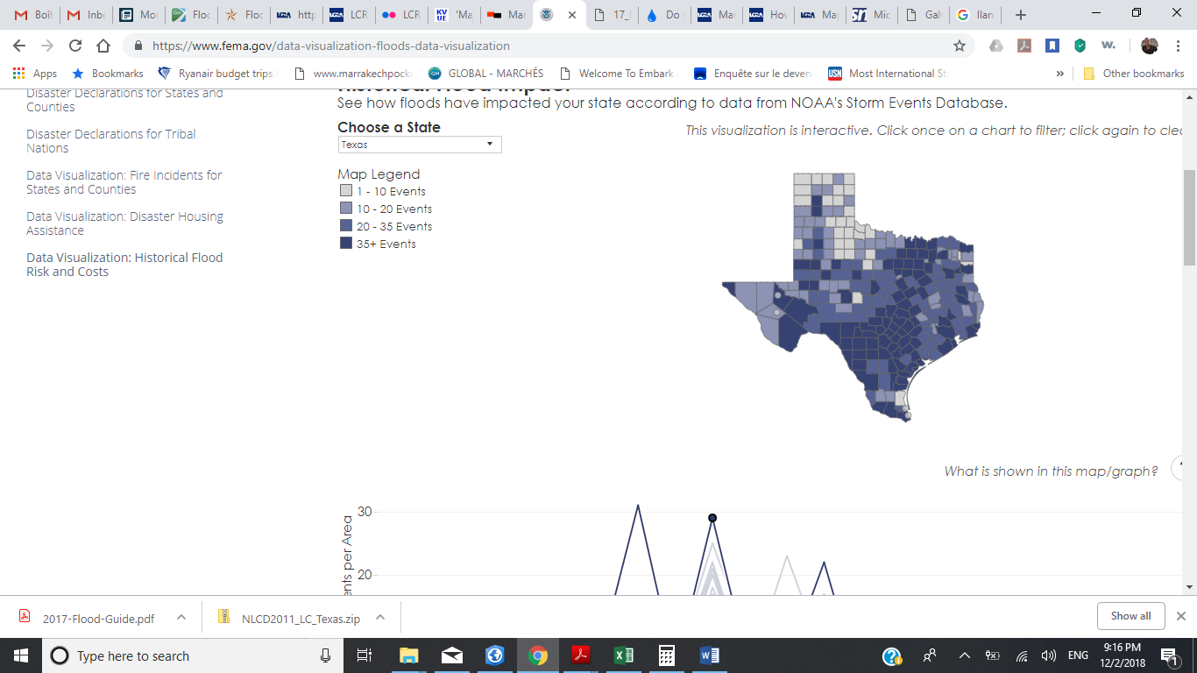
Central Texas Hill Country flooding
Context
3
1
2
4
# | State | NFIP Payments | %
1 | Louisiana | 16,087,259,069.92 | 38%
2 | Texas | 5,094,691,952.54 | 12%
3 | New Jersey | 4,604,858,460.72 | 11%
4 | New York | 4,443,074,843.54 | 10%
5 | Florida | 2,683,983,509.65 | 6%
6 | Mississippi | 2,499,691,844.26 | 6%
7 | North Carolina | 803,491,400.21 | 2%
8 | Alabama | 733,761,015.07 | 2%
9 | Pennsylvania | 700,458,383.63 | 2%
10 | Virginia | 515,746,634.99 | 1%
Data source: National Flood Insurance Program 1996-2016
- Central Texas phenomenon: Flash Flood Alley (One of the most flood prone regions in the continent due to intense rainfall events and efficient drainage off the landscape)
Data source: NOAA's Storm Events Database 1996-2016
Notes:
National Oceanic and Atmospheric Administration National Weather service NOAA NWS defines a flood as "any high flow, overflow, or inundation by water which causes or threatens damage"

Slide 4
Central Texas Hill Country flooding
Context
3
1
2
4
Data source: NOAA's Storm Events Database 1996-2016

Slide 5
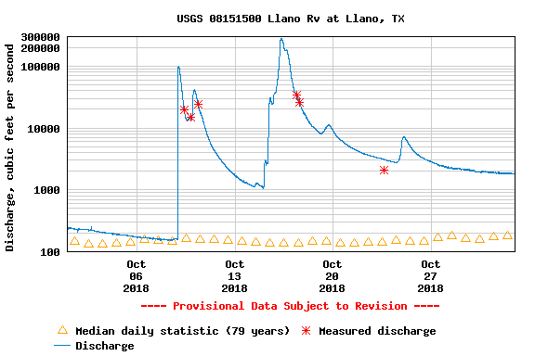
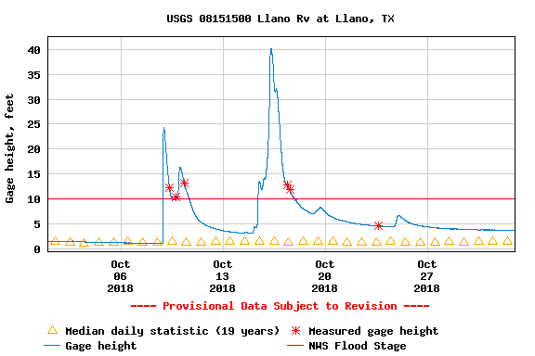
Central Texas Hill Country flooding
Context
3
1
2
4
Maximum gage height of 40.17 ft on Oct 16th
(Highest crest ever recorded was 41.5 ft in 1935)
Data source: USGS

Slide 6
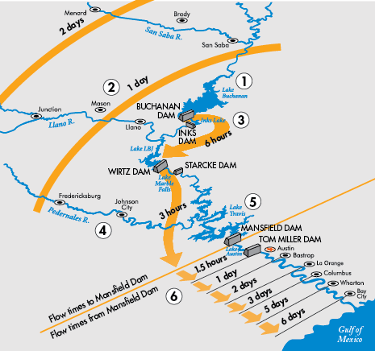
Central Texas Hill Country flooding
Context
3
1
2
4
Data source: Lower Colorado River Authority

Slide 7
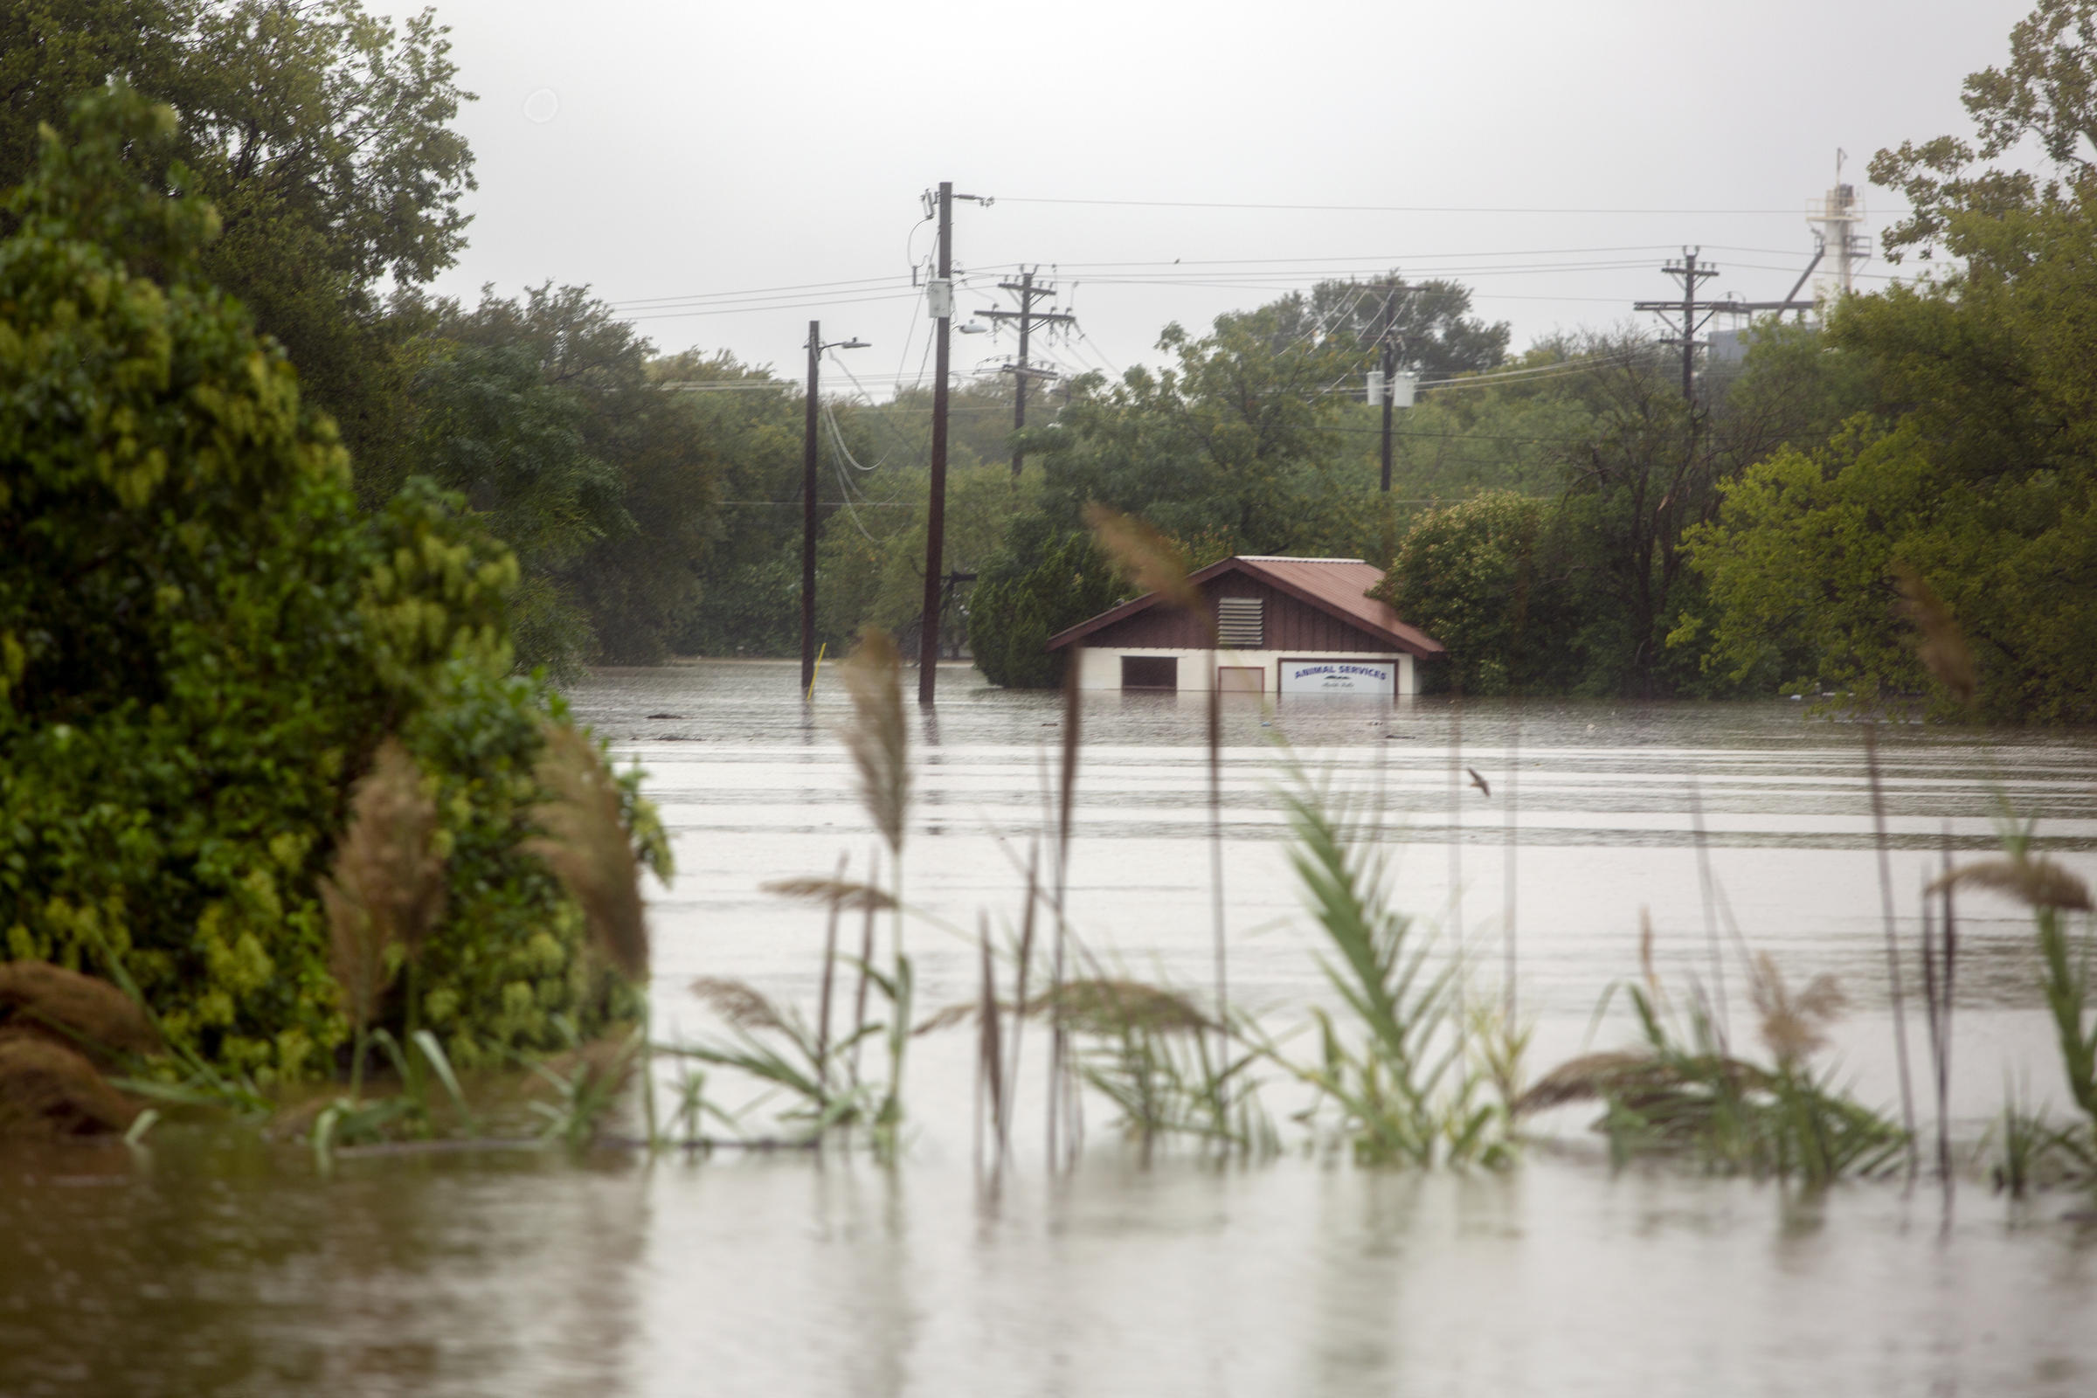
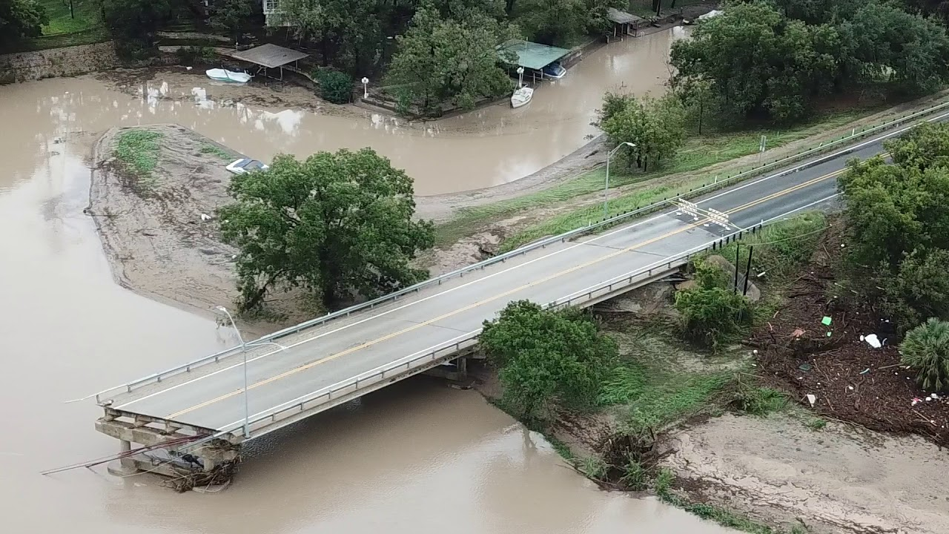
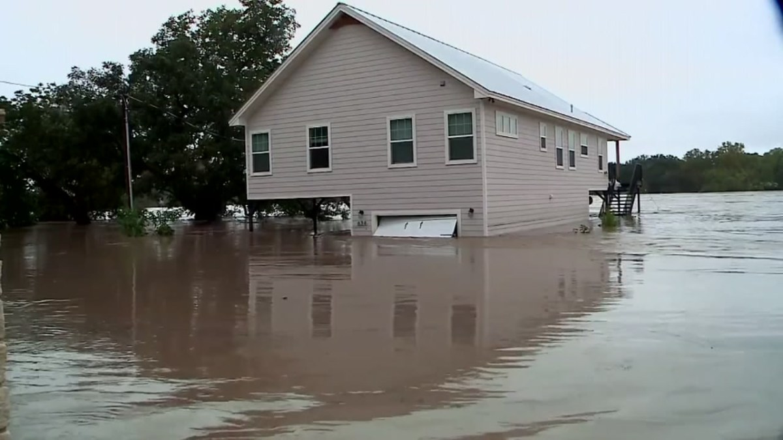
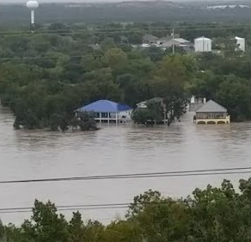
Central Texas Hill Country flooding
Context
3
1
2
4
Llano:
Kingsland:
Granite shoals:
Marble Falls:

Slide 8
Central Texas Hill Country flooding
Focus area
1
2
3
4

Slide 9
Central Texas Hill Country flooding
HAND
1
2
3
4

Slide 10
Central Texas Hill Country flooding
HAND
1
2
3
4
Based on Oct 16th mean discharge of 169,000 cfs at Llano stream gage (Floodflow=180,318.6 cfs in Kingsland catchment) :
Expected flood height: 11.75m

Slide 11
Central Texas Hill Country flooding
HAND
1
2
3
4

Slide 12
Central Texas Hill Country flooding
HAND
1
2
3
4
Catchment population: 1420
Inundated population: 580
41% of the catchment area is inundated

Slide 13
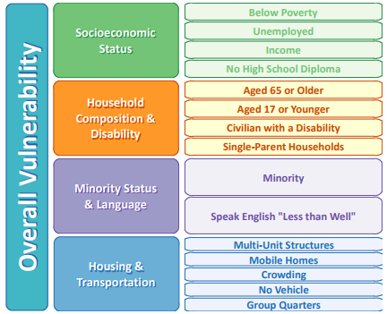
Central Texas Hill Country flooding
HAND
1
2
3
4

Slide 14
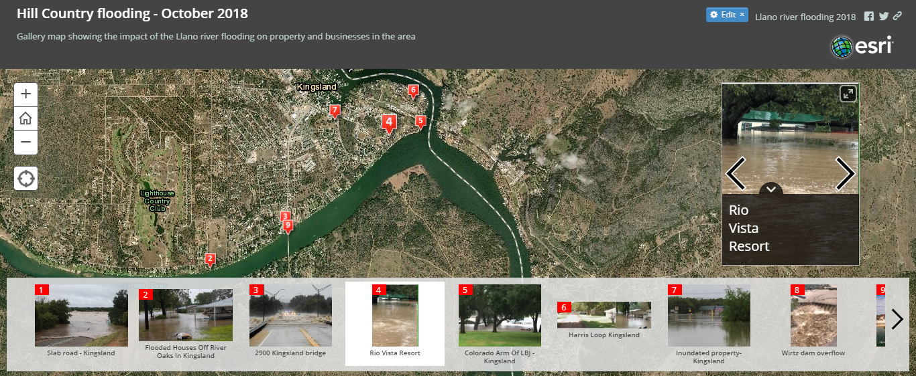
Central Texas Hill Country flooding
HAND
1
2
3
4
ESRI Story map: (Flood height observed on images of inundated areas ≈ 8m)

Slide 15
Limitations and suggestions
Central Texas Hill Country flooding
1
2
3
4
Limitations and assumptions:
Catchment population approximated due to unsuccessful weighted intersected polygon method
Population density assumed uniform per block, and geometrical measurement/approximation to estimate catchment population
Inundated population based on uniform catchment population density
Discrepancy between CatchPoly definition and the NHD Catchment results in inconsistencies in some areas
Suggestions:
Comparison of the HAND layer with a detailed map/assessment of damaged areas
HAND in neighboring catchments for aggregated results/estimations

Slide 16
CE 394K.3 GIS in Water Resources
Fall Semester 2018
Central Texas Hill Country flooding
Thank you!
Questions?

