Slide 1

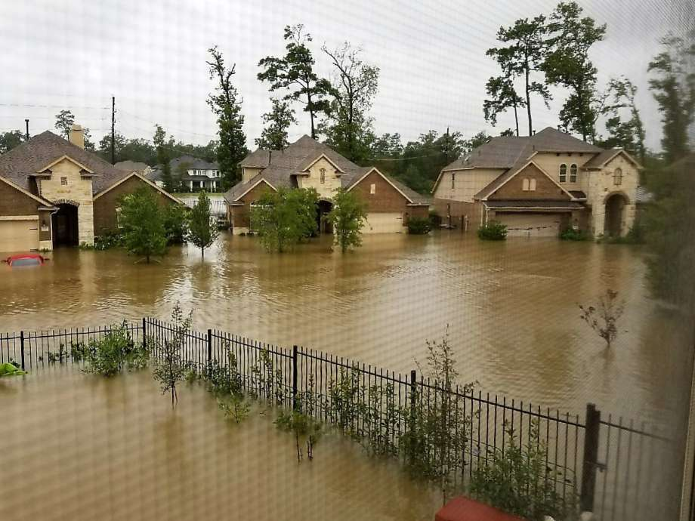

December 2018
Historic flooding in timarron lakes neighborhood
An investigation of the inundation depths of historic and recent storms in a residential area of The Woodlands, Texas that resulted in a lawsuit against the developers and engineers.
Kylee Ward
EWRE Master’s Student, The University of Texas at Austin

Slide 2
Outline
Motivation
Background
GIS Process
Results
Conclusion
Motivation Background GIS Process Results Conclusion

Slide 3
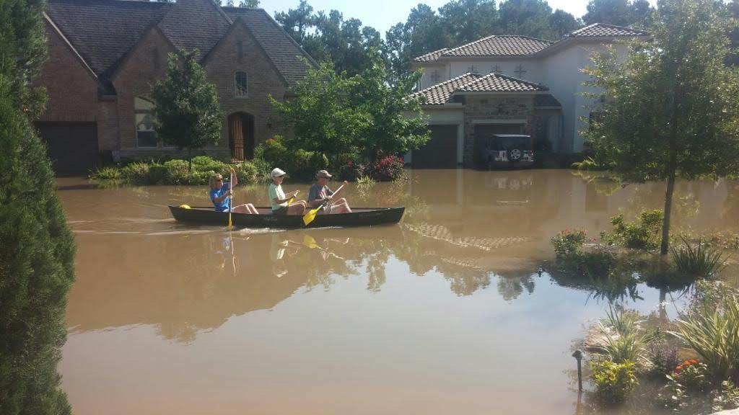
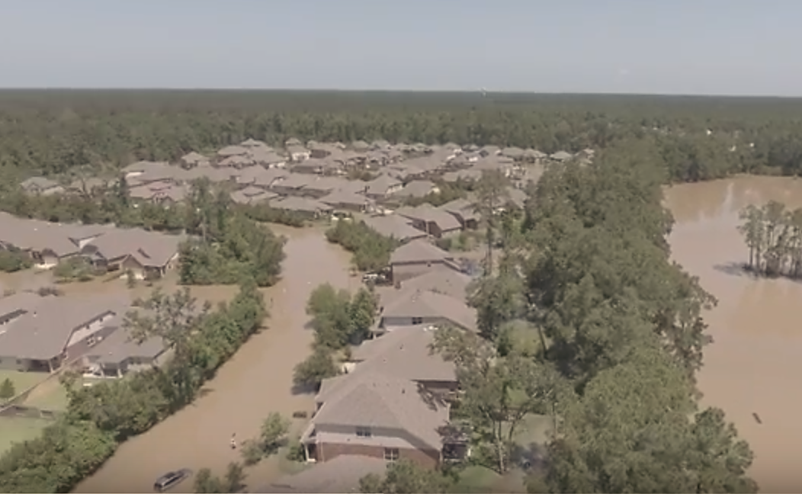
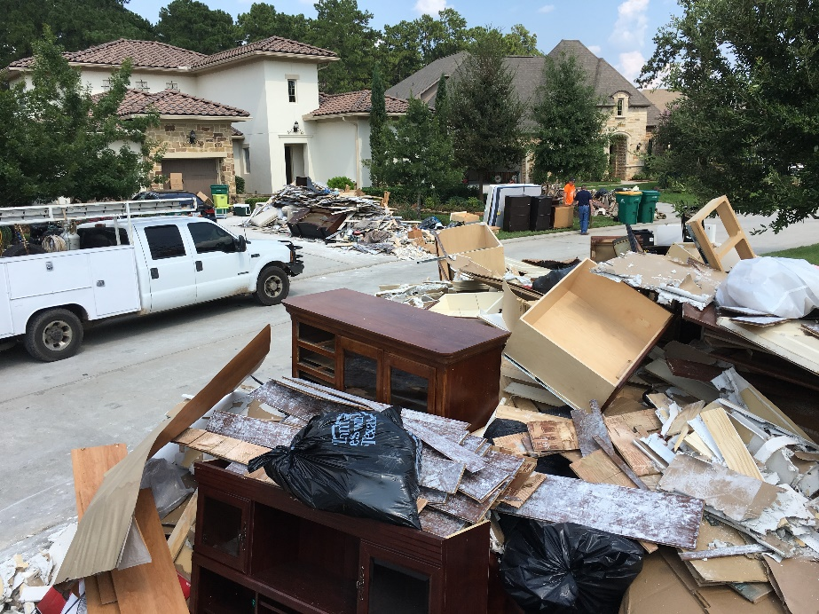
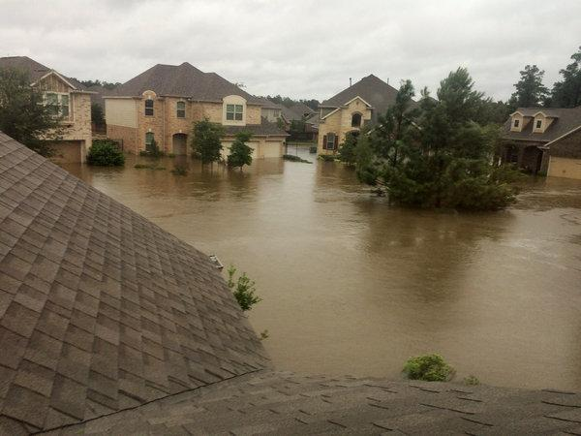
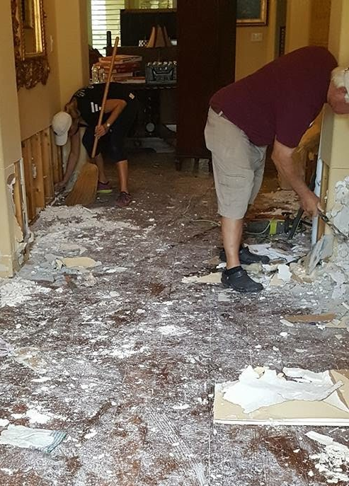
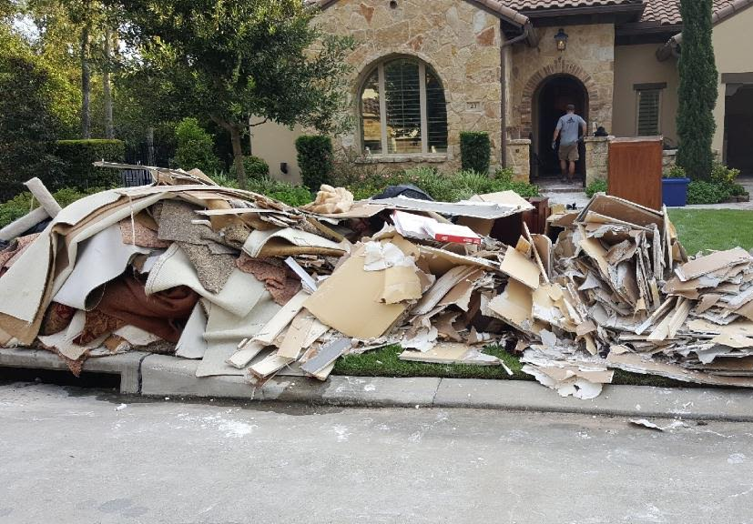
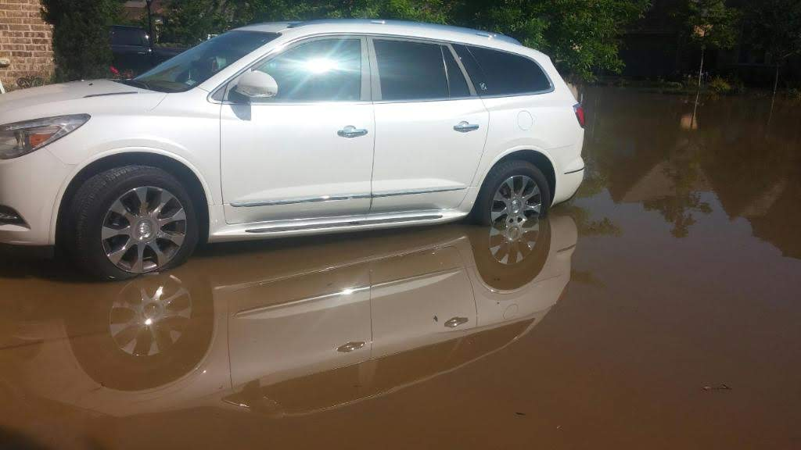
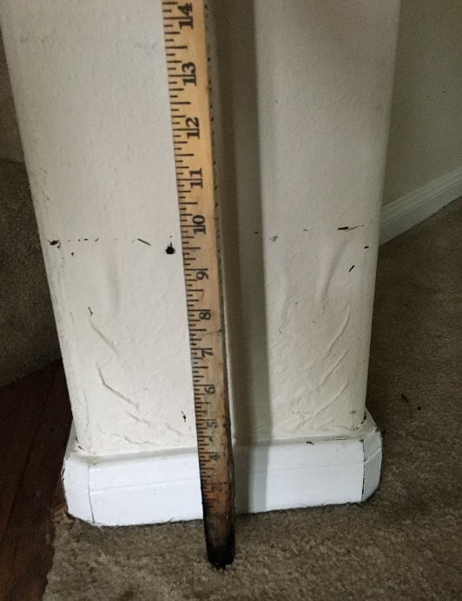
Memorial Day 2016
Hurricane Harvey 2017
Motivation Background GIS Process Results Conclusion

Slide 4
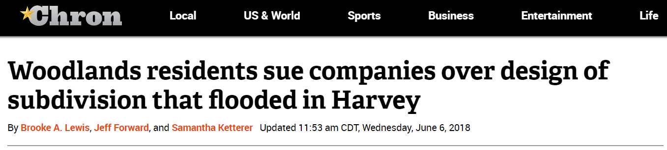
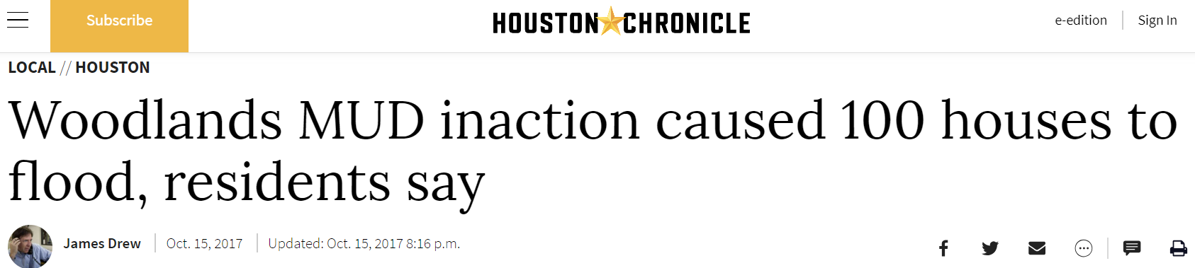

Motivation Background GIS Process Results Conclusion

Slide 5
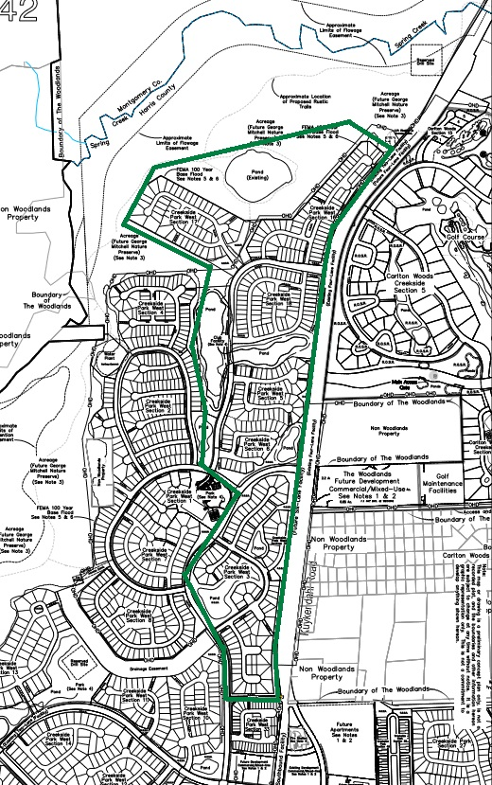
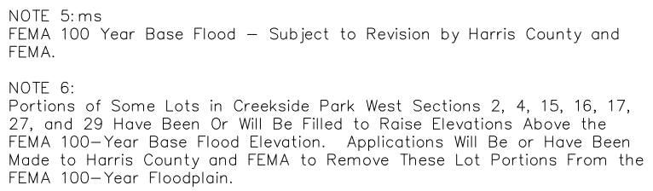
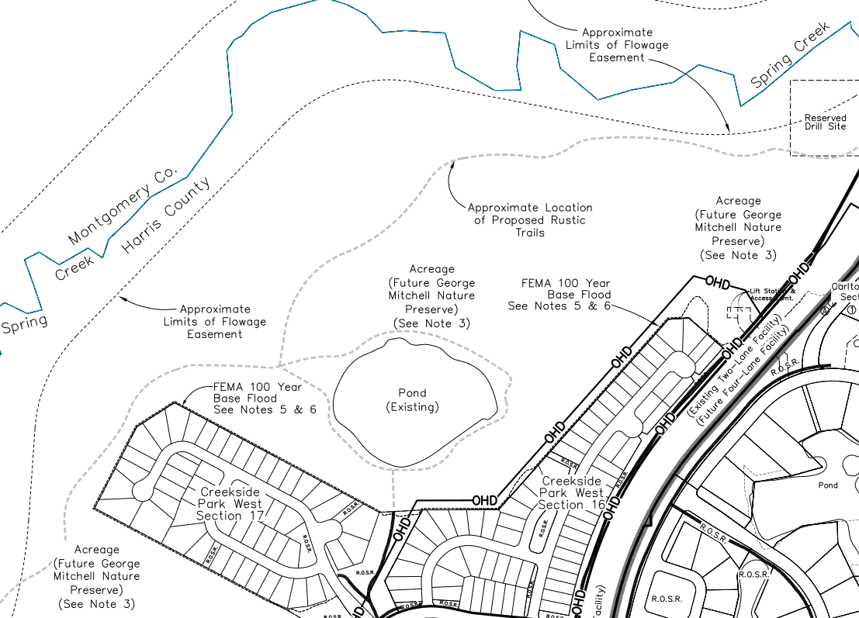
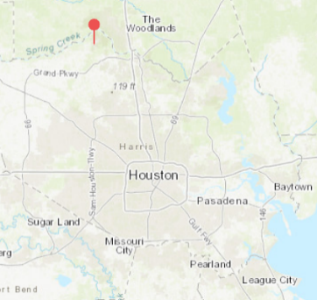
Motivation Background GIS Process Results Conclusion

Slide 6
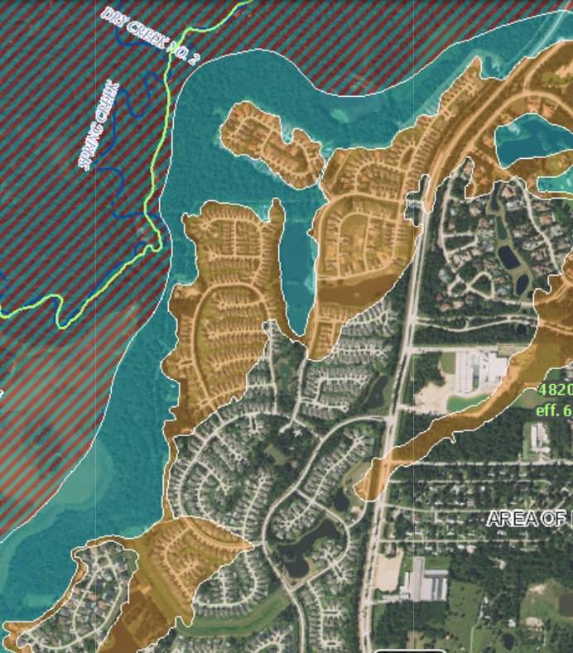
FEMA Flood Map
Map from the National Flood Hazard Layer (NFHL)
Texas Department of Insurance only requires flood insurance purchase in 100-year flood zones
100-Year Floodplain
500-Year Floodplain
Regulatory Floodway
Motivation Background GIS Process Results Conclusion

Slide 7
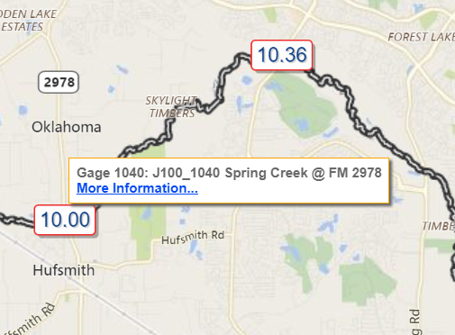

Stream Gage Data
Harris Country Flood Control District Stream Elevation Sensors
Motivation Background GIS Process Results Conclusion

Slide 8
Basemap
662 total homes
Basin with catchments and flowlines
“Catchpoly” layer
Neighborhood boundary and address points
Motivation Background GIS Process Results Conclusion

Slide 9
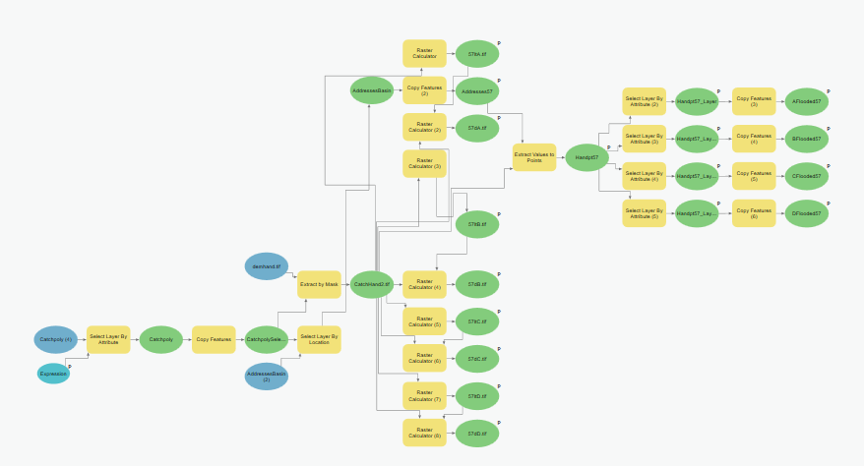
HAND & Inundation Calculations
Model Builder
Basin with HAND raster
Motivation Background GIS Process Results Conclusion

Slide 10
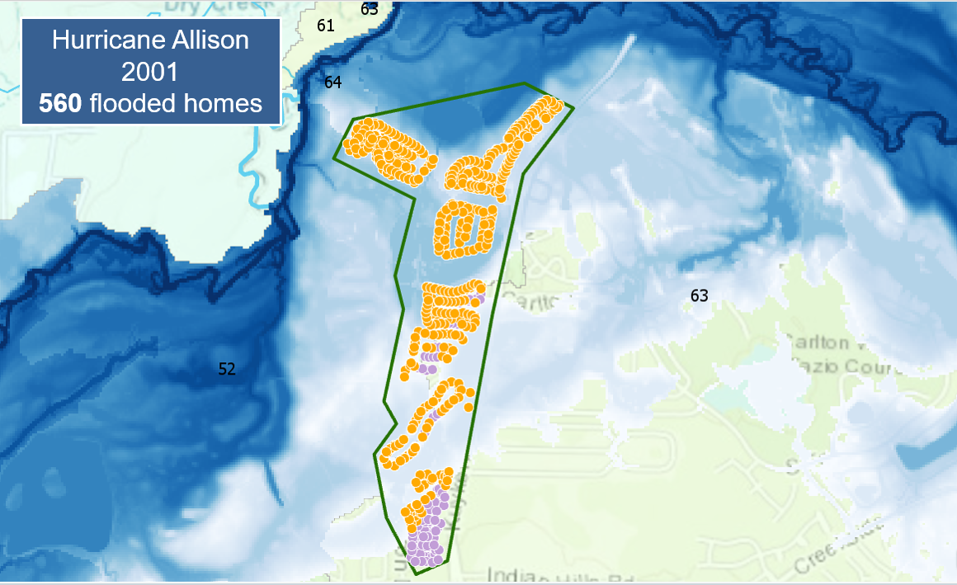
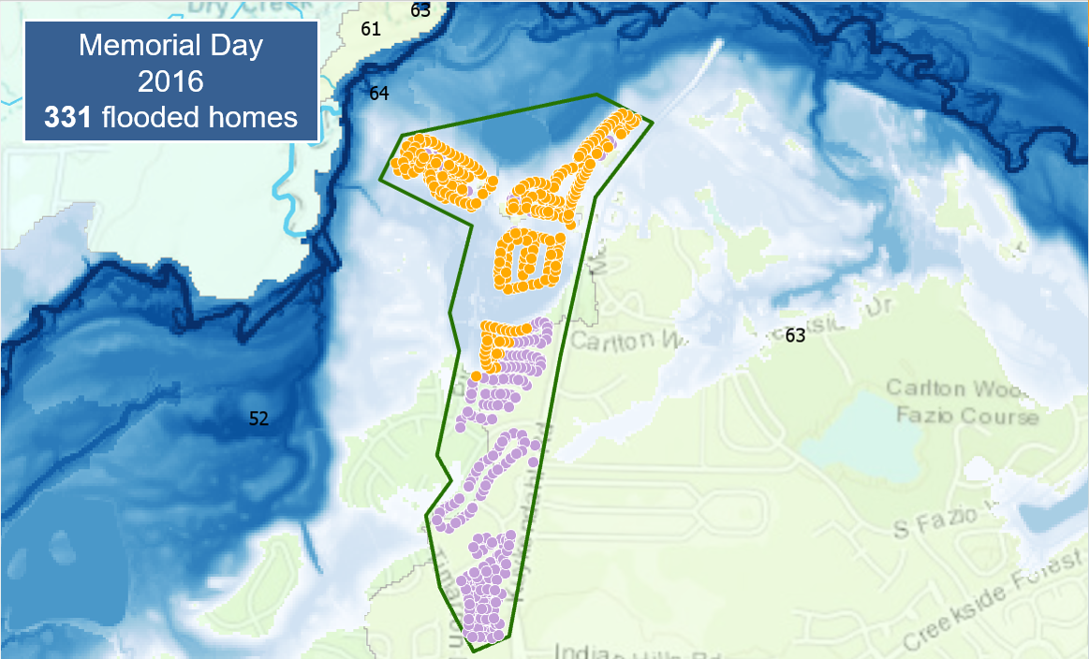

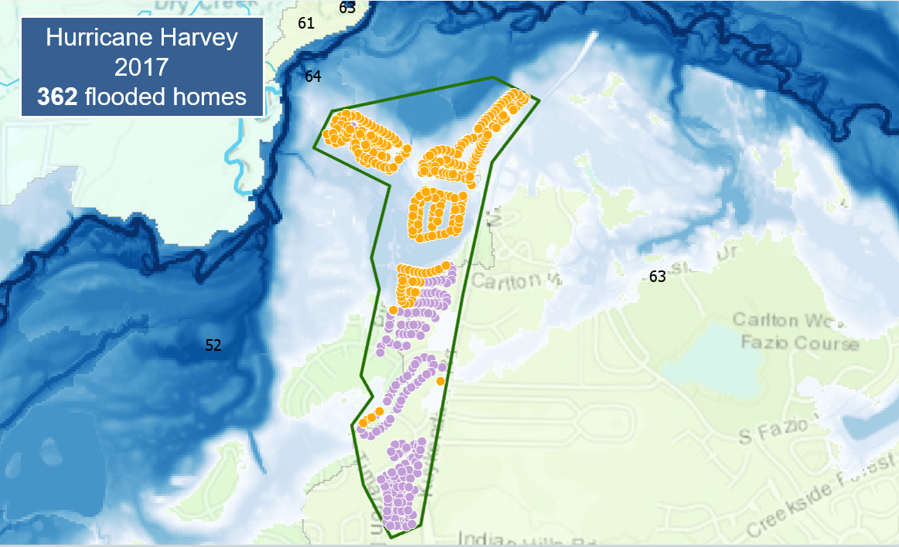
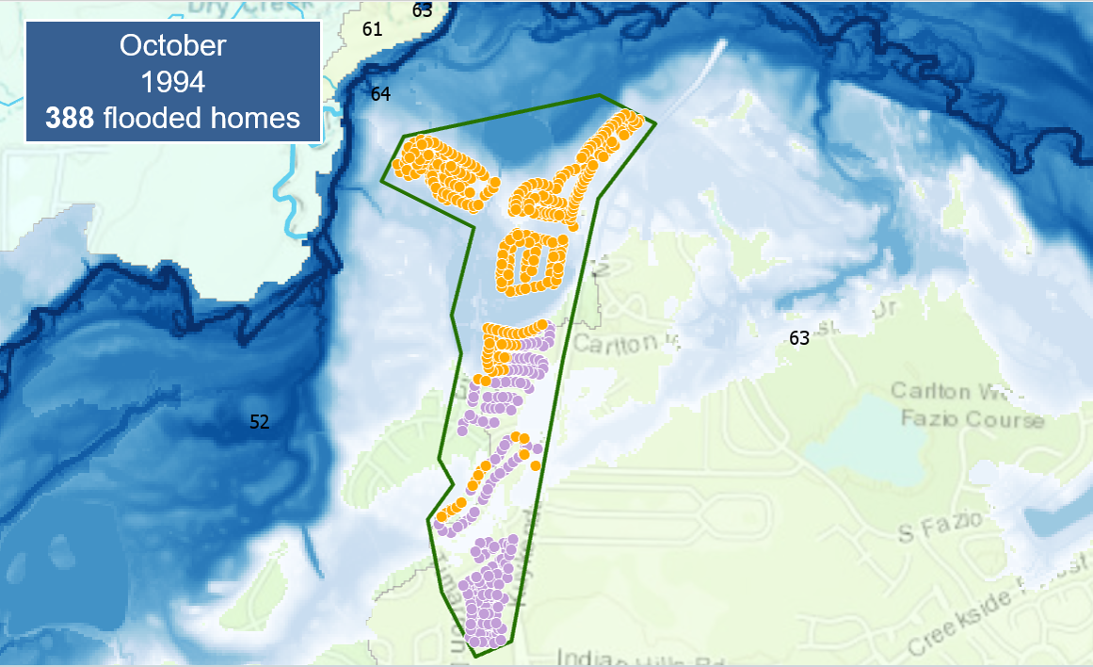
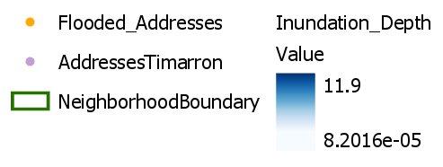
Results
Motivation Background GIS Process Results Conclusion

Slide 11
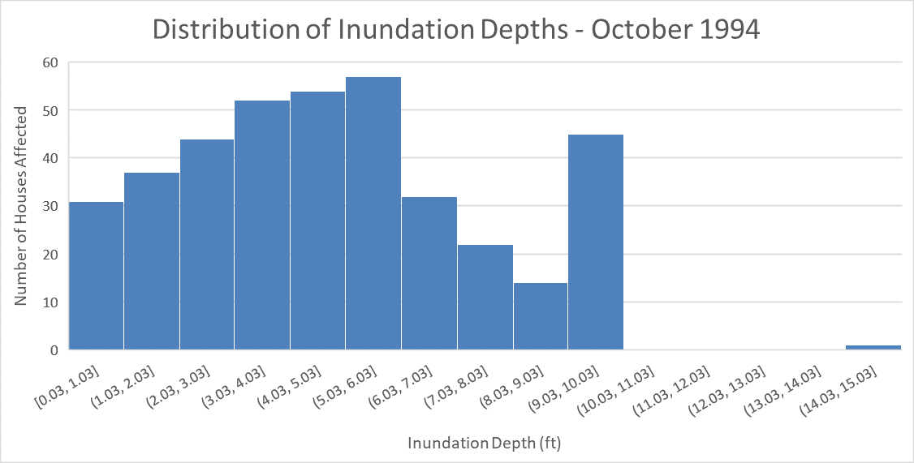
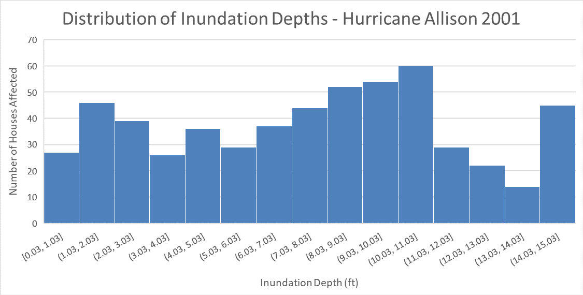
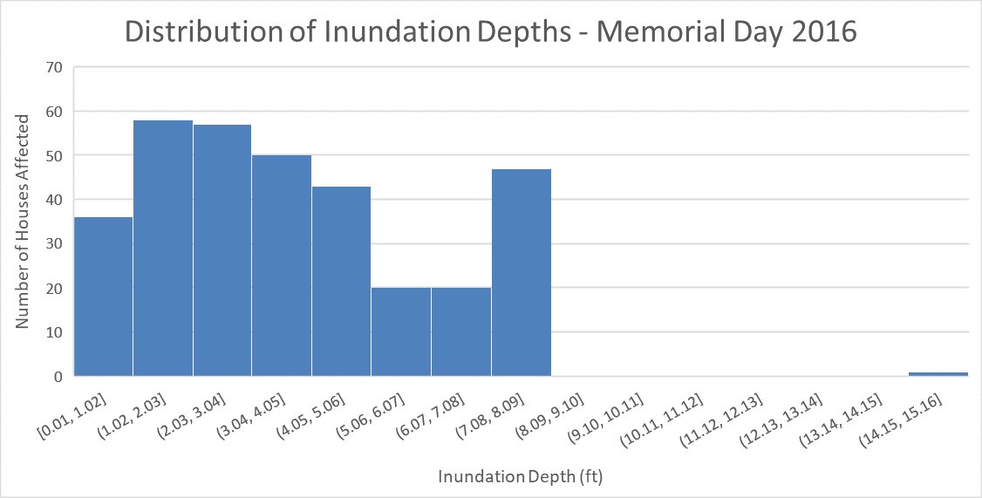
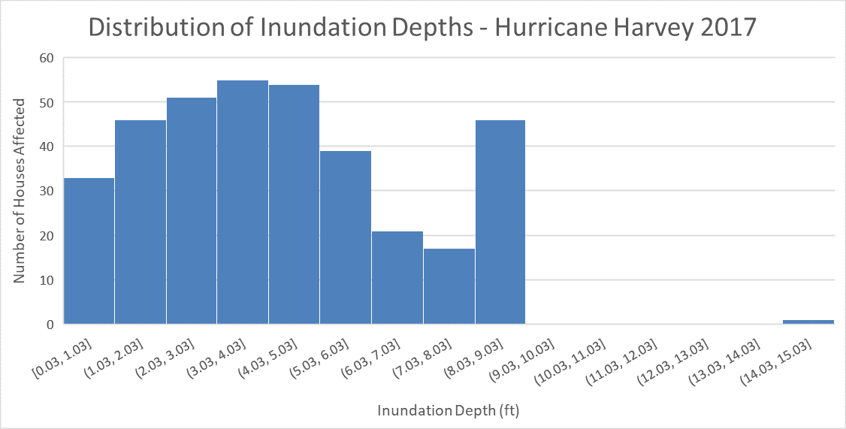
Avg. Depth = 4.76 ft
Avg. Depth = 7.52 ft
Avg. Depth = 3.71 ft
Avg. Depth = 4.24 ft
Motivation Background GIS Process Results Conclusion

Slide 12

Things to Consider
Address Points
  Use a single coordinate, but inundation depths may vary across a property.
Inconsistencies
  Catchpoly derived using D8, HAND calculated using DINF.
All models are wrong?
Observed: 10” inside
GIS: 24” for address point
Motivation Background GIS Process Results Conclusion

Slide 13


Conclusions
Lawsuit still ongoing
Possible need for reevaluation of storm event frequencies (Austin Atlas 14)
Lawful vs. ethical practices
  Quick profit vs. longevity of development
  Consideration of ground subsidence
500-year floodplain
100-year floodplain
“Hold paramount the safety, health,
and welfare of the public.”
Motivation Background GIS Process Results Conclusion

Slide 14
References
FEMA’s National Flood Hazard Layer (NFHL) Viewer: https://hazards-fema.maps.arcgis.com/apps/webappviewer/index.html?id=8b0adb51996444d4879338b5529aa9cd&extent=-95.561312968323,30.159113858434328,-95.54303103167702,30.168389933512845
FEMA Flood Map Service Center (FMSC) Historic Products: https://msc.fema.gov/portal/advanceSearch#searchresultsanchor
Harris County Flood Warning System: https://www.harriscountyfws.org/GageDetail/Index/1060?span=24%20Hours&v=rainfall
Houston Chronicle “Woodlands residents sue companies over design of subdivision that flooded in Harvey”: https://www.chron.com/neighborhood/woodlands/news/article/Woodlands-residents-sue-companies-over-design-of-12956892.php
Houston Chronicle “Woodlands MUD inaction caused 100 houses to flood, residents say”: https://www.houstonchronicle.com/news/houston-texas/houston/article/Homeowners-say-Woodlands-MUD-is-refusing-to-12279507.php
New York Times “Builders Said Their Homes Were Out of a Flood Zone. Then Harvey Came.”: https://www.nytimes.com/2017/12/02/us/houston-flood-zone-hurricane-harvey.html
USGS National Elevation Dataset Downloads: https://viewer.nationalmap.gov/basic/

Slide 15
Questions?

