Slide 1
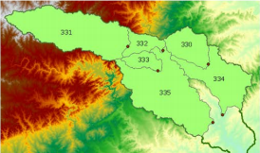
Differences in Average Elevation by Subwatershed for Ex 3, p.40
Calculating average subwatershed elevation involves about half a million cells per subwatershed, the differences in average elevation are about 5 cm in 250m, or about 0.02%
Average Elevation (m)
HydroID | Student | Exercise | Diff (Cm) | # Cells
330 | 189.91 | 189.86 | -5.00 | 323069
331 | 418.54 | 418.48 | -6.00 | 1023567
332 | 288.63 | 288.57 | -6.00 | 165683
333 | 266.19 | 266.11 | -8.00 | 140798
334 | 151.93 | 151.94 | 1.00 | 579142
335 | 183.59 | 183.54 | -5.00 | 1089142
Average | 249.80 | 249.75 | -4.83 | 553567
Root Mean Square Error of National Elevation Dataset from true elevation is 2.34m
Computational error is far smaller than the inherent error in the elevation data themselves

