Slide 1
How does the Dinfinity method work in case the angle doesn't fit into the steepest triangle?
z₀
Elevations at each vertex z_{i}
z₂
z₁
Δ
If α₁ does not fit within the triangle the angle is chosen along the steepest edge or diagonal resulting in a slope and direction equivalent to D8

Slide 2
Example
47
46
38
$$\operatorname{atan}\left(\frac{0.5}{0.2}\right)={68}^{o}$$
48
43
$$\frac{\left(43−38\right)}{10}=0.5$$
45
47
44
43
$$\frac{\left(45−43\right)}{10}=0.2$$
Choose
$$α={45}^{o}$$
Δ
$$S=\frac{45−38}{10×\sqrt{2}}=0.495$$
10

Slide 3
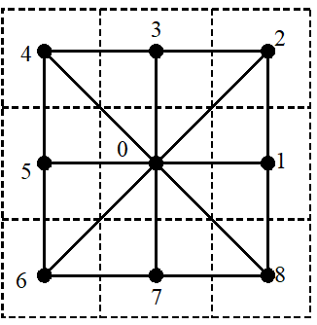
Example 2
43
42
44
$$\frac{\left(43−42\right)}{10}=0.1$$
48
46
45
$$\frac{\left(45−43\right)}{10}=0.2$$
47
48
47
$$\operatorname{atan}\left(\frac{0.1}{0.2}\right)={26.6}^{o}$$
Choose
$$α={90}^{o}$$
Δ
10
$$S=\frac{45−42}{10}=0.3$$

Slide 4
Example 3
41
46
47
$$\frac{\left(42−41\right)}{10}=0.1$$
$$α_{4}=atan\left(\frac{0.1}{0.3}\right)={18.4}^{o}$$
42
46
45
43
44
47
$$\frac{\left(45−42\right)}{10}=0.3$$
$$ang={180}^{o} −{18.4}^{o}={161.6}^{o}$$
Δ
$$S=\sqrt{{0.1}^{2}+{0.3}^{2}}=0.316$$
10
Choose

Slide 5
To turn in: Table giving slope, aspect, hydrologic slope and flow direction at grid cells A and B. For hydrologic slope report results from both D8 and DINF methods. Include in your solution diagrams or sketches that define or indicate what each of these numbers means for the specific values obtained for cells A and B."
For the first part of the question, am I required to enlist the values obtained from ArcGIS regardless of the fact that it gives some wrong answers?
Yes. Report the answers from ArcGIS. Note if/when you believe them to be incorrect.
And also, what does the "solution diagrams or sketches" in the second part mean? Do I need to sketch that raster and show the angle/direction there to indicate what that value actually means?
This value is believed to be incorrect. Hand calculations indicate it should be 4.2%
Point | Slope (%) | Aspect (deg) | D8 Slope (%) | Flow Dir (D8) | DinfPercDrop (%) | DinfFlowDir (deg)
A | 11.4 | 265.6 | 3.33 | 8 | 4.47 | 206.6
B

Slide 6
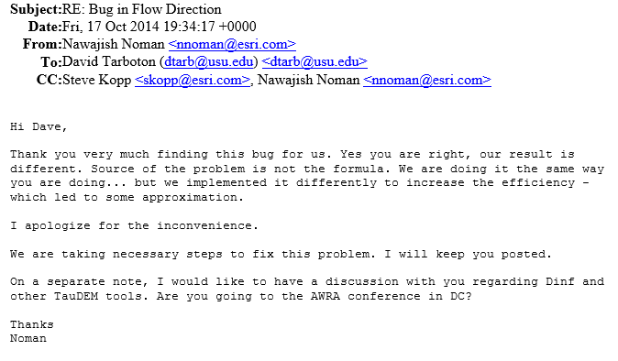
From http://pro.arcgis.com/en/pro-app/tool-reference/spatial-analyst/flow-direction.htm

