Slide 1
Exercise 3 Overview
Slope calculations by hand
Verifying using ArcGIS
Automating and applying to larger dataset using Modelbuilder
Spatial Analysis of San Marcos Elevation and Precipitation
Projecting rasters
Examining and visualizing topography
Zonal average calculations
Thiessen polygons
Surface smoothing to average precipitation

Slide 2
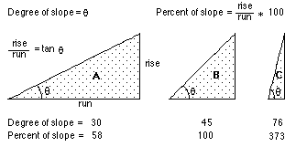
Slope and Aspect
$$y$$
$$Δx$$
$α$ = aspect clockwise from North
$$Δy$$
$$α$$
$$x$$
https://pro.arcgis.com/en/pro-app/tool-reference/spatial-analyst/how-slope-works.htm

Slide 3
ArcGIS “Slope” tool
y
a
b
c
$$\frac{\frac{\frac{a−c}{2∆}+\frac{d−f}{2∆}}{2}+\frac{\frac{d−f}{2∆}+\frac{g−i}{2∆}}{2}}{2}$$
$$\frac{dz}{dx}=\frac{\left(a+2d+g\right)−\left(c+2f+i\right)}{8∆}$$
Similarly
$$\frac{dz}{dy}=\frac{\left(g+2h+i\right)−\left(a+2b+c\right)}{8∆}$$
Slope magnitude =
$$\sqrt{{\left(\frac{dz}{dx}\right)}^{2}+{\left(\frac{dz}{dy}\right)}^{2}}$$
d
e
f
g
h
i
x
$$\frac{a−c}{2∆}$$
$$\frac{d−f}{2∆}$$
c
$$\frac{g−i}{2∆}$$
$$∆$$
b
f
a
e
i
d
h
g
$$2∆$$
x
y

Slide 4
ArcGIS Aspect – the steepest downslope direction
$$Δy=$$
$$Δx=$$
$$Δx$$
$$Δy$$
$$α$$
Use atan2 to resolve ambiguity in atan direction
$$−Δx$$
$$−Δy$$
$$α+{180}^{o}$$
https://pro.arcgis.com/en/pro-app/tool-reference/spatial-analyst/how-aspect-works.htm

Slide 5
Example
30
a
b
c
80
74
63
d
e
f
145.2º
69
67
56
g
h
i
60
52
48

Slide 6
Hydrologic Slope (Flow Direction Tool)
- Direction of Steepest Descent
30
30
80
74
63
80
74
63
69
67
56
69
67
56
60
52
48
60
52
48
Slope:

Slide 7
Eight Direction Pour Point Model
32
64
128
16
1
8
4
2
ESRI Direction encoding

Slide 8
The D∞ Algorithm
z₀
Elevations at each vertex z_{i}
z₂
z₁
Δ
If α₁ does not fit within the triangle the angle is chosen along the steepest edge or diagonal resulting in a slope and direction equivalent to D8

Slide 9
D∞ Example
30
80
74
63
69
e_{o}
67
56
60
e₇
e₈
52
48
284.9º
14.9º
From ArcGIS Pro Help:

Slide 10
10
z₀
4
3
2
$$α=\operatorname{atan}\left(\frac{z_{5}−z_{6}}{z_{0}−z_{5}}\right)$$
z₅
26.0
26.4
5
1
$$α$$
$$S=\sqrt{{\left(\frac{z_{5}−z_{6}}{∆}\right)}^{2}+{\left(\frac{z_{o}−z_{5}}{∆}\right)}^{2}}$$
25.8
6
7
8
z₆

Slide 11
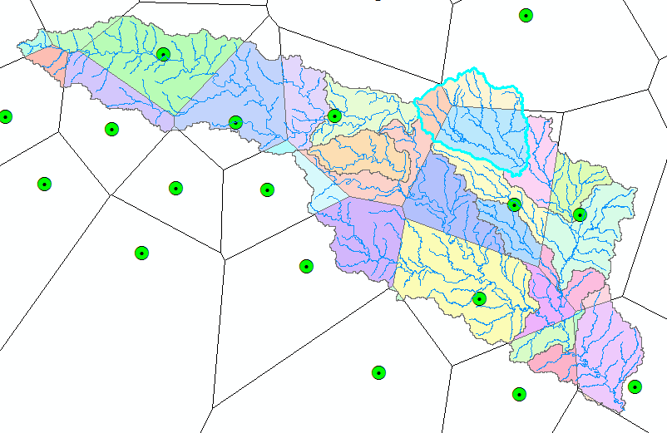
Subwatershed Precipitation by Thiessen Polygons
P2
Thiessen Polygons
Intersect with Subwatersheds
Evaluate A*P Product
Summarize by subwatershed
P1
A1
A2
A3
P3
$$P=\frac{P1∗A1+P2∗A2+P3∗A3}{A1+A2+A3}$$

Slide 12
Subwatershed Precipitation by Thiessen Polygons
Thiessen Polygons
Intersect with Subwatersheds
Evaluate A*P Product
Summarize by subwatershed
$$P_{i}=\frac{\sum_{k}{A_{ik}P_{k}}}{\sum_{k}{A_{ik}}}$$

