Slide 1

Spatial & Temporal Analysis of Groundwater Level Response to 2014 Environmental Pulse-Flow to the Colorado River Delta
Stephanie Arnold

Slide 2
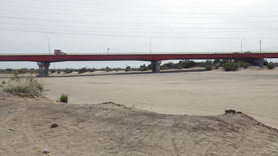
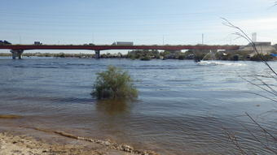
Before
Background
What: planned environmental flow
Why: Minute 319 binational agreement
Who: IBWC
Where: Colorado River Delta
After
Before & After Images of Colorado River at International Boundary¹
2

Slide 3
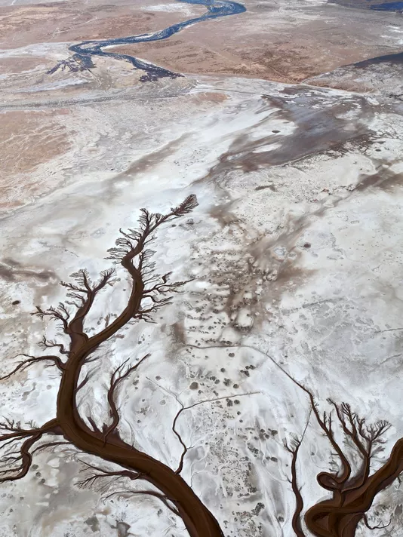
Colorado River
Background
Tidal Channel
When: March 23-May 18, 2014
How: dams & irrigation canals
Colorado River Reconnects with Gulf of Mexico²
3

Slide 4
Study Area
Spatial Data:
  Hydro1K- DEMs
  NHD- subbasin & flowline
4

Slide 5
Location of Piezometer Sites
Collected by UABC, USGS, USBR
Continuous & manual measurements
5

Slide 6
Temporal Analyses
Short-term change in groundwater levels after pulse-flow for P piezometers (UABC)
Short-term analysis: plots of continuous data
Progression of flow
Long-Term analysis: TBD
6

Slide 7
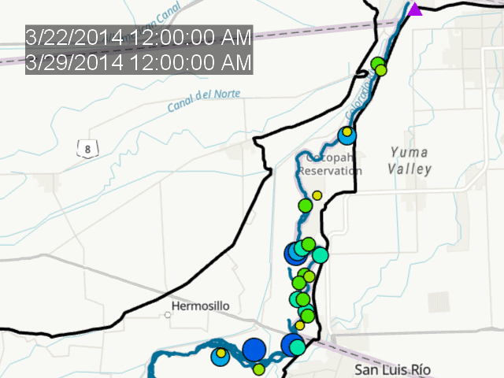
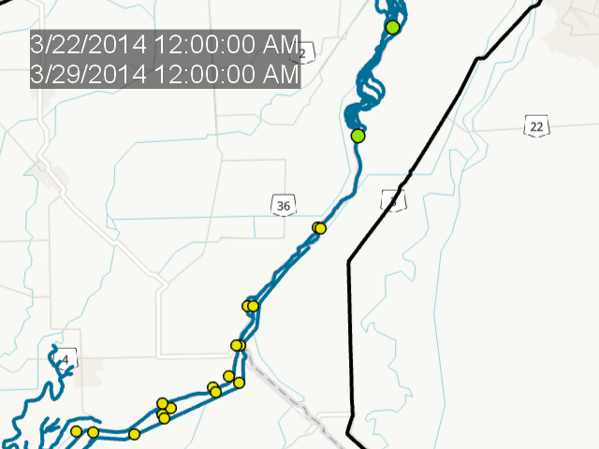
Change in Weekly Avg Water Table Elevations
March 22 – July 5, 2014
Red: decrease
Yellow: increase by 1 m
Green: increase by 2-4 m
Blue: increase by 5-7 m
7

Slide 8
Spatial Analysis
8

Slide 9
Take-Aways
Example of Incomplete DEM along international water body
Strong groundwater response to flow
Temporally: changed quickly
Spatially: dry region had largest response
Further research: surface water, vegetation
Room for improvement: international datasets
9

Slide 10
Questions?
10

Slide 11
References
1. https://www.usgs.gov/news/a-river-ran-through-it-and-brought-life-least-a-while
2. https://www.ibwc.gov/EMD/Min319Monitoring.pdf
3. https://www.sciencebase.gov/catalog/item/530d21d2e4b08f991722dd41
11

