Slide 1
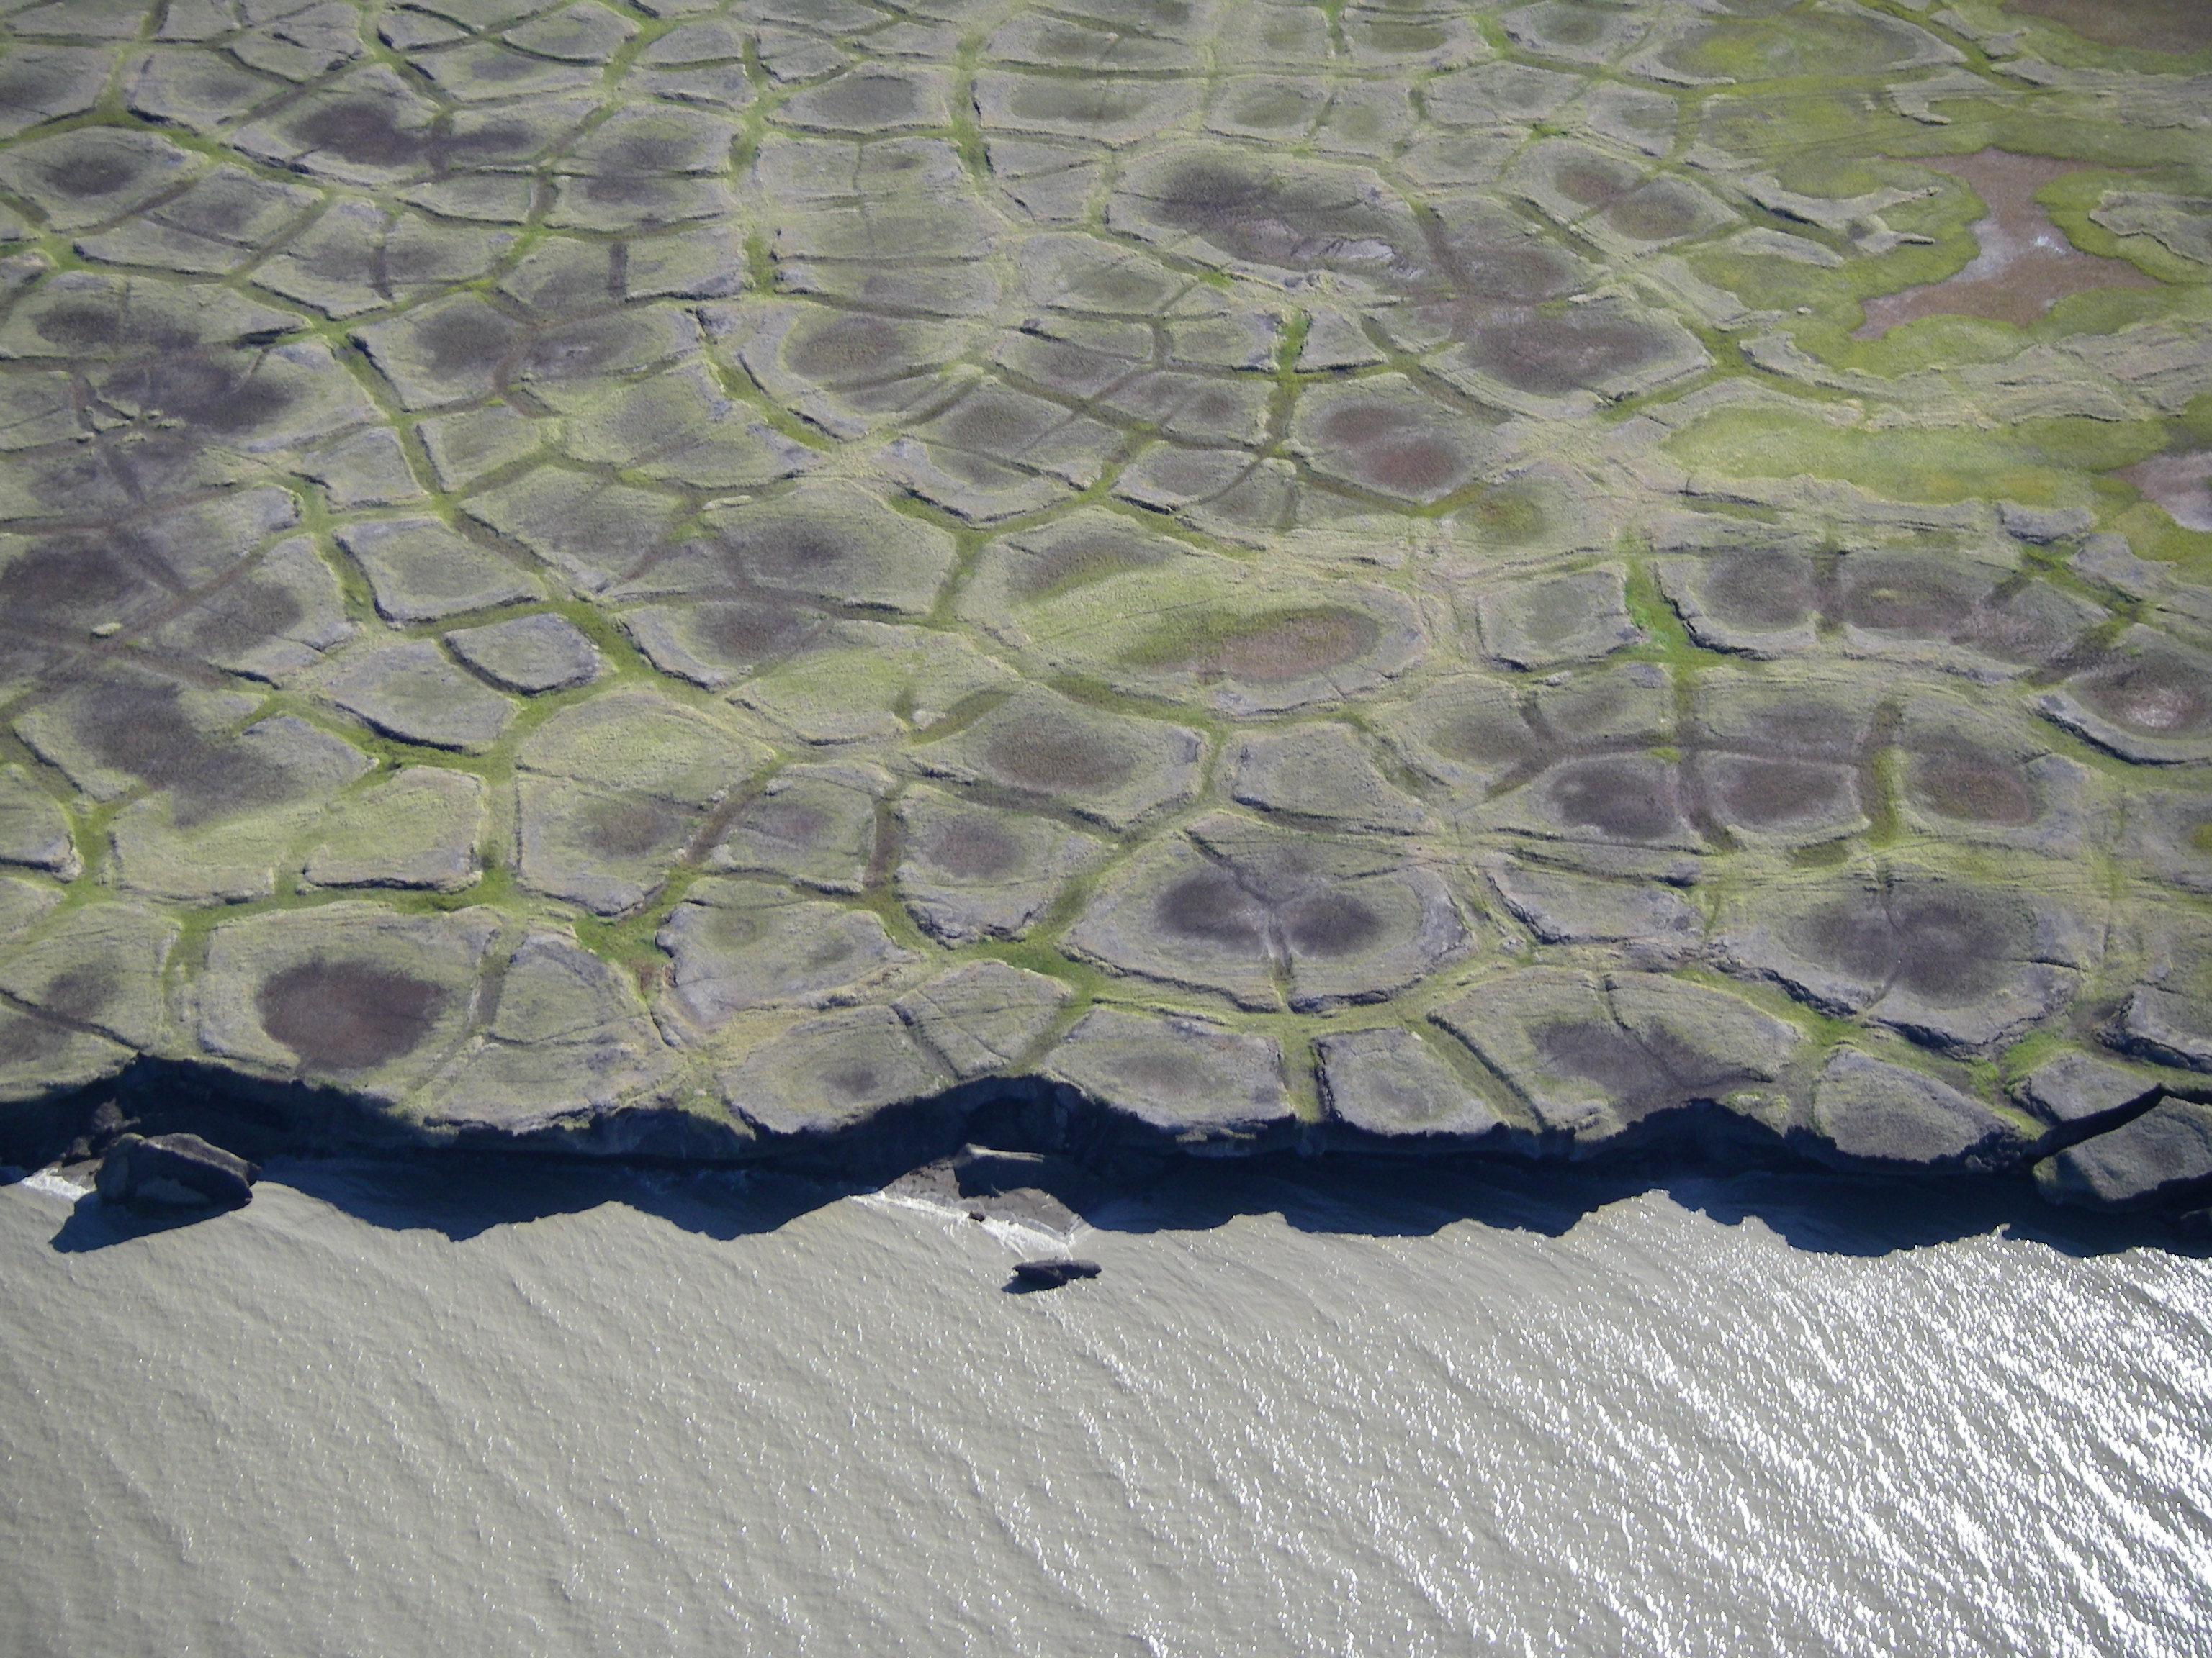
Predicting watershed DOC and DON concentrations using concentration-slope relationships
Photo by Cameron W. Wobus
Emily Bristol

Slide 2
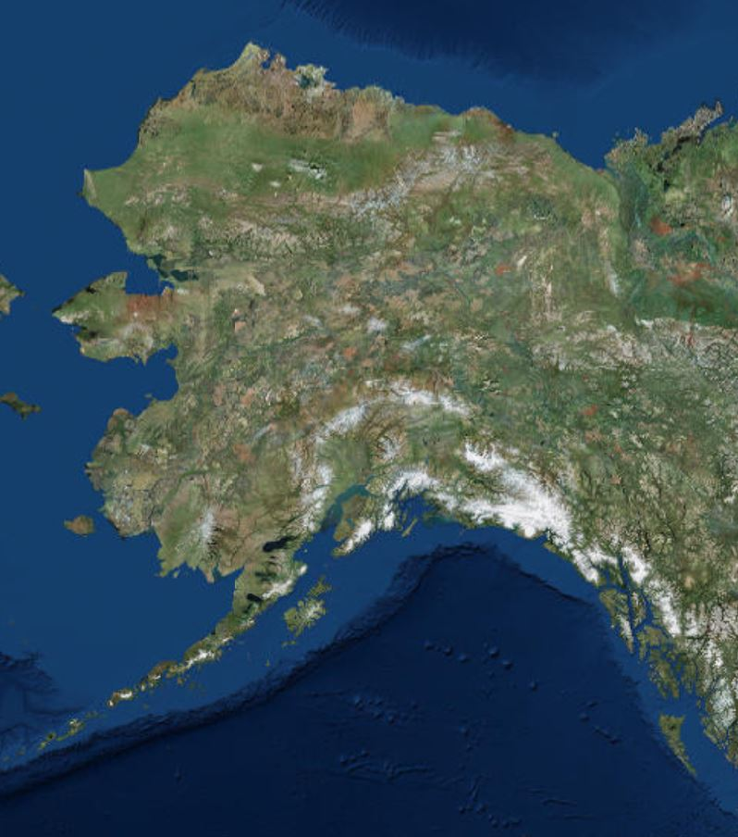
Beaufort Sea Lagoons
Elson Lagoon
Simpson Lagoon
Kaktovik and Lago Lagoons
1. Delineate catchments for all streams entering each lagoon.
2. Use catchment slope data to estimate dissolved organic carbon and dissolved organic nitrogen concentrations.

Slide 3
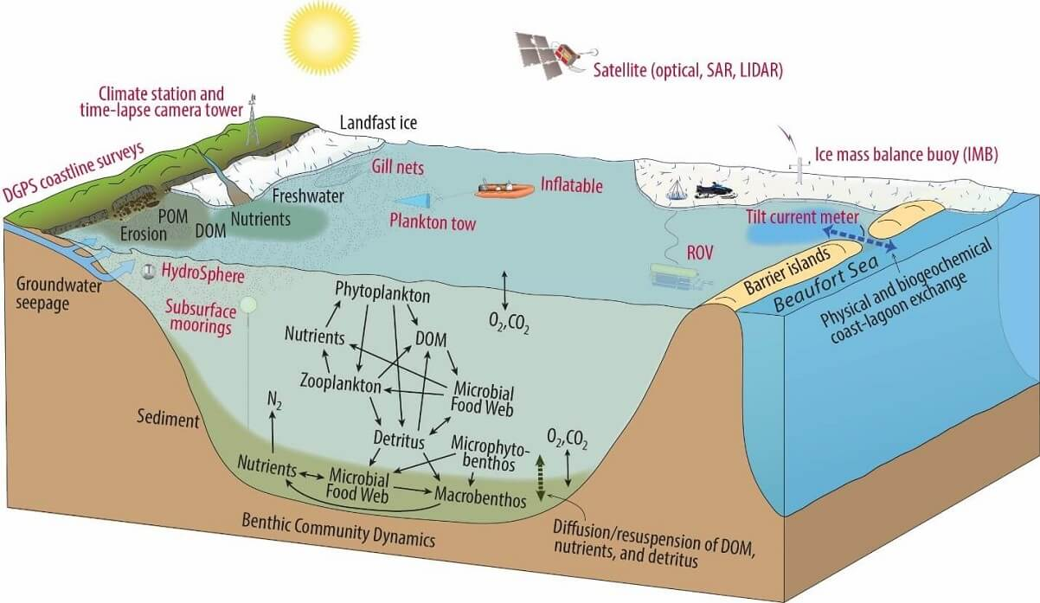
Why?
Dissolved organic matter is a critical component in these lagoon ecosystems.
Freshwater inputs influence marine ecosystem productivity.
Beaufort Sea Lagoons Long Term Ecological Research

Slide 4
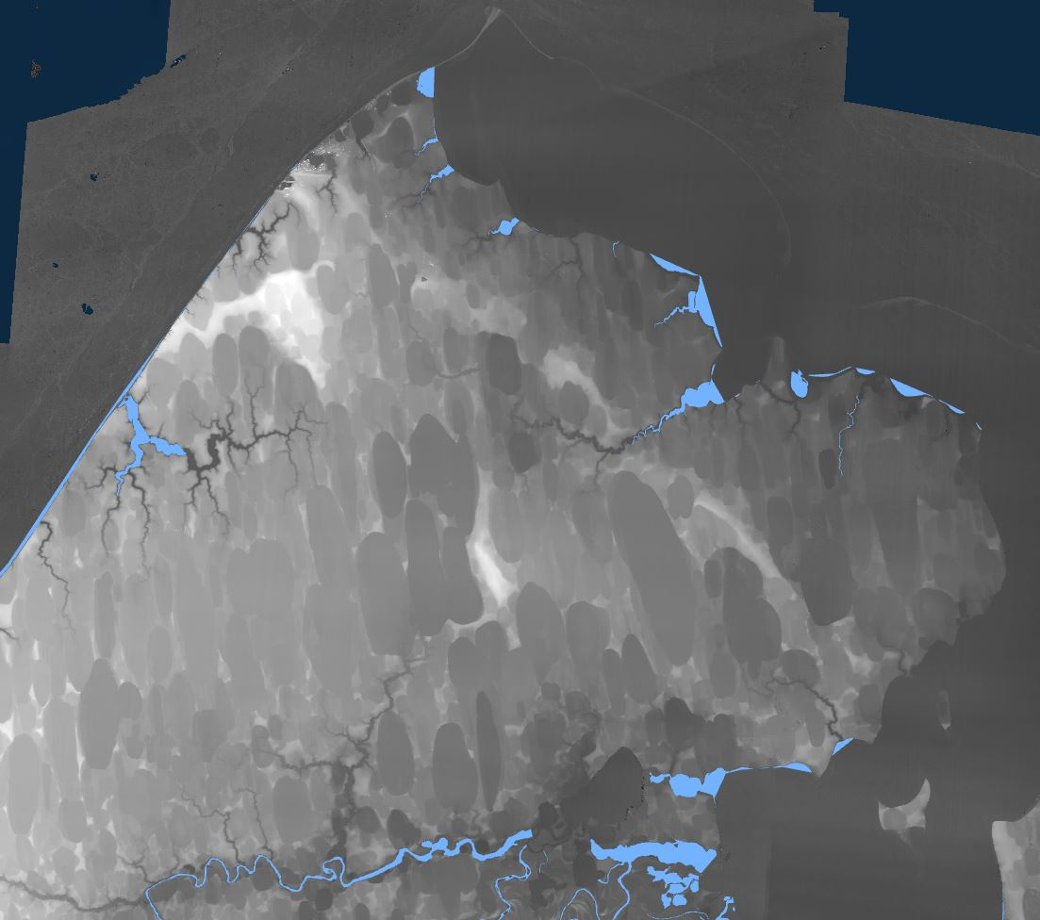
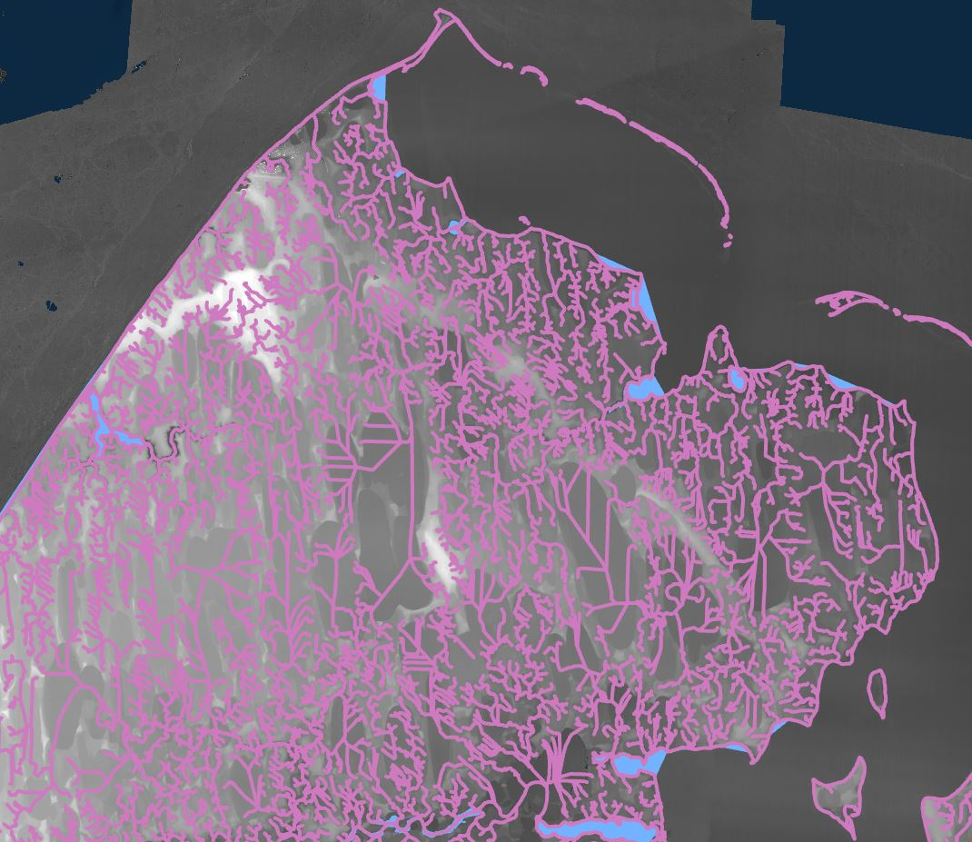
GIS Data Sources
High resolution DEM (2m) available through ArcticDEM, Polar Geospatial Center at the University of Minnesota
Limited NHD data
Aerial imagery

Slide 5
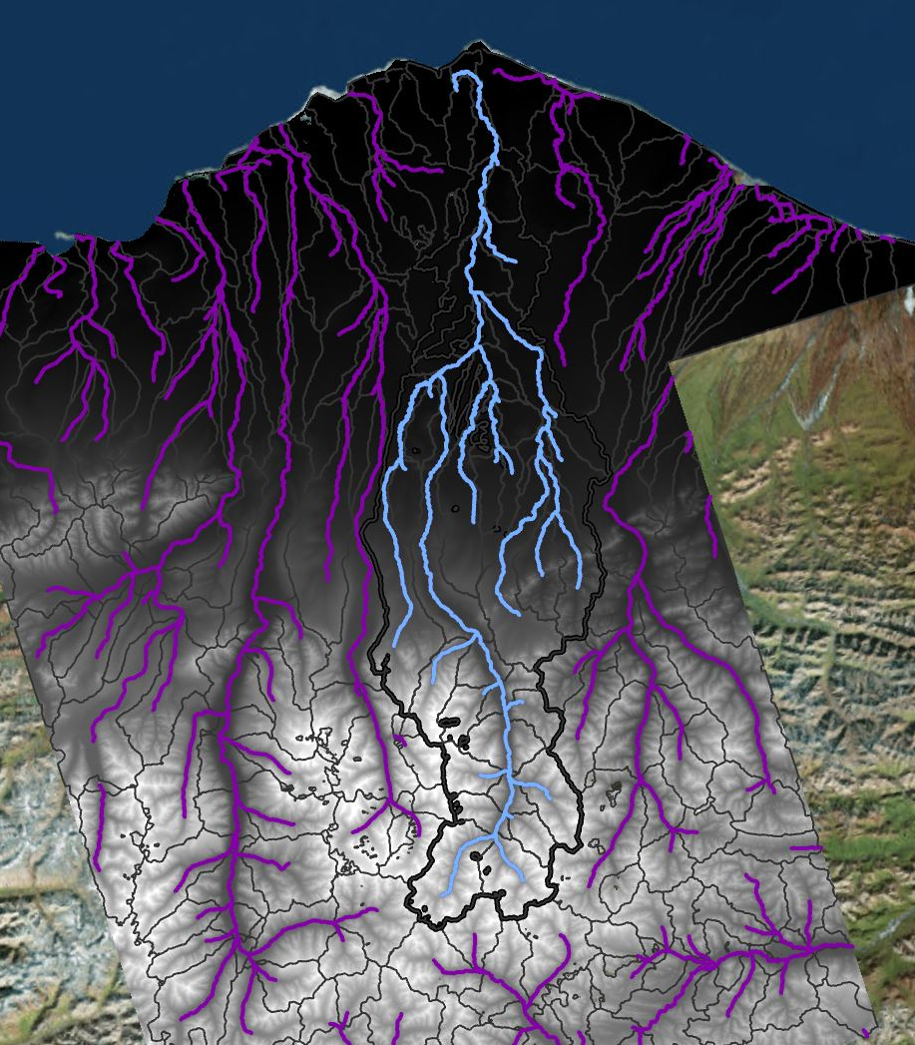
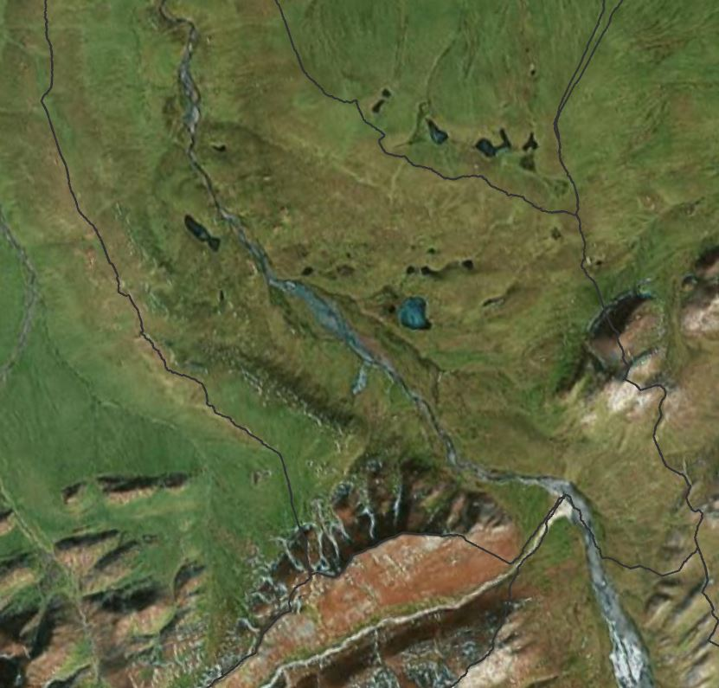
Methods
Determined minimum flow accumulation for streams using aerial imagery
Selected stream networks that drained into lagoons of interest
Created drainage basin from sub-basins that intersected with selected streams

Slide 6
Catchments draining into LTER lagoons
Kaktovik and Lago Lagoons
Elson Lagoon
Simpson Lagoon

Slide 7
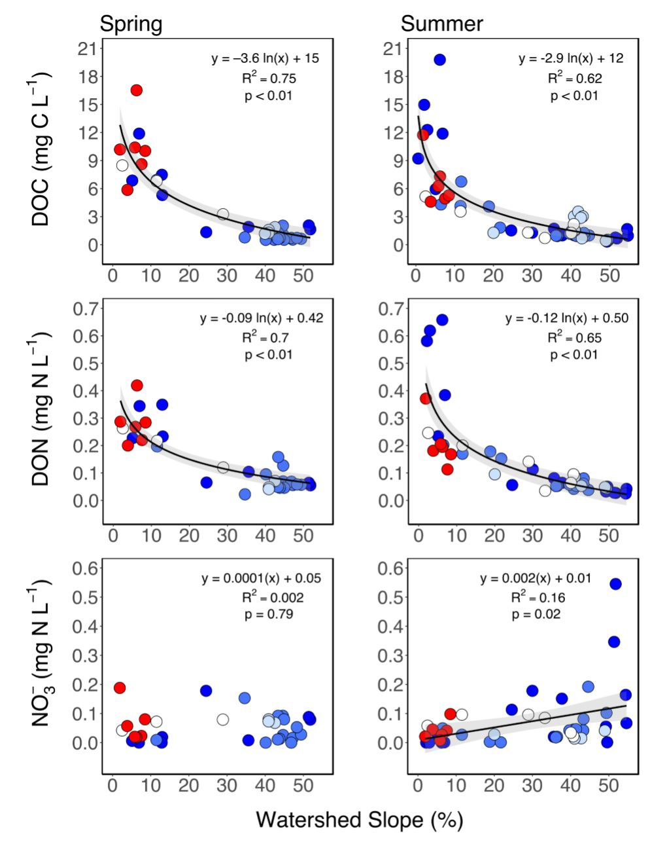
Slope-concentration models
Catchment slope explains more than half the variation in spring and summer DOC and DON concentrations in Arctic rivers.
Connolly et al. In Review.

Slide 8
Results
Lagoon | Contributing drainage area (sq km) | Catchment slope (degrees) | Catchment slope (%) | Estimated spring [DOC] | Estimated spring [DON] | Estimated summer [DOC] | Estimated summer [DON]
Elson | 427.6 | 0.38 | 0.11 | 23.0 | 0.62 | 18.5 | 0.77
Simpson | 70809.7 | 4.45 | 1.23 | 14.2 | 0.40 | 11.4 | 0.47
Kaktovik | 282.2 | 0.66 | 0.18 | 21.1 | 0.57 | 16.9 | 0.70
Lago | 2339.9 | 11.31 | 3.14 | 10.8 | 0.32 | 8.7 | 0.36
With increasing catchment slope, [DOC] and [DON] decrease.
For larger catchments, slope increases west to east.
Small coastal catchments have the highest [DOC] and [DON], but likely the lowest discharge.

Slide 9
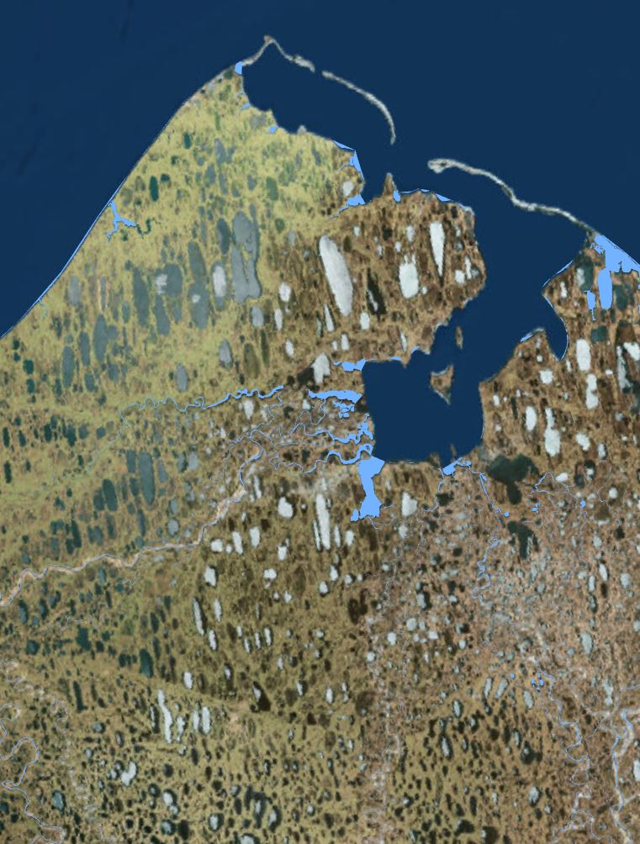
Limitations and Next Steps
Difficult to determine all freshwater inputs to lagoons; large, adjacent rivers indirectly contribute carbon and nutrients
Discharge models needed to estimate fluxes of DOC and DON
Analysis of lagoon-ocean connectivity needed to understand how nutrients are retained in lagoons

Slide 10
Questions?

