Slide 1
Evaluation of a Novel Method for Estimating Directly Connected Impervious Area and Unconnected Impervious Area
Andrew Chu, with help from Jones Edmunds and Associates
11/13/2018
University of Texas at Austin- CE 394k

Slide 2
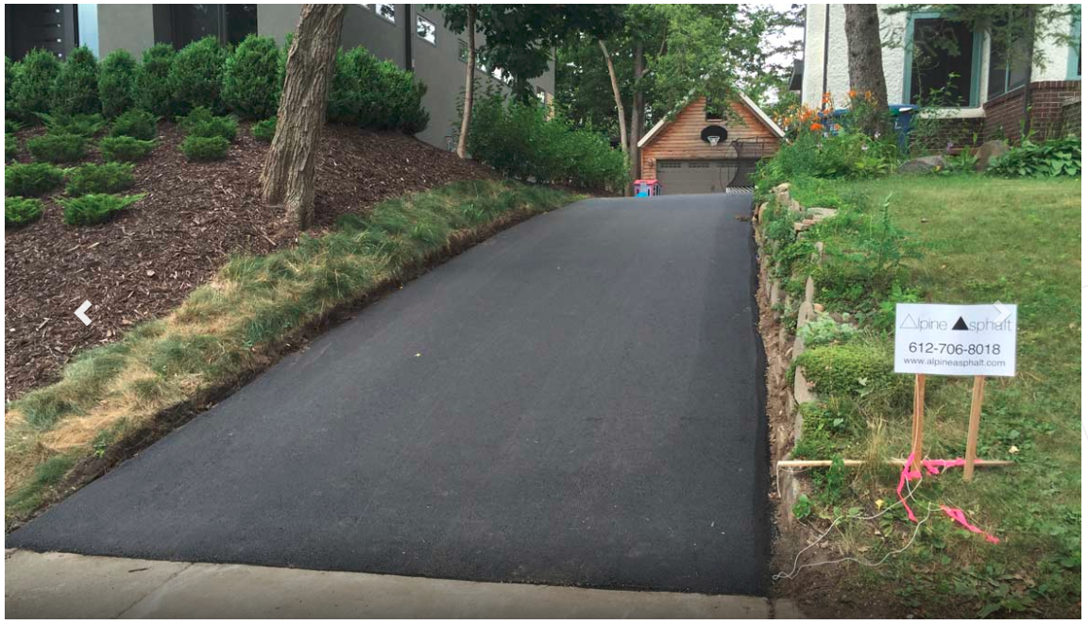
Example of Directly Connected Impervious Area (DCIA)
Directly Connected Impervious Area – Rain that falls on this area flows directly to the drainage system over impervious area.
Source: (Timbdesign, 1)

Slide 3
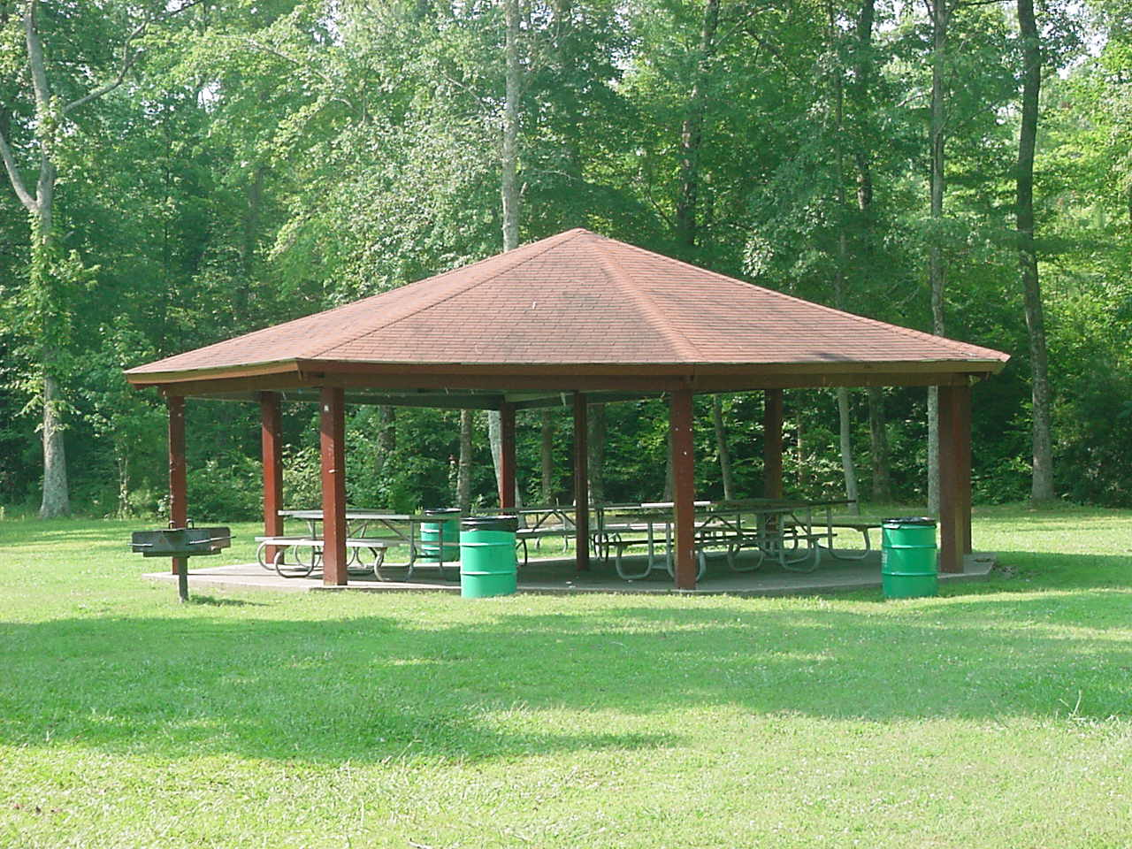
Example of Unconnected Impervious Area (UCIA)
Unconnected impervious area- Rain that falls in this area must flow over a pervious area before it enters the drainage system.
Source: (Timbdesign, 1)

Slide 4
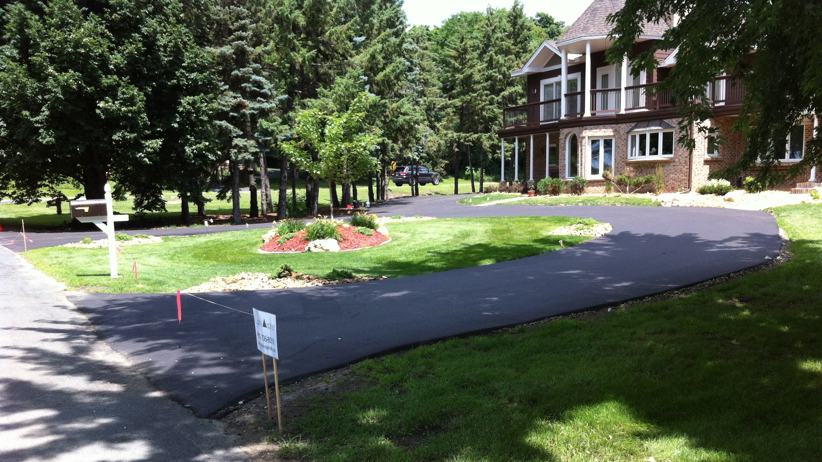

Slide 5
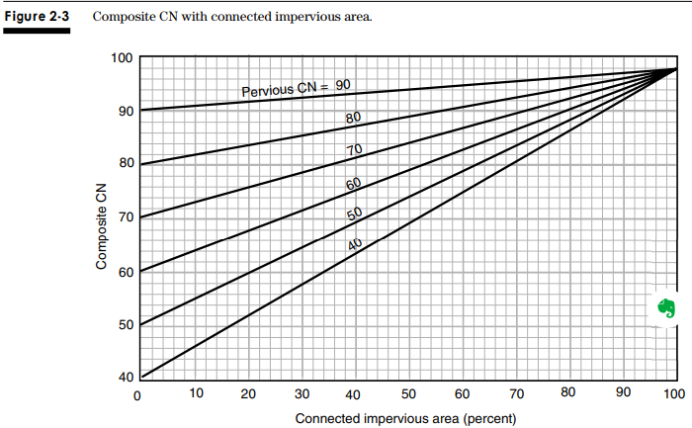
Curve Number Reduction based on DCIA Percentage
Source: (United States, 1)

Slide 6
3 Methods for determining DCIA
Manual Scanning
The Gregory Method
Representative Sampling

Slide 7
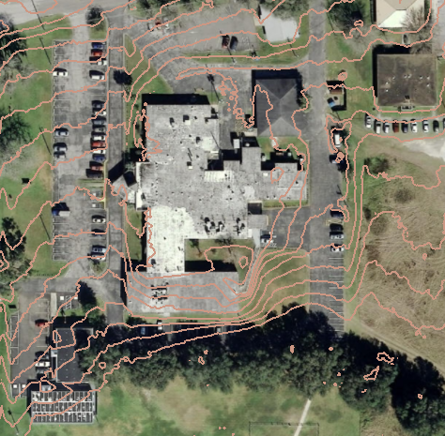
Example of Manual Scanning

Slide 8
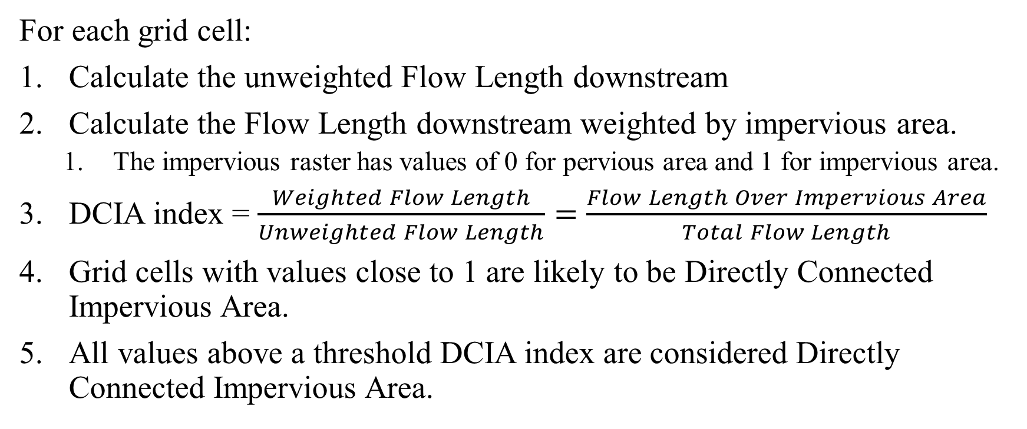
Performing the Gregory method
For each grid cell:
Calculate the unweighted Flow Length downstream
Calculate the Flow Length downstream weighted by impervious area.
  The impervious raster has values of 0 for pervious area and 1 for impervious area.
DCIA index = $\frac{Weighted Flow Length}{Unweighted Flow Length}=\frac{Flow Length Over Impervious Area}{Total Flow Length}$
Grid cells with values close to 1 are likely to be Directly Connected Impervious Area.
All values above a threshold DCIA index are considered Directly Connected Impervious Area.

Slide 9
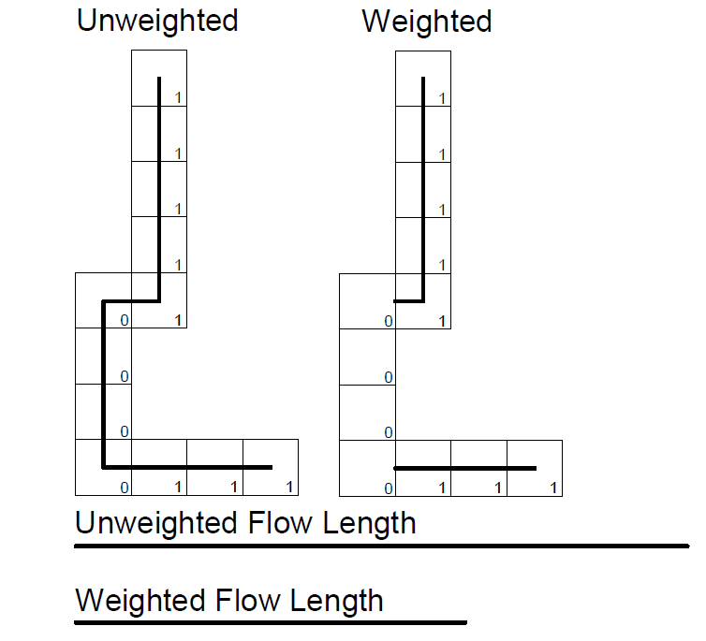
Physical Interpretation of the output- The DCIA index.
1 = impervious
0 = pervious

Slide 10
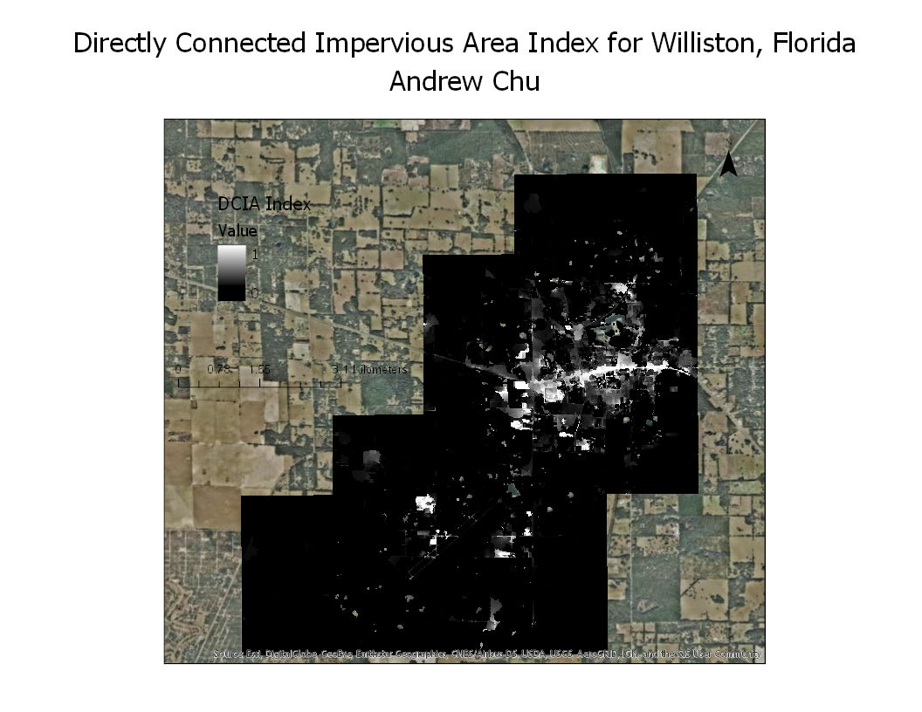

Slide 12
Comparison of DCIA estimation Methods
Comparison of DCIA Estimation Methods
Estimation Method | DCIA | Error | Time to completion
 | (ft^2) | (%) | (hours)
Gregory Method (0.95) | 2771306 | 69% | 1.25
Gregory Method (0.90) | 3763988 | 58%
Gregory Method (0.85) | 4644062 | 48%
Gregory Method (0.80) | 5680088 | 37%
Gregory Method (0.75) | 9376512 | 4%
Manual Method | 9008680 | 0% | 27
Land Cover Estimate Method | TBD | TBD | TBD

Slide 13
Strengths of the Gregory Method
Strengths
  Fast
  Detailed- The Gregory method can analyze every grid cell
  Consistent
  Does not require human work.
  The output is probabilistic, not binary

Slide 14
Weaknesses of the Gregory Method
Weaknesses
  Uncalibrated Accuracy Issues
  Fundamental
    Method requires a flow direction raster
    Sometimes pervious area gets classified as DCIA
    DCIA estimates for areas near the point of concentration are less accurate
    Requires calibration
    Uses D8 flow directions- May not represent reality at the 2.5ft grid cell level
    The end of the flow lines are not necessarily at the beginning of the stormwater system

Slide 15
Improvements to the Gregory Method
Restrict DCIA index calculation to only impervious areas
Restrict Flow Length
Develop a method for consistently calibration of the Gregory Method
Use Dinfinity flow directions

Slide 16
Works Cited
  Timbdesign. “Asphalt Driveways Minnesota | Residential Paving.” Alpine Asphalt, Alpine Asphalt, 9 Nov. 2018, alpineasphalt.com/residential/.
  United States, Congress, “Urban Hydrology for Small Watersheds.” Urban Hydrology for Small Watersheds, pp. 1–164.

