Slide 1
Annual Snow Pack Effect on Lake Powell
Andrew Jaeger

Slide 2
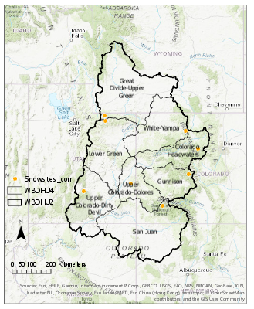

Slide 3
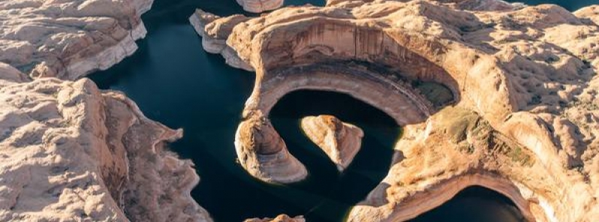
HUC 2
Total area-72.5 million acres
Expected Minimum Outflow 8.23 million acre-feet

Slide 5
Annual Lake Powell Flow Rates

Slide 6
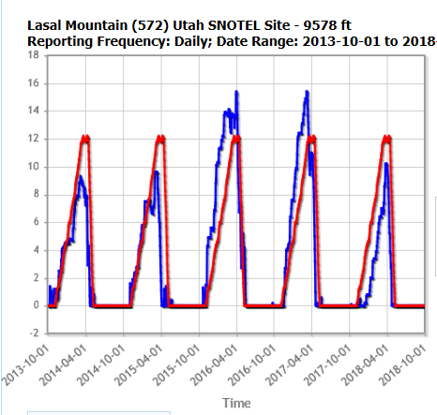
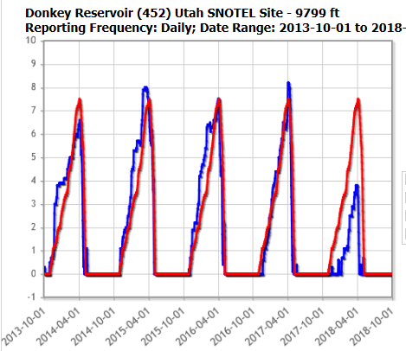

HUC 1403 and HUC 1407 (W/Central)

Slide 7
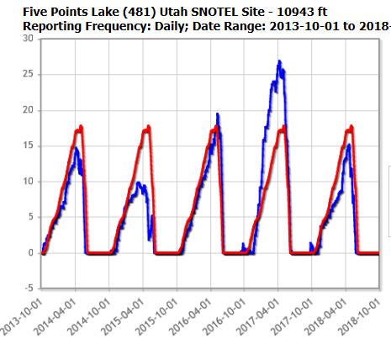
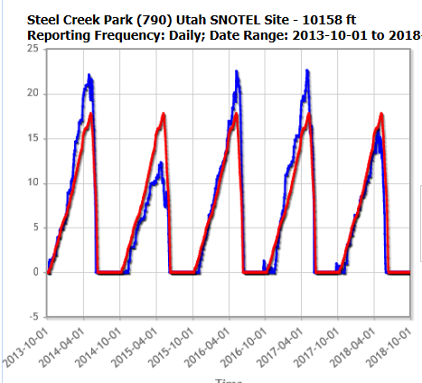
HUC 1404 and HUC 1406 (NW)

Slide 8
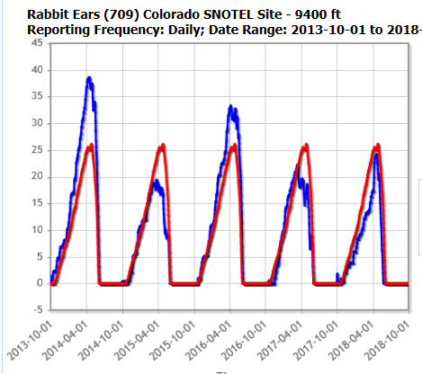
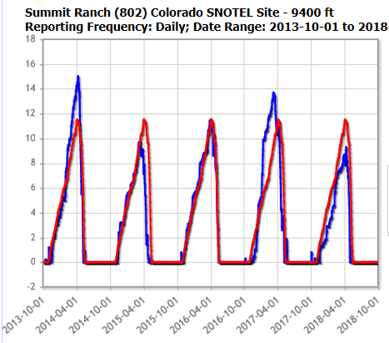
HUC 1401 and HUC 1405 (NE)

Slide 9
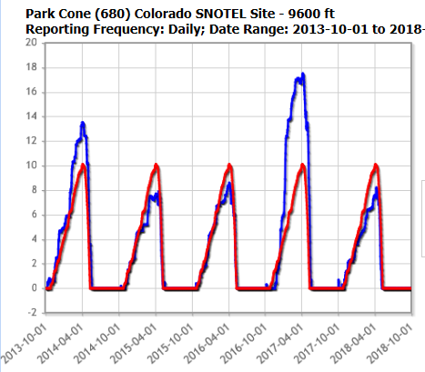
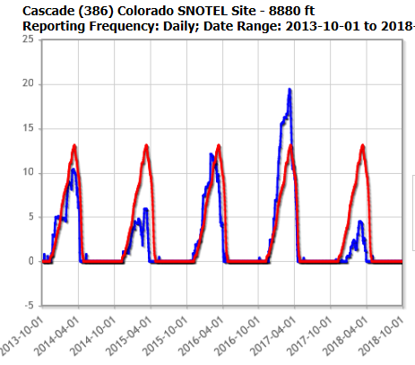
HUC 1408 and HUC 1402(SE)

Slide 10
Annual Lake Powell Flow Rates
 | 2014 | 2015 | 2016 | 2017 | 2018
HUC 1401 | Above | Below | Above | Below | Below
HUC 1402 | Below | Below | Below | Above | Below
HUC 1403 | Below | Below | Above | Above | Below
HUC 1404 | Above | Below | Above | Above | Below
HUC 1405 | Above | Below | Above | Above | Below
HUC 1406 | Below | Below | Above | Above | Below
HUC 1407 | Below | Above | Above | Above | Below
HUC 1408 | Above | Below | Below | Above | Below

Slide 11
Future Work
Complete DEM mapping for entire Upper Colorado River Basin
Elevation Estimates for Snow to supply required inflow
Map out Lake Powell at minimum elevations to calculate change in water storage

Slide 12
Works Cited
“Colorado River Basin Focus Study Area.” U.S. Geological Survey. https://water.usgs.gov/watercensus/Colorado.html.
“Drought in the Colorado River Basin.” Department of the Interior. https://www.doi.gov/water/owdi.cr.drought/en/index.htm.
USDA for SNOTEL data
http://lakepowell.water-data.com/ for flow rates and information

