Slide 1

NOVEMBER 2018
Winter Terrain comparison of six Utah Ski Resorts
Sierra Jensen
The University of Texas at Austin
Notes:
My GIS project is focusing on something a little unique compared to many other projects you will see in this class. I decided to focus on ski resorts in Utah. I grew up in Salt Lake and so I found this topic very interesting.

Slide 2






Overview
Salt Lake valley and six nearby ski resorts
Closeup of the six ski resorts
Notes:
This is the project area I am focusing on. Here is downtown salt lake and the University of Utah, and about 30 minutes there are six ski resorts. These resorts are all very close and it would be reasonable to go to any of these ski resorts.

Slide 3



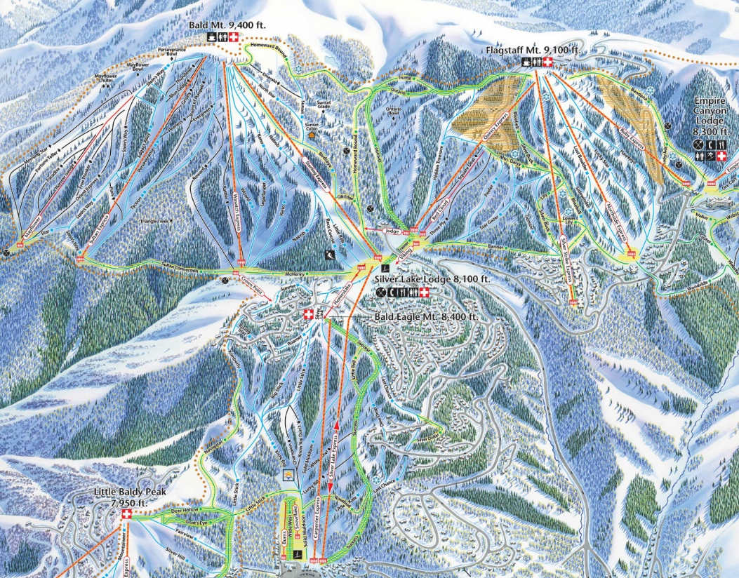
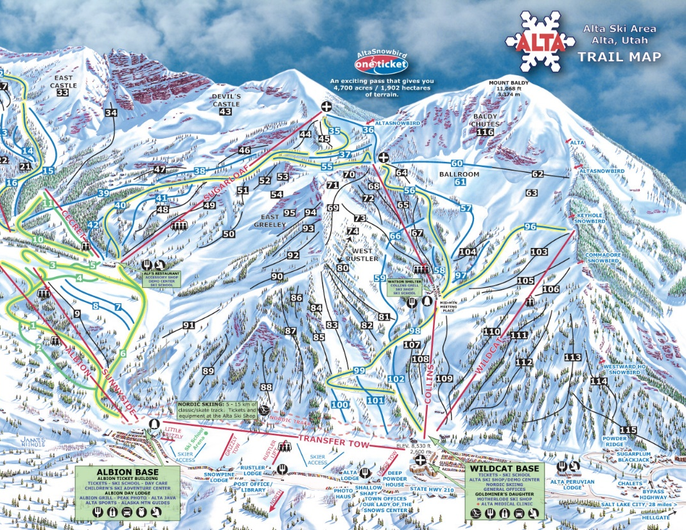
ALTA SKI AREA
Notes:
Here are two Utah ski resorts. These two resorts are only about 10 miles apart as the crow flies. Although it may be hard to tell on this map, Deer Valley is about 1.5 times larger than Alta.
These ski maps are the basic information that visitors have access to understand each resort. I am interested in organizing data based on the elevation, slopes, and other spatial characteristics to create a side-by-side comparison of the resorts. This will could potentially help visitors gain a greater understanding of these areas before they visit.
That brings me to the analysis of my project.

Slide 4
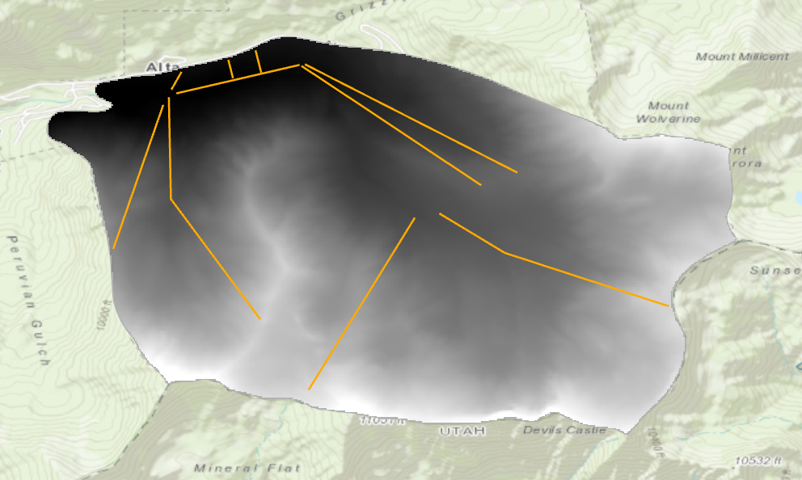
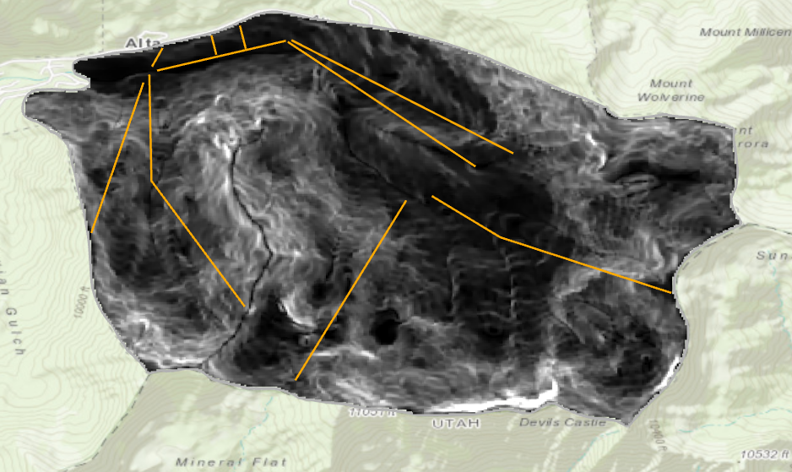
Creating Terrain Map for Alta
Utah AGRC
Ski Resort Boundaries
Ski Lift Locations
USGS National Map
10m DEM
Slope, Percent Rise
Notes:
I started at the Utah Automated Geographic Reference Center – gathered ski resort boundaries and ski lift locations. These shapes provided area and locations of the ski lifts
This was the first step of the analysis. I used the digital elevation model, trimmed to the boundaries of the ski resorts, and produced a slope map of each ski resort.
This slope map was not very useful on its own. I did some research to define this area as something understandable.

Slide 5
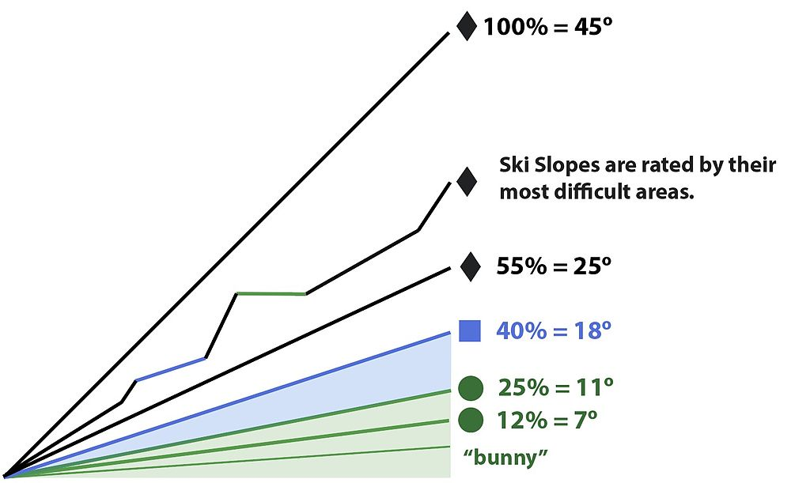
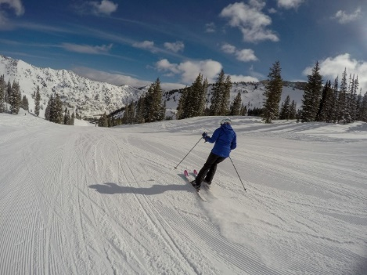
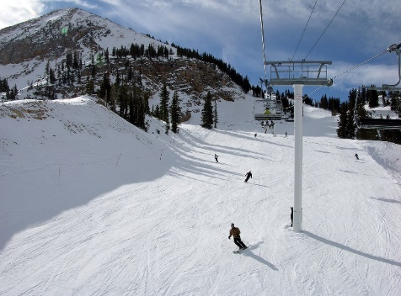
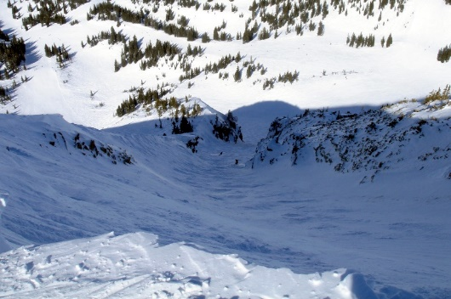
Defining Winter Terrain
Easy ≤ 25%
Intermediate ≤ 40%
Expert ≤ 100%
Notes:
From several difference sources, I was able to find some standards on how winter terrain difficulty is defined. Here are a few pictures to show the difference between some of the terrain. Green circles are slopes less than 25%. Blue squares are intermediate slopes between 25 and 40% and Expert is between 60 and 100%. I added a category in between intermediate and expert and a category after expert to get a better picture of the ski resorts. There are slopes that exist beyond 100% and these are very technical terrain, sometimes un-skiable by most standards.

Slide 6
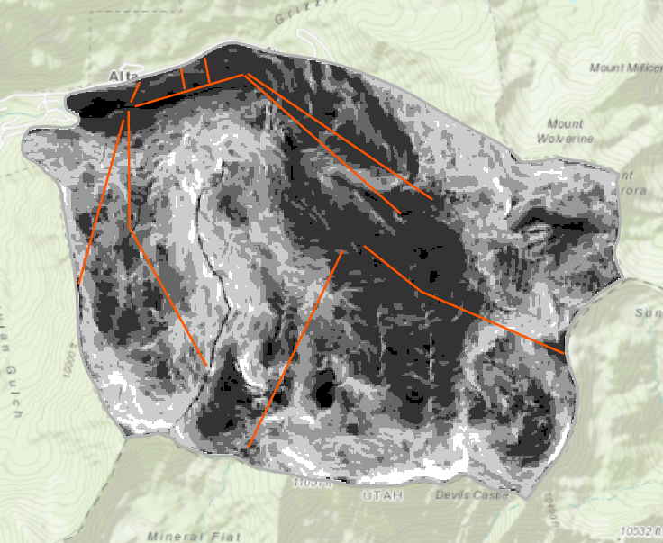
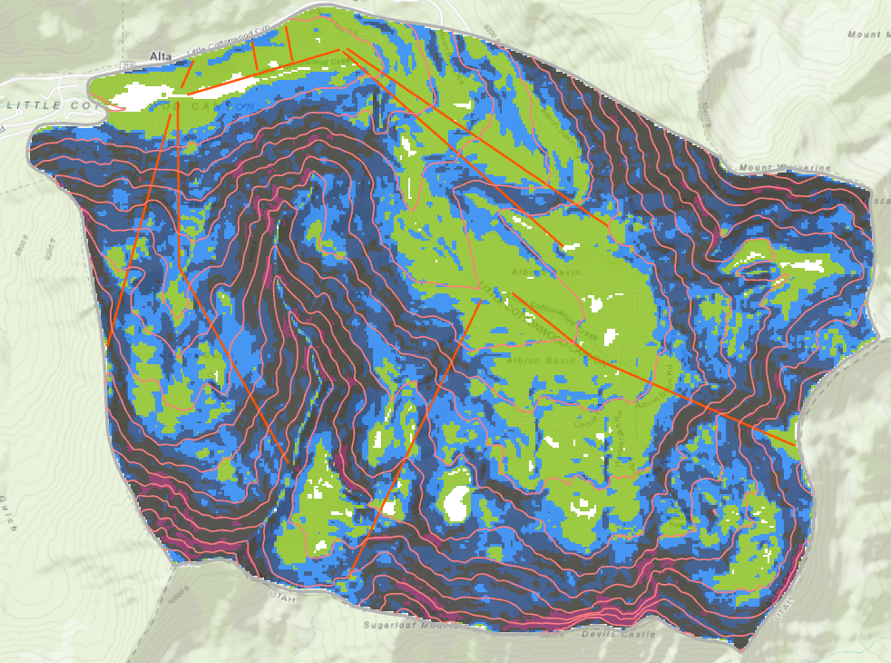
Flat | 0% - 6%
Easy | 6% - 25%
Intermediate | 25% - 40%
Intermediate-Expert | 40% - 60%
Expert | 60% - 100%
Technical | > 100%
Terrain Difficulty Map for Alta Ski Resort
Contour, Reclassify, Create Layer Definition
Notes:
Once I defined the terrain difficulty, I used the reclassify tool to create a raster that had different colors for each terrain type. I applied this layer definition to all the ski resorts.
I applied this method to all the ski resorts and this is the map I ended up with.

Slide 7
Notes:
This map isn’t very useful on its own. If I showed someone this map and told them to pick what resort looked best, they probably couldn’t tell you much.
I used the “calculate field” function to calculate the area of each terrain distinction. And then I compared them all side by side.

Slide 8
Terrain Distribution by Percentage
Notes:
I calculated the area of each terrain definition and here it is distributed by percentage.
Snowbird has the lowest percentage of easy terrain where Brighton has the largest percentage. Many people in Utah could probably describe this distribution to you. Brighton and Alta are known to be a great resorts for beginners and Snowbird is known to have a lot of technical terrain and be more popular for advanced skiers.
The main limitation of this comparison is it doesn’t consider resort size. Park City is three times larger than some of these resorts.

Slide 9
Terrain Difficulty by Area
Notes:
More interesting however is this distribution, which shows the distribution by area. Ignoring Park City, which kind of skews the data because the resort is so large.
Even with this comparison, snowbird still has the most technical terrain.
On thing that makes this comparison difficult is that Park city are so large, that even though there is a lot more beginner terrain, someone couldn’t actually visit all that terrain in one day. In my text steps I want to split Park city up geographically and see the distribution on one half or one third of the resort.

Slide 10
Limitations and Future Steps
Resort Base
Not easily accessible
Top of ridge
Notes:
With every model comes limitations: I have only used slope as a method of determining the terrain difficulty of each resort. This has resulted in a few locations that are falsely classified. For example at the base of each resort there is typically a lot of flat areas. This isn’t necessarily a skiable area. This is where people put their skis on and meet up. Along the top of the ridgeline you can see blue and green dashes. This terrain has an intermediate slope but should not be classified as such. And then the last area that is falsely categorized is this section called Catherine’s pass in order to access this area, you have to hike a little and if you aren’t careful you will get stuck in this flat area and have to hike out.
The last thing I want to expand upon is reporting on elevation change from top to bottom of each ski lift. The elevation change on each lift plays a huge role in the difficult of certain sections of the resort. I don’t know if I would be able to create a raster to describe this. I could potentially add this as a factor when defining difficulty.

Slide 11
Questions and Suggestions?
Notes:
And so with that I open it up to you. I am interested to know if anyone can think of any other analysis that could support this project. Or have any questions about my analysis.

