Slide 1
Quantifying Runoff Rates for Road Segments in Culebra, PR
By: Preston McLaughlin
11/13/2018

Slide 2
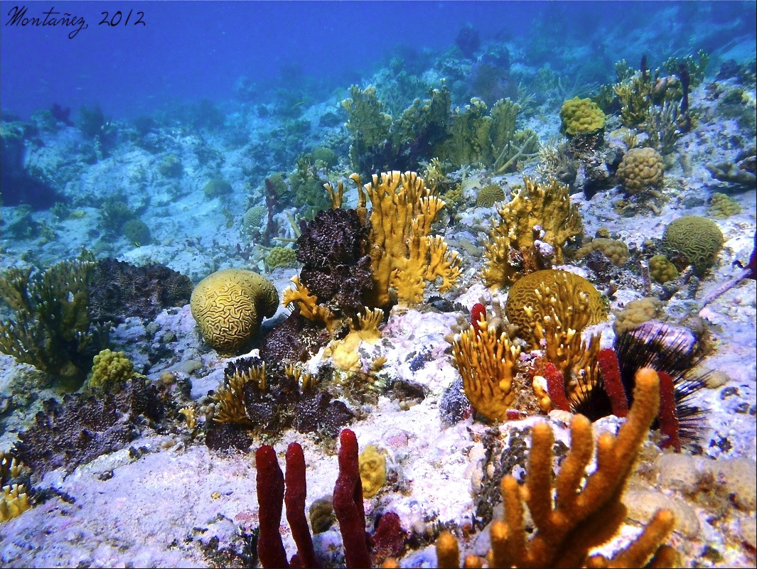
Introduction and Background
Terrigenous sediment from development is a key stressor influencing the global decline of coral reef ecosystems.
Higher turbidity = smothering, bleaching, reduced photosynthetic activity, and increased risk of disease
Corals act as nurseries for almost 1/3 of all marine fish species.
Up to 60% of all global coral is estimated to be lost by the year 2030.
Banderote Reef, at Tamarindo Bay, Culebra Alfredo Montanez, 2012

Slide 3
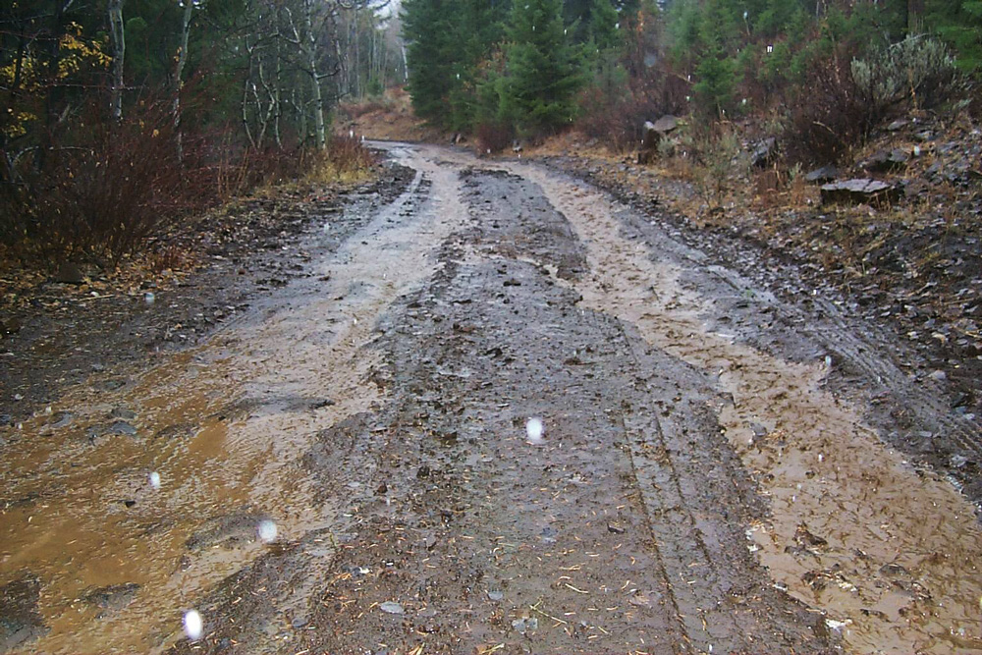
For small Caribbean watersheds, unpaved roads have been shown to be the main contributor of sediment that reaches the coast.
Erosion rates from unpaved roads can be orders of magnitude greater than that of the surrounding undisturbed environments

Slide 4
Project Objectives
1. Predict how much runoff is being produced from unpaved roads at one of our study sites
2. Create stream segments for my study area with available LiDAR DEM data
3. Determine which segments of road are producing the most runoff
4. Calculate total runoff being deposited into nearby streams from road
5. Map this information in a clear and informative way

Slide 5
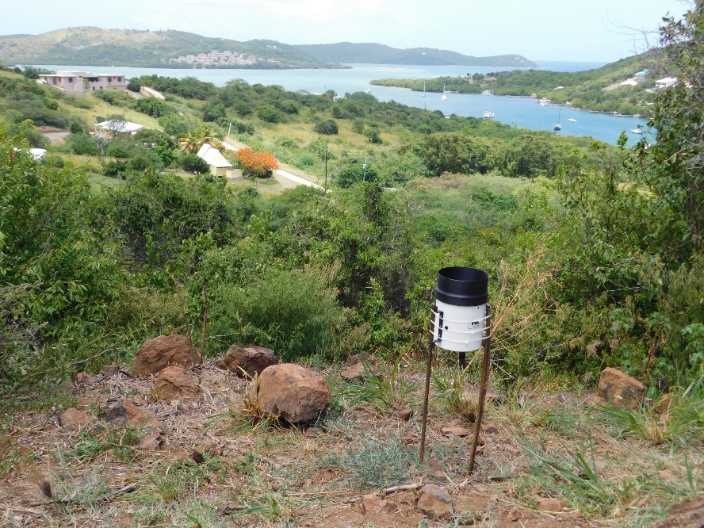
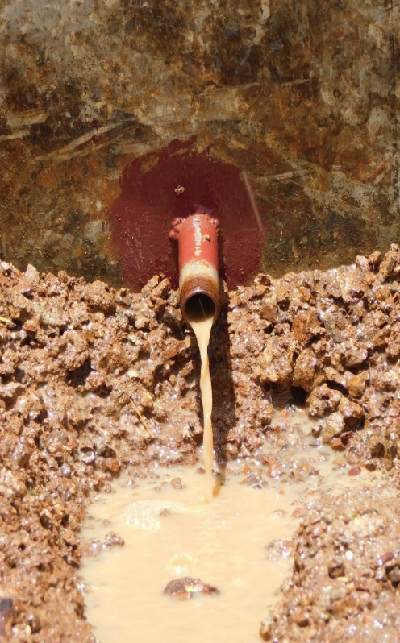
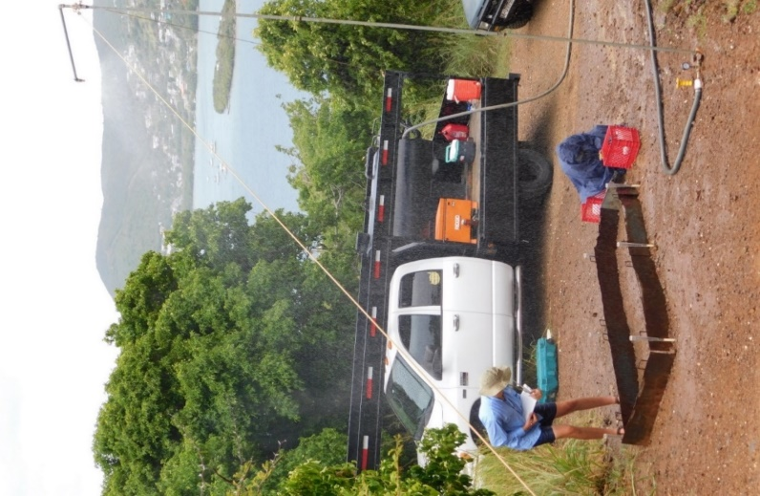
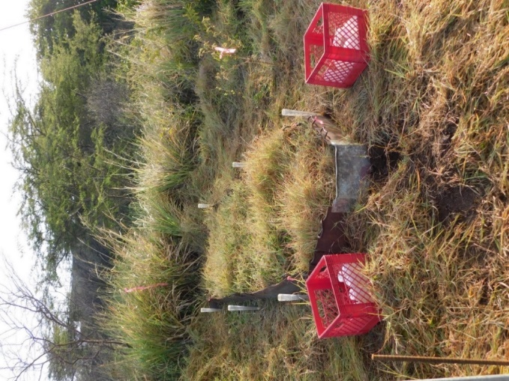
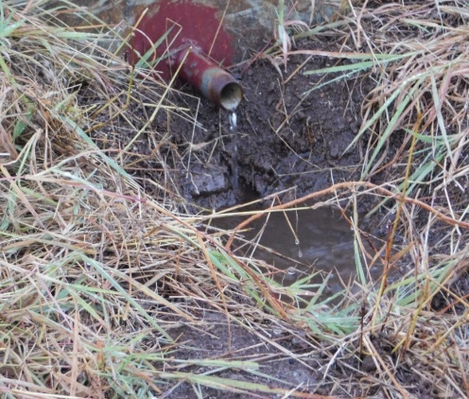
Field Data Collection
45 Rainfall Simulations at the plot scale for roads and undisturbed hillslope surfaces
Data collection for naturally occurring rainfall events over a 2 year period using tipping bucket rain gauges
Surveying and sketch mapping of road segment dimensions and drainage points
Soil
Graded Road
Ungraded Road
0 -10%
11 -20%
>20%
0 -10%
11 -20%
>20%
0 -10%
11 -20%
>20%

Slide 6
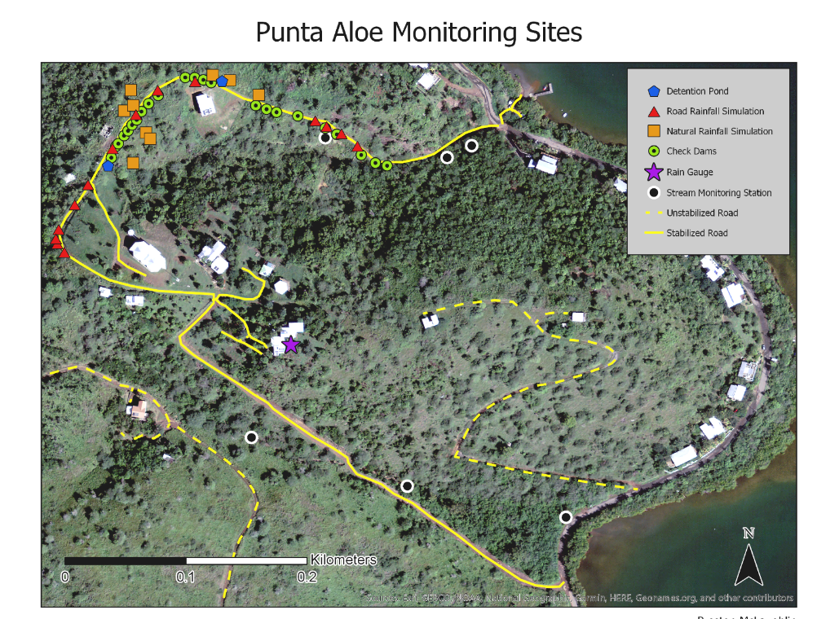
Study Area
Located 28 km (17 mi.) east of mainland Puerto Rico
Sub-Tropical Arid climate with annual rainfall of around 70 cm per year
Very hilly with a maximum elevation of 194 m
1 of 4 priority coral reef management sites in Puerto Rico
Sparsely populated (1,800 residents)
Significant increase in development since 1990s

Slide 7
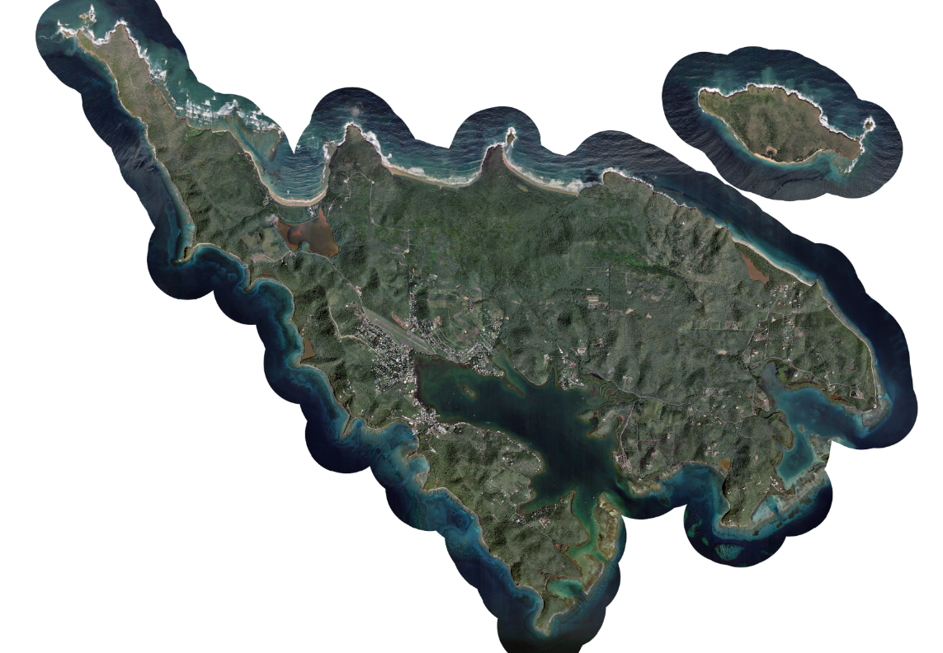
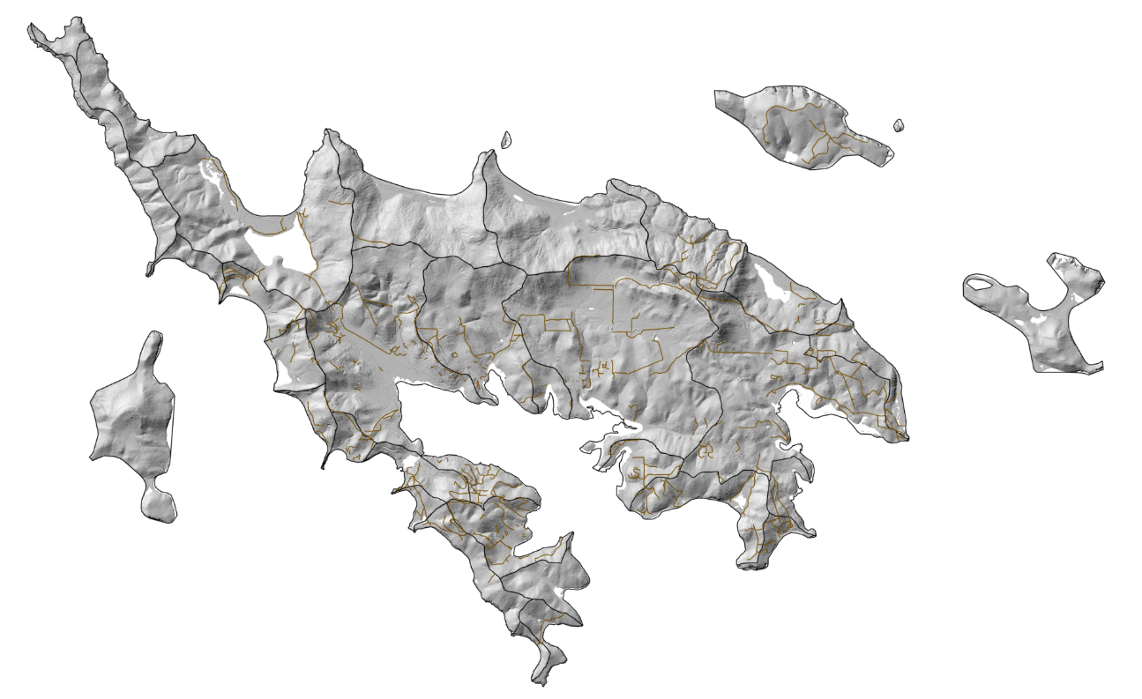
GIS Data Sources Collected
LiDAR DEM raster with 1 meter resolution (NOAA Digital Coast Online Database)
Satellite imagery with 10 meter resolution
Unpaved road and watershed polyline shapefiles from the non-profit organization “Protectores de Cuencas”

Slide 8
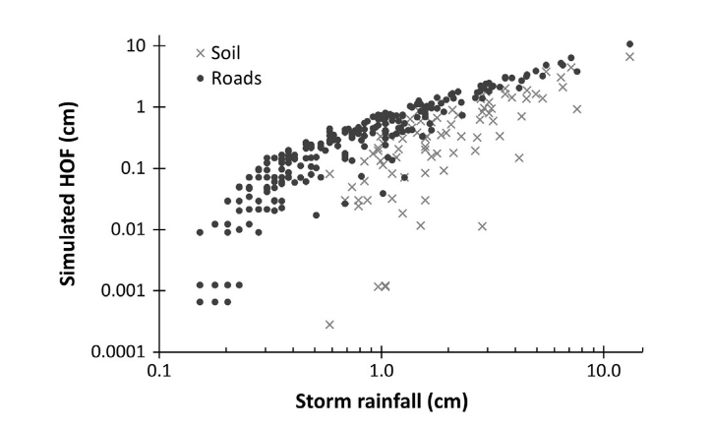
Statistical Analysis
Infiltration capacity curve values for graded and ungraded road rainfall simulations will be taken and compared with one another using a t-test
Horton’s equation will be used to calculate infiltration capacity
A hyetograph representing all recorded rainfall events over a 2 year period
Rainfall intensity compared with an averaged infiltration capacity
NSE 0.72
Figure 7. Measured monthly rainfall from August-2017 through February-2018 for three locations in Culebra

Slide 9
GIS Analysis So Far…
Upload and properly project all raster, vector and GPS point data
Cleanup catchment and road shapefiles (snap vertices, delete old roads, etc.)
Modify DEM, fill, run flow direction, run flow accumulation, delineate stream length, and convert stream raster to vector

Slide 10
Remaining Work
Complete remaining infiltration capacity curves for rainfall simulation data
Collect and analyze rainfall data
Produce a model that predicts runoff rates for different rainfall intensities
Break road shapefile into segments, and assign individual drainage points for each segment
Use road segment area and predicted runoff depth to calculate volume of runoff
Calculate runoff rates for entire road
Potentially use “Trace Downstream” tool to find flow direction of drainage points
Generate maps that represent this information

Slide 11
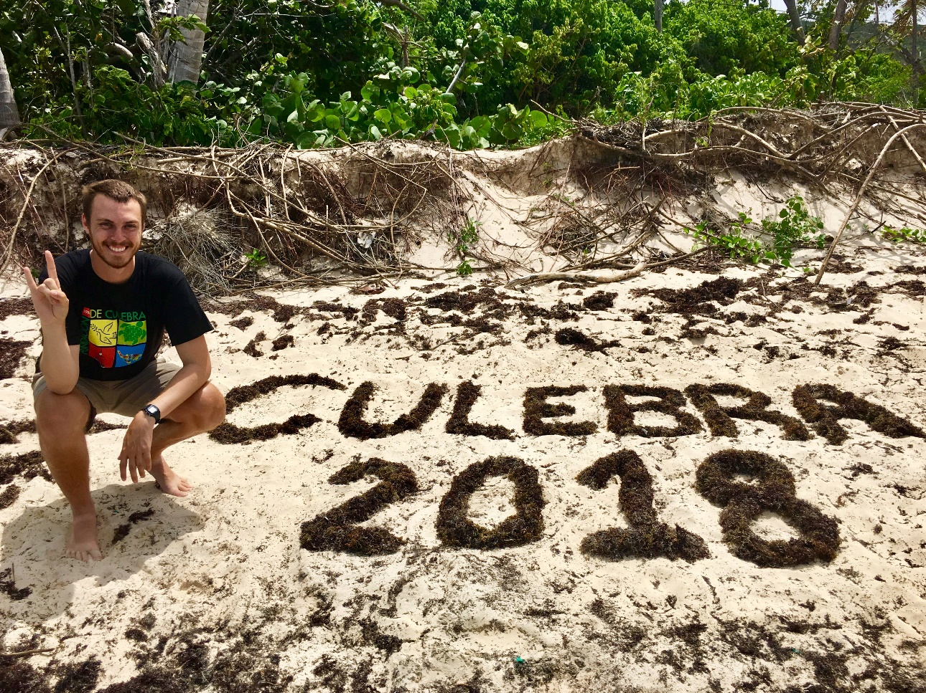
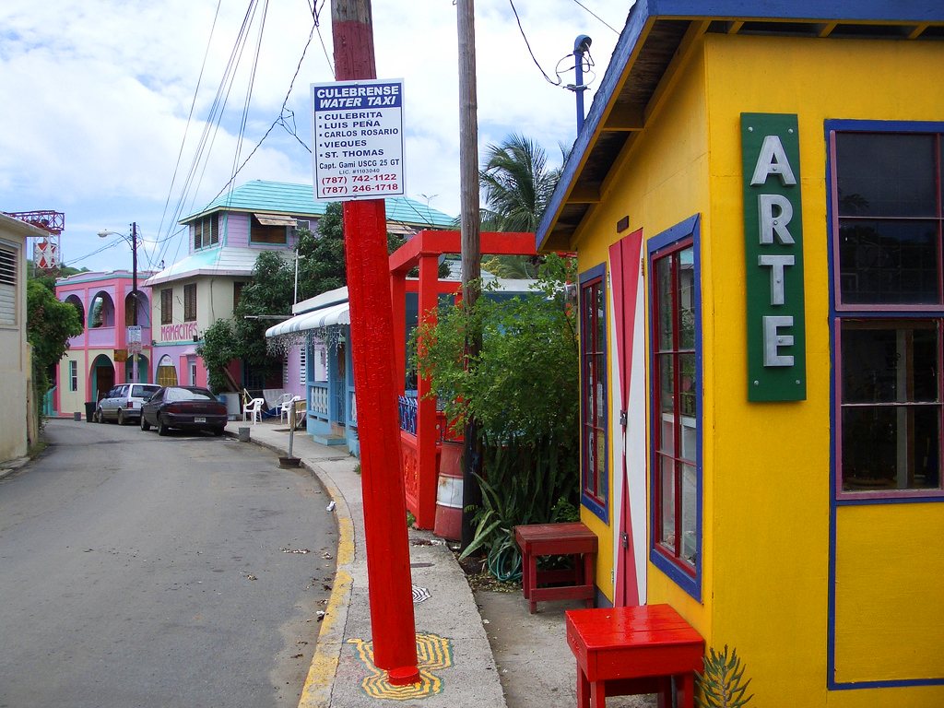
Questions?

