Slide 1
CE 394K Geographical Information System in Water Resources
Term Project Presentation
Electricity generation from natural gas liquids
in the Permian Basin in Texas
Qining Chen
11/15/2018

Slide 2
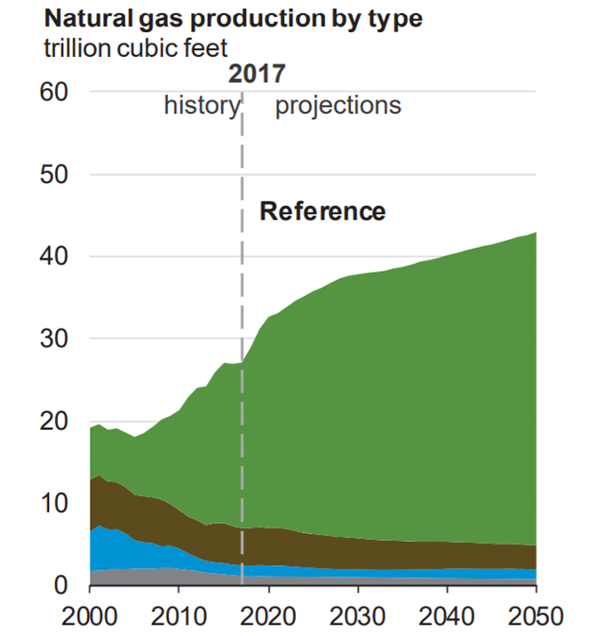
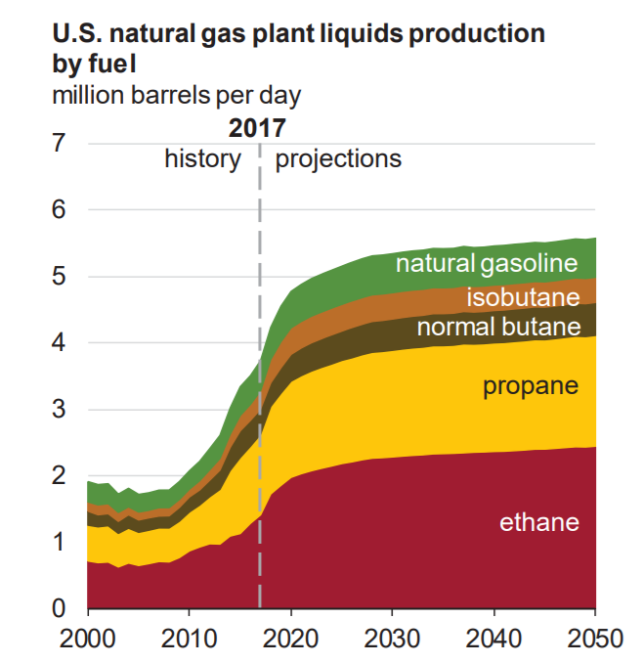
Shale revolution in the U.S.
Technology innovation: horizontal drilling and hydraulic fracturing
Expanded production of natural gas (NG) and natural gas liquids (NGLs)
tight/shale gas
U.S. Energy Information Administration. Annual Energy Outlook 2018.
Notes:
Why transportation fuels instead of chemicals?
Production of NG has expanded rapidly in the U.S. over the past decade, and are still expected to increase in the future. According to EIA, 50% 2017-2050
Meanwhile, production of NGLs also expanded significantly. This provides large amount of light alkane resources, especially ethane and propane

Slide 3
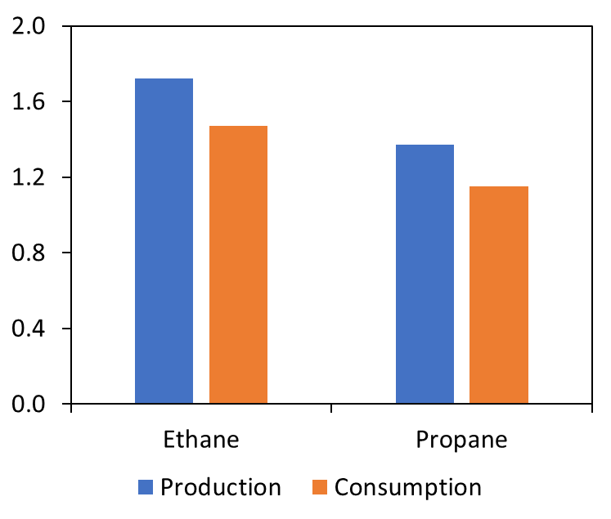
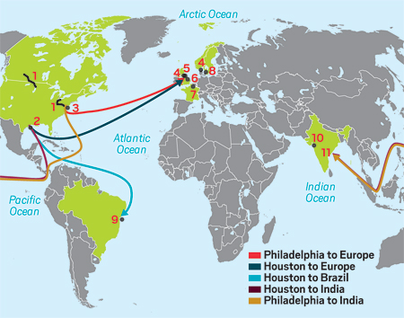
Excess of Natural Gas Liquids (NGLs)
Production exceed domestic demand
Export: high demands in pipelines
Alternative conversion on site: electricity
U.S. Production and Consumption of ethane and propane in 2018
Ethane exportation in 2016
U.S. Energy Information Administration. Short – Term Energy Outlook, September 2018.
Chemical and Engineering News, Volume 94 Issue 44, pp. 28-29, November 7, 2016.

Slide 4
Objective
Mapping of the Permian Basin in Texas
Evaluate potential electricity generation from NGLs
Integrate the NGL-based electricity production into electrical grid
Case study: Permian Basin in Texas
Located in western Texas and southeastern New Mexico
>60,000 wells, 68 gas processing plants

Slide 5
Data sources
General
• Permian basin boundary - Living Atlas in ArcGIS Pro
Objective 1: Evaluate potential electricity generation from NGLs
Shale gas wells - Drilling Info
Gas processing plants - Combined from U.S. Energy Information Administration and U.S. Environmental Protection Agency
Objective 2: Integrate the NGL-based electricity production into electrical grid
Texas electricity transmission lines - Homeland Infrastructure Foundation-Level Data
Drilling Info: https://info.drillinginfo.com/
U.S. Energy Information Administration: https://www.eia.gov/
U.S. Environmental Protection Agency Greenhouse Gas Reporting Program (GHGRP): https://www.epa.gov/ghgreporting
Homeland Infrastructure Foundation-Level Data, available at: https://hifld-geoplatform.opendata.arcgis.com/datasets/electric-power-transmission-lines?geometry=-207.054%2C9.132%2C60.661%2C57.532

Slide 6
Plant allocation
Find the nearest Plant for each well
Euclidean Allocation function
A polygon for each plant
A plant allocated to wells inside the plant polygon

Slide 7
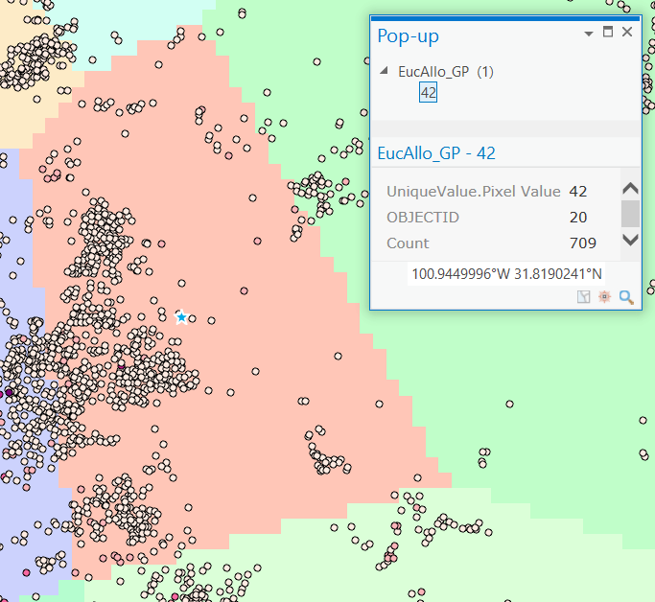
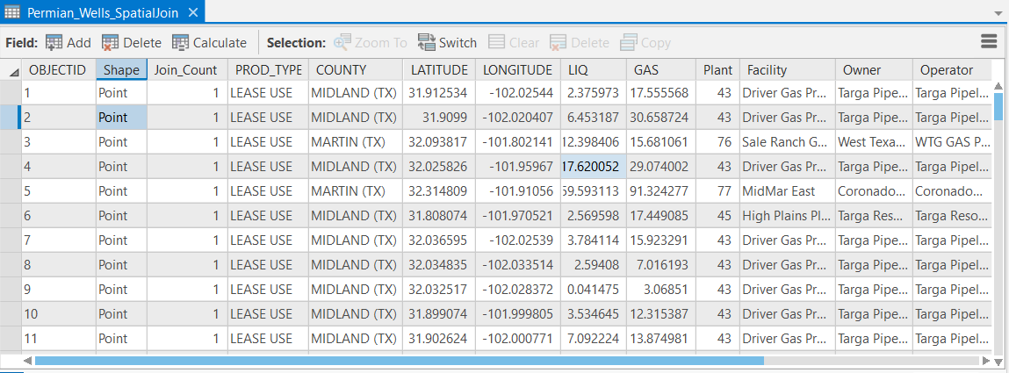
Euclidean allocation function
Visualize relationships between plants and wells
Not convenient for calculations
Alternative tool: Spatial join function
Nearest plant information joined to each well
Convenient for further calculations
Plant allocation
Well information
Nearest plant
information

Slide 8
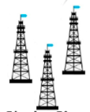
What happens in a gas processing plant?
Typical flow of the gas processing plants
Pipeline NG
(mainly CH₄)
CO₂, H₂S, H₂O
Raw gas
Gas treatment
Sweet gas
NGL Recovery
Well sites
NGLs (C2, C3, C4, C5+)
Ethane (C2)
Main assumptions in calculation
NG composition: C2/C1=0.0337
C2, C3 available for electricity generation
Energy based on lower heating values
Turbine efficiency: 34.7%
Fractionation
Propane (C3)
Heavier (C4+)

Slide 9
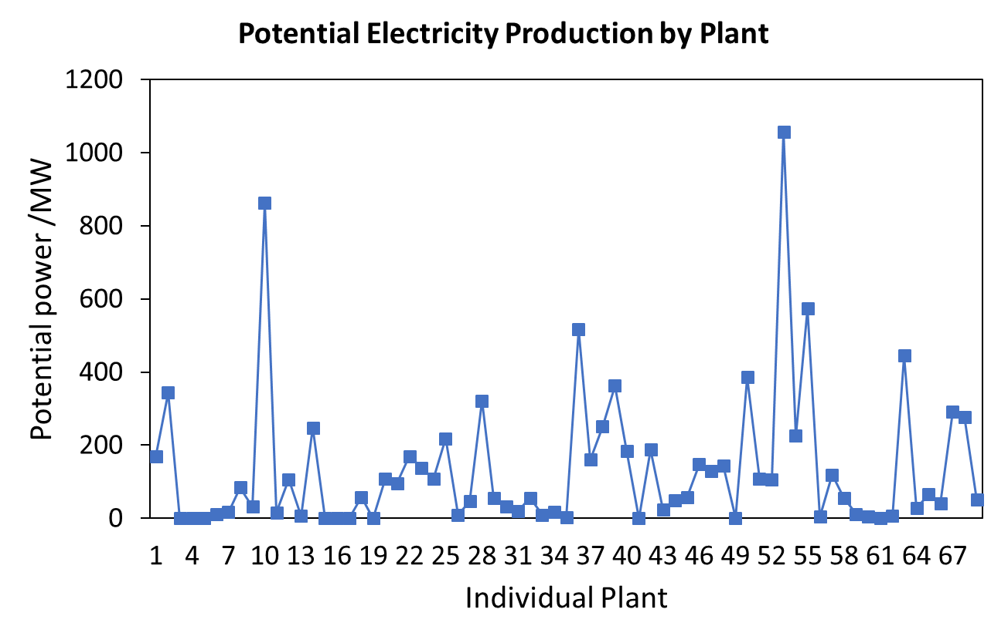
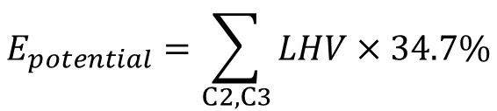
Potential electricity production
$$E_{potential}=\sum_{C2, C3}{LHV}×34.7\%$$
Among 68 gas processing plants
Total production: 9430 MW
5 plants > 400 MW, accounting for 37% of total
30 plants < 50 MW, accounting for 4% of total

Slide 10
Integration into Texas electrical grid
Average electricity demand in Texas in 2017: 73000 MW
Plant production > 50 MW integrated into electrical grid
Assume a factor of 0.9
Potential integration: 8148 MW
>10% Texas electricity demand!
Electricity Reliability Council of Texas (ERCOT). 2017 State of the Grid Report (Apr 10, 2018)

Slide 11
Suggestions for next step
Locate electricity substations
Connections between the electricity produced onsite and electricity transmission lines

Slide 12
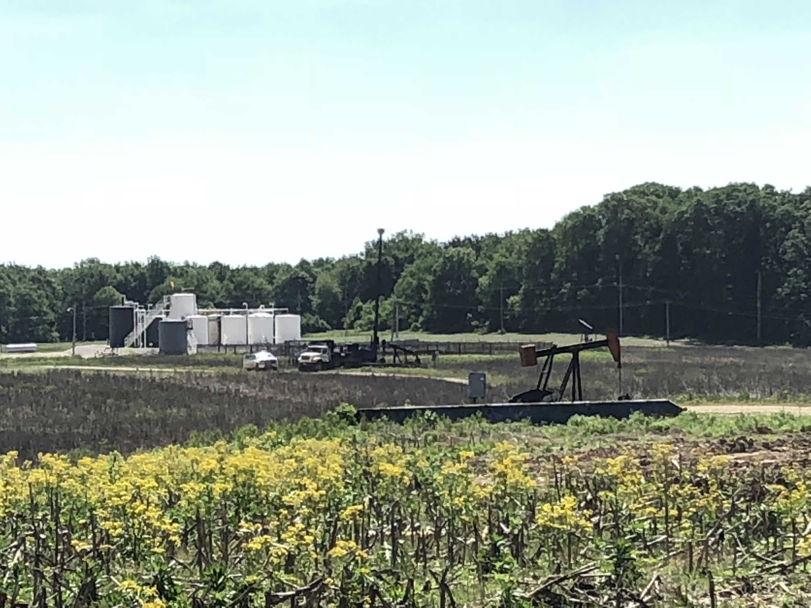
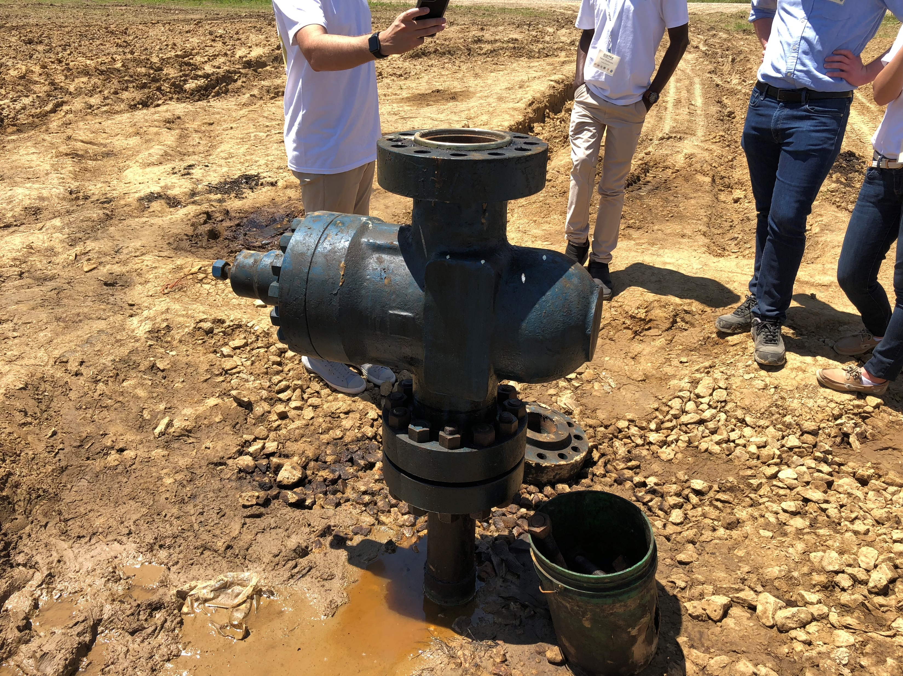
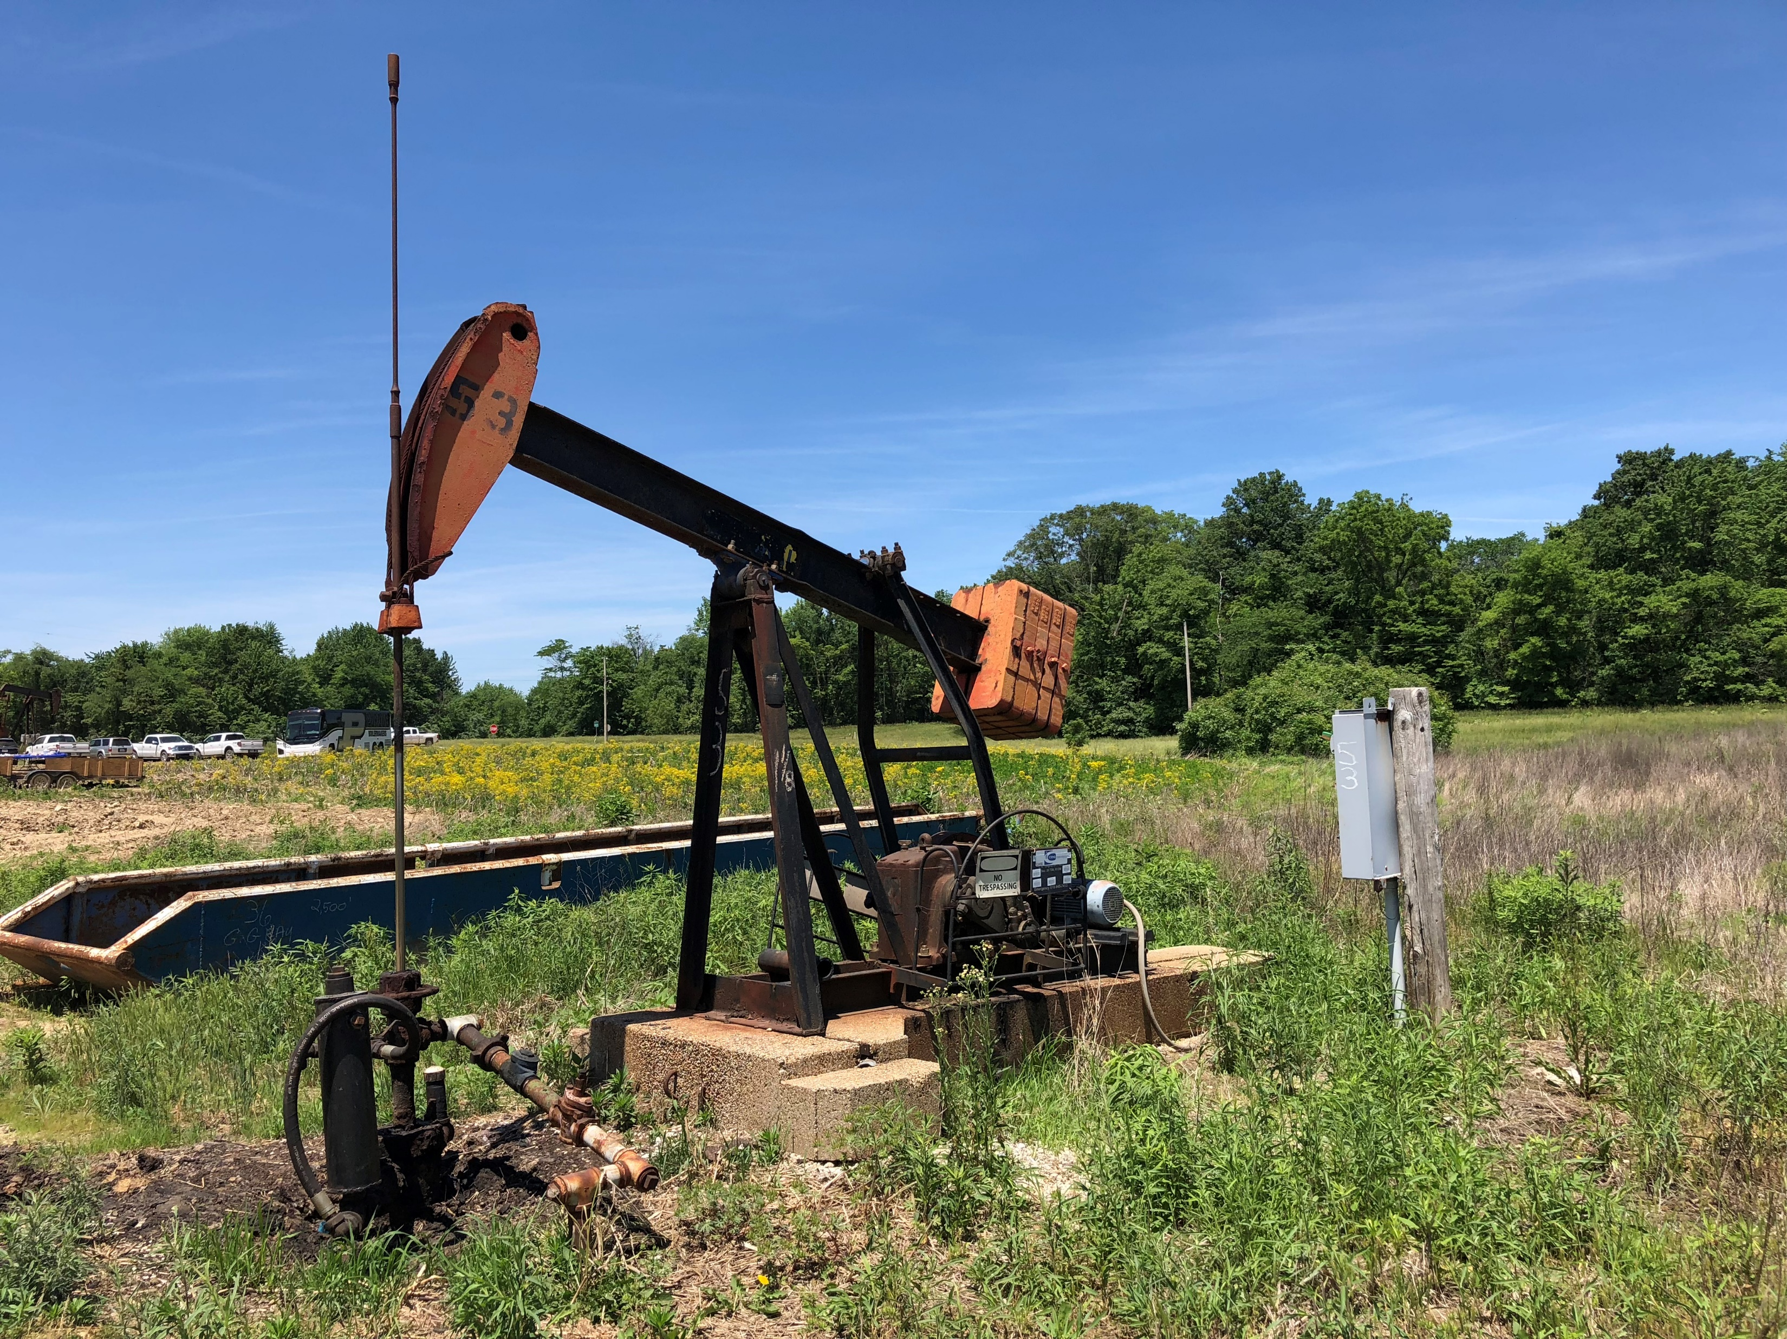
Thank you!
Pioneer extraction field in Southern Indiana, photos taken in May 2017.

