Slide 1

November 2018
Water Stress in the continental United states
Geographic Information Systems in Water Resources, Fall 2018
Hannah knaup
The University of Texas at Austin

Slide 2
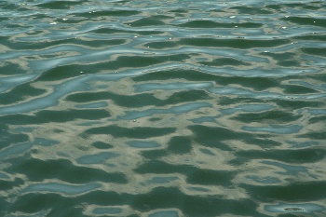

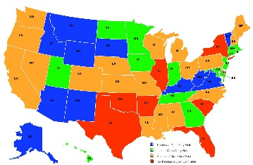

Summary
Water Stress
WaterGAP Model
Stress in the Continental United States
Future Work

Slide 3
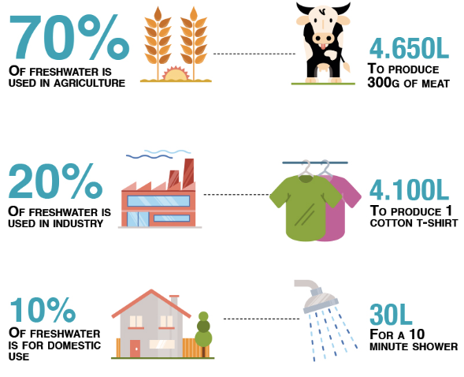
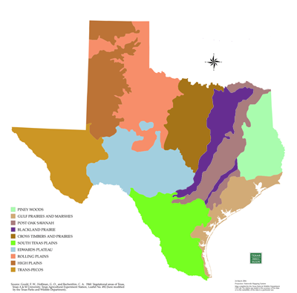
Water Stress
Human Demand For Water > Natural Supply
Notes:
Degree of water stress by ecoregion (area defined by environmental conditions – climate, landforms, soil) – where human demand for water outstrips natural supply
From the Atlas of Global Conservation
The water stress indicator calculation is based on a global water balance model, coupled with estimates of water use by sector (agriculture, domestic, and industrial). These data were derived from the WaterGAP model developed by the University of Kassel in Germany (Alcamo et al. 2003; Döll et al. 2003).

Slide 4
WaterGAP Model
Country
Sector
Population
Water Use Model
Water Withdrawals and Consumption (Irrigation, Livestock, Domestic, Industry)
Water Stress Indicators
Soils
Land Use
Climate
Hydrologic Model
Water Balance Components, River Discharge
Surface Water Only!!!
Observed Discharge Calibration
Notes:
Drawbacks: The index does not account for the use of water from alternate sources such as groundwater, desalination, or reuse of wastewater. It also does not provide any information on the water needs of the ecosystem and does not take into account water resources that are deemed unusable or degraded due to pollution. The model assumes all water available as runoff in an ecoregion can be available for human use.

Slide 5
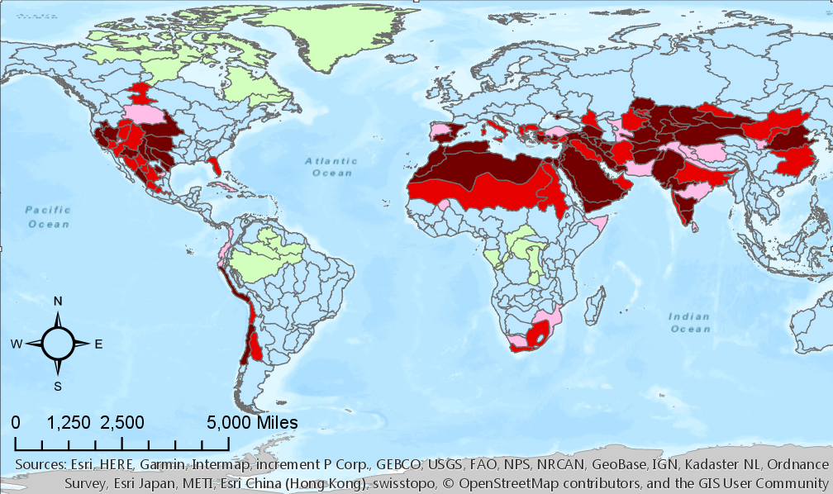
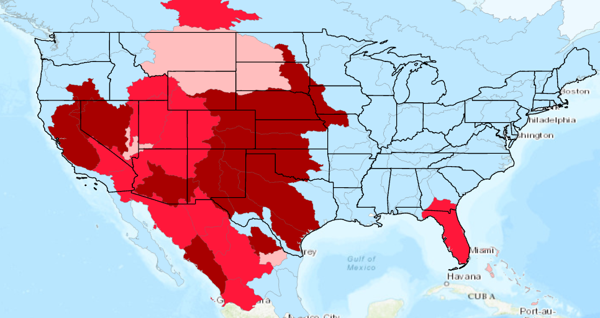
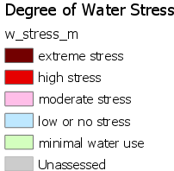

Slide 6
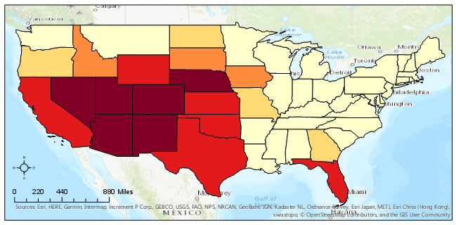
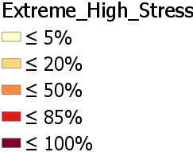
Extreme and High Stress in USA

Slide 7
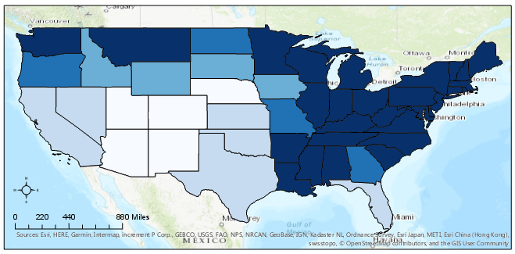
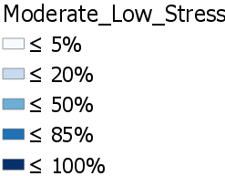
Moderate and Low Stress in the USA

Slide 8
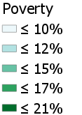
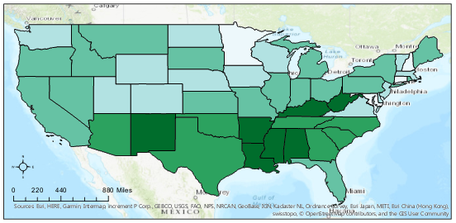
Population Percent in Poverty
State | Poverty %
Mississippi | 21
Louisiana | 20.1
New Mexico | 19.1
District of Columbia | 18.5
Kentucky | 18.2

Slide 9
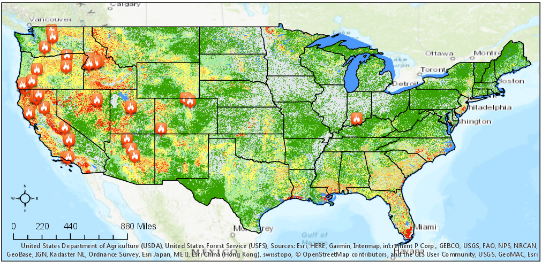
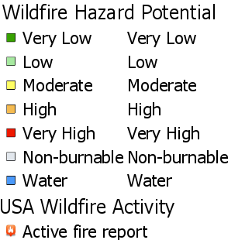
Fire Potential and Activity

Slide 10

Further Work
FIRES!!
Florida
Climate Type Trends

Slide 11
Info about layer
WaterGAP model combined precipitation, temperature, the location of reservoirs and lakes, and a water-routing network to produce the estimates of runoff by grid cell at a 0.5-degree resolution. In this model, water use statistics by country and sector were combined with satellite-derived land use data, irrigated area, as well as population density to estimate water use by grid cell.
To estimate the water stress index, we aggregated runoff and water use by ecoregion and calculated the ratio of water use to availability.
Drawbacks: The index does not account for the use of water from alternate sources such as groundwater, desalination, or reuse of wastewater. It also does not provide any information on the water needs of the ecosystem and does not take into account water resources that are deemed unusable or degraded due to pollution. The model assumes all water available as runoff in an ecoregion can be available for human use.
Notes:
Degree of water stress by ecoregion – where human demand for water outstrips natural supply
From the Atlas of Global Conservation
Projected coordinates:
The water stress indicator calculation is based on a global water balance model, coupled with estimates of water use by sector (agriculture, domestic, and industrial). These data were derived from the WaterGAP model developed by the University of Kassel in Germany (Alcamo et al. 2003; Döll et al. 2003).
WaterGAP model combined precipitation, temperature, the location of reservoirs and lakes, and a water-routing network to produce the estimates of runoff by grid cell at a 0.5-degree resolution. In this model, water use statistics by country and sector were combined with satellite-derived land use data, irrigated area, as well as population density to estimate water use by grid cell.
To estimate the water stress index, we aggregated runoff and water use by ecoregion and calculated the ratio of water use to availability.
Drawbacks: The index does not account for the use of water from alternate sources such as groundwater, desalination, or reuse of wastewater. It also does not provide any information on the water needs of the ecosystem and does not take into account water resources that are deemed unusable or degraded due to pollution. The model assumes all water available as runoff in an ecoregion can be available for human use.

Slide 12
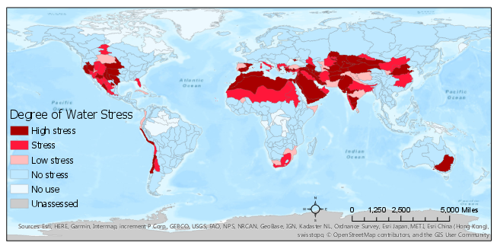
Degree of Water Stress by Ecoregion

Slide 13
State | Poverty %
Mississippi | 21
Louisiana | 20.1
New Mexico | 19.1
District of Columbia | 18.5
Kentucky | 18.2
State | Extreme and High Stress %
Colorado | 100
New Mexico | 100
Arizona | 99.5
Nebraska | 97
Utah | 97
Notes:
https://www.census.gov/data-tools/demo/saipe/saipe.html?s_appName=saipe&map_yearSelector=2015&map_geoSelector=aa_c&s_USStOnly=y&menu=grid_proxy&s_year=2015

