Slide 1


November 2018
Changes in land cover in us cities over time
Maarten Kroll

Slide 2
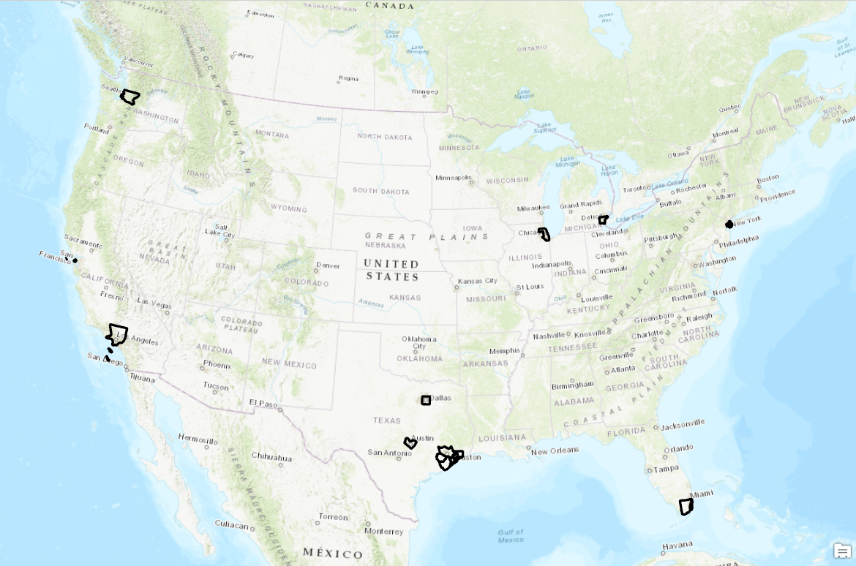
Cities
Austin
Chicago
Dallas
Detroit
Houston
Los Angeles
Miami
New York
San Francisco
Seattle

Slide 3
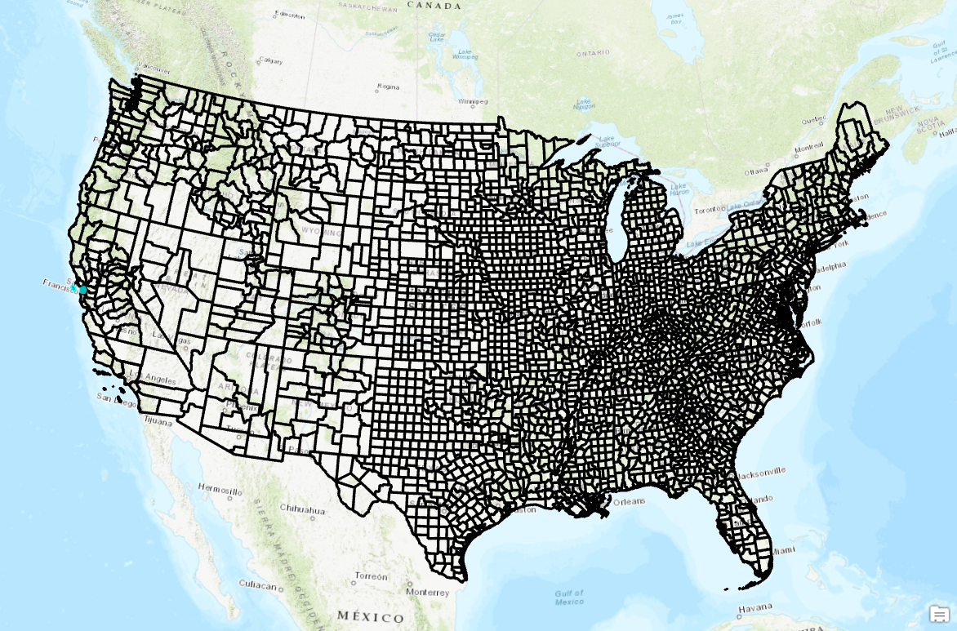
Procedure
US County Map
NAD 1983 Contiguous USA Albers

Slide 4
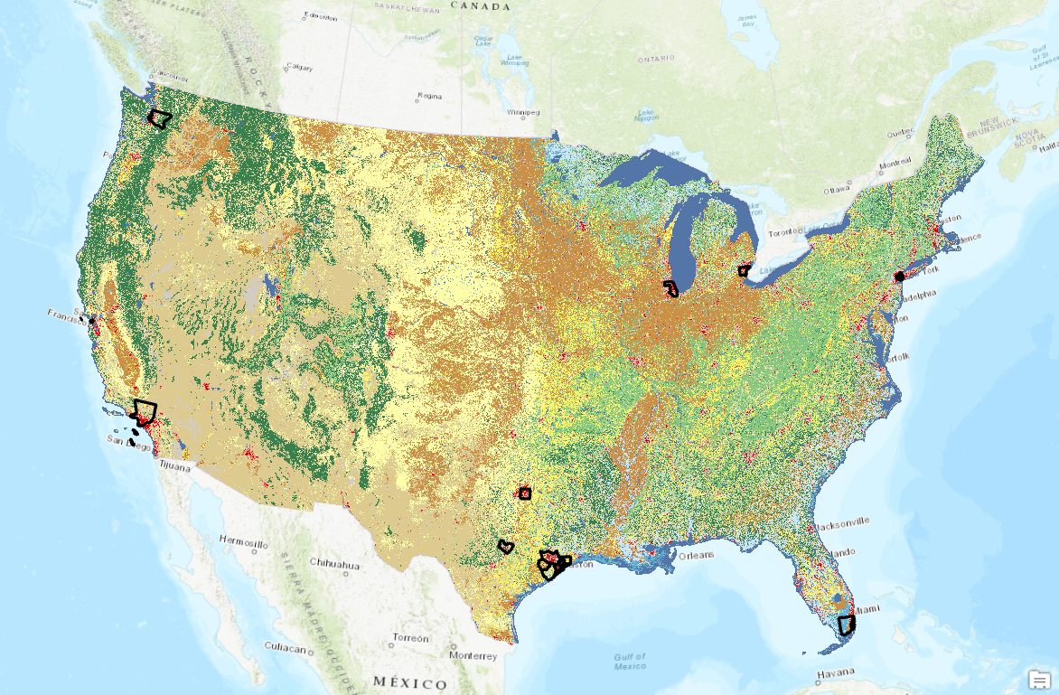
Procedure
NLCD ’01/’06/’11
NLCD website
Living Atlas
Notes:
Here I will explain how the BRB is implemented within the viaduct itself, tell a bit about the Hayward and San Andreas Fault

Slide 5
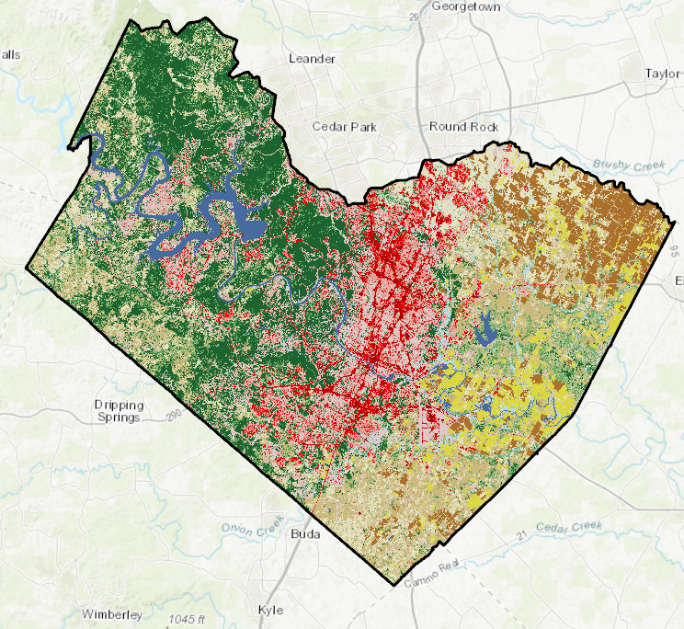
Procedure

Slide 6
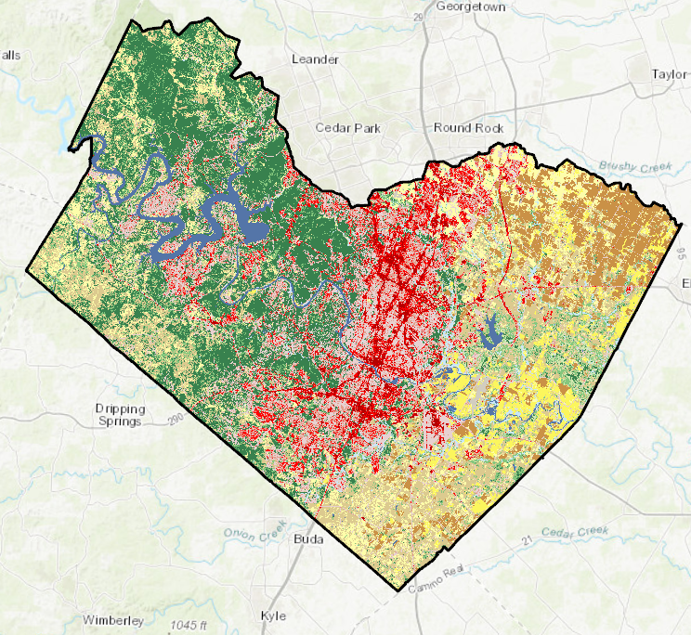
Procedure

Slide 7
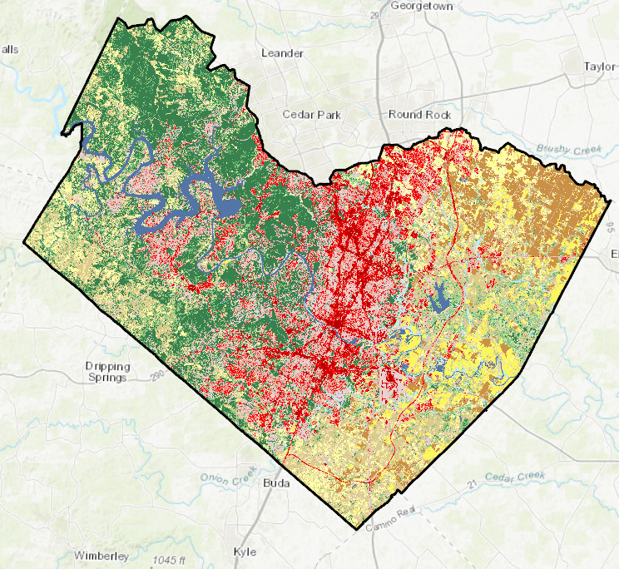
Procedure

Slide 8
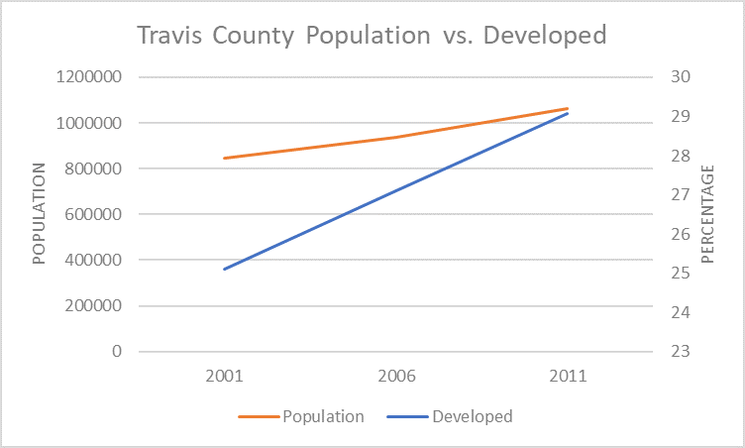
Procedure

Slide 9
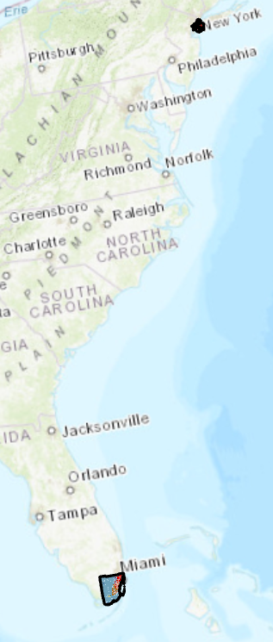
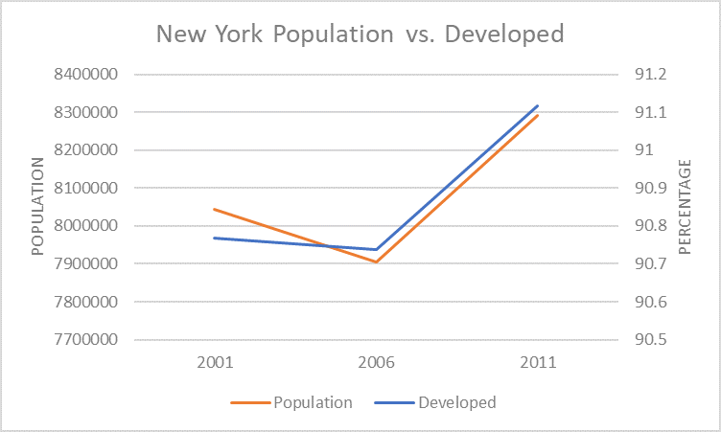
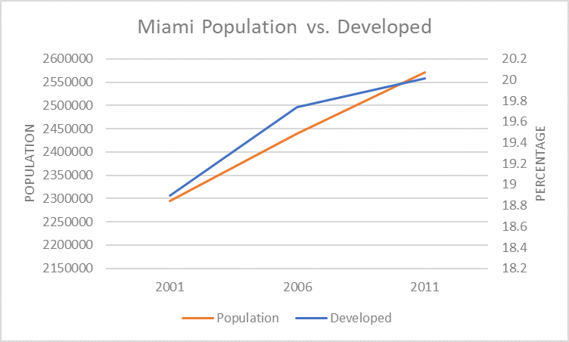
Results

Slide 10
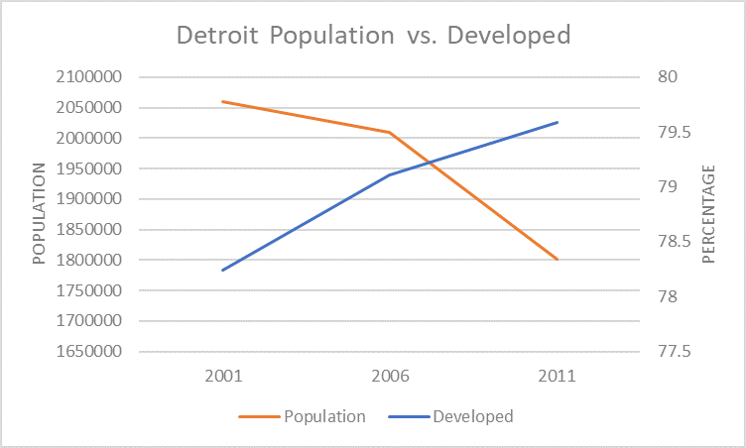
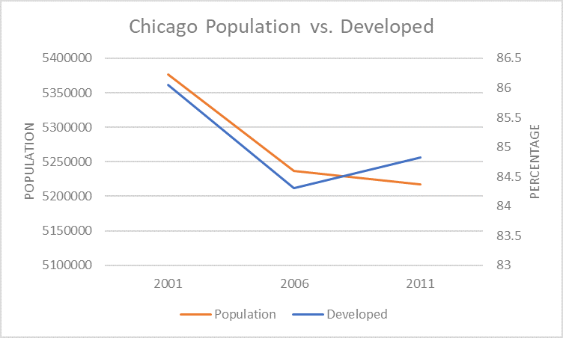
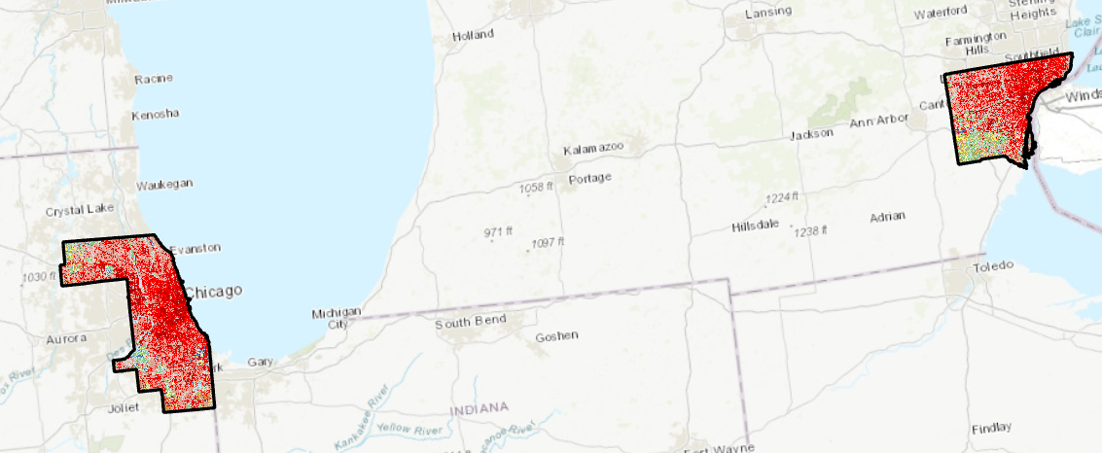
Results

Slide 11
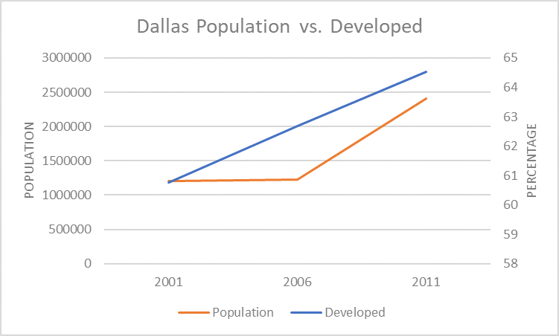
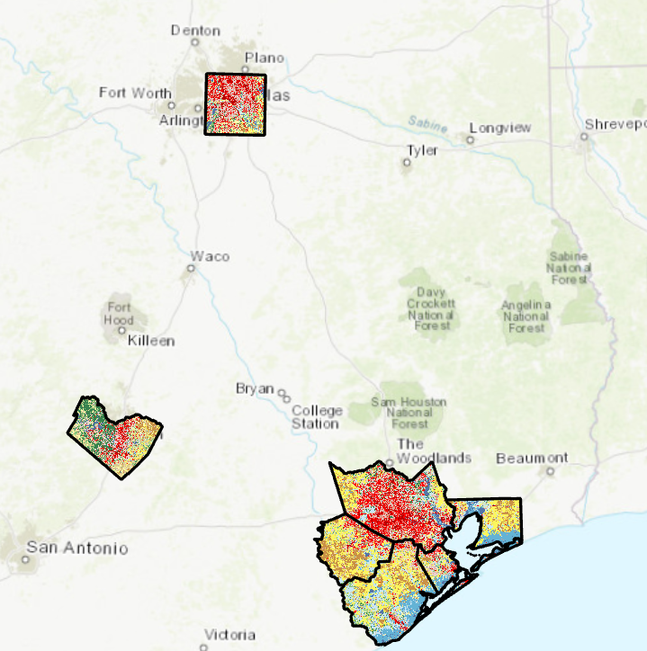
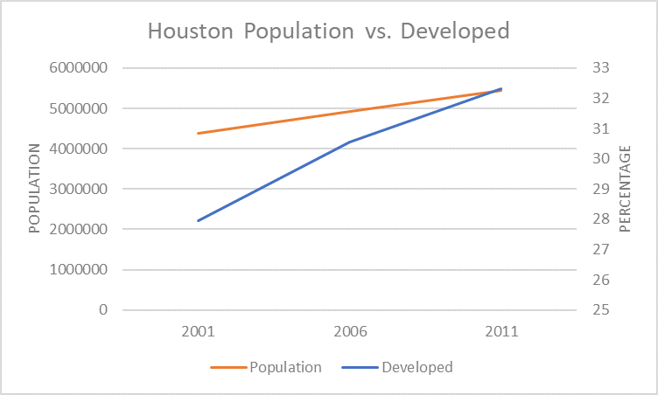
Results

Slide 12
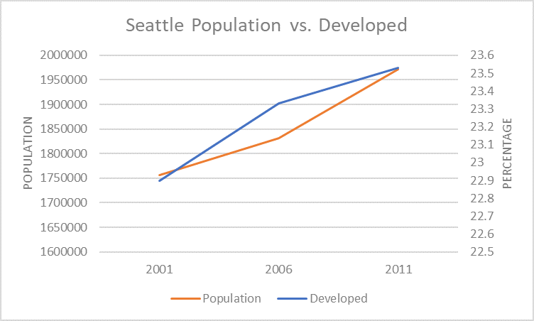
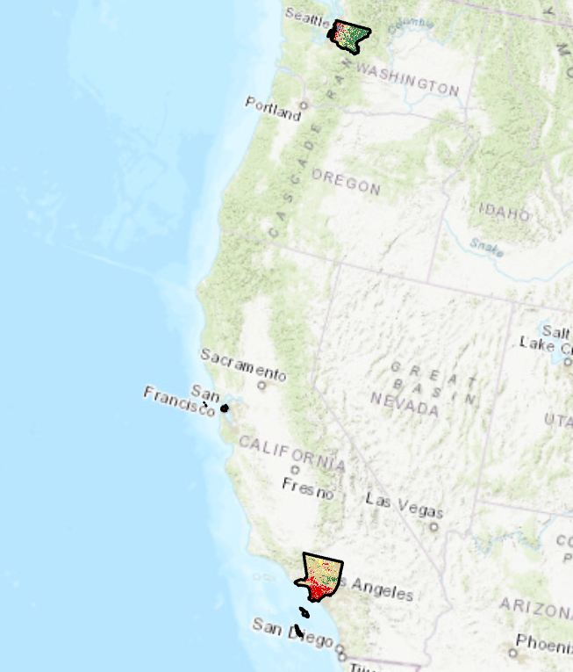
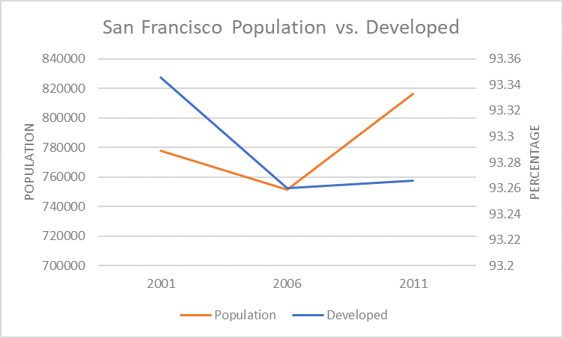
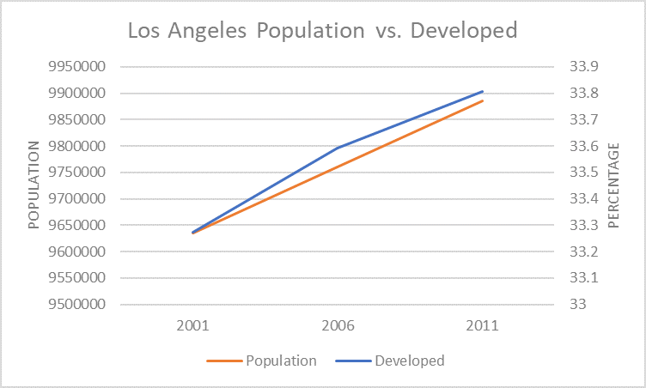
Results

Slide 13
Notable Issues
Different Surface Areas in NCLD Databases
Chicago 2001

Slide 14
Notable Issues
Different Surface Areas in NCLD Databases
Chicago 2006

Slide 15
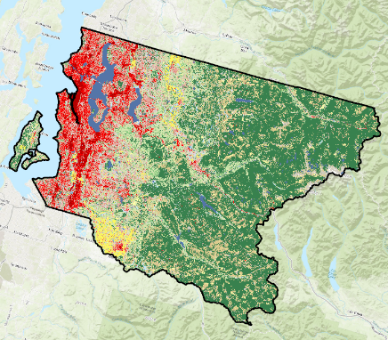
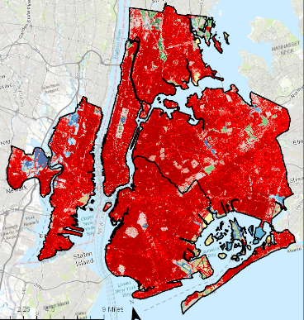
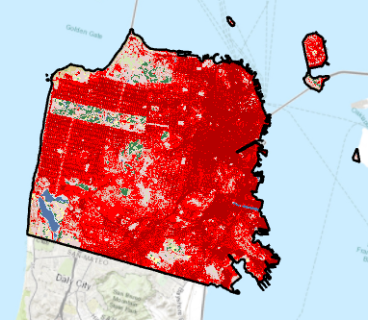
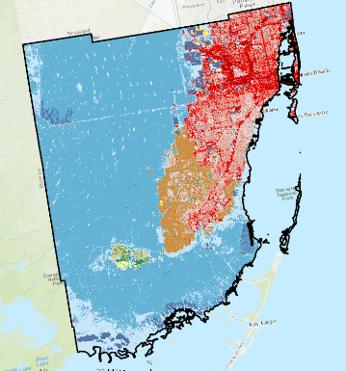
Notable Issues

Slide 16
Future Steps
Create Equal Surface Areas
Restrict to City Boundaries
  Input of %Developed Imperviousness Maps
Map of Land Cover Use Change

Slide 17

Questions?

