Slide 1
Visualization of mobile-monitored air quality data and its distribution onto the local community at Austin
Jing Wu
CE 394K
11/15/2018

Slide 2
Agenda
Purpose
  Risk on health
  Monitoring & regulation implementation
Data
  Google street view cars
  Demographic information - from ACS (American Community Survey)
    Income
    Health care spending
Analysis
  Hot spot analysis
  Grouping average
Future steps
  Statistics

Slide 3
Why monitoring? Why GIS mapping?
Source
  Traffic
  Cooking
  Industry
Long-term health impacts
  BC
  PM2.5
Useful information for the public
Promotion on air quality regulation

Slide 4
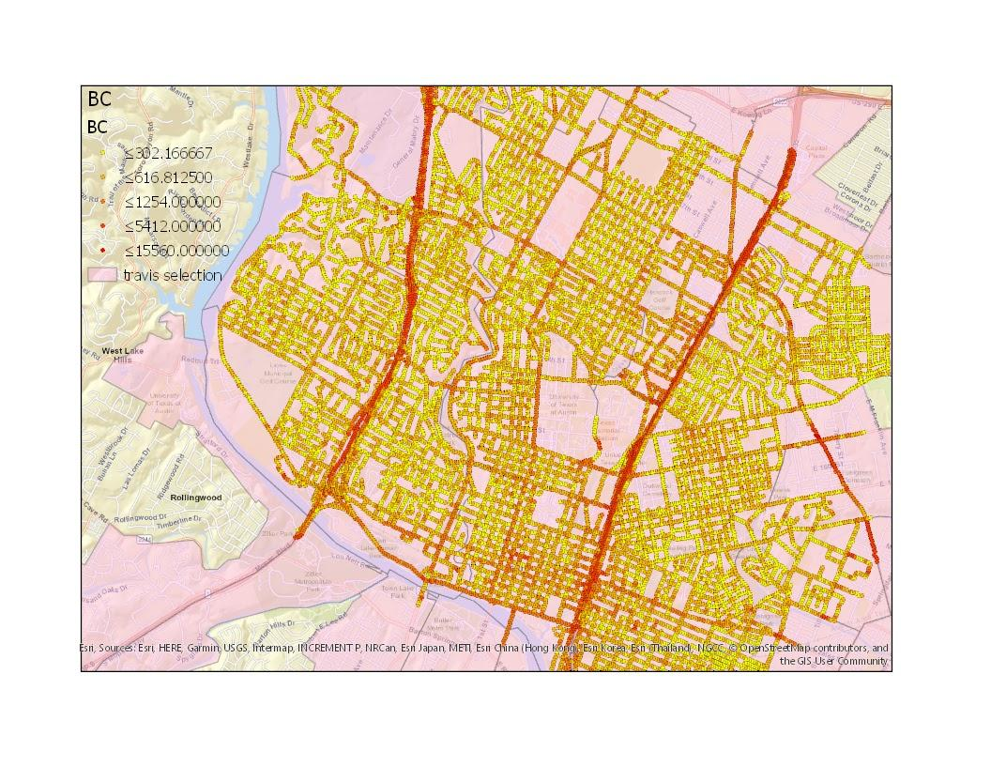
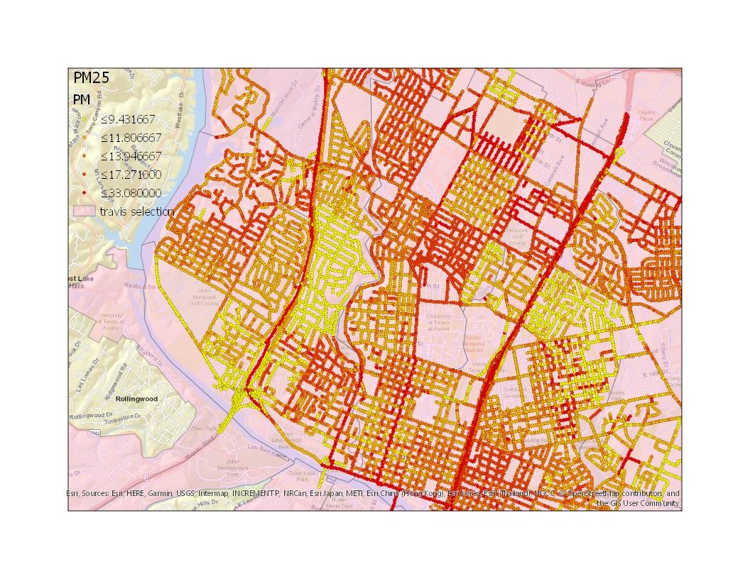
Data sources – BC (left), PM2.5 (right)

Slide 5
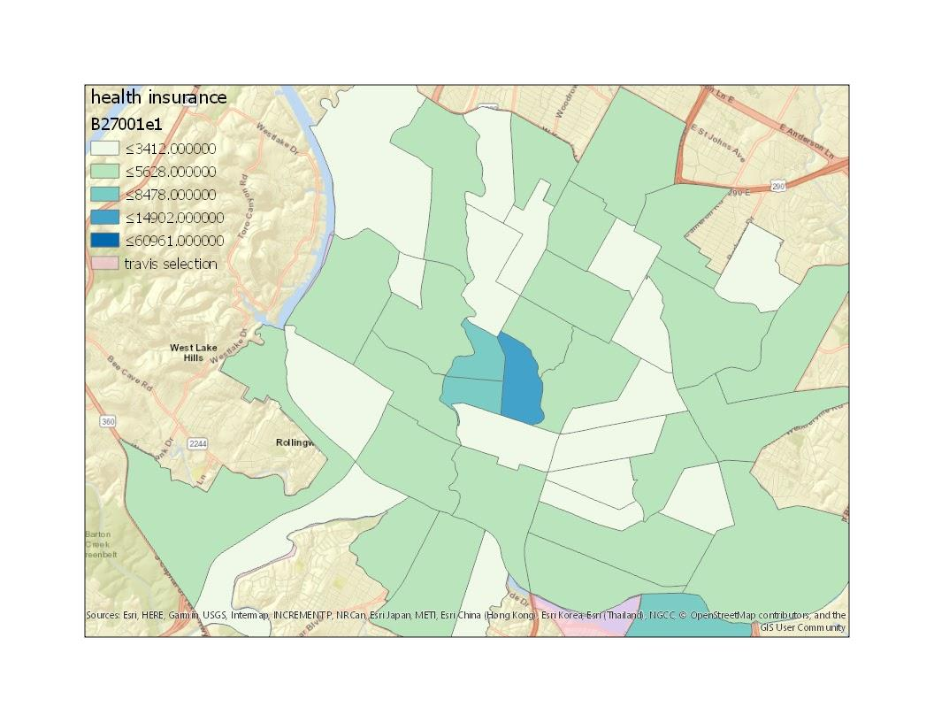
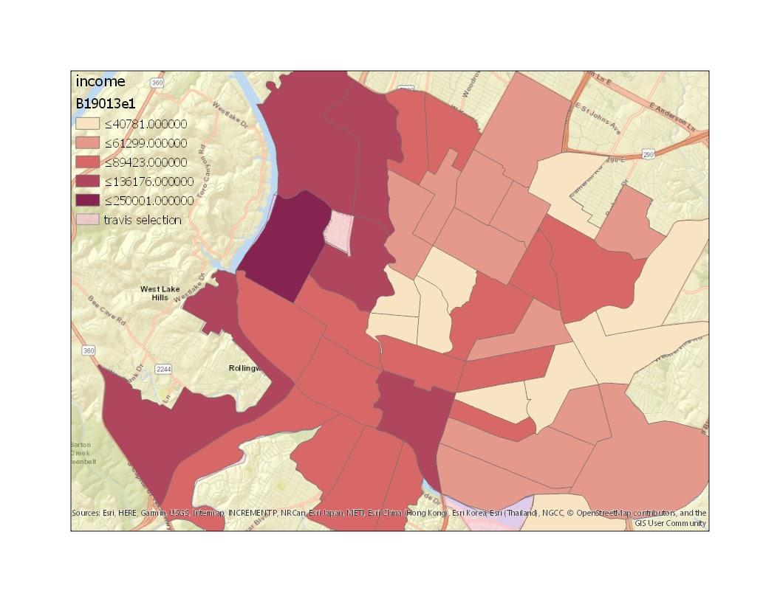
Data sources - health insurance (left), income (right)

Slide 6
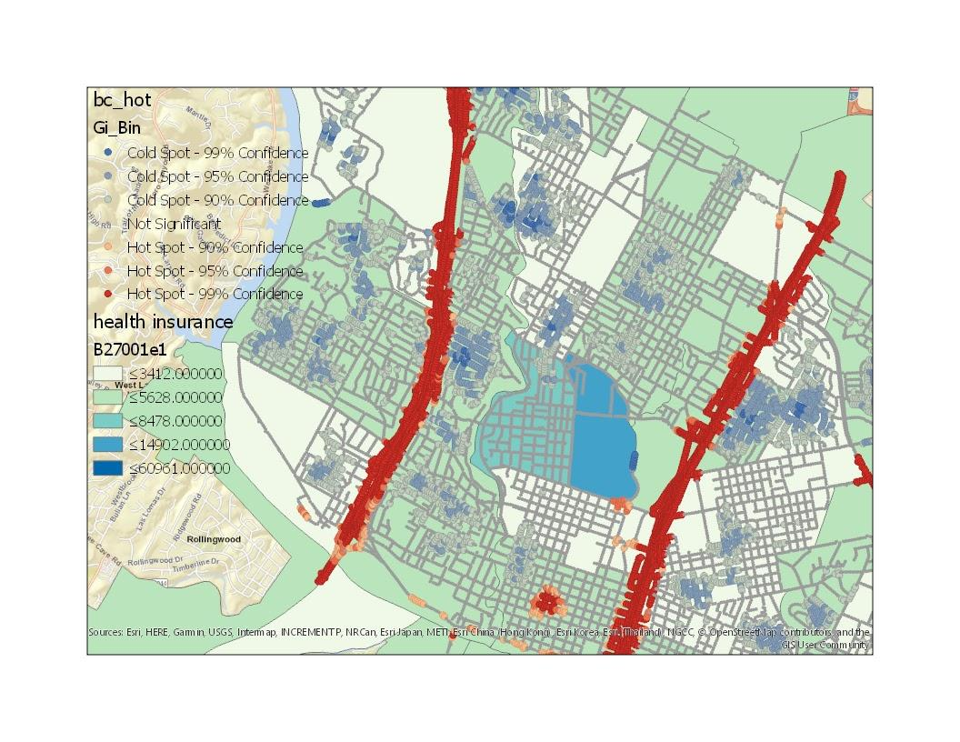
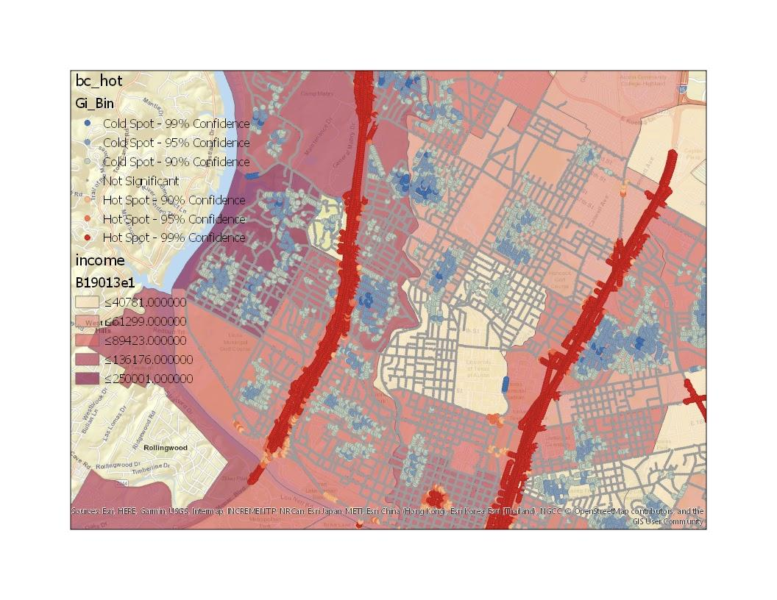
Analysis - hot spot for BC exposure

Slide 7
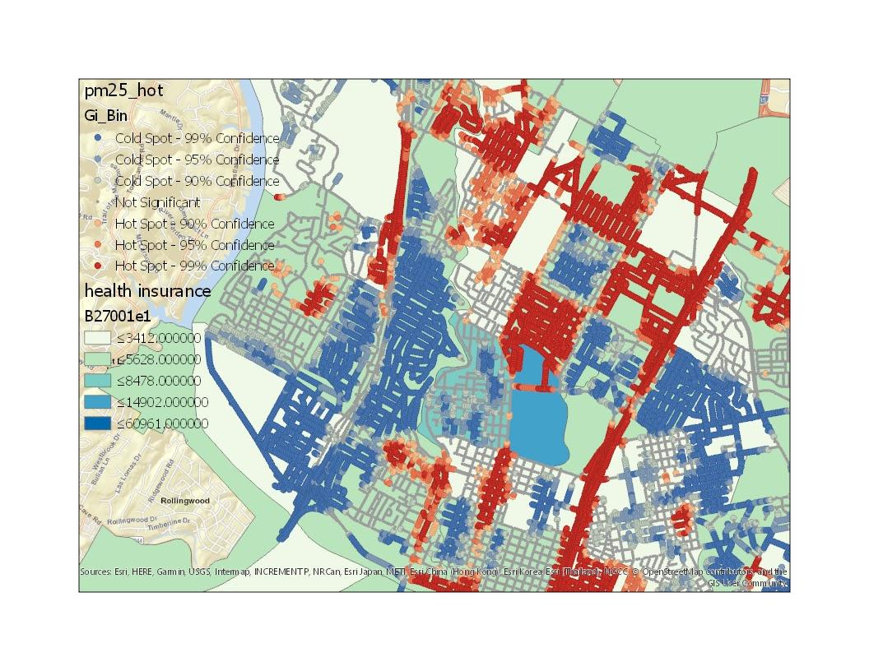
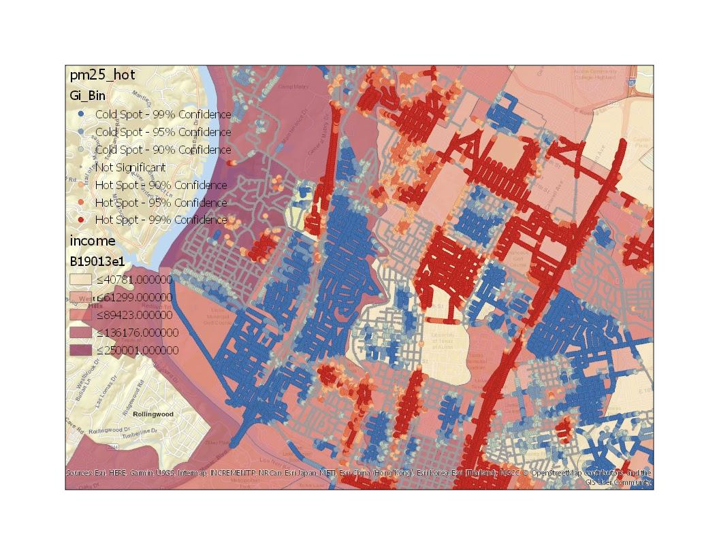
Analysis - hot spot for PM2.5 exposure

Slide 8
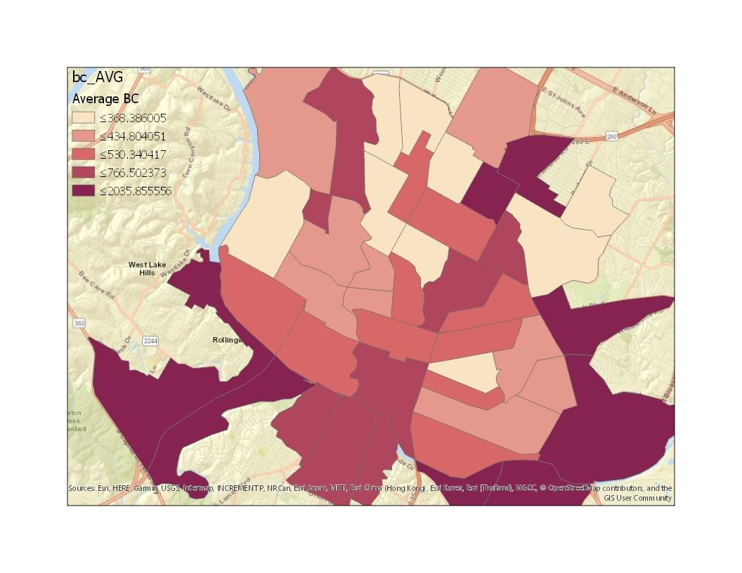
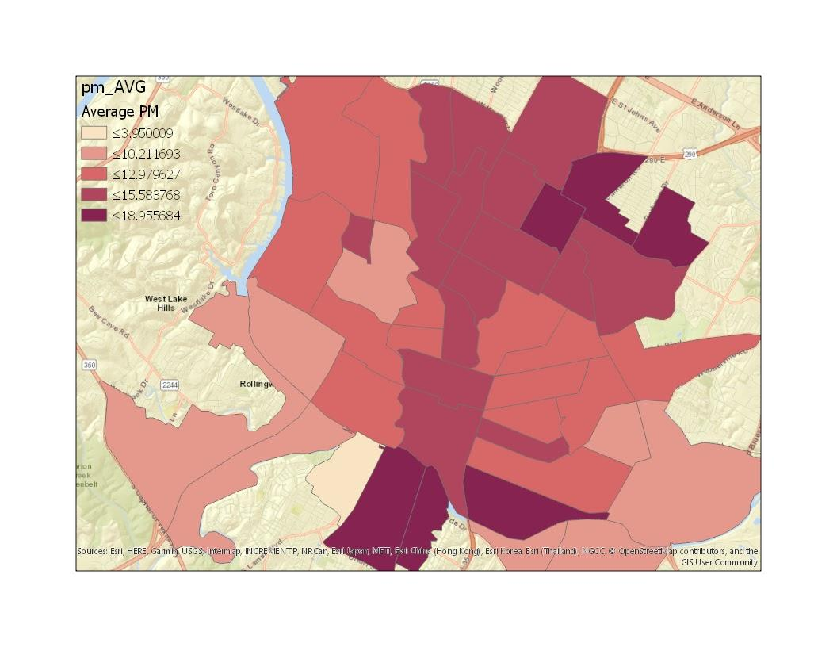
Analysis - tract averages, BC (left), PM2.5 (right)

Slide 9
Future steps
Advance database
  Insurance coverage
    By gender
    By age (focus on elder population)
More analysis
  Statistical calculations
    Tract with highest concentration of BC & PM2.5
    BC & PM2.5 status at lowest vs. highest income group

Slide 10
Thank you and any questions?

