Slide 1
2013 Floods: Mapping Hydrology and impacts in Larimer County, Colorado
Whitney Benson
CE 394 K – GIS in water resources

Slide 2
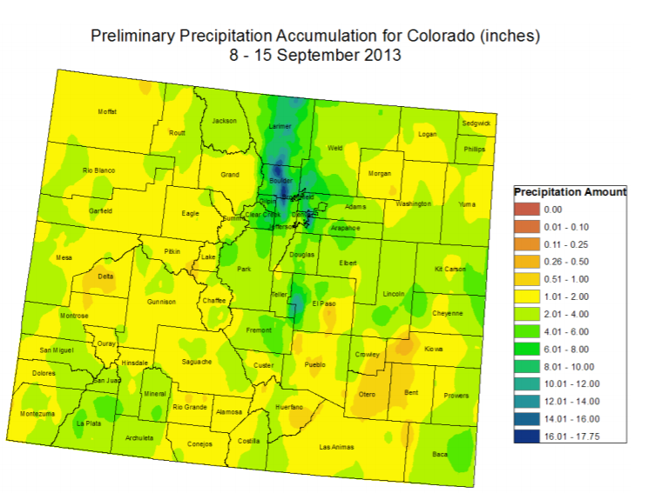
Background: 2013 Floods
September 9th : A slow moving cold front stalls
SUSTAINED HEAVY RAINFALL FOR 4 days
“1000 year” Levels of rain
  Stream flow rates were NOT 1000 year levels
State of emergency
Boulder county: over average annual rainfall in 4 days
Source: USDA Forest Service

Slide 3
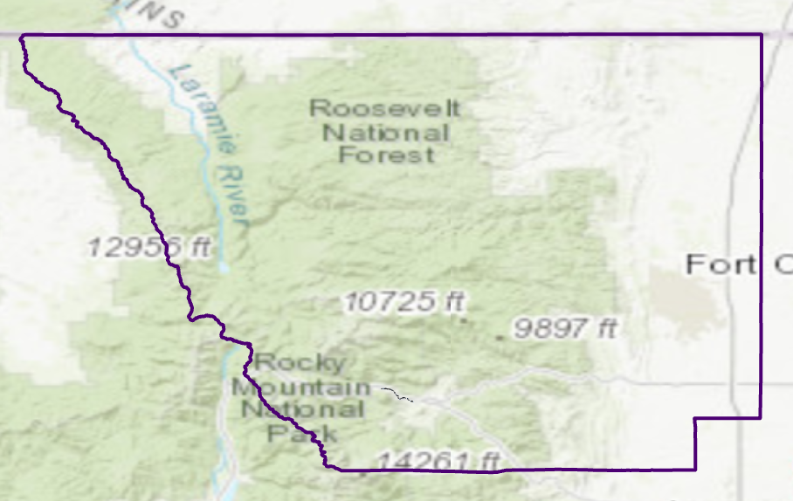

Background: Why larimer County?
Past studies focused on boulder county
Larimer county had 1500 homes destroyed
Experienced less rainfall, more damage
FOCUS: Fort COLLINS and ESTES PARK

Slide 4
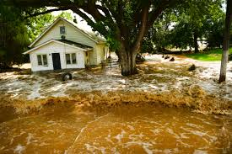
goals
Compare damage reports to HAND mapping
Examine socio economic factors and their impacts on damage
Explore other factors for flood damage
Create a story map → Create a model

Slide 5


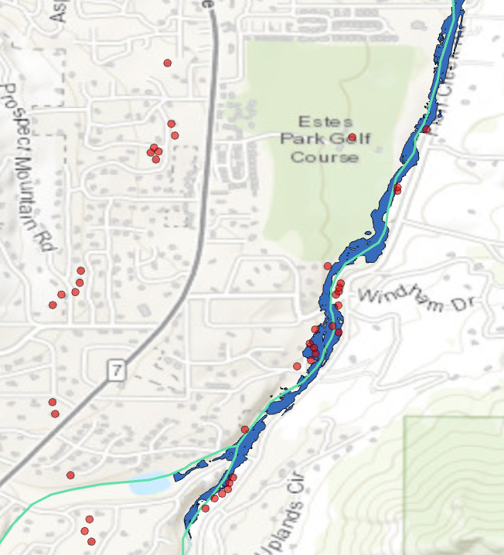
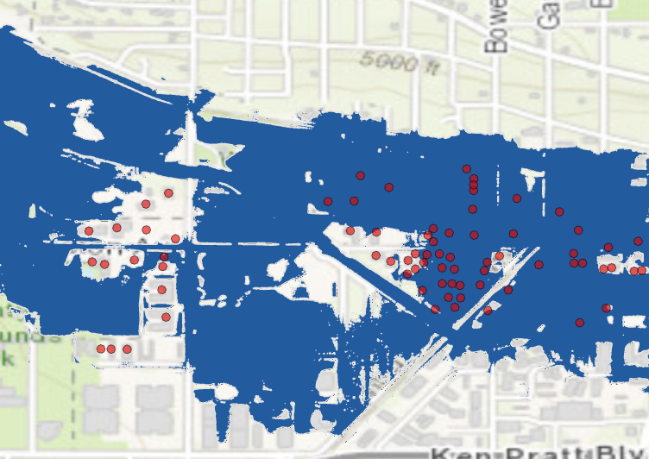
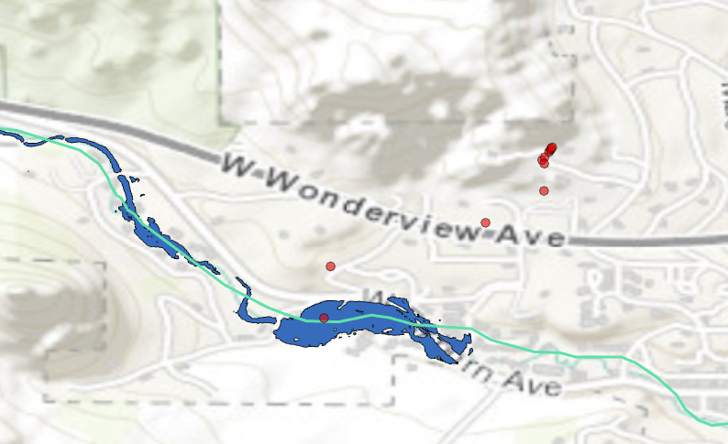
DAMAGES STRUCTURES VS. FLOOD EXTENTS

Slide 6
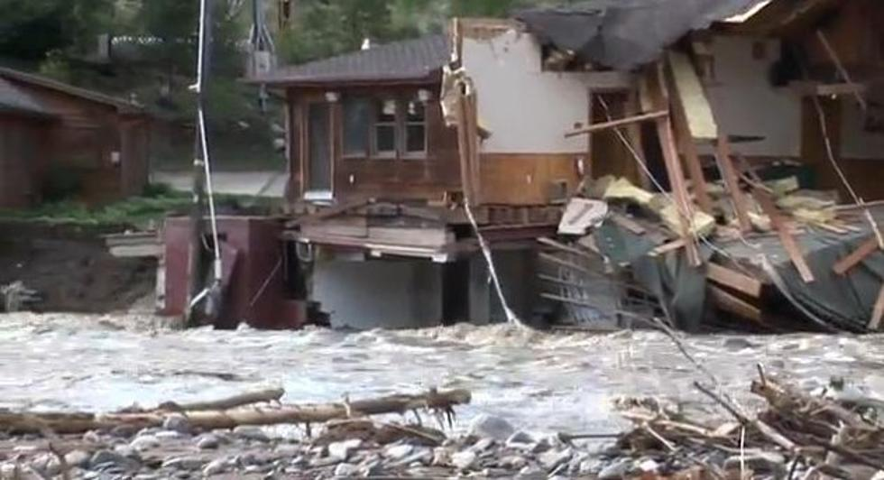
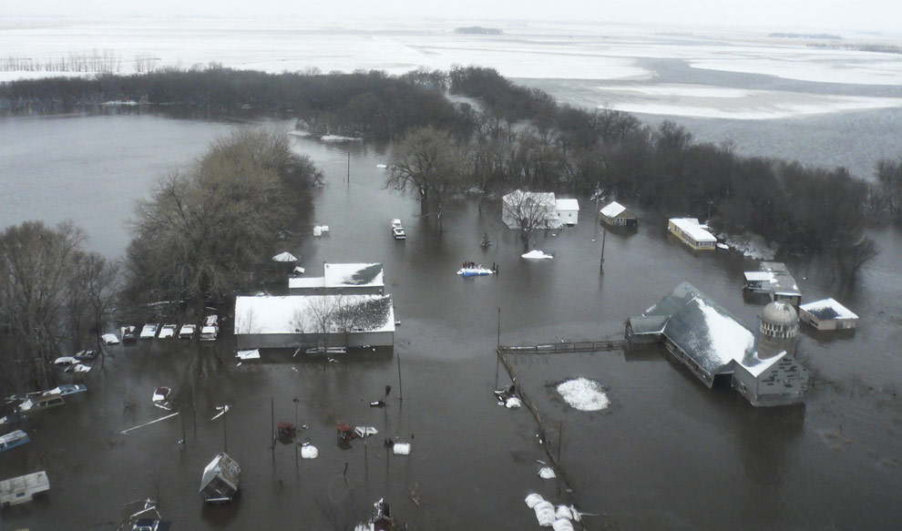
LOVELAND, COLORADO vs. FARGO, North DAKOTA
2013 flooding

Slide 7
Slope: Does it define the 2013 floods
Possible compounding issues
  General terrain of Colorado
  System characterized as “perpendicular” to drainage
    Remember: Flows Not 1000 years
Hydraulic slope can explain some damage points
Can we model the effects of both?

Slide 8

Probabilistic model for damage
Extracted raster values to data points
Damage point vs address point
Using BIoGEME to fit model
Factors considered:
  Hydraulic slope, HAND, flow accumulation, census data…
Did not examine rainfall
Floodplain significance: much lower than expected
$V_{damage}$= $β_{HAND}∗HAND+β_{SLOPE }{∗SLOPE+β}_{……..}$

Slide 9
Final thoughts
The unusual duration and intensity of this event allowed simplified analysis
Socio-Economic variables? Distance weighted variables? Non-Linear
Are FEMA flood maps effective for this case?
How do we insure?
1000 year events?
Larimer county is working with FEMA

Slide 10

Questions?

