Slide 1
November 2018
Flooding Surrounding the Addicks Reservoir during Hurricane Harvey
Carolyn Cooper

Slide 2
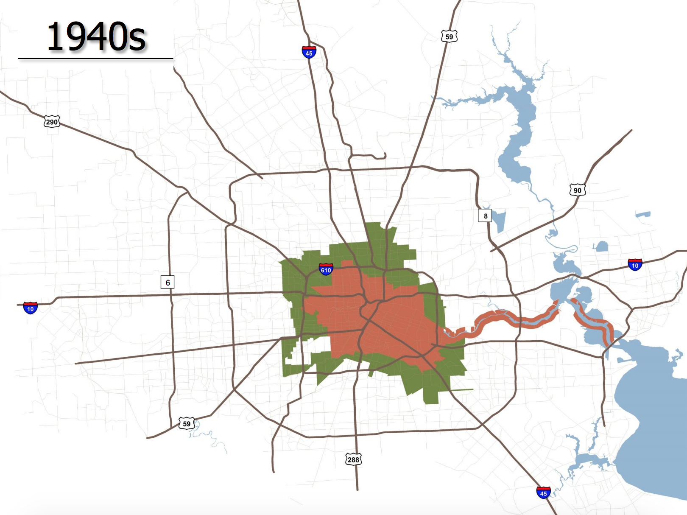
History of Addicks Reservoir
1929
1935
1948
Flood causes $2.5M in damage
Addicks Reservoir Construction Complete
Flood causes $1.4M in damage
Port of Houston crippled for months
7 people killed
1937
Harris County Flood Control District Founded
Addicks Reservoir
Barker Reservoir

Slide 3
Upstream Flooding in the Addicks Watershed
1992 Land Cover
2011 Land Cover
Substantial changes in land usage in Addicks Watershed
Reservoir pools flooded for first time during Hurricane Harvey
Notes:
https://www.npr.org/2017/11/09/563016223/exploring-why-hurricane-harvey-caused-houstons-worst-fooding

Slide 4
Digital Elevation Model Evaluation
10 M DEM from USGS National Elevation Dataset
Generated Elevation-Area Capacity Curve using Model Builder with the Surface Volume Tool
DEM is fairly accurate
Filled DEM is not representative

Slide 5
Height Above Nearest Drainage Calculation
HAND calculated to reservoir outlet
Approximates full reservoir
Address points exist within the area where HAND is zero

Slide 6
Inundation Comparison
 | Reservoir Height, ft above NAVD88 | Homes Flooded
Max during Harvey | 109.1 | 3,750
1% Error | 110.2 | 5,999
2% Error | 111.3 | 7,840
HCFD | - | 6,010
Differences between DEM and reservoir may contribute to error

Slide 7
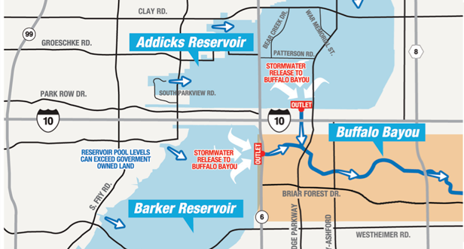
Downstream Flooding
Corps began controlled releases during Hurricane Harvey on August 29th
4,000 CFS – 8,000 CFS from both reservoirs
Notes:
https://www.lincolninst.edu/publications/articles/houston-surveys-post-harvey-policy-landscape
https://www.hcfcd.org/hurricane-harvey/flooding-impacts-in-connection-with-the-reservoirs/

Slide 8
Height Above Nearest Drainage and Rating Curve
Generated HAND for Buffalo Bayou
Developed rating curves for delineated catchments

Slide 9
Inundation Comparison
 | Homes Flooded
Current Estimate | 3,146
City of Houston | 4,000
HCFD | 17,090
Discrepancies due to difference in extent of Buffalo Bayou
Still working to improve estimate

Slide 10
Conclusions
HAND provided relatively accurate estimates
Still refining downstream inundation estimate
Understanding flooding around Houston’s reservoirs is crucial to improving flooding infrastructure
Notes:
https://spacecityweather.com/addicks-barker-reservoirs-emptied/

