Slide 1

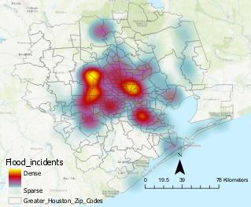
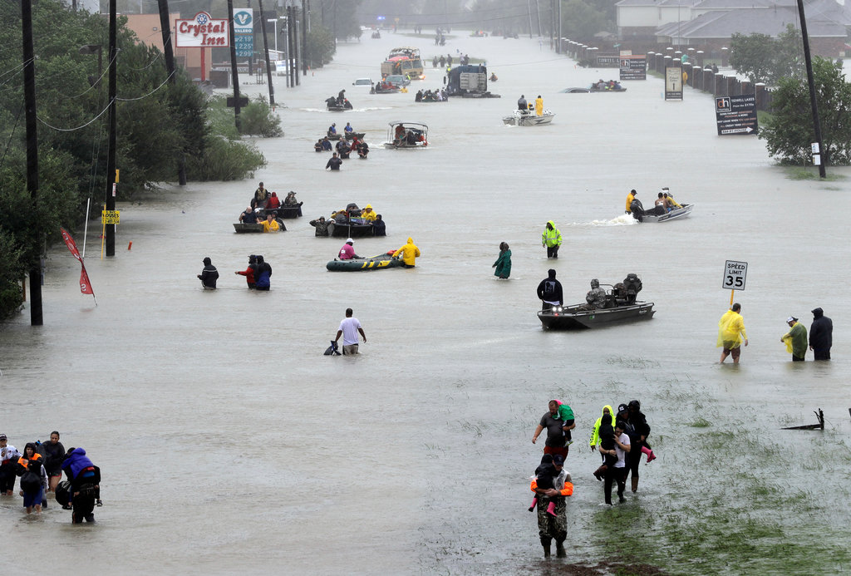
November 27, 2018
Understanding the socioeconomic trends in areas impacted by flooding during Hurricane Harvey in Houston, Texas
GIS in Water Resources
CE 394K.3
Luisa Florez
https://www.nytimes.com/interactive/2018/08/30/magazine/hurricane-harvey-houston-floods-texas-emergency.html

Slide 2

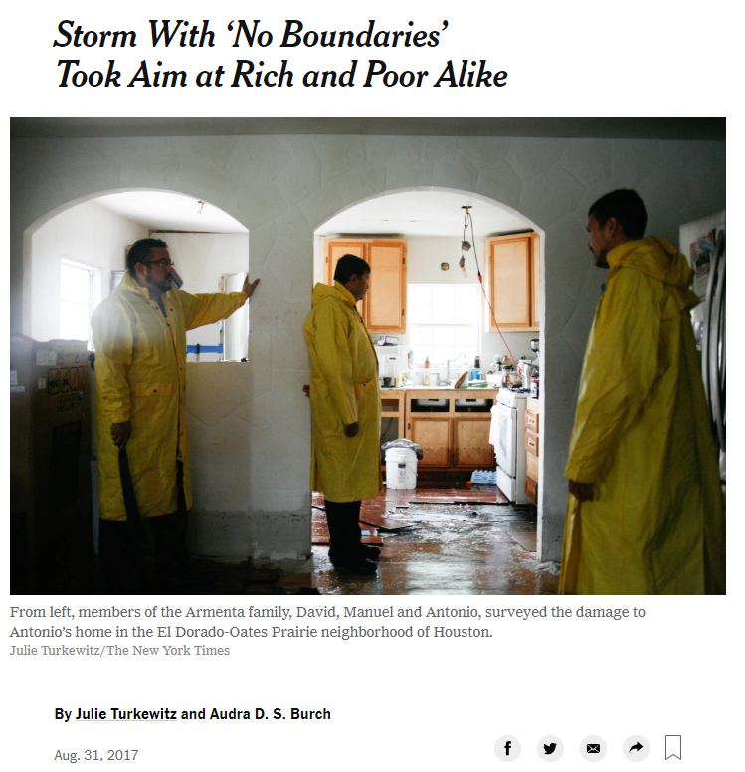
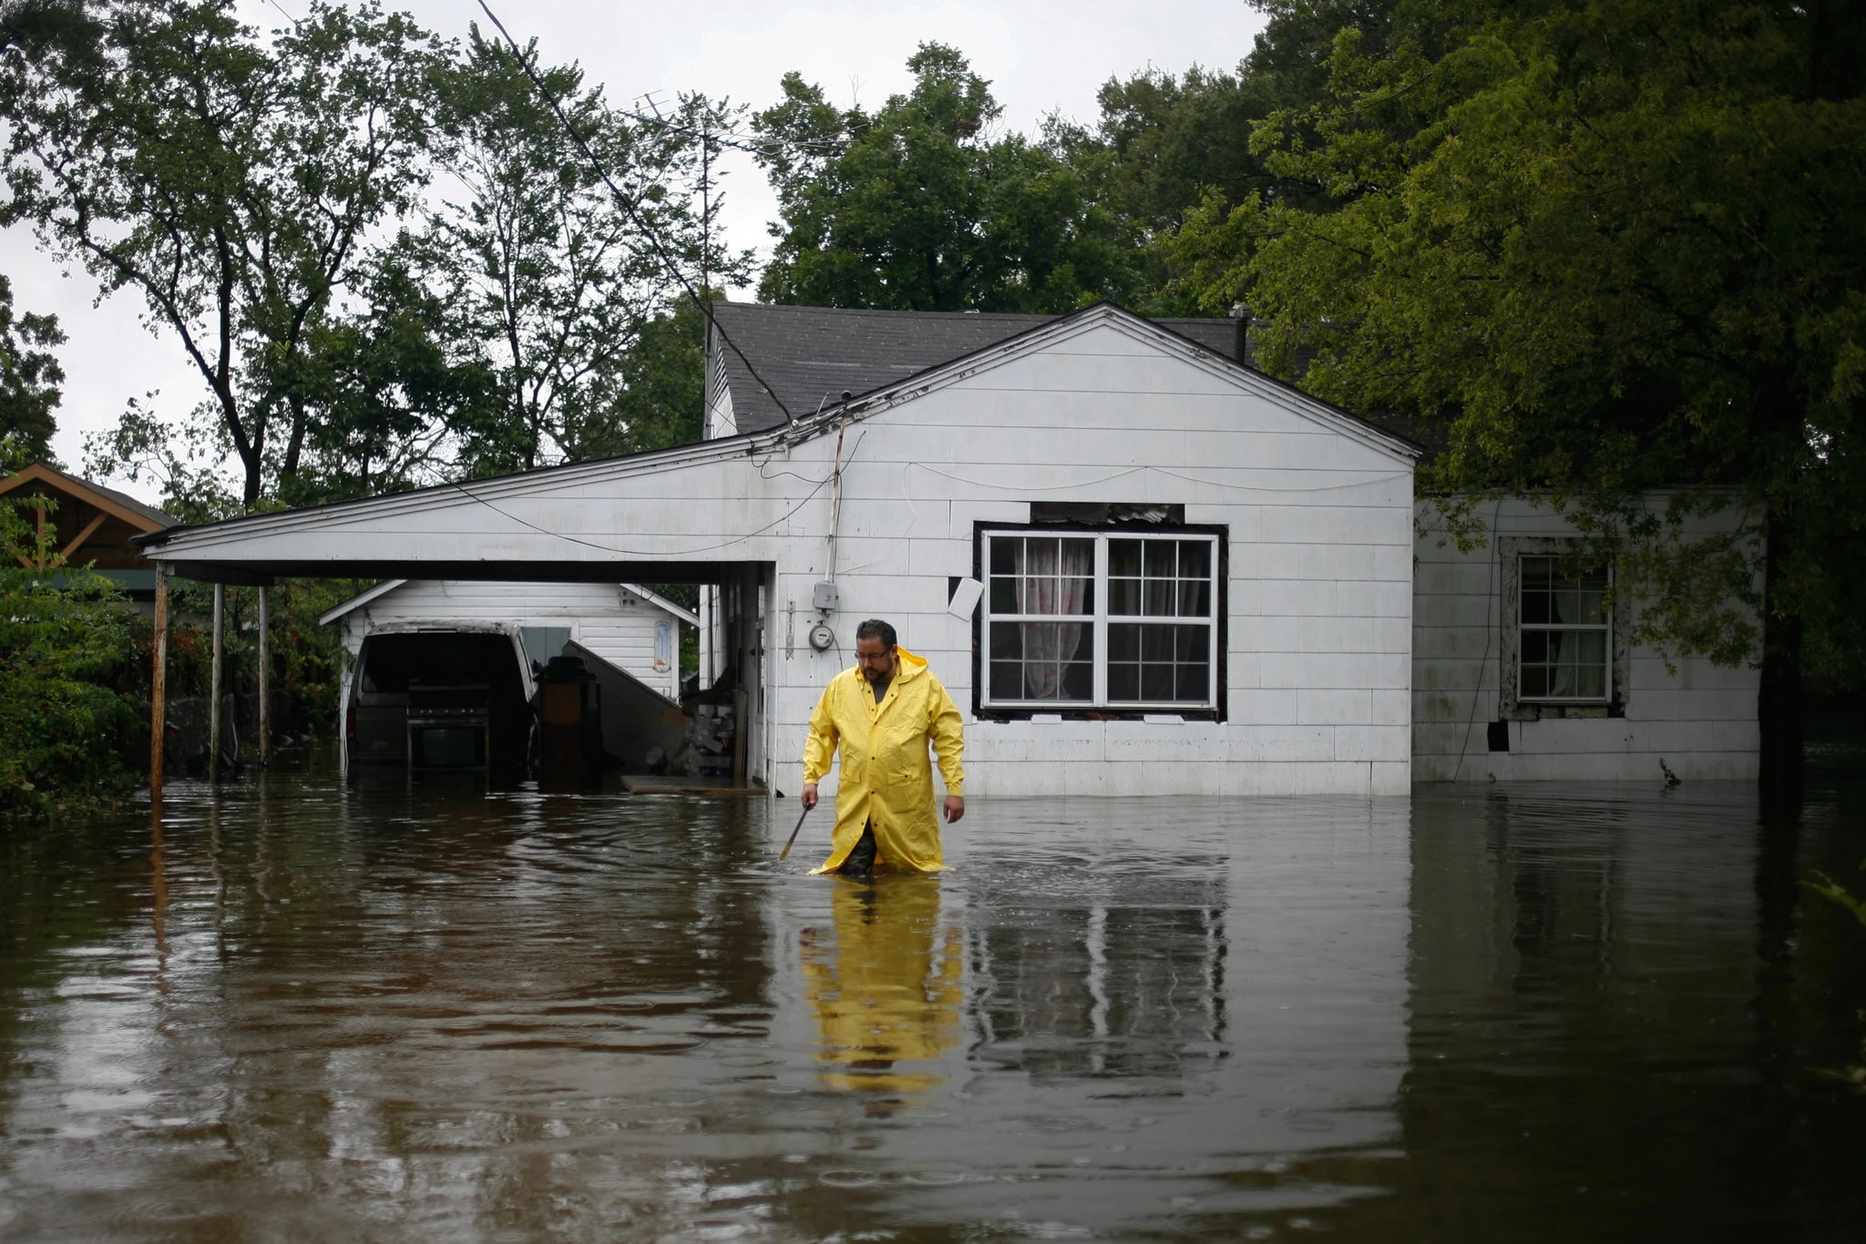
Motivation
https://www.nytimes.com/2017/08/31/us/hurricane-harvey-houston-homes-flooded.html
Motivation | Background | Analysis | Limitations | On-going Work

Slide 3
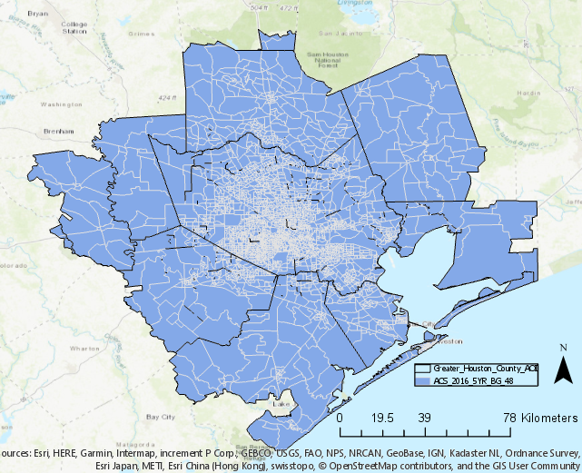
Area of interest
Area of Interest
Luisa Florez | November 2018
Pop.: ~6,200,000 (2012)
Area: ~8,000 sq miles
Counties: 10 counties including Harris, Fort Bend, Galveston, Montgomery
Motivation | Background | Analysis | Limitations | On-going Work
Notes:
https://www.houston.org/newgen/02_Geography/02C%20W001%20Houston%20Area%20Profile.pdf
Poverty level: 14.8 percent
https://www.houstonchronicle.com/business/texanomics/article/Houston-bucks-the-nation-s-decline-in-poverty-in-12197003.php
Population: ~6, 178, 218
Harris, Montgomery, Walker, Waller, Liberty, Chambers, Galveston, Brazoria, Fort Bend, Austin.

Slide 4
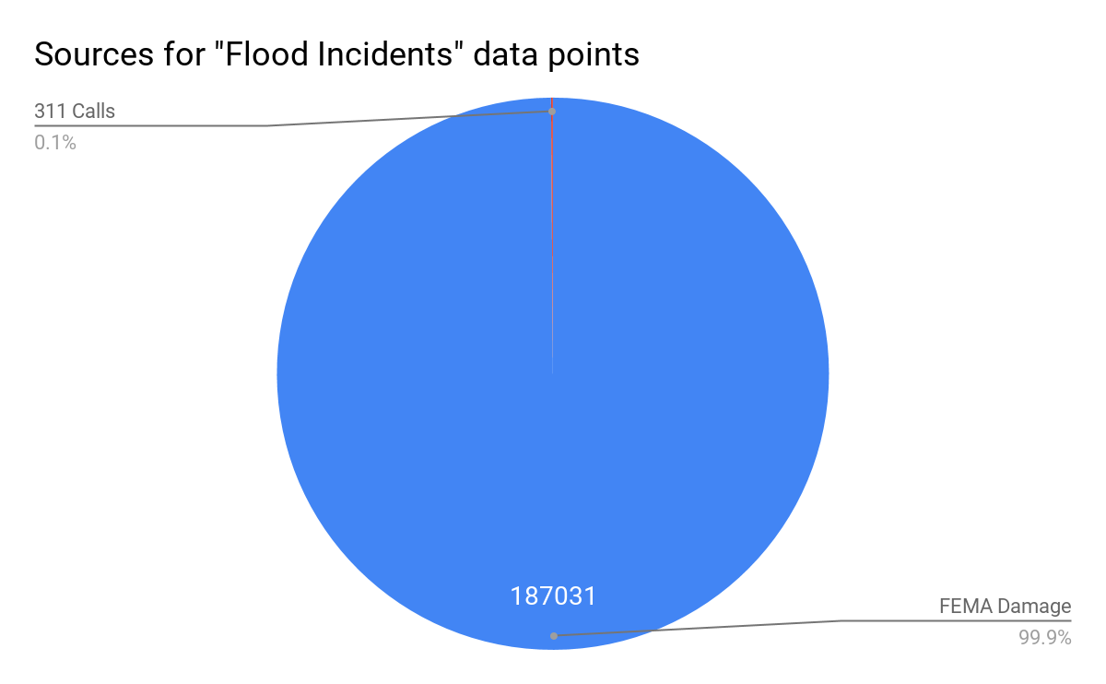
Data Sources
Income Level
American Community Survey 5-Year Estimates 2012 - 2016 | Block group: Texas
Center for Disease Control and Prenvetion’s (CDC’s) Social Vulnerability Index
Living Atlas | 2014 Socioeconomic SVI
Social Media [Twitter] | 2 (0.001%)
Motivation | Background | Analysis | Limitations | On-going Work

Slide 5
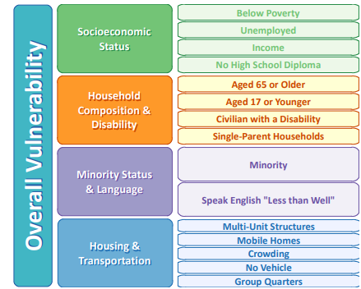
Definitions
CDC SVI - “refers to the resilience of communities when confronted by external stresses on human health...”
Income - Median Household Income in the past 12 months (in 2016 inflation-adjusted dollars)
Middle-income
⅔ to 2 times the U.S. median household income ($61,372) (2017)
Motivation | Background | Analysis | Limitations | On-going Work
Notes:
Determination of income level
Middle-income households – those with an income that is two-thirds to double the U.S. median household income PEW Research Center
$61,372 for a household of 3
http://www.pewresearch.org/fact-tank/2018/09/06/are-you-in-the-american-middle-class/
https://www.investopedia.com/financial-edge/0912/which-income-class-are-you.aspx

Slide 6
Definitions
CDC SVI - “refers to the resilience of communities when confronted by external stresses on human health...”
Income - Median Household Income in the past 12 months (in 2016 inflation-adjusted dollars)
Middle-income
⅔ to 2 times the U.S. median household income ($61,372) (2017)
Motivation | Background | Analysis | Limitations | On-going Work
Notes:
Determination of income level
Middle-income households – those with an income that is two-thirds to double the U.S. median household income PEW Research Center
$61,372 for a household of 3
http://www.pewresearch.org/fact-tank/2018/09/06/are-you-in-the-american-middle-class/
https://www.investopedia.com/financial-edge/0912/which-income-class-are-you.aspx

Slide 7
Definitions
CDC SVI - “refers to the resilience of communities when confronted by external stresses on human health...”
Income - Median Household Income in the past 12 months (in 2016 inflation-adjusted dollars)
Middle-income
⅔ to 2 times the U.S. median household income ($61,372) (2017)
Motivation | Background | Analysis | Limitations | On-going Work
Notes:
Determination of income level
Middle-income households – those with an income that is two-thirds to double the U.S. median household income PEW Research Center
$61,372 for a household of 3
http://www.pewresearch.org/fact-tank/2018/09/06/are-you-in-the-american-middle-class/
https://www.investopedia.com/financial-edge/0912/which-income-class-are-you.aspx

Slide 8
Definitions
CDC SVI - “refers to the resilience of communities when confronted by external stresses on human health...”
Income - Median Household Income in the past 12 months (in 2016 inflation-adjusted dollars)
Middle-income
⅔ to 2 times the U.S. median household income ($61,372) (2017)
Motivation | Background | Analysis | Limitations | On-going Work
Notes:
Determination of income level
Middle-income households – those with an income that is two-thirds to double the U.S. median household income PEW Research Center
$61,372 for a household of 3
http://www.pewresearch.org/fact-tank/2018/09/06/are-you-in-the-american-middle-class/
https://www.investopedia.com/financial-edge/0912/which-income-class-are-you.aspx

Slide 9
Definitions
CDC SVI - “refers to the resilience of communities when confronted by external stresses on human health...”
Income - Median Household Income in the past 12 months (in 2016 inflation-adjusted dollars)
Middle-income
⅔ to 2 times the U.S. median household income ($61,372) (2017)
Motivation | Background | Analysis | Limitations | On-going Work
Notes:
Determination of income level
Middle-income households – those with an income that is two-thirds to double the U.S. median household income PEW Research Center
$61,372 for a household of 3
http://www.pewresearch.org/fact-tank/2018/09/06/are-you-in-the-american-middle-class/
https://www.investopedia.com/financial-edge/0912/which-income-class-are-you.aspx

Slide 10
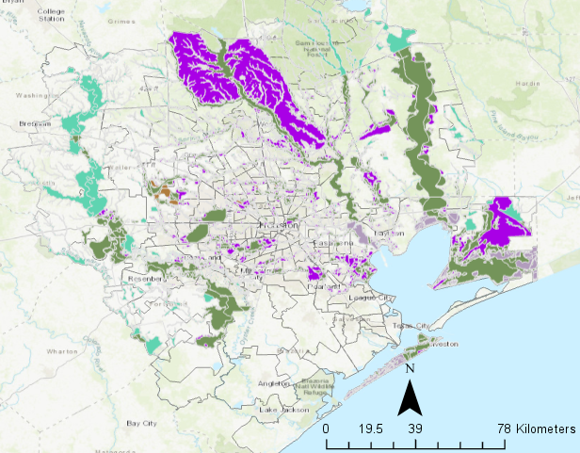
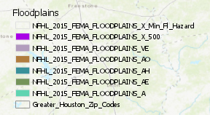
FEMA Floodplains
Luisa Florez | November 2018
A zones | 1% (100-year floods)
X Shaded | 1% - 0.2% (100-year to 500-year floods)
X Unshaded | Min. flood hazard
V Zones | 1% (100-year floods) in Coastal Zones
Motivation | Background | Analysis | Limitations | On-going Work

Slide 11
FEMA Floodplains
Luisa Florez | November 2018
Flood Incidents Hot Spots
Luisa Florez | November 2018
Motivation | Background | Analysis | Limitations | On-going Work

Slide 12
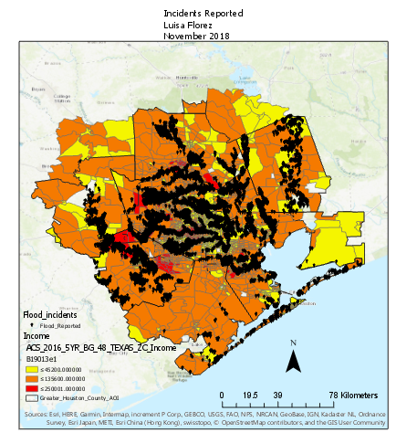
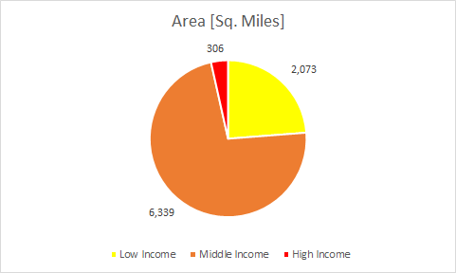

Flood Incidents
Luisa Florez | November 2018
Motivation | Background | Analysis | Limitations | On-going Work

Slide 13
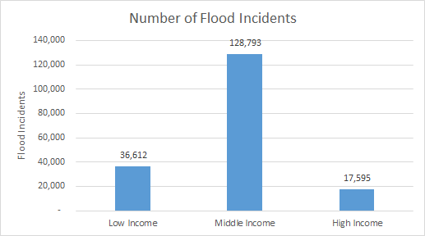
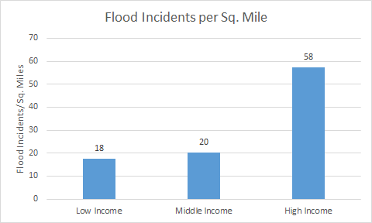
Flood Incidents
Luisa Florez | November 2018
Motivation | Background | Analysis | Limitations | On-going Work

Slide 14
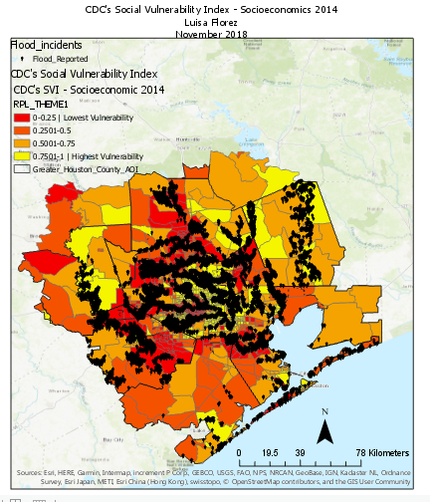
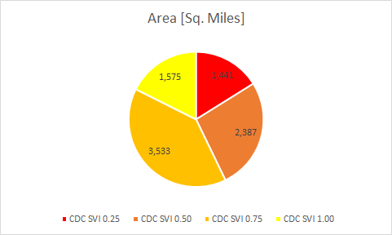
CDC’s Social Vulnerability Index - Socioeconomics 2014
Luisa Florez | November 2018
Motivation | Background | Analysis | Limitations | On-going Work

Slide 15
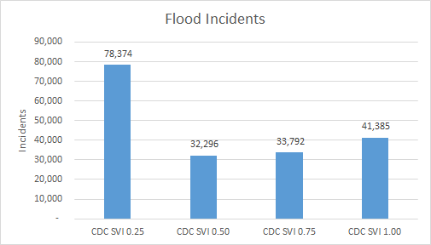
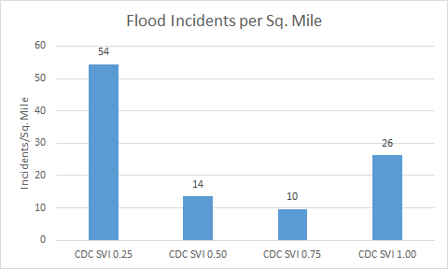
CDC’s Social Vulnerability Index - Socioeconomics 2014
Luisa Florez | November 2018
Motivation | Background | Analysis | Limitations | On-going Work

Slide 16
Limitations
-Incomplete data
-Nature of the proxy data may not capture scale of impact (e.g. number of people affected)
-“Select by location”
Motivation | Background | Analysis | Limitations | On-going Work

Slide 17
On-going Work
-Flood Incidents/unemployment
Motivation | Background | Analysis | Limitations | On-going Work

Slide 18
Thank you!
Questions?

Slide 20
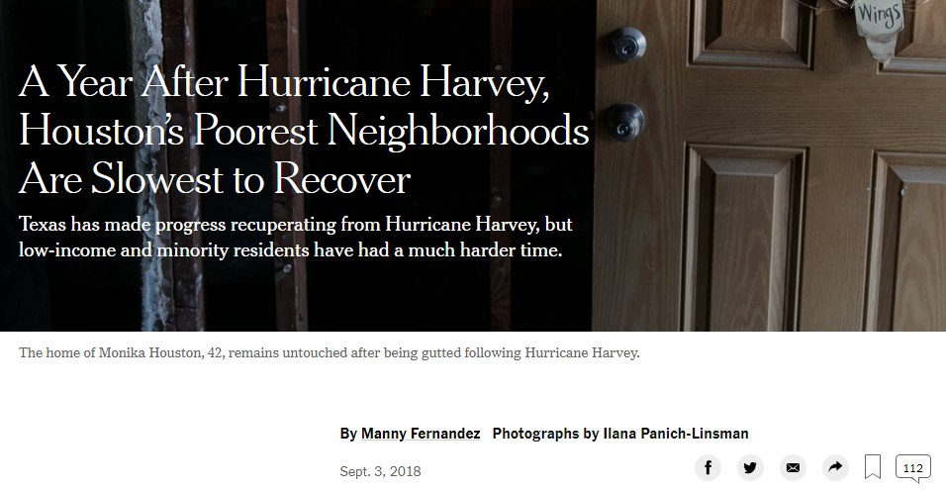

Slide 21
Flood Incidents
Luisa Florez
November 2018
 | Low income <$45,200 | Medium Income $45,200 - $135,600 | High Income >$135,600
Incidents | 36,612 | 128,793 | 17,595
% of total incidents | 20 | 70 | 10
Incidents/area [sq. mile] | 17.7 | 20.3 | 57.5
Motivation | Background | Analysis | Limitations | On-going Work

Slide 22
 | CDC SVI 0.00 - 0.25 | CDC SVI 0.25 - 0.50 | CDC SVI 0.50 - 0.75 | CDC SVI 0.75 - 1.00
Incidents | 78,374 | 32,296 | 33,792 | 41,385
% of total incidents | 42.2 | 17.3 | 18.2 | 22.3
Incidents/area [sq. mile] | 54.4 | 13.5 | 9.6 | 26.3
Motivation | Background | Analysis | Limitations | On-going Work

Slide 23



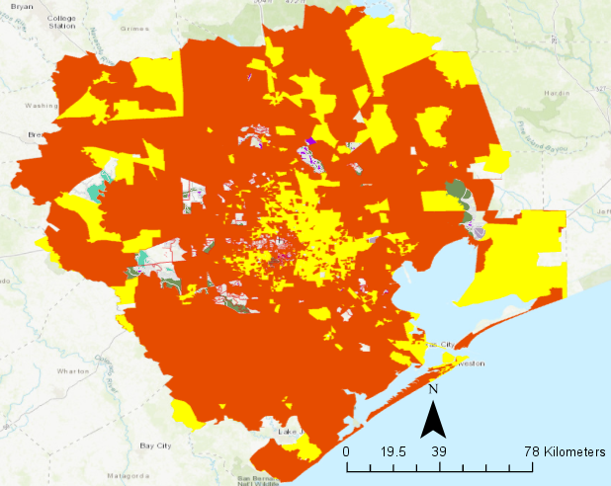
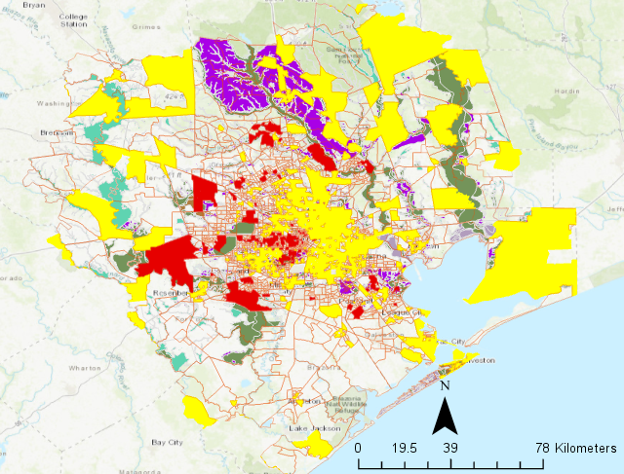
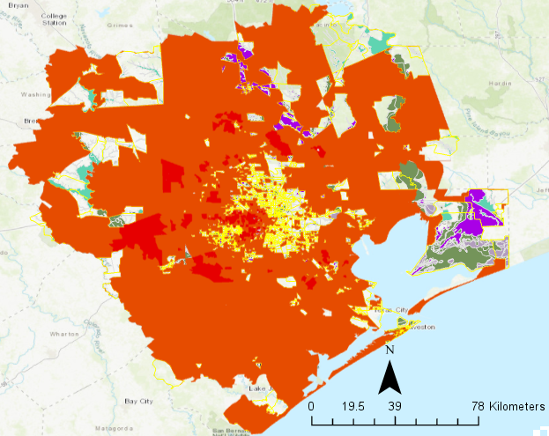
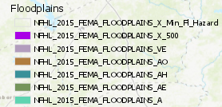
High Income
Middle Income
Low Income
Floodzones for income levels
Luisa Florez | November 2018
Motivation | Background | Analysis | Limitations | On-going Work

