Slide 1

GIS Term Project fall 2018
A Study on the lake Conroe dam release following hurricane Harvey
Emily Luomala
EWRE Graduate Student, The University of Texas at Austin
Background
Problem Statement
Approach
Findings
Notes:
Hi everyone. My name is Emily Luomala and my project looked into the Lake Conroe Dam Release that happened just following Hurricane Harvey.

Slide 2



Background
Hurricane Harvey Stats
27 trillion gallons of water over Texas and Louisiana
Equivalent to 1 million gallons per person!
30,000 - 40,000 homes destroyed
$150 billion for recovery costs
Background
Problem Statement
Approach
Findings
Notes:
Hurricane Harvey, as you all know by now, was unlike any storm that the US had seen before unleashing 27 trillion gallons of water over Texas and Louisiana. This is equivalent to 1 million gallons of water per person (depicted in the image) [1]. 30,000-40,000 homes were destroyed and 35,000 people had to be relocated to emergency shelters. Recovery costs were estimated at $150 billion.
[1] https://www.vox.com/science-and-health/2017/8/28/16217626/harvey-houston-flood-water-visualized

Slide 3
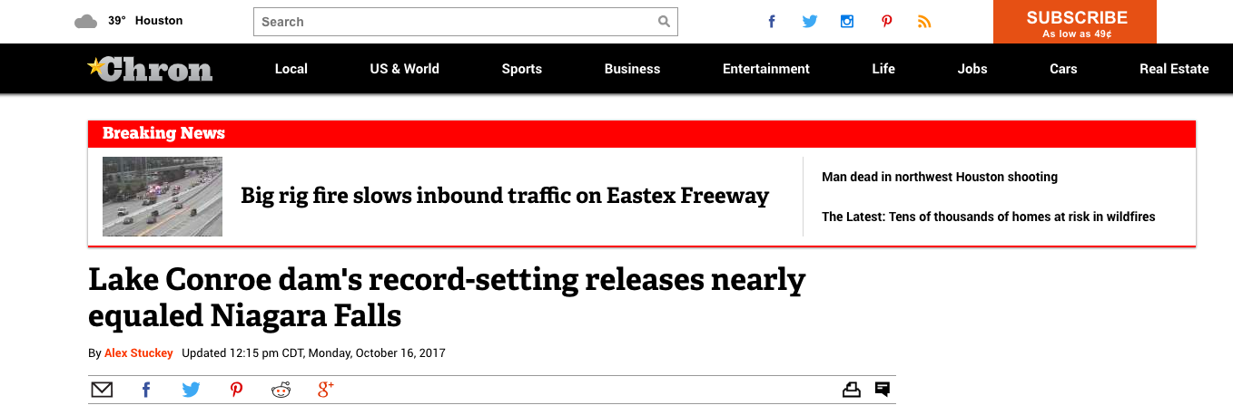
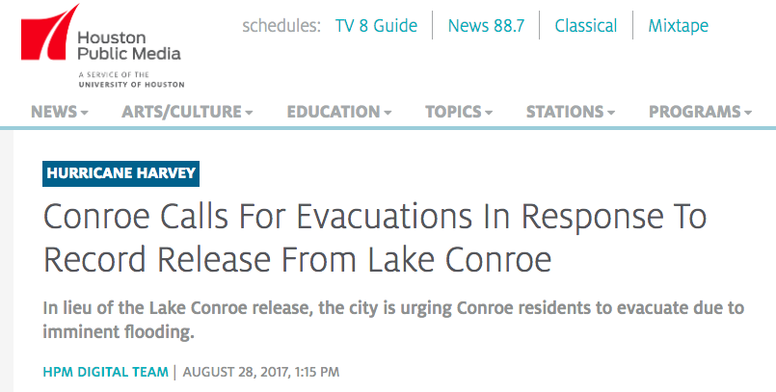
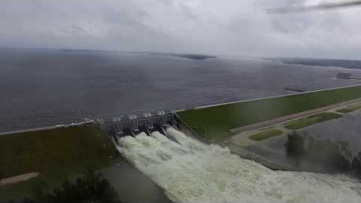
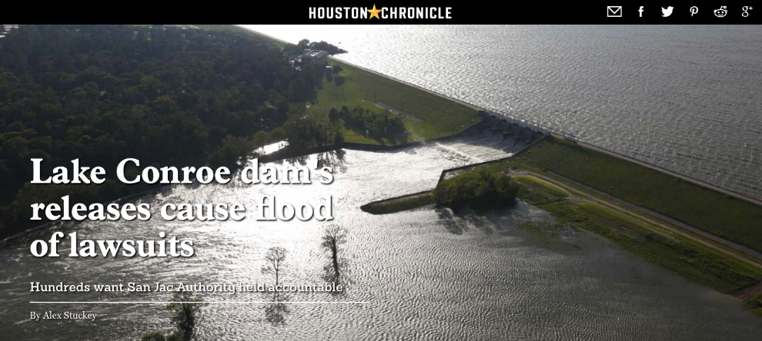

Background
Lake Conroe Dam
Approached the average volume pouring over Niagara Falls
Background
Problem Statement
Approach
Findings
Notes:
But the physical water volume was not the only thing that impacted the Houston area. The existing infrastructure was put under additional strain. This project is going to focus on the Lake Conroe Dam release that happened just following Hurricane Harvey. As can be seen in the video, a volume of water that approached the average volume pouring over Niagara Falls was released from the Lake Conroe Dam. Many homeowners are currently suing the San Jacinto River Authority as they believe that their home would have been safe from Hurricane Harvey, but only flooded due to the dam release.

Slide 4
Problem statement
Modeling Scenarios
Actual release: 79,141 cfs
No dam: 130,000 cfs
Background
Problem Statement
Approach
Findings
Notes:
The San Jacinto River Authority claims that had they not provided enough water board and released the water, the dam was at risk of collapsing, which would have released the full 130,000 cfs that entered the Lake Conroe dam. The problem statement that I wanted to look at was which homes flooded specifically due to the dam release and then how many homes would have flooded if the dam had collapsed and the full inflow was released downstream.

Slide 5
Approach
(1) Create a base map
Dam location
Background
Problem Statement
Approach
Findings
Notes:
The first step in looking into this problem was simply creating a base map of the area that encompassed the Lake Conroe Dam. You can see the subwatersheds, graduated flow lines, and catchpolys of the area above. The dam location is highlighted here.

Slide 6
Approach
(2) Develop focus area
Conroe
Kingwood
Background
Problem Statement
Approach
Findings
Notes:
The second step was determining a focus area. Only areas downstream of the dam were considered. The US census population overlay was used to determine where the most populated places were (i.e. where the most people would have been affected). The Conroe area immediately downstream of the dam was selected as well as the Kingwood area at the bottom of the basin that included additional portions of Houston and Humble. In total, 22 catchpolys were analyzed, 16 in the Conroe area and 6 in the Kingwood area.

Slide 7
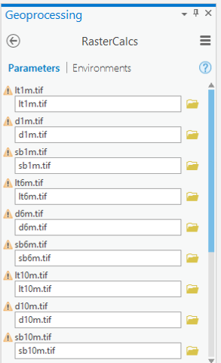
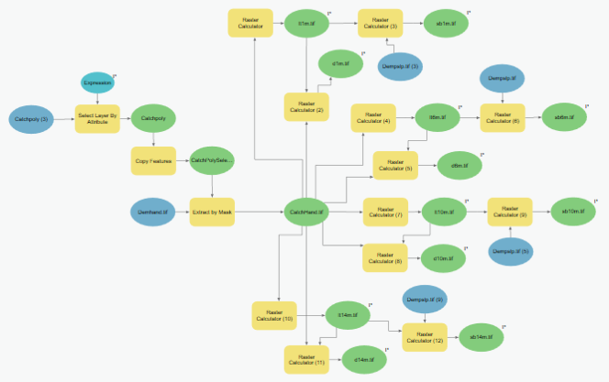
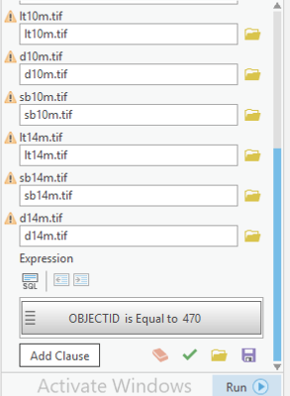
Approach
Runs analysis needed to develop rating curve
(3) Develop discharge curves
Can be run for each catchpoly
Background
Problem Statement
Approach
Findings
Notes:
To determine the discharge curves for each catchpoly, a model builder was created that could be run for each catchpoly to determine the flooded cells, inundation depths, and slope raster to find the wetted bed areas.

Slide 8
Approach
(4) Perform HAND analysis
Interpolate for desired discharges
Background
Problem Statement
Approach
Findings
Notes:
From the model builder results, a table and discharge curve was developed for each catchpoly. For the sake of time and scale, the 4 stage heights used in class were used to develop the rating curves for each of the catchpolys. This proved to be more than necessary in most cases. Future work will include finer resolution to develop individual rating curves that focus on a smaller range of discharges. Since I knew the inflow into Lake Conroe and the flow released from the dam, I interpolated to determine the stage heights for both scenarios for each catchpoly. For simplicity, I also assumed that the entire inflow or outflow would have affected each catchpoly without accounting for the contributing area for each reach.

Slide 9
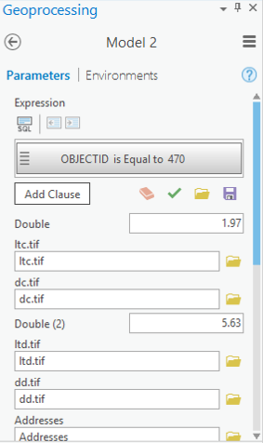
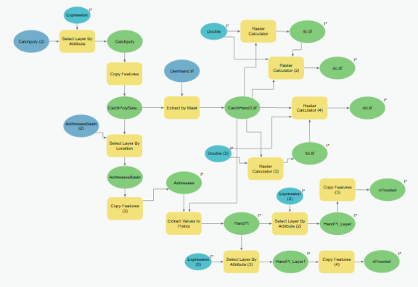
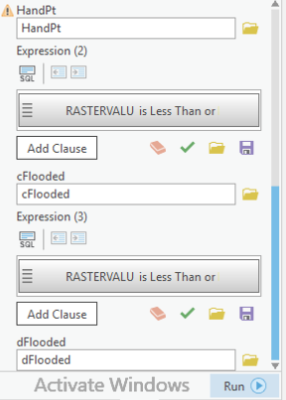
Approach
Respective stage heights are the second input
(5) Identify flooded address points
Can be run for each catchpoly
Background
Problem Statement
Approach
Findings
Notes:
Finally, an additional model builder was developed to determine the flooded address points for each scenario and respective catchpoly. The second input to the model were the previously determined stage heights. The outputs for this model were the flooded address points for each of the two scenarios.

Slide 10
Findings: Conroe
Background
Problem Statement
Approach
Findings
Notes:
The black dots represent the total number of address points for the catchpolys of interest within the Conroe section. The blue dots show which homes flooded from the dam release, and finally the magenta dots show the homes that would have flooded had the entire inflow been released in the case of a dam collapse. As you can see here, as expected there would have many additional flooded address points.

Slide 11
Conroe
Dam Release
No Dam
4 – 6 m
6 – 8 m
Total Address Points
4 – 6 m
< 0.5 m
24,341
< 0.5 m
Flooded Addresses – Dam Release
2 – 4 m
0.5 – 1 m
3,322
2 – 4 m
0.5 – 1 m
Flooded Addresses – No Dam
1 – 2 m
1 – 2 m
5,506
Background
Problem Statement
Approach
Findings
Notes:
Here are those dots in numbers. Additionally, these pie charts show the distribution of inundation depths for the overall sector. As can be seen, in addition to the additional homes flooded with a dam collapse, the inundation depths are much higher for the previously flooded homes, creating more damage for the homeowners.

Slide 12
Findings: Kingwood
Background
Problem Statement
Approach
Findings
Notes:
Here are the same images for the Kingwood area with additional address points in the Humble and Houston areas.

Slide 13
Kingwood
4 – 6 m
2 – 4 m
Dam Release
No Dam
6 – 8 m
4 – 6 m
> 8 m
Total Address Points
6 – 8 m
49,639
< 0.5 m
Flooded Addresses – Dam Release
0.5 – 1 m
2 – 4 m
4,126
Flooded Addresses – No Dam
1 – 2 m
7,790
Background
Problem Statement
Approach
Findings
Notes:
Similarly, additional homes would have flooded and the damage would have been more severe and extensive. While this isn’t to say that the dam would have collapsed had they not released the dam waters, it shows the severity of risking the dam collapse.

Slide 14
Conclusion
Future Work
If the dam collapsed:
Refine discharge curves to find more accurate stage heights
A minimum of 5,800 additional homes would have flooded
Previously flooded homes would have experienced more damage
Look at a larger area and rerun analysis
Include and differentiate between homes that flooded due to rainfall
Model builder is an incredibly helpful tool, but glitches often
Background
Problem Statement
Approach
Findings
Notes:
In conclusion, almost 7500 homes flooded exclusively due to the dam release. Had the dam collapsed, an additional 5800 homes would have been flooded and the damage would have been more severe with a larger portion of homes experiencing more than 2 m (roughly 6 feet) of flooding. Additionally, model builder is an incredibly helpful tool when you want to run the same analysis on different areas, but it is very glitchy and caused ArcGIS to shut down multiple times in the middle of running.
For future work, I hope to refine the discharge curves to provide more accurate stage heights and look at a larger area or more catchpolys. Finally, I would be interested in looking at which homes were also affected from Harvey and see how the homes that flooded due to the dam release differed from these other flooded homes.

Slide 15
Questions?
Background
Problem Statement
Approach
Findings

