Slide 1
Inundation Mapping in Harris County, Texas
Spatial Refinement of Hedonic Analysis of Flood Risk
Julian Plough
GIS in Water Resources, 2018

Slide 2
Hedonic Method Overview
Theory (Rosen 1974) that properties may be viewed as bundles of characteristics
If model is properly specified, fixed effects and other controls can hold constant those characteristics 1 thru (n-1)
Temporal variation in the (n-1)th characteristic can be then exploited pre and post home sale, to estimate the marginal implicit price of that characteristic

Slide 3
Project Goal:
Use improved spatial analysis to find more granular definitions of flooded properties in the Harris County, FL area
  VIA parcel level HAND analysis
  Also allows for easier analysis of “nuisance” flooding
Use these improved flood treatment definitions to update an econometric model and compare with “traditional” methods

Slide 4
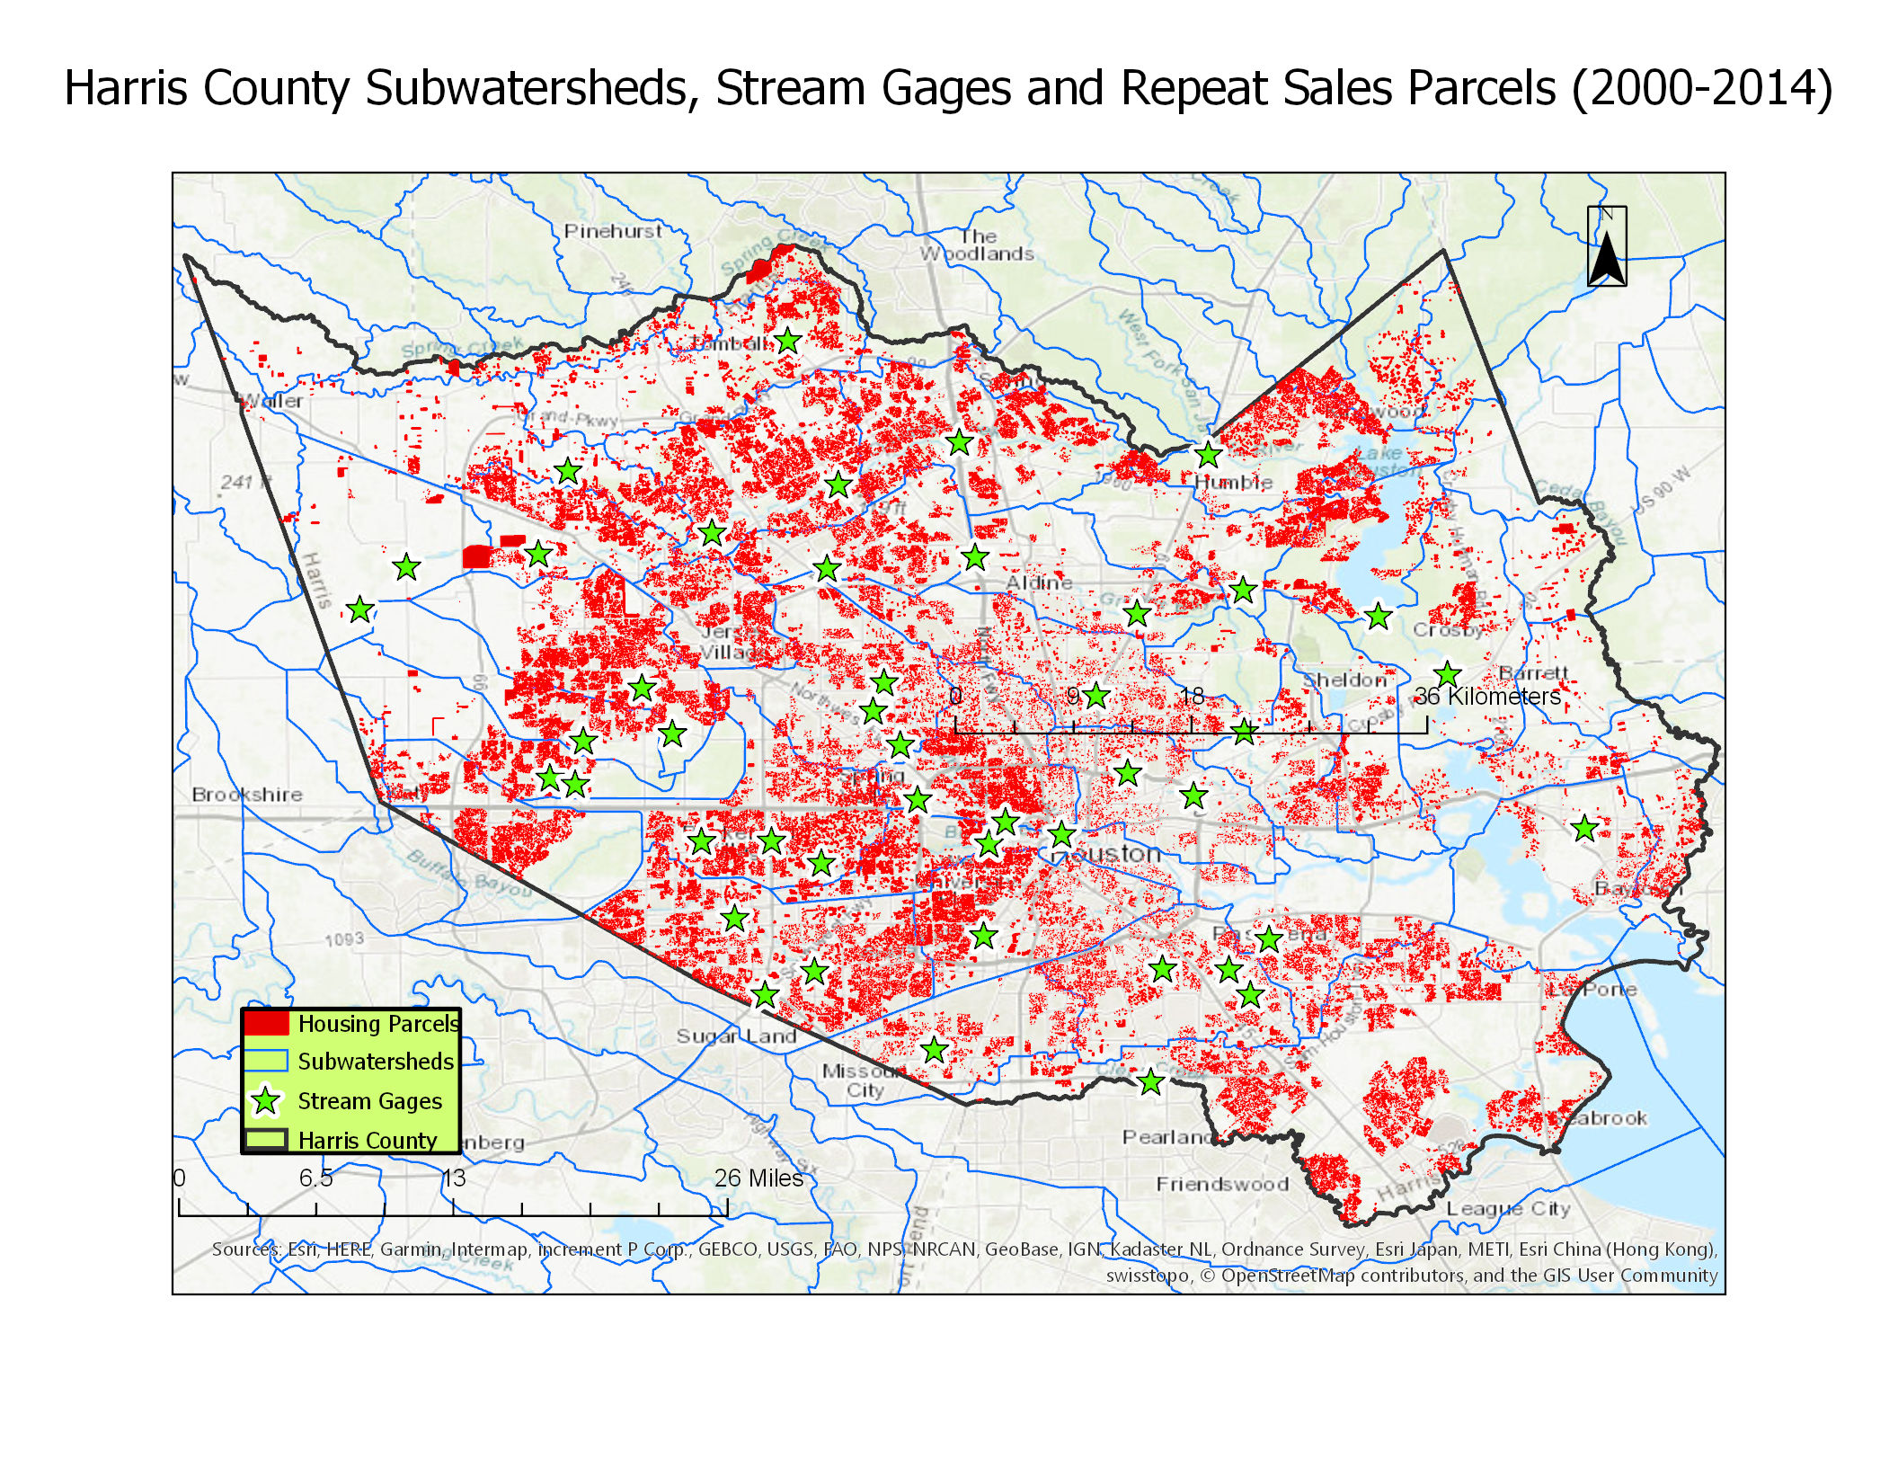
Study Area

Slide 5
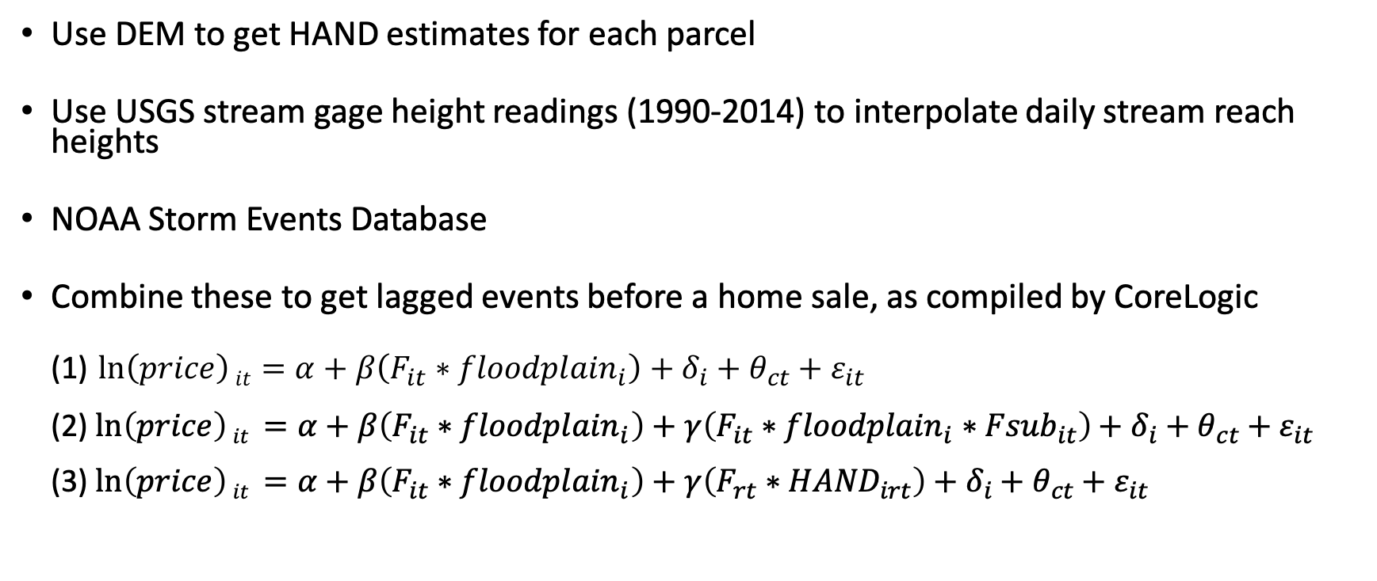
Data/Methods
Use DEM to get HAND estimates for each parcel
Use USGS stream gage height readings (1990-2014) to interpolate daily stream reach heights
NOAA Storm Events Database
Combine these to get lagged events before a home sale, as compiled by CoreLogic
(1) $\ln\left(price\right)it=α+β\left(F_{it}∗{floodplain}_{i}\right)+δ_{i}+θ_{ct}+ε_{it}$
(2) $\ln\left(price\right)it =α+β\left(F_{it}∗{floodplain}_{i}\right)+γ\left(F_{it}∗{floodplain}_{i}∗{Fsub}_{it}\right)+δ_{i}+θ_{ct}+ε_{it}$
(3) $\ln\left(price\right)it =α+β\left(F_{it}∗{floodplain}_{i}\right)+γ\left(F_{rt}∗{HAND}_{irt}\right)+δ_{i}+θ_{ct}+ε_{it}$

Slide 6
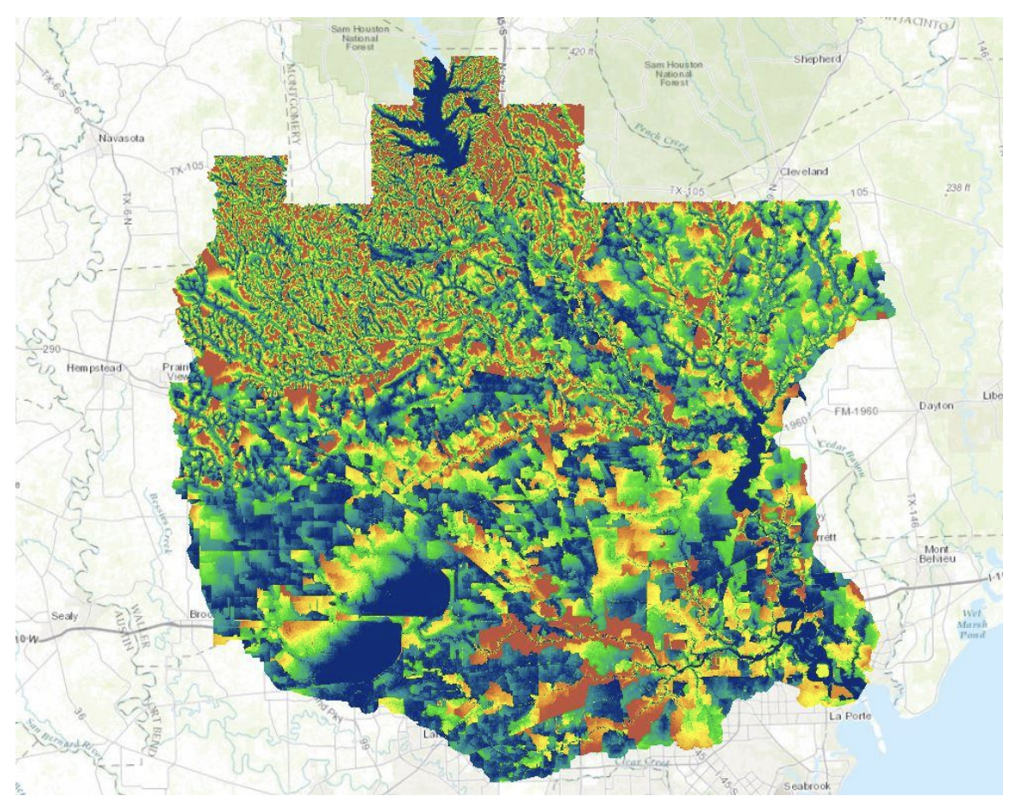
HAND (so far) Harris Metro
Have done HAND for the Houston Metro subdataset
Have realized that daily stream interpolation can go many ways
(spline, local polynomial smoothing, simple OLS, spline etc).

Slide 7
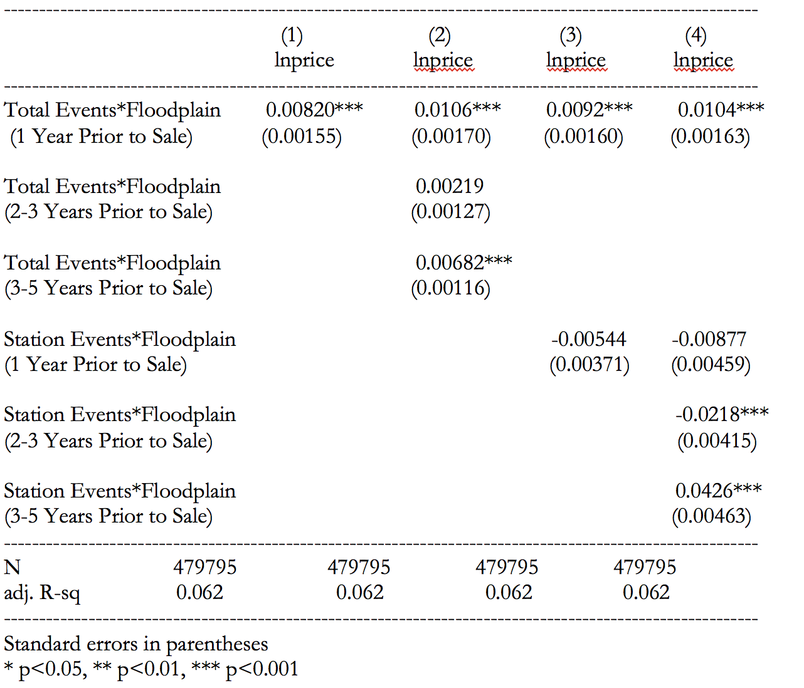
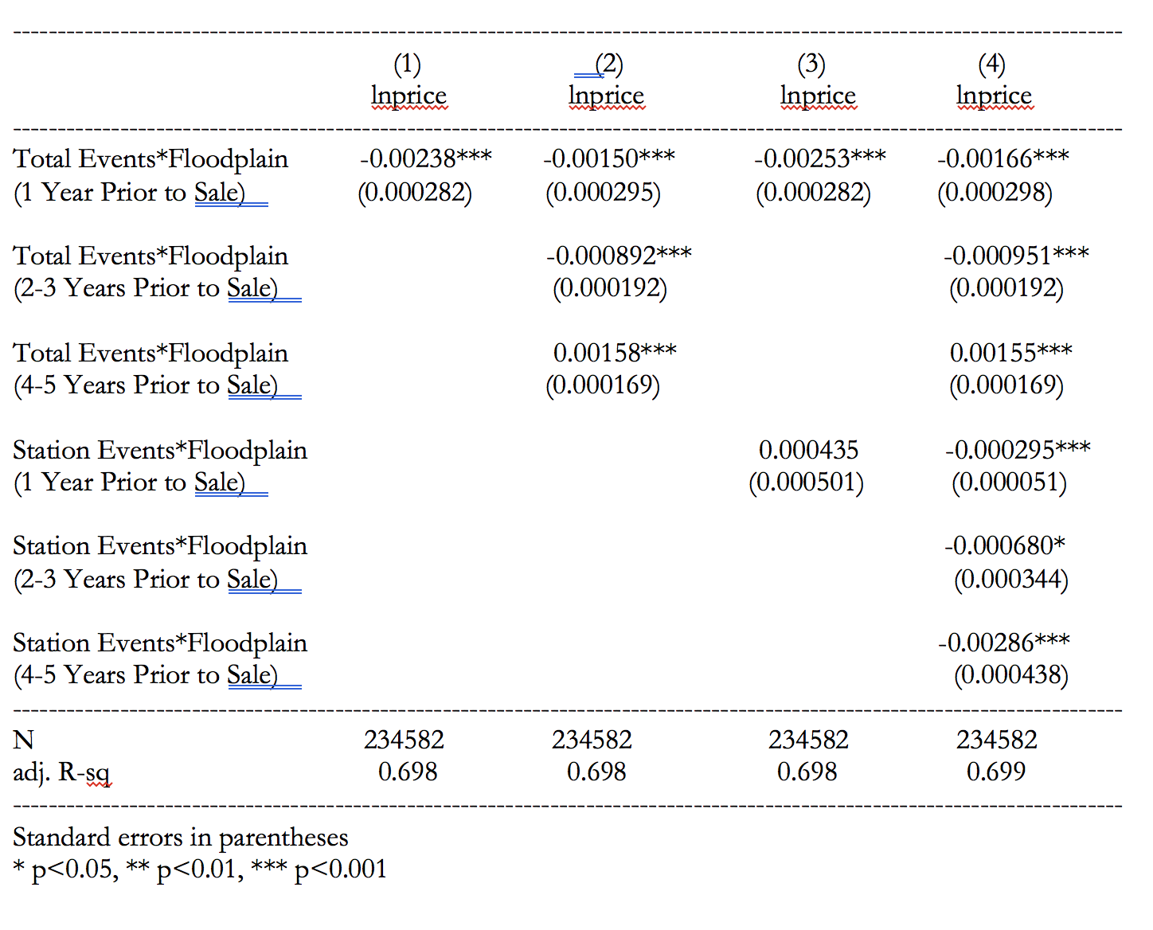
Preliminary Results
Harris County, TX
Tampa Bay, FL

