Slide 1
Investigating the effect of sunlight and nutrient limitation on Texas seagrass cover
Jenelle Estrada

Slide 2
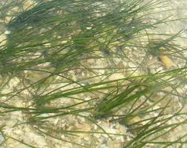
Photosynthesis
Light
6CO₂ + 6H₂O ------------> C₆H₁₂O₆ + 6O₂
Nutrients
Thalassia testudinum
Halodule wrightii

Slide 3
Nutrient Limitation & Irradiance
Nutrients
Redfield (ideal) ratio of nutrients for seagrasses is C:N:P = 550:30:1
N:P determines if the environment is limited in Phosphorus or Nitrogen
Ideal ratio N:P = 30
Phosphorus Limited N:P > 30
Nitrogen Limited N:P < 30
Irradiance
Measured in K_{d} for downward irradiance in shallow water

Slide 4
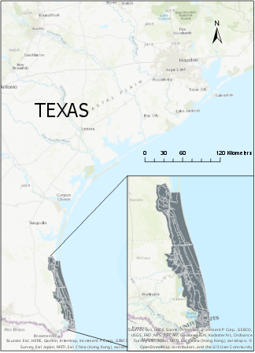
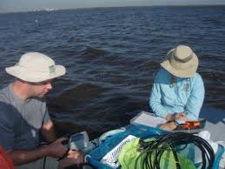
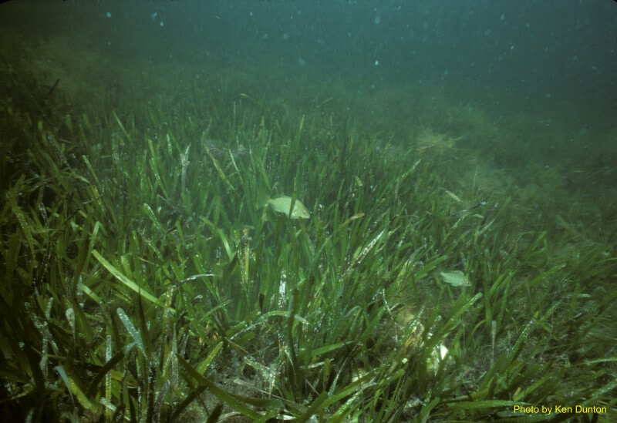
Lower Laguna Madre
Data Sources
Texas Statewide Seagrass Monitoring Program
NOAA

Slide 5
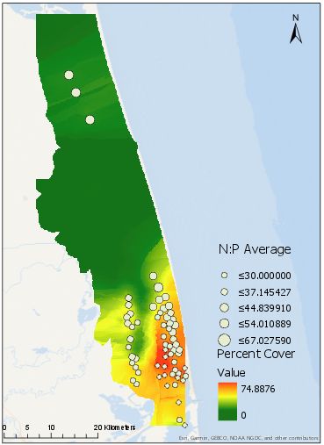
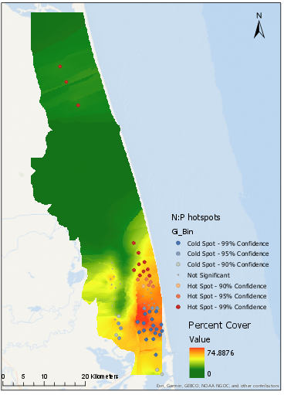
N:P Ratios
Thalassia testudinum

Slide 6
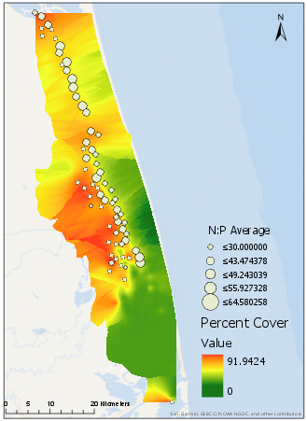
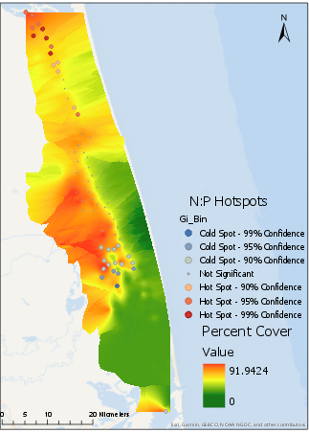
N:P Ratio
Halodule wrightii

Slide 7
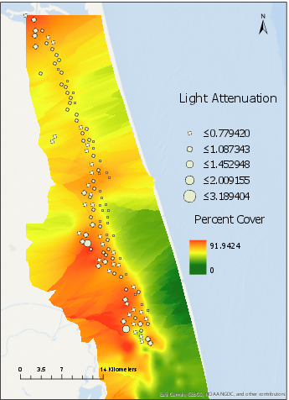
Light attenuation
Thalassia testudinum
Halodule wrightii

Slide 8
Takeaways
N:P ratios near 30 often correlate to higher seagrass cover but not for every region
Lower light attenuation is helpful for seagrasses to reduce the amount of sun bleaching
Both are likely to be helpful in creating seagrass cover models

Slide 9
Limitations and Future Work
Removed sampling points with only one year of data
Restricted the years to 2011-2015 for percent cover to match the nutrient data
Input the light attenuation and N:P into a statistical program for a regression to model the amount each variable influences seagrass cover

Slide 10
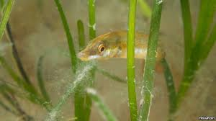
Questions?

