Slide 1
Rookery Island Bird Abundance: A 40 Year Study
Miranda Madrid

Slide 2
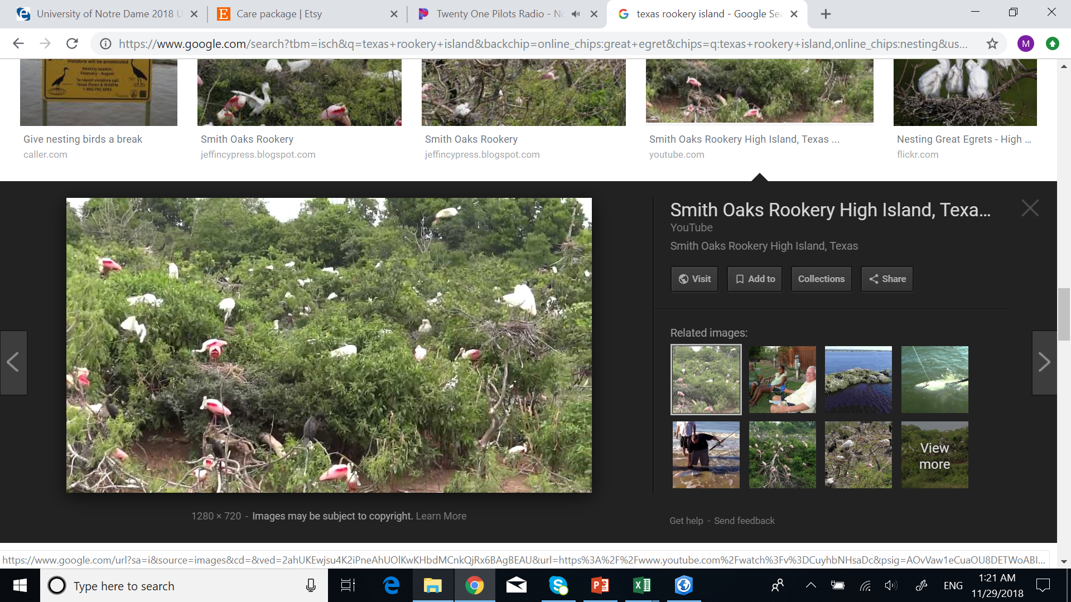
What are rookery islands?
Where colonial waterbirds gather in rookeries or colonies during nesting season
Islands along the Texas coast
Increased likelihood of chick survival
Threats include: habitat loss and degradation, predation, human disturbance, marine debris

Slide 3
Why does this matter?
Stakeholders
  Conservationists: high quality habitat through effective management
  Birders and Hunters: high aesthetic and recreational value
  Larger Ecosystem: bioindicators
Objective: How have nesting dynamics changed on rookery islands over the years

Slide 4
The Data
Texas Coastal Waterbird Survey: longest standing and most comprehensive for state
  Observations 1973-2013 of 35 species
    Includes 5 T&E species (TPWD and/or USFWS)
Restoration Islands for Coastal Bend Bays and Estuaries Program
Mission Aransas NERR Boundary

Slide 5
Focused Study Area
Mission Aransas National Estuarine Research Reserve (NERR)
6 Rookery Islands in Redfish and Mesquite Bays
TCW Surveys conducted
CBBEP Restoration

Slide 6

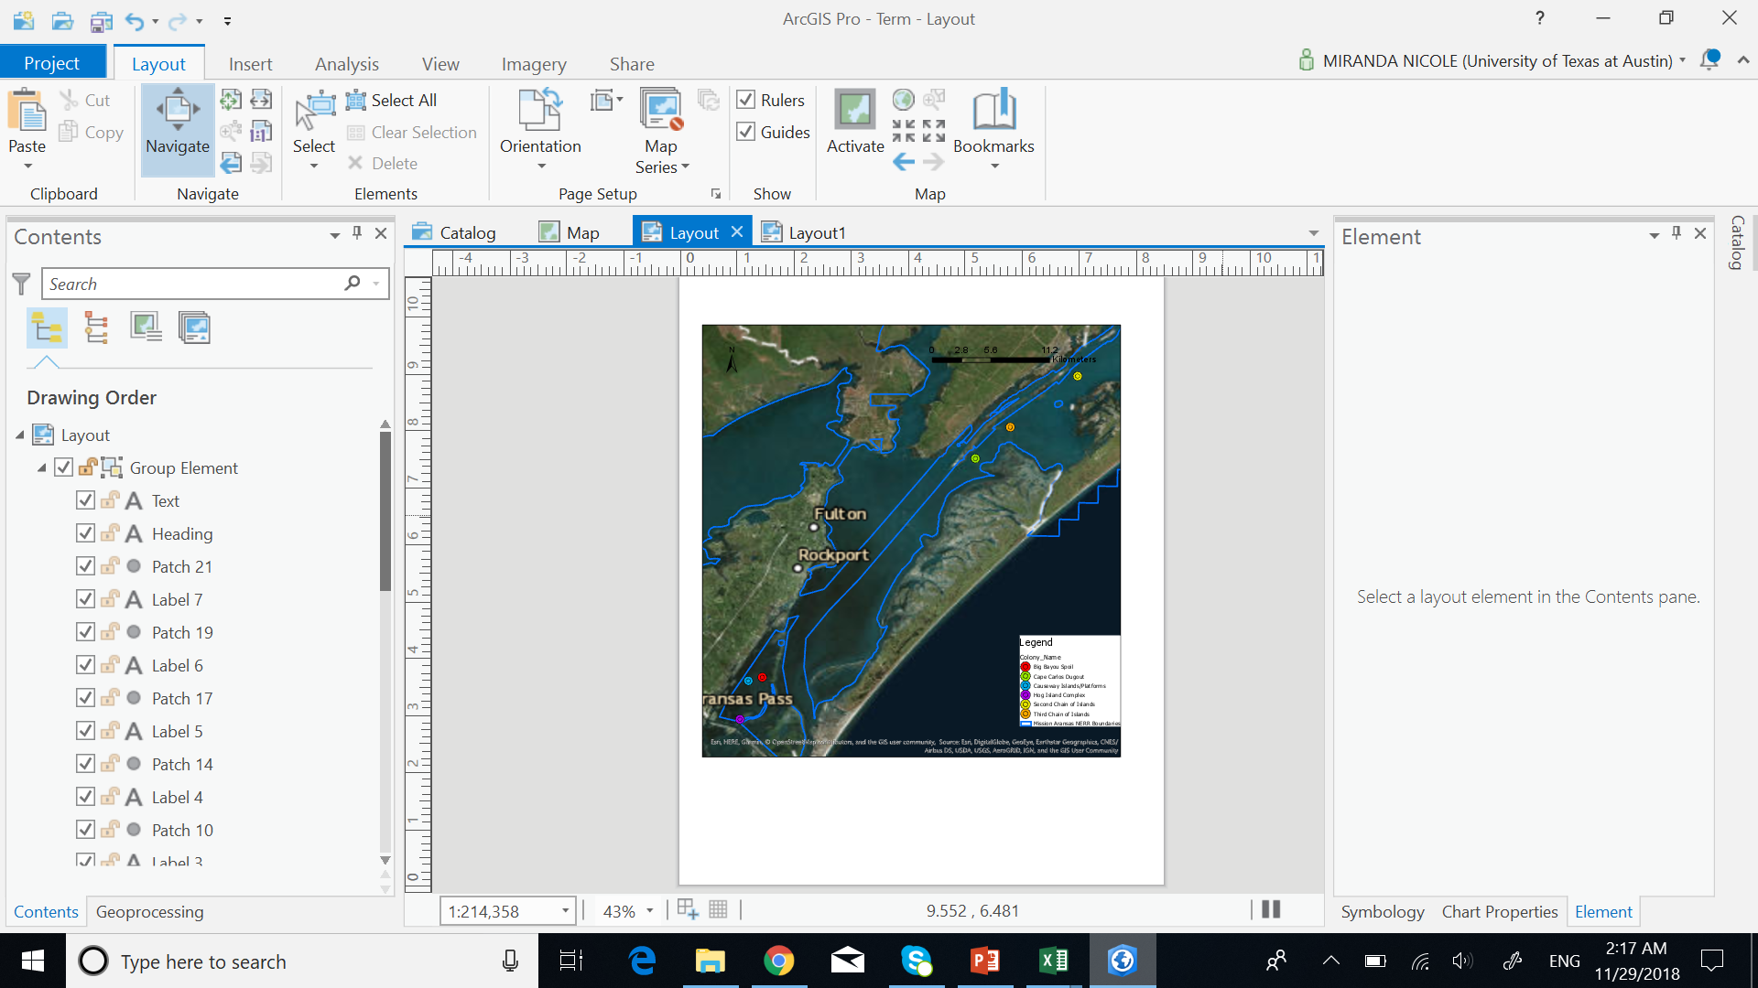

Slide 7
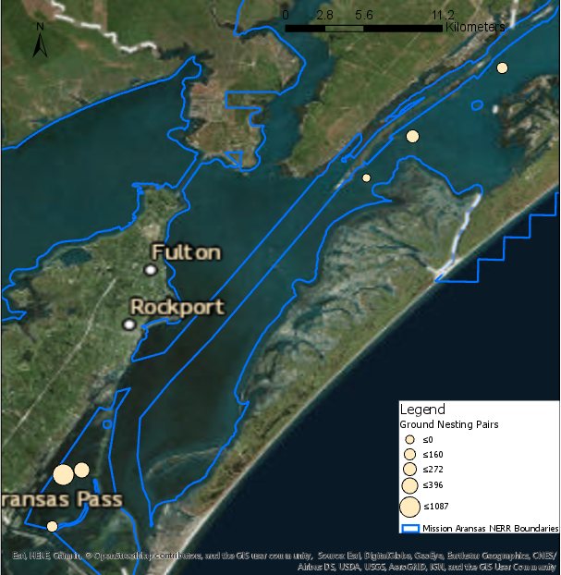
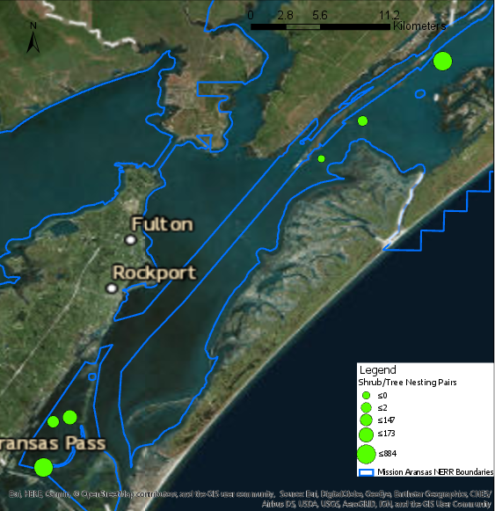
1975
Ground Nesting Pair Abundance
Shrub Nesting Pair Abundance

Slide 8

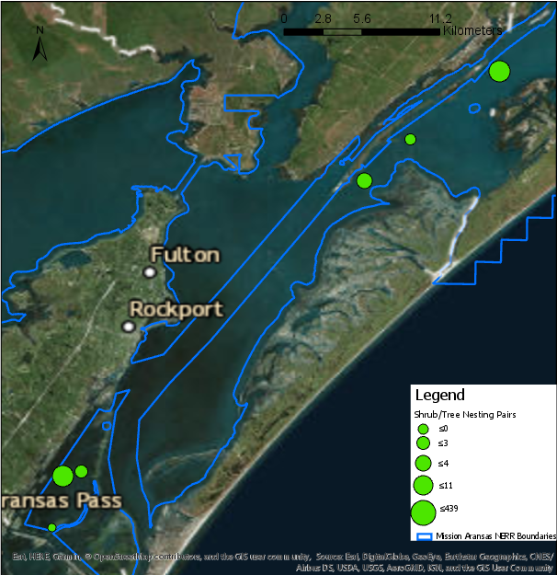
2012
Ground Nesting Pair Abundance
Shrub Nesting Pair Abundance

Slide 9
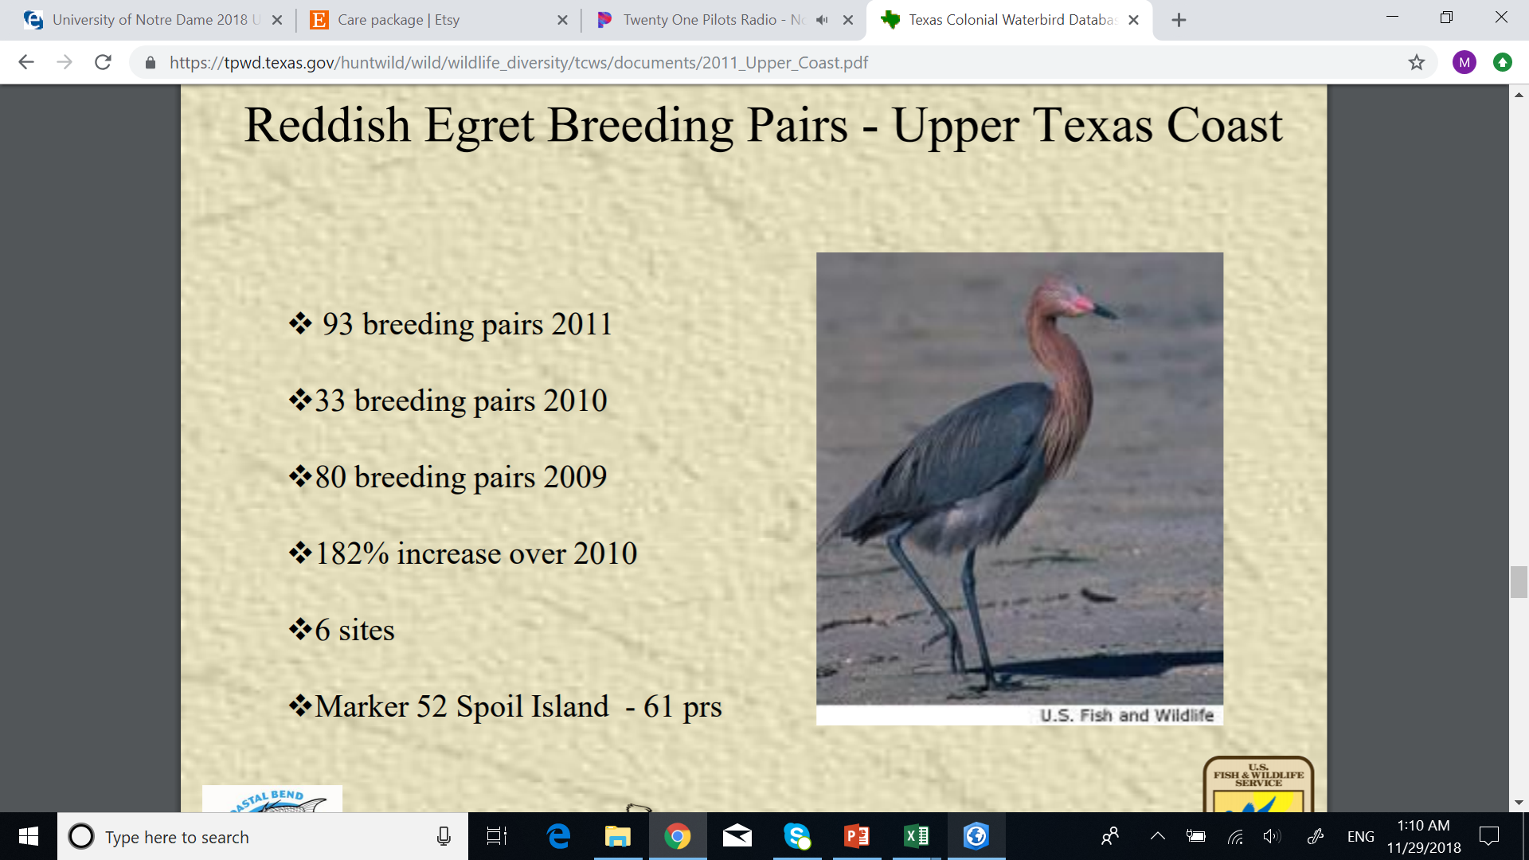
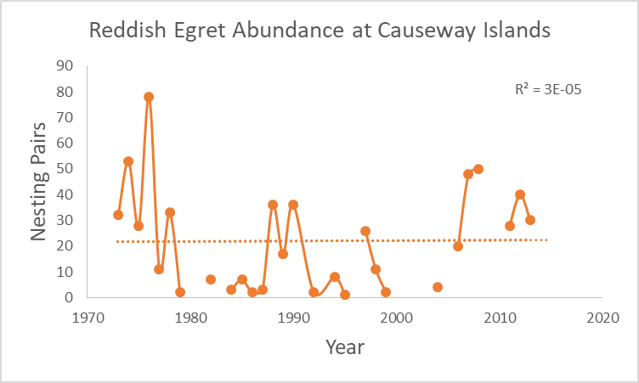
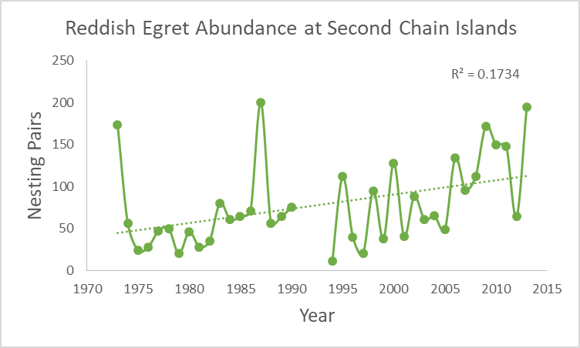
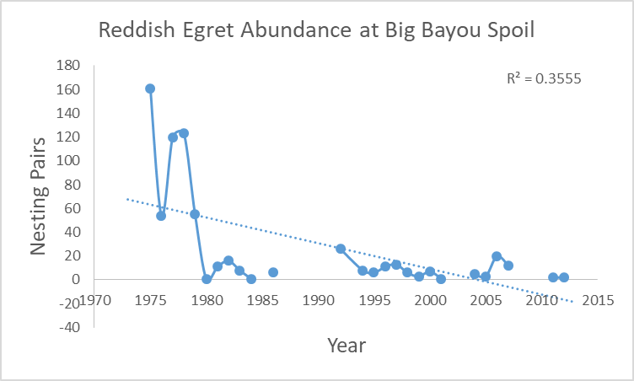
Reddish Egret (Ground nester): TPWD Threatened species

Slide 10
Considerations
Preferred nesting habitat focus
  Food availability?
  Pollution?
  Breeding success?
  Factors outside of the study region
Survey limitations
Local versus Regional

Slide 11
Continued work
Better visual of temporal analysis
Abundance by island area
How to include land cover/vegetation change over time…

Slide 12
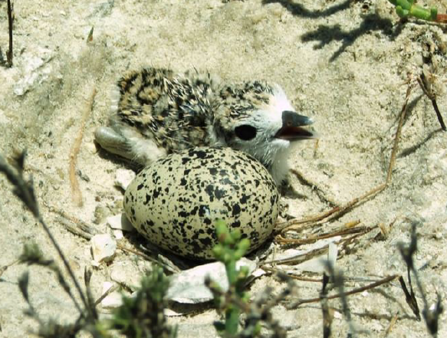
Questions?

