Slide 1


11/29/2018
Brackish Water Recharge Potential
Term Project Presentation
David Nguyen
C E 394K GIS in Water Resources, The University of Texas at Austin

Slide 2
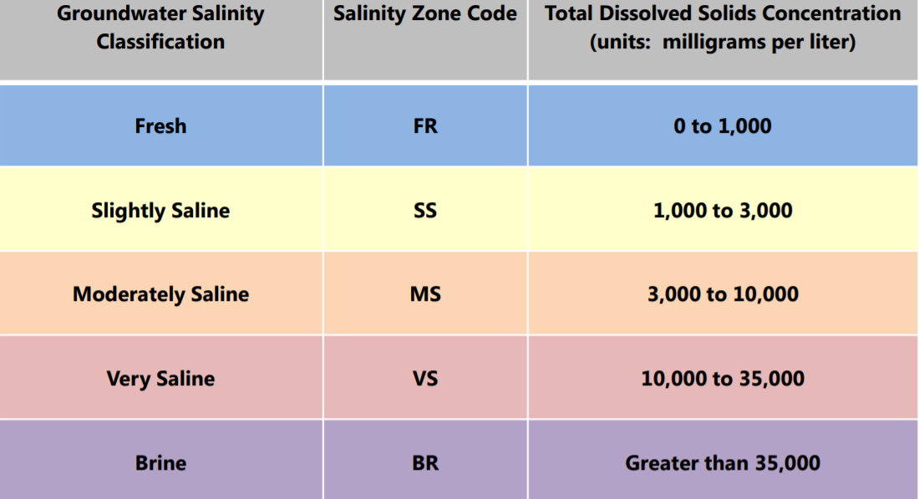
Definition
~ 880 trillion gallons of brackish water
in Texas
}

Slide 3
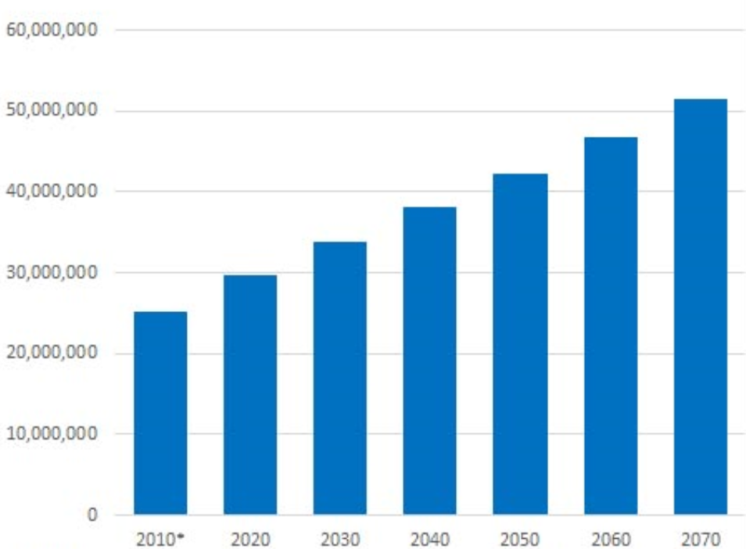
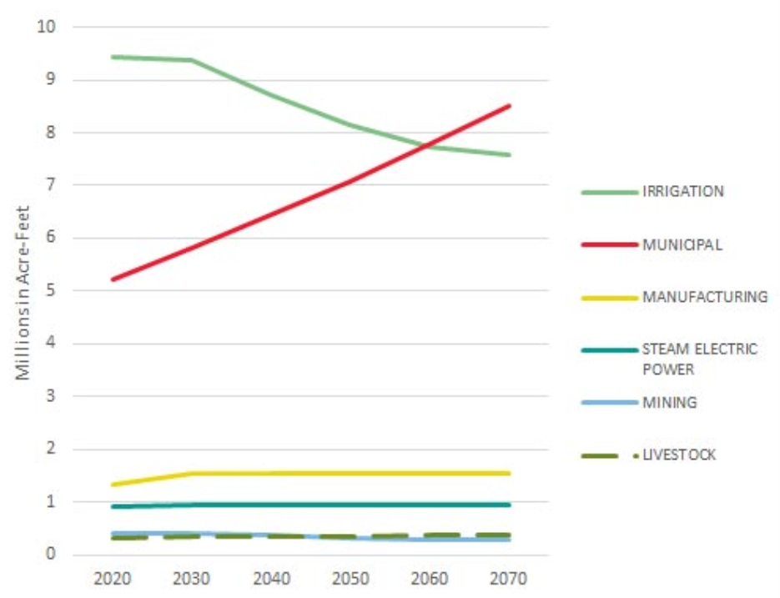
The Need
TWDB to release characterization of brackish water production zones by 2022
Brackish water desalination potentially the next WTP in Austin
Texas Water Development Board. State Water Plan 2017

Slide 4
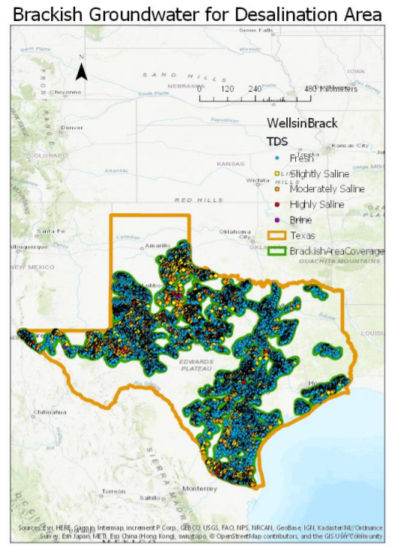
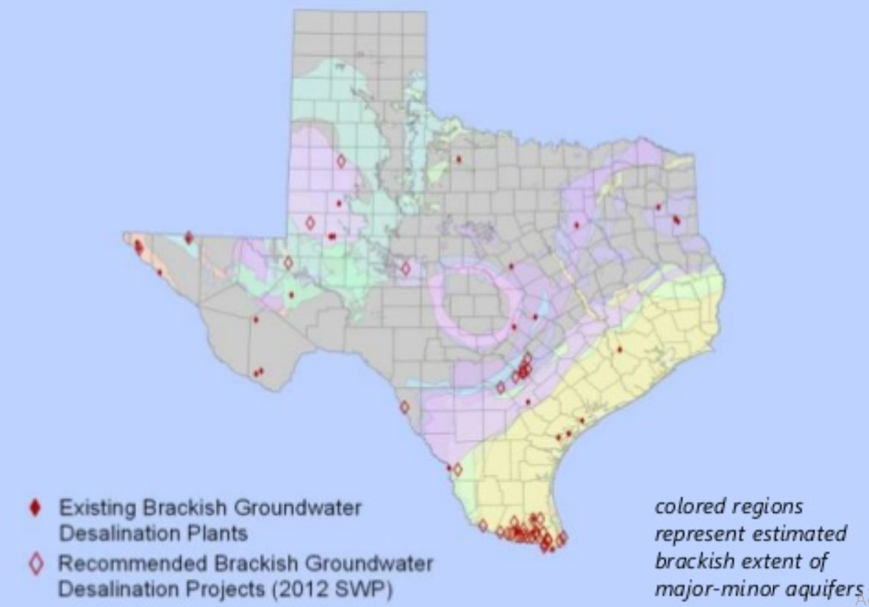
Objective
Create a raster representing the potential for brackish water recharge beneath Texas
Identify cities that could benefit from desalination

Slide 5



Data Sources
Objective 1: Create a raster representing the potential for brackish water recharge beneath Texas
TDS Water Quality by Wells - TWDB
Precipitation - TWDB
National Elevation Dataset -USGS
National Land Cover Database - USGS
Geologic Atlas of Texas - TNRIS/USGS
Objective 2: Identify cities that could benefit from desalination
World Cities Database - SimpleMaps

Slide 6
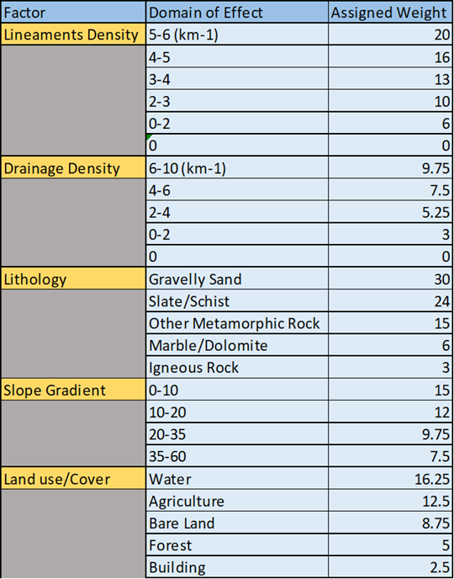
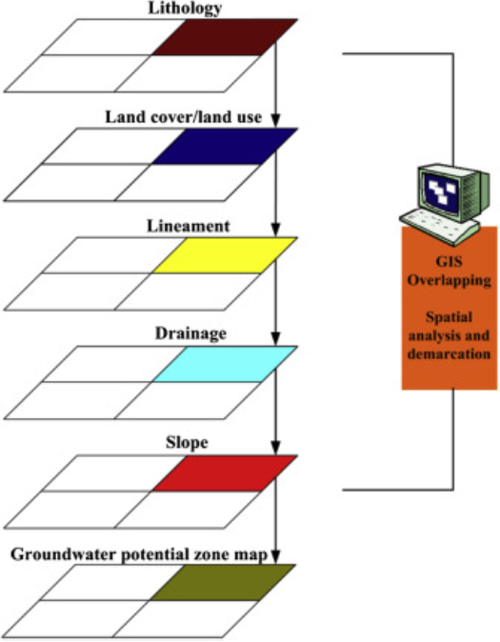

Methods
$$P_{r}={LD}_{w}+{DD}_{w}+{LG}_{w}+{SG}_{w}+{LC}_{w}$$

Slide 7
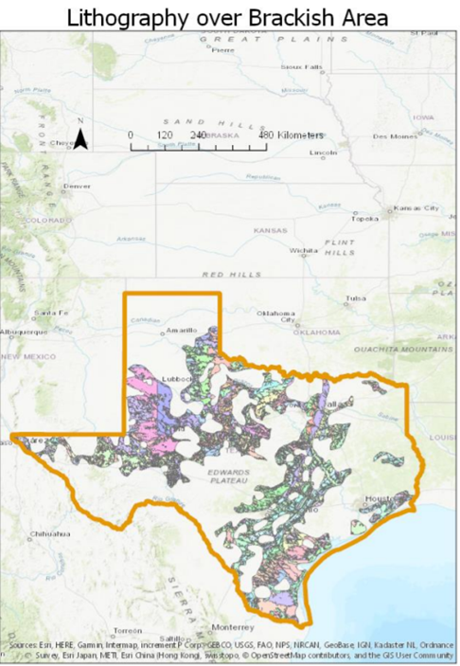
Lithography
Different porosities changes percolation of water flow into the ground

Slide 8
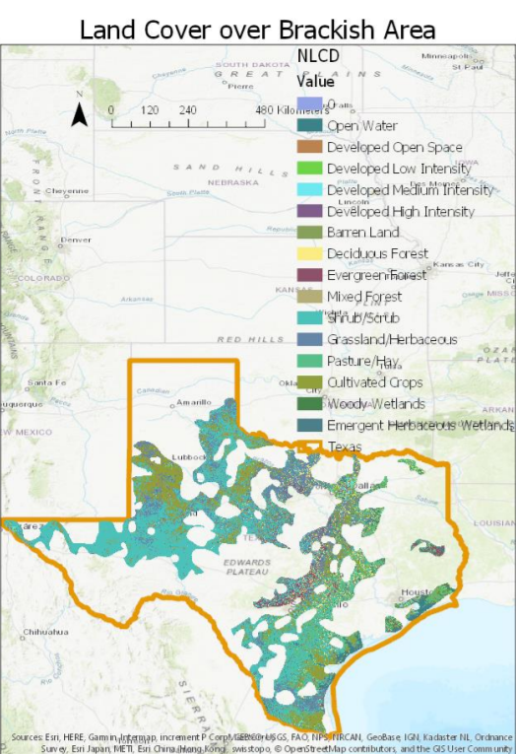
Land Use
Evapotransporation
Runoff
Penetration
Notes:
H.F. Yeh, C.H. Lee, K.C. Hsu, P.H. ChangGIS for the assessment of the groundwater recharge potential zone. Environ Geol, 58 (2009), pp. 185-195

Slide 9
Recharge=
ReClass(!Value!)
Coding Block def ReClass(Value) if (Value = 11 or Value = 90 or Value = 95): return 16.25 elif (Value = 81 or Value = 82): return 12.5 elif (Value = 31 or Value = 71): return 8.75 elif (Value = 52 or Value = 41 or Value = 42 or Value = 43): return 5 elif (Value = 21 or Value = 22 or Value = 23 or Value = 24): return 2.5
Converting Feature Classes to Rasters

Slide 10
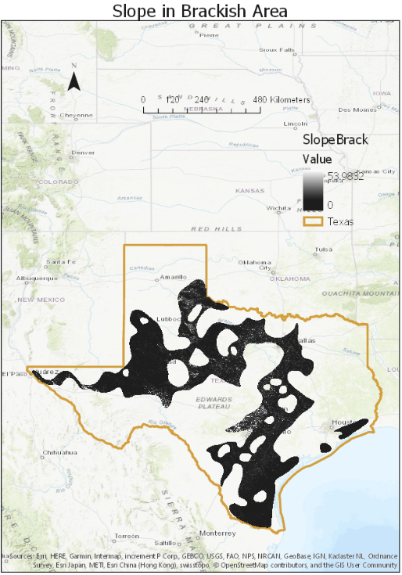
Slope
Infiltration time
Often ignored, especially in mountainous terrain

Slide 11
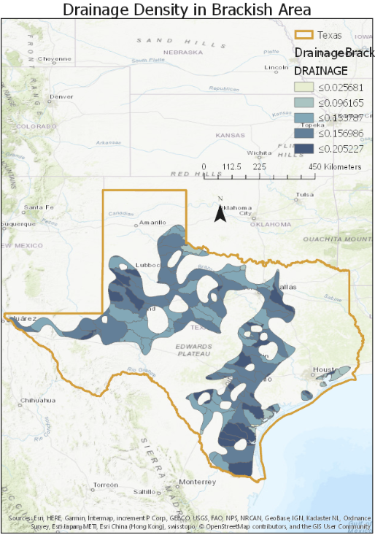
Drainage Density
Amount of water that can enter the ground

Slide 12
Coding for Large Datasets
import arcpy, sys
InFolder = r"F:\New folder\elevation_NED30M_tx_3641694_01\elevation"
OutFolder = r"F:\New folder\texaselevation"
OutSR = arcpy.SpatialReference(26914)
arcpy.env.workspace = InFolder
for Ras in arcpy.ListRasters():
arcpy.AddMessage("Projecting " + Ras)
arcpy.ProjectRaster_management (InFolder + "\\" + Ras, OutFolder + "\\" + Ras,OutSR)
arcpy.AddMessage("Projecting complete")

Slide 13
Finishing Up
Run Code to Create Rasters
Calculate Sum Raster Values for Total Recharge Potential
Average Raster Values in City Thiessen Polygon

Slide 14
Questions?

