Slide 1
Data Sources for GIS in Water Resources by David R. Maidment, and David G. Tarboton
GIS in Water Resources
Fall 2018

Slide 2
Outline
The hierarchical system of watersheds and basins
Where to obtain data and maps
  National/State/Global Data repositories
  Hydrography
  USGS National Water Information System
  Land Cover
  Census
  Elevation
  Soil (Statsgo/Surgo)
  Weather
  Regional data for Texas and Utah

Slide 3
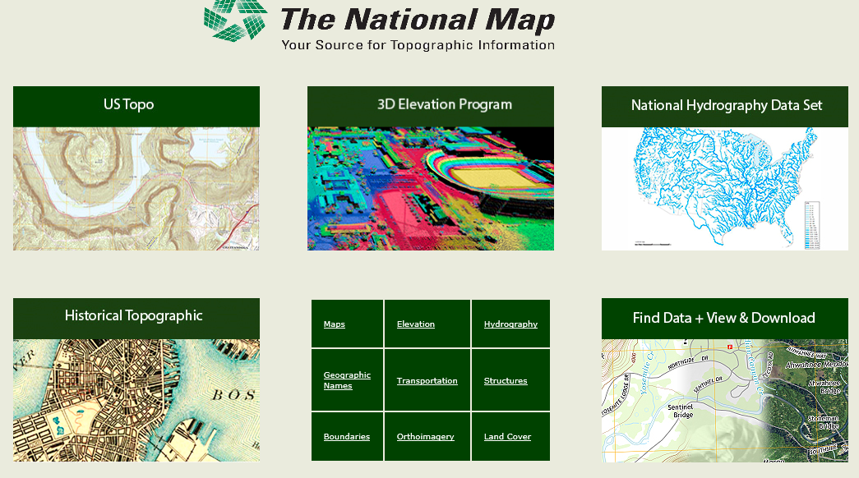
The National Map
http://nationalmap.gov/
A central source for US Government data

Slide 4
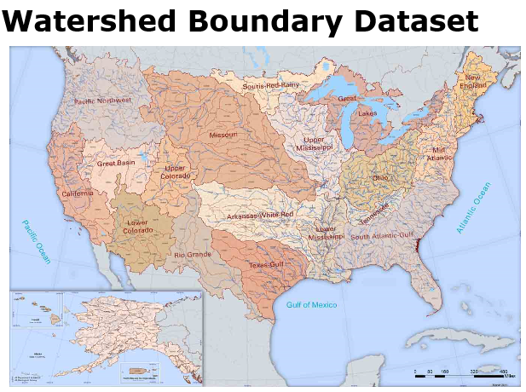
https://nhd.usgs.gov/wbd.html

Slide 5
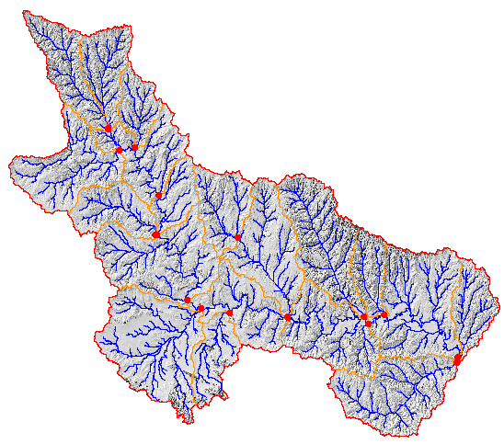
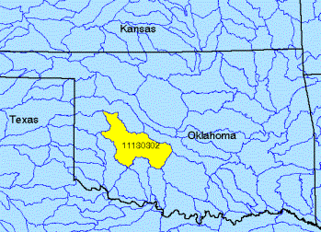
Watershed Boundary Dataset
http://nhd.usgs.gov/wbd.html
National Program by USGS and USDA (NRCS)
Boundaries for 10- and 12- digit watersheds
First cut is by automated delineation from NED
Hand checked and edited
10-digit watersheds

Slide 6
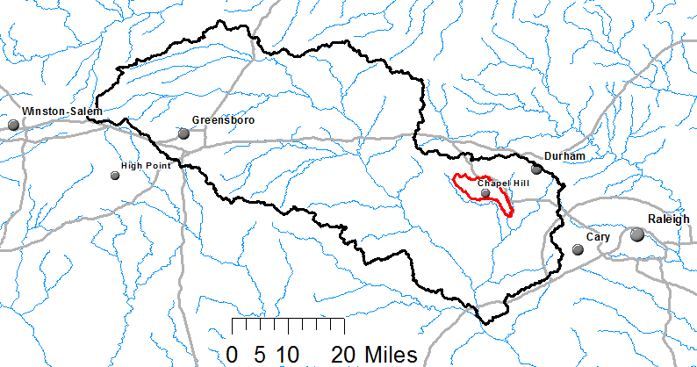
Watershed Hierarchy
Each hydrologic unit is identified by a unique hydrologic unit code (HUC) consisting of two to or more digits based on the levels of classification in the hydrologic unit system.
Digit #
2
4
6
8 HUC
10
12
NHDPlus
HAW HUC 8 03030002
Little Creek HUC 12 030300020603

Slide 7
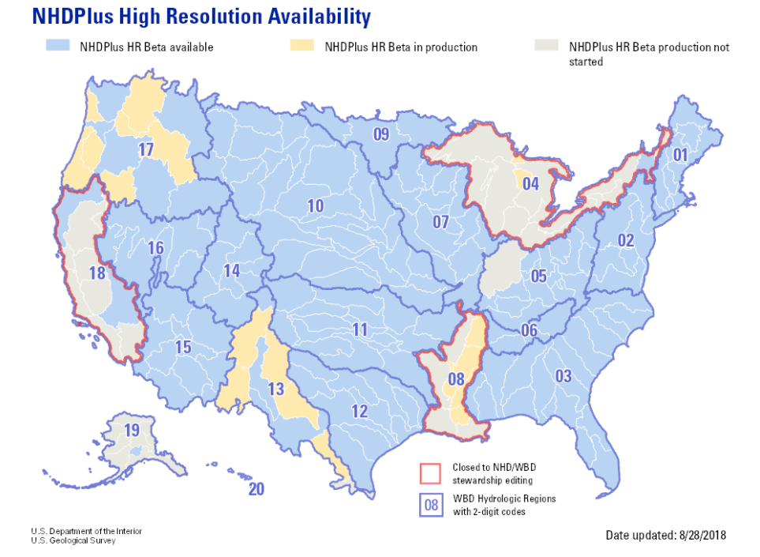
National Hydrography Dataset
https://nhd.usgs.gov/

Slide 8

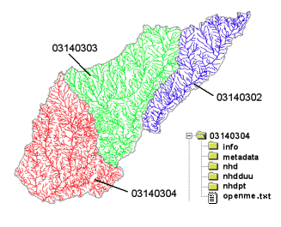
River networks
for 8-digit HUC
watersheds
http://nhd.usgs.gov/

Slide 9
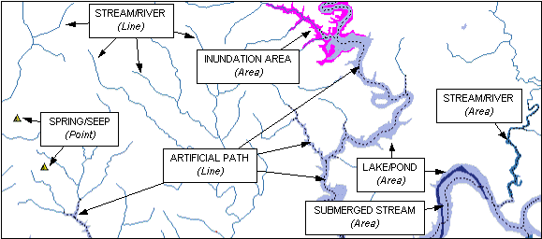

Slide 10
River Reach Codes
Used for river address locations
ReachCode =
12030102000151
ReachCode = 12030102000005
HUC#
Segment#
Location 0.392
on Reach
12030102000005

Slide 11
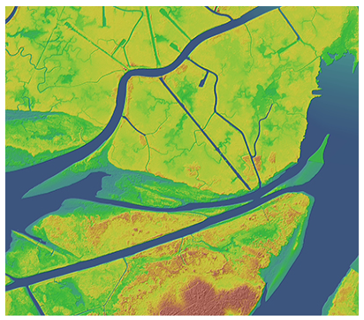

National Elevation Dataset
https://nationalmap.gov/elevation.html

Slide 12

National Elevation Dataset
Digital Elevation Model with 1 arc-second (30m), 1/3 arc-second (10m) and some 1/9 arc second (3m) cells
Distributed as part of the National Map
10 billion data
Derived from USGS 1:24,000 quadrangle sheets and at higher resolution from LIDAR

Slide 13
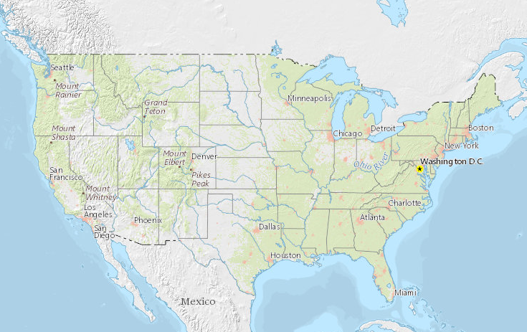
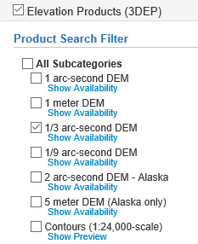
National Elevation Dataset Availability
https://viewer.nationalmap.gov/basic/

Slide 14

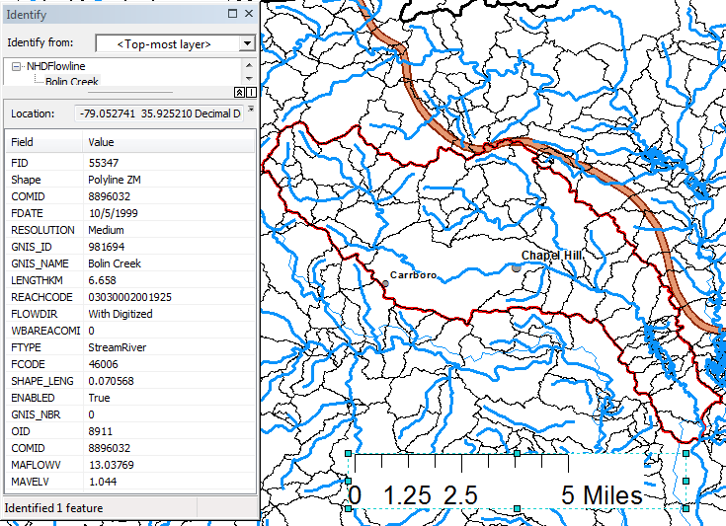
Slope
Elevation
Mean annual flow
  Corresponding velocity
Drainage area
% of upstream drainage area in different land uses
Stream order
http://www.horizon-systems.com/nhdplus/

Slide 15
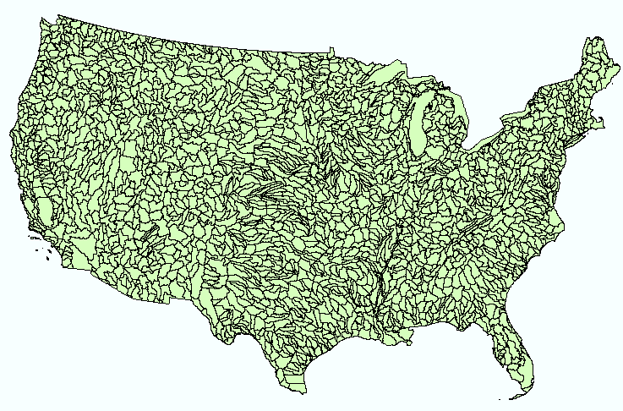
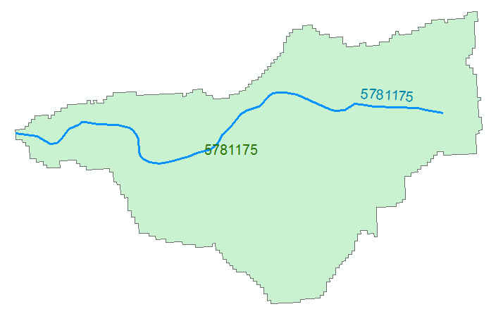
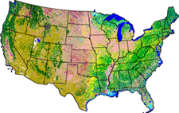
NHDPlus Version 2.1
Foundation for a Geospatial Hydrologic Framework for the United States
NHDPlus
2.7 million reach catchments in US
average area 3 km²
reach length 2 km
Uniquely labelled
National Elevation Dataset
Watershed Boundary Dataset
National Hydrography Dataset
National Land Cover Dataset
http://www.arcgis.com/home/item.html?id=5600cf6b463043ec97b764fb258997be#!

Slide 16
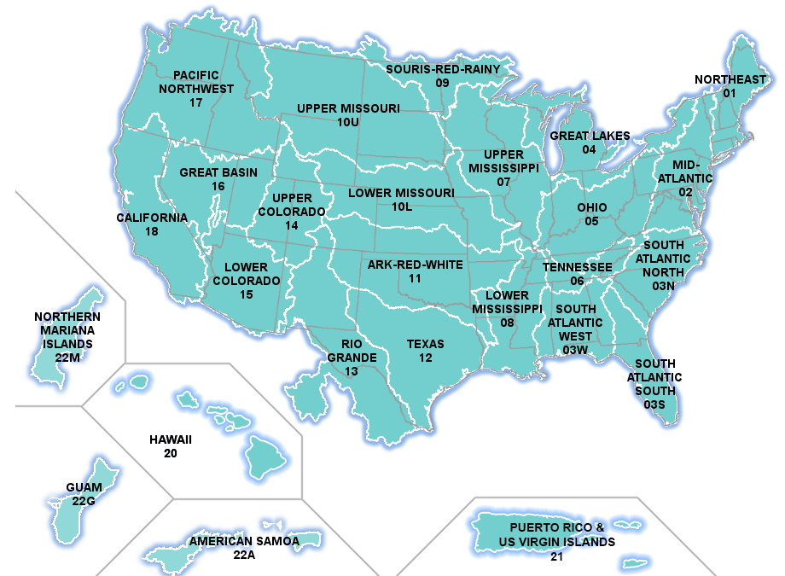
NHDPlus Data Download
http://www.horizon-systems.com/nhdplus/NHDPlusV2_data.php

Slide 17
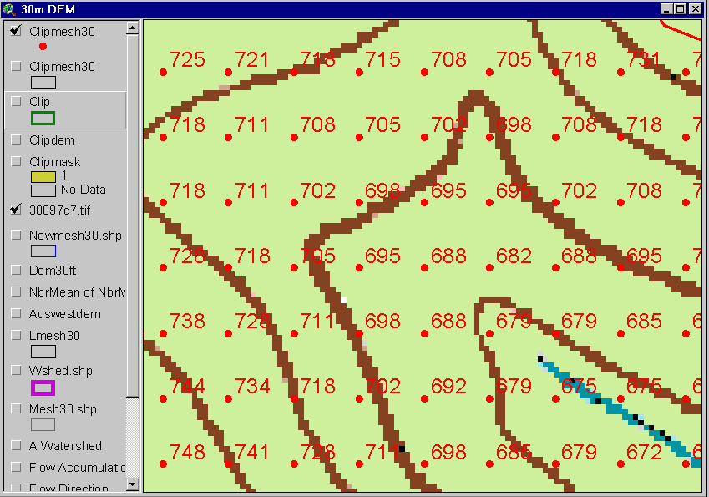
Digital Elevation Model (DEM)
720
720
Contours
740
720
700
680
740
720
700
680

Slide 18
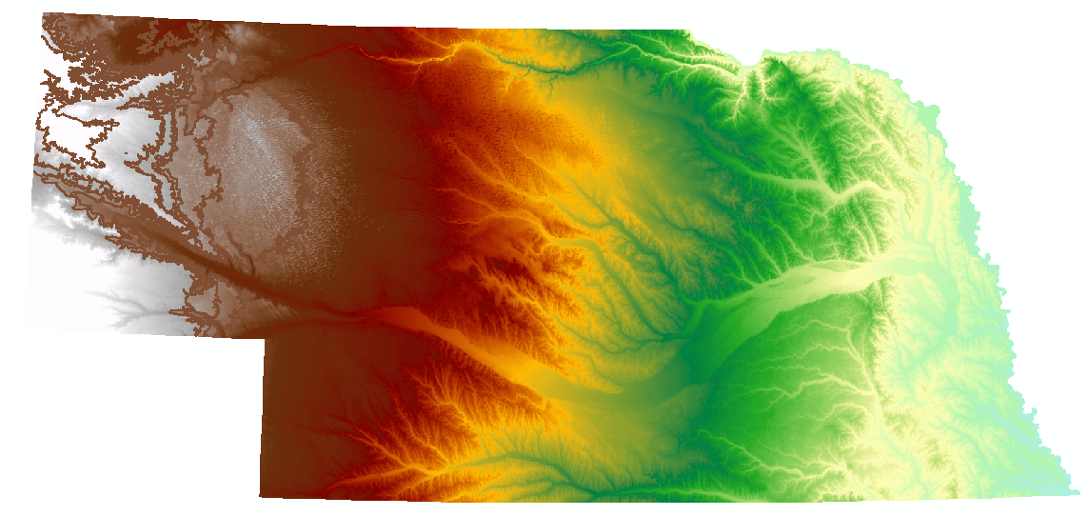
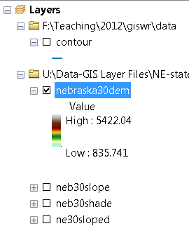
Digital Elevation Model (DEM)-30 meter

Slide 19
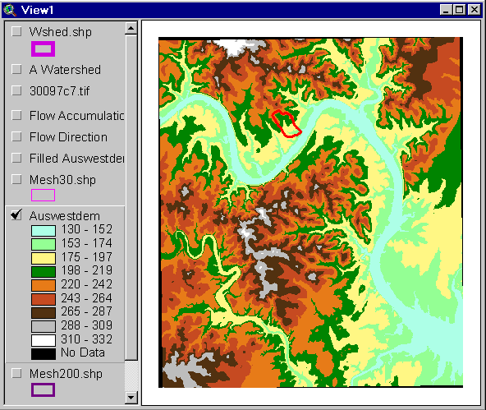
Austin West 30 Meter DEM

Slide 20
Eight Direction Pour Point Model
ArcGIS raster operations involved in watershed delineation are derived from the premise that “water flows downhill, in doing so, will follow the steepest descent
32
64
128
16
1
8
4
2
Water in a given cell flows to one of eight adjacent cells in the direction of steepest descent

Slide 21
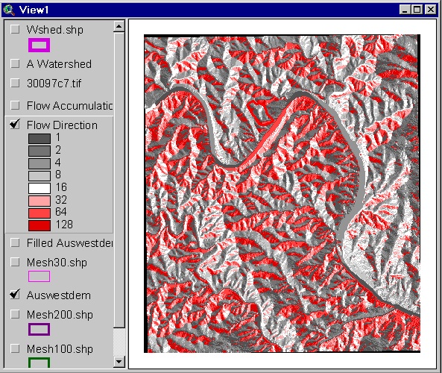
Flow Direction Grid
32
64
128
16
1
8
4
2

Slide 22
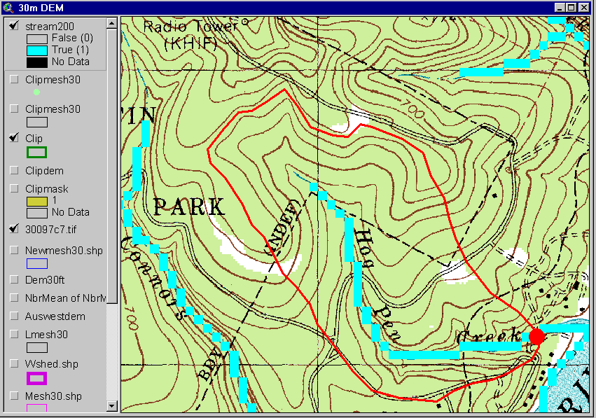
Delineation of Streams and Watersheds on a DEM

Slide 23

https://lta.cr.usgs.gov/SRTM

Slide 24
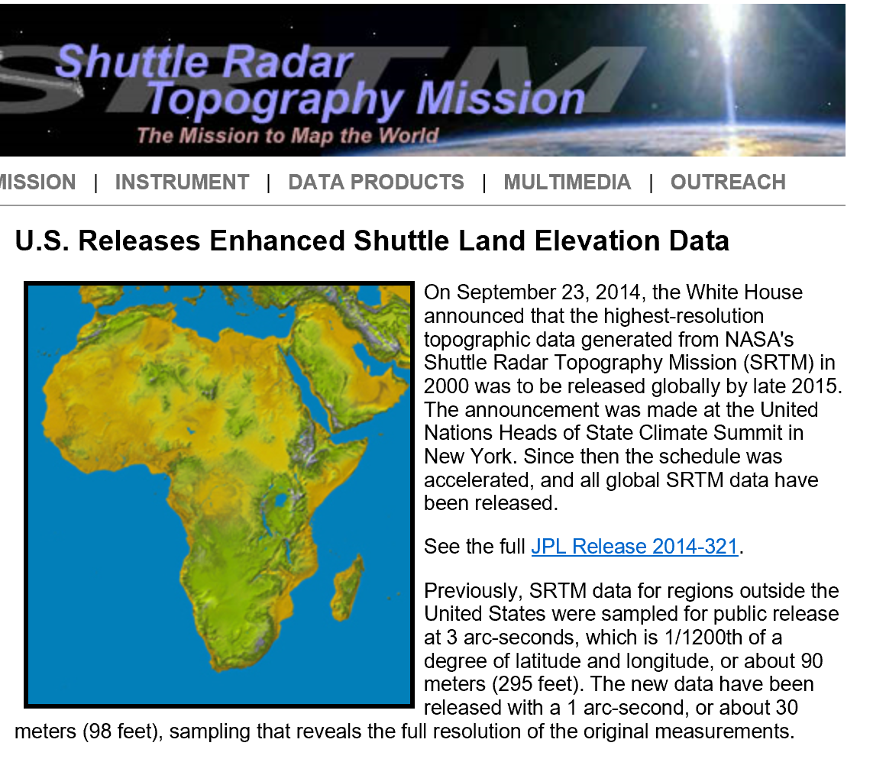
SRTM Topographic Data
(all 30m data now public for world)
http://www2.jpl.nasa.gov/srtm/

Slide 25
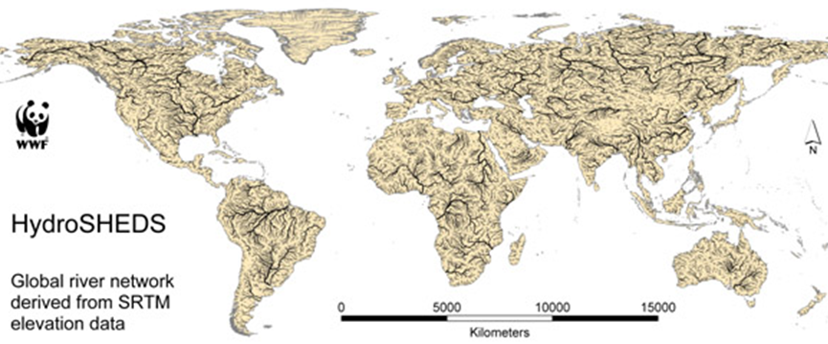
HydroSheds derived from SRTM
http://hydrosheds.cr.usgs.gov/

Slide 26
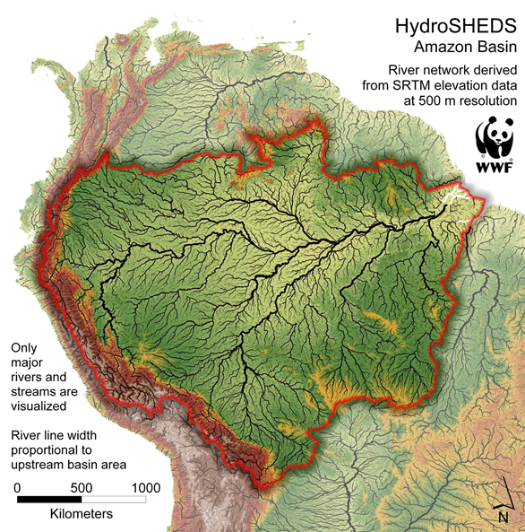

Slide 27
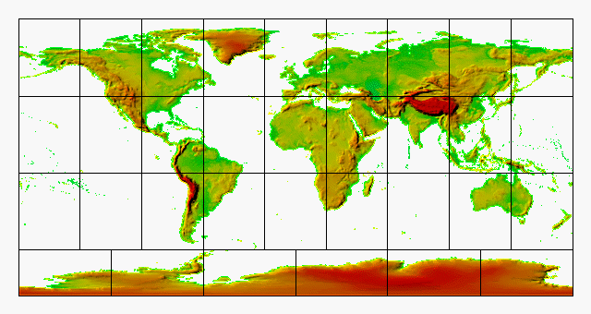
GTOPO30 - 1 km Digital Elevation Model of the Earth
https://lta.cr.usgs.gov/GTOPO30

Slide 28
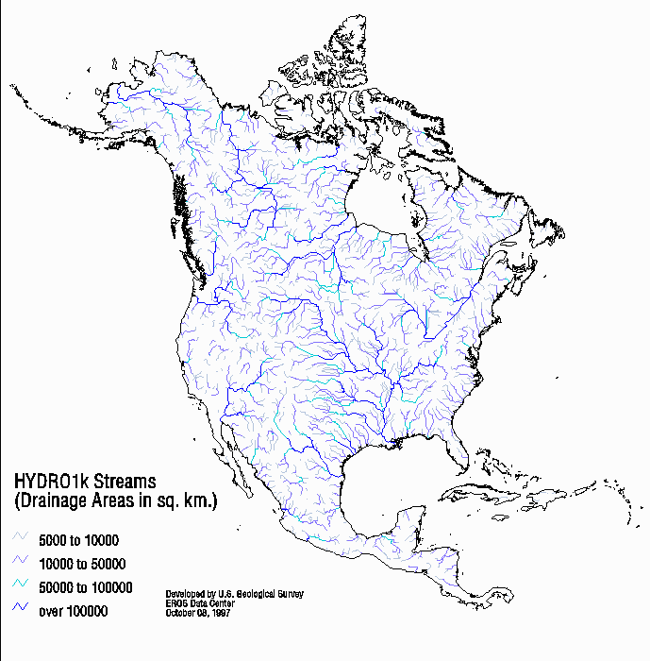
Drainage in North America
Hydro1K is
derived from
GTOPO30
using raster
GIS analysis
https://lta.cr.usgs.gov/HYDRO1K

Slide 29
Soil Data
Natural Resources Conservation Service (NRCS)
State Soil Geographic Database-STATSGO
Soil Survey Geographic Database- SSURGO
http://www.nrcs.usda.gov/wps/portal/nrcs/site/soils/home/
http://websoilsurvey.sc.egov.usda.gov/App/WebSoilSurvey.aspx
https://gdg.sc.egov.usda.gov/

Slide 30

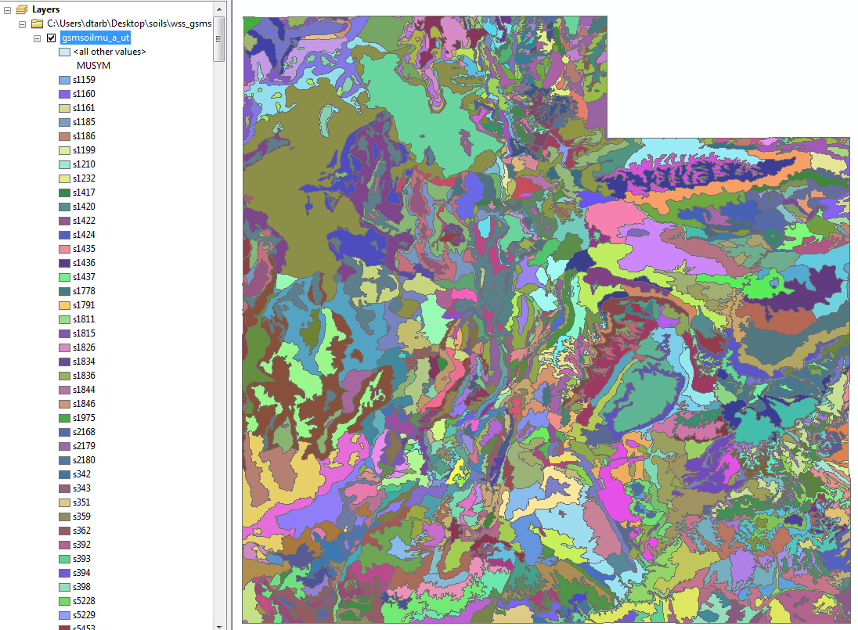
1:250,000 Scale Soil Information
https://gdg.sc.egov.usda.gov/

Slide 31
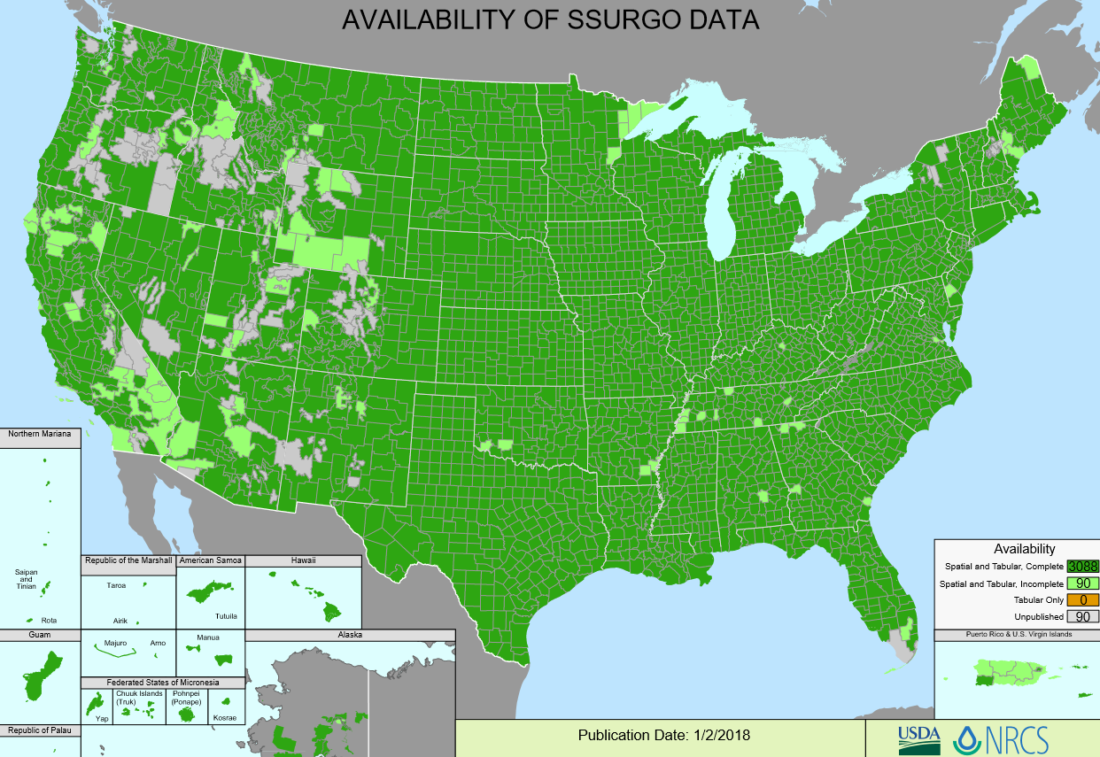
SSURGO:
County Level
Digital Soil Maps
1:24,000 scale
soil information
http://websoilsurvey.nrcs.usda.gov/DataAvailability/SoilDataAvailabilityMap.pdf

Slide 32
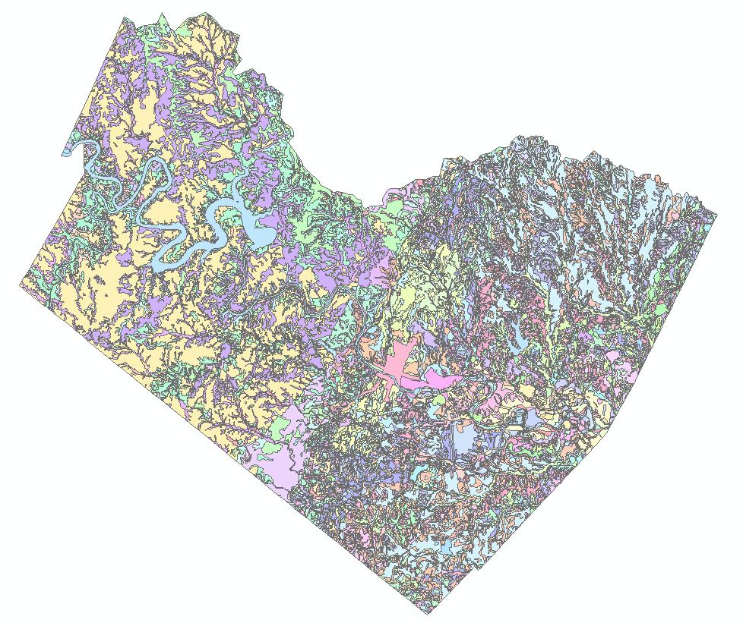
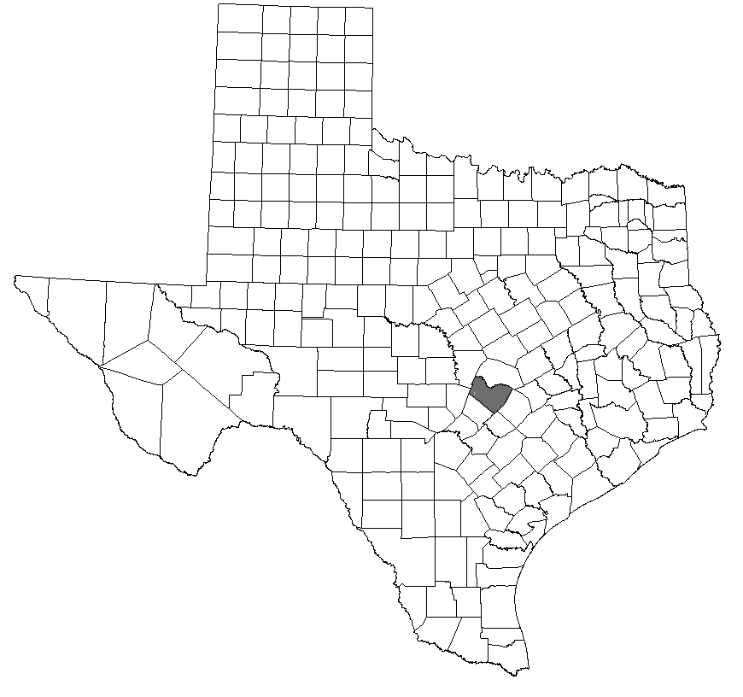
Ssurgo for Travis County
103 soil map units described by 7530 polygons of average area 35.37 ha (87 acres)

Slide 33
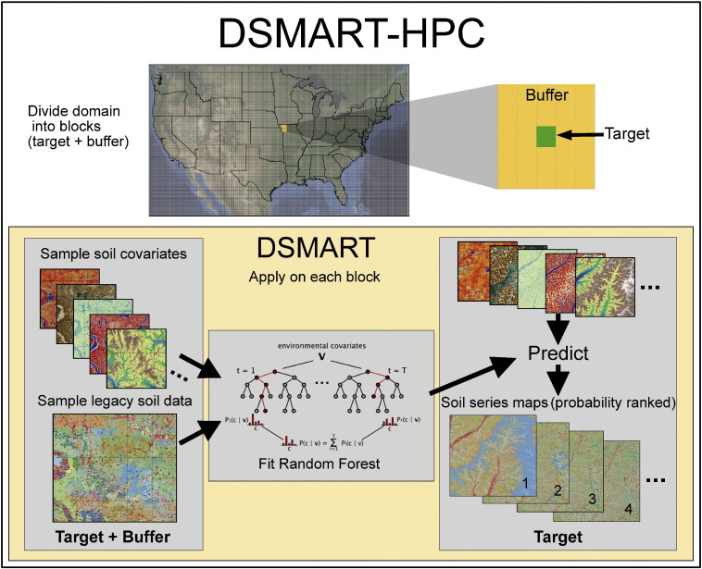
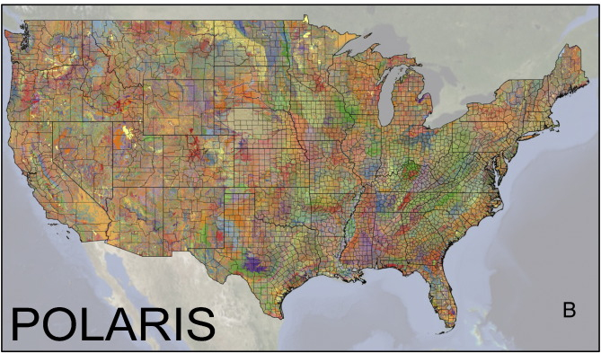
POLARIS: A 30-meter probabilistic soil series map of the contiguous United States
Chaney, N. W., E. F. Wood, A. B. McBratney, J. W. Hempel, T. W. Nauman, C. W. Brungard and N. P. Odgers, (2016), "POLARIS: A 30-meter probabilistic soil series map of the contiguous United States," Geoderma, 274: 54-67, http://www.sciencedirect.com/science/article/pii/S0016706116301434.
http://stream.princeton.edu/POLARIS/

Slide 34

http://landcover.usgs.gov/

Slide 35
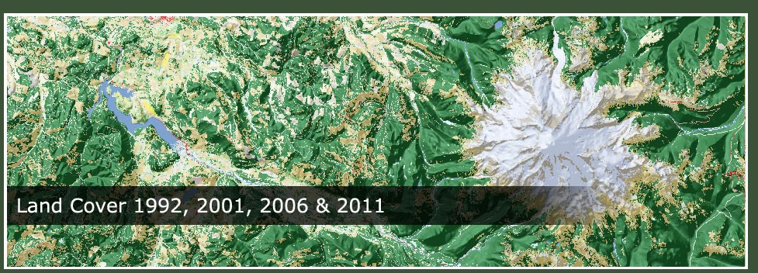
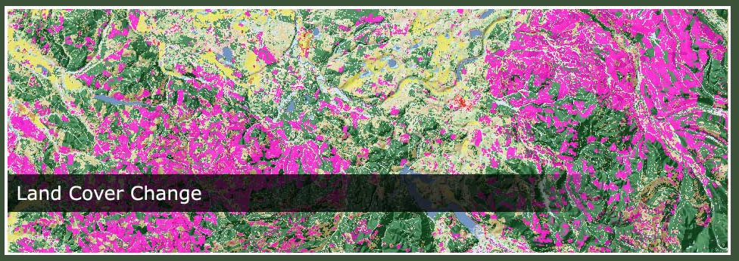
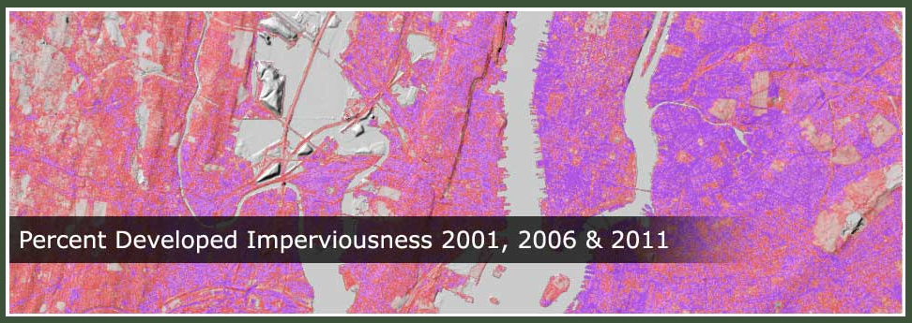
National Land Cover Data
http://www.mrlc.gov/

Slide 36
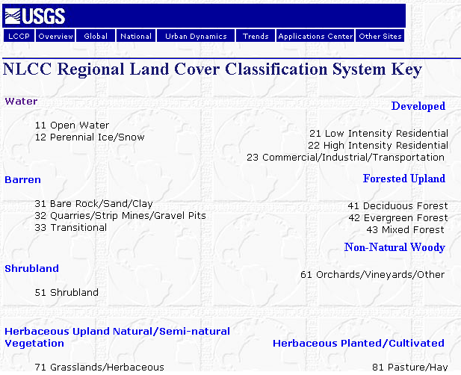

Slide 37
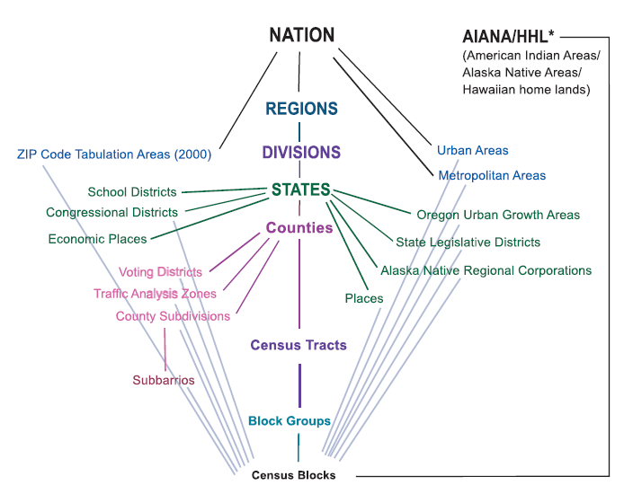
Hierarchy of Census Geographic Entities
http://www.caee.utexas.edu/prof/maidment/giswr2014/Census/AccessingCensusData.pdf
74,000
220,000 (avg 600 households/block grp)
US Population: 316 million
US Households: 133 million
11,000,000
Notes:
This diagram depicts the geographic hierarchy, as a series of nesting relationships, based on the legal, administrative, or areal relationships of the entities. For example, a line joining the lower-level entity “place” and the higher-level entity “state” means that a place cannot cross a state boundary.

Slide 38
American Community Survey
Source of detailed demographic and housing characteristics, including:
  Income
  Language spoken at home
  Educational attainment
  Occupation
  Place of work and journey to work
Data collected annually from approximately 3 million households per year. Approximately 250,000 households per month.
Data collected throughout the year—produces period estimates rather than point estimates.
 | ACS 1-Year Data | ACS 3-Year Data | ACS 5-Year Data
Geographic Areas | 65,000 or more population | 20,000 or more population | All areas, block group or higher

Slide 39
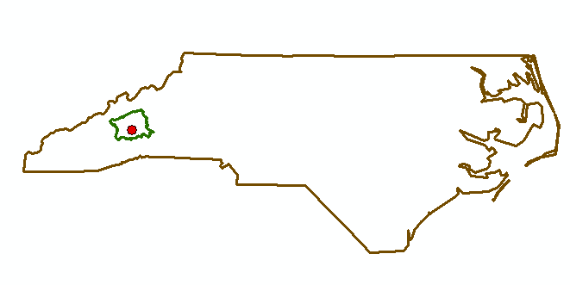
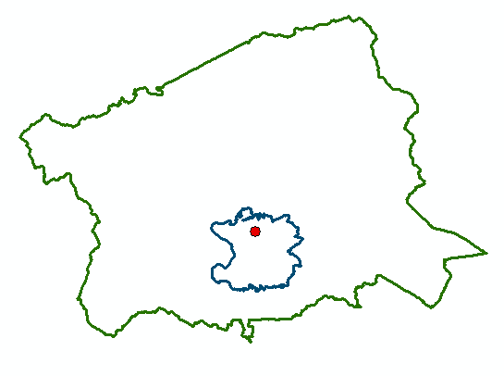
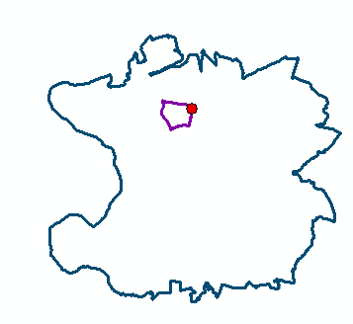
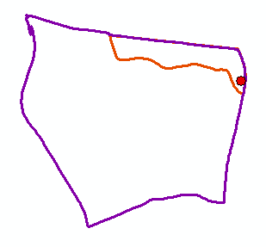
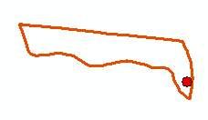
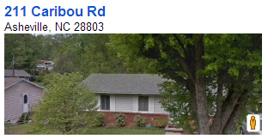
North Carolina
Buncombe County
Zip Code 28803
Census Block Group 370210020004
Scales of
Data Aggregation
Census Block 370210020004000
A single property – 211 Caribou Rd

Slide 40
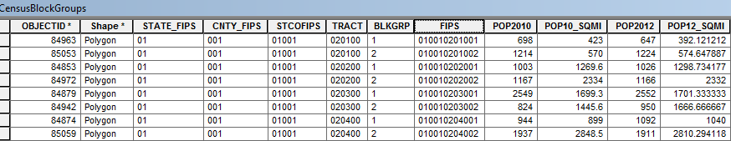
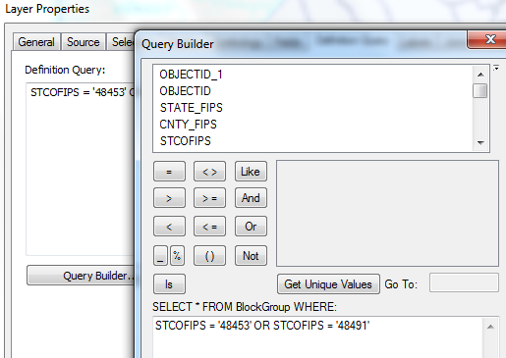
Census Block Groups for the US
http://www.caee.utexas.edu/prof/maidment/giswr2014/census/census.gdb.zip (308MB)
State
County
Tract
Block Group
Definition query to isolate Travis and Williamson Counties

Slide 41
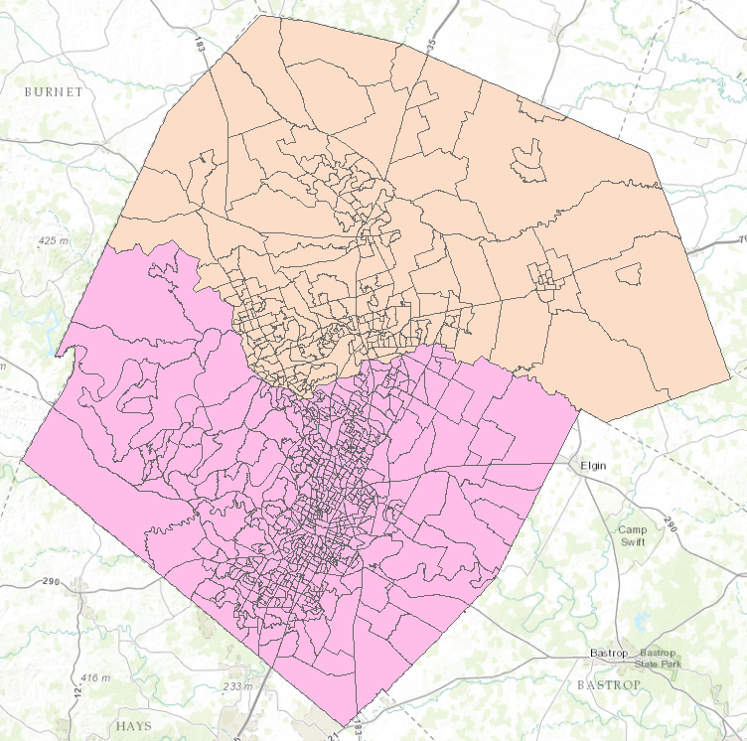

Census Block Groups in Travis and Williamson Counties
Williamson County
Travis County

Slide 42
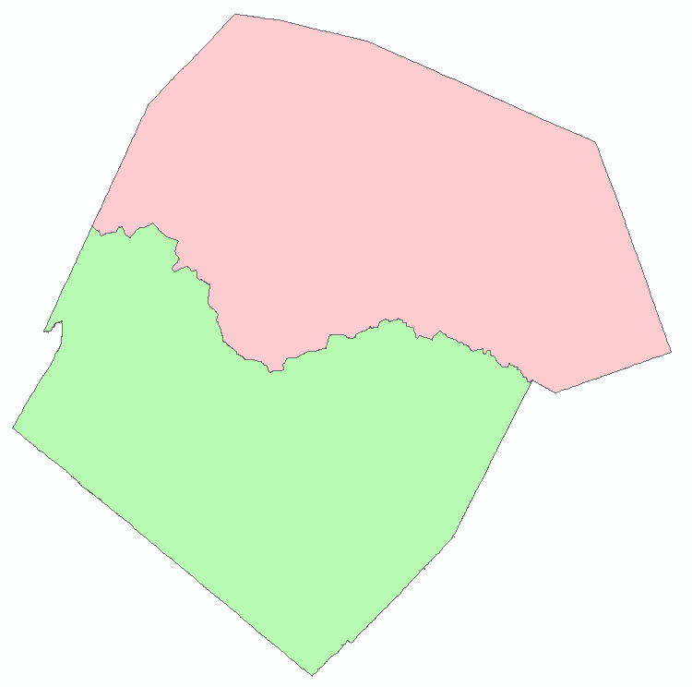
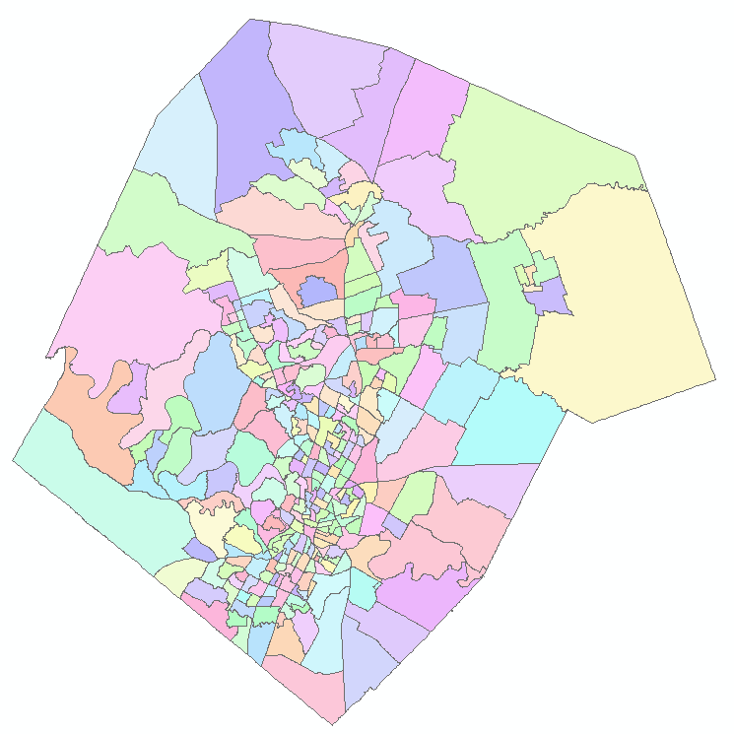
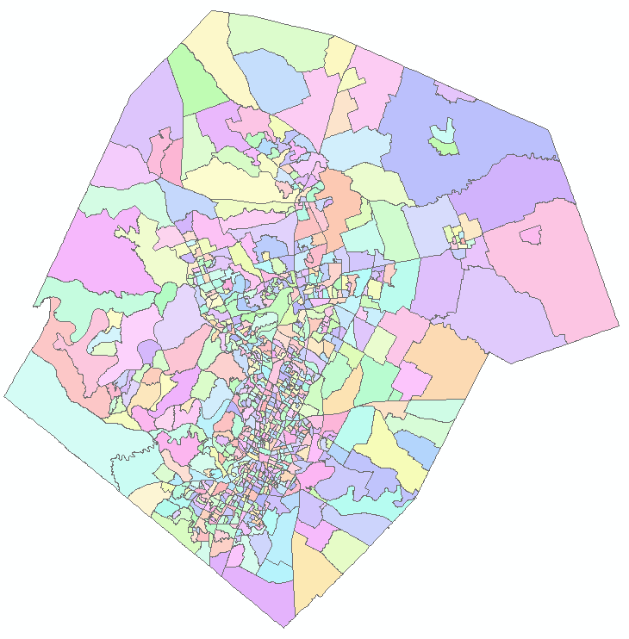
Demographic Analysis
Williamson
Travis
Two Counties
307 Tracts
823 Block Groups

Slide 43

https://www.ncei.noaa.gov/

Slide 44

www.climate.gov

Slide 45


PRISM Mean Annual Precipitation (Oregon State U.)
http://prism.oregonstate.edu/

Slide 46

National Water Information System
Web access to USGS water
resources data in real time
http://waterdata.usgs.gov/usa/nwis/

Slide 47


USGS Water Watch
Web access to USGS water resources data in real time
http://waterdata.usgs.gov/nwis/rt

Slide 48


USGS National Water Information System.
http://water.usgs.gov
Real-time and Historic Data
  Streamflow and stage
  Groundwater levels
  Water Quality
  Site information
Tabular or Graphical Format

Slide 49

ArcGIS Online: Living Atlas
http://doc.arcgis.com/en/living-atlas/

Slide 50

Ready to Use Services in ArcGIS Pro e.g Watershed Delineation

Slide 51


Hurricane Florence Forecast as of 11AM Weds 12 Sept 2018
Source: National Hurricane Center
https://www.nhc.noaa.gov/

Slide 52

National Water Model Forecasts for Carolina Coast
http://water.noaa.gov/map

Slide 53


River Discharge Forecast from Florence
River Discharge
(cubic feet per second)
160,000 cfs
on Sunday evening
Wed
Thu
Fri
Sat
Sun
Mon
Forecast as of Weds Sept 12 at 8 AM

Slide 54

http://water.weather.gov/ahps/

Slide 55

http://water.weather.gov/ahps/

Slide 56

CUAHSI HydroClient http://data.cuahsi.org
Query for Streamflow Data in the Houston Area during Hurricane Harvey – 39 time series identified

Slide 57



Time Series Data
Downloaded to Excel

Slide 58


http://enviroatlas.epa.gov/enviroatlas/

Slide 59



Texas Natural Resource Information System http://www.tnris.org/

Slide 60

TWDB http://www.twdb.texas.gov/mapping/gisdata.asp

Slide 61


Preserving A Flood of Data:
Hurricane Harvey 2017 Data Archive
Dr. David Arctur
Center for Water
and the Environment
University of Texas at Austin
NSF RAPID
Award 1761673
Presentation to the 2018 Hurricane Harvey Research Symposium, Port Aransas
Acknowledgments for Harvey data: David R. Maidment, Harry R. Evans, Michael Ouimet
For Data Archive: Dave Tarboton, Jerad Bales, Martin Seul, Tony Castronova, Ray Idaszak
University of Texas at Austin, Texas DPS Division of Emergency Management, City of Austin,
National Weather Service, Univ of Illinois Urbana-Champaign, Utah State Univ, CUAHSI, RENCI*, Esri, Kisters,
Interagency Flood Risk Management Group, Harris County Flood Control District, Dept of Homeland Security,
Commission for State Emergency Communications, Texas 911 Alliance, Emergency GIS Response Team,
Texas GIS 911 User Group. *RENCI is an Institute at the University of North Carolina at Chapel Hill
Notes:
This is the story about a project that’s been my main focus since 2 yr before Hurricane Harvey: to help develop a flood response system for Texas. Our team, under the scientific leadership of Dr. David Maidment, started in earnest on this project in the spring of 2015, after severe flash floods in central Texas. Because of our work on that project, our team was in a position to help with the flood mapping during Hurricane Harvey, 2 years later. Harry Evans is former chief of staff for the Austin Fire Dept, and served as our liaison to the Public Safety community. Mike Ouimet is Manager of Critical Information Systems with the Texas Division of Emergency Management, and sponsored our work during the 2 years before Harvey.

Slide 62

Hurricane Harvey Story Map
http://arcg.is/001jje

Slide 63

CUAHSI Project: Hurricanes 2017 Data Archive
https://www.cuahsi.org/projects/hurricanes-2017-data-archive
Notes:
Here’s the landing page at cuahsi.org for the three data archives, with links highlighted for the Harvey archive.

Slide 64

https://www.hydroshare.org/resource/2836494ee75e43a9bfb647b37260e461/
Notes:
Scrolling down on the HydroShare resource page, we can see the area of coverage represented by data in this collection, and the collection contents. There are enough different types of data in this overall collection that we have multiple levels of hierarchy, eg, root collection > flood data collections > types of flood data. We’ll see some of these later on.

Slide 65

River Forecast Centers
https://www.cbrfc.noaa.gov

Slide 66




Logan River
1460 cfs 6/5/17

Slide 67


http://www.wcc.nrcs.usda.gov/snotel/

Slide 68

SNOTEL System for Measuring Snow and Supporting Spring Runoff and Water Supply Forecasts

Slide 69

USU Doc Daniels SNOTEL Site

Slide 70


Measuring Snow Water Equivalent

Slide 71


http://www.cbrfc.noaa.gov

Slide 72

CBRFC SNOTEL Ensemble
http://www.cbrfc.noaa.gov/station/sweplot/sweplot.cgi?tglu1

Slide 73

NASA Airborne Snow Observatory
https://nsidc.org/data/aso

Slide 74

SNODAS gridded mapping of snow across US
https://www.nohrsc.noaa.gov/archived_data/

Slide 75

http://gis.utah.gov

Slide 76

Utah GIS Portal Download GIS Data
http://gis.utah.gov/data/

Slide 77

http://geology.utah.gov/maps/gis/index.htm

Slide 78

http://www.wrcc.dri.edu/

Slide 79

Bear River Watershed
http://www.bearriverinfo.org/

Slide 80


MODIS on NASA Worldview
(Shrinking Great Salt Lake)
2012-05-11
2017-08-27
https://worldview.earthdata.nasa.gov/?p=geographic&l=MODIS_Aqua_CorrectedReflectance_TrueColor,MODIS_Terra_CorrectedReflectance_TrueColor,Reference_Features,Coastlines&t=2012-05-11&v=-114.20487628044651,40.12581729563662,-110.51347003044651,42.16048526438662
https://worldview.earthdata.nasa.gov/?p=geographic&l=MODIS_Aqua_CorrectedReflectance_TrueColor,MODIS_Terra_CorrectedReflectance_TrueColor,Reference_Features,Coastlines&t=2017-08-27&z=3&v=-114.20487628044651,40.12581729563662,-110.51347003044651,42.16048526438662

Slide 81

Smoke from Fires over W US
MODIS 2018-08-04
https://worldview.earthdata.nasa.gov/?p=geographic&l=MODIS_Aqua_CorrectedReflectance_TrueColor,MODIS_Terra_CorrectedReflectance_TrueColor,Reference_Features,Coastlines&t=2018-08-04-T00%3A00%3A00Z&z=3&v=-133.43412432732154,32.05965518626162,-103.90287432732154,48.91707706126162

Slide 82
Summary
There are a plethora of data sources available
Knowing what is available is important to scope GIS analyses and projects
GIS is about creating knowledge, telling stories, making decisions – all involve integrating information from multiple sources
The way that data is organized can enhance or inhibit the analyses that can be done
Data dissemination is increasingly becoming service based

