Slide 1
Demography
David R. Maidment
GIS in Water Resources Fall 2018

Slide 2
Data Tabulation Programs
Decennial Census of Population and Housing: every 10 years
Population Estimates and Projections Program: every year
Small Area Income and Poverty Estimates Program: every year
American Community Survey: every year
Economic Census: every 5 years
Local Employment Dynamics Program: every year
Census of Governments: every 5 years
Over 100 Annual, Quarterly or Monthly Surveys, including 13 principal economic indicators
(Political Reapportionment)
(Socioeconomics)

Slide 3
American Community Survey
Source of detailed demographic and housing characteristics, including:
Income
Language spoken at home
Educational attainment
Occupation
Place of work and journey to work
Data collected annually from approximately 3 million households per year. Approximately 250,000 households per month.
Data collected throughout the year—produces period estimates rather than point estimates.
 | ACS 1-Year Data | ACS 3-Year Data | ACS 5-Year Data
Geographic Areas | 65,000 or more population | 20,000 or more population | All areas, block group or higher

Slide 4
Hierarchy of Census Geographic Entities
74,000
220,000 (avg 600 households/block grp)
US Population: 316 million US Households: 133 million
11,000,000
Notes:
This diagram depicts the geographic hierarchy, as a series of nesting relationships, based on the legal, administrative, or areal relationships of the entities. For example, a line joining the lower-level entity “place” and the higher-level entity “state” means that a place cannot cross a state boundary.

Slide 5
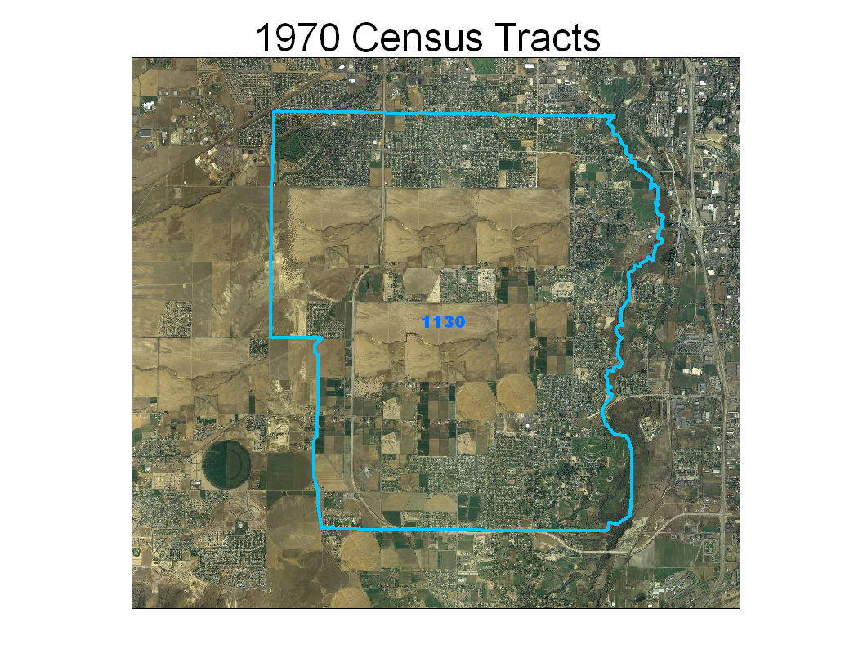
Notes:
The next few slides show an example of an area where population continues to grow and therefore the census tract is split over the decades.
This is the original tract 1130 in South Jordan City, Utah during the 1970 Census

Slide 6
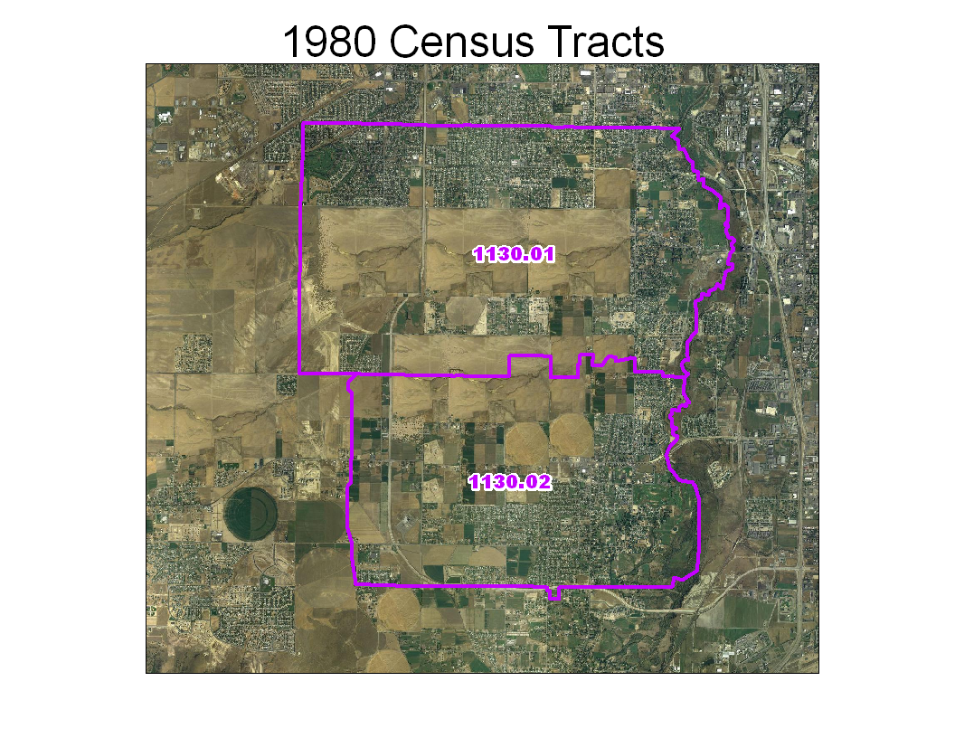
Notes:
For the 1980 Census, enough growth occurred to split the original tract 1130 into two new pieces. Note the tract suffixes .01 and .02.

Slide 7
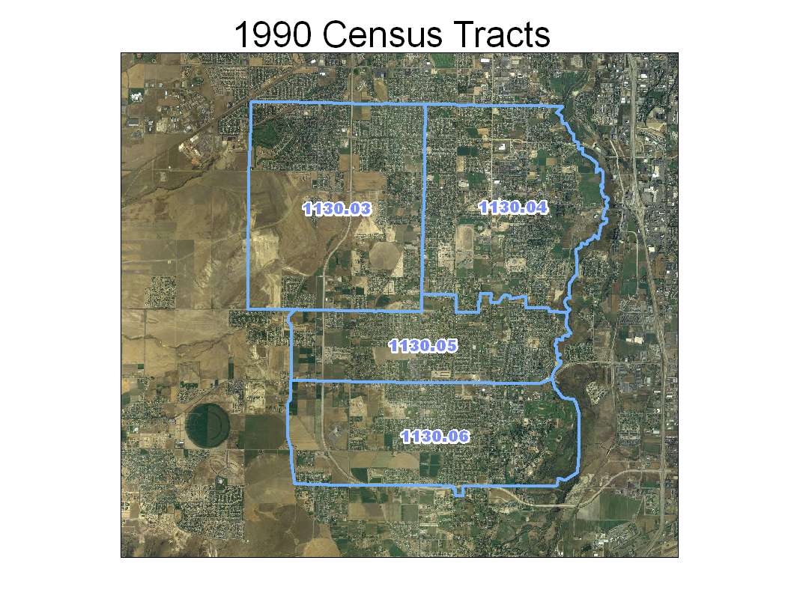
Notes:
For the 1990 Census, growth has again continued at an accelerated pace requiring the two tracts from 1980 to be split further. Notice the original suffixes are no longer used and new ones are provided.

Slide 8
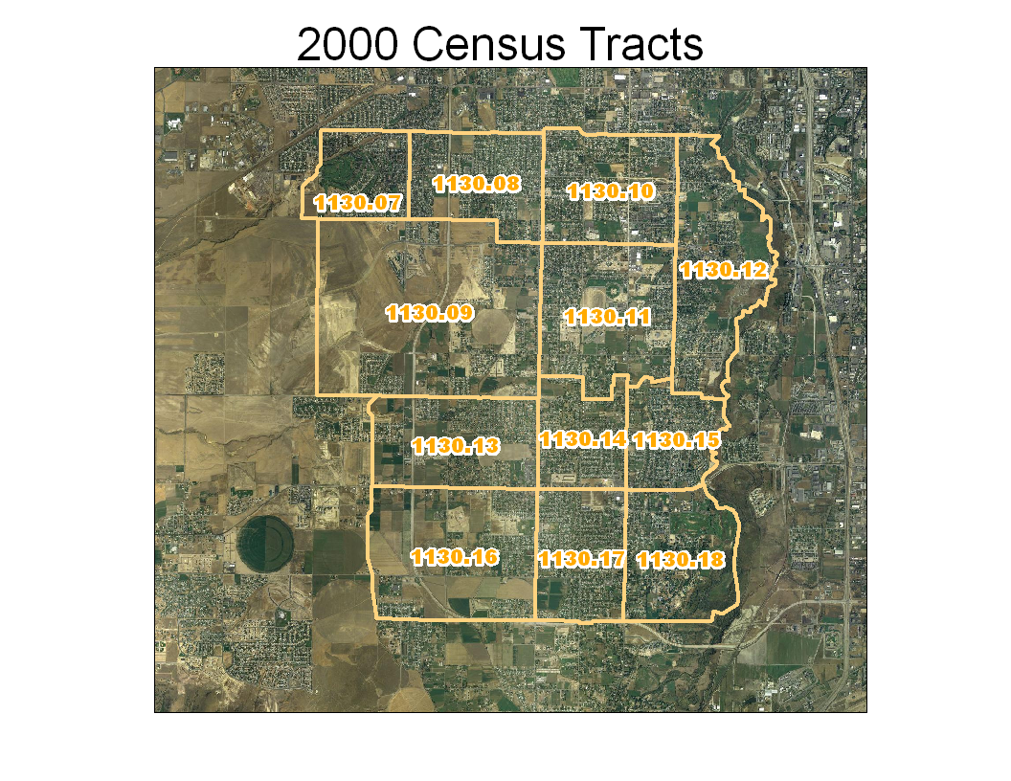
Notes:
Finally in the 2000 Census, the four tracts from 1990 had to be further sub-divided. Once again, the tract suffixes from 1990 are no longer used and new ones are given. You can see that the original outline of tract 1130 still exists, so you can compare the data from 2000 to the same geographic area in 1970.

Slide 9
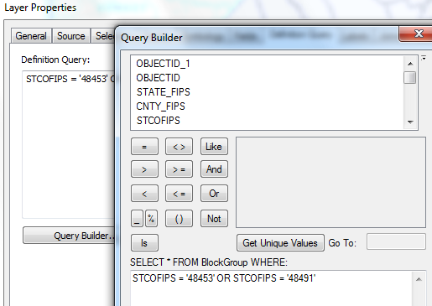
Census Block Groups for the US
http://www.caee.utexas.edu/prof/maidment/giswr2014/census/census.gdb.zip (308MB)
State
County
Tract
Block Group
Definition query to isolate Travis and Williamson Counties

Slide 10
Briefing by Census Bureau
https://www.census.gov/content/dam/Census/programs-surveys/acs/guidance/training-presentations/20180516_Geodatabase.pdf

Slide 11
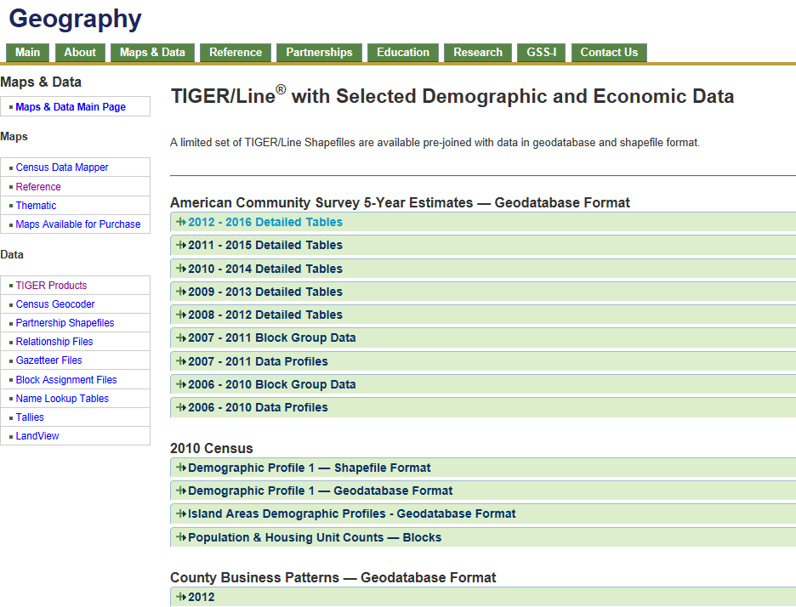
Census TIGER files
https://www.census.gov/geo/maps-data/data/tiger-data.html

Slide 12
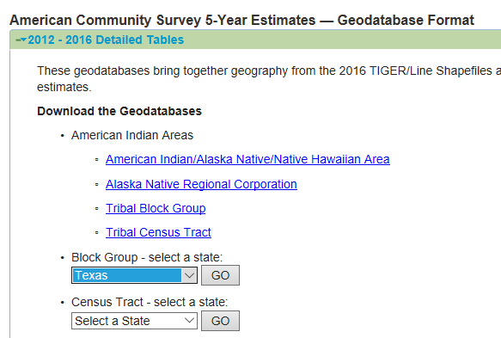
American Community Survey for Texas
5 year Survey for 2012 to 2016
Download a Geodatabase by Block Groups

Slide 13
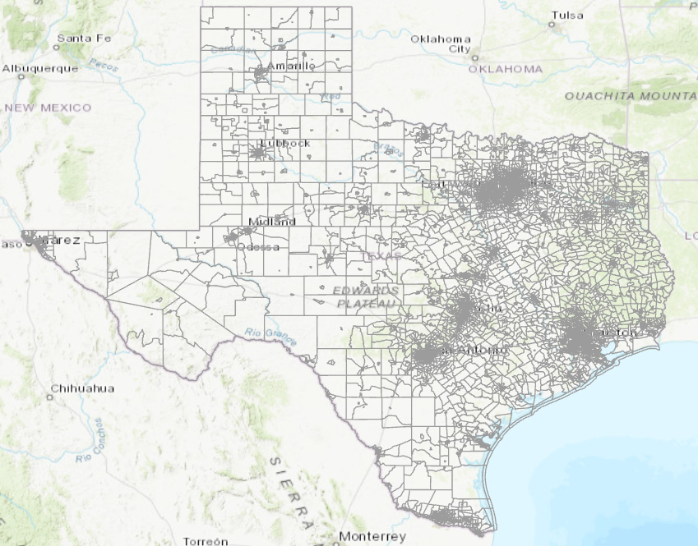
Geodatabase by Block Groups
Indexed by GEOID_Data

Slide 14
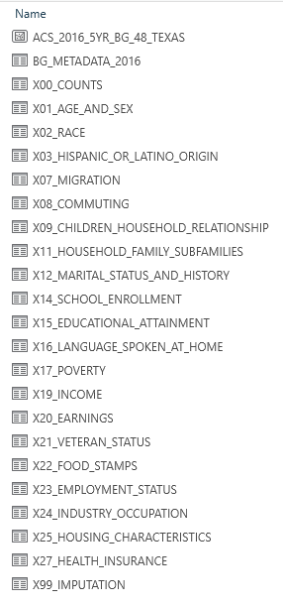
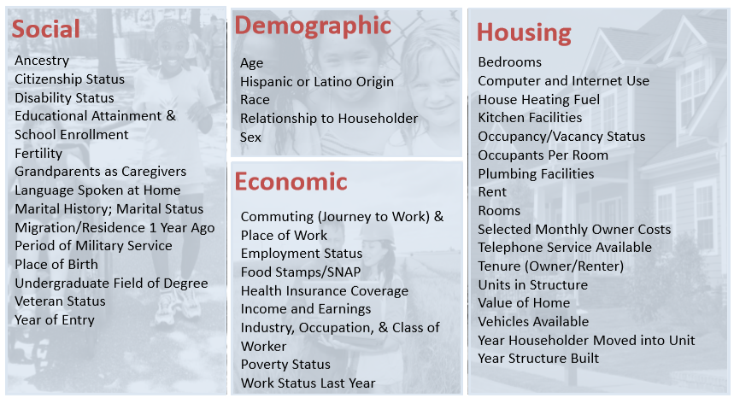
ACS Table Structure
Geospatial data for Block Groups
Metadata for table names and column headers
BG_Metadata_2016.xlsx
7731 variables in 21 tables
Attribute Tables for

Slide 15
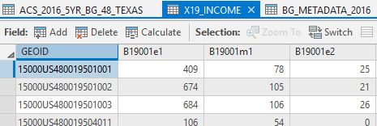
Median Household Income
e = Estimate
m = Margin of Error

Slide 16
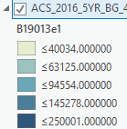
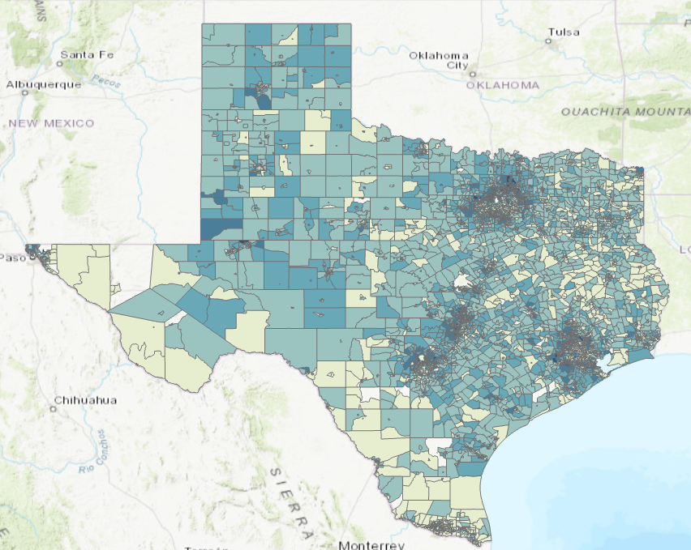
Map of Median Household Income
Join the ACS Spatial Geodatabase table (GEOID_Data) to the Income table (GEOID)
Symbolize by required attribute ( B19013e1)

Slide 17
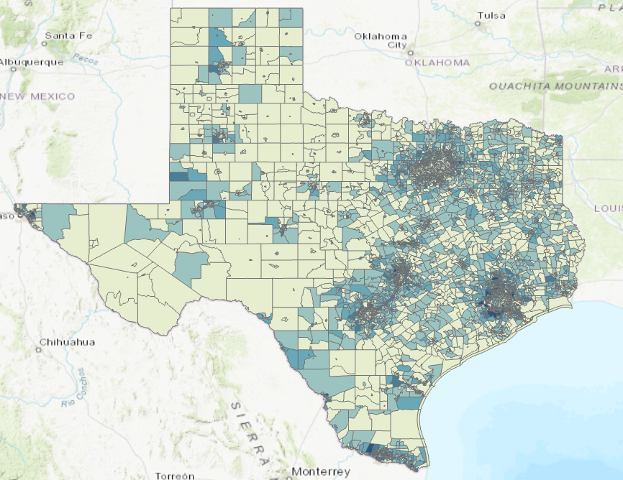
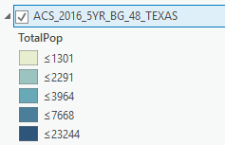
Total Population by Block Group

Slide 18
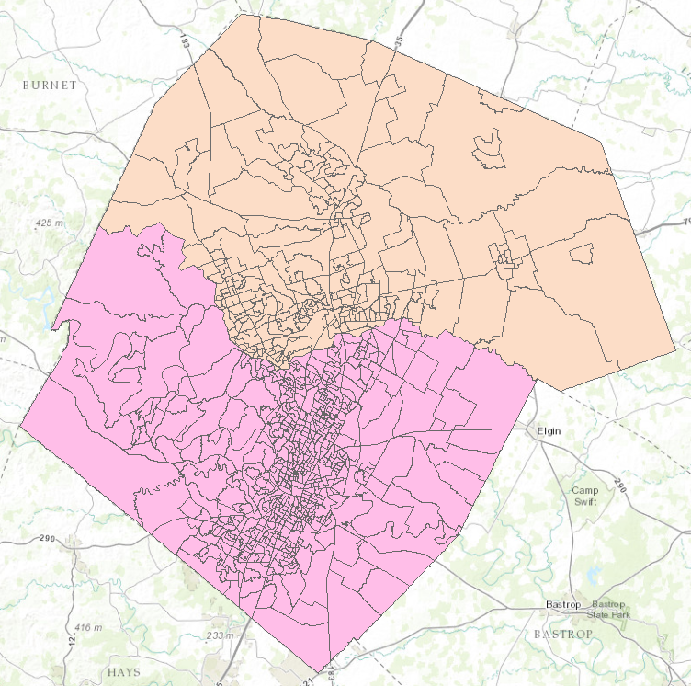
Census Block Groups in Travis and Williamson Counties
Williamson County
Travis County

Slide 19
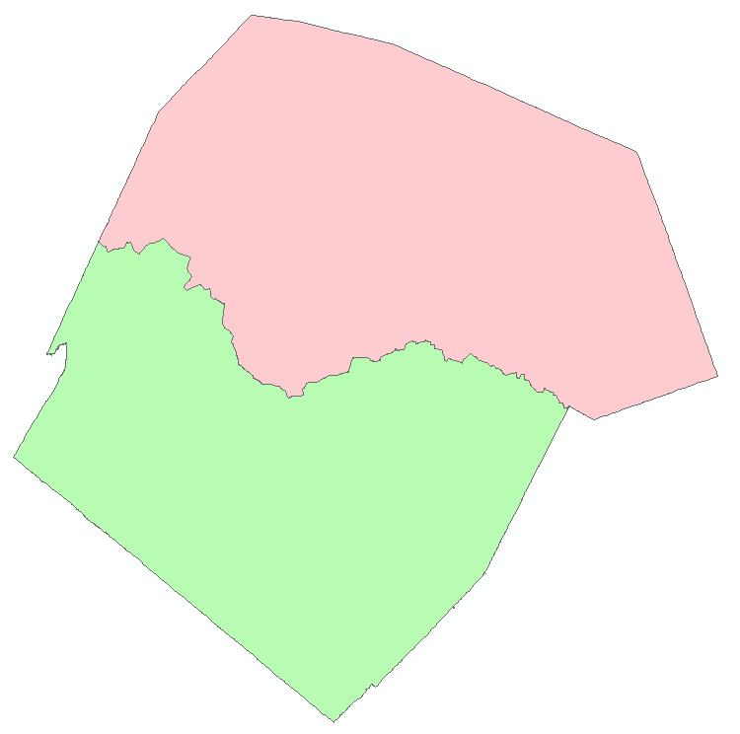
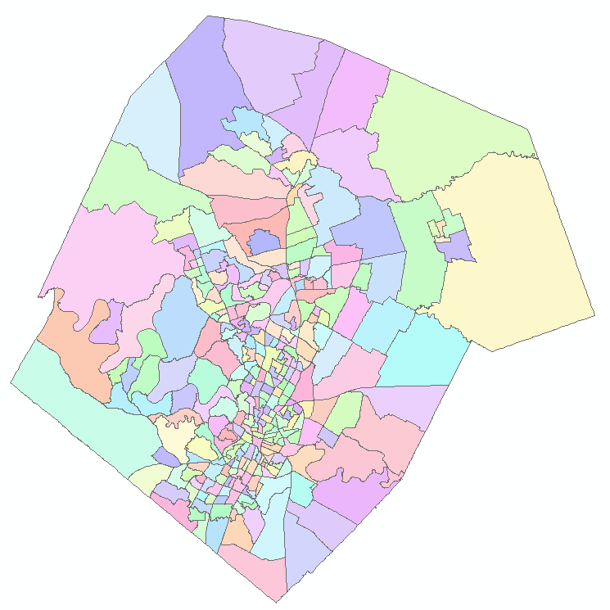
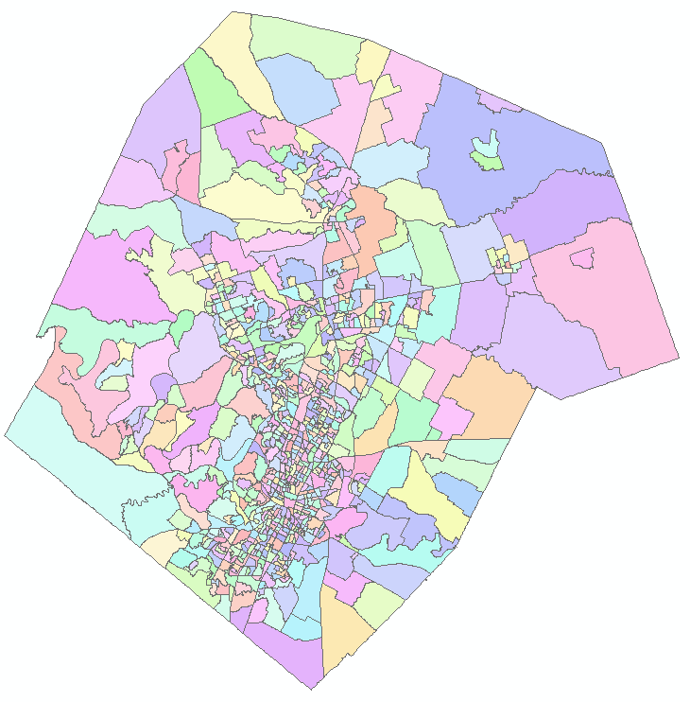
Demographic Analysis
Williamson
Travis
Two Counties
307 Tracts
823 Block Groups

Slide 20
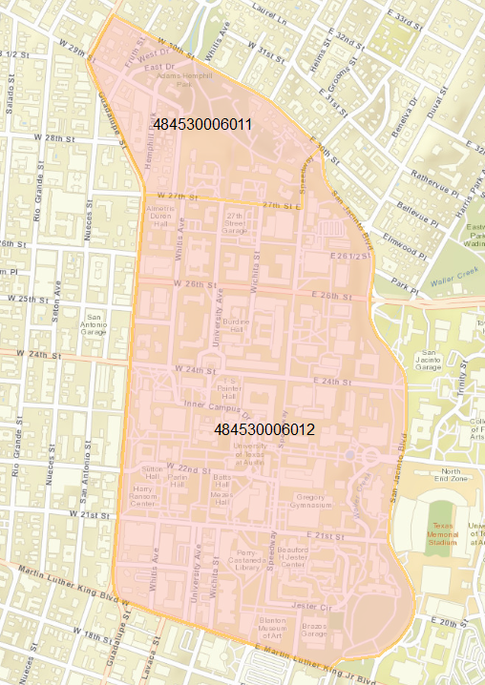
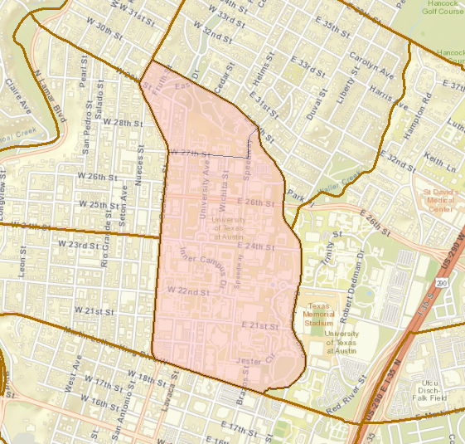
UT Demography
Census Block Groups
UT Campus
48 453 000601

Slide 21
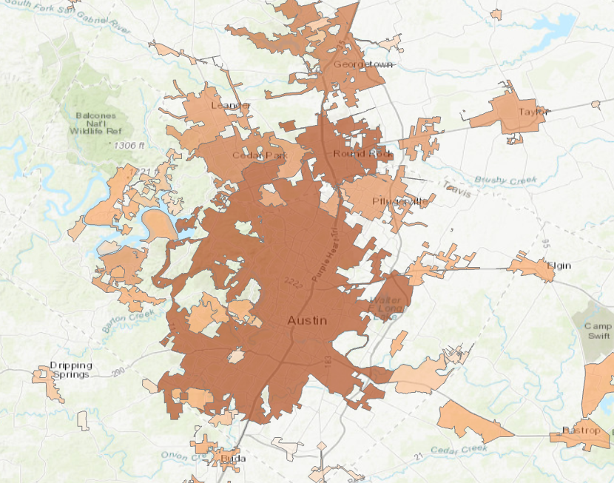
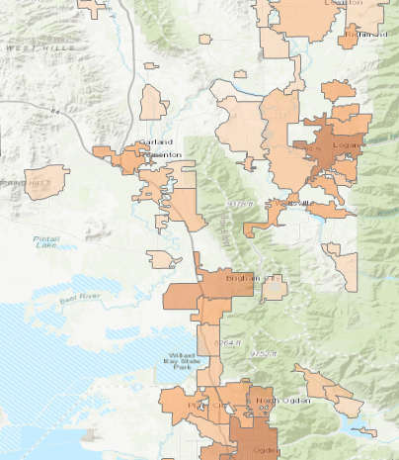
USA Census Populated Places
Logan
Austin

Slide 22
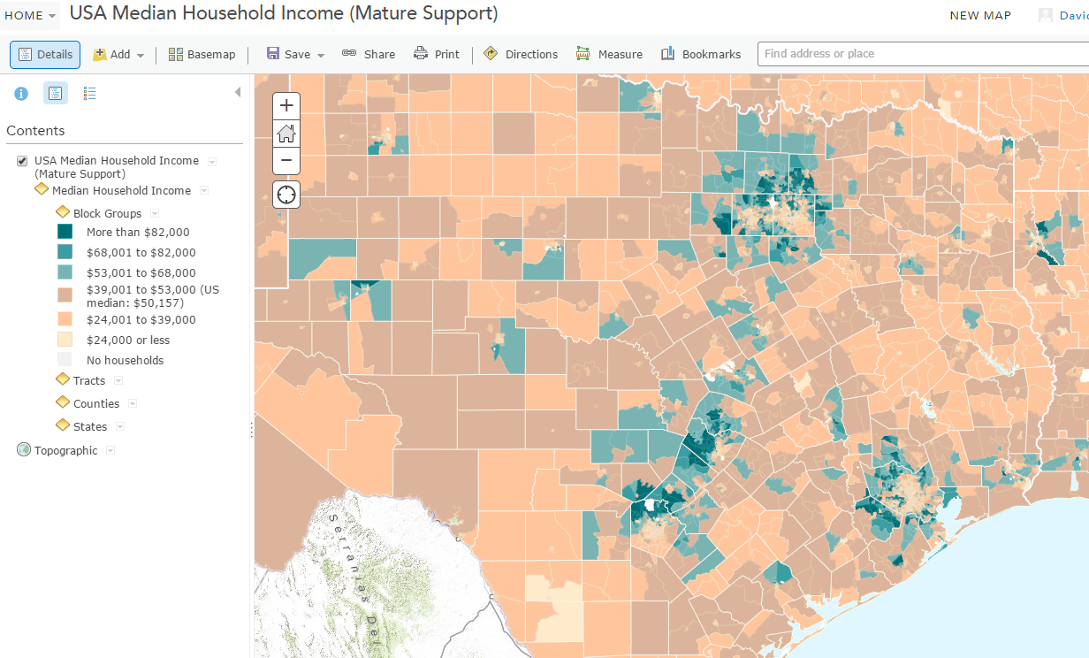
Median Household Income
https://ut-austin.maps.arcgis.com/home/webmap/viewer.html?layers=da76de09076b4959ad005e1dc2c48049

Slide 23
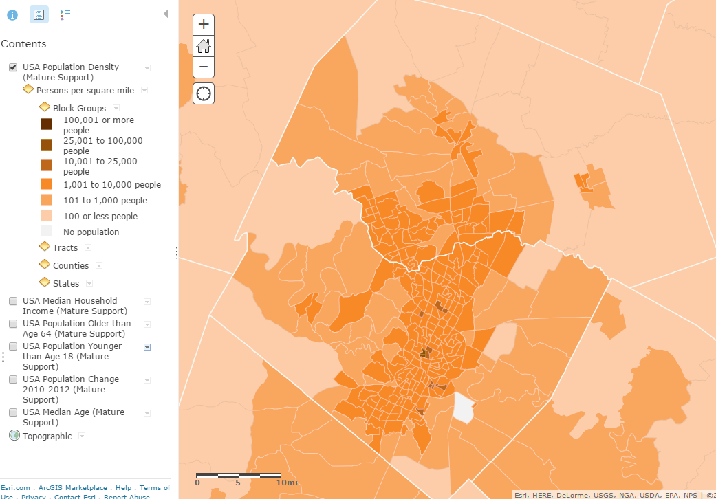
Population Density

Slide 24
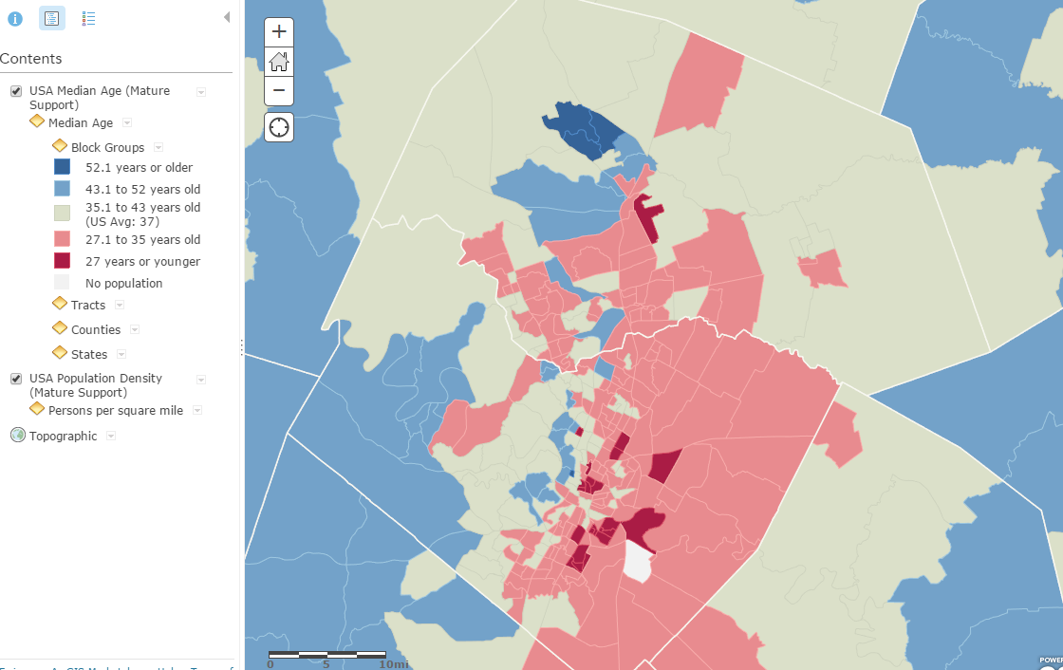
Median Age

Slide 25
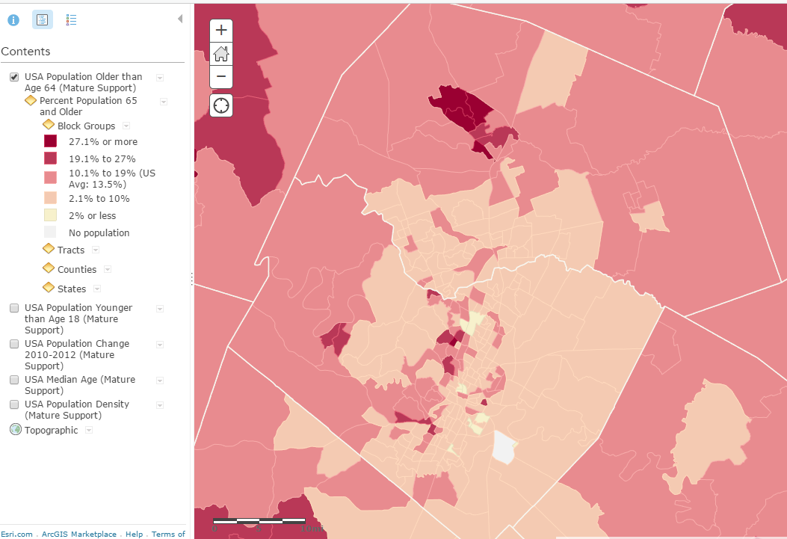
% Population 65 and older

Slide 26
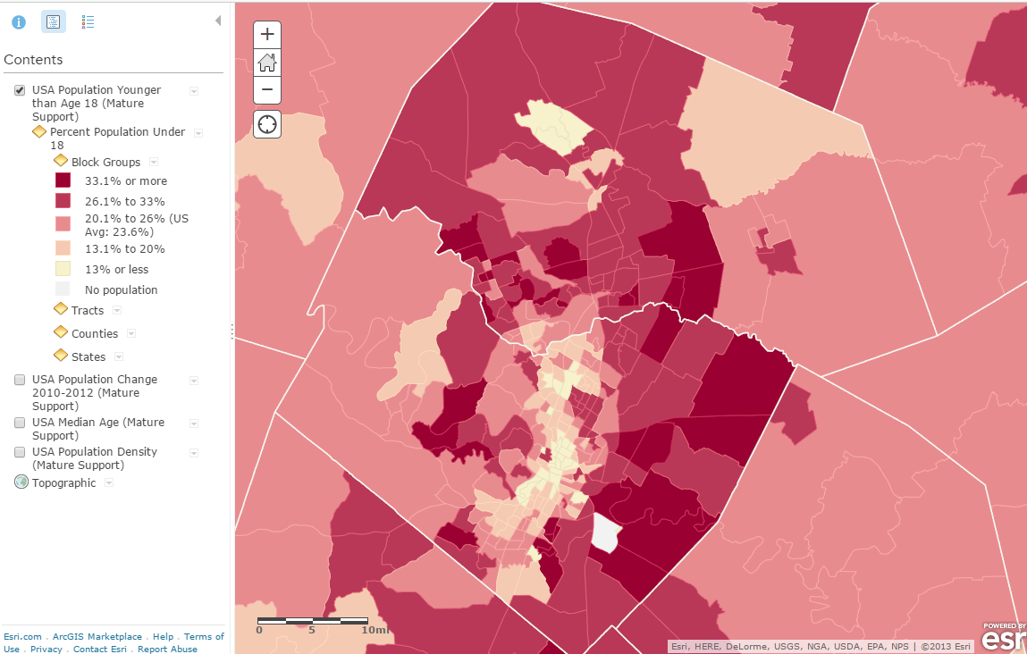
% Population under age 18

Slide 27
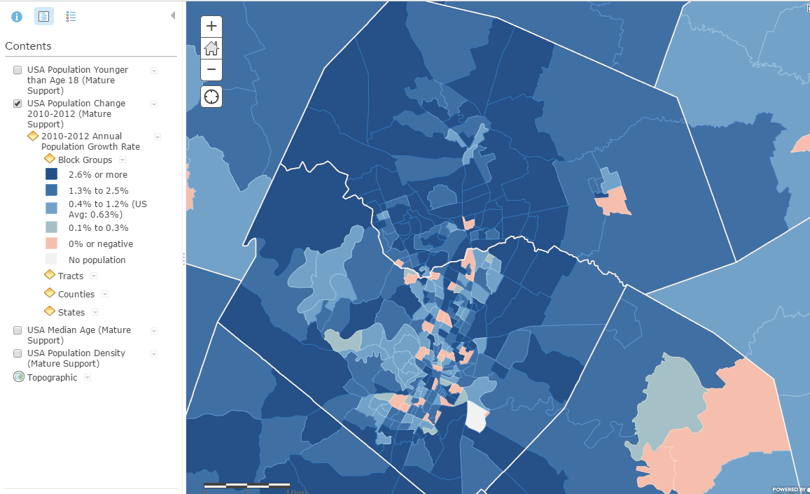
Annual Population Growth Rate

Slide 28
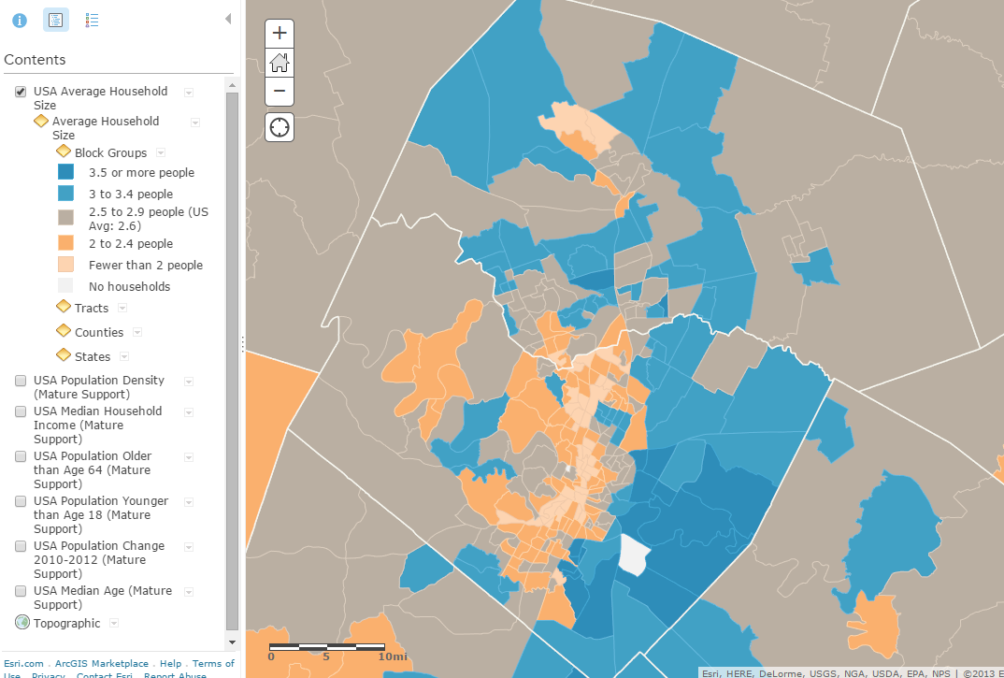
Average Household Size

Slide 29
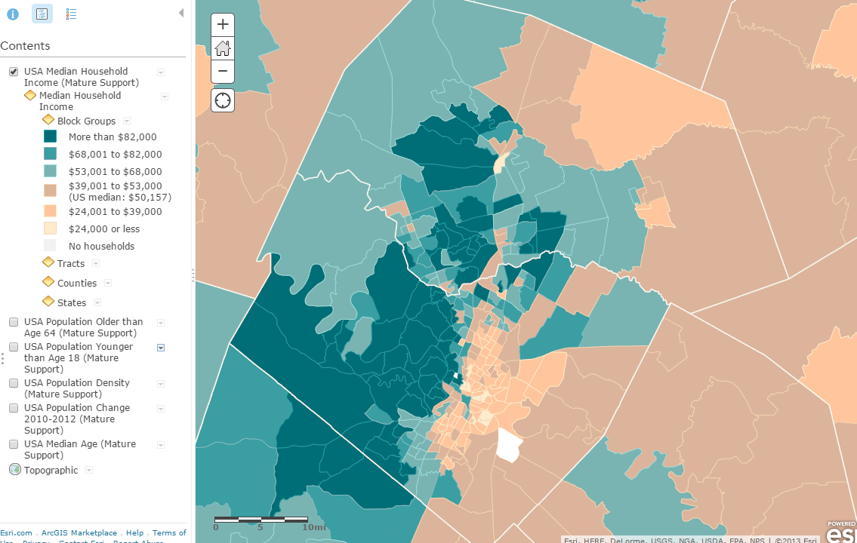
Median Household Income

Slide 30
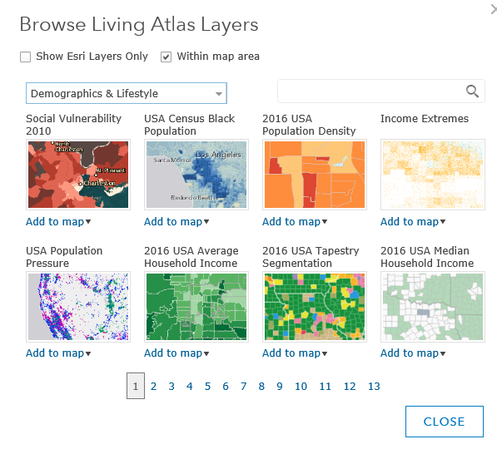
Demography in Living Atlas

Slide 31
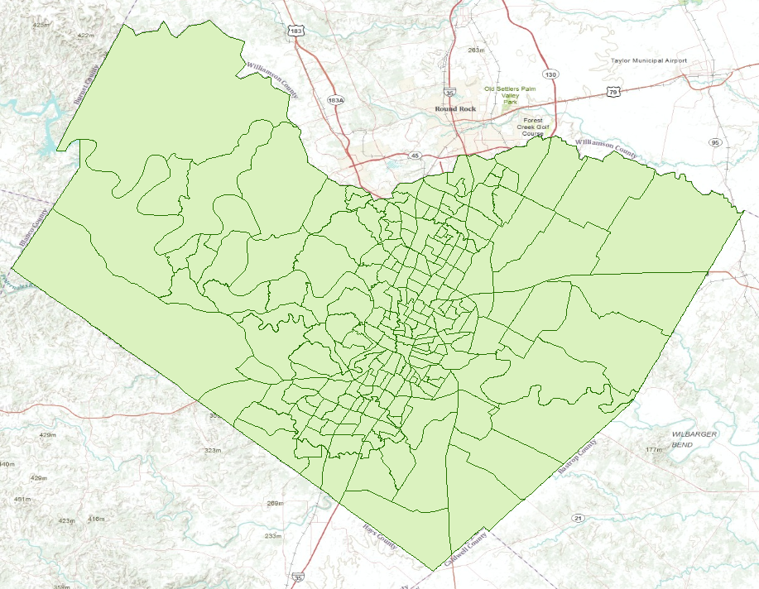
Travis County Census Tracts (218)

Slide 32
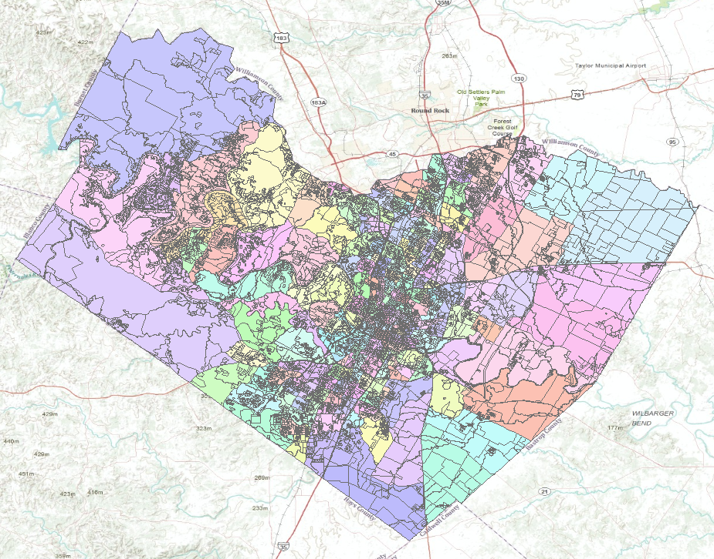
Travis County Census Blocks (15922)
Average of 73 Blocks per Tract

Slide 33
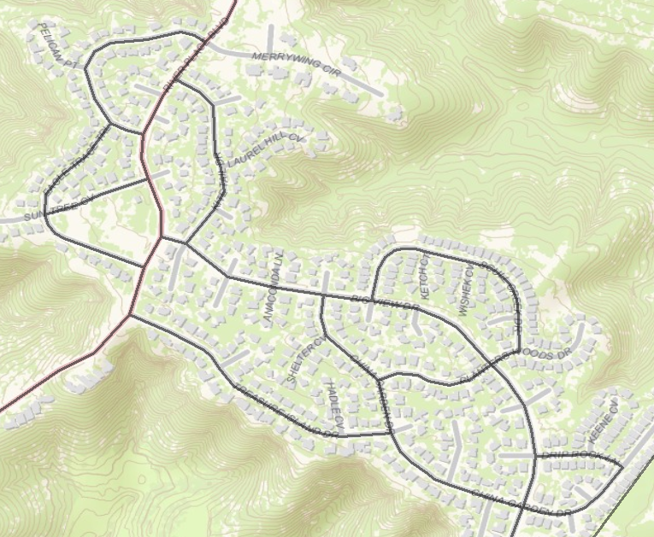
Census Blocks

Slide 34
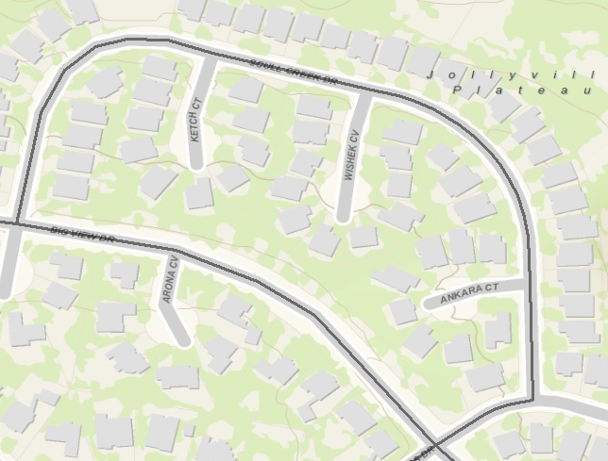
A Census Block (38 houses)
Texas
Travis

Slide 35
All the Census Blocks for a State
https://www2.census.gov/geo/tiger/TIGER2010BLKPOPHU/

Slide 36
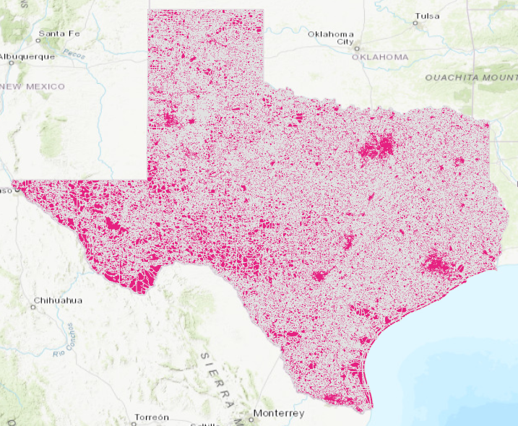
Census Blocks for Texas (914,231)

Slide 37
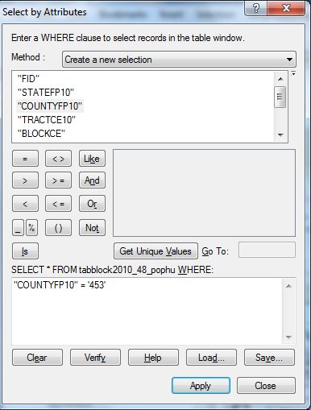
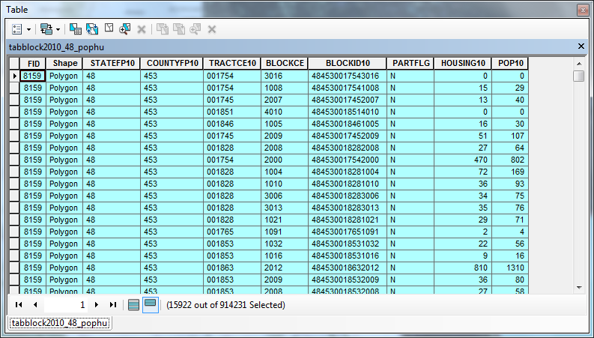
Census Blocks in Travis County

Slide 38
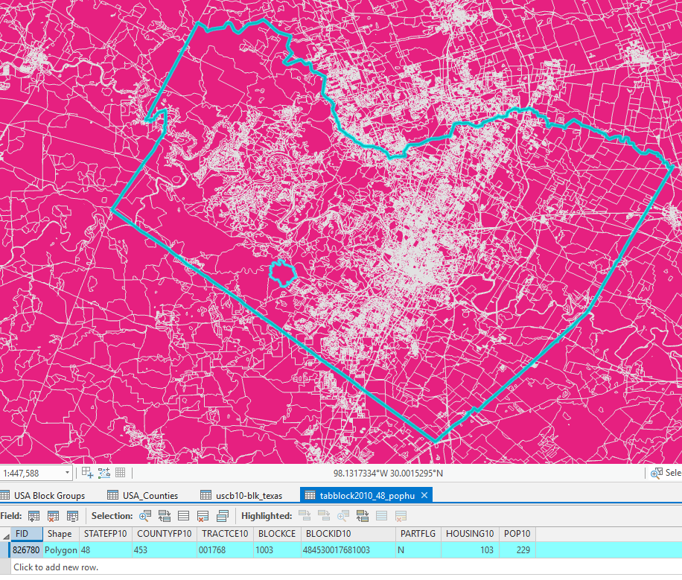
A Census Block in Travis County
State = 48 (Texas)
County = 453 (Travis)
Tract = 001768
Block = 1003
Housing Units = 103
Population = 229
In the 2010 Census

Slide 39
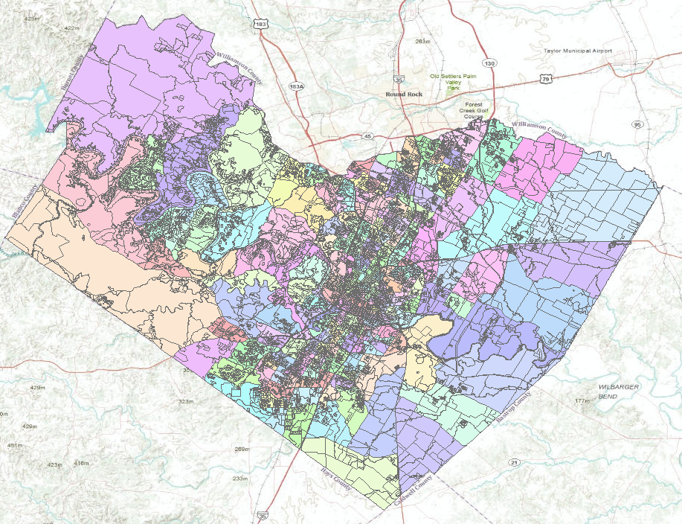
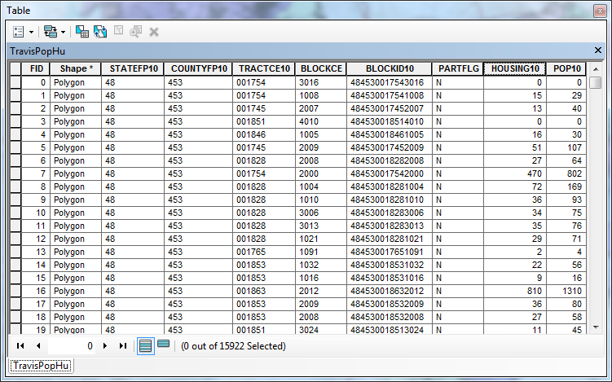
Population and Housing Units

Slide 40
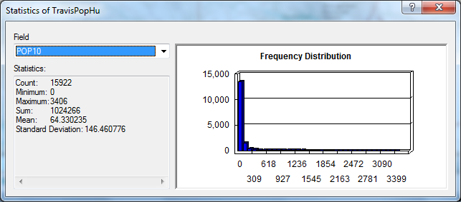
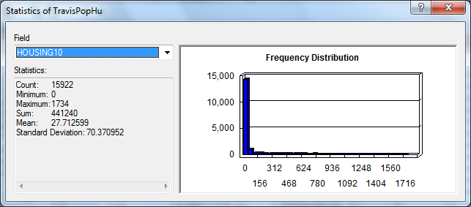
Population and Housing Units in Travis County in 2010
Population = 1,024,266
Pop/HU = 2.32
Housing Units = 441,240

Slide 41
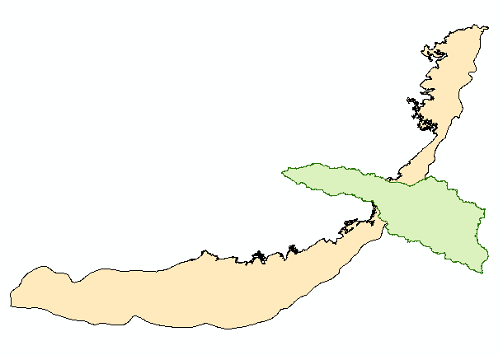
Surface and Groundwater Systems

Slide 42
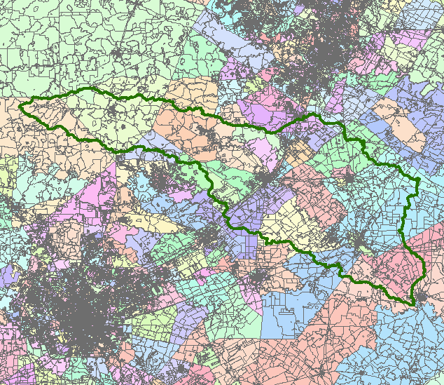
San Marcos Basin
Austin
San Antonio

Slide 43
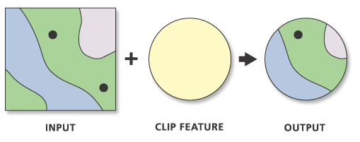
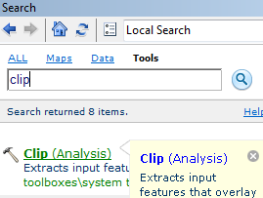
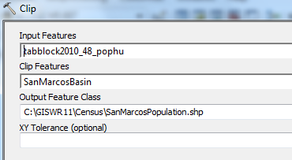
Clip Function

Slide 44
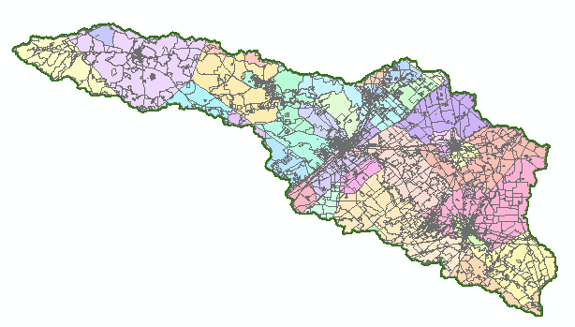
Population of the San Marcos Basin
Clip slightly overestimates
Population since it includes
all population in clipped
Polygons. Can compute
population per square mile
and then multiply by
clipped polygon area to
get better result.
Population (2010) = 179,727

Slide 45
Edwards Aquifer

Slide 46
Population Living Over the Edwards Aquifer
Population (2010) = 2,352,709
Small Tracts in High Population Areas
Large Tracts in Low Population Areas

Slide 47
Demography Summary
Demographic data are compiled by Counties
Counties contain Census Tracts
Tracts contain Census Block Groups
Block Groups contain Census Blocks
American Community Survey data are compiled by Census Block Groups – a continually functioning sample of economic and population info
Population Census is done once every 10 years by Census Blocks – a complete enumeration of population and household units
Sources for map info:
https://www.census.gov/geo/maps-data/data/tiger-data.html
https://www2.census.gov/geo/tiger/TIGER2010BLKPOPHU/

