Slide 1
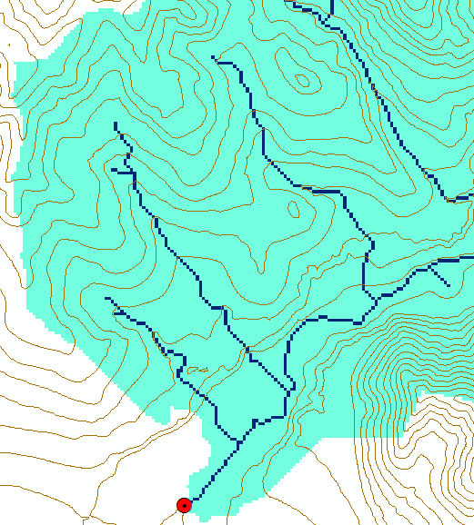
Extended Hydrologic Terrain Analysis
Establishing the terrain flow analysis framework
Hydrologic Terrain Analysis Software
Channelization threshold?
Geomorphology
Dinfinity
Generalized flow accumulation
Height above the nearest drainage (HAND)

Slide 2
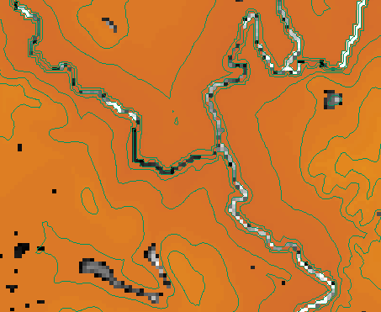
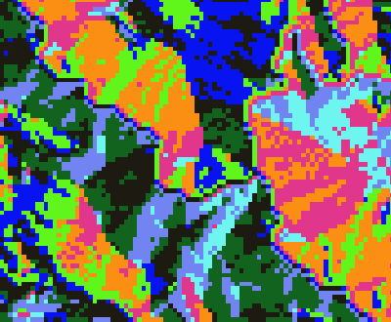
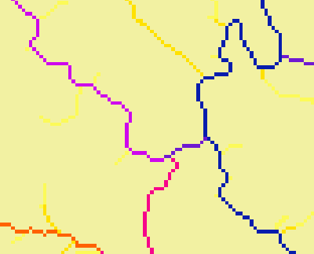
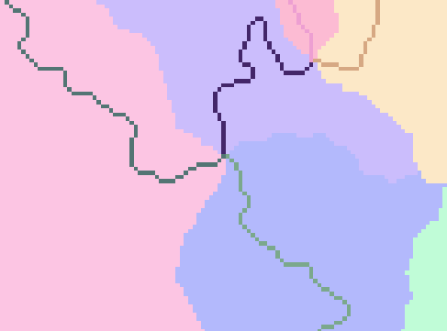
Terrain Flow Analysis Framework
Conditioned DEM (Fill)
Flow Direction
Flow Accumulation
Stream Definition
Stream Links
Catchments

Slide 3
A Hydrologically Conditioned Digital Elevation Model (DEM) is one where there is a non increasing flow path from each grid cell to the outlet or edge of the domain

Slide 4
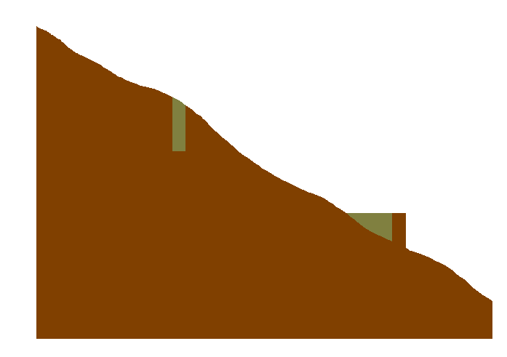
Conditioning the DEM - Pit Filling
Increase elevation until the pit drains to a neighbor and ultimately out of the domain
Original DEM
Pits Filled
Pits
Grid cells or zones completely surrounded by higher terrain

Slide 5
Using Vector Stream Information
“Burning In” the Streams
• Take a mapped stream network and a DEM
• Make a grid of the streams
• Raise the off-stream DEM cells by an arbitrary elevation
increment
• Produces "burned in" DEM streams = mapped streams
+
=

Slide 6
AGREE Elevation Grid Modification Methodology – DEM Reconditioning

Slide 7
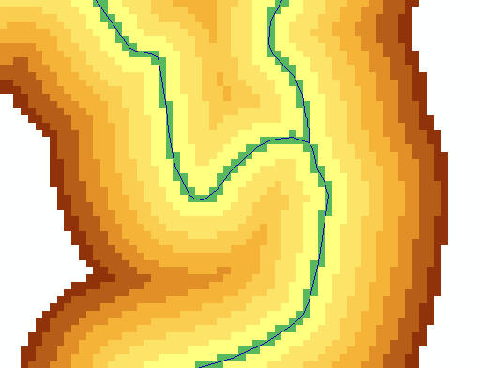
AGREE Implemented using Raster Calculator
Convert stream vector to raster
Distance
Raster Calculation
Subtract 10 at all stream grid cells
“dem" - 10 * “streamraster" - 0.02 * (500 - "distance") * ("distance" < 500)
500
500
Subtract an amount that tapers from 0.02*500=10 when distance is 0, to 0 when distance is 500 from stream
Only do taper when distance is less than 500, otherwise this is 0 and nothing is subtracted
10
10

Slide 8
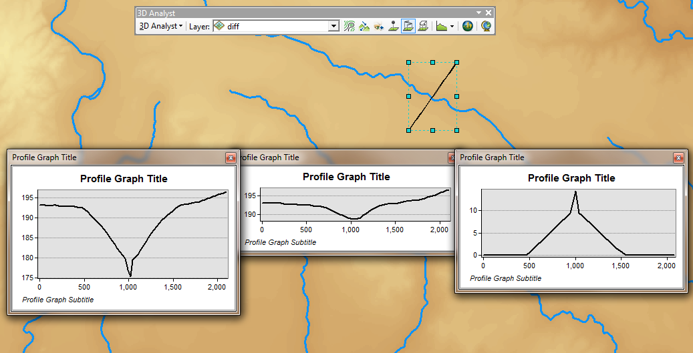
Profiles
(using 3D Analyst)
Original DEM
Difference
Conditioned DEM

Slide 9


Conditioning the DEM - Carving
Lower elevation of neighbor along a predefined drainage path until the pit drains to the outlet point

Slide 10
Carving
Original DEM
Carved DEM
Pits
Carve outlets
Notes:
Elevations are filled to that of the pools pour point

Slide 11
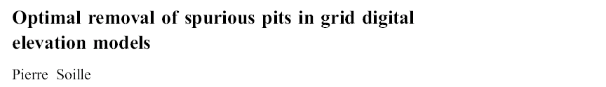
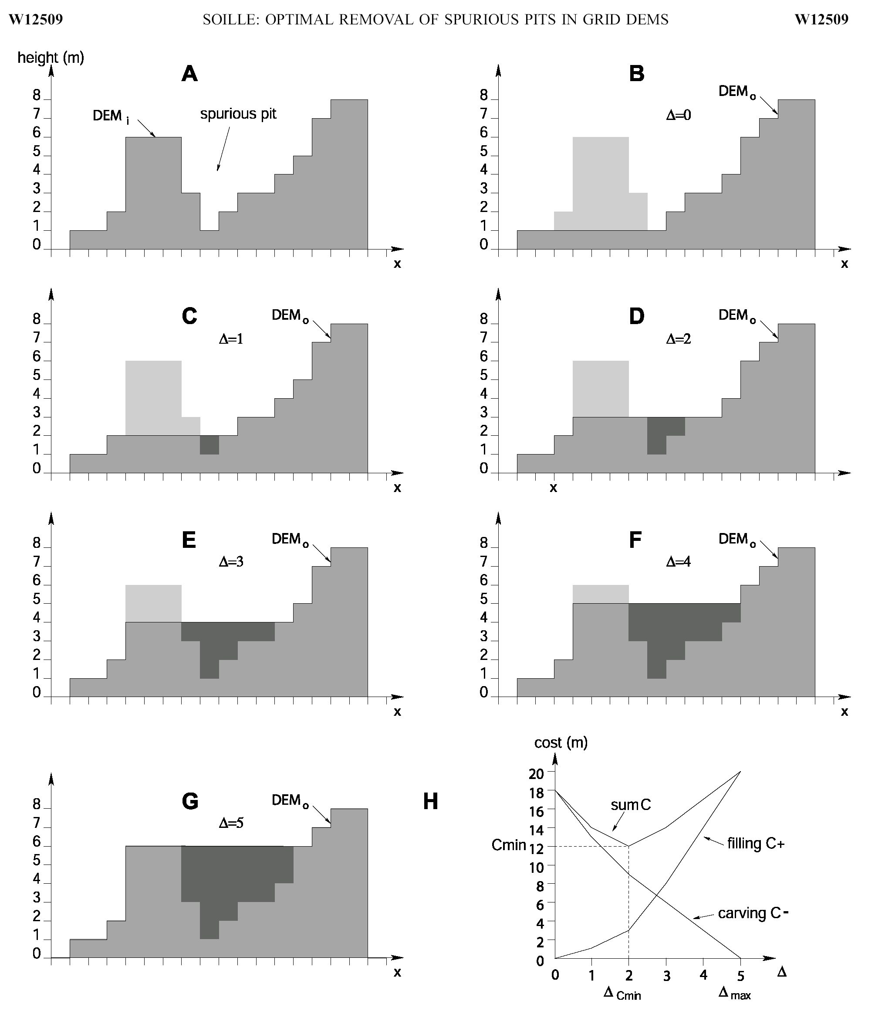
Filling
Minimizing Alterations
Carving

Slide 12
Minimizing DEM Alterations
Original DEM
Optimally adjusted
Carved
Pits
Filled
Notes:
Elevations are filled to that of the pools pour point

Slide 13
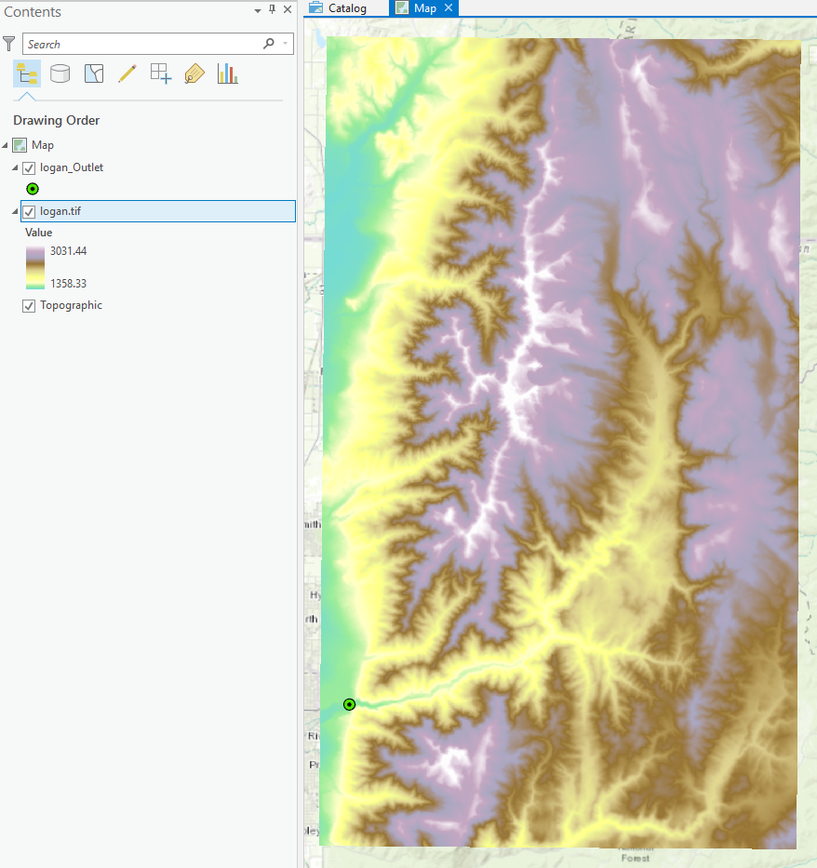
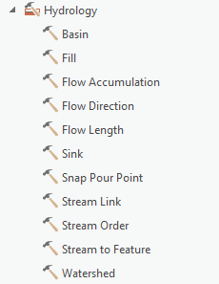
Key Watershed Delineation Processing Steps
[DEM Reconditioning]
Pit Removal (Fill Sinks)
Flow Direction
Flow Accumulation
Stream Definition
Stream Segmentation
Catchment Grid Delineation
Raster to Vector Conversion (Catchment Polygon, Drainage Line, Catchment Outlet Points)

Slide 14
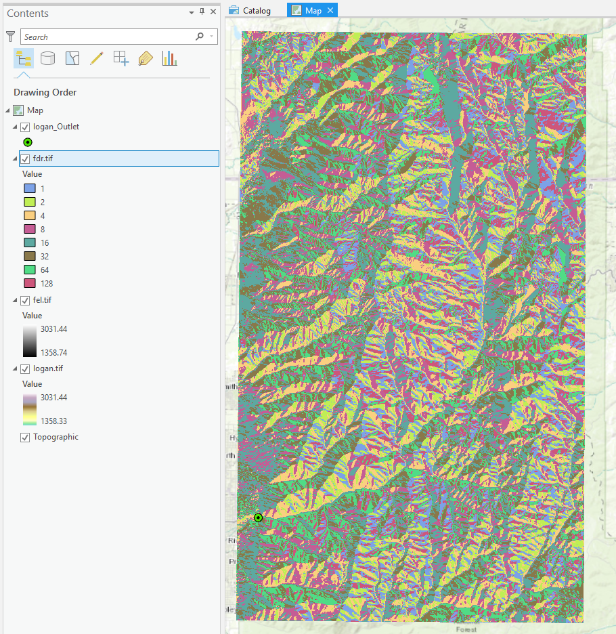
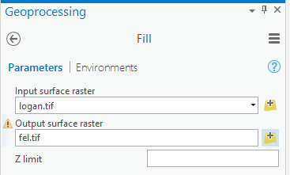
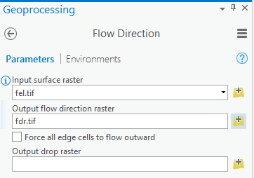
Fill and Flow Direction
1
2
32
64
128
16
1
8
4
2

Slide 15
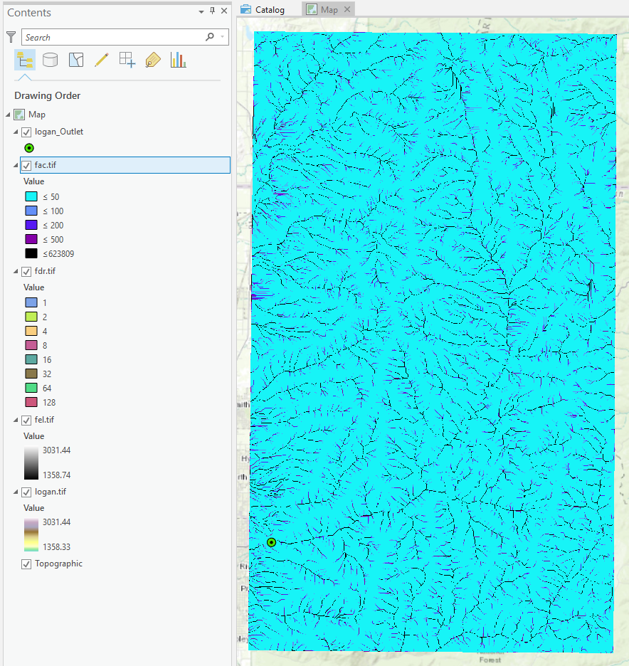
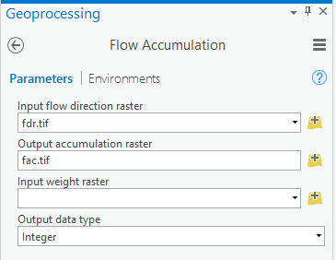
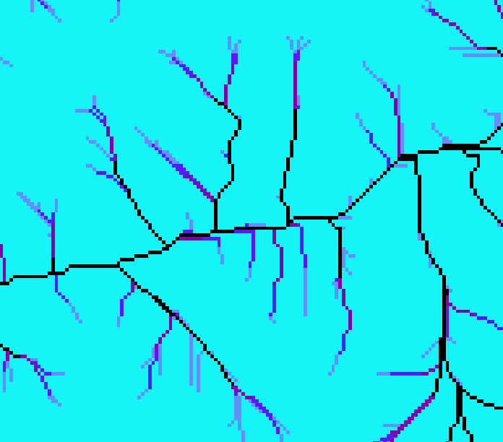
Flow Accumulation
3

Slide 16
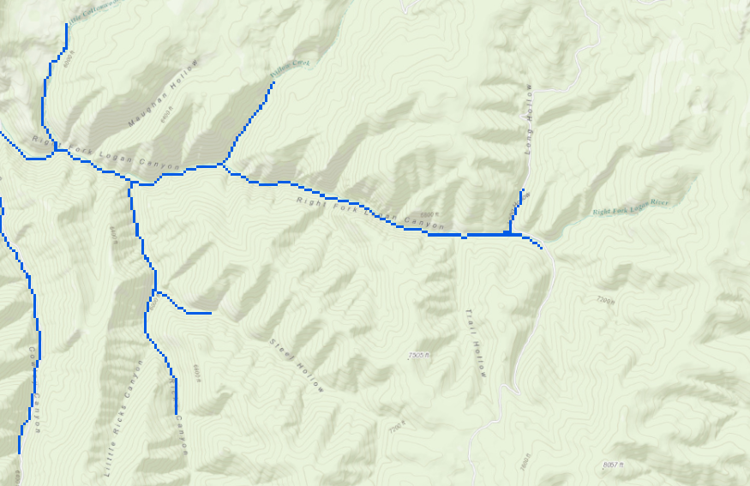

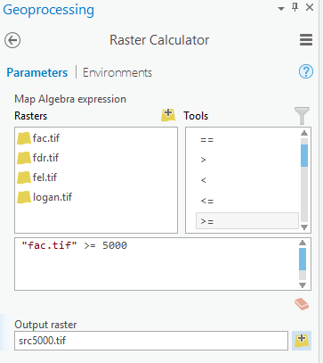
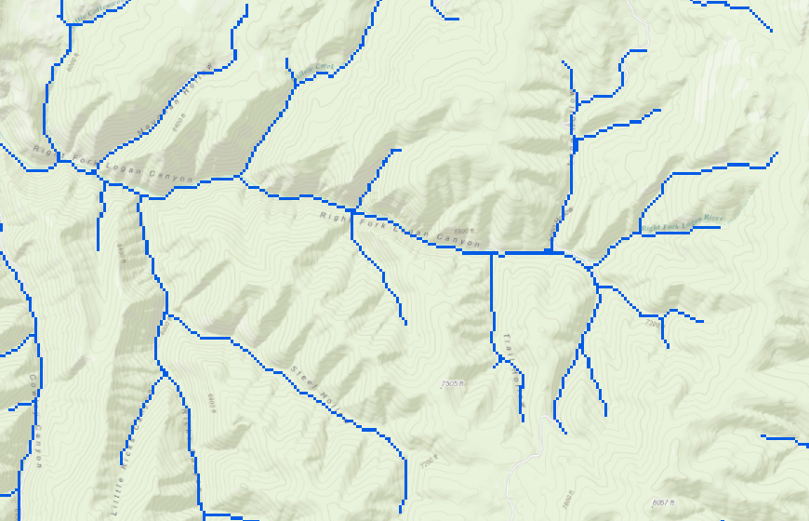
Stream definition by theshold
5000
4
500

Slide 17
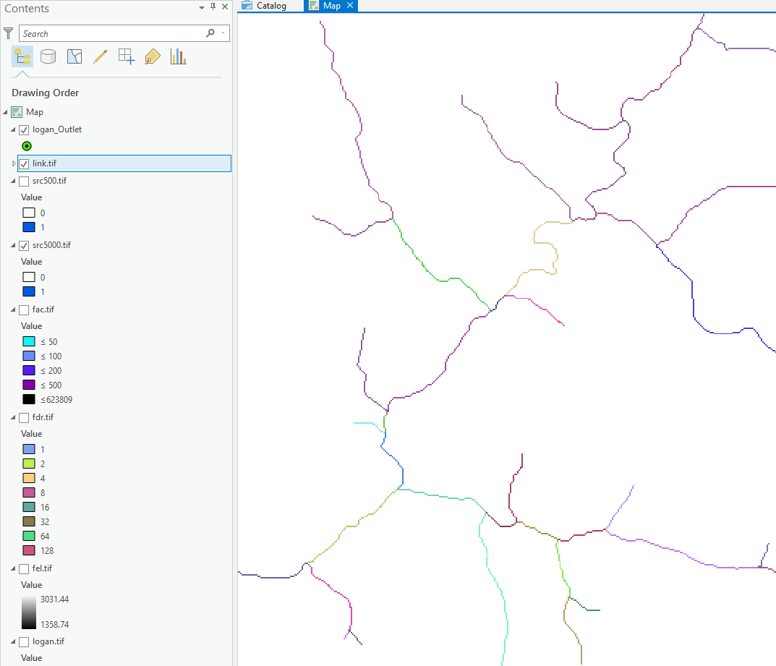
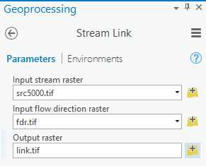
Stream Segmentation
5

Slide 18
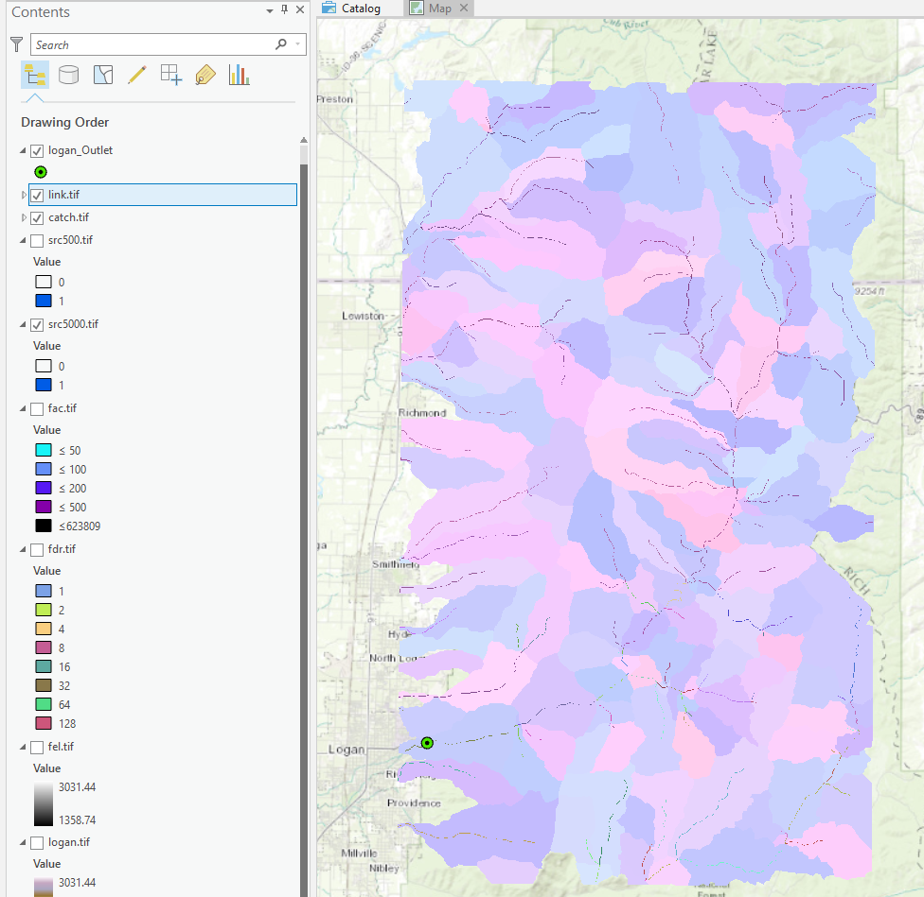
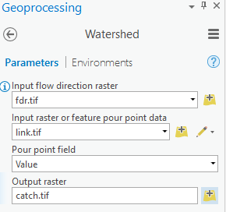
Catchment Delineation
6

Slide 19
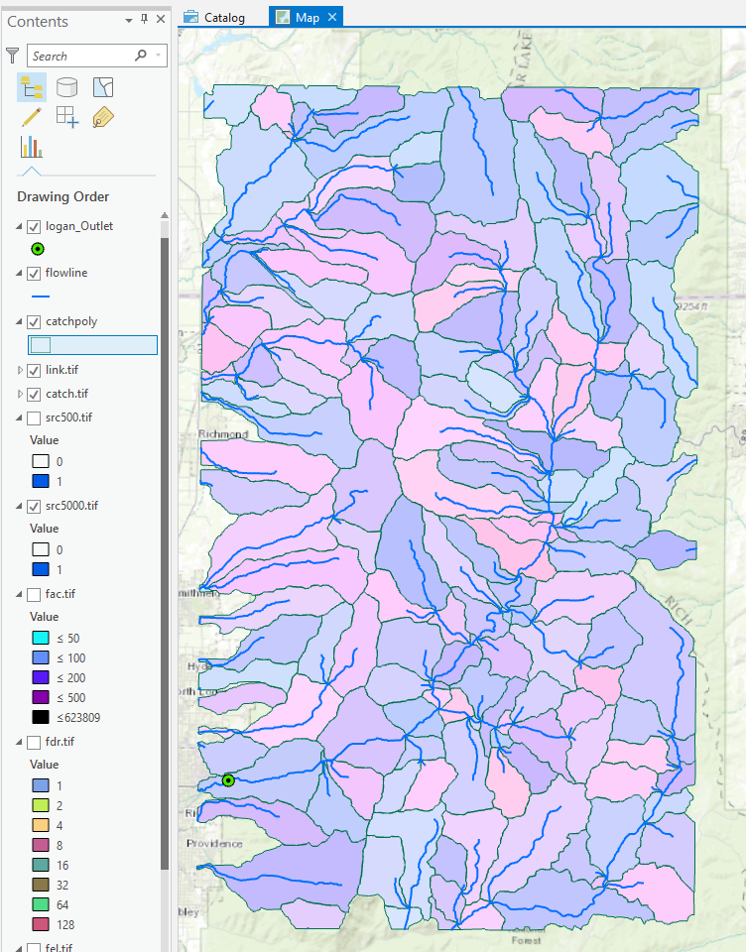
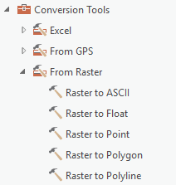
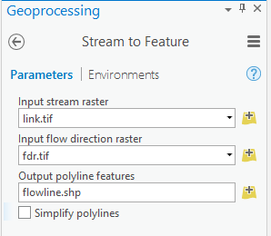
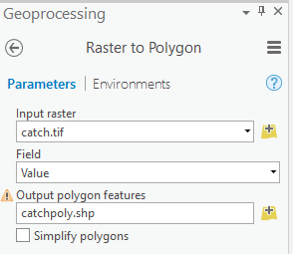
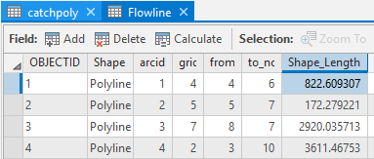
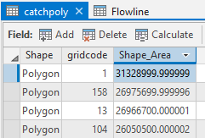
Conversion to Vector
8
7

Slide 20
Hydrologic Terrain Analysis Software
ArcGIS Portal ready to use tools
ArcGIS Hydrology Tools
ArcHydro
TauDEM
[RiverTools]
[GRASS]

Slide 21
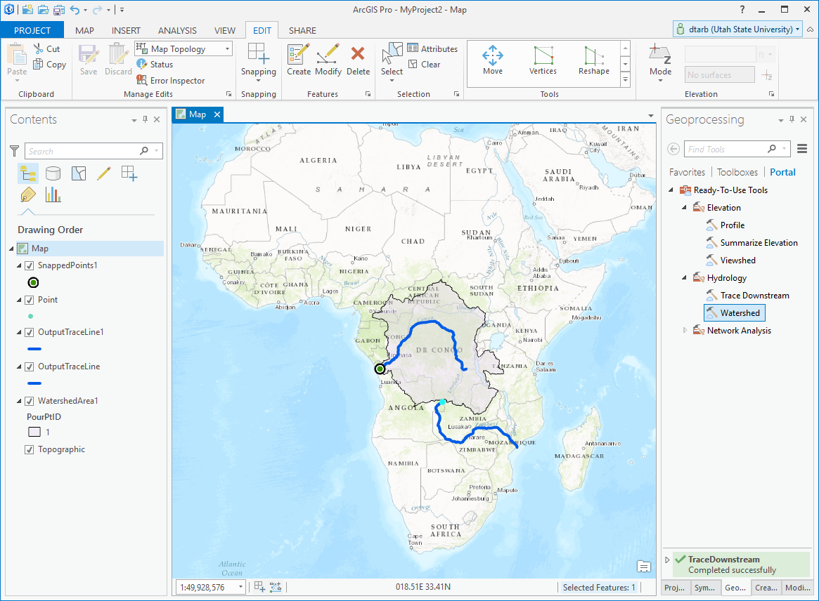
ArcGIS Pro Ready to Use Tools

Slide 22
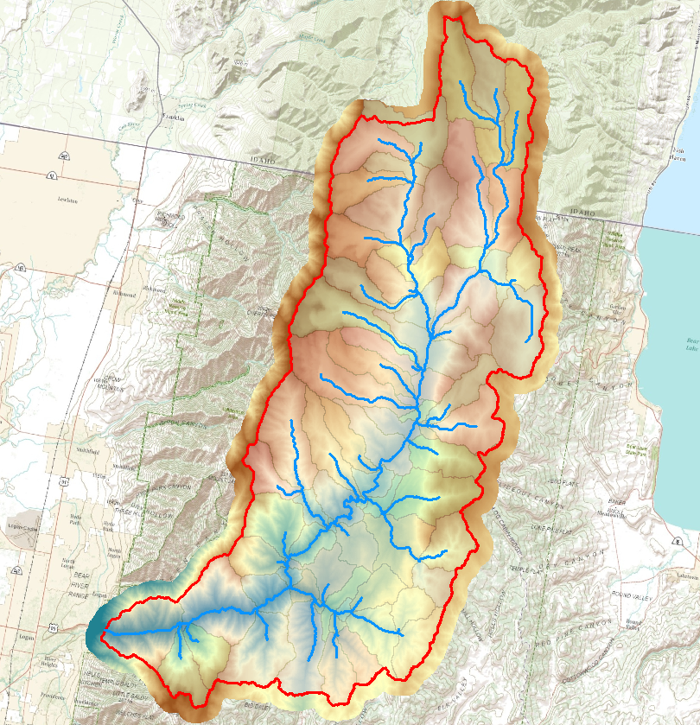
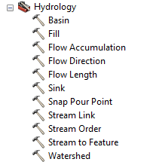
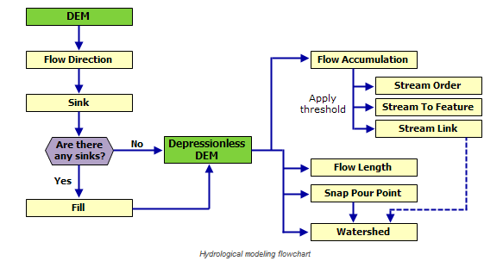
ArcGIS Hydrology Toolset

Slide 23
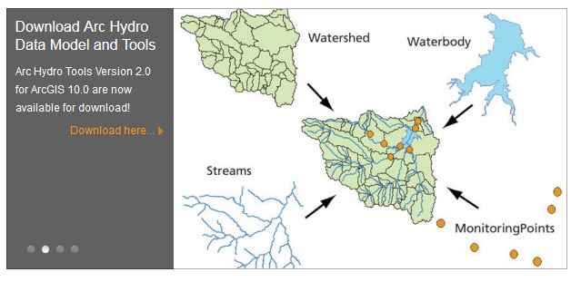
ArcHydro
http://resources.arcgis.com/en/communities/hydro/

Slide 24
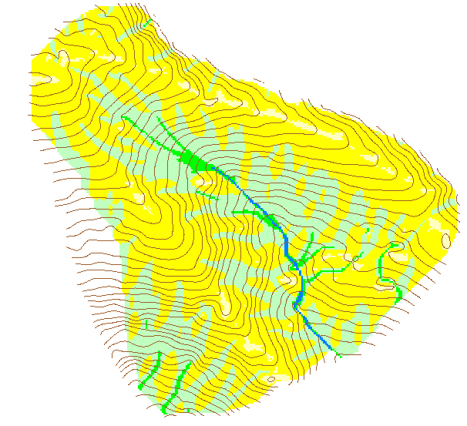
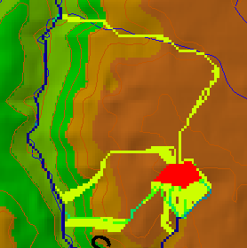
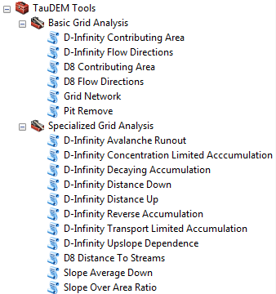
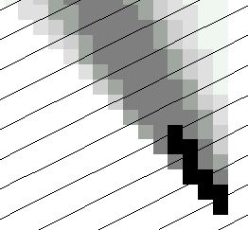
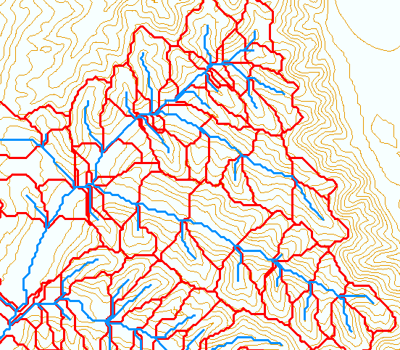
TauDEM
Stream and watershed delineation
Multiple flow direction flow field
Calculation of flow based derivative surfaces
MPI Parallel Implementation for speed up and large problems
Open source platform independent C++ command line executables for each function
Deployed as an ArcGIS Toolbox with python scripts that drive command line executables
CSDMS Cluster Implementation
Open Topography implementation
CyberGIS Implementation
http://hydrology.usu.edu/taudem/

Slide 25
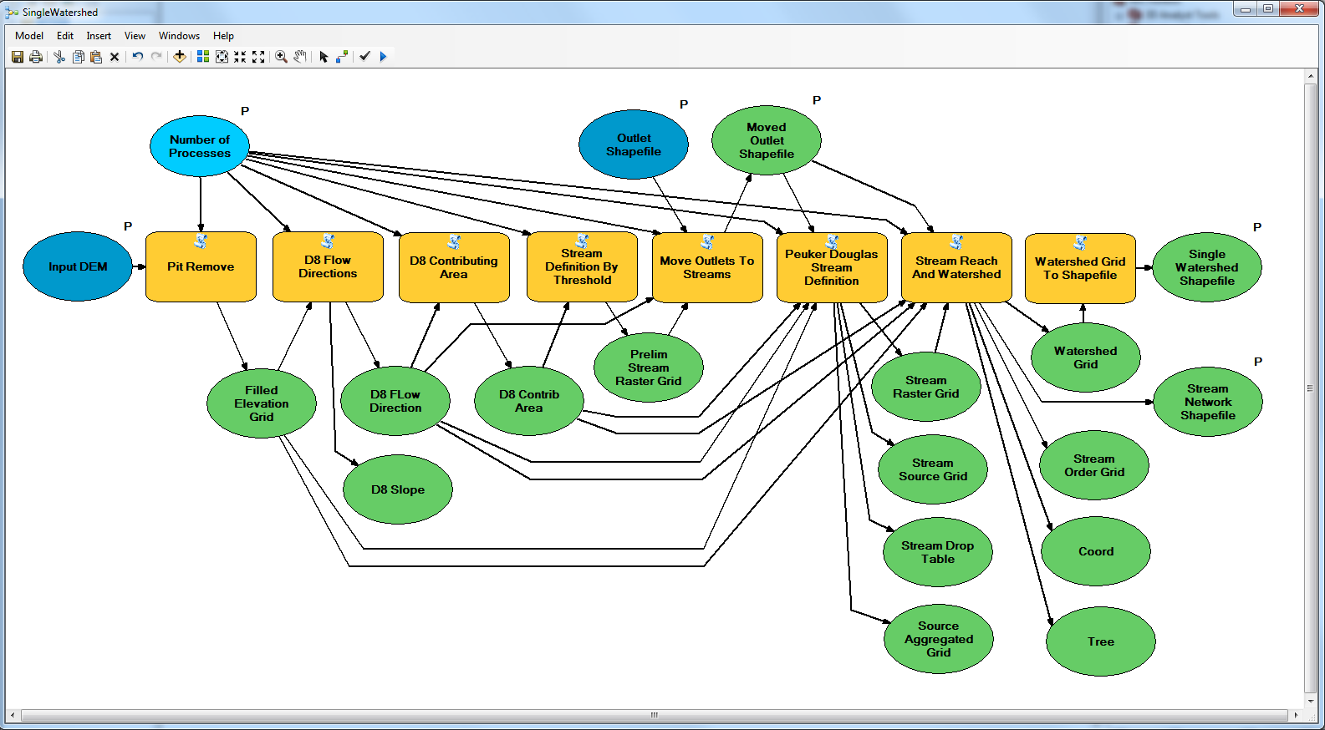
Workflow to automatically generate stream network upstream of outlet

Slide 26
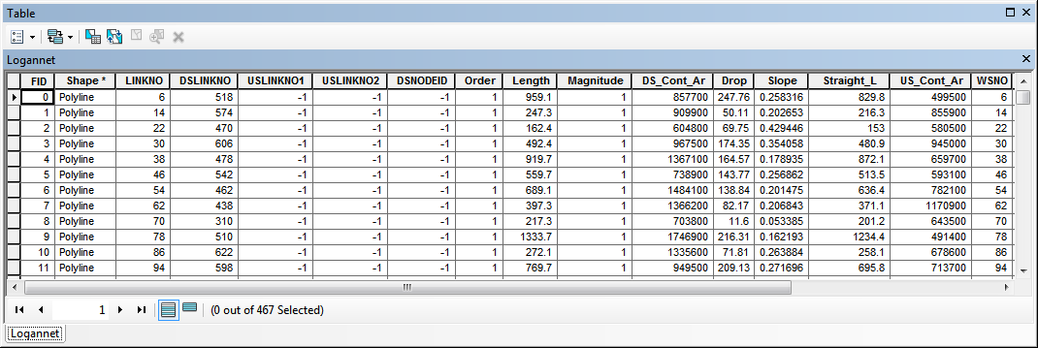
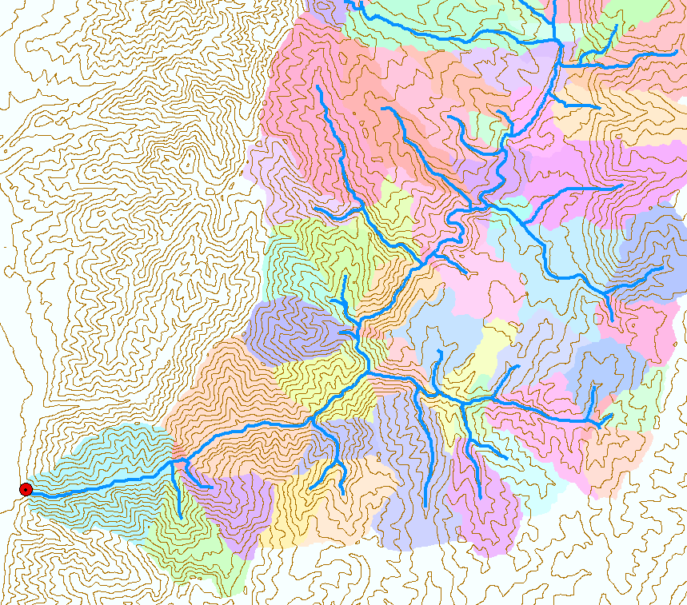
Catchments linked to Stream Network
The starting point for catchment based distributed hydrologic modeling

Slide 27
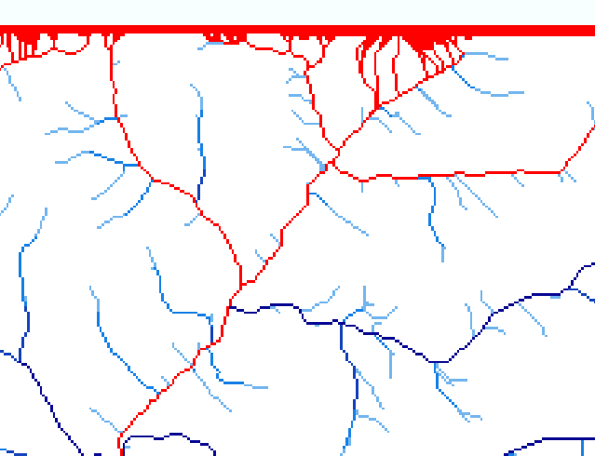
Edge contamination
Edge contamination arises when a contributing area value depends on grid cells outside of the domain. This occurs when drainage is inwards from the boundaries or areas with no data values. The algorithm recognizes this and reports "no data" resulting in streaks of "no data" values extending inwards from boundaries along flow paths that enter the domain at a boundary.

Slide 28
How to decide on stream delineation threshold ?
AREA 2
3
AREA 1
12
Why is it important?

Slide 29
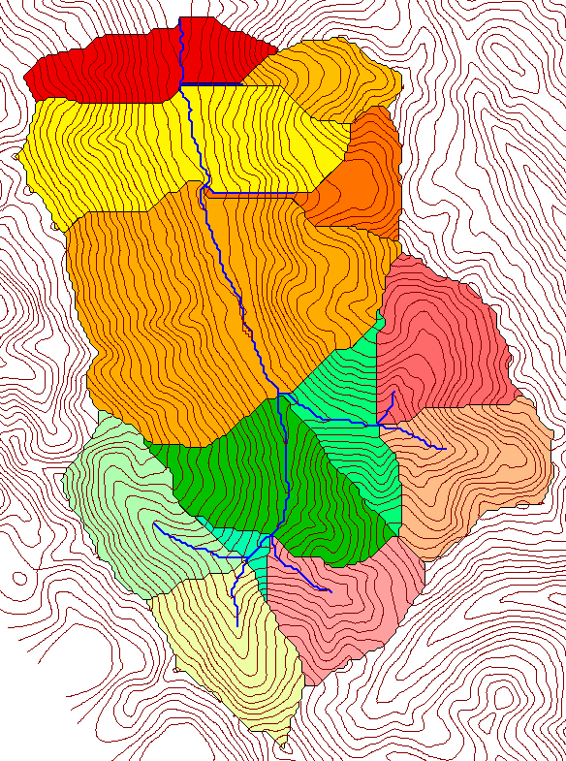
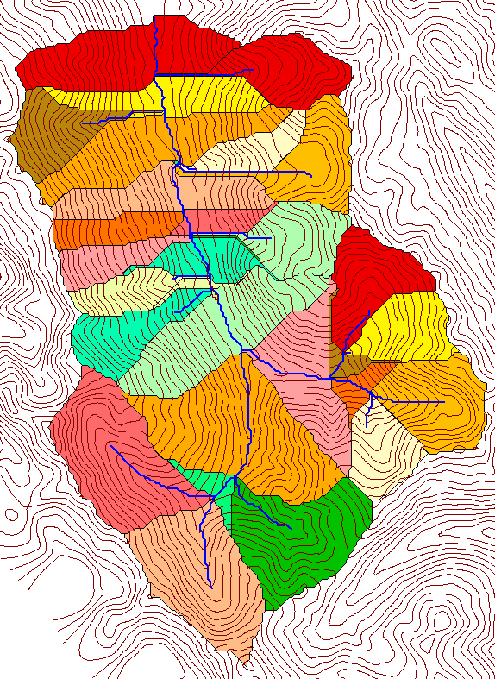
Delineation of Channel Networks and Catchments
500 cell theshold
1000 cell theshold

Slide 30
Hydrologic processes are different on hillslopes and in channels. It is important to recognize this and account for this in the delineation of streams.
Drainage area can be concentrated or dispersed (specific catchment area) representing concentrated or dispersed flow.

Slide 31
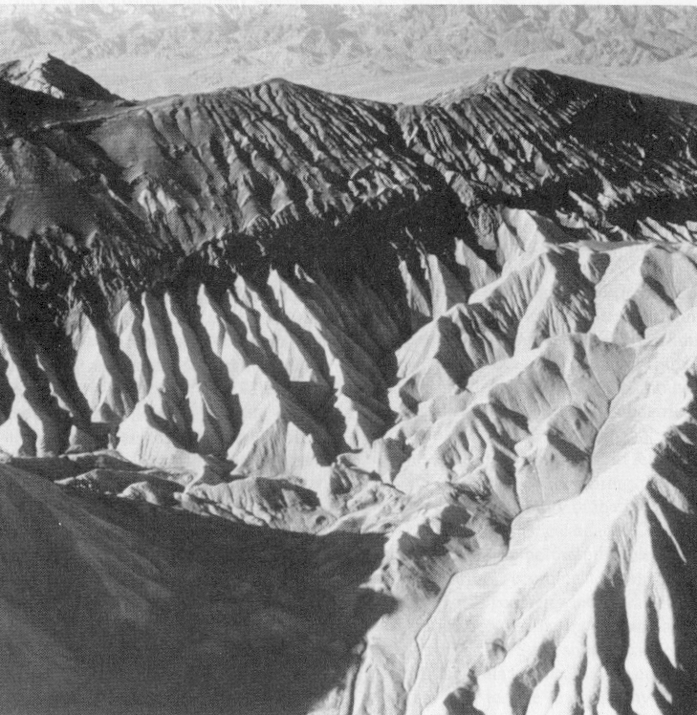
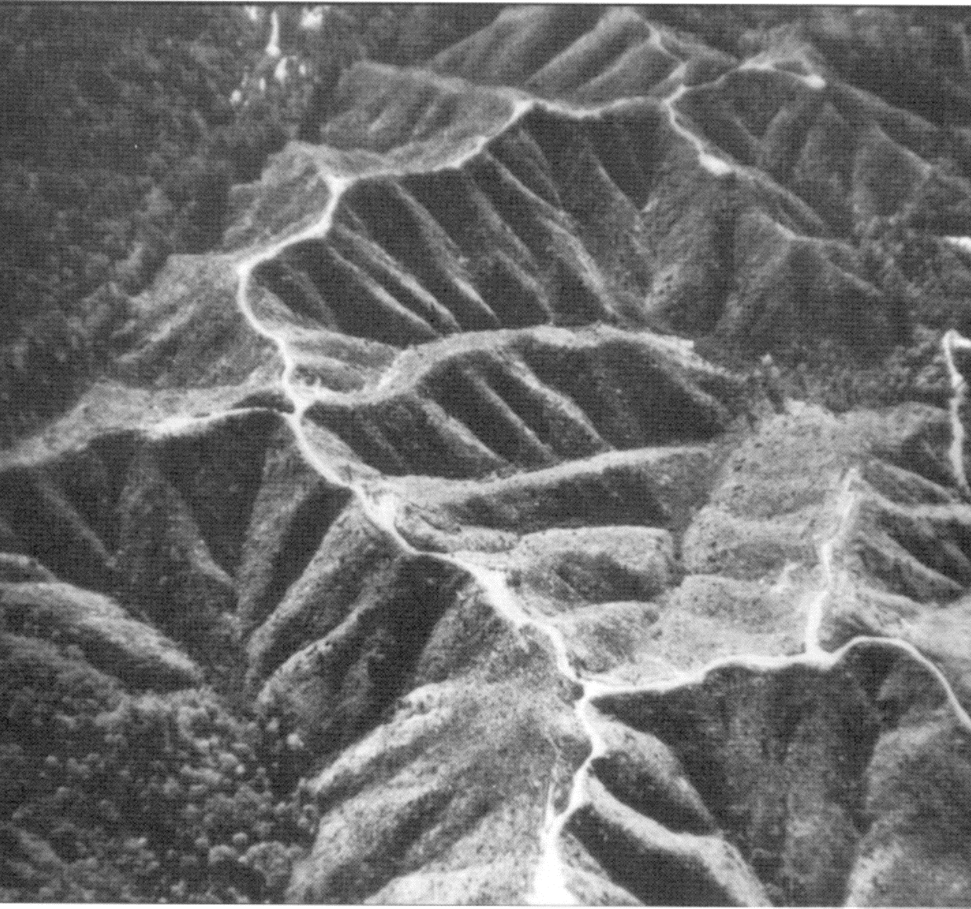
Examples of differently textured topography
Badlands in Death Valley.
from Easterbrook, 1993, p 140.
Coos Bay, Oregon Coast Range.
from W. E. Dietrich

Slide 32
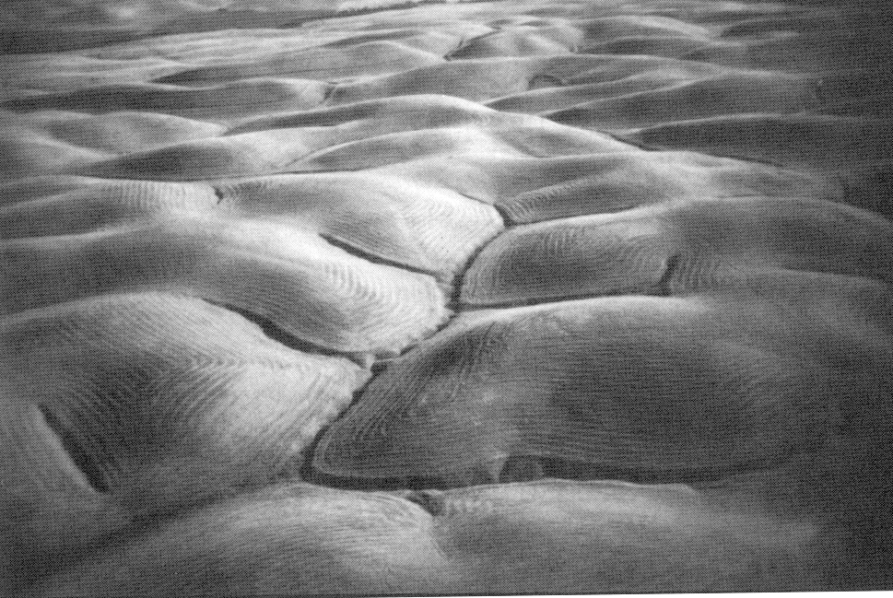
Gently Sloping Convex Landscape
From W. E. Dietrich

Slide 33
Topographic Texture and Drainage Density
Driftwood, PA
Same scale, 20 m contour interval
Sunland, CA

Slide 34
“landscape dissection into distinct valleys is limited by a threshold of channelization that sets a finite scale to the landscape.” (Montgomery and Dietrich, 1992, Science, vol. 255 p. 826.)
Suggestion: One contributing area threshold does not fit all watersheds.
Lets look at some geomorphology.
    Drainage Density
    Horton’s Laws
    Slope – Area scaling
    Stream Drops

Slide 35
Drainage Density
D_{d} = L/A
Hillslope length ≈ 1/(2D_{d})
B
B
Hillslope length = B
A = 2B L
D_{d} = L/A = 1/(2B)
∴ B= 1/(2D_{d})
L

Slide 36



Drainage Density for Different Support Area Thresholds
EPA Reach Files
100 grid cell threshold
1000 grid cell threshold

Slide 37
Drainage Density Versus Contributing Area Threshold

Slide 38

Hortons Laws: Strahler system for stream ordering
1
3
1
2
1
2
1
1
1
1
1
2
2
1
1
1
1
1
1

Slide 39
Constant Stream Drops Law
Broscoe, A. J., (1959), "Quantitative analysis of longitudinal stream profiles of small watersheds," Office of Naval Research, Project NR 389-042, Technical Report No. 18, Department of Geology, Columbia University, New York.

Slide 40

Stream Drop
Elevation difference between ends of stream
Nodes
Links
Single Stream
Note that a “Strahler stream” comprises a sequence of links (reaches or segments) of the same order

Slide 41
Suggestion: Map channel networks from the DEM at the finest resolution consistent with observed channel network geomorphology ‘laws’.
Look for statistically significant break in constant stream drop property as stream delineation threshold is reduced
Break in slope versus contributing area relationship
Physical basis in the form instability theory of Smith and Bretherton (1972), see Tarboton et al. 1992

Slide 42
Statistical Analysis of Stream Drops

Slide 43
T-Test for Difference in Mean Values
0
72
130
T-test checks whether difference in means is large (> 2)
when compared to the spread of the data around the mean values

Slide 44
Objectively Selected Support Area Threshold

Slide 45
100 grid cell constant support area threshold stream delineation

Slide 46
200 grid cell constant support area based stream delineation

Slide 47

Local Curvature Computation
(Peuker and Douglas, 1975, Comput. Graphics Image Proc. 4:375)
43
48
48
51
51
56
41
47
47
54
54
58

Slide 48
Contributing area of upwards curved grid cells only

Slide 49
Upward Curved Contributing Area Threshold

Slide 50
Curvature based stream delineation

Slide 51


Dinfinity Representation of Flow Field
D8
D∞
Tarboton, D. G., (1997), "A New Method for the Determination of Flow Directions and Contributing Areas in Grid Digital Elevation Models," Water Resources Research, 33(2): 309-319.)
http://hydrology.usu.edu/taudem

Slide 52


Contributing Area
D∞
D8

Slide 53



Contributing area from D-Infinity
Notes:
Note the detail in the representation of flow paths at features such as roads

Slide 54

Contributing area from D-Infinity
Notes:
Note the detail in the representation of flow paths at features such as roads

Slide 55

Generalized Flow Accumulation
w(x)
x

Slide 56
Generalization to Flow Algebra
Replace
P_{ki}
P_{ki}
P_{ki}
i
by general function
Flow direction proportions
Input Results from upslope
θ_{i} = F(γ_{i}, P_{ki}, θ_{k}, γ_{k})
Output Result,
Quantity being calculated
Other inputs at cell and upslope
Tarboton, D. G. and M. E. Baker, (2008), "Towards an Algebra for Terrain-Based Flow Analysis," in Representing, Modeling and Visualizing the Natural Environment: Innovations in GIS 12, Edited by N. J. Mount, G. L. Harvey, P. Aplin and G. Priestnall, CRC Press, Florida, p.496, http://dx.doi.org/10.1201/9781420055504.ch12.

Slide 57
General Pseudocode Upstream Flow Algebra Evaluation
Global P, γ, θ FlowAlgebra(i) for all k neighbors of i if P_{ki}>0 FlowAlgebra(k) next k θ_{i} = FA(γ_{i}, P_{ki}, θ_{k}, γ_{k}) return
P_{ki}

Slide 58


Example: Retention limited runoff generation with run-on
q_{k}
r
Global P, (r,c), q FlowAlgebra(i) for all k neighbors of i if P_{ki}>0 FlowAlgebra(k) next k return
q_{i}
c

Slide 59
General Pseudocode Downstream Flow Algebra Evaluation
Global P, γ, θ FlowAlgebra(i) for all k neighbors of i if P_{ik}>0 FlowAlgebra(k) next k θ_{i} = FA(γ_{i}, P_{ik}, θ_{k}, γ_{k}) return
P_{ki}

Slide 60

0.6
0
0
0.3
0.3
0
0
0.6
0
0
1
0
0
1
0
Grid cells y
Dependence function of grid cells y
Useful for example to track where a contaminant may come from

Slide 61

General Proximity Functions as weighted distance to a target set along Dinfinity Flow Directions
Ridge
sr
sr
pr
pr
vr
Point of interest
Stream
ps
ps
ss
vs
ss
D∞
hr
hs
hr
hs
Tesfa, T. K., D. G. Tarboton, D. W. Watson, K. A. T. Schreuders, M. E. Baker and R. M. Wallace, (2011), "Extraction of hydrological proximity measures from DEMs using parallel processing," Environmental Modelling & Software, 26(12): 1696-1709, http://dx.doi.org/10.1016/j.envsoft.2011.07.018.

Slide 62
Height above Nearest Drainage (HAND) evaluated using TauDEM Dinfinity Vertical Distance Down function
TauDEM Vertical Distance Down a special case of a general hydrological proximity measure
D∞
Ridge
sr
sr
pr
Point of interest
pr
vr
Stream
ps
ps
ss
vs
D∞
ss
hr
hs
hr
hs
Vertical distance to stream evaluated as weighted average over multiple flow paths. This results in a “smooth” height above nearest drainage layer
Tesfa, T. K., D. G. Tarboton, D. W. Watson, K. A. T. Schreuders, M. E. Baker and R. M. Wallace, (2011), "Extraction of hydrological proximity measures from DEMs using parallel processing," Environmental Modelling & Software, 26(12): 1696-1709, http://dx.doi.org/10.1016/j.envsoft.2011.07.018.

Slide 63
Flooding occurs when water depth is greater than Height Above Nearest Drainage (HAND)
Height Above the Nearest Drainage. The distance to streams (nearest drainage) calculated vertically along TauDEM Dinfinity flow directions
Serves to support flood inundation mapping where the data to support hydraulic calculations is limited
Enables evaluation of reach level hydraulic properties
Can take advantage of high resolution DEM data (but is only as good as the given DEM data)
Has been evaluated across continental US using 10 m resolution DEM and NHDPlus streams for use in US National Water Model flood inundation mapping
Flood Depth
Height Above
Nearest Drainage
(HAND)
Normal Depth
Ridge
sr
sr
pr
vr
Point of interest
pr
Stream
ps
vs
ps
ss
ss
hr
hs
hr
hs

Slide 64

HAND from TauDEM for Onion Creek near Austin Texas
1/3 arc second NED DEM

Slide 65
Mapping Flood Inundation with Height above the Nearest Drainage (HAND)
Each stream reach has a water depth h_{w} (from a hydraulic model)
Each stream reach has an ID
Each grid cell has the ID of the reach it connects to and the height above the nearest drainage h_{d}
Evaluate inundation using h_{w}-h_{d}
    If(h_{w}(id) > h_{d}(id))
      Inundation depth = h_{w}(id) - h_{d}(id)
    Else
      Inundation depth = 0
This is approximate because it neglects many details of the river hydraulics and flow over flood plains. But more detailed approaches often demand hard to obtain and uncertain inputs so this may be a helpful approach to get screening level and real time flood maps
Premised on good elevation model and consistent stream raster

Slide 66




Flood Inundation Mapping – HAND Method
Reach Scale Flood Depth
Comid | Depth (ft)
5781365 | 8
5781381 | 9
5781405 | 10
5781401 | 15
5781399 | 14
5781383 | 12
5781933 | 11
Catchments and Flowlines
Inundation map
(Height above
drainage < water depth)
Digital Elevation Model
Height Above Nearest Drainage
(relative elevation of land surface cell above cell in stream to which it flows)

Slide 67
Summary Concepts
The GIS grid based terrain flow data model enables derivation of a wide variety of information useful for the study of hydrologic processes.
Knowledge from geomorphology enables objective selection of channel network delineation threshold
Terrain surface derivatives enhanced by use of DInfinity model.
Flow algebra a general “recipe” for terrain flow related modeling.
Programming supports automation of repetitive tasks and implementation of functionality not available

