Slide 1
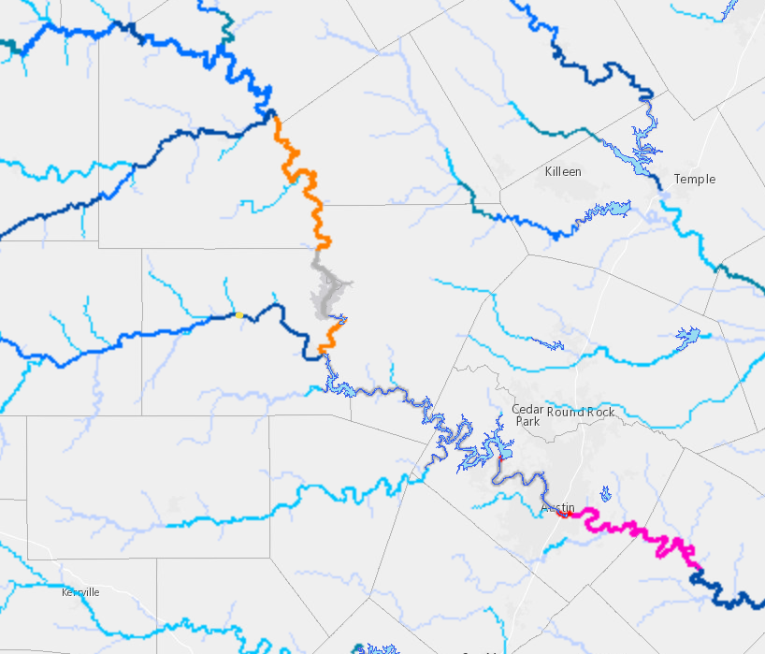
Highland Lake Reservoir System
Colorado R.
San Saba R.
Highland Lakes
Llano R.
Bridge washout
Lake Travis
Pedernales R.
Austin
Colorado R.

Slide 2
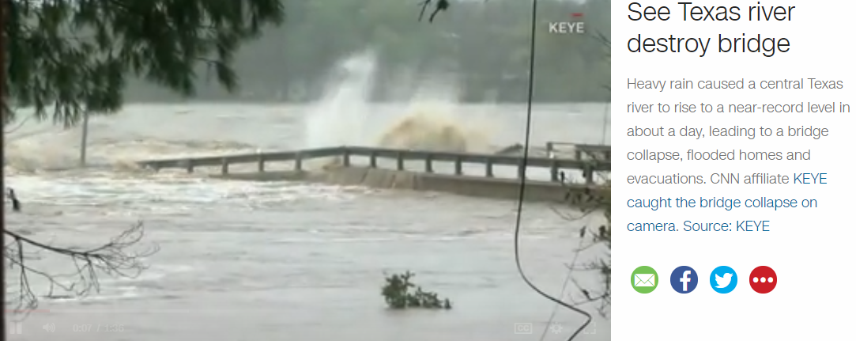
Bridge Washes Away
https://www.cnn.com/videos/weather/2018/10/16/llano-river-2900-bridge-texas-collapse-vpx.keye
16 October 2018, RM 2900 Llano River at Kingsland

Slide 3
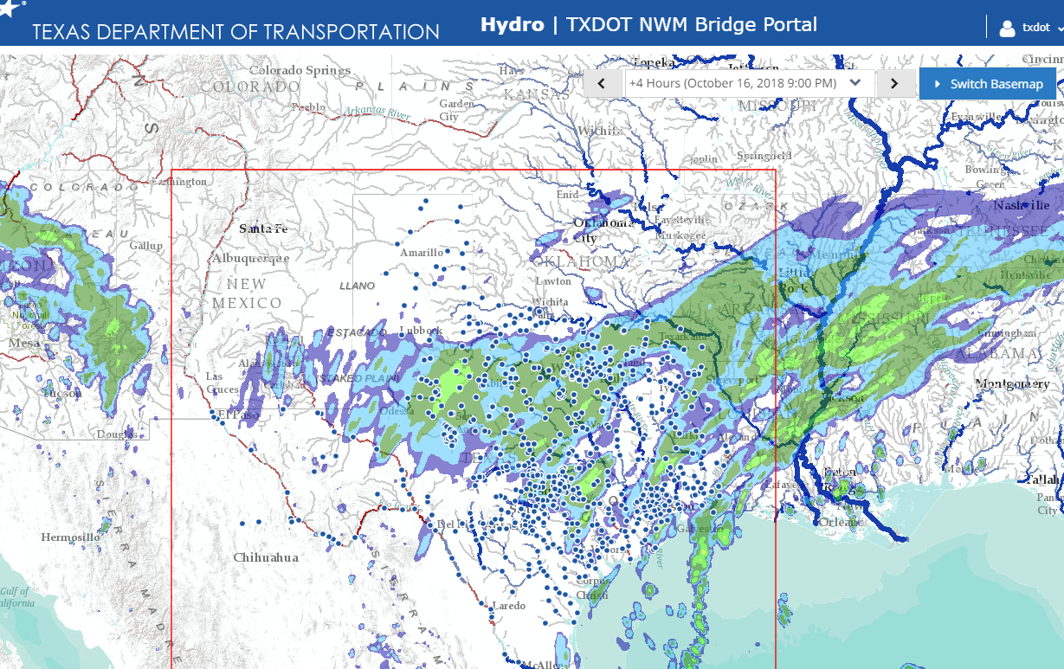
TxDOT NWM Bridge Portal 16 October 2018, 2PM

Slide 4
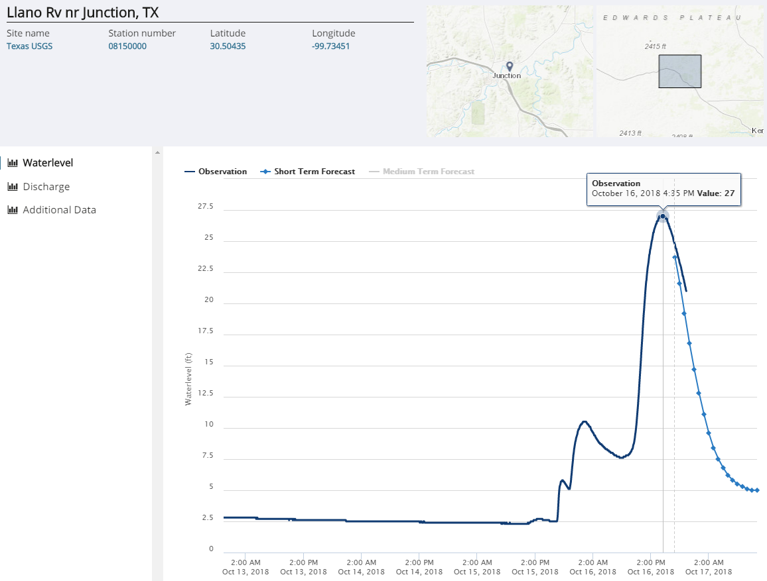
Llano River Near Junction

Slide 5
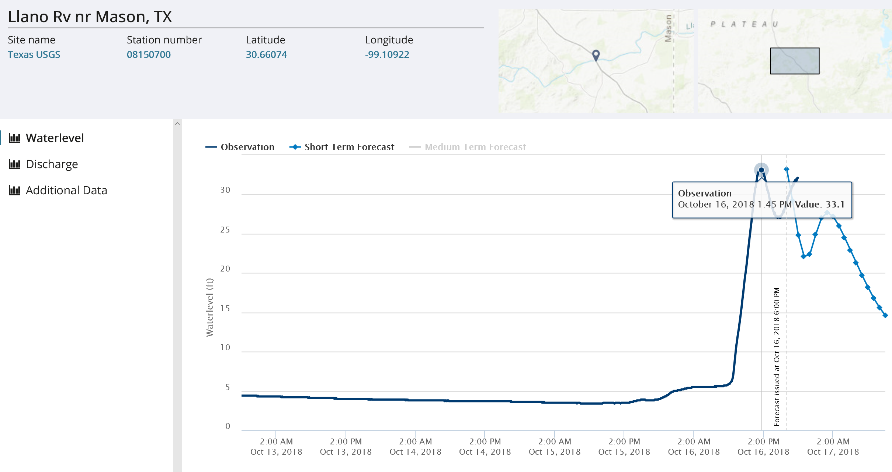
Llano River near Mason

Slide 6
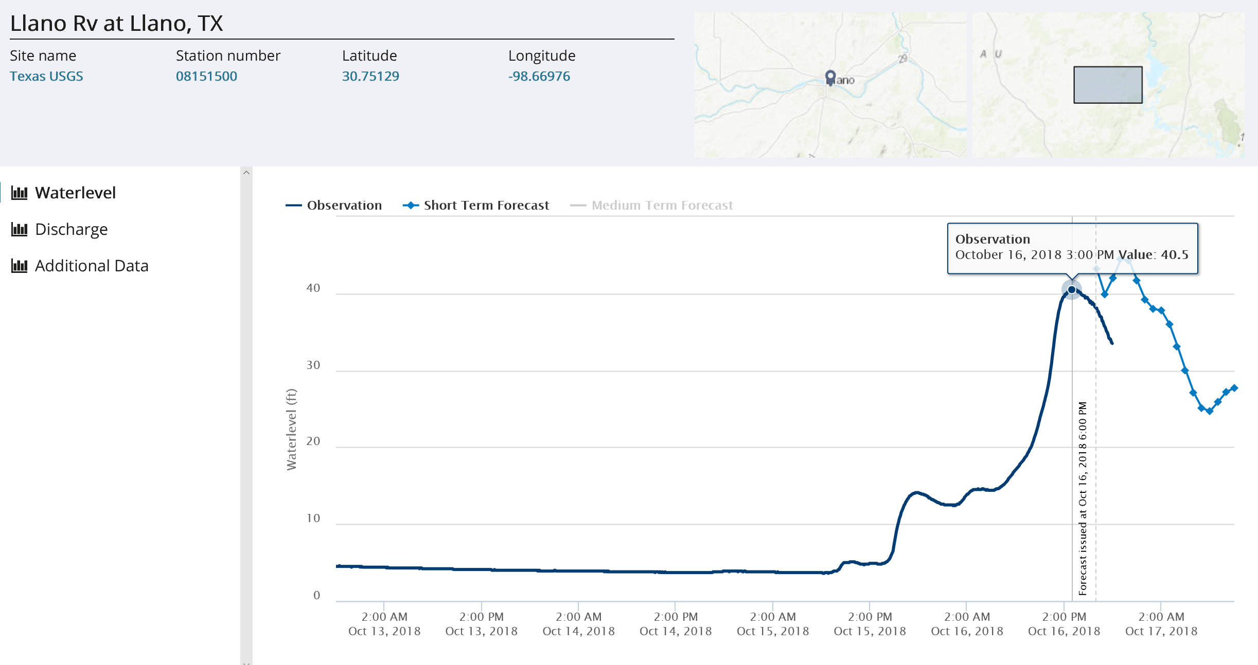
Llano River at Llano

Slide 7
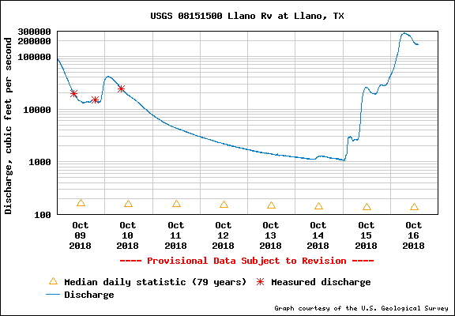
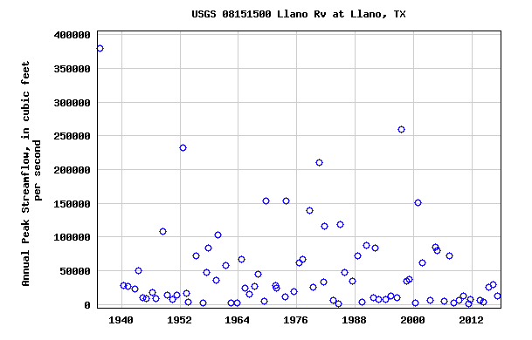
Llano River at Llano
276,000 cfs peak flow
276,000 cfs
Current flow measurements
Annual Maximum Flows on Llano River
Current discharge is second largest on record
since 1939

Slide 8
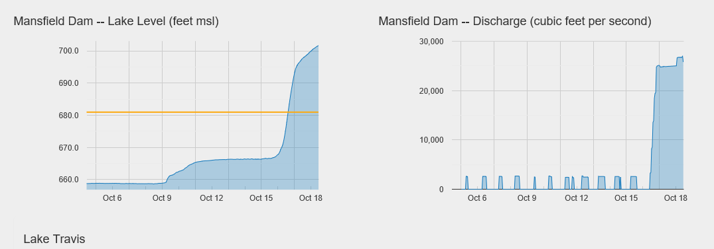
Lake Travis Conditions at 11:30AM, 18 October 2018
Spillway, Elevation 714
12 feet
34 feet
https://floodstatus.lcra.org/#llevels

Slide 9
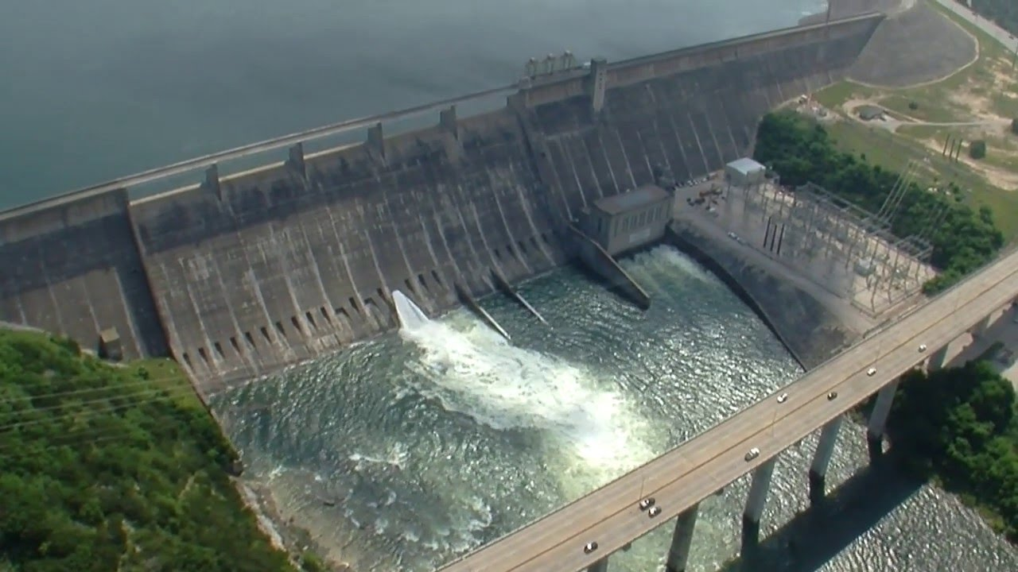
Gates and Spillway at Mansfield Dam on Lake Travis
4 gates open today, 18 October 2018

Slide 10
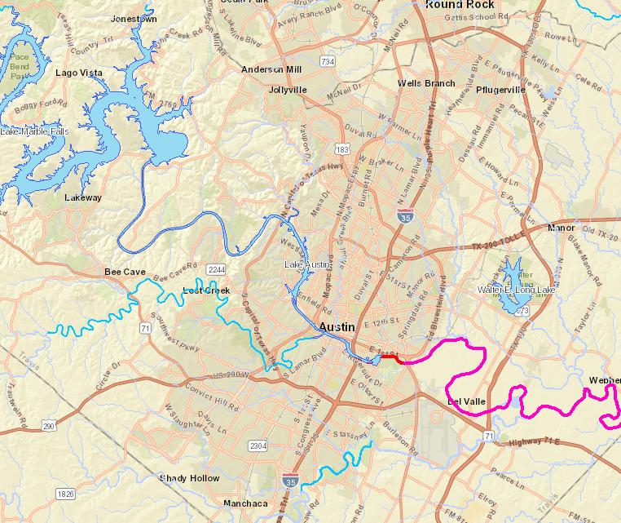
Lake Travis and City of Austin
Lake
Travis
Mansfield
Dam
Austin

Slide 11
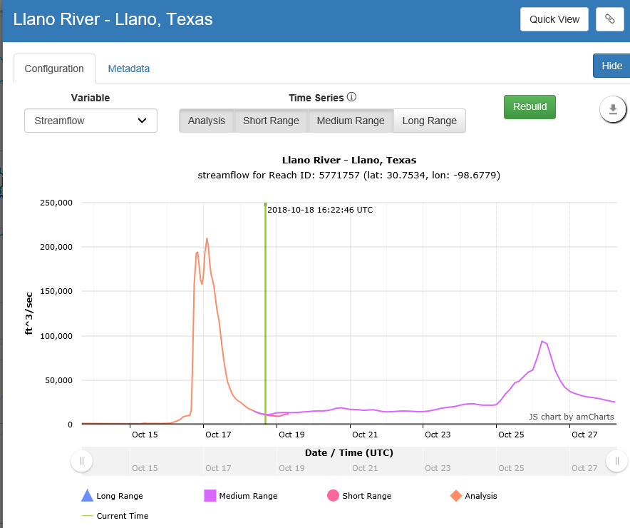
NWM Medium Range Forecast on Llano River
Oct 26

