Slide 1
National Water Model Forecast for Harvey

Slide 2
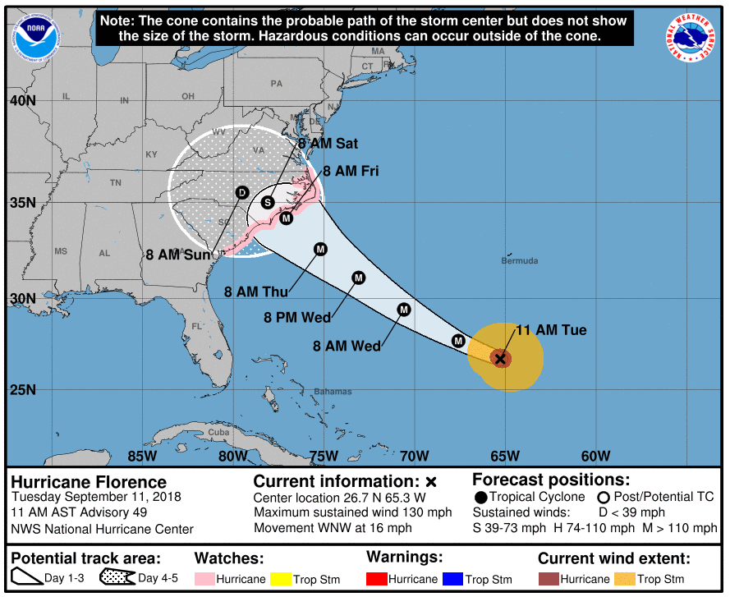
Hurricane Florence Forecast
As of Tuesday 11 September 2018, 12:10PM

Slide 3
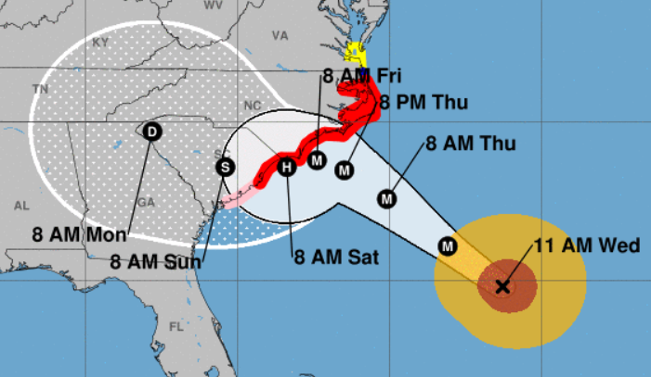
Hurricane Florence Forecast as of 11AM Weds 12 Sept 2018
Source: National Hurricane Center
https://www.nhc.noaa.gov/

Slide 4
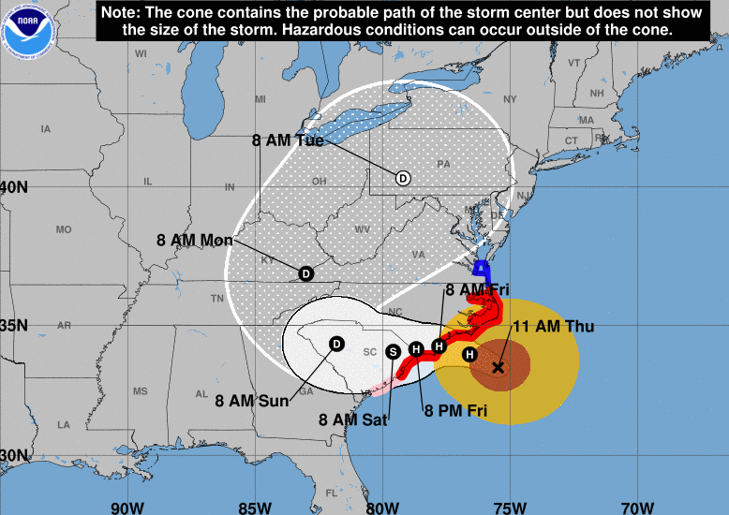
Hurricane Florence Forecast
As of Thursday 13 September 2018, 12:10PM

Slide 5
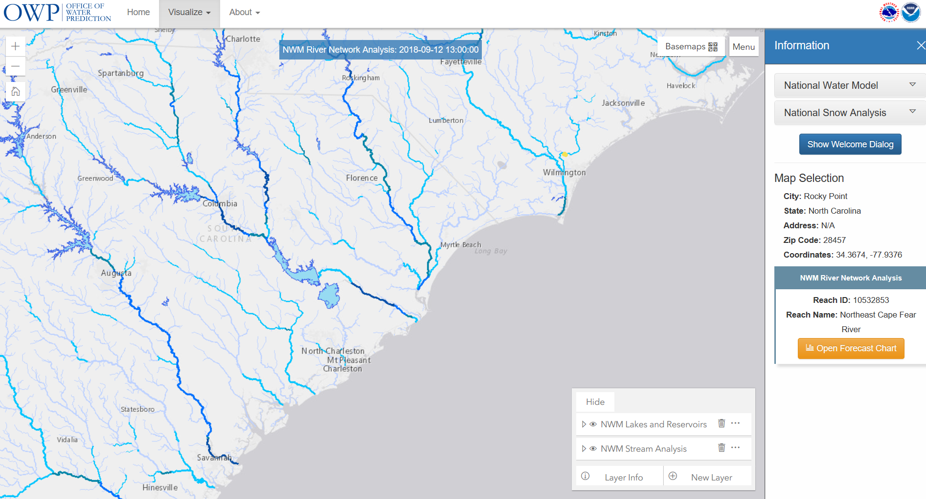
National Water Model Forecasts for Carolina Coast
http://water.noaa.gov/map

Slide 6
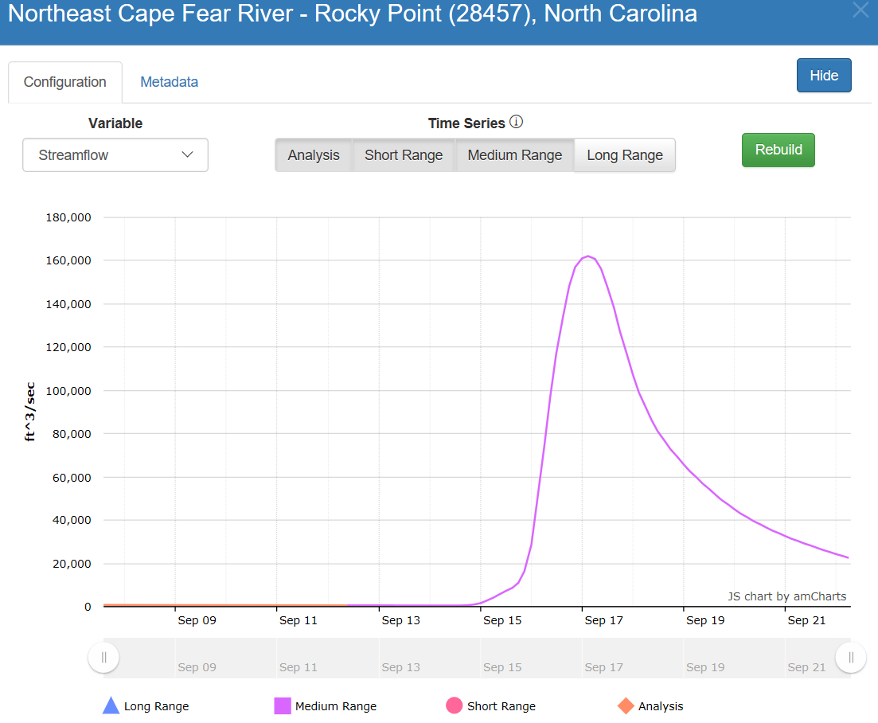
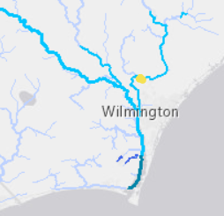
River Discharge Forecast from Florence
River Discharge
(cubic feet per second)
160,000 cfs
on Sunday evening
Wed
Thu
Fri
Sat
Sun
Mon
Forecast as of Weds Sept 12 at 8 AM

Slide 7
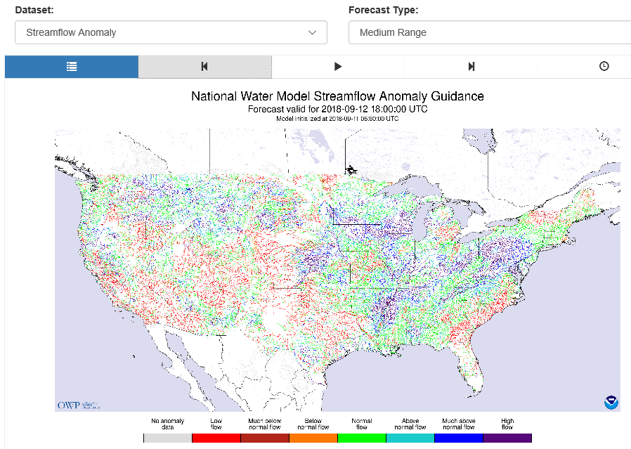
National Water Model Streamflow Anomaly Map Medium Range Forecast (10 days ahead)
http://water.noaa.gov/tools/nwm-image-viewer#iv-app-wrapper

Slide 8
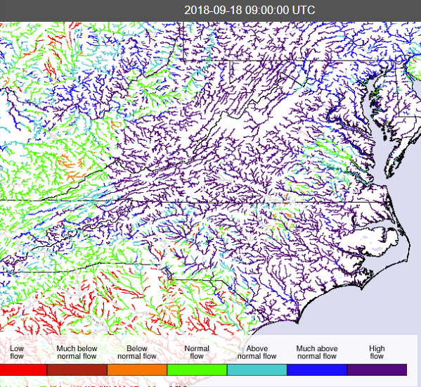
National Water Model Anomaly Map Medium range forecast
http://water.noaa.gov/tools/nwm-image-viewer#iv-app-wrapper

