Slide 1
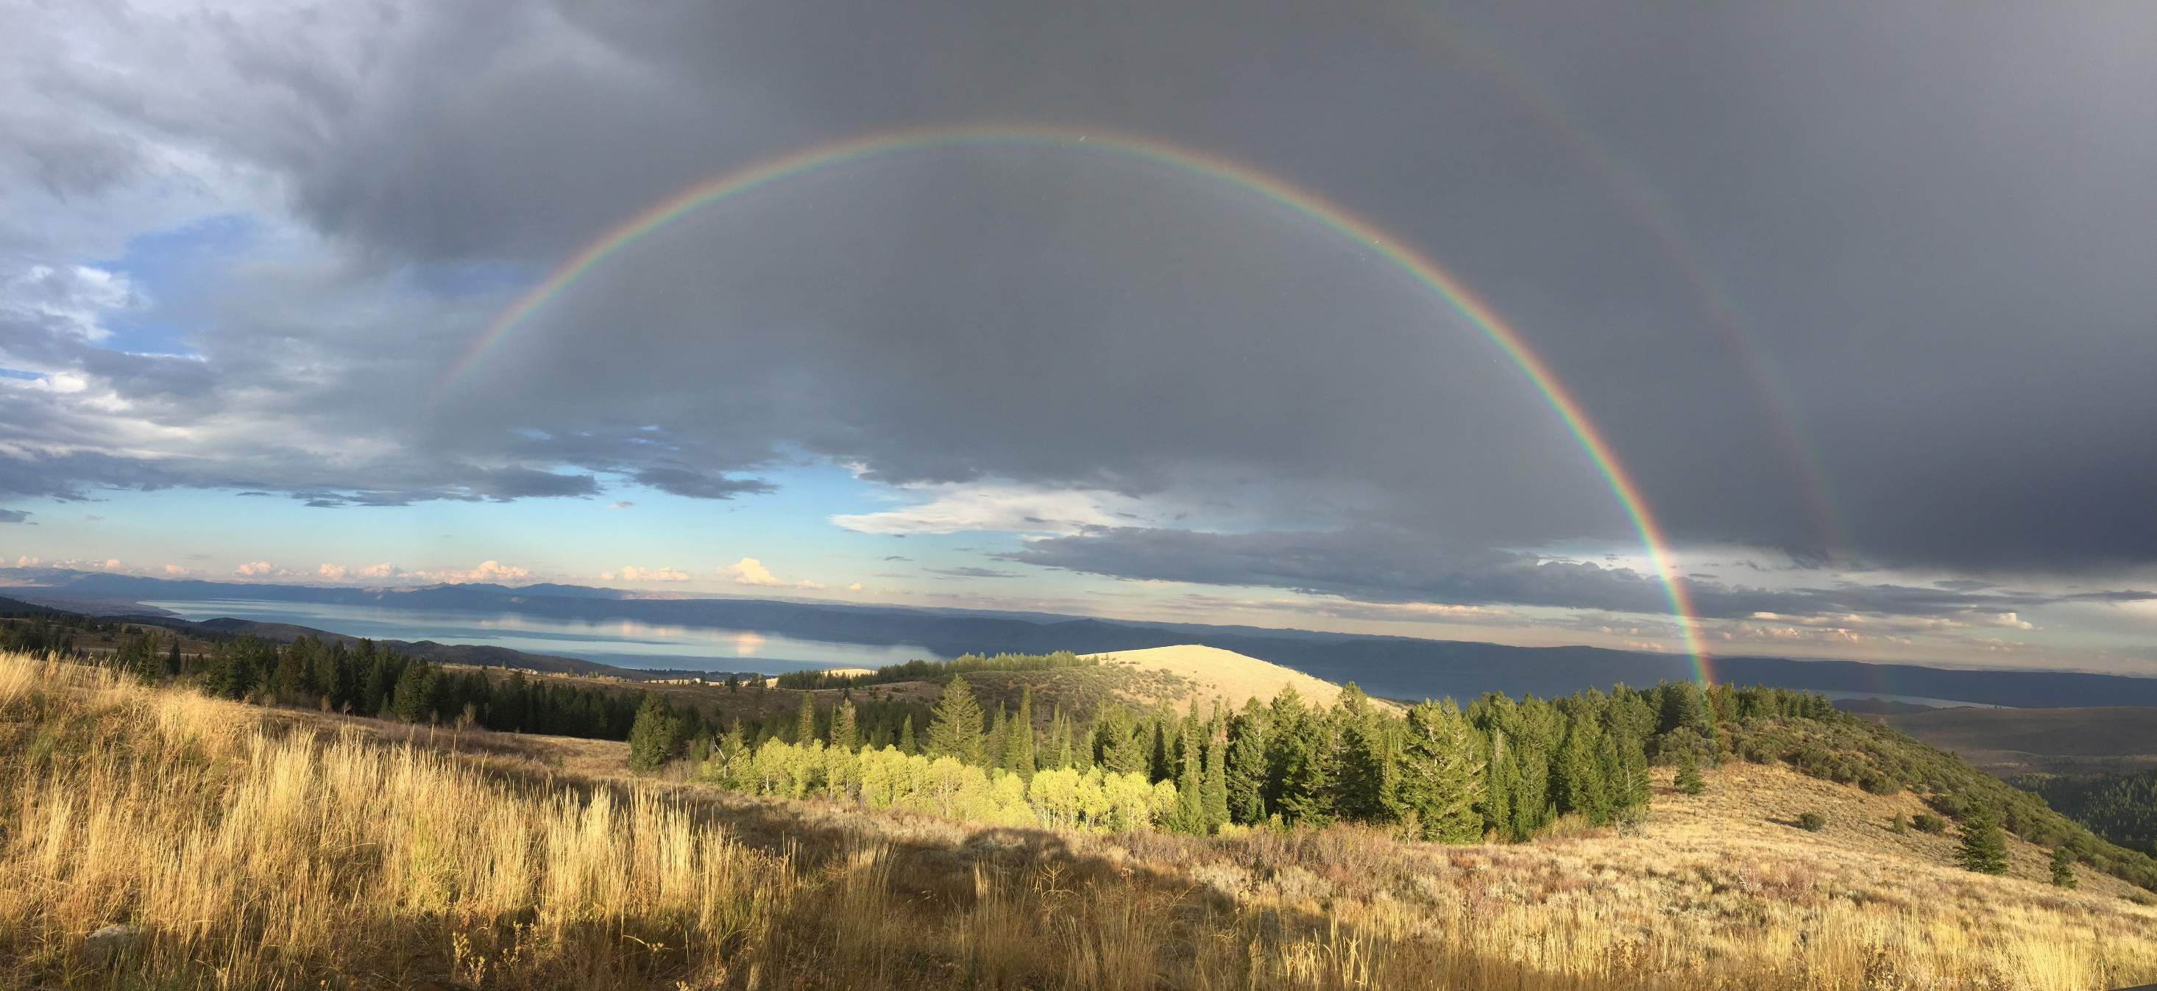
Water Information Sharing and HydroShare Advancing Hydrology through Collaborative Data and Model Sharing
OAC-1664061
OAC-1664018
OAC-1664119
2017-2021
ACI-1148453
ACI-1148090
2012-2017
David Tarboton, Ray Idaszak, Jeffery S Horsburgh, Daniel P Ames, Jonathan L Goodall, Alva Couch, Richard Hooper, Shaowen Wang, Martyn Clark, Pabitra Dash, Hong Yi, David Maidment, Christina Bandaragoda, Anthony Castronova, Tian Gan, Zhiyu Li, Mohamed Morsy, Maurier Ramirez, Jeffrey Sadler, Dandong Yin, Yan Liu, Bart Nijssen.
HydroShare is operated by the Consortium of Universities for the Advancement of Hydrologic Science, Inc. (CUAHSI) with ongoing development through a collaborative project among Utah State University, Brigham Young University, CyberGIS Center University of Illinois, Tufts, University of Virginia, and RENCI University of North Carolina.
http://www.hydroshare.org

Slide 2
CUAHSI (coo-WAH-see)
Consortium of Universities for the Advancement of Hydrologic Science, Inc.
CUAHSI is a 501(c)3 Non-Profit Consortium of about 130 U.S. Academic Institutions, Non-Profits, and International Universities; also open to private organizations
CUAHSI's mission is to shape the future of hydrologic science by:
Strengthening collaboration
Developing and delivering data, models, instrumentation and technologies
Promoting education
Key Activities
Community Services, such as workshops, community meetings, training, etc.
Data and Model Services, including HydroShare and time-series services
Notes:
CUAHSI = Consortium of Universities for the Advancement of Hydrologic Science
Key support comes from:
Department of Homeland Security
Federal Emergency Management Agency
Johnson Family Foundation
National Aeronautics and Space Administration
National Oceanic and Atmospheric Administration
National Science Foundation
National Weather Service
William Penn Foundation

Slide 3
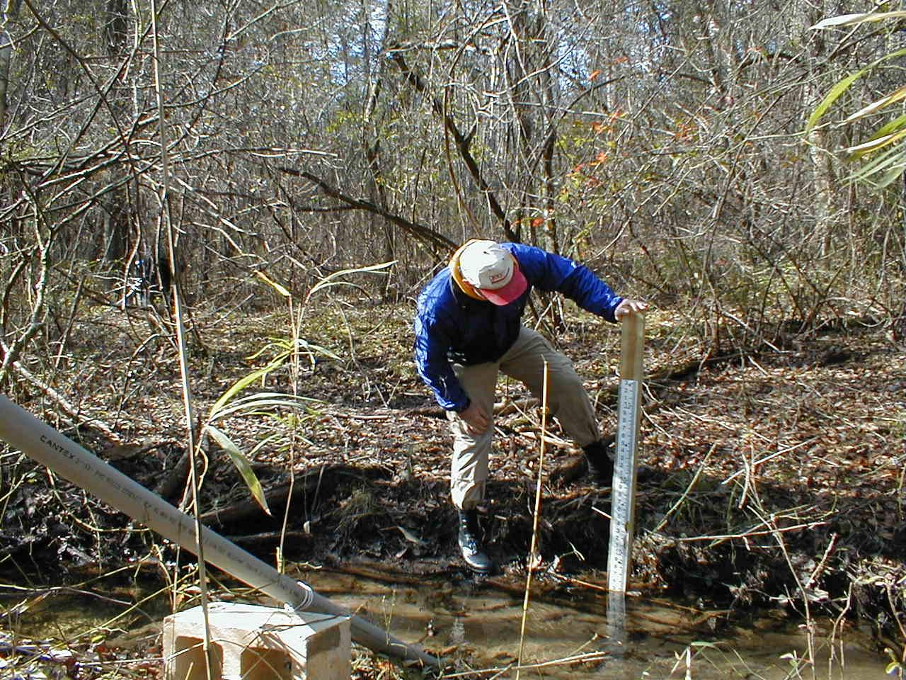
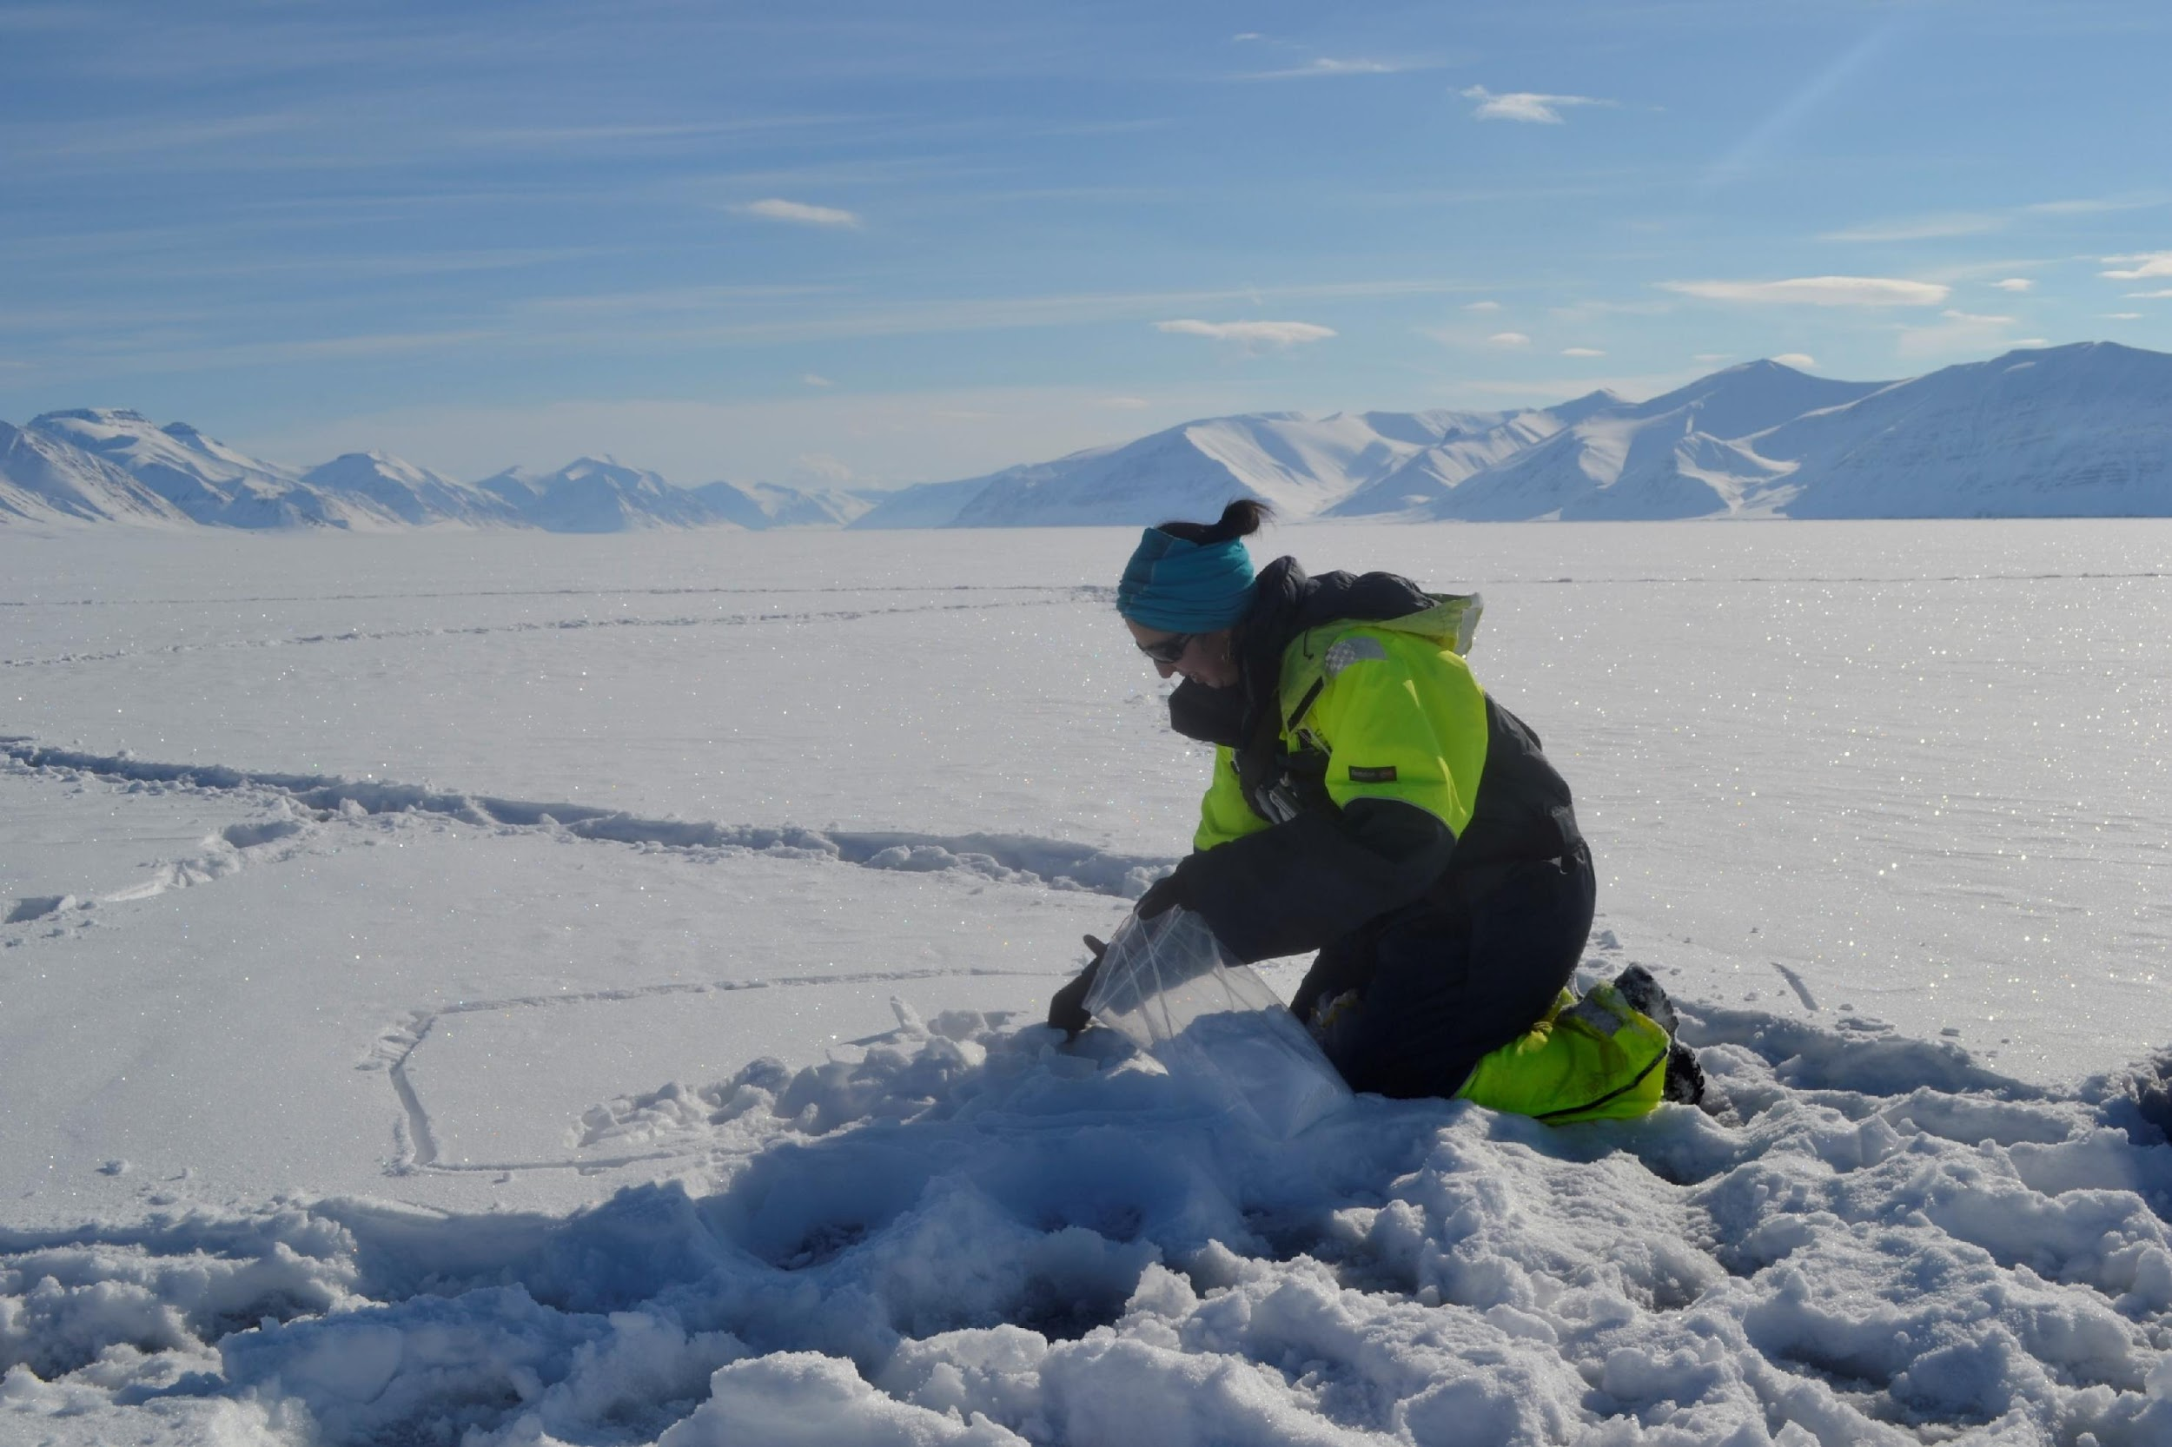
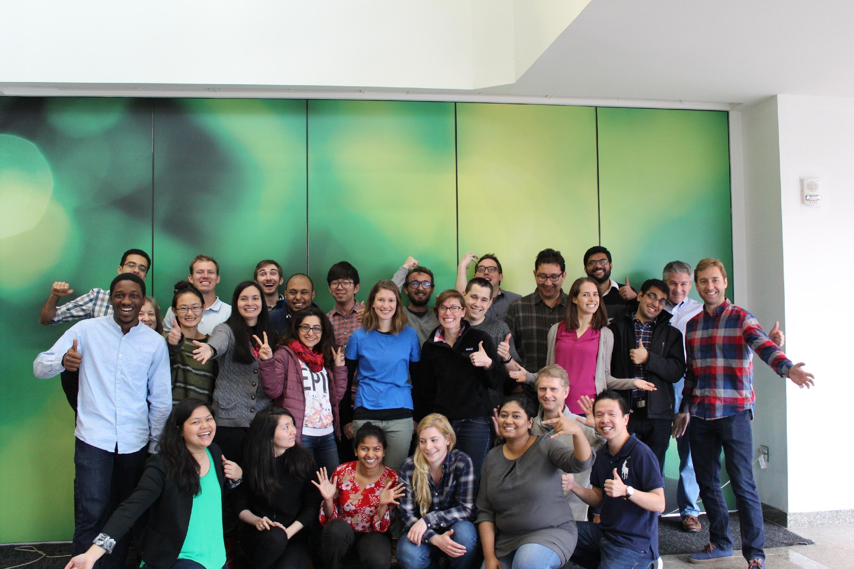
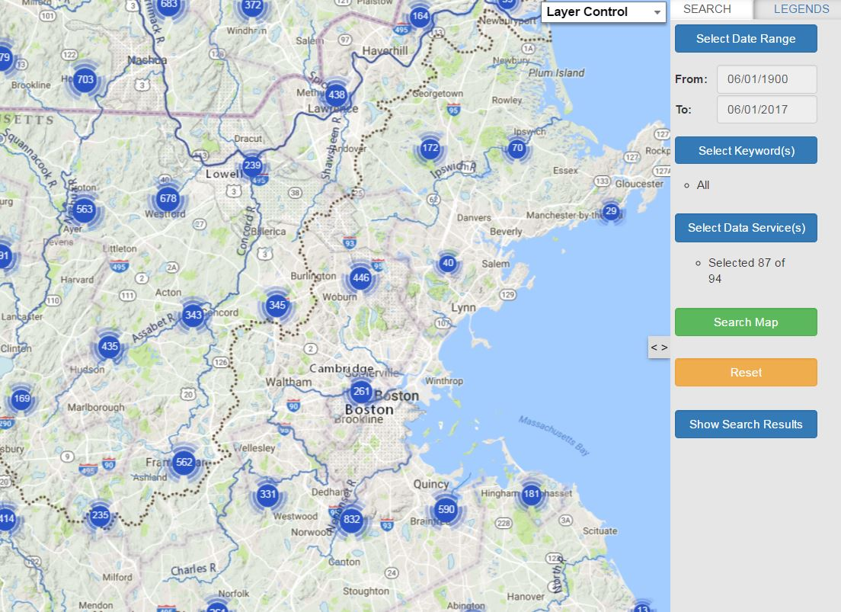
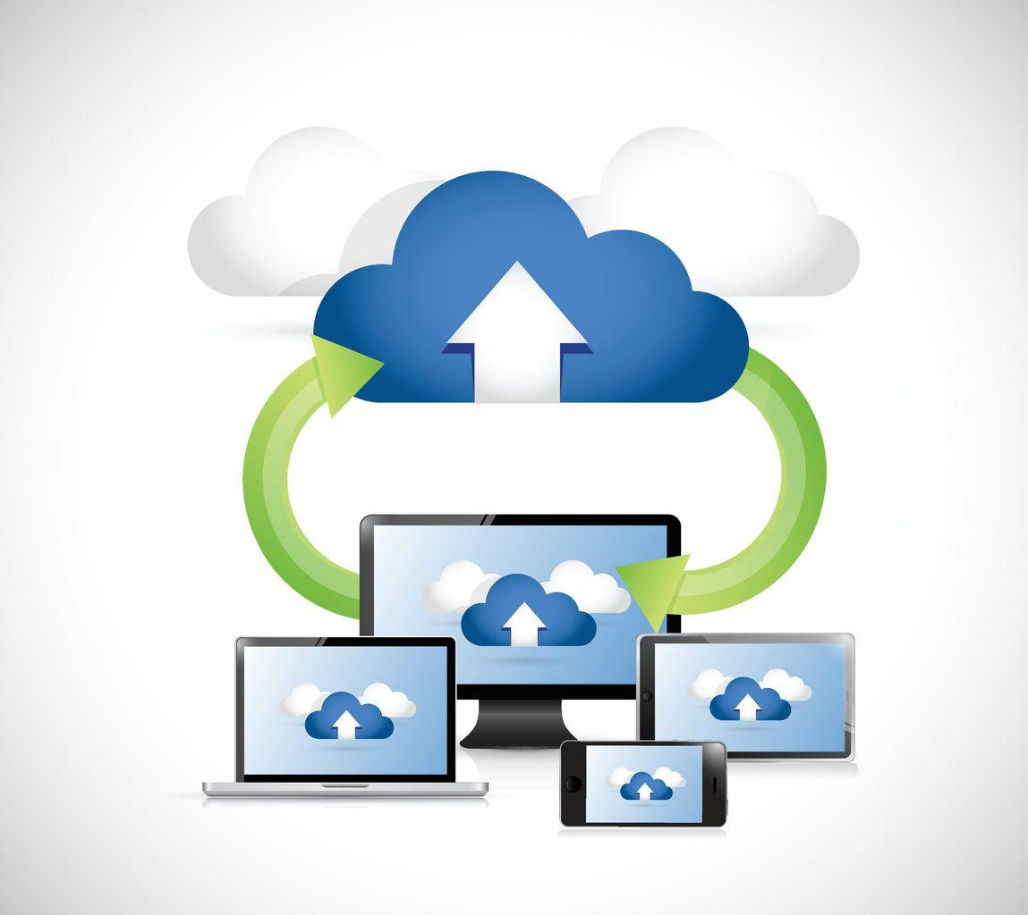
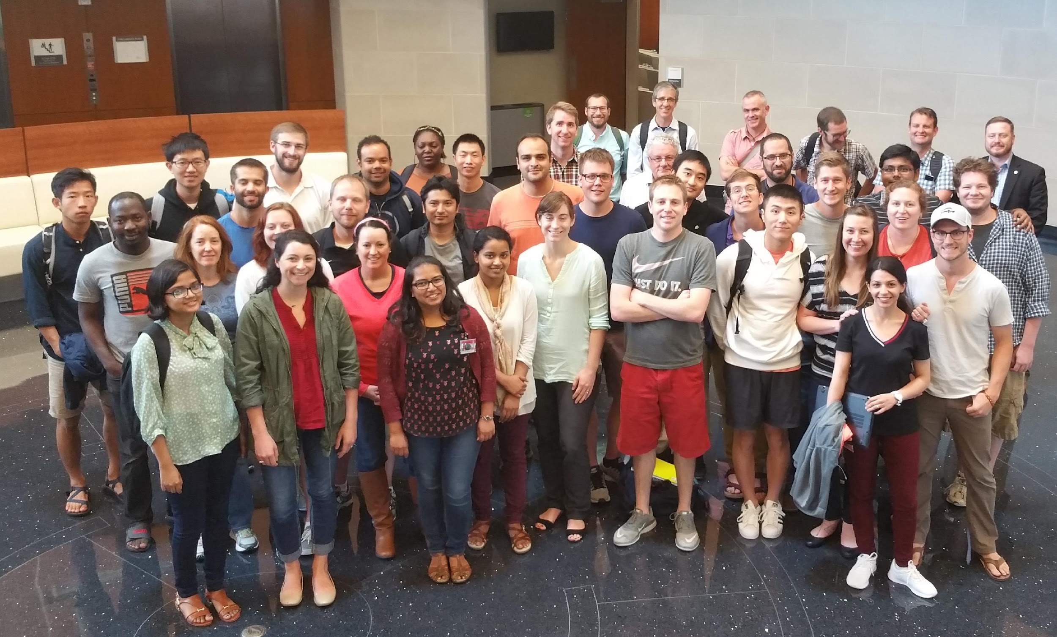
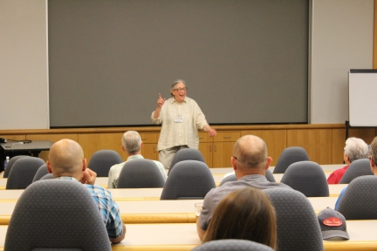
CUAHSI Programs
Community Services: Resources and training to build capacity and extend capabilities
Data Services: Access to data and models to facilitate research and education.

Slide 4
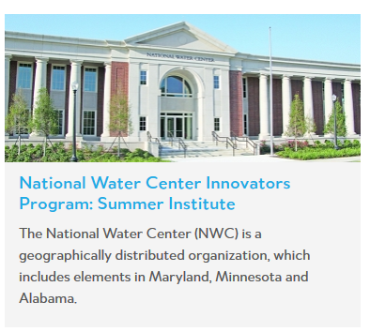
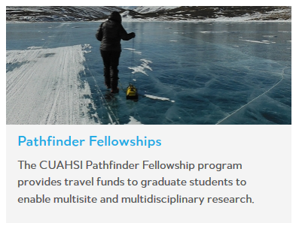
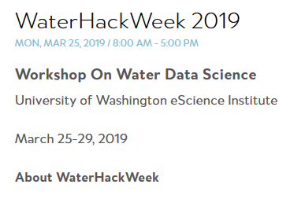
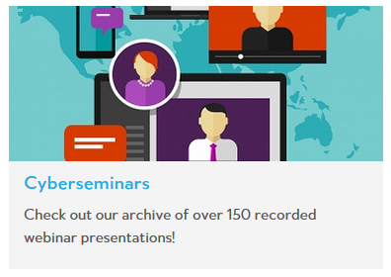
Student Opportunities
https://www.cuahsi.org/education
https://waterhackweek.github.io/
WaterHackWeek is a 5-day hackweek to be held at the University of Washington in partnership with the University of Washington eScience Institute. Participants will learn about open source technologies used to analyze water-related datasets.
https://www.cuahsi.org/education/summerinstitute
Student applications open Nov 12, 2019

Slide 5
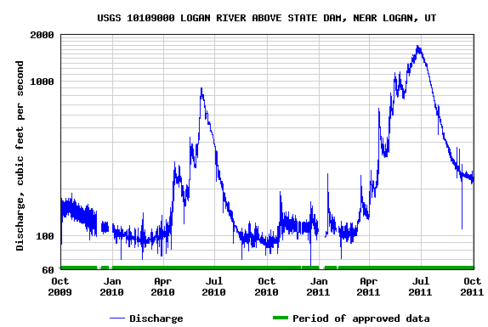
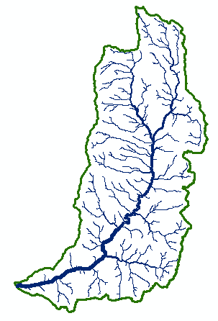
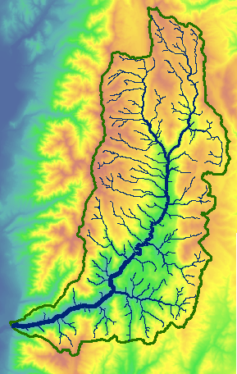
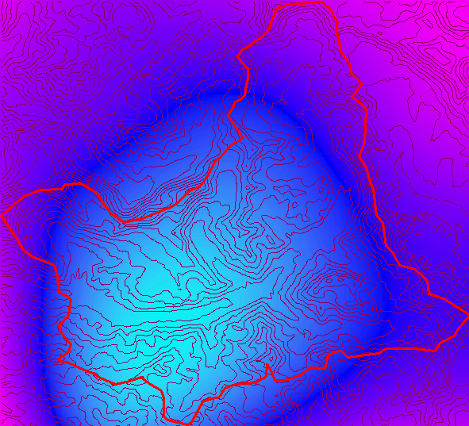
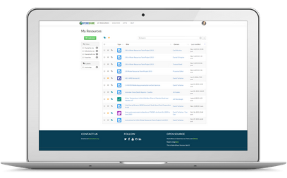
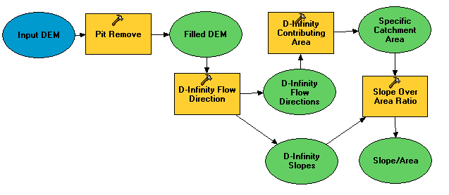
Motivation: Collaborative research
Resources
Data and models
Social Objects
Advancing Hydrologic Understanding
requires integration of information from multiple sources
using diverse types of data and models
may be data and computationally intensive
requires collaboration and working as a team/community
publication of data and models for transparency, reproducibility, and trust (open data)
t
y
x
Hydrologic Research is a team sport

Slide 6
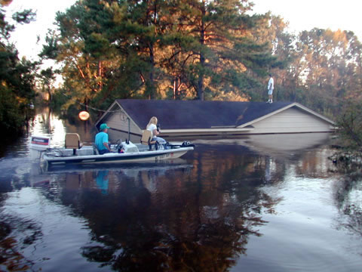
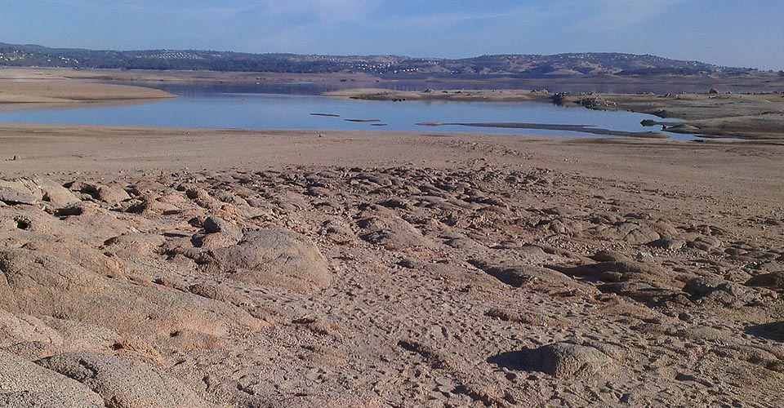
Grand Challenge
Better hydrologic forecasting that quantifies effects and consequences of land surface change on hydrologic processes and conditions
by enabling access to and organizing data for integrated analysis and modeling
From https://ca.water.usgs.gov/california-drought/
We want to be able to better forecast, plan for and mitigate the effects of floods.
We want to ensure sufficient water resources in times of shortage.
Notes:
Harnessing the data revolution to address grand challenge in hydrology

Slide 7
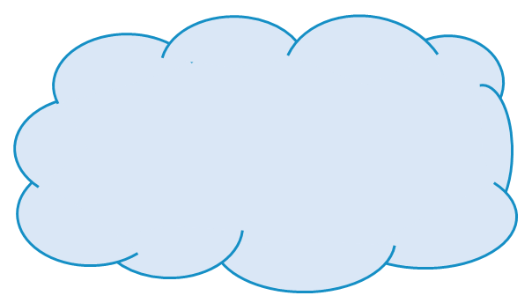
Vision
Part of an ecosystem of cyberinfrastructure elements that make up an integrated cyberinfrastructure for collaboration and computation that integrates data storage, data organization, discovery, analysis and modeling through web applications (web apps) and that allows researchers to employ services beyond their desktop to make data storage and manipulation more reliable and scalable, while improving ability to collaborate and reproduce results.
Analysis
Data
Models
Don’t need your own software and platform to use
Reduce installation, library and platform dependencies
Data access and size, faster computation
Re-use
Reproducibility
Transparency
Trust
Collaboration

Slide 8
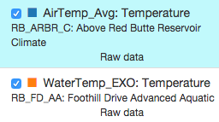
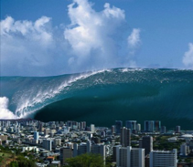
The Data Deluge
One week = 672 observations
One day = 96 observations
One month = 2880 observations
One year = 35,040 observations
So far (~1.5 years) = 55,000+ observations
Times 14 Aquatic Sites with ~26 Variables
Times 14 Climate Sites with ~74 Variables
Plus different versions of the data (raw versus checked) = 43,400,000+ observations
You need some infrastructure to manage and share the data.
From Jeff Horsburgh
Notes:
So, let’s talk about the volume of data being generated in the network.

Slide 9
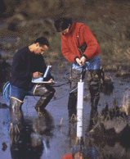
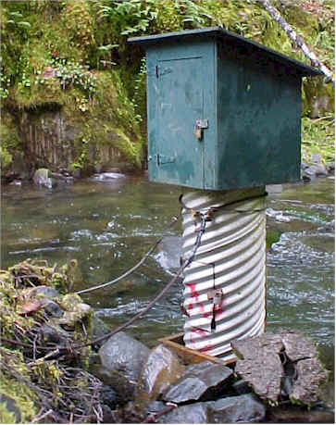
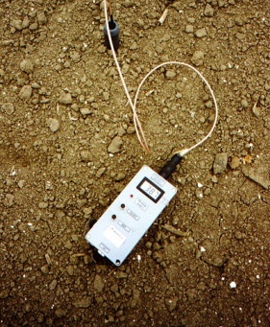
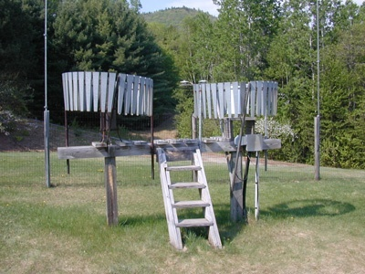
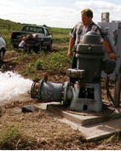
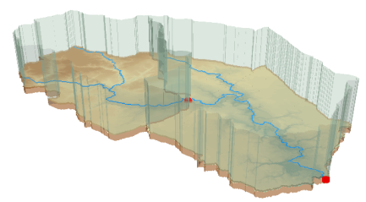
The challenge of data heterogeneity
Water quality
Water quantity
From dispersed federal agencies
From investigators collected for different purposes
Different formats
Points
Lines
Polygons
Fields
Time Series
Rainfall and Meteorology
Soil water
Groundwater
The way that data is stored can enhance or inhibit the analysis that can be done
We need ways to organize the data we work with
Data models
GIS

Slide 10
Geographic Data Model
“All geographic information systems are built using formal models that describe how things are located in space. A formal model is an abstract and well-defined system of concepts. A geographic data model defines the vocabulary for describing and reasoning about the things that are located on the earth. Geographic data models serve as the foundation on which all geographic information systems are built.”
Scott Morehouse, Preface to “Modeling our World”, First Edition. He was the chief software engineer at ESRI
Or, more simply: the way that data is organized can enhance or inhibit the analysis that can be done

Slide 11
The way that data is organized can enhance or inhibit the analysis that can be done
I have your information right here …
Picture from: http://initsspace.com/

Slide 12
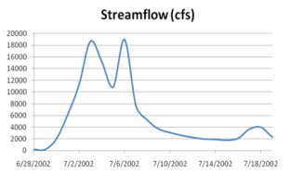
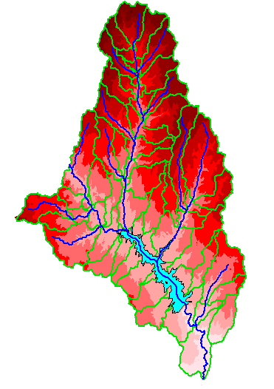
Hydrologic Science
It is as important to represent hydrologic environments precisely with
data as it is to represent hydrologic processes with equations
Physical laws and principles
(Mass, momentum, energy, chemistry)
Hydrologic Process Science
(Equations, simulation models, prediction)
Hydrologic conditions
(Fluxes, flows, concentrations)
Hydrologic Information Science
(Observations, data models, visualization
Hydrologic environment
(Physical earth)
From David Maidment

Slide 13
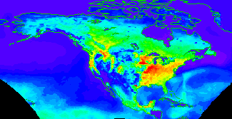
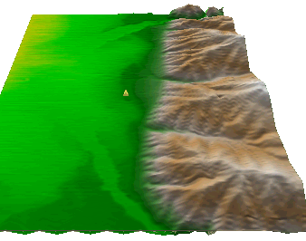
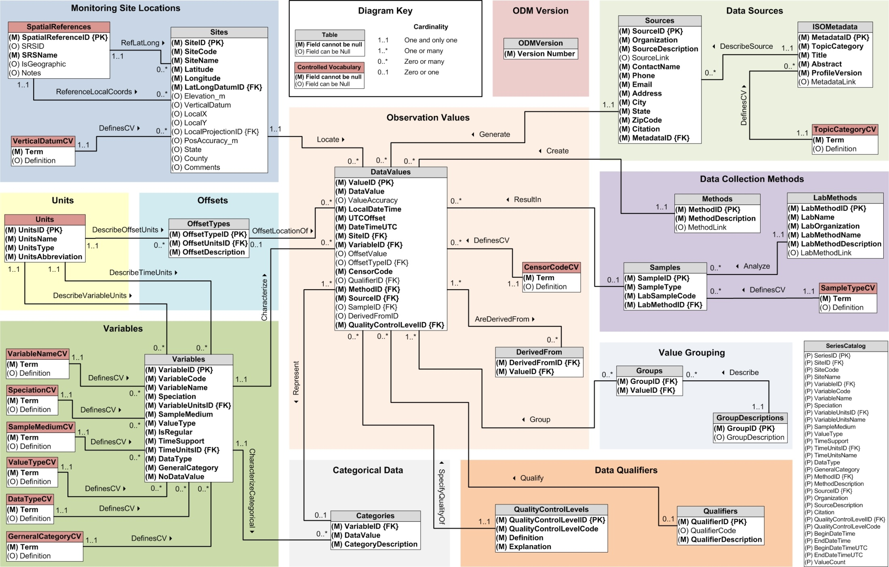
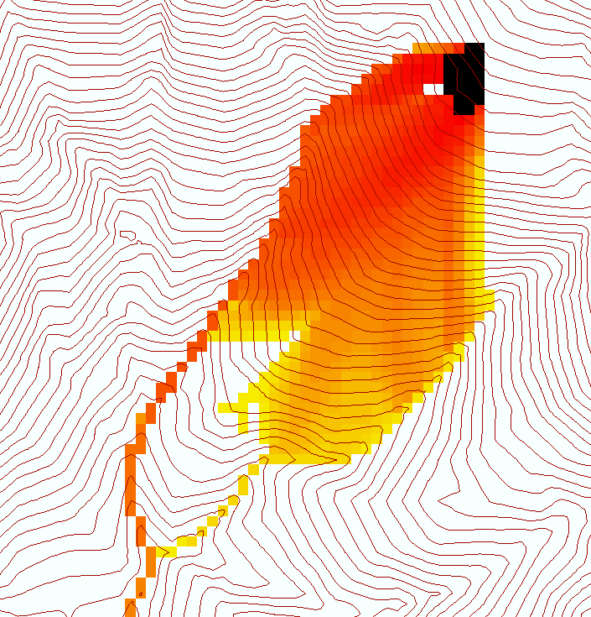
Data models organize the diversity of natural systems
NetCDF (Unidata) - A model for Continuous Space-Time data
ArcHydro – A model for Discrete Space-Time Data
Time, TSDateTime
Time, T
Coordinate
dimensions
{X}
TSValue
D
Space, FeatureID
Space, L
CUAHSI Observations Data Model: What are the basic attributes to be associated with each single data value and how can these best be organized?
Variables, TSTypeID
Variables, V
Variable dimensions
{Y}
Terrain Flow Data Model used to enrich the information content of a digital elevation model

Slide 14
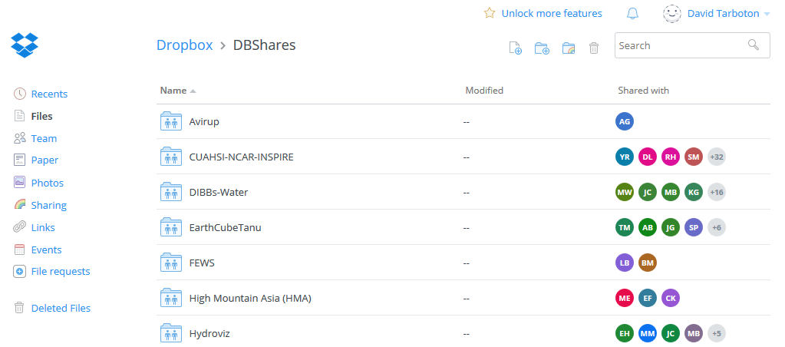
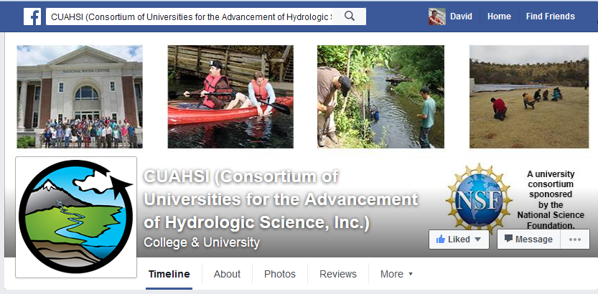
How do people share other content now
YouTube
Facebook
Instagram
Drop Box
Google Drive
ArcGIS Online
Hydrologic data ?

Slide 15
HydroShare is a platform for sharing Hydrologic Resources and Collaborating
File Storage
DropBox-ish Functionality
Meta Data Descriptions
Data Access API
Web Apps
Social Functions
DOI Data Publication
Value Added Functionality
dropbox.com
From Dan Ames

Slide 16
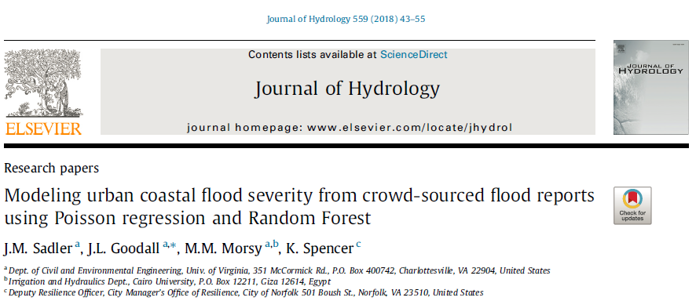
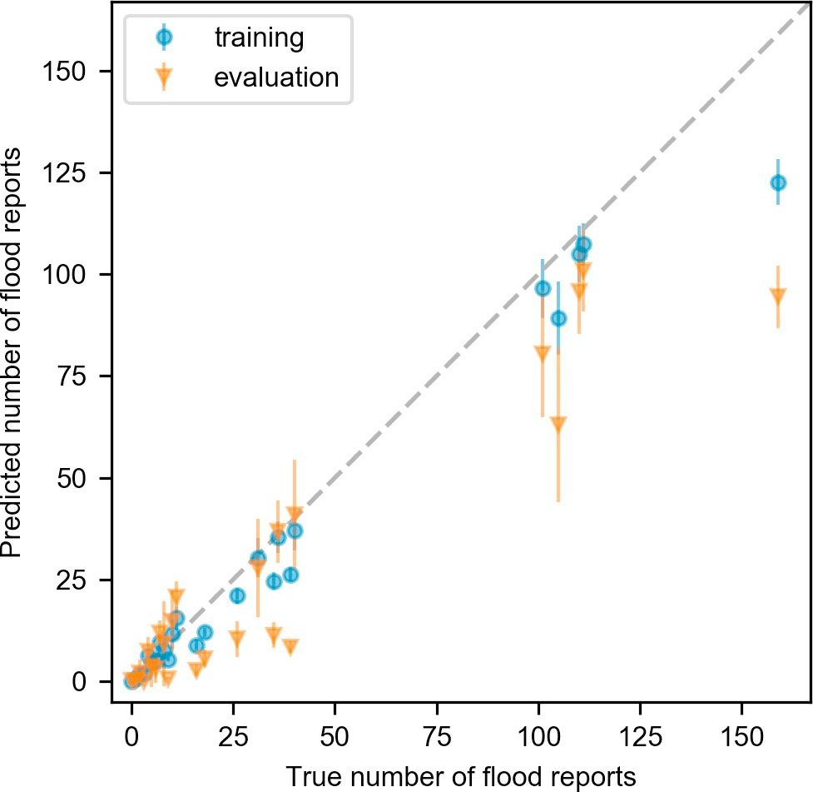
Example: Data-driven methods model flood severity using crowd-sourced and environmental data.

Slide 17
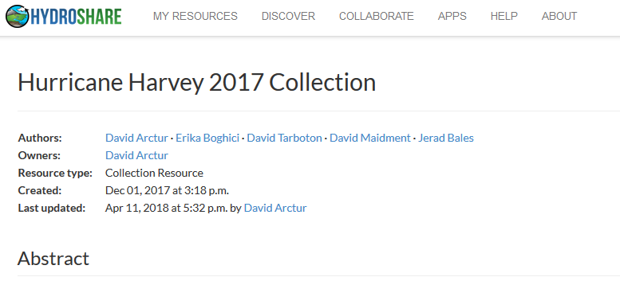
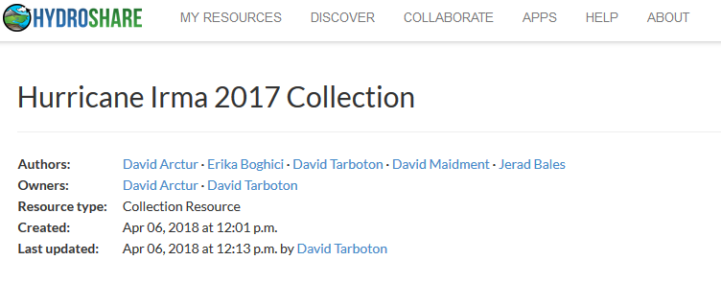
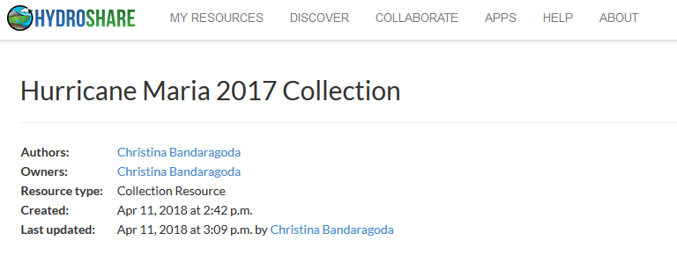
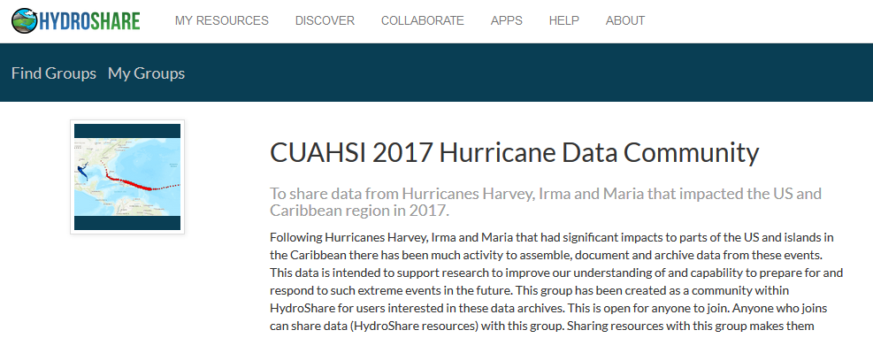
Example: Data from 2017 US Hurricanes
Look in HydroShare for keywords harvey2017, irma2017, maria2017

Slide 18
- iUTAH Proposal Data Management Plan
Data Management
“All of the primary datasets collected as part of this project will be made freely and publicly available…”
Many of us put statements like this in our Data Management Plan, but how do we really accomplish this?
From Jeff Horsburgh

Slide 19
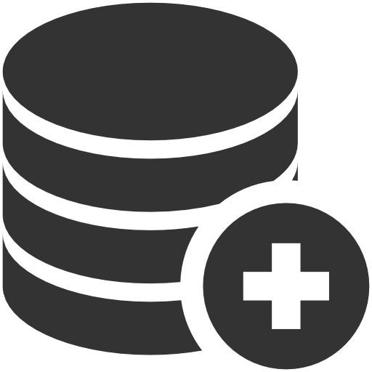
Ideal Investigator Data Workflow
Easily create a digital instance of a dataset or model
Quickly share it with colleagues (perhaps privately at first)
Add value through collaboration, annotation, and iteration
Describe with metadata
Eventually…share publicly or permanently Publish
DOI
META
This is still not as easy as it should be!
From Jeff Horsburgh
Notes:
Focusing in on one generalized workflow for doing science:
the tools we have available to use to do this can still be difficult to string together, and it isn’t clear how to get from point A to point B
There’s collaboration that happens along the way, and the tools that we have available to us now don’t foster that collaboration

Slide 20
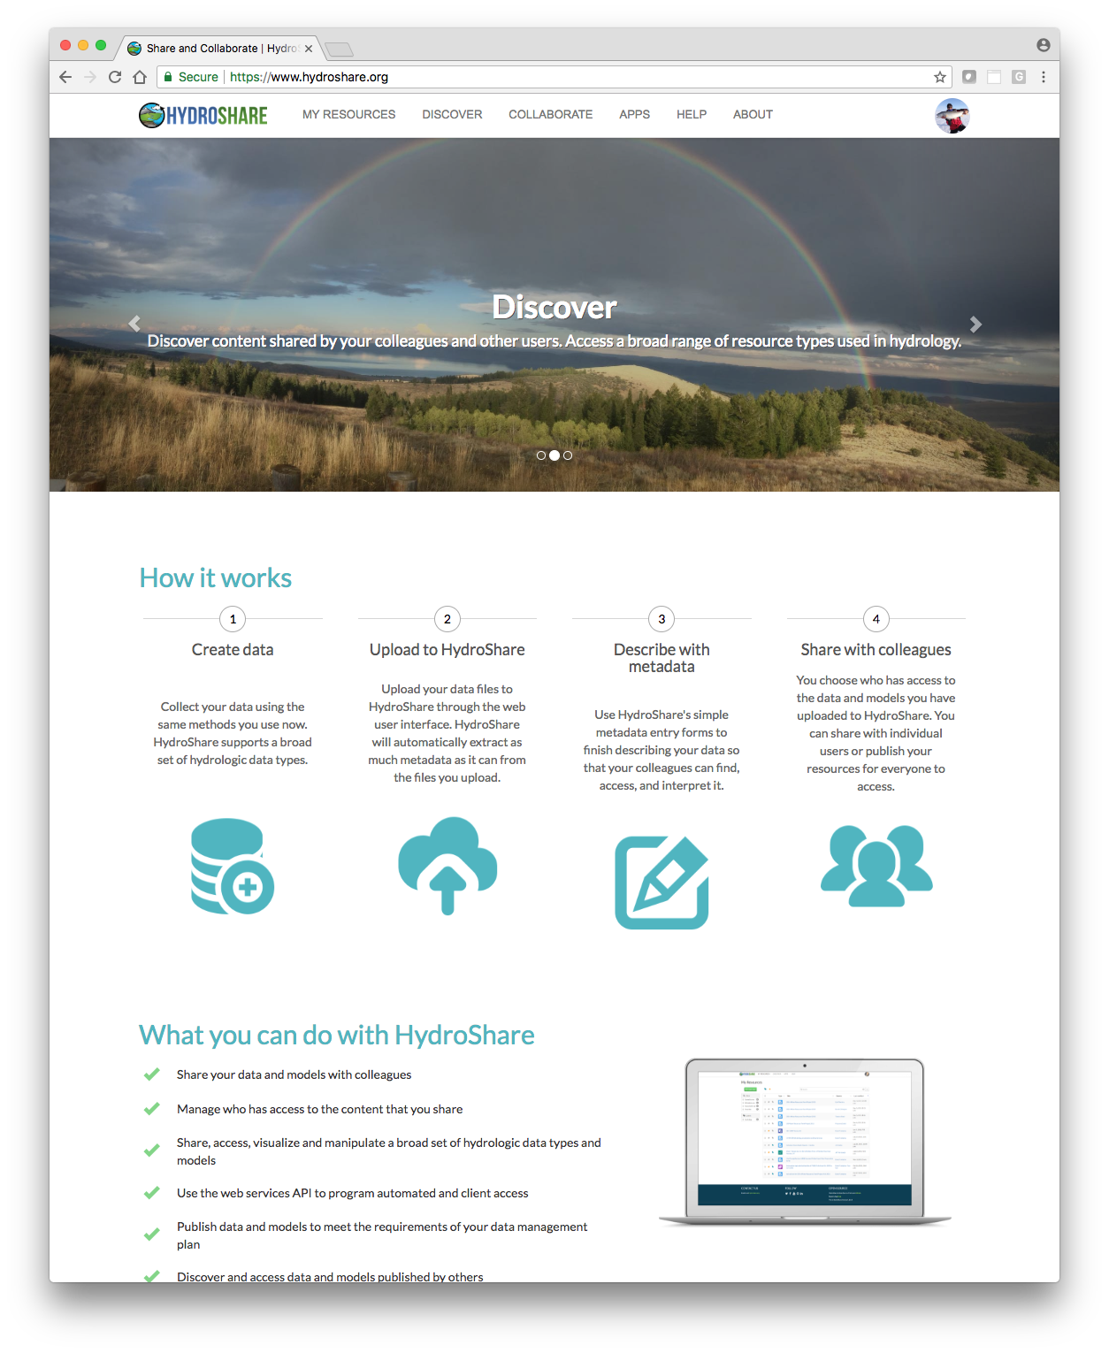
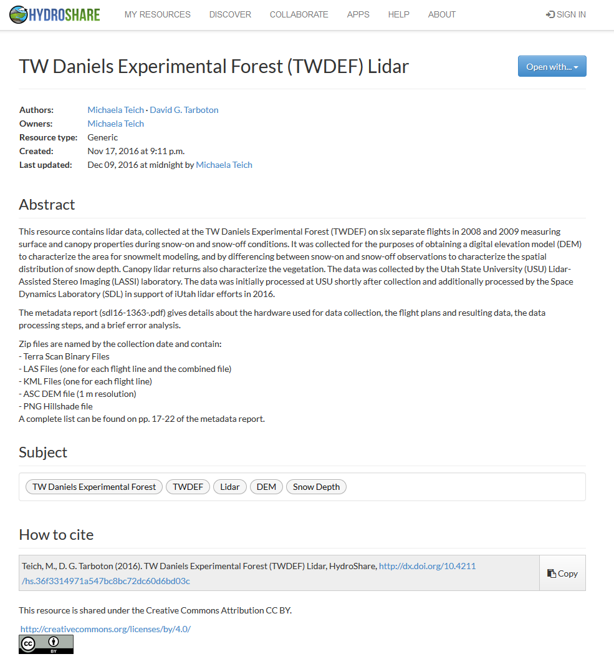
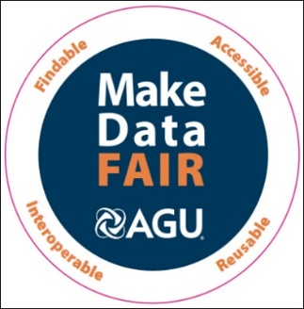
http://www.hydroshare.org
Gives you a way to share datasets, models, and other research products
Has capabilities for collaboration
Has Links to computational resources
Provides permanent publication of data and models with citable digital object identifiers that can link to literature
A system to advance hydrologic science by enabling the community to more easily and freely share products resulting from their research, not just the scientific publication summarizing a study, but also the data and models used to create the scientific publication.
Findable
Accessible
Interoperable
Reusable

Slide 21
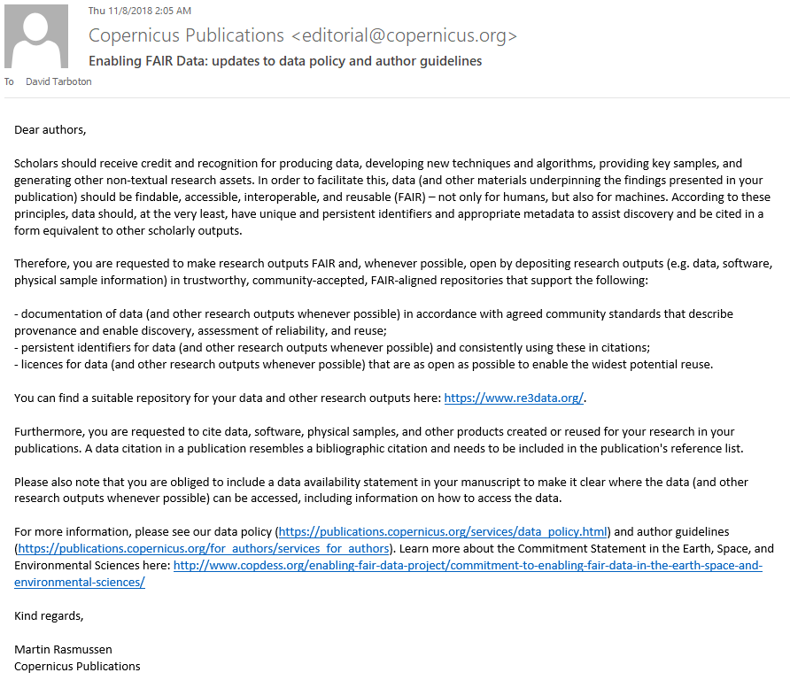
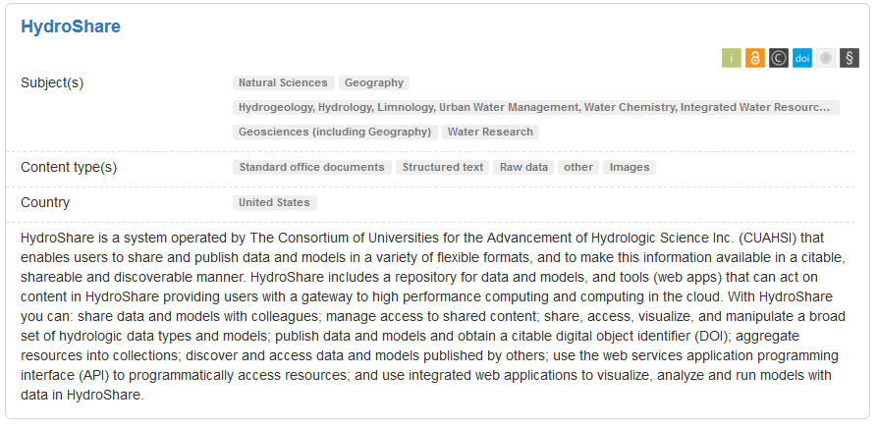
Received today
https://www.re3data.org/

Slide 22
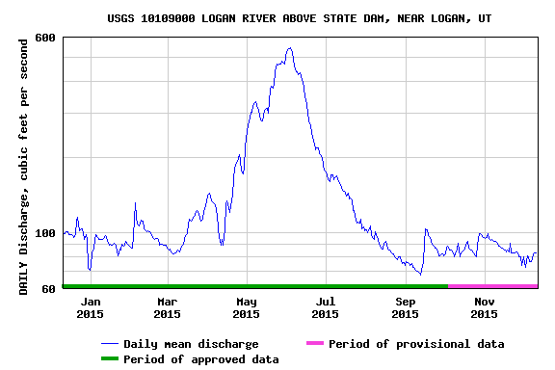
Data and models used by hydrologists are diverse…
Time series
Geographic rasters
Geographic features
Multidimensional space/time
Model programs
Model instances
…
http://www.usgs.gov
http://www.unidata.ucar.edu
http://www.esri.com
HydroShare can hold data in a wide variety of formats
From Jeff Horsburgh
Notes:
But, the data we use are diverse, and we don’t currently have a lot of options for sharing models or model instances. We’ve nailed time series down, but we still don’t have great cyberinfrastructure embraced by our community that supports the broad spectrum of data and models we use.

Slide 23
OAI-ORE standard based Resource Data Model
Dublin Core machine readable metadata and data model to make data in HydroShare FAIR
Horsburgh, J. S., M. M. Morsy, A. M. Castronova, J. L. Goodall, T. Gan, H. Yi, M. J. Stealey and D. G. Tarboton, (2016), "HydroShare: Sharing Diverse Environmental Data Types and Models as Social Objects with Application to the Hydrology Domain," JAWRA Journal of the American Water Resources Association, 52(4): 873-889, http://dx.doi.org/10.1111/1752-1688.12363.

Slide 24
Collaborative data sharing
Add content to HydroShare to share with your colleagues or permanently publish to document result reproducibility

Slide 25
Resources (data and models) in HydroShare are objects of collaboration (social objects)
For each resource you can
Manage who has access
To edit
To view
Comment or rate
Obtain unique identifier
Describe with metadata
Organize into collections
Permanently publish with DOI
Version
Open with compatible web app

Slide 26
Resource Organization Concepts
A resource can hold multiple aggregations
Each being a different type of data
Managed as one discoverable resource
One set of access controls (Owners, Editors etc.)
One unique identifier
One set of resource level metadata
A collection can hold multiple resources
Collections and their members may each be discovered separately
Unique keyword tags form informal collections
(e.g. “OACwebinar”)
Resource
Multi-dimensional
Feature
Grid
Collection

Slide 27
Automatic and simple metadata gathering eases some of the pain of metadata entry
For geographic raster WGS 84 Coverage information automatically harvested from GeoTIFF coordinate system information
For multidimensional netCDF data with CF convention metadata the HydroShare metadata can be fully and automatically completed

Slide 28
Apps act on resources to support web based visualization and analysis http://www.hydroshare.org/apps

Slide 29
Conceptual Architecture
Resource exploration
Actions on Resources
Django Website
HydroShare Apps
Organize and annotate your content
Manage access
API
Web software to operate on content you have access to (Apps)
Extensibility
OAuth
Anyone can set up a server/app platform (software service) to operate on HydroShare resources through iRODS and API
API
API
Moving towards fully web based hydrologic innovation environment
Distributed file storage
Resource Storage
iRODS “Network File System”
SWATShare (Hubzero)
JupyterHub
Unidata – THREDDS
NWM Viewer
Tethys Apps
HydroShare Data Store
Federated Data Store

Slide 30
HydroShare Web App Linkage
Anybody can create a web app on any web server and configure a web app resource for it to be launched from HydroShare
Web App #1
Web App Metadata
HydroShare Resource Catalog
Web App #1 Metadata
Web App #2
Predefined URL Launch Parameters:
Resource ID: ${HS_RES_ID}
Resource Type: ${HS_RES_TYPE}
HydroShare username: ${HS_USR_NAME}
Web App #2 Metadata
Web App #3 Metadata
Tethys Platform Apps
Examples:
https://apps.hydroshare.org/apps/ hydroshare-gis/?res_id= ${HS_RES_ID}
https://mygeohub.org/.../?res_id= ${HS_RES_ID}&usr=${HS_USR_NAME}&src=hs
http://hyrax.hydroshare.org/ opendap/${HS_RES_ID}/data/ contents/
Web App Resource Type
Web App #3
HydroShare Python REST API
3rd Party Apps

Slide 31
JupyterHub App

Slide 32
JupyterHub App Analysis
Write and execute code in a Jupyter Notebook, acting on content of HydroShare resources and saving results back to HydroShare Repository
Reproducibility
Collaboration
Access to enhanced computation

Slide 33
Demo

Slide 34
Value that HydroShare provides
Integration of information from multiple sources to enhance research
Re-use of data beyond the purpose for which it was originally collected, extending the value of measurement, monitoring and research investments
A platform for data management to support mandates for open data and access to the data that supports research findings
Enhanced trust in research findings and management decisions through transparency and support for reproducibility

Slide 35
HydroShare 2.0
Hydrologic modeling
Systematic hypothesis testing (SUMMA)
Transform National Water Model into community water model platform
Social Collaboration
User driven design
Incentives, metrics, group collaboration
Storage Agility
Use 3rd party storage (Dropbox, Box, Google, University libraries and digital commons)
App Nursery
Make it easier to write apps
Develop and deploy new apps

Slide 36
Software Engineering Process
1. Issue
2. Branch
3. Pull Request
4.1 Deploy on test platform
4.2 Code Review
4.3 Jenkins Test
5. Merge
Collaborative open development process used by multidisciplinary team of professional programmers and hydrologic scientists for HydroShare development.
6. Deploy

Slide 37
HydroShare User Experience Redesign
Leveraging user-oriented design practices to inform future design decisions to the HydroShare interface
Design practices:
Talking to users
Co-design
Design frameworks e.g. personas, journey maps, etc.
Wireframing
Keenan, Patrick, Andrew, Mackenzie, & Celina

Slide 38
Example: Recommendation for Dashboard and “Search all of HydroShare”
Full Final Report: https://www.hydroshare.org/resource/9e888ababe6648ad95d07b6ec5ed7cb0/
Notes:
This is an MVP.
Wanted to capture links that users found most useful

Slide 39
Summary
HydroShare is a web based collaboration environment to enable more rapid advances in hydrologic understanding through collaborative data sharing, analysis and modeling
Sharing and publication of data (DOI)
Social discovery and added value
Model sharing
Model input data preparation
Model execution
Visualization and analysis (best of practice tools)
Collaboration, Reproducibility, Credit, Transparency
Server/Cloud Computation
Platform independence
Big data
Reproducibility
Reduce needs for software installation and configuration

Slide 40
Thanks to the HydroShare team!
OAC-1664061
OAC-1664018
OAC-1664119
2017-2021
To learn more
Publications https://help.hydroshare.org/about-hydroshare/publish/
Online Help https://help.hydroshare.org/
http://www.hydroshare.org
Notes:
The HydroShare project is part of a broad effort in CUAHSI in the area of Hydrologic Information Systems. We have a team of developers and domain scientists from eight universities working on HydroShare. This is part of the even broader focus in NSF on data management, Cyberinfrastructure and sustainable software.

