Slide 1
Welcome to GIS in Water Resources
2018
David Maidment, David Tarboton

Slide 2
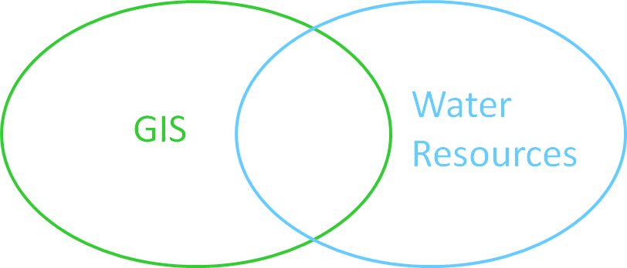
Introduction to GIS in Water Resources
Course Overview
Creating Water Knowledge
What is GIS
Shape of the Earth

Slide 3
Introduction to GIS in Water Resources
Course Overview
Creating Water Knowledge
What is GIS
Shape of the Earth

Slide 4
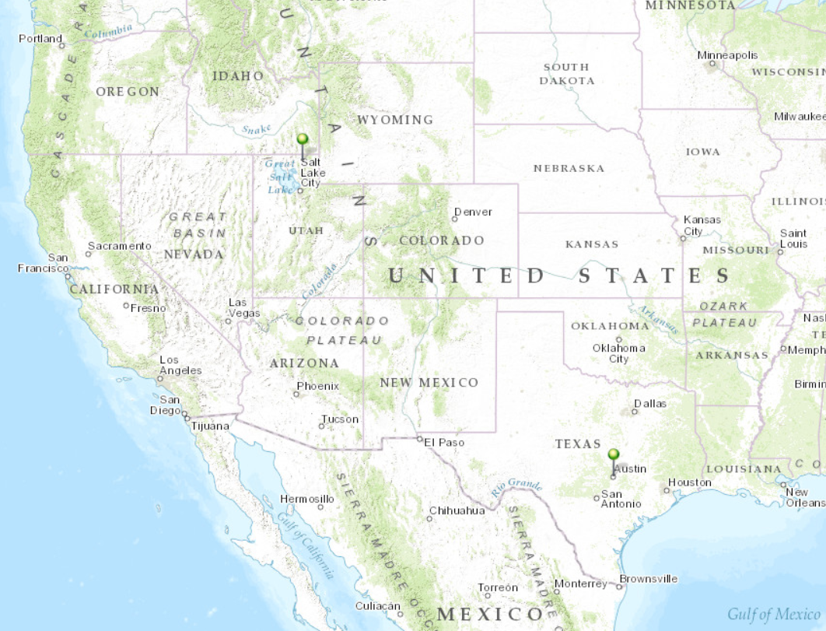
Our Classroom
Dr David Tarboton
Students at Utah State University
Dr David Maidment Students at University of Texas at Austin

Slide 5

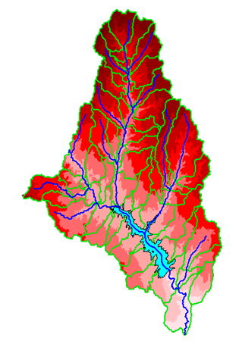
David Maidment
B.E. in Agricultural Engineering (with First Class Honors) from University of Canterbury, Christchurch, New Zealand, 1972
MS, PhD in Civil Engineering from University of Illinois, 1974 and 1976, respectively
1981 – joined University of Texas at Austin as an Assistant Professor, and have been on the faculty ever since. Now Hussein M. Alharthy Centennial Chair in Civil Engineering
Initiated the GIS in Water Resources course in 1991.
Worked with ESRI since 1994 on a GIS Hydro Preconference seminar for the ESRI Users Conference
Leader of the CUAHSI Hydrologic Information System project from 2004-2011
Elected to National Academy of Engineering in 2016 “for development of geographic information systems applied to hydrologic processes”.

Slide 6

David Tarboton
B.Sc Eng in Civil Engineering from the University of Natal, Durban, South Africa 1981
M.S. and Sc.D from MIT, Cambridge, Massachusetts, 1987 and 1990 respectively
1990 - Joined Faculty at Utah State University in Civil and Environmental Engineering
1996 - Developed D-Infinity research terrain analysis codes that became TauDEM, and are now incorporated into ArcGIS
Participated in GIS in Water Resources since 1999
Research includes snow energy balance, stochastic streamflow and physically based hydrologic modeling
Leader of CUAHSI HydroShare project to develop a system for sharing of hydrologic data and models
Elected Fellow of the American Geophysical Union in 2018 “for fundamental contributions that have advanced hydrologic information systems and hydrologic modeling”

Slide 7
Six Basic Course Elements
Lectures
  Powerpoint slides
  Video streaming
Readings
  Assigned web materials
Homework
  Computer exercises
  Hand exercises
Term Project
  Oral presentation
  pdf report
Class Interaction
  Email
  Discussion
Examinations
  Midterm, final

Slide 8
University Without Walls
Traditional Classroom
Community
Inside and Outside
The Classroom

Slide 9
Learning Styles
Instructor-Centered Presentation
Community-Centered Presentation
Instructor
Student
We learn from the instructors and each other

Slide 10
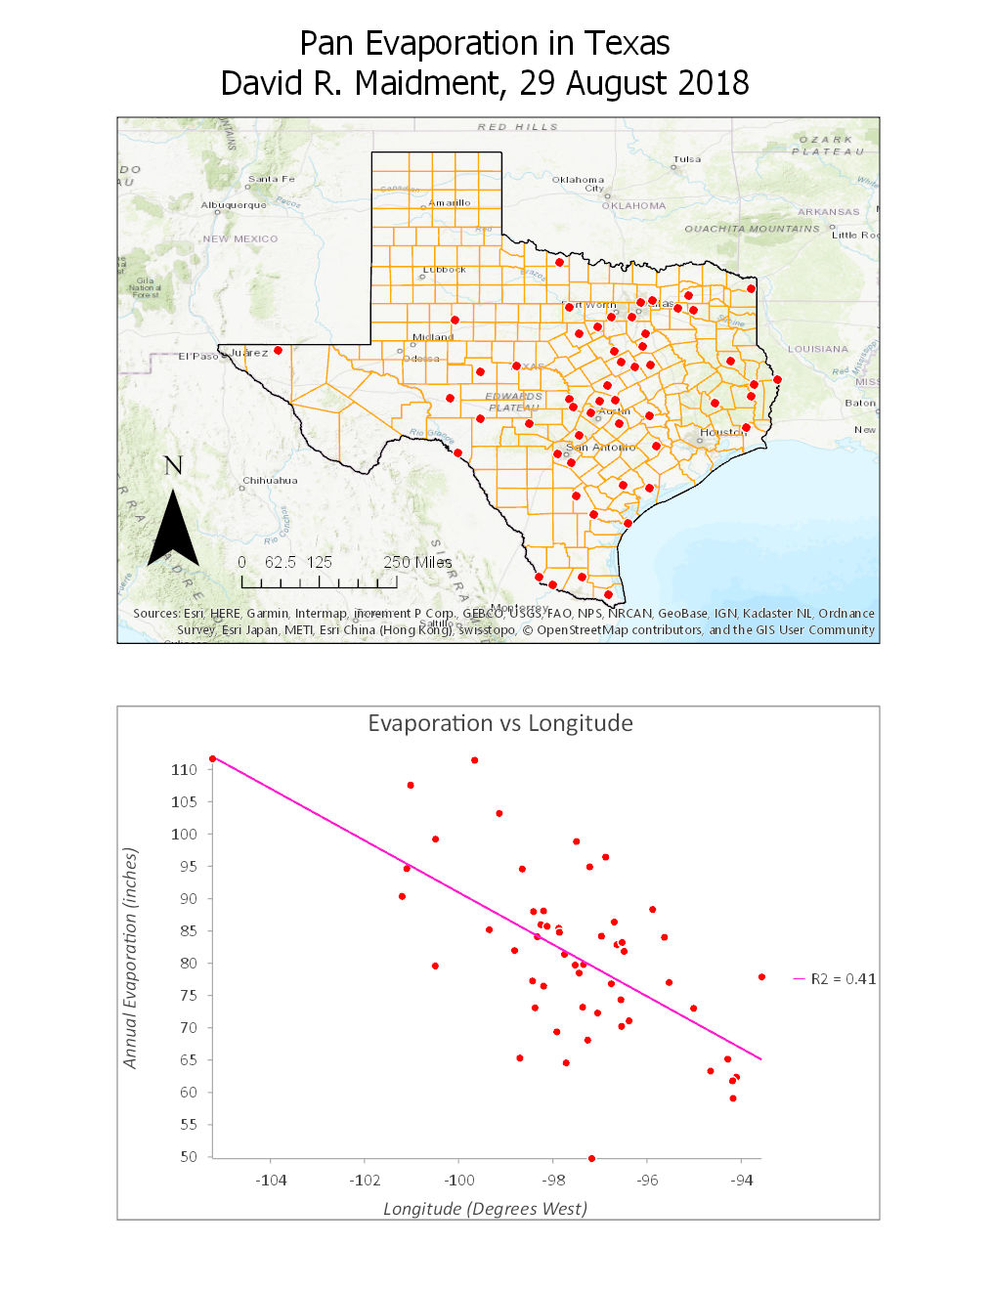
Exercise 1: Introduction to ArcGIS
Class | Subject
0 | Intro class at USU
1 | Introduction to GIS in Water Resources
2 | Introduction to ArcGIS
3 | Exercise 1: Introduction to ArcGIS
Goal: Understand how to use ArcGIS to prepare a map and a chart of observations data at point locations.

Slide 11
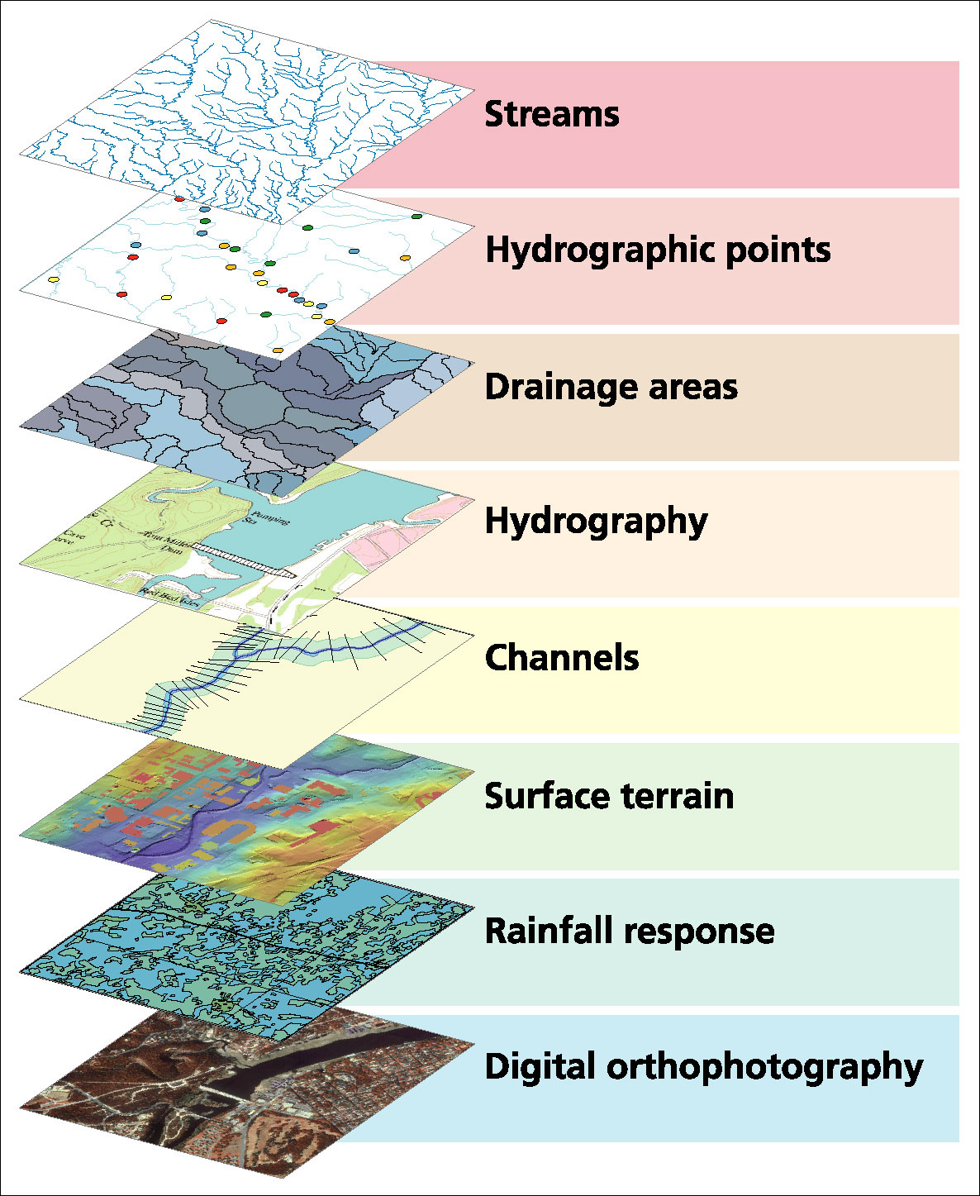
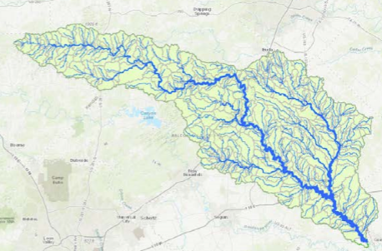
Exercise 2: Building a Base Map
Thematic layers
Class | Subject
4 | Data Sources for GIS in Water Resources
5 | Map Projections and Coordinate Systems
6 | Exercise 2: Building a base map.
San Marcos basin
Goal: Create a geospatial database for a particular watershed as a collection of thematic layers

Slide 12
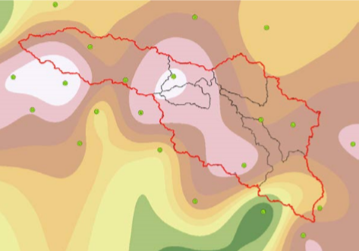
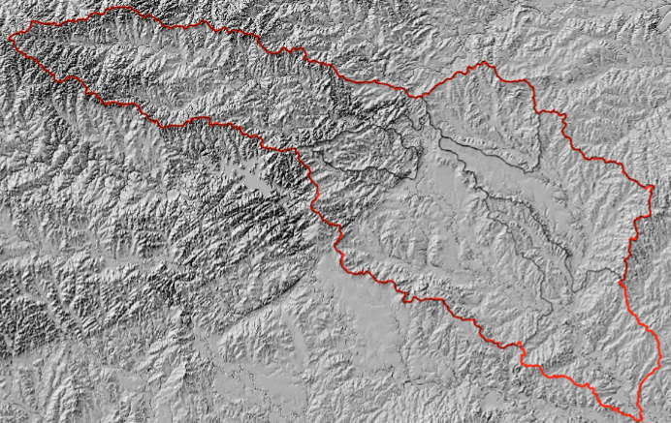
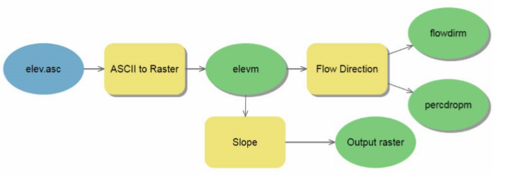
Exercise 3: Spatial Analysis
Class | Subject
7 | Spatial Analysis [1 page term project proposal due]
8 | Exercise 3: Spatial analysis in Hydrology
Goal: Analysis of raster data representing spatially continuous surfaces
Rainfall map of the
San Marcos basin
Land surface
topography
Model Builder

Slide 13
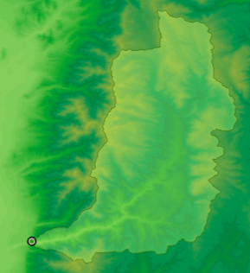
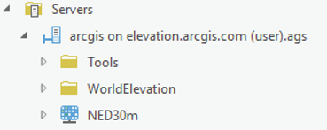
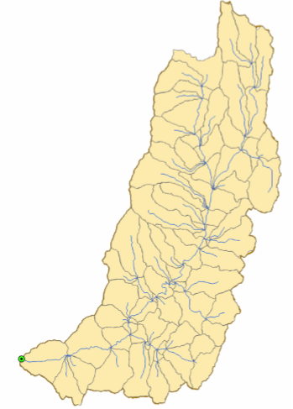
Exercise 4: Watershed and Stream Network Delineation
Class | Subject
9 | Digital Elevation Model Watershed and Stream Network Delineation
10 | Extended Hydrologic Terrain Analysis
11 | Exercise 4. Watershed and Stream Network Delineation
Raster
Feature
Online data and services
Goal: Create a detailed set of watershed and stream network features from a raster terrain model

Slide 14
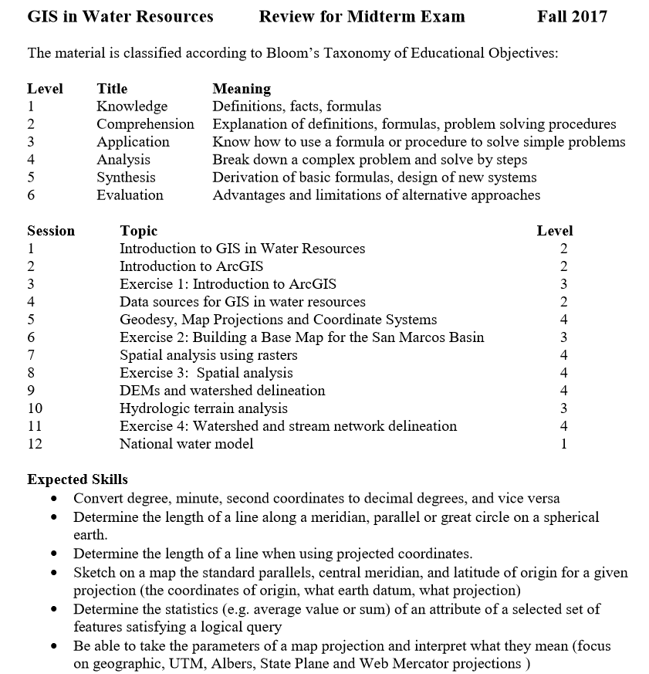
Midterm Exam
(Tues Oct 16)
Class | Subject
12 | National Water Model
13 | Review for Midterm Exam
14 | Midterm exam
15 | Groundwater. Midterm return
Goal: Knowledge and Comprehension of concepts. Application and Analysis calculations.

Slide 15
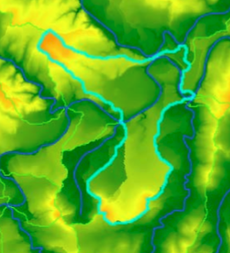
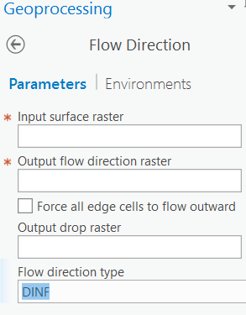
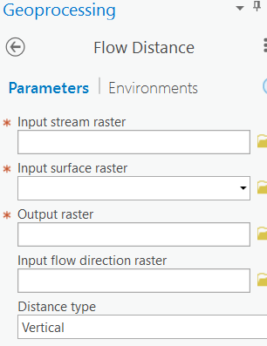
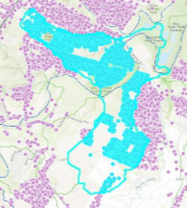
Exercise 5: Flood Inundation Analysis
Class | Subject
16 | Height above Nearest Drainage (HAND) flood inundation mapping. [Term project 2 page progress report due]
17 | Exercise 5: Height above nearest drainage (HAND) Flood Inundation mapping
Goal: Creating flood inundation maps and identifying flooded homes

Slide 16
Term Project
Oral presentations
Proposal
Due
Sept 20
Progress
Report
Oct 23
Nov 13
Dec 6
Class
7
16
22
28
18 | Tuesday, October 30, 2018 | Extending ArcGIS using Programming (Python)
19 | Thursday, November 1, 2018 | Demography
20 | Tuesday, November 6, 2018 | LIDAR
21 | Thursday, November 8, 2018 | Water information sharing and HydroShare
22 | Tuesday, November 13, 2018 | Term Paper Presentations Texas
23 | Thursday, November 15, 2018 | Term Paper Presentations Texas
24 | Tuesday, November 20, 2018 | Term Paper Presentations USU
 | Thursday, November 22, 2018 | Thanksgiving
25 | Tuesday, November 27, 2018 | Term Paper Presentations Texas
26 | Thursday, November 29, 2018 | Term Paper Presentations USU
27 | Tuesday, December 4, 2018 | Term Paper Presentations Texas
28 | Thursday, December 6, 2018 | Term Paper Presentations Texas
 | Friday, December 7, 2018 | Term project due
Additional lectures
Oral presentations
(10 min)
Written report

Slide 17
Introduction to GIS in Water Resources
Course Overview
Creating Water Knowledge
What is GIS
Shape of the Earth

Slide 18
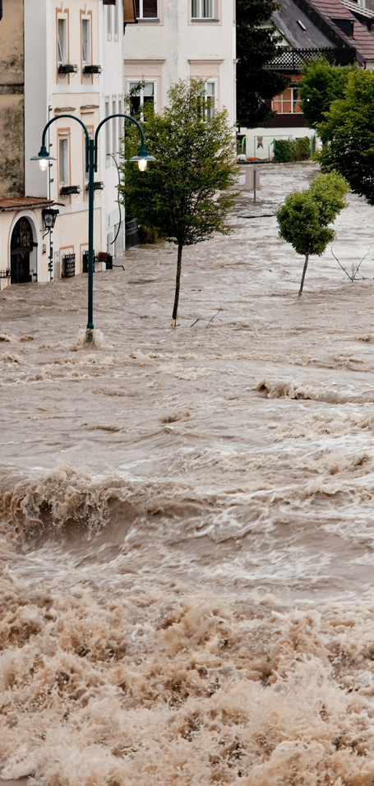
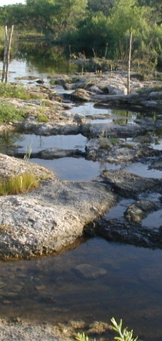

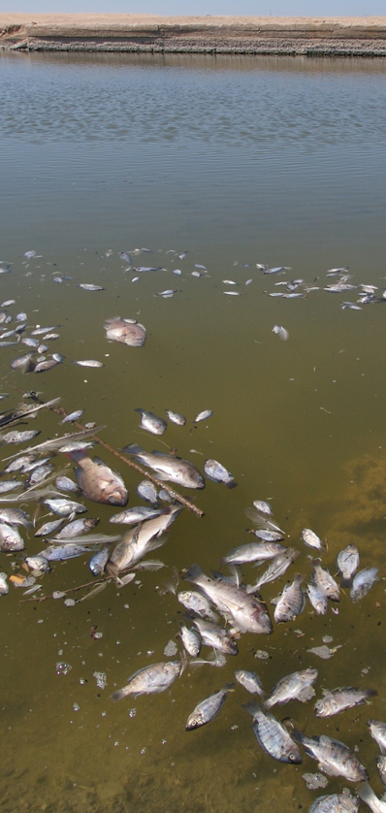
Four water problems to be solved …
… we need a framework for all of these
Flood
Drought
Water Pollution
Ecological Degradation
Notes:
There are four basic problems to be solved in natural water systems:
Flooding – how to characterize and mitigate floods
Droughts – how to assess water availability and define water supply
Dirty water – how to assess water quality assessment and calculate Total Maximum Daily Load estimates
Environmental Issues – how to ensure that there is enough water quantity and quality to support aquatic life?

Slide 19
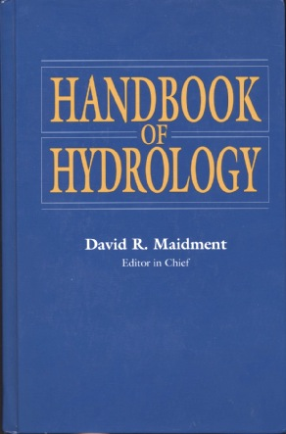
How is new knowledge discovered?
After completing a Handbook of Hydrology, I asked myself the question: how is new knowledge discovered in hydrology?
Deduction
from existing knowledge
By deduction from existing knowledge
By experiment in a laboratory
By observation of the natural environment
Experiment
in a laboratory
Observation
of the natural environment
Notes:
After completing a Handbook of Hydrology, I asked myself the question: how is new knowledge discovered in hydrology?
<Click> to show answers
By deduction from existing knowledge
By experiment in a laboratory
By observation of the natural environment

Slide 20

Deduction – Isaac Newton
“The ancients divided mechanics into two parts; the rational, which proceeds accurately by demonstration; and the practical.
It occurs that mechanics is so distinguished from geometry, that what is perfectly accurate is called geometrical, what is less so, is called mechanical. Yet the errors do not come from the art but from those who practice the art.
In this sense rational mechanics will be the science of motions resulting from any forces whatsoever, and of the forces required to produce any motions, accurately proposed and demonstrated.”
Isaac Newton
Trinity College, Cambridge
8 May, 1686

Slide 21
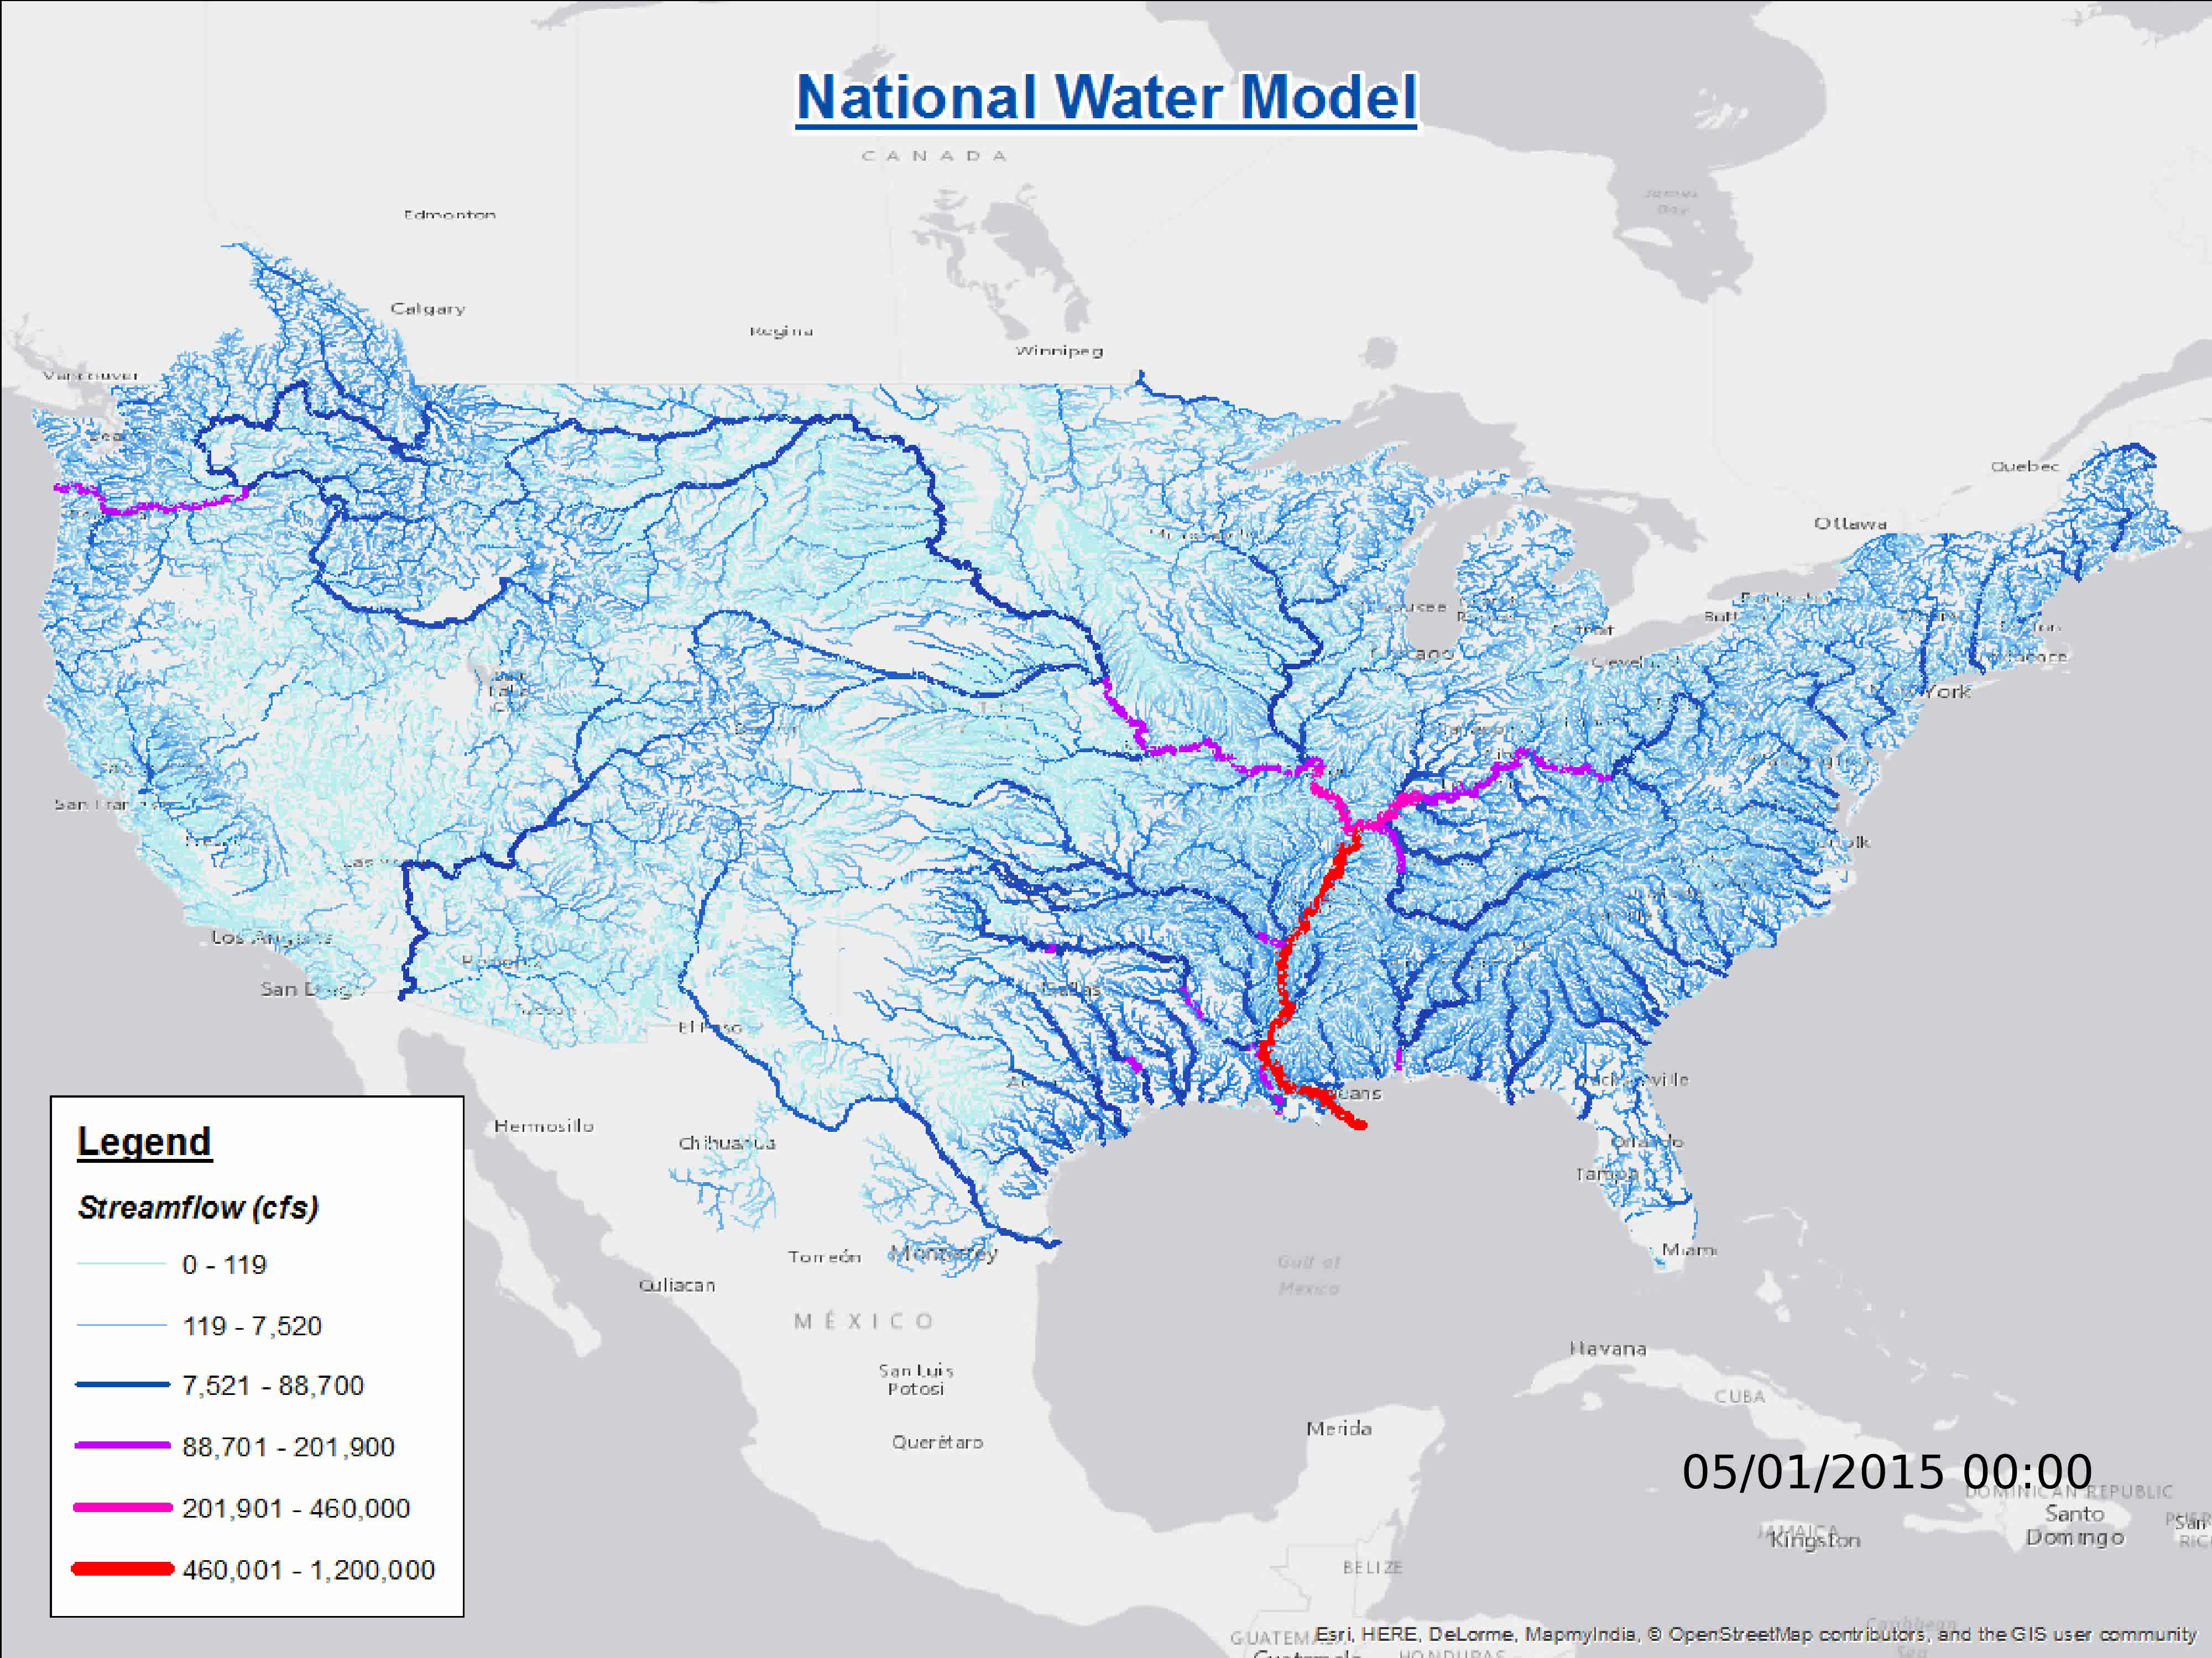
Computer Modeling as Deduction
Deduction
is the classical path of mathematical physics:
  Given a set of axioms
  Then by a logical process
  Derive a new principle or equation
Computer Modeling
is a modern equivalent that says:
  Given a set of input data
  Then using an algorithm
  Derive a computational result

Slide 22

Experiment – Louis Pasteur
Experiment is the classical path of laboratory science – a simplified view of the natural world is replicated under controlled conditions
Pasteur showed that microorganisms cause disease and discovered vaccination
  a foundation of scientific medicine
Laboratory experiments are more for microscale than the macroscale
  hard to conduct at the global scale
Experiment – a simplified view of the natural world is replicated under controlled conditions
Pasteur showed that microorganisms cause disease and discovered vaccination
    a foundation of scientific medicine
Laboratory experiments are more for microscale than the macroscale
Important for water chemistry and microbiology
Notes:
Experiment is the classical path of laboratory science – a simplified view of the natural world is replicated under controlled conditions
Pasteur showed that microorganisms cause disease and discovered vaccination
a foundation of scientific medicine
Laboratory experiments are more for microscale than the macroscale
hard to conduct at the global scale

Slide 23

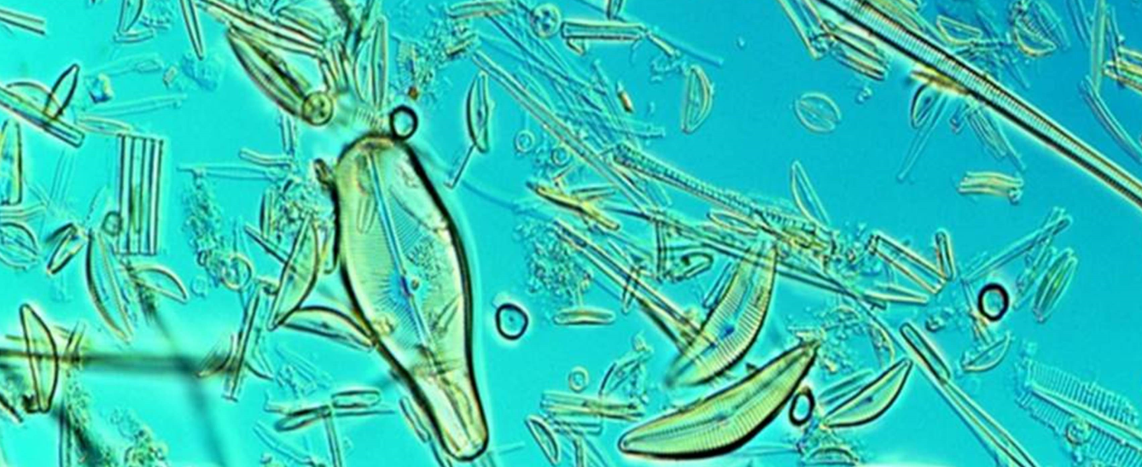
Microorganisms in Water

Slide 24

Observation – Charles Darwin
“When on board H.M.S. Beagle, as naturalist, I was much struck with certain facts in the distribution of the inhabitants of South America, and in the geological relations of the present to the past inhabitants of that continent. These facts seemed to me to throw some light on the origin of species -- that mystery of mysteries, as it has been called by one of our greatest philosophers. On my return home, it occurred to me, in 1837, that something might perhaps be made out on this question by patiently accumulating and reflecting on all sorts of facts which could possibly have any bearing on it.
I can here give only the general conclusions at which I have arrived, with a few facts in illustration, but which, I hope, in most cases will suffice.”
Published 24 November,1859
Most accessible book of great
scientific imagination ever written

Slide 25
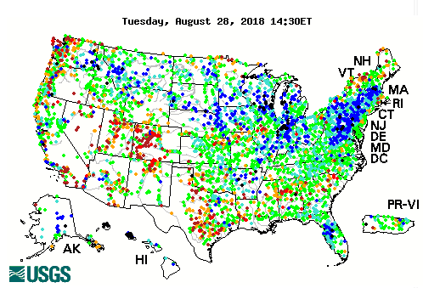

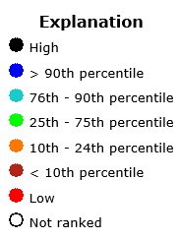
Real-Time Map of Water Flow Observations

Slide 26
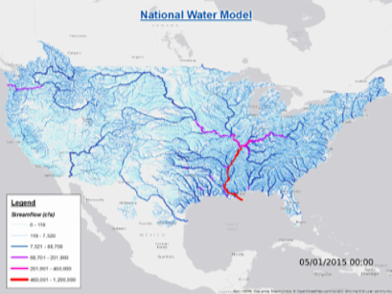
Linking Modeling and Observations ….
…. needs an information framework

Slide 27
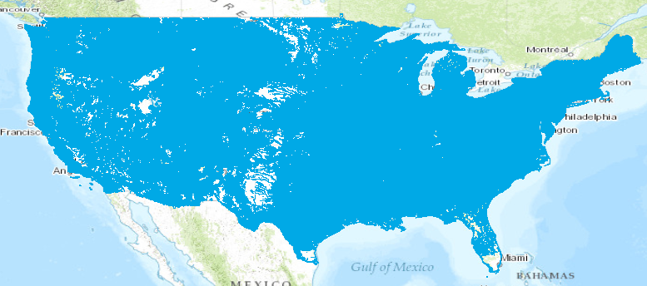
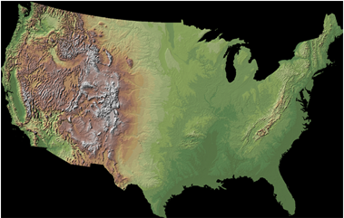
Linking Water and Land Systems ….
…. needs an information framework
River and Stream Lines
Land Surface Topography
Spatially Discrete Features
Spatially Continuous Raster

Slide 28
Putting Everything Together….
…. needs an information framework
Streamflow Modeling
Stream Gage (Points)
Rivers and Streams (Lines)
Land Surface Topography

Slide 29
Information Frameworks
Conceptual Model – a set of concepts that describe a subject and allow reasoning about it
Mathematical Model – a conceptual model expressed in symbols and equations
Data Model – a conceptual model expressed in a data structure (e.g. ascii files, Excel tables, …..)
Geographic Data Model – a conceptual model for describing and reasoning about the world expressed in a GIS database
A data model is important because the way that information is organized can enhance or inhibit the analysis that can be done

Slide 30
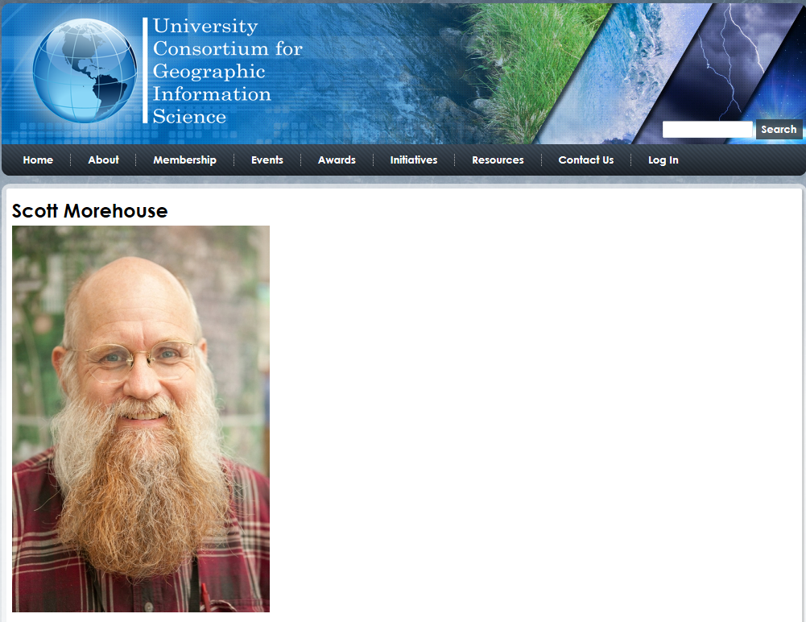
http://ucgis.org/ucgis-fellow/scott-morehouse
Made a Fellow of UCGIS in 2014
“All geographic information systems are built using formal models that describe how things are located in space. A formal model is an abstract and well-defined system of concepts. A geographic data model defines the vocabulary for describing and reasoning about the things that are located on the earth. Geographic data models serve as the foundation on which all geographic information systems are built.”
Scott Morehouse, is the original information architect of ArcGIS

Slide 31
Introduction to GIS in Water Resources
Course Overview
Creating Water Knowledge
What is GIS
Shape of the Earth

Slide 32




What is GIS
A geographic information system (GIS) is a system designed to capture, store, manipulate, analyze, manage, and present all types of geographical data. -- Wikipedia
data
computers
maps
tools

Slide 33
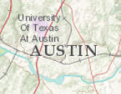
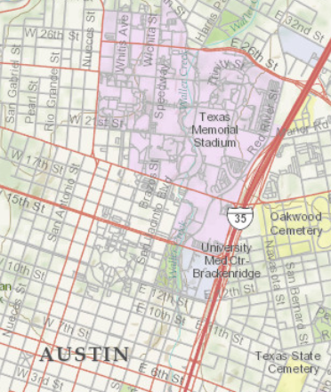
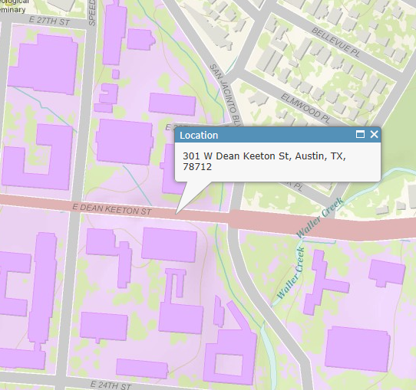
Geography is visualized in maps
map
www.arcgis.com

Slide 34
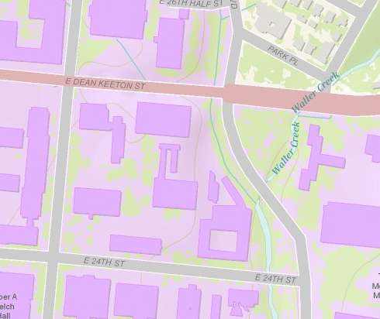
Maps are built from data
Road
Name: E. Dean Keeton St
Type: Div Highway
Speed: 35 mph
Shape: [Geometry]
Building
Name: Ernest Cockrell Jr Hall
Address: 301 E. Dean Keeton St
Shape: [Geometry]
data
Shape includes the geometry of the feature and where it is located on earth
map

Slide 35
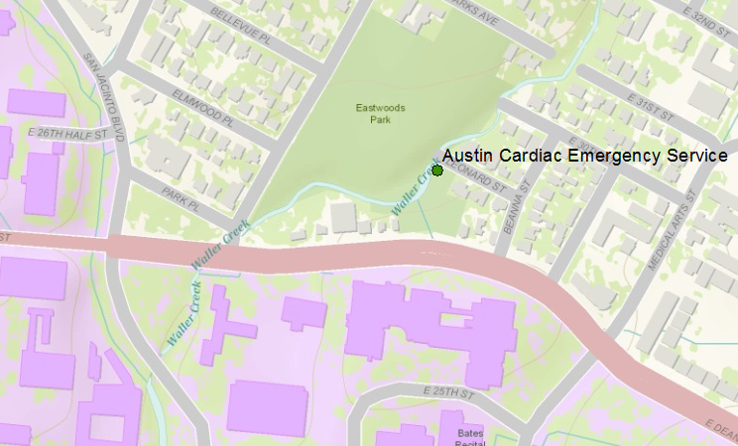
Vector data represent discrete features
points
lines
data
polygons
map

Slide 36
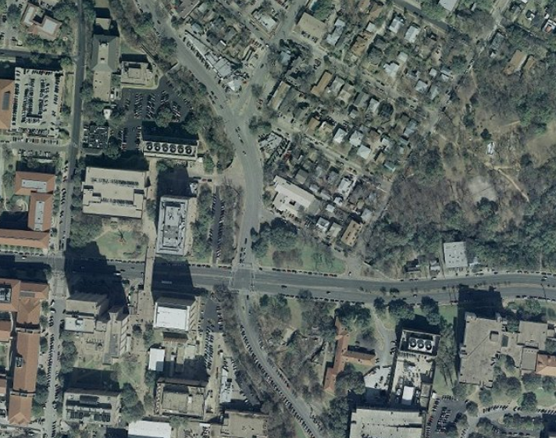
Raster data form a grid of cells or pixels
data
map

Slide 37
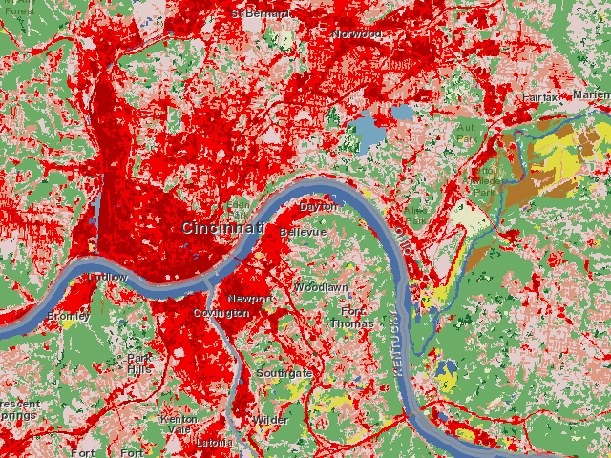
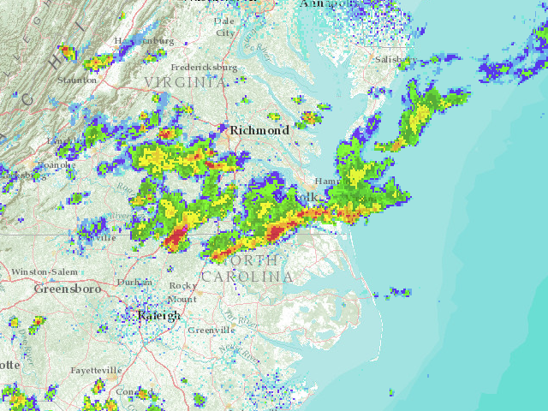
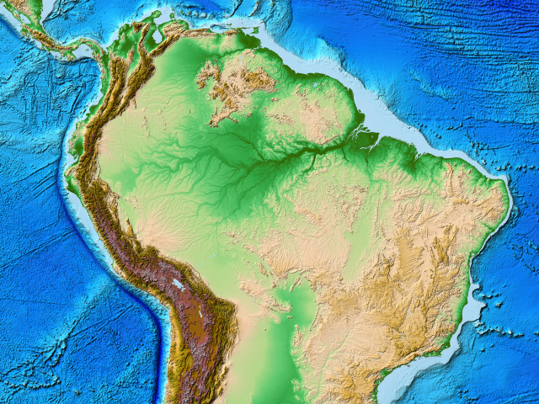
More Raster Examples
data
land use
rainfall
elevation
map

Slide 38
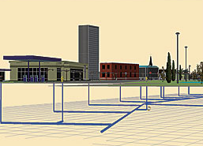
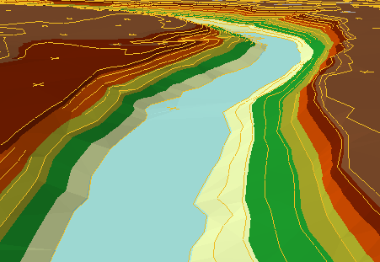
There are many more data types
multipatch
triangulated
irregular network
data
Martin Luther King Dr W
annotation
map

Slide 39
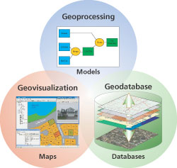
Three Views of GIS
Geodatabase view: Structured data sets that represent geographic information in terms of a generic GIS data model.
Geovisualization view: A GIS is a set of intelligent maps and other views that shows features and feature relationships on the earth's surface. "Windows into the database" to support queries, analysis, and editing of the information.
Geoprocessing view: Information transformation tools that derive new geographic data sets from existing data sets.
adapted from www.esri.com

Slide 40
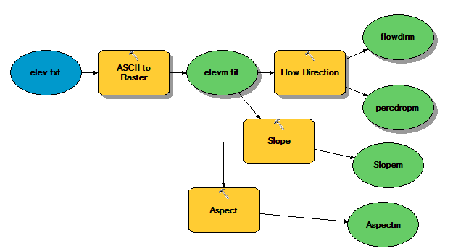
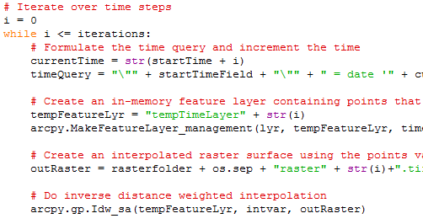
Programming
Automation of repetitive tasks (workflows)
Implementation of functionality not available (programming new behavior)

Slide 41
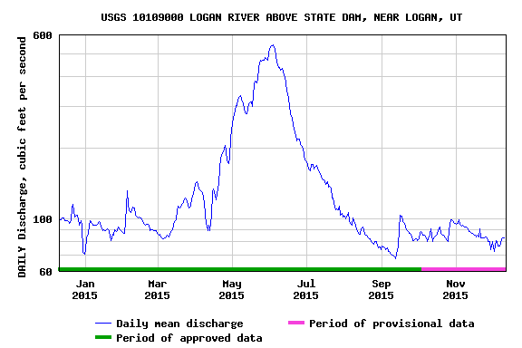
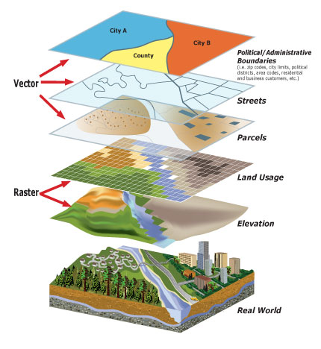

The data and models used by hydrologists are diverse…
Time series
Geographic rasters
Geographic features
Multidimensional space/time
Model programs
Model instances
…
http://www.usgs.gov
http://www.unidata.ucar.edu
We need a general web based Hydrologic Information Systems that better supports the data/models we use and the way we work
http://www.esri.com
http://www.hydroshare.org
Notes:
But, the data we use are diverse, and we don’t currently have a lot of options for sharing models or model instances. We’ve nailed time series down, but we still don’t have great cyberinfrastructure embraced by our community that supports the broad spectrum of data and models we use.

Slide 42


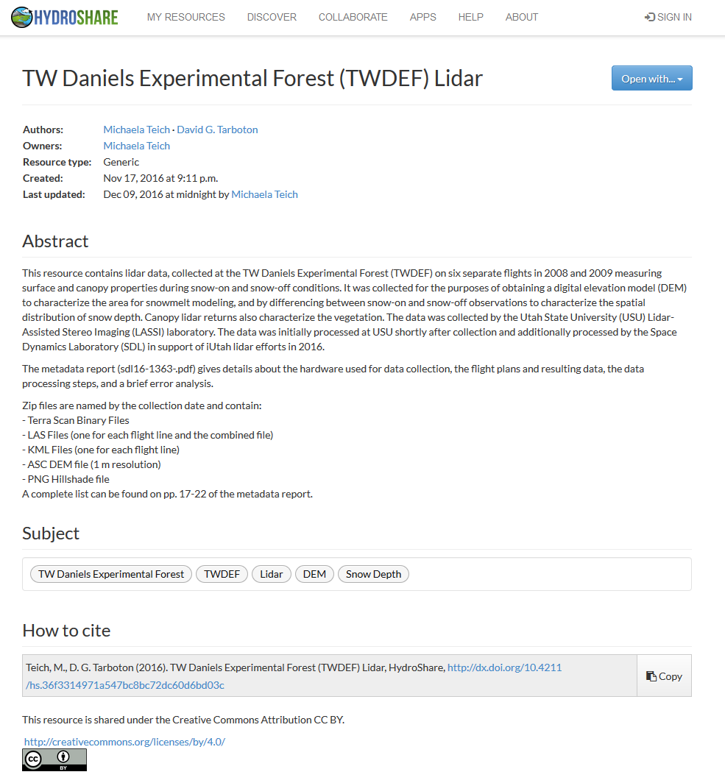

http://www.hydroshare.org
Web-based Hydrologic Information System operated by the Consortium of Universities for the Advancement of Hydrologic Science, Inc. (CUAHSI)
Gives you a way to share datasets, models, and other research products
Has capabilities for collaboration
Has Links to computational resources
Provides permanent publication of data and models with citable digital object identifiers that can link to literature
A system to advance hydrologic science by enabling the community to more easily and freely share products resulting from their research, not just the scientific publication summarizing a study, but also the data and models used to create the scientific publication.
  Findable
  Accessible
  Interoperable
  Reusable

Slide 43
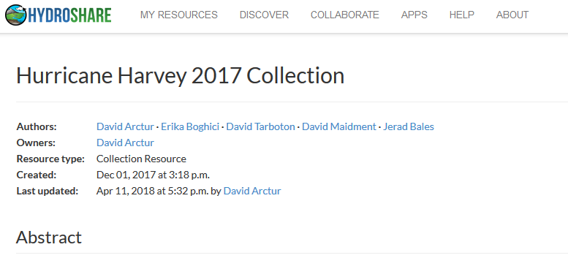
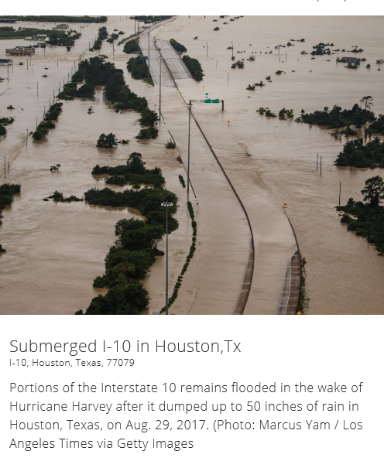
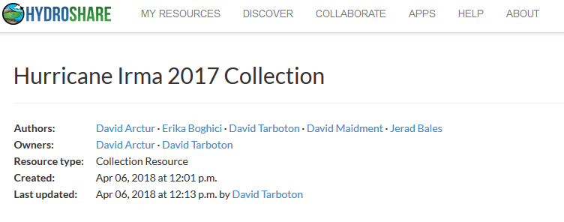
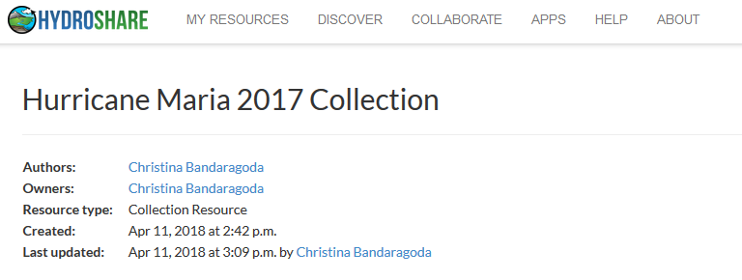

Data from 2017 US Hurricanes
Look in HydroShare for keywords harvey2017, irma2017, maria2017

Slide 44
Introduction to GIS in Water Resources
Course Overview
Creating Water Knowledge
What is GIS
Shape of the Earth

Slide 45



Slide 46

Origin of Geographic Coordinates
Equator
(0,0)
Prime Meridian

Slide 47
Latitude and Longitude
Longitude line (Meridian)
N
W
E
S
Range: 180ºW - 0º - 180ºE
Latitude line (Parallel)
N
W
E
S
(0ºN, 0ºE)
Equator, Prime Meridian
Range: 90ºS - 0º - 90ºN

Slide 48

Latitude and Longitude in North America
Austin:
Logan:
(30°18' 22" N, 97°45' 3" W)
60 N
30 N
(41°44' 24" N, 111°50' 9" W)
120 W
60 W
90 W
0 N

Slide 49
Map Projection
Flat Map
Cartesian coordinates: x,y
(Easting & Northing)
Curved Earth
Geographic coordinates: φ, λ
(Latitude & Longitude)
Notes:
DRM

Slide 50


Earth to Globe to Map
Map Scale:
Map Projection:
Representative Fraction
Globe distance
Earth distance
Scale Factor
Map distance
Globe distance
=
=
(e.g. 1:24,000)
(e.g. 0.9996)

Slide 51
Coordinate Systems
A planar coordinate system is defined by a pair
of orthogonal (x,y) axes drawn through an origin
Y
Origin
X
(x_{o},y_{o})
(φ_{o},λ_{o})
Projected Coordinates
Geographic Coordinates

