Slide 1
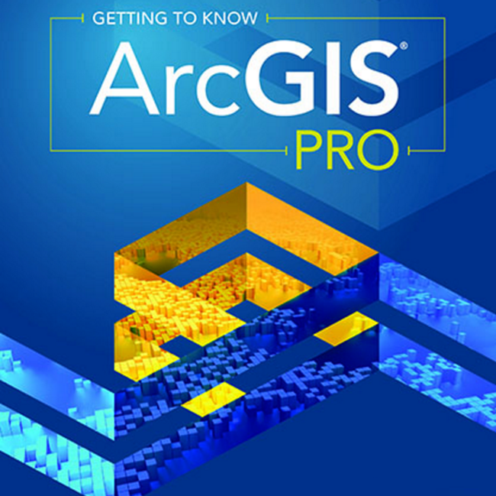
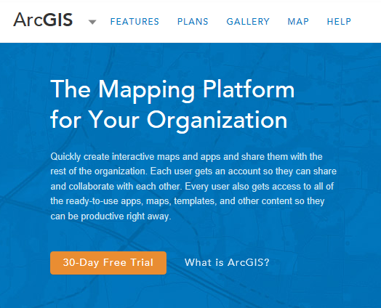
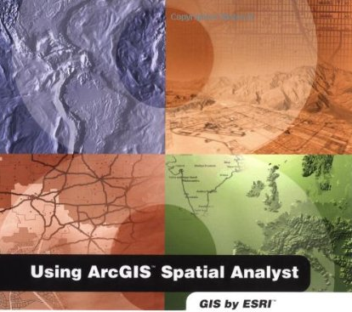
Introduction to ArcGIS Software

Slide 2
Jack Dangermond, President, ESRI
Article from NY Times:
http://www.nytimes.com/2011/07/10/business/esris-chief-on-tending-his-plants-and-his-company.html?_r=2

Slide 3
Videos from Plenary Session of 2018 ESRI User Conference
http://p.ctx.ly/r/7zha

Slide 4
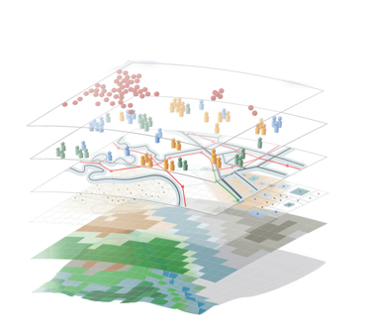
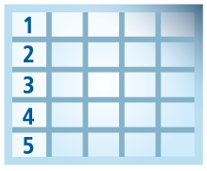
Geospatial Systems Are Helping Us Understand
Understanding
Sharing and Collaboration
Knowledge
Information
Integration
Mapping
Data
. . . Helping Us Make Better Decisions

Slide 5
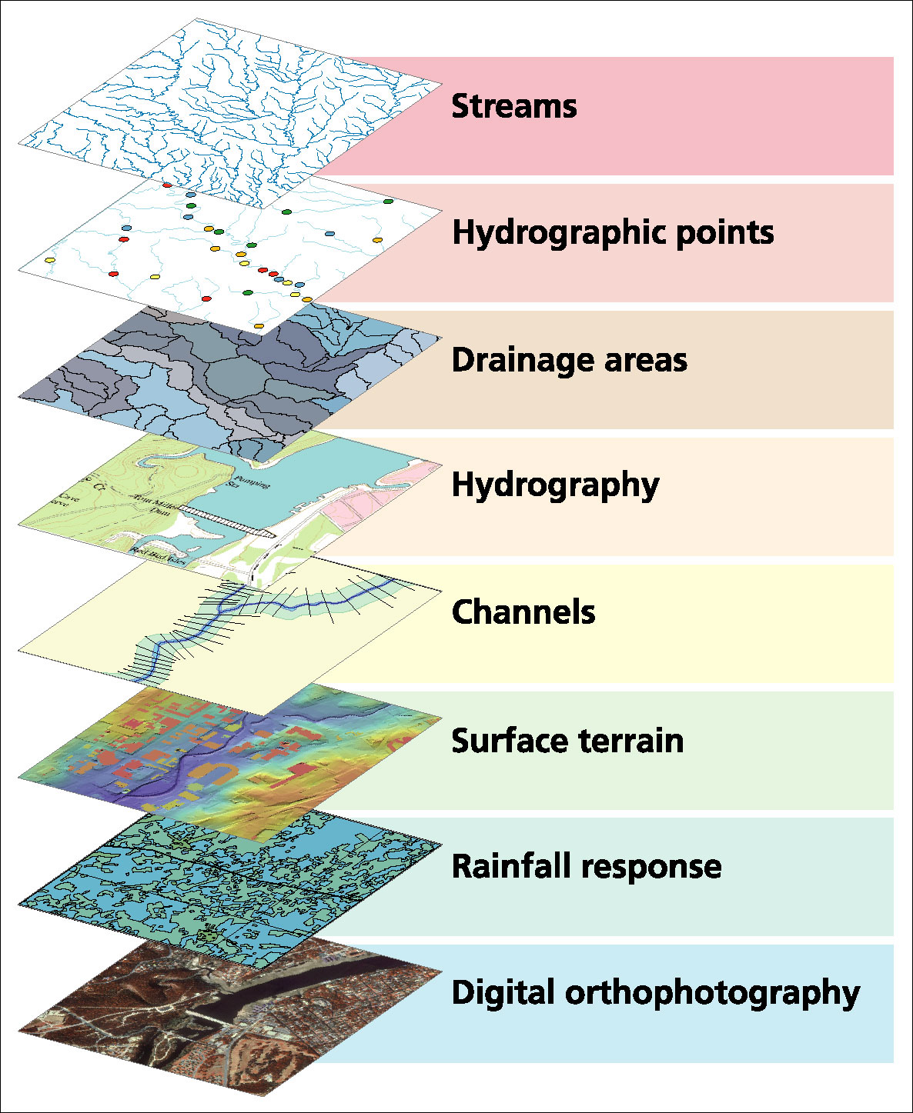
Data Model based on a collection of data themes

Slide 6
Spatial Data: Vector format
Vector data are defined spatially:
(x₁,y₁)
Point - a pair of x and y coordinates
vertex
Line - a sequence of points
Node
Polygon - a closed set of lines
Notes:
DRM

Slide 7
Kissimmee watershed, Florida
Themes

Slide 8
Attributes of a Selected Feature

Slide 9
Raster and Vector Data
Raster data are described by a cell grid, one value per cell
Vector
Raster
Point
Line
Zone of cells
Polygon
Notes:
DRM

Slide 10
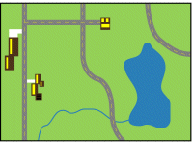
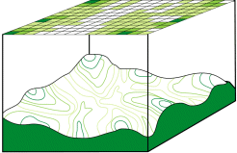
Discrete (vector) and continuous (raster) data
Images from http://resources.arcgis.com/en/help/main/10.1/index.html#/Discrete_and_continuous_data/009t00000007000000/

Slide 11
Two fundamental ways of representing geography are discrete objects and fields.
f(x,y)
y
x
Notes:
DRM

Slide 12
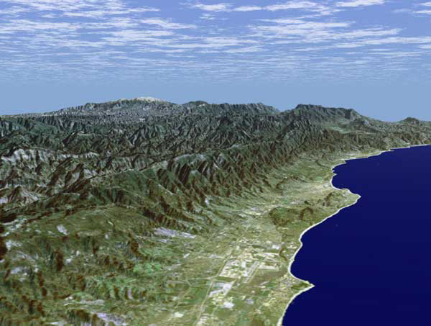
Santa Barbara, California
An example of a popular worldwide geographic raster dataset
http://srtm.usgs.gov/srtmimagegallery/index.html

Slide 13
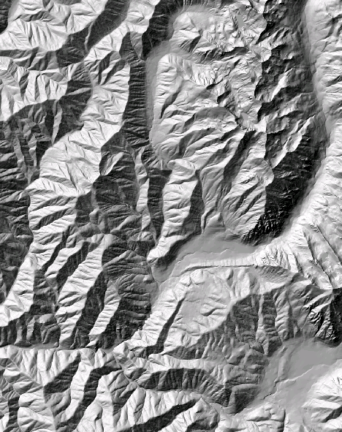
The challenge of increasing Digital Elevation Model (DEM) resolution
e.g. 50,000 km²
Watershed
1980’s DMA 90 m
10² cells/km²
27 MB
1990’s USGS DEM 30 m
10³ cells/km²
240 MB
2000’s NED 10 m
10⁴ cells/km²
2 GB
2010’s LIDAR ~1 m
10⁶ cells/km²
200 GB
A factor 10,000 increase in 30 years

Slide 14
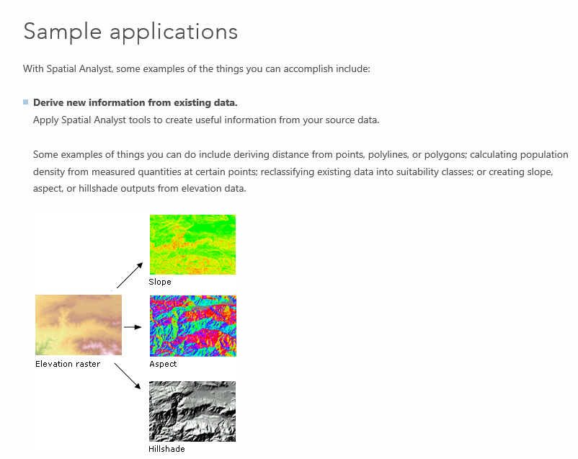
Spatial Analyst
https://desktop.arcgis.com/en/arcmap/latest/extensions/spatial-analyst/what-is-the-spatial-analyst-extension.htm

Slide 15
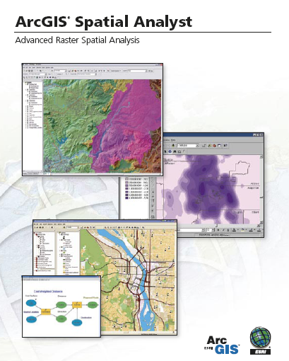
Spatial Analyst
Analysis of land surface terrain as a grid
Key means of defining drainage areas and connectivity to stream network

Slide 16
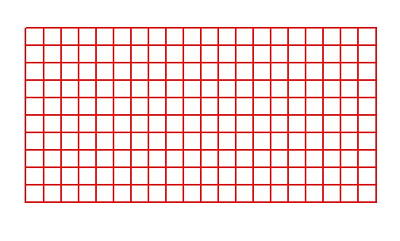
Grid Datasets
Cellular-based data structure composed of square cells of equal size arranged in rows and columns.
The grid cell size and extension (number of rows and columns), as well as the value at each cell have to be stored as part of the grid definition.
Number of columns
Cell size
Number of rows

Slide 17
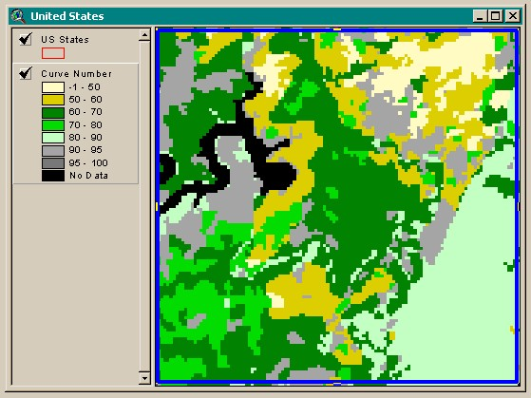
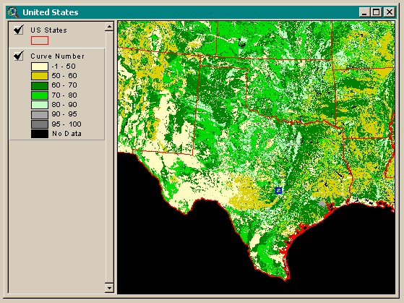
Grid Datasets
Grid datasets

Slide 18
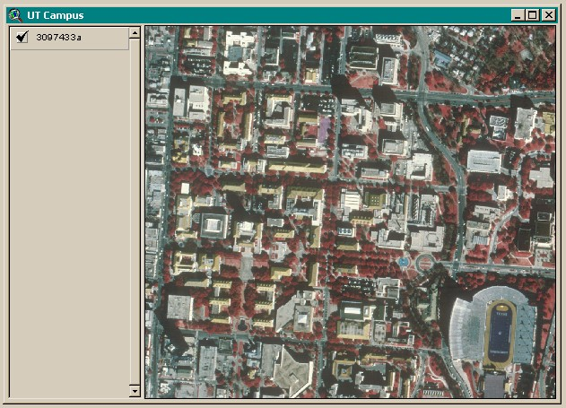
Image Datasets
Digital Orthophotos and satellite imagery
Image datasets

Slide 19
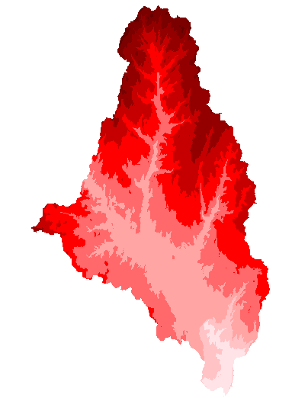
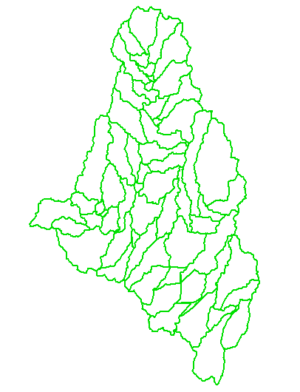
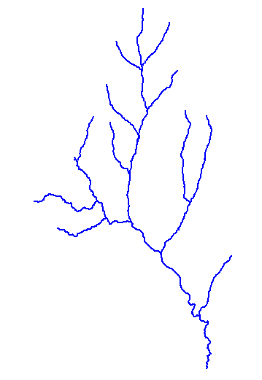
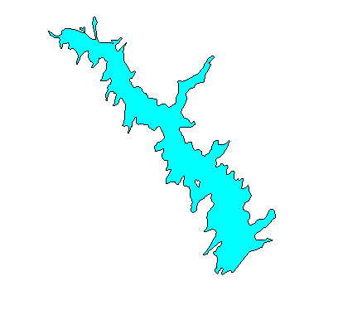
How do we combine these data?
Digital Elevation
Models
Watersheds
Streams
Waterbodies

Slide 20
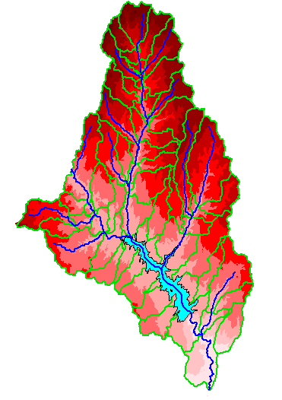
An integrated raster-vector database

Slide 21
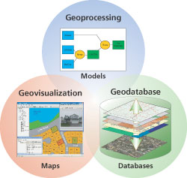
Three Views of GIS
Geodatabase view: Structured data sets that represent geographic information in terms of a generic GIS data model.
Geovisualization view: A GIS is a set of intelligent maps and other views that shows features and feature relationships on the earth's surface. "Windows into the database" to support queries, analysis, and editing of the information.
Geoprocessing view: Information transformation tools that derive new geographic data sets from existing data sets.
adapted from www.esri.com

Slide 22
ESRI GIS Development
Arc/Info (coverage model)
Versions 1-7 from 1980 – 1999
Arc Macro Language (AML)
ArcGIS (geodatabase model)
Version 8.0, …, 10.6 from 2000 – Python scripting
ArcView (shapefile model)
Versions 1-3 from 1994 – 1999
Avenue scripting language
32 bit
2016
64 bit

Slide 23
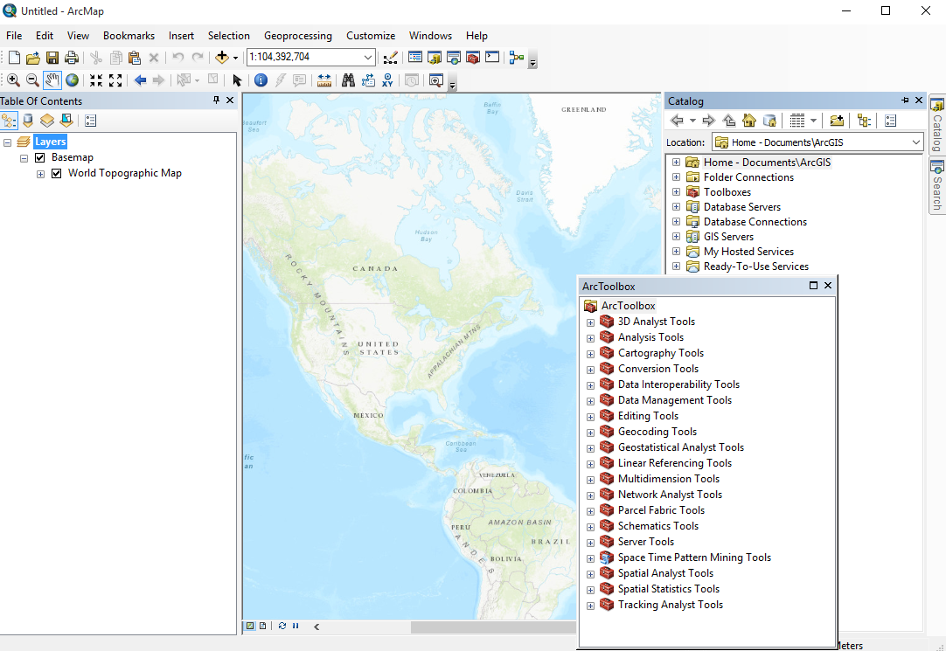
ArcMap, ArcCatalog and ArcToolbox are separate but connected systems

Slide 24
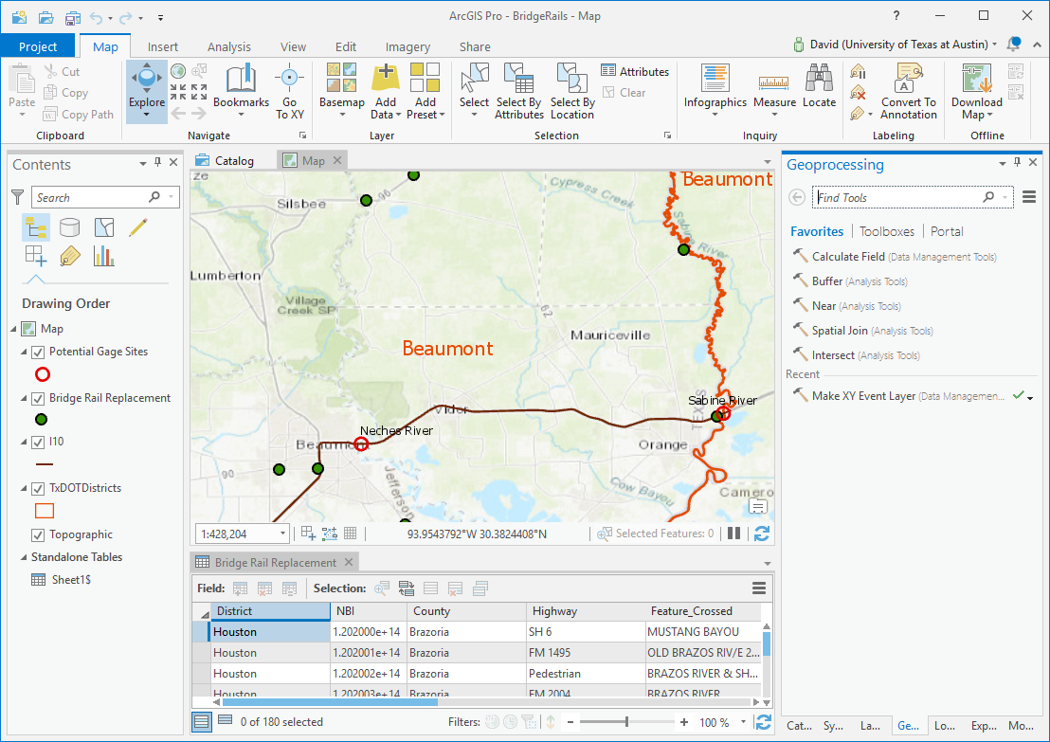
ArcGIS Pro – a single integrated project environment
One folder for your project
with everything in it

Slide 25
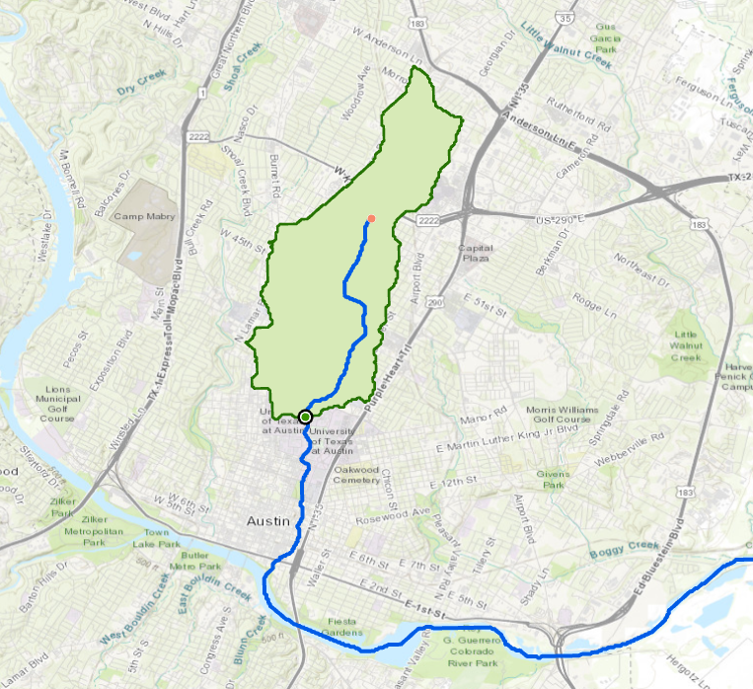
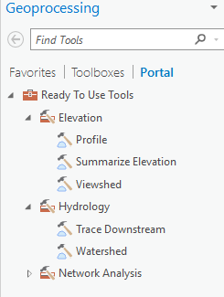
Ready to Use Tools for Anywhere in World
Watershed of Waller Creek at UT Austin

Slide 26
Geodatabase
http://pro.arcgis.com/en/pro-app/help/data/geodatabases/overview/what-is-a-geodatabase-.htm

Slide 27
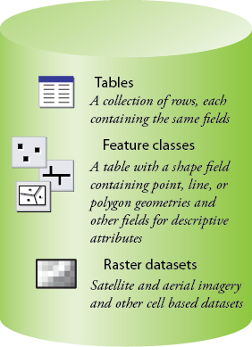
Common Geospatial Information Types
Image: Michael Zeiler, ESRI

Slide 28
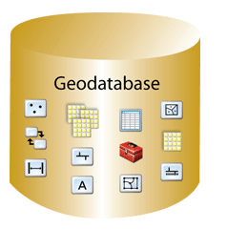
Geodatabase – a store for all types of geospatial information

Slide 29
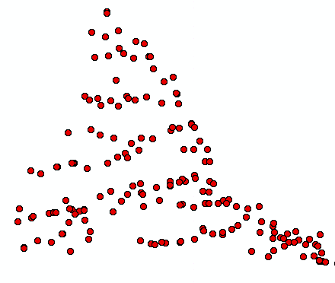
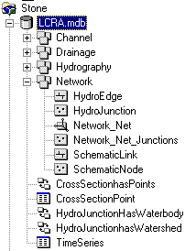
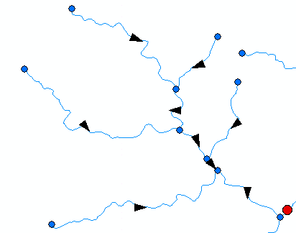
ArcGIS Geodatabase
Workspace
Geodatabase
Feature Dataset
Feature Class
Geometric
Network
Relationship
Object Class

Slide 30
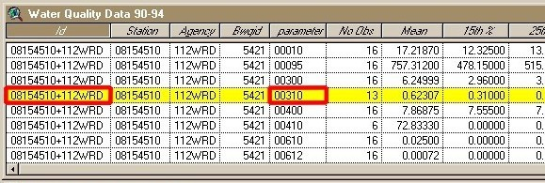
Object Class
An object class is a collection of objects in tabular format that have the same behavior and the same attributes.
An object class is a table that has a unique identifier (ObjectID)
for each record

Slide 31
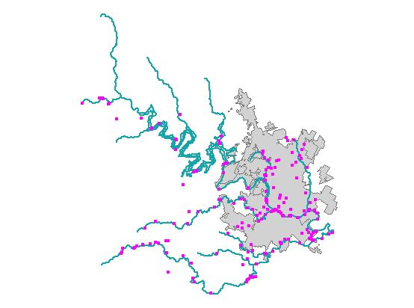
Feature Class
A feature class is a collection of geographic objects in tabular format that have the same behavior and the same attributes.
Feature Class = Object class + spatial coordinates

Slide 32
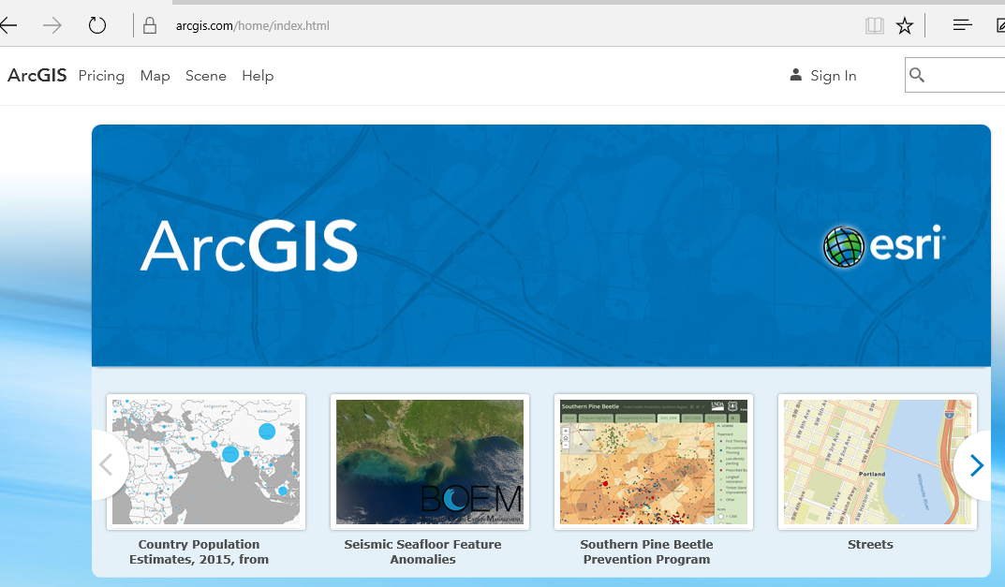
ArcGIS Online
Mapping on the web

Slide 33
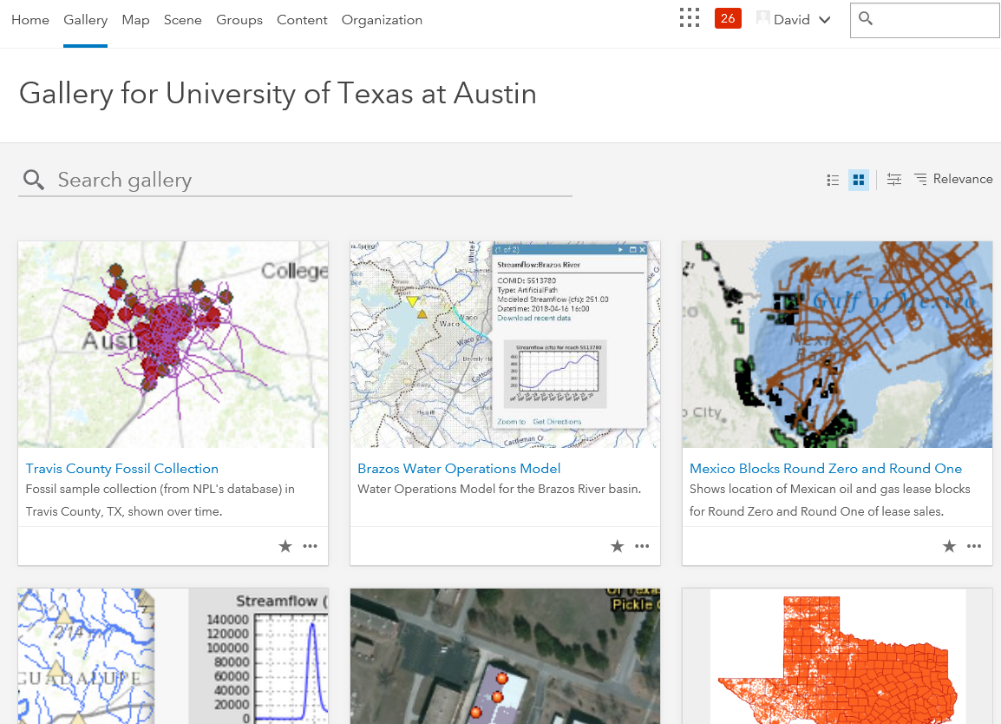
Sharing Information at UT Austin
UT Austin Organizational Group for ArcGIS Online

Slide 34
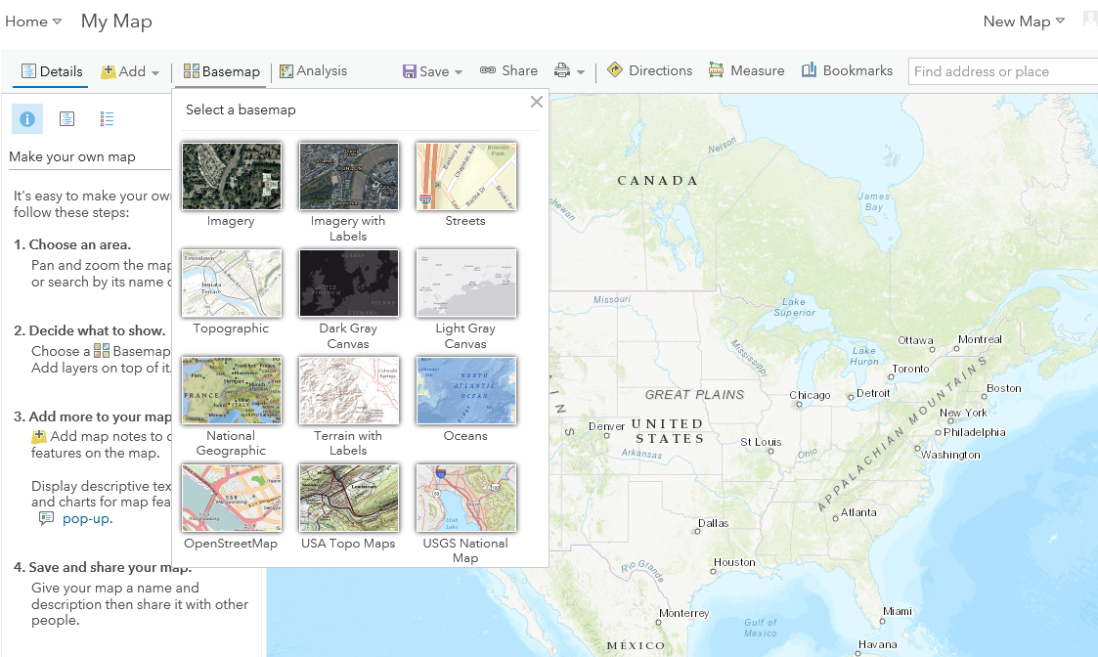
Make a Map Select a base map and add things to it

Slide 35
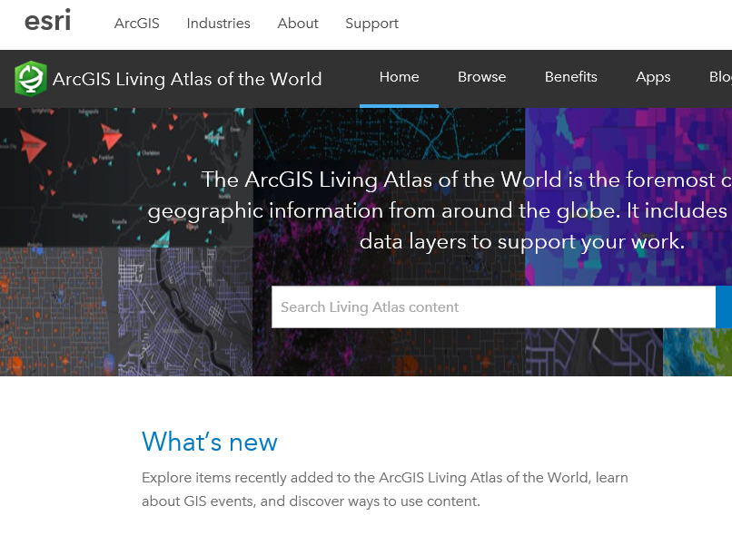
Living Atlas
https://livingatlas.arcgis.com/en/

Slide 36
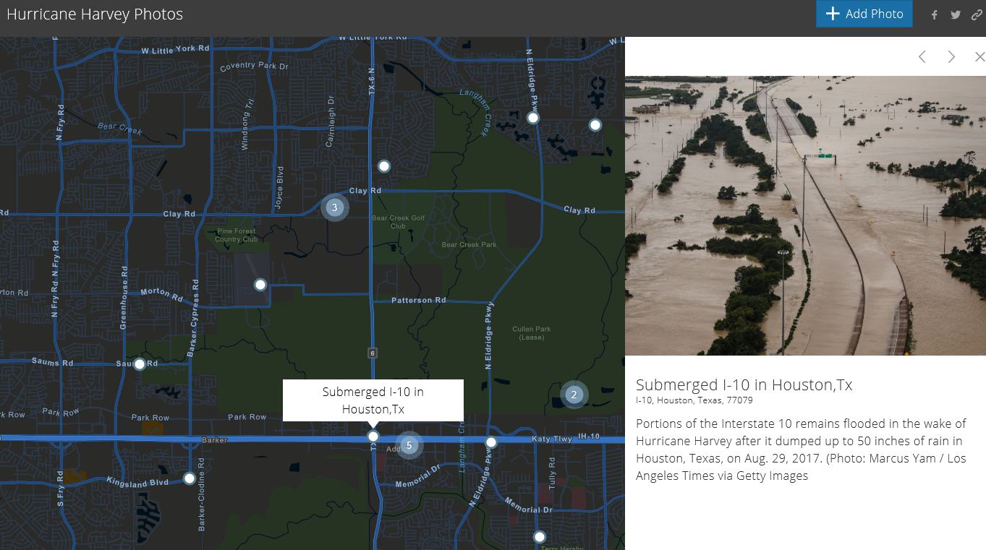
Story Maps: Hurricane Harvey
https://napsg.maps.arcgis.com/apps/StoryMapCrowdsource/index.html?appid=b6ef838e4d26489e8f62102639dc3d91

